Slide 1
LOWER SIXTH ARTS
GEOGRAPHY
Lesson 4
The Earth's Radiation Balance
Notes:
Good morning, class, and welcome to our geography lesson. I am your geography teacher, Mr Kamdem. Today we are starting Lesson 4: The Earth's Radiation Balance.

Slide 2
CLASS INFO
Class, Chapter and Duration
Class | Lower Sixth Arts
Chapter | Module 1: Understanding and managing atmospheric and hydrological phenomena and hazards across the world in general and Cameroon in particular
Duration | 2 periods (2 × 50 minutes)
Notes:
This lesson is for Lower Sixth Arts. It belongs to Module 1: Understanding and managing atmospheric and hydrological phenomena and hazards across the world in general and Cameroon in particular. We shall need 2 periods to cover it.

Slide 3
IDENTIFICATION
Lesson Identification
Topic | Energy in the Atmosphere
Sub-topic | The Earth's Heat Budget on a Global Scale
Lesson | Lesson 4: The Earth's Radiation Balance
Notions / Concepts | Heat budget, insolation, terrestrial radiation, energy surplus, energy deficit, angle of incidence, albedo, heat transfer.
Syllabus focus | The global heat budget; latitudinal heat imbalance (zones of surplus and deficit); reasons for the imbalance; balancing mechanisms.
Competence | Learners are able to explain why the tropics have an energy surplus and the high latitudes a deficit, and how heat is redistributed.
Notes:
Our topic is Energy in the Atmosphere, and the sub-topic is The Earth's Heat Budget on a Global Scale. The key notions we shall use today are: heat budget, insolation, terrestrial radiation, energy surplus, energy deficit, angle of incidence, albedo, heat transfer. At the end, you should be able to do this: learners are able to explain why the tropics have an energy surplus and the high latitudes a deficit, and how heat is redistributed.

Slide 4

HOMEWORK CORRECTION
Correction of the Homework
Question (Lesson 3: Solar Radiation):
Define the heat budget of the Earth.
Notes:
Before we start the new lesson, let us correct the homework I gave you at the end of Lesson 3: Solar Radiation. The question was: Define the heat budget of the Earth. Take out your exercise books.

Slide 5
HOMEWORK CORRECTION
Correction: Possible Answer
The heat budget is the balance between the solar energy received by the Earth and the energy it sends back to space.
Notes:
Here is a good answer. The heat budget is the balance between the solar energy received by the Earth and the energy it sends back to space. Compare it with your own answer and correct your work in red.

Slide 6
LESSON PLAN
Lesson Plan
Correction of the homework
Objectives and recall
Real-life situation and action to take
Learning activities
Board summary
Evaluation, remediation and homework
Notes:
Here is the plan of our lesson today. First, we shall correct the homework. Then we shall look at the objectives and recall what you already know. After that, we shall study a situation from real life and the action to take, and do the learning activities. Finally, we shall copy the board summary, do the evaluation and the remediation, and I will give you the homework.

Slide 7
OBJECTIVES
Objectives
By the end of this lesson, you should be able to:
Define the heat budget.
Locate the zones of energy surplus and deficit.
Notes:
Take your time to copy this part; we will continue together.

Slide 8
OBJECTIVES
Objectives (continued)
Explain the reasons for the latitudinal imbalance.
Explain how the atmosphere and oceans balance the heat.
Notes:
By the end of this lesson, you should be able to do four things. Number 1: define the heat budget. Number 2: locate the zones of energy surplus and deficit. Number 3: explain the reasons for the latitudinal imbalance. Number 4: explain how the atmosphere and oceans balance the heat.

Slide 9
PREVIOUS KNOWLEDGE
Previous Knowledge
Solar radiation is reduced by reflection, scattering and absorption.
Snow has a high albedo.
Garoua is at about 9° N.
Notes:
Let us first remember what you already know. Solar radiation is reduced by reflection, scattering and absorption. Snow has a high albedo. Garoua is at about 9° N. Keep this in mind, because we shall build on it today.

Slide 10
REAL-LIFE SITUATION
Situation in Real Life
In December, you call a friend from Garoua who now plays football in Marseille, France.
You complain about the strong sun and the dry Harmattan; he complains about the freezing cold and wears a coat, gloves and a hat.
Notes:
Take your time to copy this part; we will continue together.

Slide 11
REAL-LIFE SITUATION
Situation in Real Life (continued)
You ask: "How can two places on the same Earth receive such different amounts of heat at the same time, and why do the tropics not keep getting hotter?"
Notes:
Listen carefully to this situation from real life. In December, you call a friend from Garoua who now plays football in Marseille, France. You complain about the strong sun and the dry Harmattan; he complains about the freezing cold and wears a coat, gloves and a hat. You ask: "How can two places on the same Earth receive such different amounts of heat at the same time, and why do the tropics not keep getting hotter?" Think about it, because I am going to ask you some questions.

Slide 12
REAL-LIFE SITUATION
Situation: Question 1
What is the problem in the situation?
Notes:
Question 1: What is the problem in the situation? Think for a moment, then raise your hand to answer.

Slide 13
REAL-LIFE SITUATION
Answer
The learner does not understand the unequal distribution and balance of heat on Earth.
Notes:
Good. The learner does not understand the unequal distribution and balance of heat on Earth.

Slide 14
REAL-LIFE SITUATION
Situation: Question 2
Why is the sun stronger in Garoua than in Marseille in December?
Notes:
Question 2: Why is the sun stronger in Garoua than in Marseille in December? Think for a moment, then raise your hand to answer.

Slide 15
REAL-LIFE SITUATION
Answer
Garoua receives near-vertical rays; Marseille receives slanting rays that spread the energy.
Notes:
Good. Garoua receives near-vertical rays; Marseille receives slanting rays that spread the energy.

Slide 16
REAL-LIFE SITUATION
Situation: Question 3
Why do the tropics not keep getting hotter?
Notes:
Question 3: Why do the tropics not keep getting hotter? Think for a moment, then raise your hand to answer.

Slide 17
REAL-LIFE SITUATION
Possible Answer
Winds and ocean currents carry the extra heat towards the poles.
Notes:
Good. Winds and ocean currents carry the extra heat towards the poles.

Slide 18
ACTION TO TAKE
Action to Take
Use the idea of the heat budget to explain differences in climate between Cameroon and Europe.
Notes:
From this situation, the action we are working towards in this lesson is the following: use the idea of the heat budget to explain differences in climate between Cameroon and Europe.

Slide 19
JUSTIFICATION
Justification of the Lesson
This lesson explains the origin of the large differences in temperature on Earth and of the global circulation of air and water.
Notes:
Why is this lesson important for you? This lesson explains the origin of the large differences in temperature on Earth and of the global circulation of air and water.

Slide 20
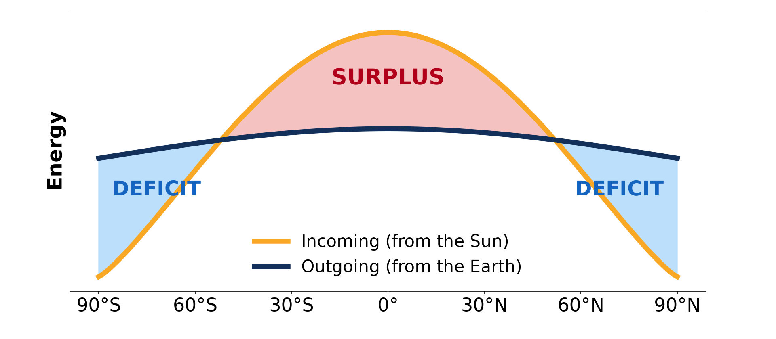
1. HEAT BUDGET
Activity 1
The radiation balance.
Notes:
Activity 1. Look carefully at this diagram: the radiation balance. Observe every detail before I ask the question.

Slide 21
1. HEAT BUDGET
Activity 1: Question
Is the Earth as a whole gaining or losing energy?
Notes:
Here is the question for Activity 1: Is the Earth as a whole gaining or losing energy? Take one minute to think and write your answer in your rough notebook.

Slide 22
1. HEAT BUDGET
Activity 1: Answer
Neither: incoming and outgoing energy are balanced.
Notes:
Let us check the answer together. Neither: incoming and outgoing energy are balanced.

Slide 23
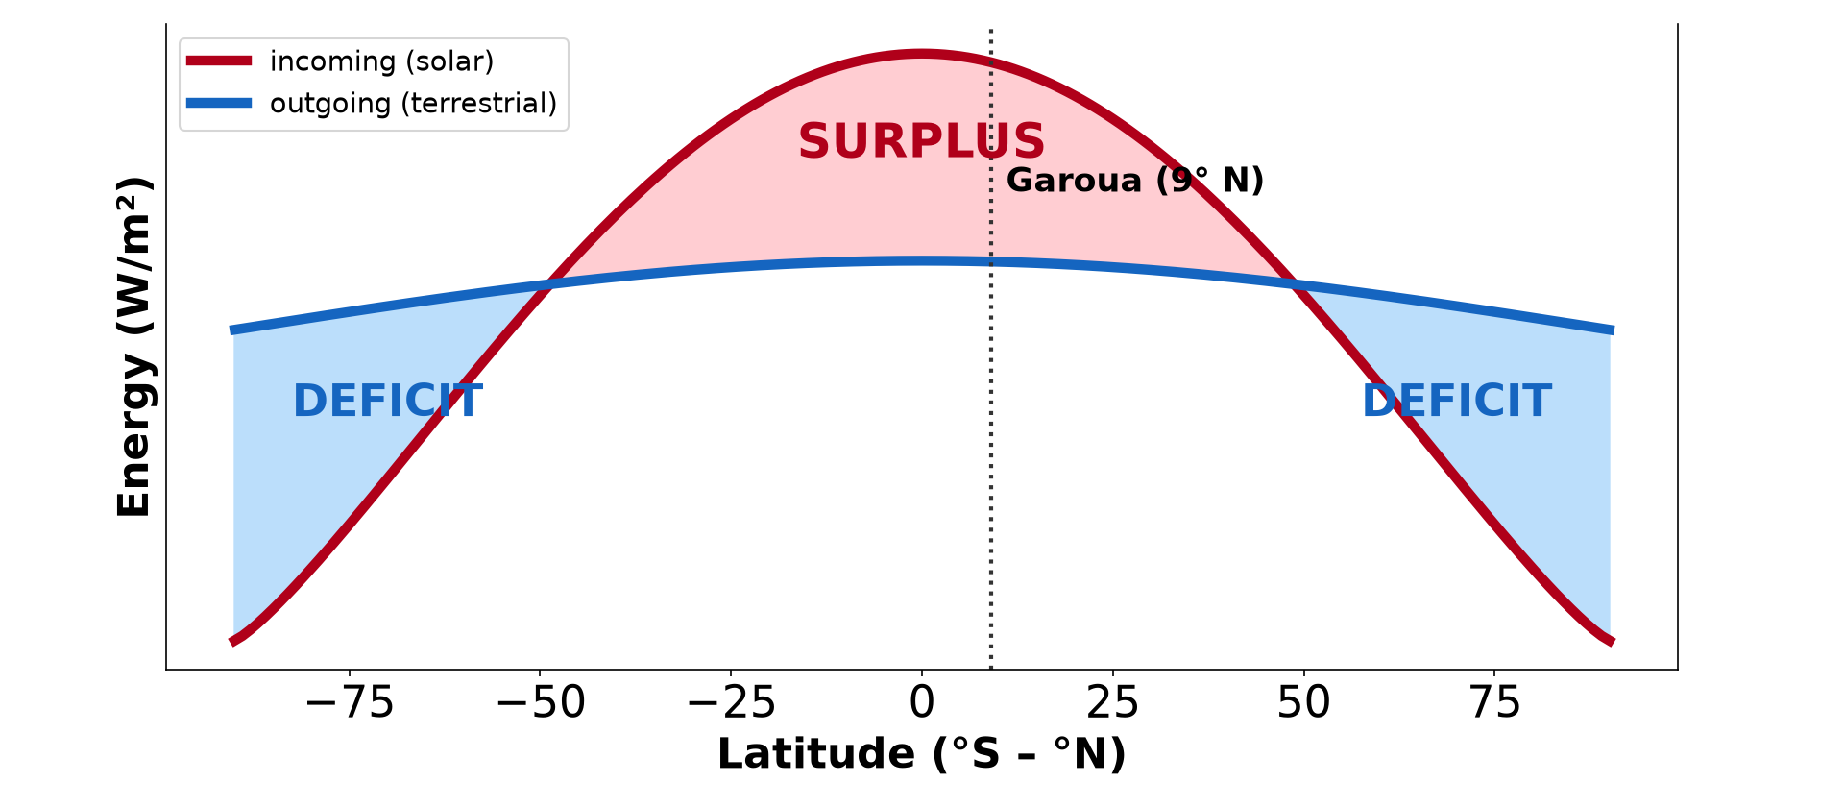
2. IMBALANCE
Activity 2
Surplus and deficit by latitude.
Notes:
Activity 2. Look carefully at this picture: surplus and deficit by latitude. Observe every detail before I ask the question.

Slide 24
2. IMBALANCE
Activity 2: Question
Is Garoua in the zone of surplus or deficit?
Notes:
Here is the question for Activity 2: Is Garoua in the zone of surplus or deficit? Take one minute to think and write your answer in your rough notebook.

Slide 25
2. IMBALANCE
Activity 2: Answer
In the zone of surplus.
Notes:
Let us check the answer together. In the zone of surplus.

Slide 26

3. REASONS
Activity 3
Direct and slanting rays.
Notes:
Activity 3. Look carefully at this diagram: direct and slanting rays. Observe every detail before I ask the question.

Slide 27
3. REASONS
Activity 3: Question
Why do slanting rays heat less?
Notes:
Here is the question for Activity 3: Why do slanting rays heat less? Take one minute to think and write your answer in your rough notebook.

Slide 28
3. REASONS
Activity 3: Answer
They spread the same energy over a larger area and cross more atmosphere.
Notes:
Let us check the answer together. They spread the same energy over a larger area and cross more atmosphere.

Slide 29
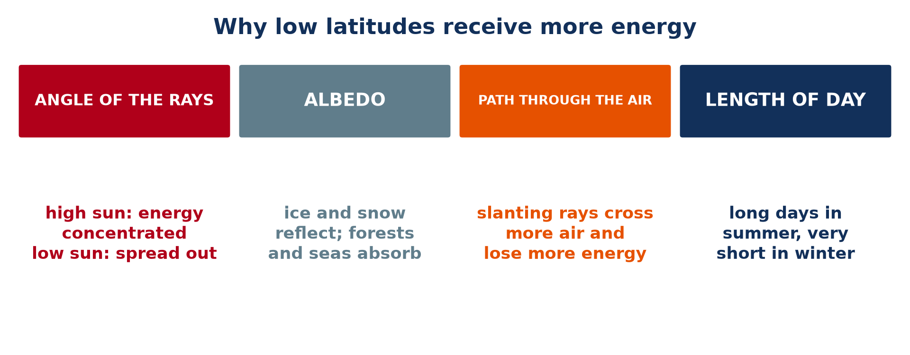
3. REASONS
Activity 4
Reasons for the imbalance.
Notes:
Activity 4. Look carefully at this picture: reasons for the imbalance. Observe every detail before I ask the question.

Slide 30
3. REASONS
Activity 4: Question
How does ice reduce the heating of polar lands?
Notes:
Here is the question for Activity 4: How does ice reduce the heating of polar lands? Take one minute to think and write your answer in your rough notebook.

Slide 31
3. REASONS
Activity 4: Answer
Its high albedo reflects most sunlight.
Notes:
Let us check the answer together. Its high albedo reflects most sunlight.

Slide 32

4. BALANCE
Activity 5
Ocean currents.
Notes:
Activity 5. Look carefully at this diagram: ocean currents. Observe every detail before I ask the question.

Slide 33
4. BALANCE
Activity 5: Question
Name one way heat is carried from the tropics to the poles.
Notes:
Here is the question for Activity 5: Name one way heat is carried from the tropics to the poles. Take one minute to think and write your answer in your rough notebook.

Slide 34
4. BALANCE
Activity 5: Answer
Winds (atmospheric circulation) or ocean currents such as the Gulf Stream.
Notes:
Let us check the answer together. Winds (atmospheric circulation) or ocean currents such as the Gulf Stream.

Slide 35
BOARD SUMMARY
Board Summary
Topic: Energy in the Atmosphere
Sub-topic: The Earth's Heat Budget on a Global Scale
Lesson 4: The Earth's Radiation Balance
Notes:
Now we are going to copy the board summary. Write the title and the headings neatly in your notebooks. I will give you enough time for each slide, so do not rush.

Slide 36
BOARD SUMMARY
DEFINITIONS
The key terms of this lesson are defined as follows:
Heat budget: It is the balance between incoming solar radiation and outgoing terrestrial radiation.
Terrestrial radiation: It is the long-wave heat energy given off by the Earth.
Notes:
Let us copy the definitions. The key terms of this lesson are defined as follows. On this slide we have Heat budget and Terrestrial radiation. Write each point on a new line, with the key term first, and explain it in your own words when we revise. When you finish, we go to the next slide.

Slide 37
BOARD SUMMARY
DEFINITIONS (continued)
Positive balance (surplus): It is the situation where an area receives more energy than it loses.
Negative balance (deficit): It is the situation where an area loses more energy than it receives.
Notes:
We continue with the definitions. On this slide we have Positive balance (surplus) and Negative balance (deficit). Write each point on a new line, with the key term first, and explain it in your own words when we revise.

Slide 38
BOARD SUMMARY
1. The Global Radiation Balance
The Earth as a whole has the following radiation balance:
Global balance: Over a year, the energy the Earth receives from the Sun equals the energy it sends back to space as terrestrial radiation. This is why the average temperature of the Earth stays stable, at about 15 °C.
Illustration: the radiation balance
Notes:
Let us copy The Global Radiation Balance. The Earth as a whole has the following radiation balance. Copy the point on Global balance on the left, then draw the diagram on the right: the radiation balance. Give it a title and label it clearly.

Slide 39

BOARD SUMMARY
1. The Global Radiation Balance
The greenhouse effect: Water vapour, carbon dioxide and methane absorb part of the terrestrial radiation and send it back to the ground. They keep the Earth about 33 °C warmer than it would be without an atmosphere.
Illustration: the greenhouse effect
Notes:
Copy the point on The greenhouse effect on the left, then draw the diagram on the right: the greenhouse effect. Give it a title and label it clearly.

Slide 40
BOARD SUMMARY
2. Zones of Positive and Negative Balance
The balance differs between the following latitudinal zones:
The inter-tropical zone (positive balance): Between about 35 to 40° N and S, incoming solar radiation is greater than outgoing radiation. These latitudes, which include all of Cameroon, have an energy surplus and are warm all year.
Illustration: zones of surplus and deficit
Notes:
Let us copy Zones of Positive and Negative Balance. The balance differs between the following latitudinal zones. Copy the point on The inter-tropical zone (positive balance) on the left, then draw the diagram on the right: zones of surplus and deficit. Give it a title and label it clearly.

Slide 41
BOARD SUMMARY
2. Zones of Positive and Negative Balance
Mid-latitudes and polar zones (negative balance): Towards the poles from about 35 to 40°, the Earth loses more radiation to space than it receives. These regions have an energy deficit, so they are cool or cold.
Notes:
We continue with Zones of Positive and Negative Balance. Copy the point on Mid-latitudes and polar zones (negative balance): write the key term first, then its explanation.

Slide 42
BOARD SUMMARY
3. Reasons for the Differences
The differences between the zones are explained by the following reasons:
Angle of incidence: Near the Equator the sun is high, so its energy is concentrated on a small area. Near the poles the rays are slanting and the same energy is spread over a much larger area.
Illustration: the angle of the sun rays
Notes:
Let us copy Reasons for the Differences. The differences between the zones are explained by the following reasons. Copy the point on Angle of incidence on the left, then draw the diagram on the right: the angle of the sun rays. Give it a title and label it clearly.

Slide 43
BOARD SUMMARY
3. Reasons for the Differences
Thickness of atmosphere crossed: Slanting rays cross a thicker layer of air before reaching the ground. They therefore lose more energy by reflection, scattering and absorption.
Illustration: the path of the rays
Notes:
Copy the point on Thickness of atmosphere crossed on the left, then draw the diagram on the right: the path of the rays. Give it a title and label it clearly.

Slide 44
BOARD SUMMARY
3. Reasons for the Differences
Albedo: Ice and snow in polar regions reflect up to 85 % of the radiation they receive. Dark forests and oceans of the tropics absorb most of it and become warm.
Notes:
We continue with Reasons for the Differences. Copy the point on Albedo: write the key term first, then its explanation.

Slide 45
BOARD SUMMARY
3. Reasons for the Differences
Length of day: Polar regions have months of darkness in winter, when they receive no solar radiation at all. The tropics have about 12 hours of daylight all year.
Notes:
We continue with Reasons for the Differences. Copy the point on Length of day: write the key term first, then its explanation.

Slide 46
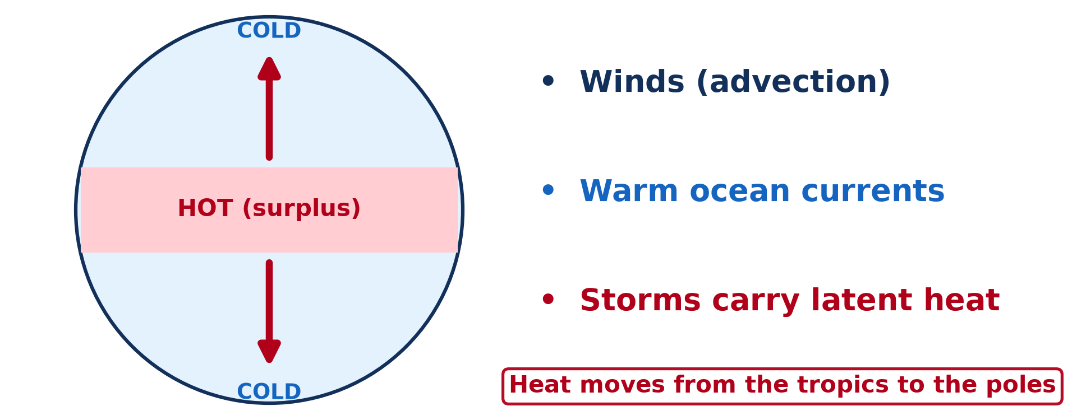
BOARD SUMMARY
4. Balancing Mechanisms
The surplus of the tropics is carried to the zones of deficit by the following mechanisms:
Atmospheric circulation: Winds, air masses and storms carry warm air towards the poles and cold air towards the Equator. They transfer about two-thirds of the heat that moves from the tropics to higher latitudes.
Illustration: heat transfer towards the poles
Notes:
Let us copy Balancing Mechanisms. The surplus of the tropics is carried to the zones of deficit by the following mechanisms. Copy the point on Atmospheric circulation on the left, then draw the diagram on the right: heat transfer towards the poles. Give it a title and label it clearly.

Slide 47
BOARD SUMMARY
4. Balancing Mechanisms
Ocean currents: Warm currents such as the Gulf Stream carry warm water towards the poles, while cold currents bring cool water towards the Equator. They transfer about one-third of the surplus heat.
Illustration: ocean currents
Notes:
Copy the point on Ocean currents on the left, then draw the diagram on the right: ocean currents. Give it a title and label it clearly.

Slide 48
BOARD SUMMARY
4. Balancing Mechanisms
Transfer of latent heat: Water that evaporates from tropical oceans stores heat in its vapour. Winds carry this vapour to higher latitudes, where the heat is released when it condenses into clouds.
Notes:
We continue with Balancing Mechanisms. Copy the point on Transfer of latent heat: write the key term first, then its explanation.

Slide 49
FORMATIVE EVALUATION
Evaluation 1
Why does a farmer in Garoua receive more intense heat than a fisherman in Norway?
Notes:
Now let us check what you have understood. Question 1: Why does a farmer in Garoua receive more intense heat than a fisherman in Norway? Answer in your exercise book.

Slide 50
FORMATIVE EVALUATION
Expected Answer
The sun is high over Garoua, so its rays are concentrated; in Norway the rays are slanting and spread out.
Notes:
The expected answer is: the sun is high over Garoua, so its rays are concentrated; in Norway the rays are slanting and spread out. If you got it right, well done.

Slide 51
FORMATIVE EVALUATION
Evaluation 2
Give two mechanisms that transfer heat from the tropics to the poles.
Notes:
Now let us check what you have understood. Question 2: Give two mechanisms that transfer heat from the tropics to the poles. Answer in your exercise book.

Slide 52
FORMATIVE EVALUATION
Expected Answer
Winds (atmospheric circulation) and ocean currents.
Notes:
The expected answer is: winds (atmospheric circulation) and ocean currents. If you got it right, well done.

Slide 53
REMEDIATION
Remediation
Fill in the blanks:
The tropics have an energy ______.
Snow has a high ______.
The Gulf Stream is a ______ current.
Notes:
For those who need more practice, fill in the blanks in your exercise book. The answers are: number 1, surplus; number 2, albedo; number 3, warm.

Slide 54
HOMEWORK
Homework
Define advection.
Notes:
For your homework: Define advection. We shall correct it at the beginning of our next lesson.

Slide 55
NEXT LESSON
Next Lesson
Our next lesson will be on:
Lesson 5: Heat Transport
Notes:
Our next lesson will be on Lesson 5: Heat Transport. Thank you for your attention, and see you next time.

Slide 56
BILINGUAL GAME
Bilingual Game (Jeu Bilingue)
English | Français
Heat budget | Le bilan thermique
Solar radiation | Le rayonnement solaire
Energy surplus | L'excédent d'énergie
Energy deficit | Le déficit d'énergie
Latitude | La latitude
Ocean current | Le courant marin
Notes:
Let us play the bilingual game. I say a word in English, and you give me the French word. Then we do the reverse.

Slide 57
LOGBOOK
Official Logbook (1/2)
Module / Topic | Energy in the Atmosphere
Lesson Title | Lesson 4: The Earth's Radiation Balance
Expected Learning Outcomes | Define the heat budget. Locate the zones of energy surplus and deficit. Explain the reasons for the latitudinal imbalance. Explain how the atmosphere and oceans balance the heat.
Competence | Learners are able to explain why the tropics have an energy surplus and the high latitudes a deficit, and how heat is redistributed.
Notes:
I record this information in the official logbook of the class after the lesson.

Slide 58
LOGBOOK
Official Logbook (2/2)
Matter Taught | DEFINITIONS; The Global Radiation Balance; Zones of Positive and Negative Balance; Reasons for the Differences; Balancing Mechanisms.
Evaluation | Formative evaluation and remediation exercise.
Homework | Define advection.
Enrolment / Present / Absent | ____ / ____ / ____
Achievement | To be completed after the lesson.
Notes:
I complete the second page of the logbook: the matter taught, the evaluation, the homework and the attendance.

Slide 59
TEACHER'S NOTE
Teacher's Note
Timing: Homework correction, plan, objectives 8 min | Recall, situation, action 10 min | 5 activities 30 min | Board summary (copying) 30 min | Evaluation, remediation 10 min | Homework, next lesson 5 min | Logbook 7 min
Without the projector (Activity 1): draw arrows in and out.
Without the projector (Activity 2): shade surplus in red and deficit in blue on a sketch.
Without the projector (Activity 3): shine a torch straight and slanted.
Without the projector (Activity 4): list the four reasons.
Without the projector (Activity 5): trace the Gulf Stream on a map.
Notes:
This slide is for me, the teacher: it gives the timing of the lesson and what to do if the projector is not available.

Slide 60
REFERENCES
References
Geography Syllabus for Sixth Forms (Lower and Upper Sixth), MINESEC, 2019 — Module 1 (Meteorology, Climatology & Hydrology).
Teacher's course notes: Mr KAMDEM E., Meteorology (LSA), GBHS Garoua, 2026.
Diagrams and animations: drawn for this lesson (Geography Department).
Notes:
These are the references and picture credits used to prepare this lesson.

