Slide 1
LOWER SIXTH ARTS
GEOGRAPHY
Lesson 5
Heat Transport
Notes:
Good morning, class, and welcome to our geography lesson. I am your geography teacher, Mr Kamdem. Today we are starting Lesson 5: Heat Transport.

Slide 2
CLASS INFO
Class, Chapter and Duration
Class | Lower Sixth Arts
Chapter | Module 1: Understanding and managing atmospheric and hydrological phenomena and hazards across the world in general and Cameroon in particular
Duration | 2 periods (2 × 50 minutes)
Notes:
This lesson is for Lower Sixth Arts. It belongs to Module 1: Understanding and managing atmospheric and hydrological phenomena and hazards across the world in general and Cameroon in particular. We shall need 2 periods to cover it.

Slide 3
IDENTIFICATION
Lesson Identification
Topic | Energy in the Atmosphere
Sub-topic | The Earth's Heat Budget on a Global Scale
Lesson | Lesson 5: Heat Transport
Notions / Concepts | Heat transfer, advection, air mass, ocean current, terrestrial radiation, conduction, convection, latent heat.
Syllabus focus | Horizontal heat transfer (advection by air masses and winds, ocean currents); vertical heat transfer (terrestrial radiation, conduction, convection, latent heat).
Competence | Learners are able to explain how heat moves horizontally and vertically in the atmosphere, using the seasons of Garoua.
Notes:
Our topic is Energy in the Atmosphere, and the sub-topic is The Earth's Heat Budget on a Global Scale. The key notions we shall use today are: heat transfer, advection, air mass, ocean current, terrestrial radiation, conduction, convection, latent heat. At the end, you should be able to do this: learners are able to explain how heat moves horizontally and vertically in the atmosphere, using the seasons of Garoua.

Slide 4

HOMEWORK CORRECTION
Correction of the Homework
Question (Lesson 4: The Earth's Radiation Balance):
Define advection.
Notes:
Before we start the new lesson, let us correct the homework I gave you at the end of Lesson 4: The Earth's Radiation Balance. The question was: Define advection. Take out your exercise books.

Slide 5
HOMEWORK CORRECTION
Correction: Possible Answer
Advection is the horizontal transfer of heat or moisture by moving air.
Notes:
Here is a good answer. Advection is the horizontal transfer of heat or moisture by moving air. Compare it with your own answer and correct your work in red.

Slide 6
LESSON PLAN
Lesson Plan
Correction of the homework
Objectives and recall
Real-life situation and action to take
Learning activities
Board summary
Evaluation, remediation and homework
Notes:
Here is the plan of our lesson today. First, we shall correct the homework. Then we shall look at the objectives and recall what you already know. After that, we shall study a situation from real life and the action to take, and do the learning activities. Finally, we shall copy the board summary, do the evaluation and the remediation, and I will give you the homework.

Slide 7
OBJECTIVES
Objectives
By the end of this lesson, you should be able to:
Distinguish horizontal and vertical heat transfer.
Explain advection by air masses and ocean currents.
Notes:
Take your time to copy this part; we will continue together.

Slide 8
OBJECTIVES
Objectives (continued)
Explain conduction and convection.
Explain latent heat.
Explain why the atmosphere is heated from below.
Notes:
By the end of this lesson, you should be able to do five things. Number 1: distinguish horizontal and vertical heat transfer. Number 2: explain advection by air masses and ocean currents. Number 3: explain conduction and convection. Number 4: explain latent heat. Number 5: explain why the atmosphere is heated from below.

Slide 9
PREVIOUS KNOWLEDGE
Previous Knowledge
The tropics have an energy surplus.
The Harmattan comes from the Sahara.
Winds and ocean currents carry heat.
Notes:
Let us first remember what you already know. The tropics have an energy surplus. The Harmattan comes from the Sahara. Winds and ocean currents carry heat. Keep this in mind, because we shall build on it today.

Slide 10
REAL-LIFE SITUATION
Situation in Real Life
In the dry season, the Harmattan blows from the north over Garoua: it is hot by day, dusty and very dry, and it cracks our lips.
Around May, before the rains, the air becomes heavy, humid and extremely hot, and the wind comes from the south.
Notes:
Take your time to copy this part; we will continue together.

Slide 11
REAL-LIFE SITUATION
Situation in Real Life (continued)
You ask: "Why does the air feel so different in the two seasons, and how does the heat of the ground get into the air?"
Notes:
Listen carefully to this situation from real life. In the dry season, the Harmattan blows from the north over Garoua: it is hot by day, dusty and very dry, and it cracks our lips. Around May, before the rains, the air becomes heavy, humid and extremely hot, and the wind comes from the south. You ask: "Why does the air feel so different in the two seasons, and how does the heat of the ground get into the air?" Think about it, because I am going to ask you some questions.

Slide 12
REAL-LIFE SITUATION
Situation: Question 1
What is the problem in the situation?
Notes:
Question 1: What is the problem in the situation? Think for a moment, then raise your hand to answer.

Slide 13
REAL-LIFE SITUATION
Answer
The learner does not understand how heat is moved in the atmosphere.
Notes:
Good. The learner does not understand how heat is moved in the atmosphere.

Slide 14
REAL-LIFE SITUATION
Situation: Question 2
What do we call the horizontal movement of heat by wind?
Notes:
Question 2: What do we call the horizontal movement of heat by wind? Think for a moment, then raise your hand to answer.

Slide 15
REAL-LIFE SITUATION
Answer
Advection.
Notes:
Good. Advection.

Slide 16
REAL-LIFE SITUATION
Situation: Question 3
Why does humid air before a storm feel so hot?
Notes:
Question 3: Why does humid air before a storm feel so hot? Think for a moment, then raise your hand to answer.

Slide 17
REAL-LIFE SITUATION
Possible Answer
It stores latent heat, released when its vapour condenses.
Notes:
Good. It stores latent heat, released when its vapour condenses.

Slide 18
ACTION TO TAKE
Action to Take
Use shade and ventilation at home to reduce heat gained by conduction and radiation.
Notes:
From this situation, the action we are working towards in this lesson is the following: use shade and ventilation at home to reduce heat gained by conduction and radiation.

Slide 19
JUSTIFICATION
Justification of the Lesson
This lesson explains how the atmosphere gets its heat and how winds change the weather of Garoua.
Notes:
Why is this lesson important for you? This lesson explains how the atmosphere gets its heat and how winds change the weather of Garoua.

Slide 20

1. HORIZONTAL TRANSFER
Activity 1
Harmattan haze.
Notes:
Activity 1. Look carefully at this picture: harmattan haze. Observe every detail before I ask the question.

Slide 21
1. HORIZONTAL TRANSFER
Activity 1: Question
Is the Harmattan an example of advection or convection?
Notes:
Here is the question for Activity 1: Is the Harmattan an example of advection or convection? Take one minute to think and write your answer in your rough notebook.

Slide 22
1. HORIZONTAL TRANSFER
Activity 1: Answer
Advection (horizontal movement of an air mass).
Notes:
Let us check the answer together. Advection (horizontal movement of an air mass).

Slide 23

1. HORIZONTAL TRANSFER
Activity 2
Ocean currents.
Notes:
Activity 2. Look carefully at this diagram: ocean currents. Observe every detail before I ask the question.

Slide 24
1. HORIZONTAL TRANSFER
Activity 2: Question
Which warm current flows along the coast of Cameroon?
Notes:
Here is the question for Activity 2: Which warm current flows along the coast of Cameroon? Take one minute to think and write your answer in your rough notebook.

Slide 25
1. HORIZONTAL TRANSFER
Activity 2: Answer
The Guinea Current.
Notes:
Let us check the answer together. The Guinea Current.

Slide 26
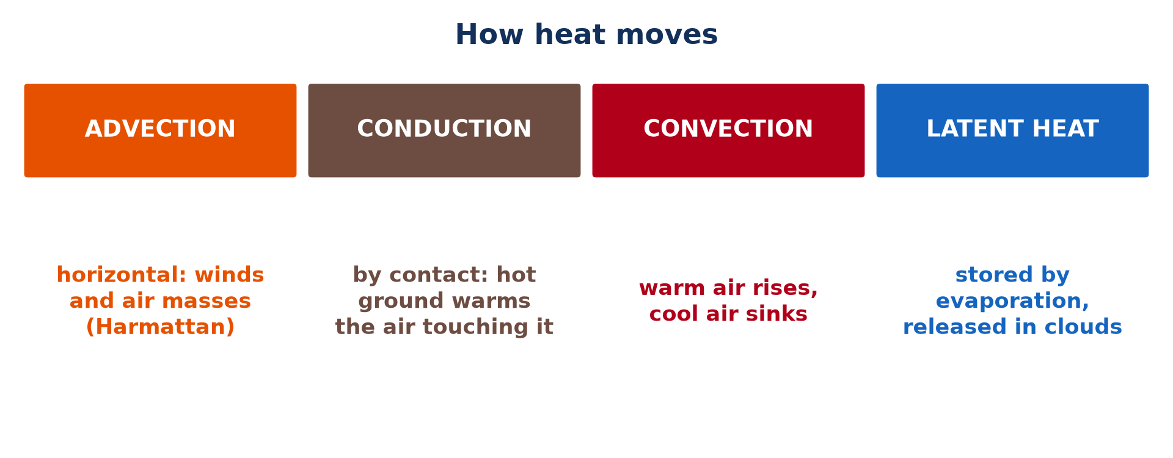
2. VERTICAL TRANSFER
Activity 3
Four ways heat moves.
Notes:
Activity 3. Look carefully at this picture: four ways heat moves. Observe every detail before I ask the question.

Slide 27
2. VERTICAL TRANSFER
Activity 3: Question
What is conduction?
Notes:
Here is the question for Activity 3: What is conduction? Take one minute to think and write your answer in your rough notebook.

Slide 28
2. VERTICAL TRANSFER
Activity 3: Answer
Transfer of heat by direct contact.
Notes:
Let us check the answer together. Transfer of heat by direct contact.

Slide 29

2. VERTICAL TRANSFER
Activity 4
Animation: convection.
Notes:
Activity 4. Look carefully at this animation: animation: convection. Watch the animation to the end; it will play again.

Slide 30
2. VERTICAL TRANSFER
Activity 4: Question
Why does air heated by the ground rise?
Notes:
Here is the question for Activity 4: Why does air heated by the ground rise? Take one minute to think and write your answer in your rough notebook.

Slide 31
2. VERTICAL TRANSFER
Activity 4: Answer
It becomes lighter (less dense).
Notes:
Let us check the answer together. It becomes lighter (less dense).

Slide 32
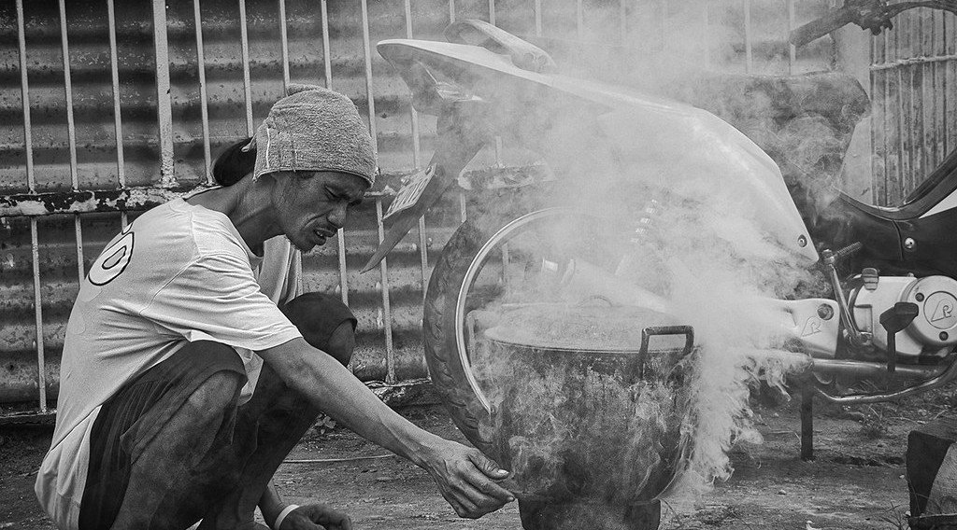
2. VERTICAL TRANSFER
Activity 5
Steam rising.
Notes:
Activity 5. Look carefully at this picture: steam rising. Observe every detail before I ask the question.

Slide 33
2. VERTICAL TRANSFER
Activity 5: Question
When is latent heat released into the atmosphere?
Notes:
Here is the question for Activity 5: When is latent heat released into the atmosphere? Take one minute to think and write your answer in your rough notebook.

Slide 34
2. VERTICAL TRANSFER
Activity 5: Answer
When water vapour condenses into clouds.
Notes:
Let us check the answer together. When water vapour condenses into clouds.

Slide 35
BOARD SUMMARY
Board Summary
Topic: Energy in the Atmosphere
Sub-topic: The Earth's Heat Budget on a Global Scale
Lesson 5: Heat Transport
Notes:
Now we are going to copy the board summary. Write the title and the headings neatly in your notebooks. I will give you enough time for each slide, so do not rush.

Slide 36
BOARD SUMMARY
DEFINITIONS
The key terms of this lesson are defined as follows:
Heat transfer: It is the movement of heat from warmer to cooler places.
Advection: It is the horizontal transfer of heat or moisture by moving air.
Notes:
Let us copy the definitions. The key terms of this lesson are defined as follows. On this slide we have Heat transfer and Advection. Write each point on a new line, with the key term first, and explain it in your own words when we revise. When you finish, we go to the next slide.

Slide 37
BOARD SUMMARY
DEFINITIONS (continued)
Sensible heat flux: It is the heat carried by air that we can feel and measure with a thermometer.
Latent heat flux: It is the heat carried in water vapour, taken during evaporation and released during condensation.
Notes:
We continue with the definitions. On this slide we have Sensible heat flux and Latent heat flux. Write each point on a new line, with the key term first, and explain it in your own words when we revise. When you finish, we go to the next slide.

Slide 38
BOARD SUMMARY
DEFINITIONS (continued)
Conduction: It is the transfer of heat by direct contact.
Convection: It is the vertical transfer of heat by rising warm air and sinking cool air.
Notes:
We continue with the definitions. On this slide we have Conduction and Convection. Write each point on a new line, with the key term first, and explain it in your own words when we revise.

Slide 39
BOARD SUMMARY
1. Horizontal Heat Transfer
Heat is transferred horizontally in the following ways:
Advection by air masses and winds: An air mass takes the heat and moisture of its source region and carries them when it moves. For example, the Harmattan brings hot, dry and dusty Saharan air to Garoua in the dry season, while the monsoon brings warm, moist air from the Atlantic.
Illustration: advection by air masses
Notes:
Let us copy Horizontal Heat Transfer. Heat is transferred horizontally in the following ways. Copy the point on Advection by air masses and winds on the left, then draw the diagram on the right: advection by air masses. Give it a title and label it clearly.

Slide 40
BOARD SUMMARY
1. Horizontal Heat Transfer
Transfer by ocean currents: Warm currents carry heat from the tropics towards the poles, and cold currents bring cool water towards the Equator. For example, the warm Guinea Current keeps the coast of Cameroon warm and humid, while the cold Benguela Current cools the coast of Namibia.
Illustration: ocean currents
Notes:
Copy the point on Transfer by ocean currents on the left, then draw the diagram on the right: ocean currents. Give it a title and label it clearly.

Slide 41
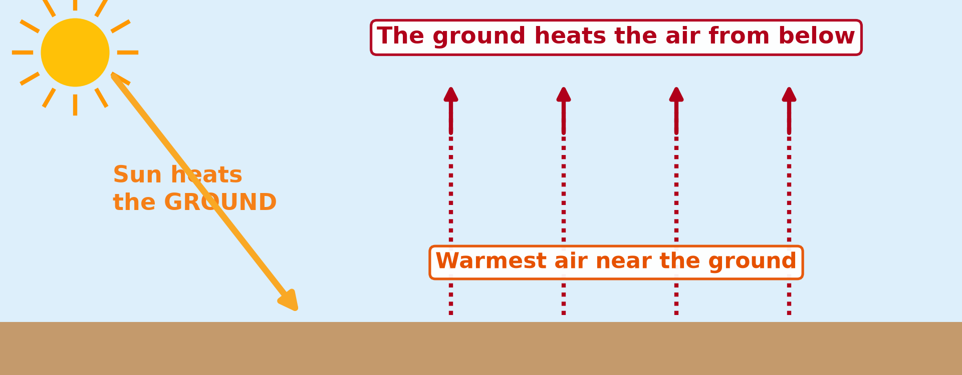
BOARD SUMMARY
2. Vertical Heat Transfer
The lower atmosphere obtains and keeps its heat in the following ways:
Absorption of radiation: Solar radiation crosses the air and heats the ground, which then gives off long-wave terrestrial radiation. Water vapour and carbon dioxide absorb this radiation, so the atmosphere is heated mainly from below.
Illustration: the air heated from below
Notes:
Let us copy Vertical Heat Transfer. The lower atmosphere obtains and keeps its heat in the following ways. Copy the point on Absorption of radiation on the left, then draw the diagram on the right: the air heated from below. Give it a title and label it clearly.

Slide 42
BOARD SUMMARY
2. Vertical Heat Transfer
Conduction: The hot ground heats the thin layer of air in direct contact with it. Since air is a poor conductor, this process only heats the first few centimetres.
Notes:
We continue with Vertical Heat Transfer. Copy the point on Conduction: write the key term first, then its explanation.

Slide 43
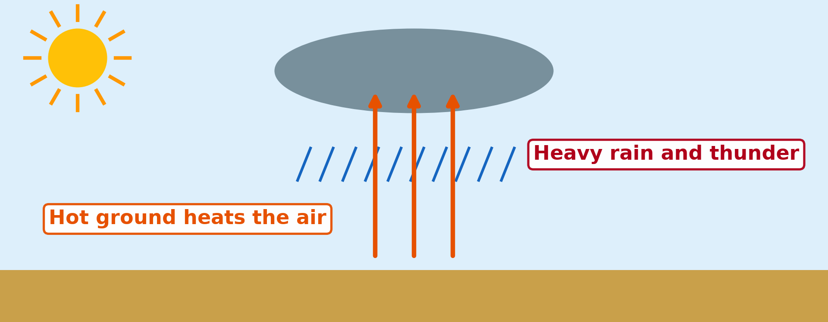
BOARD SUMMARY
2. Vertical Heat Transfer
Convection: Air heated at the surface becomes light and rises, while cooler, denser air sinks to replace it. These currents carry heat upwards and are the main way the lower atmosphere is heated.
Illustration: convection currents
Notes:
Copy the point on Convection on the left, then draw the diagram on the right: convection currents. Give it a title and label it clearly.

Slide 44
BOARD SUMMARY
2. Vertical Heat Transfer
Latent heat of vaporisation: When water evaporates from the Benue, Lake Lagdo and plants, it takes heat and stores it in the vapour. This heat is released high up when the vapour condenses into clouds, and it warms the upper air.
Illustration: evaporation
Notes:
Copy the point on Latent heat of vaporisation on the left, then draw the diagram on the right: evaporation. Give it a title and label it clearly.

Slide 45
FORMATIVE EVALUATION
Evaluation 1
Distinguish advection from convection.
Notes:
Now let us check what you have understood. Question 1: Distinguish advection from convection. Answer in your exercise book.

Slide 46
FORMATIVE EVALUATION
Expected Answer
Advection is horizontal transfer of heat by wind; convection is vertical transfer by rising and sinking air.
Notes:
The expected answer is: advection is horizontal transfer of heat by wind; convection is vertical transfer by rising and sinking air. If you got it right, well done.

Slide 47
FORMATIVE EVALUATION
Evaluation 2
Why is the atmosphere said to be heated from below?
Notes:
Now let us check what you have understood. Question 2: Why is the atmosphere said to be heated from below? Answer in your exercise book.

Slide 48
FORMATIVE EVALUATION
Expected Answer
Sunlight heats the ground first, and the ground then heats the air by radiation, conduction and convection.
Notes:
The expected answer is: sunlight heats the ground first, and the ground then heats the air by radiation, conduction and convection. If you got it right, well done.

Slide 49
REMEDIATION
Remediation
Fill in the blanks:
Transfer of heat by contact is ______.
Rising warm air is an example of ______.
Heat stored in water vapour is ______ heat.
Notes:
For those who need more practice, fill in the blanks in your exercise book. The answers are: number 1, conduction; number 2, convection; number 3, latent.

Slide 50
HOMEWORK
Homework
State how temperature changes from the Equator to the poles.
Notes:
For your homework: State how temperature changes from the Equator to the poles. We shall correct it at the beginning of our next lesson.

Slide 51
NEXT LESSON
Next Lesson
Our next lesson will be on:
Lesson 6: Latitudinal Distribution of Temperature
Notes:
Our next lesson will be on Lesson 6: Latitudinal Distribution of Temperature. Thank you for your attention, and see you next time.

Slide 52
BILINGUAL GAME
Bilingual Game (Jeu Bilingue)
English | Français
Heat transfer | Le transfert de chaleur
Advection | L'advection
Convection | La convection
Conduction | La conduction
Latent heat | La chaleur latente
Air mass | La masse d'air
Notes:
Let us play the bilingual game. I say a word in English, and you give me the French word. Then we do the reverse.

Slide 53
LOGBOOK
Official Logbook (1/2)
Module / Topic | Energy in the Atmosphere
Lesson Title | Lesson 5: Heat Transport
Expected Learning Outcomes | Distinguish horizontal and vertical heat transfer. Explain advection by air masses and ocean currents. Explain conduction and convection. Explain latent heat. Explain why the atmosphere is heated from below.
Competence | Learners are able to explain how heat moves horizontally and vertically in the atmosphere, using the seasons of Garoua.
Notes:
I record this information in the official logbook of the class after the lesson.

Slide 54
LOGBOOK
Official Logbook (2/2)
Matter Taught | DEFINITIONS; Horizontal Heat Transfer; Vertical Heat Transfer.
Evaluation | Formative evaluation and remediation exercise.
Homework | State how temperature changes from the Equator to the poles.
Enrolment / Present / Absent | ____ / ____ / ____
Achievement | To be completed after the lesson.
Notes:
I complete the second page of the logbook: the matter taught, the evaluation, the homework and the attendance.

Slide 55
TEACHER'S NOTE
Teacher's Note
Timing: Homework correction, plan, objectives 8 min | Recall, situation, action 10 min | 5 activities 30 min | Board summary (copying) 30 min | Evaluation, remediation 10 min | Homework, next lesson 5 min | Logbook 7 min
Activity 4 is an animation (GIF): it plays automatically in slide-show mode.
Without the projector (Activity 1): describe the Harmattan.
Without the projector (Activity 2): locate the Gulf of Guinea.
Without the projector (Activity 3): touch the handle of a hot pot.
Without the projector (Activity 4): watch smoke rise from a fire.
Without the projector (Activity 5): describe steam from a pot.
Notes:
This slide is for me, the teacher: it gives the timing of the lesson and what to do if the projector is not available.

Slide 56
REFERENCES
References
Geography Syllabus for Sixth Forms (Lower and Upper Sixth), MINESEC, 2019 — Module 1 (Meteorology, Climatology & Hydrology).
Teacher's course notes: Mr KAMDEM E., Meteorology (LSA), GBHS Garoua, 2026.
Photo, Activity 1: “Bamenda sob a poeira do Harmattan” by carlosoliveirareis, CC BY-NC-SA 2.0, via Flickr (https://www.flickr.com/photos/54218923@N00/387054136)
Photo, Activity 5: “Tea Anyone?” by Beegee49 (Thanks for 12m views,account locked, CC BY-ND 2.0, via Flickr (https://www.flickr.com/photos/66358983@N07/42256910960)
Diagrams and animations: drawn for this lesson (Geography Department).
Notes:
These are the references and picture credits used to prepare this lesson.

