Slide 1
LOWER SIXTH ARTS
GEOGRAPHY
Lesson 8
Vertical Distribution of Temperature
Notes:
Good morning, class, and welcome to our geography lesson. I am your geography teacher, Mr Kamdem. Today we are starting Lesson 8: Vertical Distribution of Temperature.

Slide 2
CLASS INFO
Class, Chapter and Duration
Class | Lower Sixth Arts
Chapter | Module 1: Understanding and managing atmospheric and hydrological phenomena and hazards across the world in general and Cameroon in particular
Duration | 2 periods (2 × 50 minutes)
Notes:
This lesson is for Lower Sixth Arts. It belongs to Module 1: Understanding and managing atmospheric and hydrological phenomena and hazards across the world in general and Cameroon in particular. We shall need 2 periods to cover it.

Slide 3
IDENTIFICATION
Lesson Identification
Topic | Energy in the Atmosphere
Sub-topic | Vertical Distribution of Heat in the Atmosphere
Lesson | Lesson 8: Vertical Distribution of Temperature
Notions / Concepts | Environmental lapse rate, terrestrial radiation, air density, pressure, expansion, adiabatic cooling.
Syllabus focus | The decrease of temperature with height in the troposphere; the environmental lapse rate; reasons for the lapsing of temperature.
Competence | Learners are able to explain why temperature falls with altitude and calculate temperatures at different heights.
Notes:
Our topic is Energy in the Atmosphere, and the sub-topic is Vertical Distribution of Heat in the Atmosphere. The key notions we shall use today are: environmental lapse rate, terrestrial radiation, air density, pressure, expansion, adiabatic cooling. At the end, you should be able to do this: learners are able to explain why temperature falls with altitude and calculate temperatures at different heights.

Slide 4

HOMEWORK CORRECTION
Correction of the Homework
Question (Lesson 7: Geographical Factors Affecting Temperature):
Define the environmental lapse rate.
Notes:
Before we start the new lesson, let us correct the homework I gave you at the end of Lesson 7: Geographical Factors Affecting Temperature. The question was: Define the environmental lapse rate. Take out your exercise books.

Slide 5
HOMEWORK CORRECTION
Correction: Possible Answer
The environmental lapse rate is the rate at which air temperature falls with height, on average 6.5 °C per 1,000 m.
Notes:
Here is a good answer. The environmental lapse rate is the rate at which air temperature falls with height, on average 6.5 °C per 1,000 m. Compare it with your own answer and correct your work in red.

Slide 6
LESSON PLAN
Lesson Plan
Correction of the homework
Objectives and recall
Real-life situation and action to take
Learning activities
Board summary
Evaluation, remediation and homework
Notes:
Here is the plan of our lesson today. First, we shall correct the homework. Then we shall look at the objectives and recall what you already know. After that, we shall study a situation from real life and the action to take, and do the learning activities. Finally, we shall copy the board summary, do the evaluation and the remediation, and I will give you the homework.

Slide 7
OBJECTIVES
Objectives
By the end of this lesson, you should be able to:
Describe the vertical variation of temperature in the troposphere.
Define and use the environmental lapse rate.
Notes:
Take your time to copy this part; we will continue together.

Slide 8
OBJECTIVES
Objectives (continued)
Explain why the atmosphere is heated from below.
Explain the roles of air density and pressure.
Notes:
By the end of this lesson, you should be able to do four things. Number 1: describe the vertical variation of temperature in the troposphere. Number 2: define and use the environmental lapse rate. Number 3: explain why the atmosphere is heated from below. Number 4: explain the roles of air density and pressure.

Slide 9
PREVIOUS KNOWLEDGE
Previous Knowledge
The troposphere is the lowest layer.
The ground heats the air above it.
Mountains are cooler than plains.
Notes:
Let us first remember what you already know. The troposphere is the lowest layer. The ground heats the air above it. Mountains are cooler than plains. Keep this in mind, because we shall build on it today.

Slide 10
REAL-LIFE SITUATION
Situation in Real Life
During the holidays, your family drives from Garoua to Rhumsiki in the Mandara Mountains.
As the car climbs past Guider, the air through the window becomes cooler and cooler, and at Rhumsiki you feel a little cold.
Yet you are higher, so "closer to the Sun".
Notes:
Take your time to copy this part; we will continue together.

Slide 11
REAL-LIFE SITUATION
Situation in Real Life (continued)
You ask: "Why does it get colder as we go up, and by how much?"
Notes:
Listen carefully to this situation from real life. During the holidays, your family drives from Garoua to Rhumsiki in the Mandara Mountains. As the car climbs past Guider, the air through the window becomes cooler and cooler, and at Rhumsiki you feel a little cold. Yet you are higher, so "closer to the Sun". You ask: "Why does it get colder as we go up, and by how much?" Think about it, because I am going to ask you some questions.

Slide 12
REAL-LIFE SITUATION
Situation: Question 1
What is the problem in the situation?
Notes:
Question 1: What is the problem in the situation? Think for a moment, then raise your hand to answer.

Slide 13
REAL-LIFE SITUATION
Answer
The learner does not understand why temperature decreases with height.
Notes:
Good. The learner does not understand why temperature decreases with height.

Slide 14
REAL-LIFE SITUATION
Situation: Question 2
Is the air heated directly by the Sun?
Notes:
Question 2: Is the air heated directly by the Sun? Think for a moment, then raise your hand to answer.

Slide 15
REAL-LIFE SITUATION
Answer
No, mainly from below, by the ground.
Notes:
Good. No, mainly from below, by the ground.

Slide 16
REAL-LIFE SITUATION
Situation: Question 3
What is the rate of cooling with height called?
Notes:
Question 3: What is the rate of cooling with height called? Think for a moment, then raise your hand to answer.

Slide 17
REAL-LIFE SITUATION
Possible Answer
The environmental lapse rate.
Notes:
Good. The environmental lapse rate.

Slide 18
ACTION TO TAKE
Action to Take
Use the lapse rate to estimate temperatures before travelling to highlands.
Notes:
From this situation, the action we are working towards in this lesson is the following: use the lapse rate to estimate temperatures before travelling to highlands.

Slide 19
JUSTIFICATION
Justification of the Lesson
This lesson explains why highlands are cool and helps us to calculate temperatures at different altitudes.
Notes:
Why is this lesson important for you? This lesson explains why highlands are cool and helps us to calculate temperatures at different altitudes.

Slide 20

1. LAPSE RATE
Activity 1
Temperature and height.
Notes:
Activity 1. Look carefully at this diagram: temperature and height. Observe every detail before I ask the question.

Slide 21
1. LAPSE RATE
Activity 1: Question
If Garoua (about 200 m) is at 35 °C, what is the temperature at 1,200 m?
Notes:
Here is the question for Activity 1: If Garoua (about 200 m) is at 35 °C, what is the temperature at 1,200 m? Take one minute to think and write your answer in your rough notebook.

Slide 22
1. LAPSE RATE
Activity 1: Answer
35 − 6.5 = 28.5 °C.
Notes:
Let us check the answer together. 35 − 6.5 = 28.5 °C.

Slide 23

1. LAPSE RATE
Activity 2
Mount Cameroon.
Notes:
Activity 2. Look carefully at this picture: mount Cameroon. Observe every detail before I ask the question.

Slide 24
1. LAPSE RATE
Activity 2: Question
Why is the summit of Mount Cameroon cold while Buea is warm?
Notes:
Here is the question for Activity 2: Why is the summit of Mount Cameroon cold while Buea is warm? Take one minute to think and write your answer in your rough notebook.

Slide 25
1. LAPSE RATE
Activity 2: Answer
The summit (4,095 m) is about 25 °C cooler because of altitude.
Notes:
Let us check the answer together. The summit (4,095 m) is about 25 °C cooler because of altitude.

Slide 26
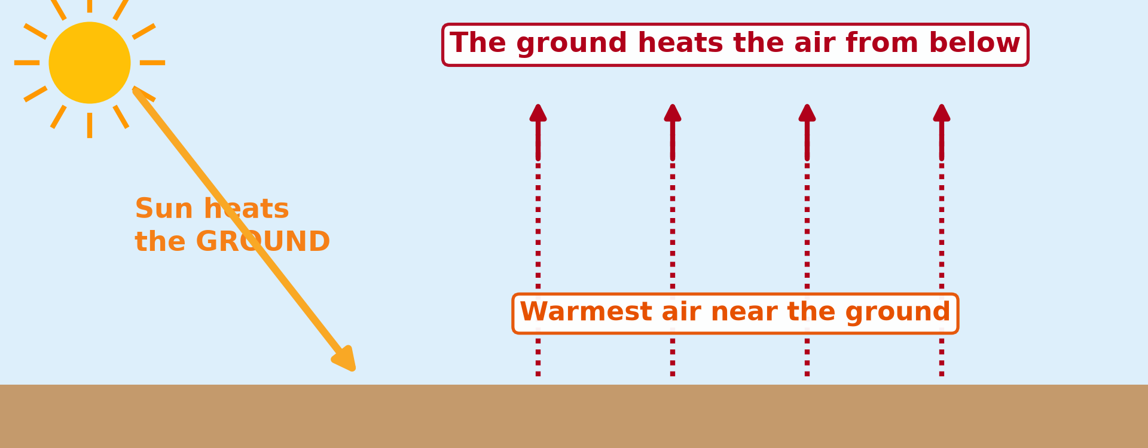
2. REASONS
Activity 3
The atmosphere is heated from below.
Notes:
Activity 3. Look carefully at this diagram: the atmosphere is heated from below. Observe every detail before I ask the question.

Slide 27
2. REASONS
Activity 3: Question
Where is the air warmest in the troposphere?
Notes:
Here is the question for Activity 3: Where is the air warmest in the troposphere? Take one minute to think and write your answer in your rough notebook.

Slide 28
2. REASONS
Activity 3: Answer
Near the ground, the source of heat.
Notes:
Let us check the answer together. Near the ground, the source of heat.

Slide 29
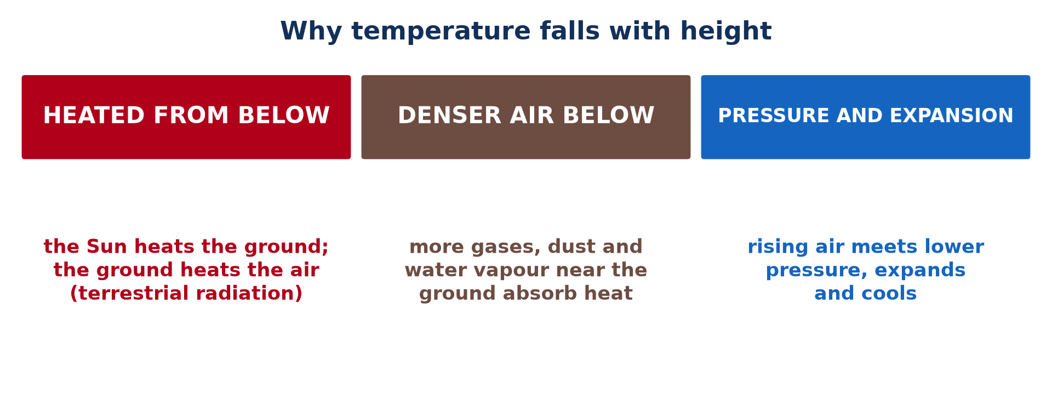
2. REASONS
Activity 4
Why temperature falls with height.
Notes:
Activity 4. Look carefully at this picture: why temperature falls with height. Observe every detail before I ask the question.

Slide 30
2. REASONS
Activity 4: Question
Why does thin air at altitude hold little heat?
Notes:
Here is the question for Activity 4: Why does thin air at altitude hold little heat? Take one minute to think and write your answer in your rough notebook.

Slide 31
2. REASONS
Activity 4: Answer
It has fewer gas molecules, dust and water vapour to absorb heat.
Notes:
Let us check the answer together. It has fewer gas molecules, dust and water vapour to absorb heat.

Slide 32
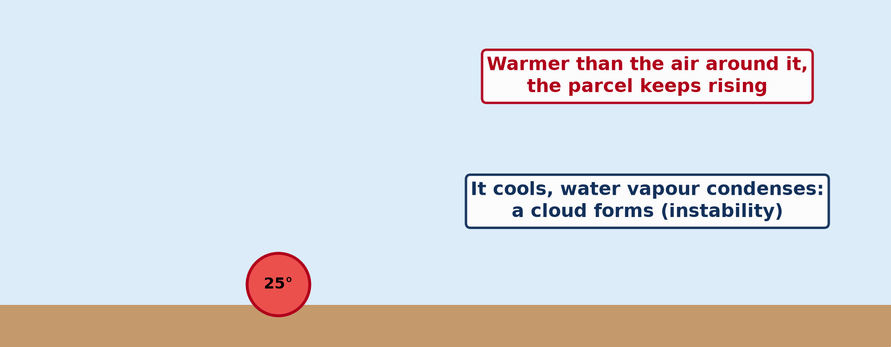
2. REASONS
Activity 5
Animation: rising air expands and cools.
Notes:
Activity 5. Look carefully at this animation: animation: rising air expands and cools. Watch the animation to the end; it will play again.

Slide 33
2. REASONS
Activity 5: Question
What happens to rising air as pressure falls?
Notes:
Here is the question for Activity 5: What happens to rising air as pressure falls? Take one minute to think and write your answer in your rough notebook.

Slide 34
2. REASONS
Activity 5: Answer
It expands and cools.
Notes:
Let us check the answer together. It expands and cools.

Slide 35
BOARD SUMMARY
Board Summary
Topic: Energy in the Atmosphere
Sub-topic: Vertical Distribution of Heat in the Atmosphere
Lesson 8: Vertical Distribution of Temperature
Notes:
Now we are going to copy the board summary. Write the title and the headings neatly in your notebooks. I will give you enough time for each slide, so do not rush.

Slide 36
BOARD SUMMARY
DEFINITIONS
The key terms of this lesson are defined as follows:
Environmental lapse rate (ELR): It is the rate at which air temperature falls with height, on average 6.5 °C per 1,000 m.
Notes:
Let us copy the definitions. The key terms of this lesson are defined as follows. On this slide we have Environmental lapse rate (ELR). Write each point on a new line, with the key term first, and explain it in your own words when we revise. When you finish, we go to the next slide.

Slide 37
BOARD SUMMARY
DEFINITIONS (continued)
Adiabatic change: It is a change of temperature of rising or sinking air caused by expansion or compression, without heat being added or removed.
Terrestrial radiation: It is the long-wave heat given off by the surface of the Earth.
Notes:
We continue with the definitions. On this slide we have Adiabatic change and Terrestrial radiation. Write each point on a new line, with the key term first, and explain it in your own words when we revise.

Slide 38
BOARD SUMMARY
1. Nature of the Variation of Temperature with Height
Temperature varies with height in the following way:
General rule: In the troposphere, temperature falls as altitude increases, on average by 6.5 °C for every 1,000 m. This fall is called the environmental lapse rate, but it changes with the time of day, the season and the place.
Illustration: the fall of temperature with height
Notes:
Let us copy Nature of the Variation of Temperature with Height. Temperature varies with height in the following way. Copy the point on General rule on the left, then draw the diagram on the right: the fall of temperature with height. Give it a title and label it clearly.

Slide 39
BOARD SUMMARY
1. Nature of the Variation of Temperature with Height
Worked example: If it is 35 °C in Garoua (about 200 m), a place 1,000 m higher, at 1,200 m, would be at about 35 − 6.5 = 28.5 °C. The same calculation shows why highland towns are cooler than lowland towns.
Notes:
We continue with Nature of the Variation of Temperature with Height. Copy the point on Worked example: write the key term first, then its explanation.

Slide 40
BOARD SUMMARY
1. Nature of the Variation of Temperature with Height
Mountains in the tropics: The summit of Mount Cameroon (4,095 m) is about 25 °C cooler than the coast at Limbe, and it can have frost. Kilimanjaro, close to the Equator, even has permanent snow.
Illustration: Mount Cameroon
Notes:
Copy the point on Mountains in the tropics on the left, then draw the diagram on the right: mount Cameroon. Give it a title and label it clearly.

Slide 41
BOARD SUMMARY
2. Reasons for the Vertical Lapsing of Temperature
Temperature falls with height for the following reasons:
Heating from below: Sunlight passes through the air and heats the ground, which then gives off heat to the air above it. The air is therefore warmest near the ground and cooler as we move away from it.
Illustration: the air heated from below
Notes:
Let us copy Reasons for the Vertical Lapsing of Temperature. Temperature falls with height for the following reasons. Copy the point on Heating from below on the left, then draw the diagram on the right: the air heated from below. Give it a title and label it clearly.

Slide 42
BOARD SUMMARY
2. Reasons for the Vertical Lapsing of Temperature
Denser air near the ground: Gravity keeps most of the gases, water vapour and dust near the ground. These absorb and keep terrestrial radiation, so the lower air holds more heat.
Illustration: density and temperature
Notes:
Copy the point on Denser air near the ground on the left, then draw the diagram on the right: density and temperature. Give it a title and label it clearly.

Slide 43
BOARD SUMMARY
2. Reasons for the Vertical Lapsing of Temperature
Thin air at high altitudes: Higher up, the air contains fewer molecules and less water vapour. It can therefore absorb and keep only a little heat, even if it receives strong sunshine.
Notes:
We continue with Reasons for the Vertical Lapsing of Temperature. Copy the point on Thin air at high altitudes: write the key term first, then its explanation.

Slide 44
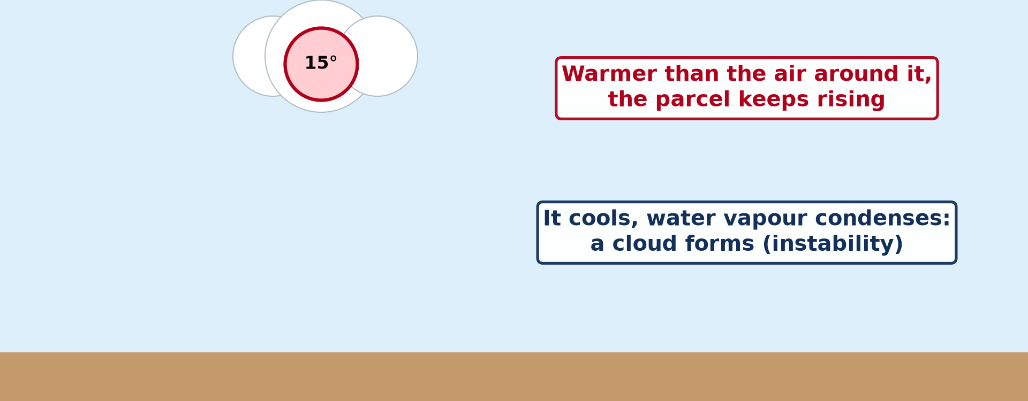
BOARD SUMMARY
2. Reasons for the Vertical Lapsing of Temperature
Adiabatic cooling: When air rises, it meets lower pressure, expands and cools, without losing heat to its surroundings. This adiabatic cooling makes rising air colder with height.
Illustration: a rising parcel of air
Notes:
Copy the point on Adiabatic cooling on the left, then draw the diagram on the right: a rising parcel of air. Give it a title and label it clearly.

Slide 45
FORMATIVE EVALUATION
Evaluation 1
Why is it colder at the top of a mountain than on the plain although it is "closer to the Sun"?
Notes:
Now let us check what you have understood. Question 1: Why is it colder at the top of a mountain than on the plain although it is "closer to the Sun"? Answer in your exercise book.

Slide 46
FORMATIVE EVALUATION
Expected Answer
The air is heated from the ground; higher air is thinner, holds less heat and cools by expansion.
Notes:
The expected answer is: the air is heated from the ground; higher air is thinner, holds less heat and cools by expansion. If you got it right, well done.

Slide 47
FORMATIVE EVALUATION
Evaluation 2
If it is 30 °C at sea level, what is the temperature at 2,000 m?
Notes:
Now let us check what you have understood. Question 2: If it is 30 °C at sea level, what is the temperature at 2,000 m? Answer in your exercise book.

Slide 48
FORMATIVE EVALUATION
Expected Answer
30 − (2 × 6.5) = 17 °C.
Notes:
The expected answer is: 30 − (2 × 6.5) = 17 °C. If you got it right, well done.

Slide 49
REMEDIATION
Remediation
Fill in the blanks:
Temperature falls with height in the ______.
The average lapse rate is ______ °C per 1,000 m.
Rising air expands and ______.
Notes:
For those who need more practice, fill in the blanks in your exercise book. The answers are: number 1, troposphere; number 2, ; number 6, 5; number 3, cools.

Slide 50
HOMEWORK
Homework
Define a temperature inversion.
Notes:
For your homework: Define a temperature inversion. We shall correct it at the beginning of our next lesson.

Slide 51
NEXT LESSON
Next Lesson
Our next lesson will be on:
Lesson 9: Temperature Inversion
Notes:
Our next lesson will be on Lesson 9: Temperature Inversion. Thank you for your attention, and see you next time.

Slide 52
BILINGUAL GAME
Bilingual Game (Jeu Bilingue)
English | Français
Altitude | L'altitude
Lapse rate | Le gradient thermique
Atmosphere | L'atmosphère
Air density | La densité de l'air
Terrestrial radiation | Le rayonnement terrestre
Pressure | La pression
Notes:
Let us play the bilingual game. I say a word in English, and you give me the French word. Then we do the reverse.

Slide 53
LOGBOOK
Official Logbook (1/2)
Module / Topic | Energy in the Atmosphere
Lesson Title | Lesson 8: Vertical Distribution of Temperature
Expected Learning Outcomes | Describe the vertical variation of temperature in the troposphere. Define and use the environmental lapse rate. Explain why the atmosphere is heated from below. Explain the roles of air density and pressure.
Competence | Learners are able to explain why temperature falls with altitude and calculate temperatures at different heights.
Notes:
I record this information in the official logbook of the class after the lesson.

Slide 54
LOGBOOK
Official Logbook (2/2)
Matter Taught | DEFINITIONS; Nature of the Variation of Temperature with Height; Reasons for the Vertical Lapsing of Temperature.
Evaluation | Formative evaluation and remediation exercise.
Homework | Define a temperature inversion.
Enrolment / Present / Absent | ____ / ____ / ____
Achievement | To be completed after the lesson.
Notes:
I complete the second page of the logbook: the matter taught, the evaluation, the homework and the attendance.

Slide 55
TEACHER'S NOTE
Teacher's Note
Timing: Homework correction, plan, objectives 8 min | Recall, situation, action 10 min | 5 activities 30 min | Board summary (copying) 30 min | Evaluation, remediation 10 min | Homework, next lesson 5 min | Logbook 7 min
Activity 5 is an animation (GIF): it plays automatically in slide-show mode.
Without the projector (Activity 1): do the calculation on the board.
Without the projector (Activity 2): compare Buea and the summit.
Without the projector (Activity 3): feel the air above hot ground.
Without the projector (Activity 4): list the three reasons.
Without the projector (Activity 5): feel the cold gas from a spray.
Notes:
This slide is for me, the teacher: it gives the timing of the lesson and what to do if the projector is not available.

Slide 56
REFERENCES
References
Geography Syllabus for Sixth Forms (Lower and Upper Sixth), MINESEC, 2019 — Module 1 (Meteorology, Climatology & Hydrology).
Teacher's course notes: Mr KAMDEM E., Meteorology (LSA), GBHS Garoua, 2026.
Photo, Activity 2: “Mount Cameroon” by John & Mel Kots, CC BY-NC-ND 2.0, via Flickr (https://www.flickr.com/photos/26745817@N00/2347261849)
Diagrams and animations: drawn for this lesson (Geography Department).
Notes:
These are the references and picture credits used to prepare this lesson.

