Slide 1
LOWER SIXTH ARTS
GEOGRAPHY
Lesson 9
Temperature Inversion
Notes:
Good morning, class, and welcome to our geography lesson. I am your geography teacher, Mr Kamdem. Today we are starting Lesson 9: Temperature Inversion.

Slide 2
CLASS INFO
Class, Chapter and Duration
Class | Lower Sixth Arts
Chapter | Module 1: Understanding and managing atmospheric and hydrological phenomena and hazards across the world in general and Cameroon in particular
Duration | 2 periods (2 × 50 minutes)
Notes:
This lesson is for Lower Sixth Arts. It belongs to Module 1: Understanding and managing atmospheric and hydrological phenomena and hazards across the world in general and Cameroon in particular. We shall need 2 periods to cover it.

Slide 3
IDENTIFICATION
Lesson Identification
Topic | Energy in the Atmosphere
Sub-topic | Vertical Distribution of Heat in the Atmosphere
Lesson | Lesson 9: Temperature Inversion
Notions / Concepts | Temperature inversion, surface (radiation) inversion, upper-air inversion, fog, smog, frost, stability.
Syllabus focus | Meaning and types of temperature inversion; causes of surface inversion; effects on weather and human activities (fog, pollution, frost).
Competence | Learners are able to explain the formation of temperature inversions and their effects, such as morning haze in the Benue valley.
Notes:
Our topic is Energy in the Atmosphere, and the sub-topic is Vertical Distribution of Heat in the Atmosphere. The key notions we shall use today are: temperature inversion, surface (radiation) inversion, upper-air inversion, fog, smog, frost, stability. At the end, you should be able to do this: learners are able to explain the formation of temperature inversions and their effects, such as morning haze in the Benue valley.

Slide 4

HOMEWORK CORRECTION
Correction of the Homework
Question (Lesson 8: Vertical Distribution of Temperature):
Define a temperature inversion.
Notes:
Before we start the new lesson, let us correct the homework I gave you at the end of Lesson 8: Vertical Distribution of Temperature. The question was: Define a temperature inversion. Take out your exercise books.

Slide 5
HOMEWORK CORRECTION
Correction: Possible Answer
A temperature inversion is a situation in which temperature increases with height instead of decreasing.
Notes:
Here is a good answer. A temperature inversion is a situation in which temperature increases with height instead of decreasing. Compare it with your own answer and correct your work in red.

Slide 6
LESSON PLAN
Lesson Plan
Correction of the homework
Objectives and recall
Real-life situation and action to take
Learning activities
Board summary
Evaluation, remediation and homework
Notes:
Here is the plan of our lesson today. First, we shall correct the homework. Then we shall look at the objectives and recall what you already know. After that, we shall study a situation from real life and the action to take, and do the learning activities. Finally, we shall copy the board summary, do the evaluation and the remediation, and I will give you the homework.

Slide 7
OBJECTIVES
Objectives
By the end of this lesson, you should be able to:
Define a temperature inversion.
Distinguish surface and upper-air inversions.
Notes:
Take your time to copy this part; we will continue together.

Slide 8
OBJECTIVES
Objectives (continued)
Explain the conditions for a surface inversion.
Explain the effects of inversions.
Notes:
By the end of this lesson, you should be able to do four things. Number 1: define a temperature inversion. Number 2: distinguish surface and upper-air inversions. Number 3: explain the conditions for a surface inversion. Number 4: explain the effects of inversions.

Slide 9
PREVIOUS KNOWLEDGE
Previous Knowledge
Temperature normally falls with height.
The ground loses heat at night.
The Harmattan air is very dry.
Notes:
Let us first remember what you already know. Temperature normally falls with height. The ground loses heat at night. The Harmattan air is very dry. Keep this in mind, because we shall build on it today.

Slide 10
REAL-LIFE SITUATION
Situation in Real Life
On an early January morning in Garoua, you walk to school.
The air near the ground is surprisingly cold on your legs, and a low haze of dust and smoke from cooking fires hangs in the air without rising.
Notes:
Take your time to copy this part; we will continue together.

Slide 11
REAL-LIFE SITUATION
Situation in Real Life (continued)
You have learnt that air gets colder with height.
You ask: "Why is the air colder at the ground this morning, and why does the smoke not rise?"
Notes:
Listen carefully to this situation from real life. On an early January morning in Garoua, you walk to school. The air near the ground is surprisingly cold on your legs, and a low haze of dust and smoke from cooking fires hangs in the air without rising. You have learnt that air gets colder with height. You ask: "Why is the air colder at the ground this morning, and why does the smoke not rise?" Think about it, because I am going to ask you some questions.

Slide 12
REAL-LIFE SITUATION
Situation: Question 1
What is the problem in the situation?
Notes:
Question 1: What is the problem in the situation? Think for a moment, then raise your hand to answer.

Slide 13
REAL-LIFE SITUATION
Answer
The learner does not understand the temperature inversion.
Notes:
Good. The learner does not understand the temperature inversion.

Slide 14
REAL-LIFE SITUATION
Situation: Question 2
What is this condition called?
Notes:
Question 2: What is this condition called? Think for a moment, then raise your hand to answer.

Slide 15
REAL-LIFE SITUATION
Answer
A temperature inversion: cold air below warmer air.
Notes:
Good. A temperature inversion: cold air below warmer air.

Slide 16
REAL-LIFE SITUATION
Situation: Question 3
Why does the smoke not rise?
Notes:
Question 3: Why does the smoke not rise? Think for a moment, then raise your hand to answer.

Slide 17
REAL-LIFE SITUATION
Possible Answer
The warm layer above acts like a lid that stops rising air.
Notes:
Good. The warm layer above acts like a lid that stops rising air.

Slide 18
ACTION TO TAKE
Action to Take
Avoid burning waste on calm, cold mornings, and drive carefully in fog and haze.
Notes:
From this situation, the action we are working towards in this lesson is the following: avoid burning waste on calm, cold mornings, and drive carefully in fog and haze.

Slide 19
JUSTIFICATION
Justification of the Lesson
This lesson explains morning fog and haze, air pollution and frost, which affect health, transport and farming.
Notes:
Why is this lesson important for you? This lesson explains morning fog and haze, air pollution and frost, which affect health, transport and farming.

Slide 20
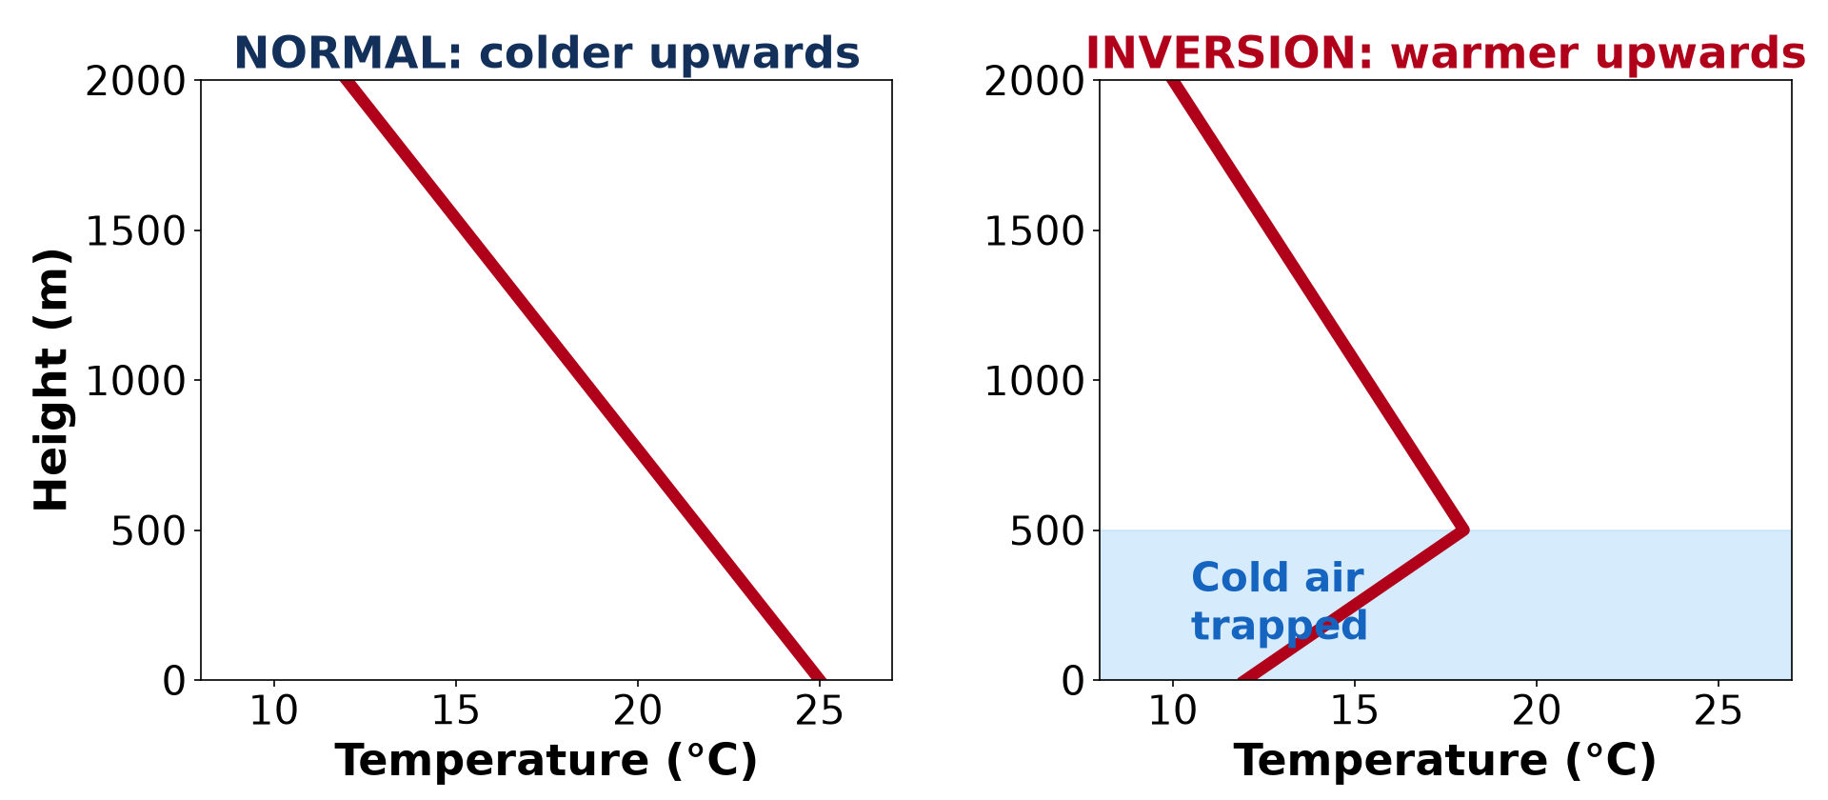
1. MEANING
Activity 1
Temperature in an inversion.
Notes:
Activity 1. Look carefully at this diagram: temperature in an inversion. Observe every detail before I ask the question.

Slide 21
1. MEANING
Activity 1: Question
How does temperature change with height in an inversion?
Notes:
Here is the question for Activity 1: How does temperature change with height in an inversion? Take one minute to think and write your answer in your rough notebook.

Slide 22
1. MEANING
Activity 1: Answer
It increases instead of decreasing.
Notes:
Let us check the answer together. It increases instead of decreasing.

Slide 23

1. MEANING
Activity 2
Animation: a night inversion forms.
Notes:
Activity 2. Look carefully at this animation: animation: a night inversion forms. Watch the animation to the end; it will play again.

Slide 24
1. MEANING
Activity 2: Question
Where is the coldest air in a surface inversion?
Notes:
Here is the question for Activity 2: Where is the coldest air in a surface inversion? Take one minute to think and write your answer in your rough notebook.

Slide 25
1. MEANING
Activity 2: Answer
Just above the ground.
Notes:
Let us check the answer together. Just above the ground.

Slide 26
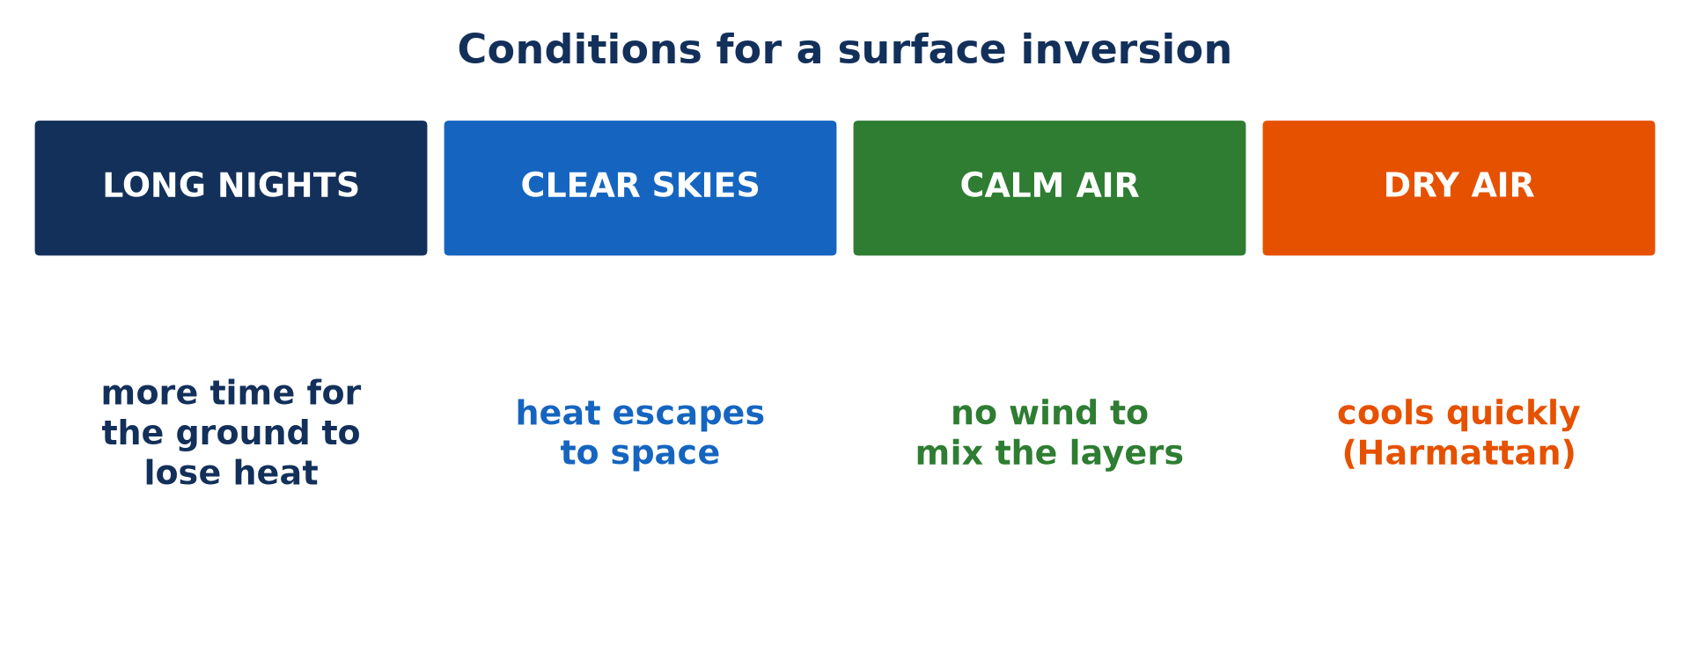
2. CAUSES
Activity 3
Conditions for an inversion.
Notes:
Activity 3. Look carefully at this picture: conditions for an inversion. Observe every detail before I ask the question.

Slide 27
2. CAUSES
Activity 3: Question
Why do clear skies help an inversion to form?
Notes:
Here is the question for Activity 3: Why do clear skies help an inversion to form? Take one minute to think and write your answer in your rough notebook.

Slide 28
2. CAUSES
Activity 3: Answer
Heat escapes from the ground to space, so the ground and the air above it cool quickly.
Notes:
Let us check the answer together. Heat escapes from the ground to space, so the ground and the air above it cool quickly.

Slide 29
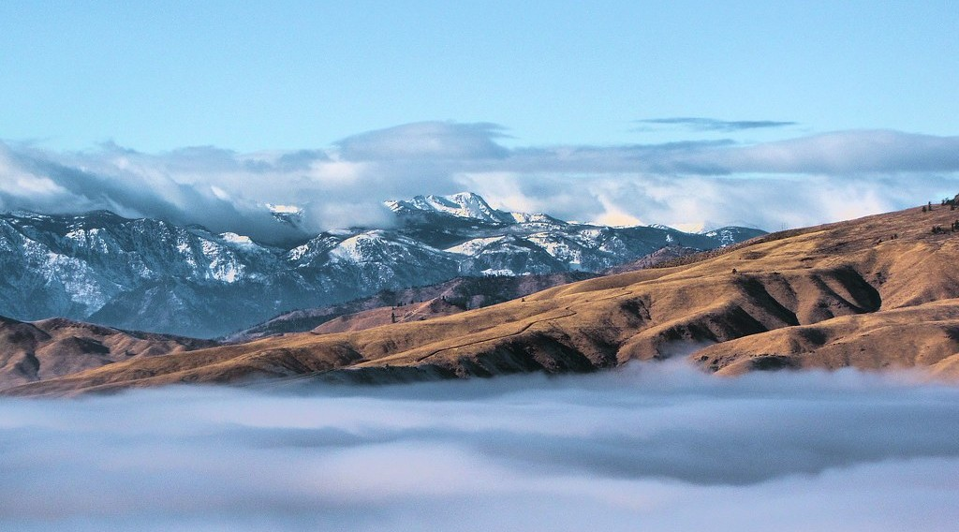
3. EFFECTS
Activity 4
Fog in a valley.
Notes:
Activity 4. Look carefully at this picture: fog in a valley. Observe every detail before I ask the question.

Slide 30
3. EFFECTS
Activity 4: Question
Why does fog form in valleys during an inversion?
Notes:
Here is the question for Activity 4: Why does fog form in valleys during an inversion? Take one minute to think and write your answer in your rough notebook.

Slide 31
3. EFFECTS
Activity 4: Answer
The cold air near the ground is cooled to its dew point.
Notes:
Let us check the answer together. The cold air near the ground is cooled to its dew point.

Slide 32

3. EFFECTS
Activity 5
Smog over a city.
Notes:
Activity 5. Look carefully at this picture: smog over a city. Observe every detail before I ask the question.

Slide 33
3. EFFECTS
Activity 5: Question
Give one health effect of pollution trapped by an inversion.
Notes:
Here is the question for Activity 5: Give one health effect of pollution trapped by an inversion. Take one minute to think and write your answer in your rough notebook.

Slide 34
3. EFFECTS
Activity 5: Answer
Coughing and breathing problems.
Notes:
Let us check the answer together. Coughing and breathing problems.

Slide 35
BOARD SUMMARY
Board Summary
Topic: Energy in the Atmosphere
Sub-topic: Vertical Distribution of Heat in the Atmosphere
Lesson 9: Temperature Inversion
Notes:
Now we are going to copy the board summary. Write the title and the headings neatly in your notebooks. I will give you enough time for each slide, so do not rush.

Slide 36
BOARD SUMMARY
DEFINITIONS
The key terms of this lesson are defined as follows:
Temperature inversion: It is a situation in which temperature increases with height, so warm air lies above cold air.
Notes:
Let us copy the definitions. The key terms of this lesson are defined as follows. On this slide we have Temperature inversion. Write each point on a new line, with the key term first, and explain it in your own words when we revise. When you finish, we go to the next slide.

Slide 37
BOARD SUMMARY
DEFINITIONS (continued)
Capping inversion: It is a warm layer of air aloft that stops rising air and clouds from going higher.
Subsidence inversion: It is an inversion formed when a large mass of air sinks slowly and warms by compression.
Notes:
We continue with the definitions. On this slide we have Capping inversion and Subsidence inversion. Write each point on a new line, with the key term first, and explain it in your own words when we revise. When you finish, we go to the next slide.

Slide 38
BOARD SUMMARY
DEFINITIONS (continued)
Fog: It is a cloud at ground level that reduces visibility to less than 1 km.
Notes:
We continue with the definitions. On this slide we have Fog. Write each point on a new line, with the key term first, and explain it in your own words when we revise.

Slide 39
BOARD SUMMARY
1. Meaning of Temperature Inversion
Temperature inversion is explained as follows:
Temperature inversion: Normally, temperature falls with height, but during an inversion a layer of warm air lies above cooler air. This warm layer acts like a lid that stops the cold air below from rising, so the air becomes very stable.
Illustration: a temperature inversion
Notes:
Let us copy Meaning of Temperature Inversion. Temperature inversion is explained as follows. Copy the point on Temperature inversion on the left, then draw the diagram on the right: a temperature inversion. Give it a title and label it clearly.

Slide 40
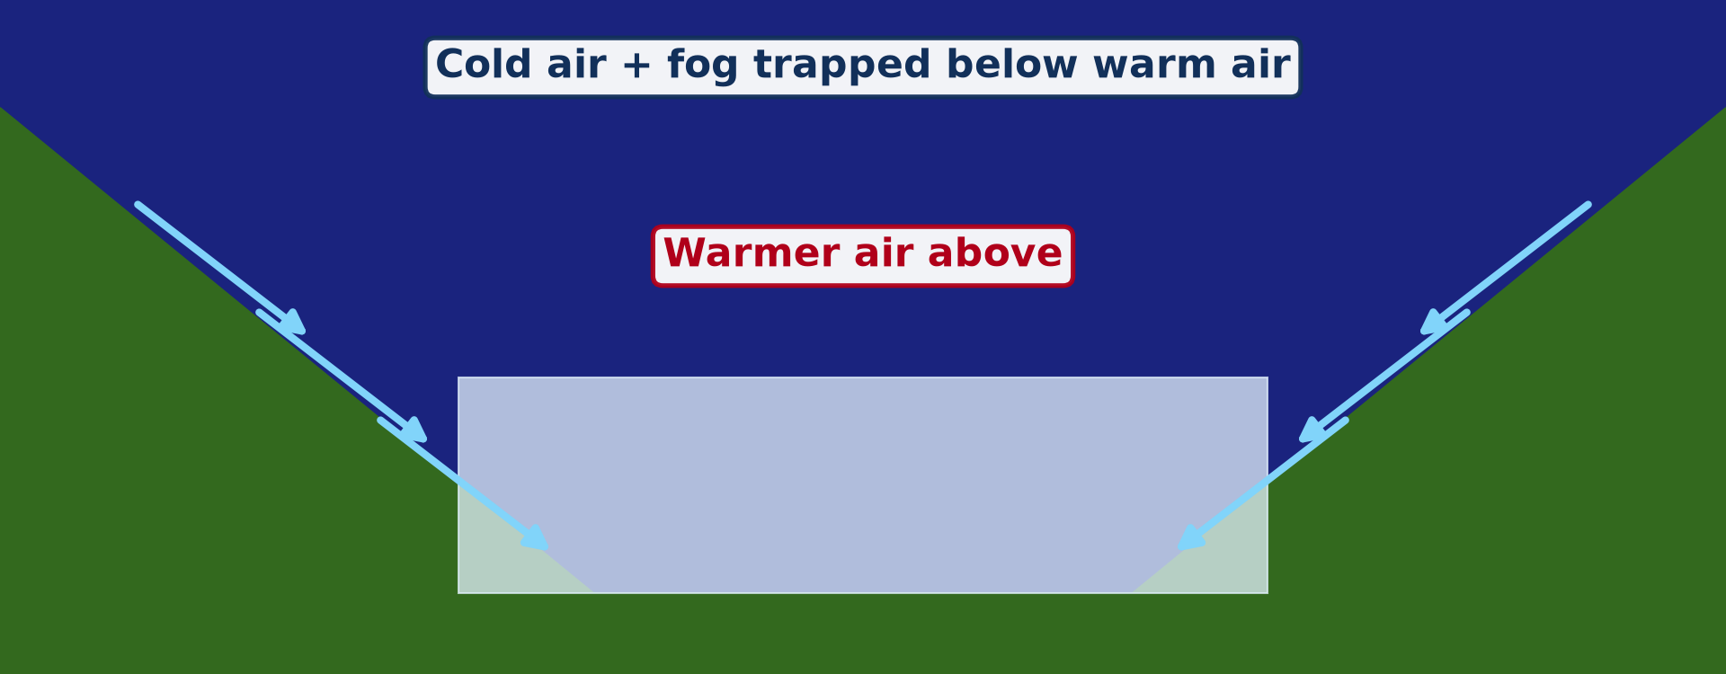
BOARD SUMMARY
2. Types of Temperature Inversion
A) Surface Inversions
The surface inversions are the following:
Radiation (ground) inversion: On clear, calm nights, the ground loses its heat quickly by radiation and cools the air in contact with it. The air near the ground becomes colder than the air above, and this is the most common type of inversion.
Illustration: a surface inversion
Notes:
Let us copy Surface Inversions. The surface inversions are the following. Copy the point on Radiation (ground) inversion on the left, then draw the diagram on the right: a surface inversion. Give it a title and label it clearly.

Slide 41
BOARD SUMMARY
2. Types of Temperature Inversion
A) Surface Inversions
Valley inversion: At night, cold, heavy air on the slopes drains down and collects in valleys and basins. The valley floor becomes colder than the slopes above, as happens in the Benue valley in the Harmattan season.
Notes:
We continue with Surface Inversions. Copy the point on Valley inversion: write the key term first, then its explanation.

Slide 42
BOARD SUMMARY
2. Types of Temperature Inversion
B) Above-Surface (Upper-Air) Inversions
The above-surface inversions are the following:
Subsidence inversion: In high-pressure areas, a large mass of air sinks slowly and is warmed by compression. A warm layer then forms a few hundred metres above the ground, as over the Sahara and the subtropical oceans.
Notes:
Let us copy Above-Surface (Upper-Air) Inversions. The above-surface inversions are the following. Copy the point on Subsidence inversion: write the key term first, then its explanation.

Slide 43
BOARD SUMMARY
2. Types of Temperature Inversion
B) Above-Surface (Upper-Air) Inversions
Frontal inversion: Along a front, warm air rises over cold, heavy air. The warm air above the cold air forms an inversion that slopes along the front.
Notes:
We continue with Above-Surface (Upper-Air) Inversions. Copy the point on Frontal inversion: write the key term first, then its explanation.

Slide 44
BOARD SUMMARY
2. Types of Temperature Inversion
B) Above-Surface (Upper-Air) Inversions
Capping inversion: A warm layer at the top of the lowest part of the atmosphere acts as a cap on rising air. It stops clouds from growing, but if strong heating breaks through it, violent storms can develop.
Notes:
We continue with Above-Surface (Upper-Air) Inversions. Copy the point on Capping inversion: write the key term first, then its explanation.

Slide 45
BOARD SUMMARY
3. Causes of a Surface Inversion
A surface inversion forms best under the following conditions:
Long nights: Long nights give the ground more time to lose heat by terrestrial radiation. This is why inversions are strongest in winter in the temperate regions.
Illustration: the causes of inversions
Notes:
Let us copy Causes of a Surface Inversion. A surface inversion forms best under the following conditions. Copy the point on Long nights on the left, then draw the diagram on the right: the causes of inversions. Give it a title and label it clearly.

Slide 46
BOARD SUMMARY
3. Causes of a Surface Inversion
Clear skies and dry air: Without clouds, and in dry air such as that of the Harmattan, heat escapes quickly to space. The ground and the air near it therefore cool rapidly after sunset.
Notes:
We continue with Causes of a Surface Inversion. Copy the point on Clear skies and dry air: write the key term first, then its explanation.

Slide 47
BOARD SUMMARY
3. Causes of a Surface Inversion
Calm air: Without wind, the cold, heavy air is not mixed with the warmer air above. It therefore stays near the ground and forms a cold layer.
Notes:
We continue with Causes of a Surface Inversion. Copy the point on Calm air: write the key term first, then its explanation.

Slide 48
BOARD SUMMARY
3. Causes of a Surface Inversion
Valleys and basins: Cold air flows down the slopes at night like water and collects in low places. Valleys and basins are therefore the places where inversions are most frequent.
Notes:
We continue with Causes of a Surface Inversion. Copy the point on Valleys and basins: write the key term first, then its explanation.

Slide 49
BOARD SUMMARY
4. Effects on Weather Conditions and Man
A) Effects on Weather
Temperature inversions have the following effects on weather:
Stable air and clear skies: The warm layer stops air from rising, so clouds and rain cannot form. For this reason, inversions give dry weather, as in the Sahara and on coastal deserts.
Notes:
Let us copy Effects on Weather. Temperature inversions have the following effects on weather. Copy the point on Stable air and clear skies: write the key term first, then its explanation.

Slide 50
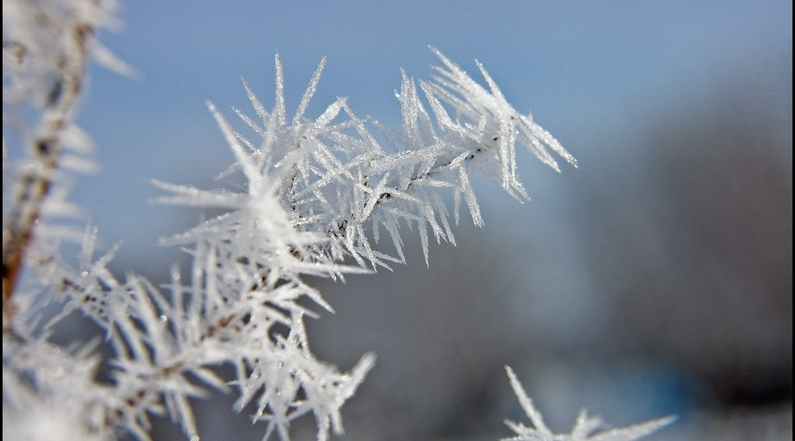
BOARD SUMMARY
4. Effects on Weather Conditions and Man
A) Effects on Weather
Frost: In cold regions and on high mountains, the air trapped near the ground can fall below 0 °C. Frost then forms on the ground and on plants.
Illustration: frost
Notes:
Copy the point on Frost on the left, then draw the diagram on the right: frost. Give it a title and label it clearly.

Slide 51
BOARD SUMMARY
4. Effects on Weather Conditions and Man
A) Effects on Weather
Haze and low clouds: Moisture and dust are trapped below the warm layer. They form a layer of haze or flat stratus clouds under the inversion.
Notes:
We continue with Effects on Weather. Copy the point on Haze and low clouds: write the key term first, then its explanation.

Slide 52
BOARD SUMMARY
4. Effects on Weather Conditions and Man
B) Effects on Man
Temperature inversions have the following effects on man:
Air pollution: Smoke, exhaust fumes and dust cannot rise and stay trapped near the ground, forming smog. This causes breathing problems, as in the London smog of 1952, which killed about 4,000 people.
Illustration: smog
Notes:
Let us copy Effects on Man. Temperature inversions have the following effects on man. Copy the point on Air pollution on the left, then draw the diagram on the right: smog. Give it a title and label it clearly.

Slide 53
BOARD SUMMARY
4. Effects on Weather Conditions and Man
B) Effects on Man
Danger for transport: Fog and smog reduce visibility on roads and at airports. They cause road accidents and delay or cancel flights.
Notes:
We continue with Effects on Man. Copy the point on Danger for transport: write the key term first, then its explanation.

Slide 54
BOARD SUMMARY
4. Effects on Weather Conditions and Man
B) Effects on Man
Damage to crops: Frost in valleys destroys crops such as coffee, tea and fruit trees. For this reason, farmers in temperate regions plant orchards on slopes above the cold valley floors.
Notes:
We continue with Effects on Man. Copy the point on Damage to crops: write the key term first, then its explanation.

Slide 55
BOARD SUMMARY
5. Fog Formation
Fog is formed in the following ways:
Radiation fog: On clear, calm nights, the air near the cold ground is cooled to its dew point and its vapour condenses into droplets. This fog is common in valleys and near rivers in the early morning and clears as the sun heats the ground.
Illustration: fog in the valleys
Notes:
Let us copy Fog Formation. Fog is formed in the following ways. Copy the point on Radiation fog on the left, then draw the diagram on the right: fog in the valleys. Give it a title and label it clearly.

Slide 56

BOARD SUMMARY
5. Fog Formation
Advection fog: When warm, moist air moves over a cold surface, such as a cold sea current, it is cooled to its dew point. This fog forms along coasts such as San Francisco and the Namib coast.
Illustration: fog
Notes:
Copy the point on Advection fog on the left, then draw the diagram on the right: fog. Give it a title and label it clearly.

Slide 57
FORMATIVE EVALUATION
Evaluation 1
How do a clear sky and calm winds help an inversion to form at night?
Notes:
Now let us check what you have understood. Question 1: How do a clear sky and calm winds help an inversion to form at night? Answer in your exercise book.

Slide 58
FORMATIVE EVALUATION
Expected Answer
Clear skies let the ground lose heat quickly; calm air lets the cold air stay near the ground without mixing.
Notes:
The expected answer is: clear skies let the ground lose heat quickly; calm air lets the cold air stay near the ground without mixing. If you got it right, well done.

Slide 59
FORMATIVE EVALUATION
Evaluation 2
Give two effects of temperature inversion on human activities.
Notes:
Now let us check what you have understood. Question 2: Give two effects of temperature inversion on human activities. Answer in your exercise book.

Slide 60
FORMATIVE EVALUATION
Expected Answer
Fog and reduced visibility, trapped pollution and health problems, frost damaging crops (any two).
Notes:
The expected answer is: fog and reduced visibility, trapped pollution and health problems, frost damaging crops (any two). If you got it right, well done.

Slide 61
REMEDIATION
Remediation
Fill in the blanks:
In an inversion, temperature ______ with height.
A mixture of smoke and fog is ______.
Inversions are strongest on ______ and calm nights.
Notes:
For those who need more practice, fill in the blanks in your exercise book. The answers are: number 1, increases; number 2, smog; number 3, clear.

Slide 62
HOMEWORK
Homework
Define relative humidity.
Notes:
For your homework: Define relative humidity. We shall correct it at the beginning of our next lesson.

Slide 63
NEXT LESSON
Next Lesson
Our next lesson will be on:
Lesson 10: Nature of Moisture
Notes:
Our next lesson will be on Lesson 10: Nature of Moisture. Thank you for your attention, and see you next time.

Slide 64
BILINGUAL GAME
Bilingual Game (Jeu Bilingue)
English | Français
Inversion | L'inversion
Fog | Le brouillard
Pollutant | Le polluant
Visibility | La visibilité
Frost | Le gel
Smog | Le smog
Notes:
Let us play the bilingual game. I say a word in English, and you give me the French word. Then we do the reverse.

Slide 65
LOGBOOK
Official Logbook (1/2)
Module / Topic | Energy in the Atmosphere
Lesson Title | Lesson 9: Temperature Inversion
Expected Learning Outcomes | Define a temperature inversion. Distinguish surface and upper-air inversions. Explain the conditions for a surface inversion. Explain the effects of inversions.
Competence | Learners are able to explain the formation of temperature inversions and their effects, such as morning haze in the Benue valley.
Notes:
I record this information in the official logbook of the class after the lesson.

Slide 66
LOGBOOK
Official Logbook (2/2)
Matter Taught | DEFINITIONS; Meaning of Temperature Inversion; Surface Inversions; Above-Surface (Upper-Air) Inversions; Causes of a Surface Inversion; Effects on Weather; Effects on Man; Fog Formation.
Evaluation | Formative evaluation and remediation exercise.
Homework | Define relative humidity.
Enrolment / Present / Absent | ____ / ____ / ____
Achievement | To be completed after the lesson.
Notes:
I complete the second page of the logbook: the matter taught, the evaluation, the homework and the attendance.

Slide 67
TEACHER'S NOTE
Teacher's Note
Timing: Homework correction, plan, objectives 8 min | Recall, situation, action 10 min | 5 activities 30 min | Board summary (copying) 30 min | Evaluation, remediation 10 min | Homework, next lesson 5 min | Logbook 7 min
Activity 2 is an animation (GIF): it plays automatically in slide-show mode.
Without the projector (Activity 1): draw the normal and the inverted line.
Without the projector (Activity 2): describe a cold early morning.
Without the projector (Activity 3): compare cloudy and clear nights.
Without the projector (Activity 4): describe fog over the Benue.
Without the projector (Activity 5): discuss smoke from cooking fires.
Notes:
This slide is for me, the teacher: it gives the timing of the lesson and what to do if the projector is not available.

Slide 68
REFERENCES
References
Geography Syllabus for Sixth Forms (Lower and Upper Sixth), MINESEC, 2019 — Module 1 (Meteorology, Climatology & Hydrology).
Teacher's course notes: Mr KAMDEM E., Meteorology (LSA), GBHS Garoua, 2026.
Photo, Activity 4: “Rising above the Inversion” by Pictoscribe -, CC BY-NC-ND 2.0, via Flickr (https://www.flickr.com/photos/70414856@N00/6535713585)
Photo, Activity 5: “Beijing smog” by kevin dooley, CC BY 2.0, via Flickr (https://www.flickr.com/photos/12836528@N00/386198516)
Photo, board summary (Frost): “Frosty Morning” by Tom Gill., CC BY-NC-ND 2.0, via Flickr (https://www.flickr.com/photos/10199807@N00/4283143427)
Photo, board summary (Advection fog): “Mist” by Art by MarkAC, CC BY-SA 2.0, via Flickr (https://www.flickr.com/photos/60580775@N08/40783321332)
Diagrams and animations: drawn for this lesson (Geography Department).
Notes:
These are the references and picture credits used to prepare this lesson.

