Slide 1
LOWER SIXTH ARTS
GEOGRAPHY
Lesson 10
Nature of Moisture
Notes:
Good morning, class, and welcome to our geography lesson. I am your geography teacher, Mr Kamdem. Today we are starting Lesson 10: Nature of Moisture.

Slide 2
CLASS INFO
Class, Chapter and Duration
Class | Lower Sixth Arts
Chapter | Module 1: Understanding and managing atmospheric and hydrological phenomena and hazards across the world in general and Cameroon in particular
Duration | 2 periods (2 × 50 minutes)
Notes:
This lesson is for Lower Sixth Arts. It belongs to Module 1: Understanding and managing atmospheric and hydrological phenomena and hazards across the world in general and Cameroon in particular. We shall need 2 periods to cover it.

Slide 3
IDENTIFICATION
Lesson Identification
Topic | Moisture in the Atmosphere
Sub-topic | Atmospheric Humidity
Lesson | Lesson 10: Nature of Moisture
Notions / Concepts | Evapotranspiration, humidity, condensation, sublimation, freezing, saturation, dew point.
Syllabus focus | Meaning and sources of moisture; the three states of moisture; absolute and relative humidity; spatial distribution of humidity; factors of humidity; relevance of moisture on weather and man.
Competence | Learners are able to explain the humidity of the air in the rainy and dry seasons of Garoua and calculate relative humidity.
Notes:
Our topic is Moisture in the Atmosphere, and the sub-topic is Atmospheric Humidity. The key notions we shall use today are: evapotranspiration, humidity, condensation, sublimation, freezing, saturation, dew point. At the end, you should be able to do this: learners are able to explain the humidity of the air in the rainy and dry seasons of Garoua and calculate relative humidity.

Slide 4

HOMEWORK CORRECTION
Correction of the Homework
Question (Lesson 9: Temperature Inversion):
Define relative humidity.
Notes:
Before we start the new lesson, let us correct the homework I gave you at the end of Lesson 9: Temperature Inversion. The question was: Define relative humidity. Take out your exercise books.

Slide 5
HOMEWORK CORRECTION
Correction: Possible Answer
Relative humidity is the amount of water vapour in the air compared with the maximum it can hold at that temperature, in %.
Notes:
Here is a good answer. Relative humidity is the amount of water vapour in the air compared with the maximum it can hold at that temperature, in %. Compare it with your own answer and correct your work in red.

Slide 6
LESSON PLAN
Lesson Plan
Correction of the homework
Objectives and recall
Real-life situation and action to take
Learning activities
Board summary
Evaluation, remediation and homework
Notes:
Here is the plan of our lesson today. First, we shall correct the homework. Then we shall look at the objectives and recall what you already know. After that, we shall study a situation from real life and the action to take, and do the learning activities. Finally, we shall copy the board summary, do the evaluation and the remediation, and I will give you the homework.

Slide 7
OBJECTIVES
Objectives
By the end of this lesson, you should be able to:
Define moisture and identify its sources.
Describe the three states of moisture.
Distinguish absolute and relative humidity.
Notes:
Take your time to copy this part; we will continue together.

Slide 8
OBJECTIVES
Objectives (continued)
Describe the spatial distribution of humidity.
Explain the factors and the relevance of atmospheric moisture on weather and man.
Notes:
By the end of this lesson, you should be able to do five things. Number 1: define moisture and identify its sources. Number 2: describe the three states of moisture. Number 3: distinguish absolute and relative humidity. Number 4: describe the spatial distribution of humidity. Number 5: explain the factors and the relevance of atmospheric moisture on weather and man.

Slide 9
PREVIOUS KNOWLEDGE
Previous Knowledge
Water vapour is a variable gas.
Latent heat is stored in water vapour.
The Harmattan is very dry.
Notes:
Let us first remember what you already know. Water vapour is a variable gas. Latent heat is stored in water vapour. The Harmattan is very dry. Keep this in mind, because we shall build on it today.

Slide 10
REAL-LIFE SITUATION
Situation in Real Life
In August, during the rainy season in Garoua, you play football with friends.
Although the sun is not very hot, you sweat a lot and your clothes feel damp and sticky.
Notes:
Take your time to copy this part; we will continue together.

Slide 11
REAL-LIFE SITUATION
Situation in Real Life (continued)
In January, during the Harmattan, the air was so dry that your lips cracked and the same game did not make you feel so uncomfortable.
You ask: "What invisible thing in the air makes it so sticky in August and so dry in January?"
Notes:
Listen carefully to this situation from real life. In August, during the rainy season in Garoua, you play football with friends. Although the sun is not very hot, you sweat a lot and your clothes feel damp and sticky. In January, during the Harmattan, the air was so dry that your lips cracked and the same game did not make you feel so uncomfortable. You ask: "What invisible thing in the air makes it so sticky in August and so dry in January?" Think about it, because I am going to ask you some questions.

Slide 12
REAL-LIFE SITUATION
Situation: Question 1
What is the problem in the situation?
Notes:
Question 1: What is the problem in the situation? Think for a moment, then raise your hand to answer.

Slide 13
REAL-LIFE SITUATION
Answer
The learner does not know the nature of atmospheric moisture.
Notes:
Good. The learner does not know the nature of atmospheric moisture.

Slide 14
REAL-LIFE SITUATION
Situation: Question 2
What is the invisible thing in the air?
Notes:
Question 2: What is the invisible thing in the air? Think for a moment, then raise your hand to answer.

Slide 15
REAL-LIFE SITUATION
Answer
Water vapour (moisture).
Notes:
Good. Water vapour (moisture).

Slide 16
REAL-LIFE SITUATION
Situation: Question 3
Where does the moisture around Garoua come from?
Notes:
Question 3: Where does the moisture around Garoua come from? Think for a moment, then raise your hand to answer.

Slide 17
REAL-LIFE SITUATION
Possible Answer
Evaporation from the Benue and Lake Lagdo, the soil, and transpiration from plants.
Notes:
Good. Evaporation from the Benue and Lake Lagdo, the soil, and transpiration from plants.

Slide 18
ACTION TO TAKE
Action to Take
Drink enough water in dry, hot weather and protect water bodies and vegetation that feed moisture to the air.
Notes:
From this situation, the action we are working towards in this lesson is the following: drink enough water in dry, hot weather and protect water bodies and vegetation that feed moisture to the air.

Slide 19
JUSTIFICATION
Justification of the Lesson
This lesson explains humidity, which controls clouds, rain and our comfort.
Notes:
Why is this lesson important for you? This lesson explains humidity, which controls clouds, rain and our comfort.

Slide 20

1. SOURCES
Activity 1
Animation: the water cycle.
Notes:
Activity 1. Look carefully at this animation: animation: the water cycle. Watch the animation to the end; it will play again.

Slide 21
1. SOURCES
Activity 1: Question
Name two sources of moisture in the air.
Notes:
Here is the question for Activity 1: Name two sources of moisture in the air. Take one minute to think and write your answer in your rough notebook.

Slide 22
1. SOURCES
Activity 1: Answer
Evaporation from seas, lakes and rivers, and transpiration from plants.
Notes:
Let us check the answer together. Evaporation from seas, lakes and rivers, and transpiration from plants.

Slide 23
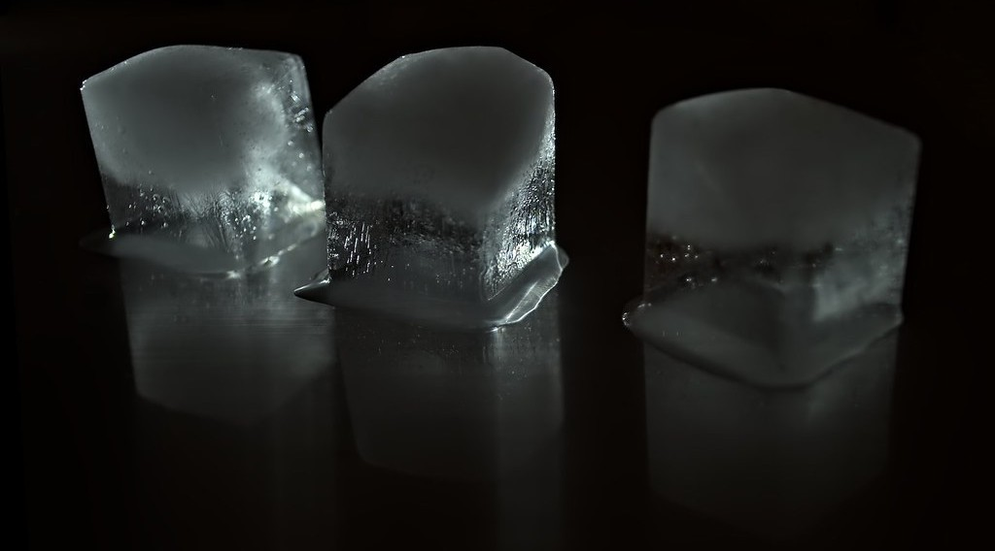
2. STATES
Activity 2
Ice.
Notes:
Activity 2. Look carefully at this picture: ice. Observe every detail before I ask the question.

Slide 24
2. STATES
Activity 2: Question
In which three states can water exist in the atmosphere?
Notes:
Here is the question for Activity 2: In which three states can water exist in the atmosphere? Take one minute to think and write your answer in your rough notebook.

Slide 25
2. STATES
Activity 2: Answer
Gas (vapour), liquid (droplets) and solid (ice crystals).
Notes:
Let us check the answer together. Gas (vapour), liquid (droplets) and solid (ice crystals).

Slide 26
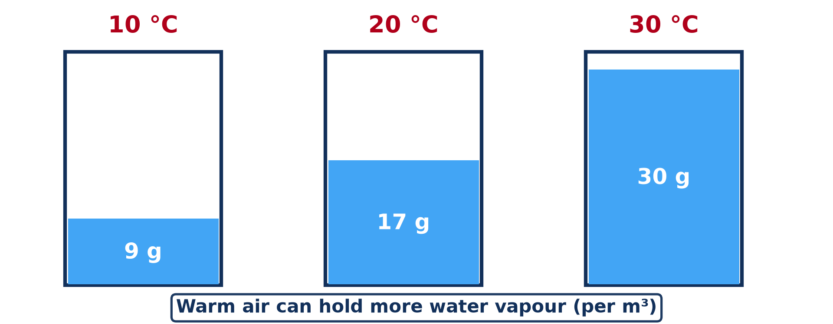
3. TYPES
Activity 3
Warm air can hold more water vapour.
Notes:
Activity 3. Look carefully at this diagram: warm air can hold more water vapour. Observe every detail before I ask the question.

Slide 27
3. TYPES
Activity 3: Question
What does a relative humidity of 100 % mean?
Notes:
Here is the question for Activity 3: What does a relative humidity of 100 % mean? Take one minute to think and write your answer in your rough notebook.

Slide 28
3. TYPES
Activity 3: Answer
The air is saturated.
Notes:
Let us check the answer together. The air is saturated.

Slide 29
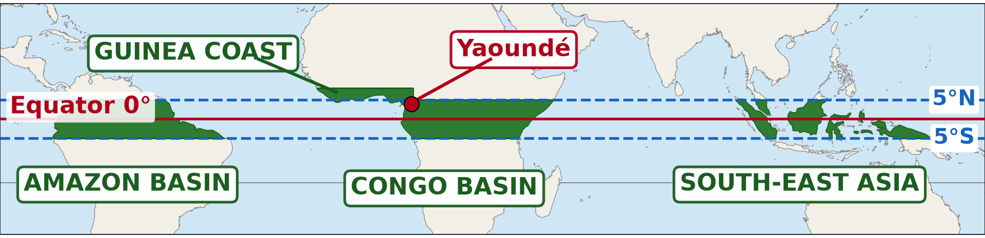
4. DISTRIBUTION
Activity 4
The equatorial regions.
Notes:
Activity 4. Look carefully at this diagram: the equatorial regions. Observe every detail before I ask the question.

Slide 30
4. DISTRIBUTION
Activity 4: Question
Why is the air very humid in the Congo Basin?
Notes:
Here is the question for Activity 4: Why is the air very humid in the Congo Basin? Take one minute to think and write your answer in your rough notebook.

Slide 31
4. DISTRIBUTION
Activity 4: Answer
High temperatures and much water from rivers and forests give strong evaporation and transpiration.
Notes:
Let us check the answer together. High temperatures and much water from rivers and forests give strong evaporation and transpiration.

Slide 32

5. FACTORS
Activity 5
Harmattan haze.
Notes:
Activity 5. Look carefully at this picture: harmattan haze. Observe every detail before I ask the question.

Slide 33
5. FACTORS
Activity 5: Question
Why is the air of Garoua so dry in January?
Notes:
Here is the question for Activity 5: Why is the air of Garoua so dry in January? Take one minute to think and write your answer in your rough notebook.

Slide 34
5. FACTORS
Activity 5: Answer
The Harmattan brings dry air from the Sahara.
Notes:
Let us check the answer together. The Harmattan brings dry air from the Sahara.

Slide 35
BOARD SUMMARY
Board Summary
Topic: Moisture in the Atmosphere
Sub-topic: Atmospheric Humidity
Lesson 10: Nature of Moisture
Notes:
Now we are going to copy the board summary. Write the title and the headings neatly in your notebooks. I will give you enough time for each slide, so do not rush.

Slide 36
BOARD SUMMARY
DEFINITIONS
The key terms of this lesson are defined as follows:
Evapotranspiration: It is the total loss of water to the atmosphere by evaporation from water and soil and by transpiration from plants.
Notes:
Let us copy the definitions. The key terms of this lesson are defined as follows. On this slide we have Evapotranspiration. Write each point on a new line, with the key term first, and explain it in your own words when we revise. When you finish, we go to the next slide.

Slide 37
BOARD SUMMARY
DEFINITIONS (continued)
Condensation: It is the change of water vapour into liquid water when air is cooled to its dew point.
Sublimation: It is the direct change of ice into water vapour, or of water vapour into ice, without passing through the liquid state.
Notes:
We continue with the definitions. On this slide we have Condensation and Sublimation. Write each point on a new line, with the key term first, and explain it in your own words when we revise. When you finish, we go to the next slide.

Slide 38
BOARD SUMMARY
DEFINITIONS (continued)
Freezing: It is the change of liquid water into ice at 0 °C.
Saturation: It is the state of air that holds the maximum water vapour possible at its temperature.
Notes:
We continue with the definitions. On this slide we have Freezing and Saturation. Write each point on a new line, with the key term first, and explain it in your own words when we revise. When you finish, we go to the next slide.

Slide 39
BOARD SUMMARY
DEFINITIONS (continued)
Dew point: It is the temperature at which air becomes saturated and condensation begins.
Notes:
We continue with the definitions. On this slide we have Dew point. Write each point on a new line, with the key term first, and explain it in your own words when we revise.

Slide 40
BOARD SUMMARY
1. Meaning and Sources of Moisture
A) Meaning of Moisture
Moisture is defined as follows:
Moisture: Moisture, also known as atmospheric humidity, is the water held in the atmosphere, mainly as invisible water vapour but also as droplets and ice crystals. In a strict sense, humidity refers only to the water vapour. Although it forms less than 4 % of the air, moisture is the source of all clouds and precipitation.
Notes:
Let us copy Meaning of Moisture. Moisture is defined as follows. Copy the point on Moisture: write the key term first, then its explanation.

Slide 41
BOARD SUMMARY
1. Meaning and Sources of Moisture
B) Sources of Moisture
The atmosphere receives its moisture from the following sources:
Oceans and seas: Oceans cover about 71 % of the Earth and supply about 86 % of the water vapour in the air by evaporation. This is why the air over the Gulf of Guinea and around Douala is always humid.
Notes:
Let us copy Sources of Moisture. The atmosphere receives its moisture from the following sources. Copy the point on Oceans and seas: write the key term first, then its explanation.

Slide 42

BOARD SUMMARY
1. Meaning and Sources of Moisture
B) Sources of Moisture
Lakes and rivers: Inland water bodies such as Lake Lagdo, the Benue and Lake Chad also lose water by evaporation, especially in the hot season. They make the air around them more humid than the surrounding dry land.
Illustration: Lake Lagdo
Notes:
Copy the point on Lakes and rivers on the left, then draw the diagram on the right: lake Lagdo. Give it a title and label it clearly.

Slide 43
BOARD SUMMARY
1. Meaning and Sources of Moisture
B) Sources of Moisture
Moist soil: After rain, the sun heats the soil and its water evaporates into the air. This source is important in the rainy season but becomes very weak in the dry season when soils dry out.
Notes:
We continue with Sources of Moisture. Copy the point on Moist soil: write the key term first, then its explanation.

Slide 44
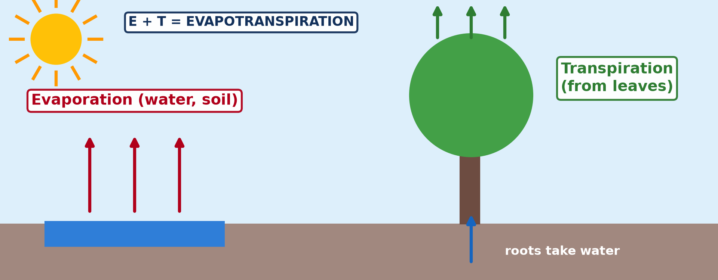
BOARD SUMMARY
1. Meaning and Sources of Moisture
B) Sources of Moisture
Plants: Plants take water from the soil through their roots and release it as vapour through the pores (stomata) of their leaves. With evaporation, this transpiration forms evapotranspiration, which makes the air over forests such as the Congo Basin very humid.
Illustration: evapotranspiration
Notes:
Copy the point on Plants on the left, then draw the diagram on the right: evapotranspiration. Give it a title and label it clearly.

Slide 45
BOARD SUMMARY
2. The Three States of Moisture
Moisture exists in the atmosphere in the following three states:
Gaseous state (water vapour): Water vapour is an invisible gas formed when water evaporates or when ice sublimates. It is the most common state of moisture and it stores latent heat, which is released when it condenses.
Notes:
Let us copy The Three States of Moisture. Moisture exists in the atmosphere in the following three states. Copy the point on Gaseous state (water vapour): write the key term first, then its explanation.

Slide 46

BOARD SUMMARY
2. The Three States of Moisture
Liquid state: When water vapour is cooled to its dew point, it condenses into tiny droplets. These droplets form clouds, fog, mist and dew, and when they grow big enough they fall as drizzle or rain.
Illustration: dew drops on grass
Notes:
Copy the point on Liquid state on the left, then draw the diagram on the right: dew drops on grass. Give it a title and label it clearly.

Slide 47

BOARD SUMMARY
2. The Three States of Moisture
Solid state: When droplets freeze, or when vapour changes directly into ice by sublimation, ice crystals are formed. They make up high clouds such as cirrus and fall as snow, hail or frost in cold regions and on high mountains.
Illustration: snow
Notes:
Copy the point on Solid state on the left, then draw the diagram on the right: snow. Give it a title and label it clearly.

Slide 48
BOARD SUMMARY
3. Types of Atmospheric Humidity
Atmospheric humidity is expressed in the following two types:
Absolute humidity: Absolute humidity is the mass of water vapour in a given volume of air, expressed in grams per cubic metre (g/m³). For example, 15 g/m³ means 15 grams of vapour in each cubic metre of air. It is high in hot equatorial air and very low in cold polar air and in deserts.
Illustration: warm air can hold more water vapour
Notes:
Let us copy Types of Atmospheric Humidity. Atmospheric humidity is expressed in the following two types. Copy the point on Absolute humidity on the left, then draw the diagram on the right: warm air can hold more water vapour. Give it a title and label it clearly.

Slide 49
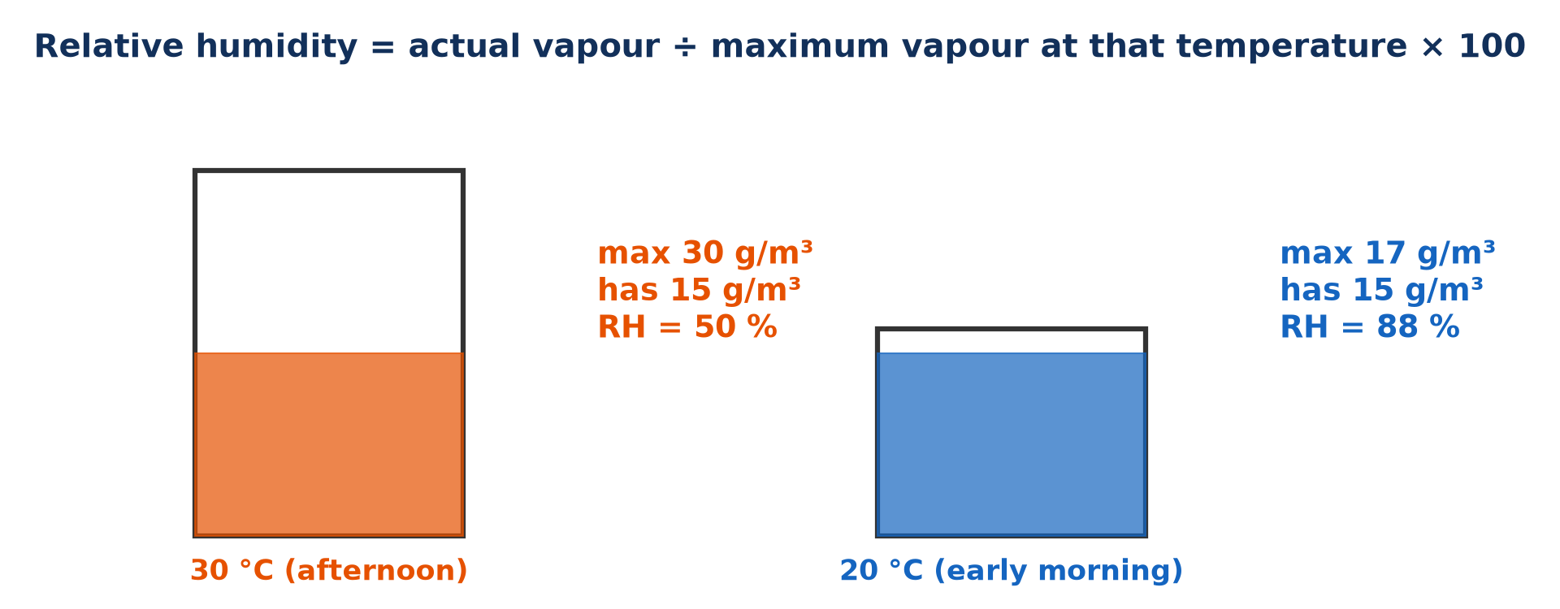
BOARD SUMMARY
3. Types of Atmospheric Humidity
Relative humidity (RH): Relative humidity compares the vapour in the air with the maximum the air can hold at the same temperature, in %: RH = actual vapour ÷ maximum vapour × 100. Air at 30 °C can hold about 30 g/m³, so if it contains 15 g/m³, its RH is 50 %. At 100 % the air is saturated and condensation begins.
Illustration: relative humidity and temperature
Notes:
Copy the point on Relative humidity (RH) on the left, then draw the diagram on the right: relative humidity and temperature. Give it a title and label it clearly.

Slide 50
BOARD SUMMARY
4. Spatial Distribution of Humidity
Humidity is distributed over the Earth as follows:
Equatorial regions: High temperatures and abundant water from oceans, rivers and forests give very high humidity all year. In the Congo Basin and on the Guinea coast, relative humidity is often above 80 %.
Illustration: the equatorial regions
Notes:
Let us copy Spatial Distribution of Humidity. Humidity is distributed over the Earth as follows. Copy the point on Equatorial regions on the left, then draw the diagram on the right: the equatorial regions. Give it a title and label it clearly.

Slide 51

BOARD SUMMARY
4. Spatial Distribution of Humidity
Tropical deserts (15° to 30° N and S): In the subtropical high-pressure belts, sinking air is warmed and dried, so relative humidity is very low, often under 20 %. The Sahara and the Kalahari therefore have clear skies and very little rain.
Illustration: the hot deserts
Notes:
Copy the point on Tropical deserts (15° to 30° N and S) on the left, then draw the diagram on the right: the hot deserts. Give it a title and label it clearly.

Slide 52
BOARD SUMMARY
4. Spatial Distribution of Humidity
Coasts and continental interiors: Air over oceans and along coasts is humid because of constant evaporation from the sea. Humidity decreases towards the interior of continents, which is why Douala is far more humid than Maroua.
Notes:
We continue with Spatial Distribution of Humidity. Copy the point on Coasts and continental interiors: write the key term first, then its explanation.

Slide 53
BOARD SUMMARY
4. Spatial Distribution of Humidity
Polar regions: Very cold air can hold little water vapour, so absolute humidity is extremely low. However, relative humidity can be high because this cold air is close to saturation even with little vapour.
Notes:
We continue with Spatial Distribution of Humidity. Copy the point on Polar regions: write the key term first, then its explanation.

Slide 54

BOARD SUMMARY
5. Factors that Influence Atmospheric Humidity
Atmospheric humidity is influenced by the following factors:
Temperature: Warm air can hold more water vapour than cold air, so a change of temperature changes relative humidity even when the amount of vapour stays the same. When the air cools at night, RH rises and dew or fog forms at dawn; when it warms in the afternoon, RH falls.
Illustration: morning fog
Notes:
Let us copy Factors that Influence Atmospheric Humidity. Atmospheric humidity is influenced by the following factors. Copy the point on Temperature on the left, then draw the diagram on the right: morning fog. Give it a title and label it clearly.

Slide 55
BOARD SUMMARY
5. Factors that Influence Atmospheric Humidity
Nearness to water bodies: Places near seas, lakes and rivers receive more water vapour by evaporation. For this reason, coastal and lakeside areas are more humid than places far inland.
Notes:
We continue with Factors that Influence Atmospheric Humidity. Copy the point on Nearness to water bodies: write the key term first, then its explanation.

Slide 56

BOARD SUMMARY
5. Factors that Influence Atmospheric Humidity
Vegetation cover: Dense vegetation releases large amounts of water vapour by transpiration. Forested areas are therefore more humid than bare land, and deforestation lowers humidity.
Illustration: a dense forest
Notes:
Copy the point on Vegetation cover on the left, then draw the diagram on the right: a dense forest. Give it a title and label it clearly.

Slide 57
BOARD SUMMARY
5. Factors that Influence Atmospheric Humidity
Winds and air masses: Winds bring the humidity of the regions they come from. In Garoua, the moist south-west monsoon from the Atlantic raises RH above 70 % in the rainy season, while the dry Harmattan from the Sahara lowers it below 20 % in the dry season.
Illustration: Harmattan haze
Notes:
Copy the point on Winds and air masses on the left, then draw the diagram on the right: harmattan haze. Give it a title and label it clearly.

Slide 58

BOARD SUMMARY
6. Relevance of Atmospheric Moisture
A) On Weather
Atmospheric moisture is important for weather in the following ways:
Formation of clouds and precipitation: All clouds, fog, dew and precipitation come from the condensation of water vapour. Moisture is therefore the source of the rain that falls on the Earth; without it, there would be no rain at all.
Illustration: clouds
Notes:
Let us copy On Weather. Atmospheric moisture is important for weather in the following ways. Copy the point on Formation of clouds and precipitation on the left, then draw the diagram on the right: clouds. Give it a title and label it clearly.

Slide 59

BOARD SUMMARY
6. Relevance of Atmospheric Moisture
A) On Weather
Transfer of heat energy: Water vapour takes latent heat during evaporation and releases it when it condenses. In this way, moisture carries heat from warm oceans and low latitudes to cooler regions and supplies the energy of thunderstorms.
Illustration: a storm cloud
Notes:
Copy the point on Transfer of heat energy on the left, then draw the diagram on the right: a storm cloud. Give it a title and label it clearly.

Slide 60
BOARD SUMMARY
6. Relevance of Atmospheric Moisture
A) On Weather
Regulation of temperature: Water vapour is a greenhouse gas that absorbs the heat radiated by the Earth and keeps the lower air warm at night. It thus reduces the daily range of temperature, which is why humid regions do not become as cold at night as dry deserts.
Notes:
We continue with On Weather. Copy the point on Regulation of temperature: write the key term first, then its explanation.

Slide 61
BOARD SUMMARY
6. Relevance of Atmospheric Moisture
B) On Man
Atmospheric moisture is important for man in the following ways:
Water supply: The rain formed from atmospheric moisture fills the rivers, lakes, springs and wells that people use every day. It also fills the reservoirs of dams such as Lagdo, which produce hydroelectricity for the North.
Illustration: Lake Lagdo
Notes:
Let us copy On Man. Atmospheric moisture is important for man in the following ways. Copy the point on Water supply on the left, then draw the diagram on the right: lake Lagdo. Give it a title and label it clearly.

Slide 62

BOARD SUMMARY
6. Relevance of Atmospheric Moisture
B) On Man
Agriculture and livestock: Moisture supplies the rain and dew that crops and pastures need to grow. In the North, farmers plant millet, maize and cotton at the start of the rains, and herders depend on the green pastures of the rainy season.
Illustration: a rice field
Notes:
Copy the point on Agriculture and livestock on the left, then draw the diagram on the right: a rice field. Give it a title and label it clearly.

Slide 63
BOARD SUMMARY
6. Relevance of Atmospheric Moisture
B) On Man
Human comfort and health: A moderate humidity keeps the skin, eyes, nose and throat moist and protects them from dryness and dust. It also makes the hot season more bearable, because the air is cooler and less dusty than during the dry Harmattan.
Notes:
We continue with On Man. Copy the point on Human comfort and health: write the key term first, then its explanation.

Slide 64
FORMATIVE EVALUATION
Evaluation 1
Distinguish absolute humidity from relative humidity.
Notes:
Now let us check what you have understood. Question 1: Distinguish absolute humidity from relative humidity. Answer in your exercise book.

Slide 65
FORMATIVE EVALUATION
Expected Answer
Absolute humidity is the mass of vapour in a volume of air; relative humidity compares this amount with the maximum possible at that temperature, in %.
Notes:
The expected answer is: absolute humidity is the mass of vapour in a volume of air; relative humidity compares this amount with the maximum possible at that temperature, in %. If you got it right, well done.

Slide 66
FORMATIVE EVALUATION
Evaluation 2
Explain why relative humidity rises at night.
Notes:
Now let us check what you have understood. Question 2: Explain why relative humidity rises at night. Answer in your exercise book.

Slide 67
FORMATIVE EVALUATION
Expected Answer
The air cools and can hold less vapour, so the same amount of vapour gives a higher percentage.
Notes:
The expected answer is: the air cools and can hold less vapour, so the same amount of vapour gives a higher percentage. If you got it right, well done.

Slide 68
REMEDIATION
Remediation
Fill in the blanks:
The water released by plants through their leaves is called ______.
Air at 100 % relative humidity is ______.
The temperature at which condensation begins is the ______ point.
Notes:
For those who need more practice, fill in the blanks in your exercise book. The answers are: number 1, transpiration; number 2, saturated; number 3, dew.

Slide 69
HOMEWORK
Homework
Name three types of clouds.
Notes:
For your homework: Name three types of clouds. We shall correct it at the beginning of our next lesson.

Slide 70
NEXT LESSON
Next Lesson
Our next lesson will be on:
Lesson 11: Forms of Condensation and Precipitation
Notes:
Our next lesson will be on Lesson 11: Forms of Condensation and Precipitation. Thank you for your attention, and see you next time.

Slide 71
BILINGUAL GAME
Bilingual Game (Jeu Bilingue)
English | Français
Moisture | L'humidité
Water vapour | La vapeur d'eau
Evapotranspiration | L'évapotranspiration
Relative humidity | L'humidité relative
Condensation | La condensation
Sublimation | La sublimation
Dew point | Le point de rosée
Notes:
Let us play the bilingual game. I say a word in English, and you give me the French word. Then we do the reverse.

Slide 72
LOGBOOK
Official Logbook (1/2)
Module / Topic | Moisture in the Atmosphere
Lesson Title | Lesson 10: Nature of Moisture
Expected Learning Outcomes | Define moisture and identify its sources. Describe the three states of moisture. Distinguish absolute and relative humidity. Describe the spatial distribution of humidity. Explain the factors and the relevance of atmospheric moisture on weather and man.
Competence | Learners are able to explain the humidity of the air in the rainy and dry seasons of Garoua and calculate relative humidity.
Notes:
I record this information in the official logbook of the class after the lesson.

Slide 73
LOGBOOK
Official Logbook (2/2)
Matter Taught | DEFINITIONS; Meaning of Moisture; Sources of Moisture; The Three States of Moisture; Types of Atmospheric Humidity; Spatial Distribution of Humidity; Factors that Influence Atmospheric Humidity; On Weather; On Man.
Evaluation | Formative evaluation and remediation exercise.
Homework | Name three types of clouds.
Enrolment / Present / Absent | ____ / ____ / ____
Achievement | To be completed after the lesson.
Notes:
I complete the second page of the logbook: the matter taught, the evaluation, the homework and the attendance.

Slide 74
TEACHER'S NOTE
Teacher's Note
Timing: Homework correction, plan, objectives 8 min | Recall, situation, action 10 min | 5 activities 30 min | Board summary (copying) 30 min | Evaluation, remediation 10 min | Homework, next lesson 5 min | Logbook 7 min
Activity 1 is an animation (GIF): it plays automatically in slide-show mode.
Without the projector (Activity 1): draw the water cycle.
Without the projector (Activity 2): show ice, water and steam.
Without the projector (Activity 3): fill a cup to the brim.
Without the projector (Activity 4): show the equator on a globe.
Without the projector (Activity 5): describe the Harmattan season.
Notes:
This slide is for me, the teacher: it gives the timing of the lesson and what to do if the projector is not available.

Slide 75
REFERENCES
References
Geography Syllabus for Sixth Forms (Lower and Upper Sixth), MINESEC, 2019 — Module 1 (Meteorology, Climatology & Hydrology).
Teacher's course notes: Mr KAMDEM E., Meteorology (LSA), GBHS Garoua, 2026.
Photo, Activity 2: “Thrice” by mpardo.photo, CC0 1.0, via Flickr (https://www.flickr.com/photos/130551911@N05/16875162129)
Photo, Activity 5: “Bamenda sob a poeira do Harmattan” by carlosoliveirareis, CC BY-NC-SA 2.0, via Flickr (https://www.flickr.com/photos/54218923@N00/387054136)
Photo, board summary (Lakes and rivers): “South Holston Lake, (Virginia-Tennessee border, USA)” by James St. John, CC BY 2.0, via Flickr (https://www.flickr.com/photos/47445767@N05/39221734762)
Photo, board summary (Liquid state): “Dew drops on grass” by Ervins Strauhmanis, CC BY 2.0, via Flickr (https://www.flickr.com/photos/76523360@N03/9537409567)
Photo, board summary (Solid state): “Peaceful Winter” by `James Wheeler, CC BY-NC-SA 2.0, via Flickr (https://www.flickr.com/photos/24128704@N08/25673217581)
Notes:
Take your time to copy this part; we will continue together.

Slide 76
REFERENCES
References (continued)
Photo, board summary (Temperature): “Mist” by Art by MarkAC, CC BY-SA 2.0, via Flickr (https://www.flickr.com/photos/60580775@N08/40783321332)
Photo, board summary (Vegetation cover): “Amazon 11” by CIAT International Center for Tropical Agriculture, CC BY-SA 2.0, via Flickr (https://www.flickr.com/photos/38476503@N08/5641587148)
Photo, board summary (Formation of clouds and precipitation): “Rising above the Inversion” by Pictoscribe -, CC BY-NC-ND 2.0, via Flickr (https://www.flickr.com/photos/70414856@N00/6535713585)
Photo, board summary (Transfer of heat energy): “When it rains in Africa!” by Martin_Heigan, CC BY-NC-ND 2.0, via Flickr (https://www.flickr.com/photos/97303475@N00/31286250004)
Photo, board summary (Agriculture and livestock): “A woman harvesting rice, Barotse floodplain, Zambia. Photo by Georgina” by WorldFish, CC BY-NC-ND 2.0, via Flickr (https://www.flickr.com/photos/61545321@N06/7848727138)
Diagrams and animations: drawn for this lesson (Geography Department).
Notes:
These are the references and picture credits used to prepare this lesson.

