Slide 1
LOWER SIXTH ARTS
GEOGRAPHY
Lesson 14
Vertical Motions: Stability and Instability
Notes:
Good morning, class, and welcome to our geography lesson. I am your geography teacher, Mr Kamdem. Today we are starting Lesson 14: Vertical Motions: Stability and Instability.

Slide 2
CLASS INFO
Class, Chapter and Duration
Class | Lower Sixth Arts
Chapter | Module 1: Understanding and managing atmospheric and hydrological phenomena and hazards across the world in general and Cameroon in particular
Duration | 2 periods (2 × 50 minutes)
Notes:
This lesson is for Lower Sixth Arts. It belongs to Module 1: Understanding and managing atmospheric and hydrological phenomena and hazards across the world in general and Cameroon in particular. We shall need 2 periods to cover it.

Slide 3
IDENTIFICATION
Lesson Identification
Topic | Global and Local Atmospheric Circulation
Sub-topic | Atmospheric Motions
Lesson | Lesson 14: Vertical Motions: Stability and Instability
Notions / Concepts | Vertical motion, air parcel, instability (absolute, conditional), stability (absolute, neutral), adiabatic, dry adiabatic lapse rate (DALR), saturated adiabatic lapse rate (SALR), environmental lapse rate (ELR).
Syllabus focus | Meaning of vertical motions; atmospheric instability and its weather; atmospheric stability and its weather; the role of adiabatic lapse rates in determining stability.
Competence | Learners are able to explain why some days bring storms and others clear skies by comparing lapse rates.
Notes:
Our topic is Global and Local Atmospheric Circulation, and the sub-topic is Atmospheric Motions. The key notions we shall use today are: vertical motion, air parcel, instability (absolute, conditional), stability (absolute, neutral), adiabatic, dry adiabatic lapse rate (DALR), saturated adiabatic lapse rate (SALR), environmental lapse rate (ELR). At the end, you should be able to do this: learners are able to explain why some days bring storms and others clear skies by comparing lapse rates.

Slide 4

HOMEWORK CORRECTION
Correction of the Homework
Question (Lesson 13: Pressure Systems):
State why warm air rises.
Notes:
Before we start the new lesson, let us correct the homework I gave you at the end of Lesson 13: Pressure Systems. The question was: State why warm air rises. Take out your exercise books.

Slide 5
HOMEWORK CORRECTION
Correction: Possible Answer
Warm air rises because it is lighter (less dense) than the cooler air around it.
Notes:
Here is a good answer. Warm air rises because it is lighter (less dense) than the cooler air around it. Compare it with your own answer and correct your work in red.

Slide 6
LESSON PLAN
Lesson Plan
Correction of the homework
Objectives and recall
Real-life situation and action to take
Learning activities
Board summary
Evaluation, remediation and homework
Notes:
Here is the plan of our lesson today. First, we shall correct the homework. Then we shall look at the objectives and recall what you already know. After that, we shall study a situation from real life and the action to take, and do the learning activities. Finally, we shall copy the board summary, do the evaluation and the remediation, and I will give you the homework.

Slide 7
OBJECTIVES
Objectives
By the end of this lesson, you should be able to:
Define vertical motions and an air parcel.
Explain atmospheric instability and its weather.
Notes:
Take your time to copy this part; we will continue together.

Slide 8
OBJECTIVES
Objectives (continued)
Explain atmospheric stability and its weather.
Use the DALR, SALR and ELR to determine stability.
Notes:
By the end of this lesson, you should be able to do four things. Number 1: define vertical motions and an air parcel. Number 2: explain atmospheric instability and its weather. Number 3: explain atmospheric stability and its weather. Number 4: use the DALR, SALR and ELR to determine stability.

Slide 9
PREVIOUS KNOWLEDGE
Previous Knowledge
Temperature falls about 6.5 °C per km (ELR).
Rising air expands and cools.
Latent heat is released when vapour condenses.
Notes:
Let us first remember what you already know. Temperature falls about 6.5 °C per km (ELR). Rising air expands and cools. Latent heat is released when vapour condenses. Keep this in mind, because we shall build on it today.

Slide 10
REAL-LIFE SITUATION
Situation in Real Life
Your teacher fills one balloon with warm air from a hair dryer and another near a bowl of ice.
The warm balloon rises easily while the cold one stays down.
Notes:
Take your time to copy this part; we will continue together.

Slide 11
REAL-LIFE SITUATION
Situation in Real Life (continued)
You remember that some afternoons in Garoua small clouds grow into huge storm clouds, while on other days, especially in the Harmattan, the sky stays clear and hazy all day.
You ask: "Why does air rise freely on some days and not on others?"
Notes:
Listen carefully to this situation from real life. Your teacher fills one balloon with warm air from a hair dryer and another near a bowl of ice. The warm balloon rises easily while the cold one stays down. You remember that some afternoons in Garoua small clouds grow into huge storm clouds, while on other days, especially in the Harmattan, the sky stays clear and hazy all day. You ask: "Why does air rise freely on some days and not on others?" Think about it, because I am going to ask you some questions.

Slide 12
REAL-LIFE SITUATION
Situation: Question 1
What is the problem in the situation?
Notes:
Question 1: What is the problem in the situation? Think for a moment, then raise your hand to answer.

Slide 13
REAL-LIFE SITUATION
Answer
The learner does not understand atmospheric stability and instability.
Notes:
Good. The learner does not understand atmospheric stability and instability.

Slide 14
REAL-LIFE SITUATION
Situation: Question 2
Why does the warm balloon rise?
Notes:
Question 2: Why does the warm balloon rise? Think for a moment, then raise your hand to answer.

Slide 15
REAL-LIFE SITUATION
Answer
Warm air is lighter than the cooler air around it.
Notes:
Good. Warm air is lighter than the cooler air around it.

Slide 16
REAL-LIFE SITUATION
Situation: Question 3
What kind of atmosphere produces storm clouds?
Notes:
Question 3: What kind of atmosphere produces storm clouds? Think for a moment, then raise your hand to answer.

Slide 17
REAL-LIFE SITUATION
Possible Answer
An unstable atmosphere, where rising air keeps rising.
Notes:
Good. An unstable atmosphere, where rising air keeps rising.

Slide 18
ACTION TO TAKE
Action to Take
Watch for towering clouds on unstable afternoons and shelter from storms and lightning.
Notes:
From this situation, the action we are working towards in this lesson is the following: watch for towering clouds on unstable afternoons and shelter from storms and lightning.

Slide 19
JUSTIFICATION
Justification of the Lesson
This lesson helps us to understand and forecast storms, clear days, fog and pollution episodes.
Notes:
Why is this lesson important for you? This lesson helps us to understand and forecast storms, clear days, fog and pollution episodes.

Slide 20
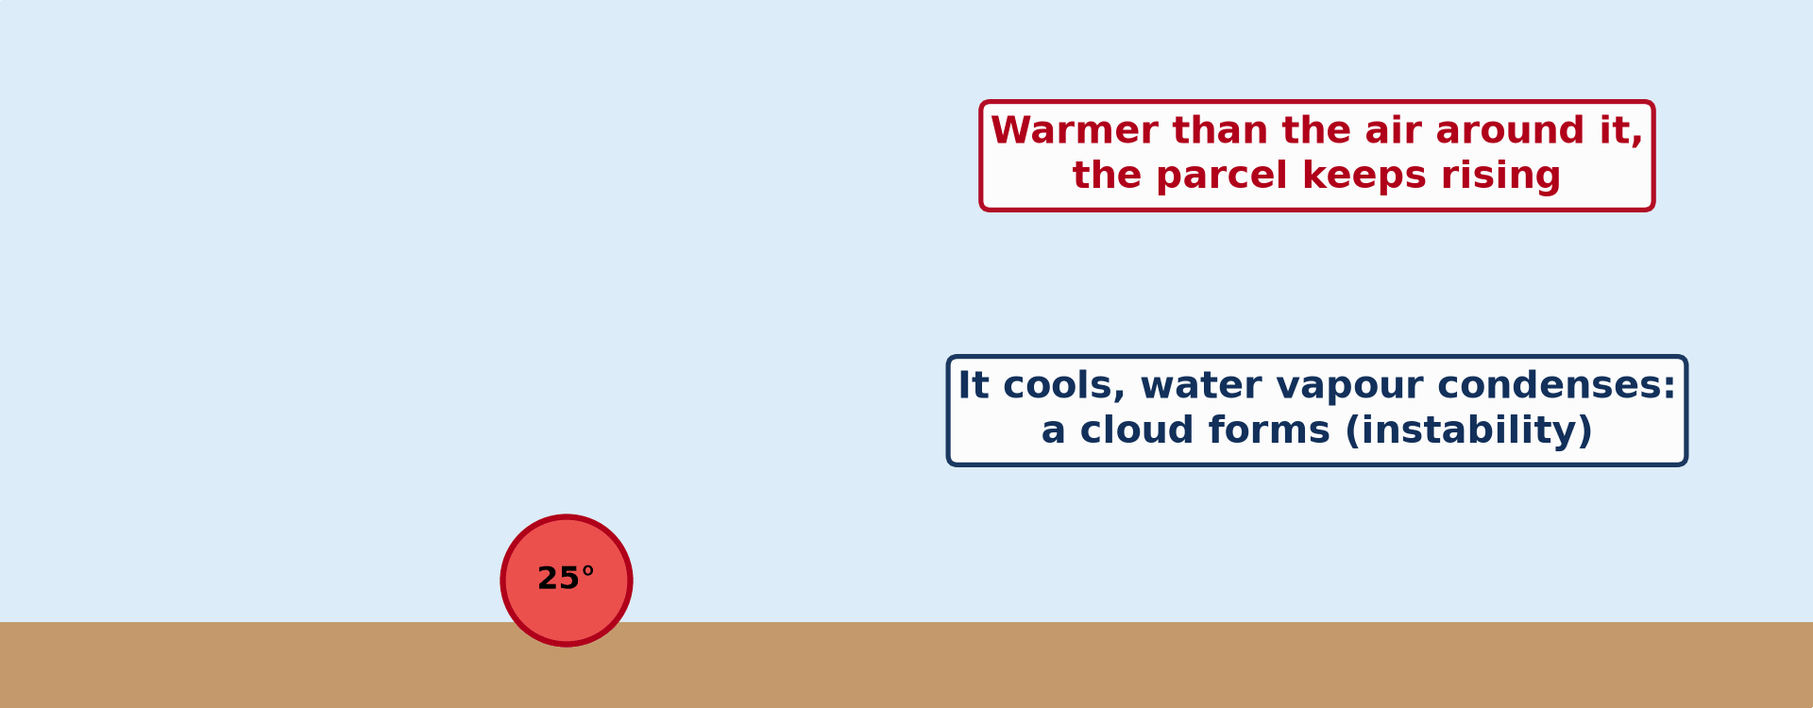
1. VERTICAL MOTIONS
Activity 1
Animation: a rising air parcel.
Notes:
Activity 1. Look carefully at this animation: animation: a rising air parcel. Watch the animation to the end; it will play again.

Slide 21
1. VERTICAL MOTIONS
Activity 1: Question
What is an air parcel?
Notes:
Here is the question for Activity 1: What is an air parcel? Take one minute to think and write your answer in your rough notebook.

Slide 22
1. VERTICAL MOTIONS
Activity 1: Answer
A small imaginary volume of air that rises or sinks without mixing with the air around it.
Notes:
Let us check the answer together. A small imaginary volume of air that rises or sinks without mixing with the air around it.

Slide 23

2. INSTABILITY
Activity 2
A towering cumulonimbus.
Notes:
Activity 2. Look carefully at this picture: a towering cumulonimbus. Observe every detail before I ask the question.

Slide 24
2. INSTABILITY
Activity 2: Question
What weather does instability bring?
Notes:
Here is the question for Activity 2: What weather does instability bring? Take one minute to think and write your answer in your rough notebook.

Slide 25
2. INSTABILITY
Activity 2: Answer
Cumulonimbus clouds, thunderstorms, heavy rain and hail.
Notes:
Let us check the answer together. Cumulonimbus clouds, thunderstorms, heavy rain and hail.

Slide 26

3. STABILITY
Activity 3
Haze trapped in stable air.
Notes:
Activity 3. Look carefully at this picture: haze trapped in stable air. Observe every detail before I ask the question.

Slide 27
3. STABILITY
Activity 3: Question
Why does pollution build up in stable air?
Notes:
Here is the question for Activity 3: Why does pollution build up in stable air? Take one minute to think and write your answer in your rough notebook.

Slide 28
3. STABILITY
Activity 3: Answer
Air does not rise, so there is no vertical mixing.
Notes:
Let us check the answer together. Air does not rise, so there is no vertical mixing.

Slide 29
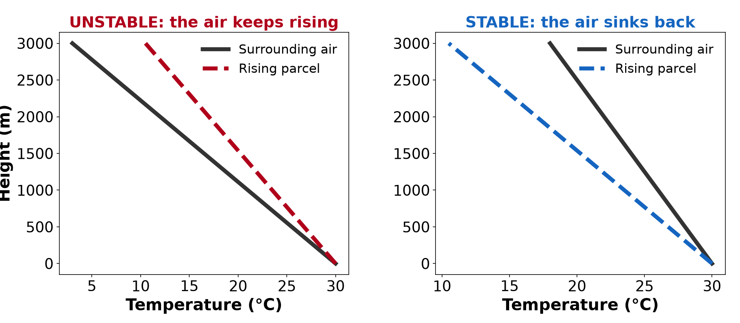
4. LAPSE RATES
Activity 4
Lapse rates and stability.
Notes:
Activity 4. Look carefully at this diagram: lapse rates and stability. Observe every detail before I ask the question.

Slide 30
4. LAPSE RATES
Activity 4: Question
Why does saturated air cool more slowly than dry air?
Notes:
Here is the question for Activity 4: Why does saturated air cool more slowly than dry air? Take one minute to think and write your answer in your rough notebook.

Slide 31
4. LAPSE RATES
Activity 4: Answer
Condensation releases latent heat.
Notes:
Let us check the answer together. Condensation releases latent heat.

Slide 32
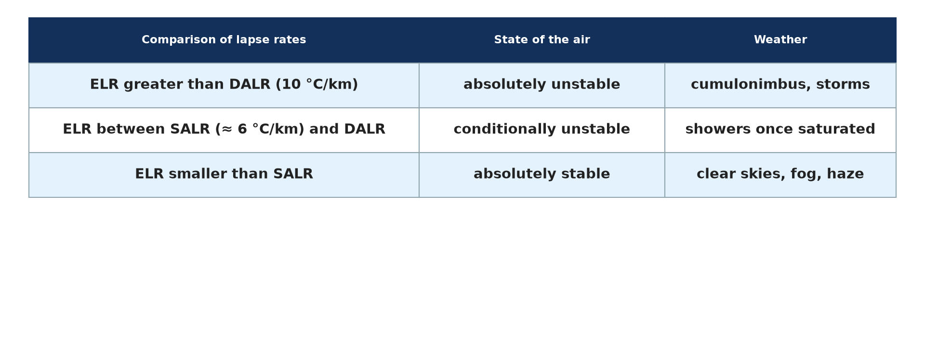
4. LAPSE RATES
Activity 5
Rules of stability.
Notes:
Activity 5. Look carefully at this picture: rules of stability. Observe every detail before I ask the question.

Slide 33
4. LAPSE RATES
Activity 5: Question
If the ELR is greater than the DALR, is the air stable or unstable?
Notes:
Here is the question for Activity 5: If the ELR is greater than the DALR, is the air stable or unstable? Take one minute to think and write your answer in your rough notebook.

Slide 34
4. LAPSE RATES
Activity 5: Answer
Absolutely unstable.
Notes:
Let us check the answer together. Absolutely unstable.

Slide 35
BOARD SUMMARY
Board Summary
Topic: Global and Local Atmospheric Circulation
Sub-topic: Atmospheric Motions
Lesson 14: Vertical Motions: Stability and Instability
Notes:
Now we are going to copy the board summary. Write the title and the headings neatly in your notebooks. I will give you enough time for each slide, so do not rush.

Slide 36
BOARD SUMMARY
DEFINITIONS
The key terms of this lesson are defined as follows:
Vertical motions: They are the upward and downward movements of air in the atmosphere.
Notes:
Let us copy the definitions. The key terms of this lesson are defined as follows. On this slide we have Vertical motions. Write each point on a new line, with the key term first, and explain it in your own words when we revise. When you finish, we go to the next slide.

Slide 37
BOARD SUMMARY
DEFINITIONS (continued)
Adiabatic lapse rate: It is the rate at which rising air cools by expansion, or sinking air warms by compression, without exchange of heat with the surrounding air.
Atmospheric instability: It is the state in which a lifted air parcel keeps rising because it is warmer than the air around it.
Notes:
We continue with the definitions. On this slide we have Adiabatic lapse rate and Atmospheric instability. Write each point on a new line, with the key term first, and explain it in your own words when we revise. When you finish, we go to the next slide.

Slide 38
BOARD SUMMARY
DEFINITIONS (continued)
Atmospheric stability: It is the state in which a lifted air parcel sinks back because it is cooler than the air around it.
Notes:
We continue with the definitions. On this slide we have Atmospheric stability. Write each point on a new line, with the key term first, and explain it in your own words when we revise.

Slide 39
BOARD SUMMARY
1. The Adiabatic Lapse Rates
Stability and instability are found by comparing the following lapse rates:
Dry adiabatic lapse rate (DALR): Unsaturated air that rises expands and cools at a fixed rate of about 10 °C per 1,000 m. Sinking air warms at the same rate.
Illustration: the lapse rates
Notes:
Let us copy The Adiabatic Lapse Rates. Stability and instability are found by comparing the following lapse rates. Copy the point on Dry adiabatic lapse rate (DALR) on the left, then draw the diagram on the right: the lapse rates. Give it a title and label it clearly.

Slide 40
BOARD SUMMARY
1. The Adiabatic Lapse Rates
Saturated adiabatic lapse rate (SALR): Once rising air is saturated, it cools more slowly, at about 5 to 7 °C per 1,000 m. This is because the condensation of vapour releases latent heat that partly warms the air.
Notes:
We continue with The Adiabatic Lapse Rates. Copy the point on Saturated adiabatic lapse rate (SALR): write the key term first, then its explanation.

Slide 41
BOARD SUMMARY
1. The Adiabatic Lapse Rates
Environmental lapse rate (ELR): It is the real fall of temperature of the still air around the parcel, on average 6.5 °C per 1,000 m. It changes from day to day, so comparing it with the DALR and SALR shows whether the air is stable or unstable.
Notes:
We continue with The Adiabatic Lapse Rates. Copy the point on Environmental lapse rate (ELR): write the key term first, then its explanation.

Slide 42
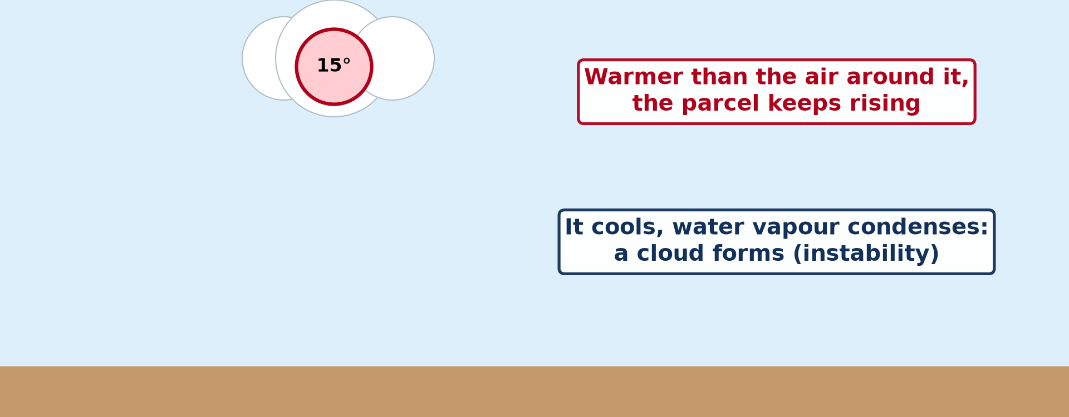
BOARD SUMMARY
2. Atmospheric Instability
A) Meaning and Types
Atmospheric instability and its types are explained as follows:
Meaning: Air is unstable when a parcel that is lifted stays warmer and lighter than the air around it. It therefore keeps rising on its own, like a hot-air balloon.
Illustration: a rising parcel of air
Notes:
Let us copy Meaning and Types. Atmospheric instability and its types are explained as follows. Copy the point on Meaning on the left, then draw the diagram on the right: a rising parcel of air. Give it a title and label it clearly.

Slide 43
BOARD SUMMARY
2. Atmospheric Instability
A) Meaning and Types
Absolute instability: It occurs when the ELR is greater than the DALR, for example on very hot afternoons when the ground is strongly heated. The parcel is always warmer than its surroundings, whether it is dry or saturated.
Notes:
We continue with Meaning and Types. Copy the point on Absolute instability: write the key term first, then its explanation.

Slide 44
BOARD SUMMARY
2. Atmospheric Instability
A) Meaning and Types
Conditional instability: It occurs when the ELR lies between the SALR and the DALR. The air is stable while it is dry, but becomes unstable once it is lifted enough to become saturated.
Notes:
We continue with Meaning and Types. Copy the point on Conditional instability: write the key term first, then its explanation.

Slide 45
BOARD SUMMARY
2. Atmospheric Instability
A) Meaning and Types
Potential instability: It occurs when a stable layer of air, dry above and moist below, is lifted as a whole, for example over mountains or at a front. The lower moist part becomes saturated first and the whole layer becomes unstable.
Notes:
We continue with Meaning and Types. Copy the point on Potential instability: write the key term first, then its explanation.

Slide 46
BOARD SUMMARY
2. Atmospheric Instability
B) Associated Weather Conditions
Unstable air brings the following weather conditions:
Towering clouds: Rising air forms cumulus clouds that grow into huge cumulonimbus reaching the tropopause. They are common on rainy-season afternoons in Garoua.
Illustration: a cumulonimbus cloud
Notes:
Let us copy Associated Weather Conditions. Unstable air brings the following weather conditions. Copy the point on Towering clouds on the left, then draw the diagram on the right: a cumulonimbus cloud. Give it a title and label it clearly.

Slide 47
BOARD SUMMARY
2. Atmospheric Instability
B) Associated Weather Conditions
Heavy showers and thunderstorms: Cumulonimbus clouds give heavy but short showers, with thunder, lightning and sometimes hail. Strong gusts of wind blow ahead of the storm.
Notes:
We continue with Associated Weather Conditions. Copy the point on Heavy showers and thunderstorms: write the key term first, then its explanation.

Slide 48
BOARD SUMMARY
2. Atmospheric Instability
B) Associated Weather Conditions
Turbulence and good dispersion: Strong up-currents make aircraft shake and can be dangerous for flights. On the other hand, they carry smoke and dust upwards, so the air near the ground stays clean.
Notes:
We continue with Associated Weather Conditions. Copy the point on Turbulence and good dispersion: write the key term first, then its explanation.

Slide 49
BOARD SUMMARY
3. Atmospheric Stability
A) Meaning and Types
Atmospheric stability and its types are explained as follows:
Meaning: Air is stable when a parcel that is lifted becomes cooler and heavier than the air around it. It therefore sinks back to its starting level and resists vertical movement.
Notes:
Let us copy Meaning and Types. Atmospheric stability and its types are explained as follows. Copy the point on Meaning: write the key term first, then its explanation.

Slide 50
BOARD SUMMARY
3. Atmospheric Stability
A) Meaning and Types
Absolute stability: It occurs when the ELR is smaller than the SALR, for example during a temperature inversion. The parcel is always cooler than its surroundings, whether it is dry or saturated.
Notes:
We continue with Meaning and Types. Copy the point on Absolute stability: write the key term first, then its explanation.

Slide 51
BOARD SUMMARY
3. Atmospheric Stability
A) Meaning and Types
Neutral stability: It occurs when the ELR is equal to the lapse rate of the parcel. The lifted parcel has the same temperature as its surroundings, so it neither rises nor sinks on its own.
Notes:
We continue with Meaning and Types. Copy the point on Neutral stability: write the key term first, then its explanation.

Slide 52
BOARD SUMMARY
3. Atmospheric Stability
B) Associated Weather Conditions
Stable air brings the following weather conditions:
Clear skies and calm weather: Air does not rise, so clouds cannot grow and there is little or no rain. This is the weather of anticyclones and of the dry season in the North.
Notes:
Let us copy Associated Weather Conditions. Stable air brings the following weather conditions. Copy the point on Clear skies and calm weather: write the key term first, then its explanation.

Slide 53
BOARD SUMMARY
3. Atmospheric Stability
B) Associated Weather Conditions
Fog and layer clouds: When stable air is moist, it forms fog near the ground or flat layers of stratus. These clouds give only drizzle or light rain.
Notes:
We continue with Associated Weather Conditions. Copy the point on Fog and layer clouds: write the key term first, then its explanation.

Slide 54
BOARD SUMMARY
3. Atmospheric Stability
B) Associated Weather Conditions
Trapped pollution: Smoke, dust and fumes cannot rise and remain near the ground. This produces haze and smog, as during the Harmattan season in towns.
Illustration: smog
Notes:
Copy the point on Trapped pollution on the left, then draw the diagram on the right: smog. Give it a title and label it clearly.

Slide 55
FORMATIVE EVALUATION
Evaluation 1
Distinguish a stable from an unstable atmosphere.
Notes:
Now let us check what you have understood. Question 1: Distinguish a stable from an unstable atmosphere. Answer in your exercise book.

Slide 56
FORMATIVE EVALUATION
Expected Answer
In a stable atmosphere, lifted air sinks back and skies stay clear; in an unstable atmosphere, lifted air keeps rising and forms storm clouds.
Notes:
The expected answer is: in a stable atmosphere, lifted air sinks back and skies stay clear; in an unstable atmosphere, lifted air keeps rising and forms storm clouds. If you got it right, well done.

Slide 57
FORMATIVE EVALUATION
Evaluation 2
Why does saturated air cool more slowly than dry air?
Notes:
Now let us check what you have understood. Question 2: Why does saturated air cool more slowly than dry air? Answer in your exercise book.

Slide 58
FORMATIVE EVALUATION
Expected Answer
Condensation releases latent heat, which partly compensates for the cooling.
Notes:
The expected answer is: condensation releases latent heat, which partly compensates for the cooling. If you got it right, well done.

Slide 59
REMEDIATION
Remediation
Fill in the blanks:
Dry air cools at about ______ °C per km.
An ELR greater than the DALR gives ______ instability.
Stable air often traps ______.
Notes:
For those who need more practice, fill in the blanks in your exercise book. The answers are: number 1, 10; number 2, absolute; number 3, pollution (haze, fog).

Slide 60
HOMEWORK
Homework
Define wind.
Notes:
For your homework: Define wind. We shall correct it at the beginning of our next lesson.

Slide 61
NEXT LESSON
Next Lesson
Our next lesson will be on:
Lesson 15: Planetary Winds
Notes:
Our next lesson will be on Lesson 15: Planetary Winds. Thank you for your attention, and see you next time.

Slide 62
BILINGUAL GAME
Bilingual Game (Jeu Bilingue)
English | Français
Stability | La stabilité
Instability | L'instabilité
Air parcel | La particule d'air
Lapse rate | Le gradient thermique
Thunderstorm | L'orage
Latent heat | La chaleur latente
Notes:
Let us play the bilingual game. I say a word in English, and you give me the French word. Then we do the reverse.

Slide 63
LOGBOOK
Official Logbook (1/2)
Module / Topic | Global and Local Atmospheric Circulation
Lesson Title | Lesson 14: Vertical Motions: Stability and Instability
Expected Learning Outcomes | Define vertical motions and an air parcel. Explain atmospheric instability and its weather. Explain atmospheric stability and its weather. Use the DALR, SALR and ELR to determine stability.
Competence | Learners are able to explain why some days bring storms and others clear skies by comparing lapse rates.
Notes:
I record this information in the official logbook of the class after the lesson.

Slide 64
LOGBOOK
Official Logbook (2/2)
Matter Taught | DEFINITIONS; The Adiabatic Lapse Rates; Meaning and Types; Associated Weather Conditions.
Evaluation | Formative evaluation and remediation exercise.
Homework | Define wind.
Enrolment / Present / Absent | ____ / ____ / ____
Achievement | To be completed after the lesson.
Notes:
I complete the second page of the logbook: the matter taught, the evaluation, the homework and the attendance.

Slide 65
TEACHER'S NOTE
Teacher's Note
Timing: Homework correction, plan, objectives 8 min | Recall, situation, action 10 min | 5 activities 30 min | Board summary (copying) 30 min | Evaluation, remediation 10 min | Homework, next lesson 5 min | Logbook 7 min
Activity 1 is an animation (GIF): it plays automatically in slide-show mode.
Without the projector (Activity 1): use the two balloons.
Without the projector (Activity 2): describe an afternoon storm.
Without the projector (Activity 3): describe Harmattan haze.
Without the projector (Activity 4): draw the DALR and SALR lines.
Without the projector (Activity 5): write the three rules.
Notes:
This slide is for me, the teacher: it gives the timing of the lesson and what to do if the projector is not available.

Slide 66
REFERENCES
References
Geography Syllabus for Sixth Forms (Lower and Upper Sixth), MINESEC, 2019 — Module 1 (Meteorology, Climatology & Hydrology).
Teacher's course notes: Mr KAMDEM E., Meteorology (LSA), GBHS Garoua, 2026.
Photo, Activity 2: “06172012 Sunday evening pulse storms/cumulonimbi” by StormRider93 | Into the Storm, CC BY-NC-ND 2.0, via Flickr (https://www.flickr.com/photos/65232104@N04/7395715628)
Photo, Activity 3: “Beijing smog” by kevin dooley, CC BY 2.0, via Flickr (https://www.flickr.com/photos/12836528@N00/386198516)
Diagrams and animations: drawn for this lesson (Geography Department).
Notes:
These are the references and picture credits used to prepare this lesson.

