Slide 1
FORM 2
GEOGRAPHY
Practical Work 4
Location of the Regional and Divisional Headquarters of Cameroon
Notes:
Good morning, class, and welcome to our geography lesson. I am your geography teacher, Mr Kamdem. Today we are starting Practical Work 4: Location of the Regional and Divisional Headquarters of Cameroon.

Slide 2
CLASS INFO
Class, Chapter and Duration
Class | Form 2
Chapter | Module 2: Space Occupation
Duration | 2 periods (2 × 50 minutes)
Notes:
This lesson is for Form 2. It belongs to Module 2: Space Occupation. We shall need 2 periods to cover it.

Slide 3
IDENTIFICATION
Lesson Identification
Topic | Space Occupation
Sub-topic | Towns and Country Sides of Africa
Lesson | Practical Work 4: Location of the Regional and Divisional Headquarters of Cameroon
Notions / Concepts | Region, division, regional headquarters, divisional headquarters, base map.
Syllabus focus | Naming the regional and divisional headquarters; locating them on a base map.
Competence | Learners are able to name and locate the regional headquarters of Cameroon and the divisional headquarters of their region.
Notes:
Our topic is Space Occupation, and the sub-topic is Towns and Country Sides of Africa. The key notions we shall use today are: region, division, regional headquarters, divisional headquarters, base map. At the end, you should be able to do this: learners are able to name and locate the regional headquarters of Cameroon and the divisional headquarters of their region.

Slide 4

HOMEWORK CORRECTION
Correction of the Homework
Question (Further Study 5: Informal Sector Activities in African Cities):
Interview one informal worker: his job, his income and his main problem.
Notes:
Before we start the new lesson, let us correct the homework I gave you at the end of Further Study 5: Informal Sector Activities in African Cities. The question was: Interview one informal worker: his job, his income and his main problem. Take out your exercise books.

Slide 5
HOMEWORK CORRECTION
Correction: Possible Answer
Answers vary. Example: a shoe repairer earns about 2,000 FCFA a day; his main problem is irregular income and no place to work when it rains.
Notes:
Here is a good answer. Answers vary. Example: a shoe repairer earns about 2,000 FCFA a day; his main problem is irregular income and no place to work when it rains. Compare it with your own answer and correct your work in red.

Slide 6
LESSON PLAN
Lesson Plan
Correction of the homework
Objectives and recall
Real-life situation and action to take
Learning activities
Board summary
Evaluation, remediation and homework
Notes:
Here is the plan of our lesson today. First, we shall correct the homework. Then we shall look at the objectives and recall what you already know. After that, we shall study a situation from real life and the action to take, and do the learning activities. Finally, we shall copy the board summary, do the evaluation and the remediation, and I will give you the homework.

Slide 7
OBJECTIVES
Objectives
By the end of this lesson, you should be able to:
Name the ten regions of Cameroon and their headquarters.
Name the divisional headquarters of their region.
Notes:
Take your time to copy this part; we will continue together.

Slide 8
OBJECTIVES
Objectives (continued)
Locate them on a base map.
Notes:
By the end of this lesson, you should be able to do three things. Number 1: name the ten regions of Cameroon and their headquarters. Number 2: name the divisional headquarters of their region. Number 3: locate them on a base map.

Slide 9
PREVIOUS KNOWLEDGE
Previous Knowledge
Cameroon has ten regions.
Yaoundé is the capital of Cameroon.
Garoua is in the North Region.
Notes:
Let us first remember what you already know. Cameroon has ten regions. Yaoundé is the capital of Cameroon. Garoua is in the North Region. Keep this in mind, because we shall build on it today.

Slide 10
REAL-LIFE SITUATION
Situation in Real Life
A new student from Bafoussam asks the class the headquarters of the North Region and of the divisions around Garoua. Nobody can show them correctly on a map.
Notes:
Listen carefully to this situation from real life. A new student from Bafoussam asks the class the headquarters of the North Region and of the divisions around Garoua. Nobody can show them correctly on a map. Think about it, because I am going to ask you some questions.

Slide 11
REAL-LIFE SITUATION
Situation: Question 1
What is the problem in the situation?
Notes:
Question 1: What is the problem in the situation? Think for a moment, then raise your hand to answer.

Slide 12
REAL-LIFE SITUATION
Answer
The class cannot locate the headquarters on a map.
Notes:
Good. The class cannot locate the headquarters on a map.

Slide 13
REAL-LIFE SITUATION
Situation: Question 2
What is the headquarters of the North Region?
Notes:
Question 2: What is the headquarters of the North Region? Think for a moment, then raise your hand to answer.

Slide 14
REAL-LIFE SITUATION
Answer
Garoua.
Notes:
Good. Garoua.

Slide 15
REAL-LIFE SITUATION
Situation: Question 3
What do we need?
Notes:
Question 3: What do we need? Think for a moment, then raise your hand to answer.

Slide 16
REAL-LIFE SITUATION
Possible Answer
A base map of Cameroon with regions and divisions.
Notes:
Good. A base map of Cameroon with regions and divisions.

Slide 17
ACTION TO TAKE
Action to Take
Draw neat maps with a title, a key and a north arrow.
Notes:
From this situation, the action we are working towards in this lesson is the following: draw neat maps with a title, a key and a north arrow.

Slide 18
JUSTIFICATION
Justification of the Lesson
This practical work helps us to know the administrative map of our country.
Notes:
Why is this lesson important for you? This practical work helps us to know the administrative map of our country.

Slide 19
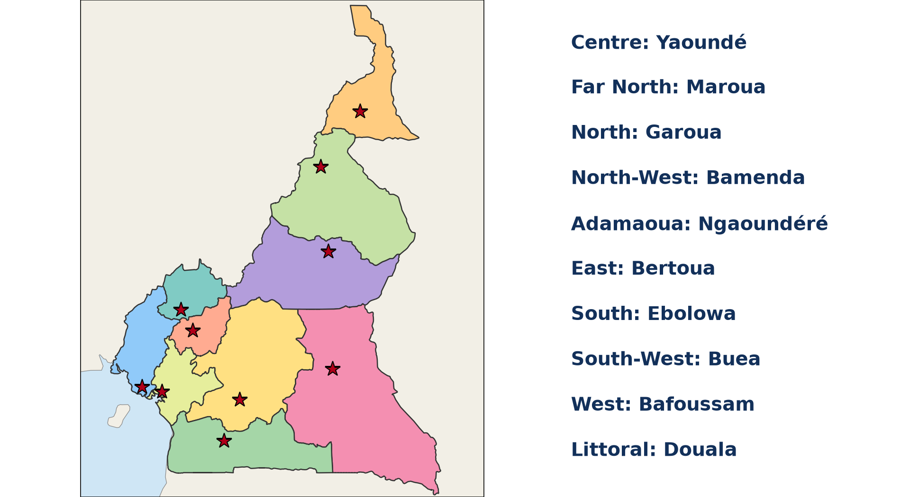
1. THEORETICAL BASIS
Activity 1
The ten regions of Cameroon.
Notes:
Activity 1. Look carefully at this diagram: the ten regions of Cameroon. Observe every detail before I ask the question.

Slide 20
1. THEORETICAL BASIS
Activity 1: Question
Name the ten regions of Cameroon.
Notes:
Here is the question for Activity 1: Name the ten regions of Cameroon. Take one minute to think and write your answer in your rough notebook.

Slide 21
1. THEORETICAL BASIS
Activity 1: Answer
Adamawa, Centre, East, Far North, Littoral, North, North-West, South, South-West and West.
Notes:
Let us check the answer together. Adamawa, Centre, East, Far North, Littoral, North, North-West, South, South-West and West.

Slide 22
2. REGIONAL HEADQUARTERS
Activity 2
Regional headquarters.
Notes:
Activity 2. Look carefully at this diagram: regional headquarters. Observe every detail before I ask the question.

Slide 23
2. REGIONAL HEADQUARTERS
Activity 2: Question
Give the headquarters of the Far North, Adamawa and South-West Regions.
Notes:
Here is the question for Activity 2: Give the headquarters of the Far North, Adamawa and South-West Regions. Take one minute to think and write your answer in your rough notebook.

Slide 24
2. REGIONAL HEADQUARTERS
Activity 2: Answer
Maroua, Ngaoundéré and Buea.
Notes:
Let us check the answer together. Maroua, Ngaoundéré and Buea.

Slide 25

2. REGIONAL HEADQUARTERS
Activity 3
Main towns of Cameroon.
Notes:
Activity 3. Look carefully at this diagram: main towns of Cameroon. Observe every detail before I ask the question.

Slide 26
2. REGIONAL HEADQUARTERS
Activity 3: Question
Which regional headquarters is on the coast?
Notes:
Here is the question for Activity 3: Which regional headquarters is on the coast? Take one minute to think and write your answer in your rough notebook.

Slide 27
2. REGIONAL HEADQUARTERS
Activity 3: Answer
Douala (Littoral); Buea is near the coast at the foot of Mount Cameroon.
Notes:
Let us check the answer together. Douala (Littoral); Buea is near the coast at the foot of Mount Cameroon.

Slide 28
3. DIVISIONAL HEADQUARTERS
Activity 4
The North Region.
Notes:
Activity 4. Look carefully at this diagram: the North Region. Observe every detail before I ask the question.

Slide 29
3. DIVISIONAL HEADQUARTERS
Activity 4: Question
Name the four divisions of the North Region and their headquarters.
Notes:
Here is the question for Activity 4: Name the four divisions of the North Region and their headquarters. Take one minute to think and write your answer in your rough notebook.

Slide 30
3. DIVISIONAL HEADQUARTERS
Activity 4: Answer
Bénoué (Garoua), Faro (Poli), Mayo-Louti (Guider) and Mayo-Rey (Tcholliré).
Notes:
Let us check the answer together. Bénoué (Garoua), Faro (Poli), Mayo-Louti (Guider) and Mayo-Rey (Tcholliré).

Slide 31

4. MAPPING
Activity 5
Elements of a map.
Notes:
Activity 5. Look carefully at this diagram: elements of a map. Observe every detail before I ask the question.

Slide 32
4. MAPPING
Activity 5: Question
How do we show the headquarters on the base map?
Notes:
Here is the question for Activity 5: How do we show the headquarters on the base map? Take one minute to think and write your answer in your rough notebook.

Slide 33
4. MAPPING
Activity 5: Answer
With a star for regional and a dot for divisional headquarters, named, with a key, title and north arrow.
Notes:
Let us check the answer together. With a star for regional and a dot for divisional headquarters, named, with a key, title and north arrow.

Slide 34
BOARD SUMMARY
Board Summary
Topic: Space Occupation
Sub-topic: Towns and Country Sides of Africa
Practical Work 4: Location of the Regional and Divisional Headquarters of Cameroon
Notes:
Now we are going to copy the board summary. Write the title and the headings neatly in your notebooks. I will give you enough time for each slide, so do not rush.

Slide 35
BOARD SUMMARY
DEFINITIONS
The key terms of this lesson are defined as follows:
Regional headquarters: It is the town where the administration of a region is found.
Divisional headquarters: It is the town where the administration of a division is found.
Notes:
Let us copy the definitions. The key terms of this lesson are defined as follows. On this slide we have Regional headquarters and Divisional headquarters. Write each point on a new line, with the key term first, and explain it in your own words when we revise.

Slide 36
BOARD SUMMARY
1. Regional Headquarters of Cameroon
The ten regions and their headquarters are the following:
North and Far North: Garoua (North) and Maroua (Far North).
Adamawa and East: Ngaoundéré (Adamawa) and Bertoua (East).
Notes:
Let us copy Regional Headquarters of Cameroon. The ten regions and their headquarters are the following. On this slide we have North and Far North and Adamawa and East. Write each point on a new line, with the key term first, and explain it in your own words when we revise. When you finish, we go to the next slide.

Slide 37
BOARD SUMMARY
1. Regional Headquarters of Cameroon (continued)
Centre and South: Yaoundé (Centre) and Ebolowa (South).
Littoral and South-West: Douala (Littoral) and Buea (South-West).
West and North-West: Bafoussam (West) and Bamenda (North-West).
Notes:
We continue with Regional Headquarters of Cameroon. On this slide we have Centre and South, Littoral and South-West and West and North-West. Write each point on a new line, with the key term first, and explain it in your own words when we revise.

Slide 38
BOARD SUMMARY
1. Regional Headquarters of Cameroon
Illustration: regions and regional headquarters
Notes:
Now draw this illustration in your notebook: regions and regional headquarters. Give it a title and label it clearly.

Slide 39
BOARD SUMMARY
2. Divisional Headquarters of the North Region
The North Region has the following divisions:
Bénoué: Its headquarters is Garoua.
Faro: Its headquarters is Poli.
Mayo-Louti: Its headquarters is Guider.
Mayo-Rey: Its headquarters is Tcholliré.
Notes:
Let us copy Divisional Headquarters of the North Region. The North Region has the following divisions. On this slide we have Bénoué, Faro, Mayo-Louti and Mayo-Rey. Write each point on a new line, with the key term first, and explain it in your own words when we revise.

Slide 40
FORMATIVE EVALUATION
Evaluation 1
Give the headquarters of the West and North-West Regions.
Notes:
Now let us check what you have understood. Question 1: Give the headquarters of the West and North-West Regions. Answer in your exercise book.

Slide 41
FORMATIVE EVALUATION
Expected Answer
Bafoussam and Bamenda.
Notes:
The expected answer is: bafoussam and Bamenda. If you got it right, well done.

Slide 42
FORMATIVE EVALUATION
Evaluation 2
What is the headquarters of Mayo-Louti?
Notes:
Now let us check what you have understood. Question 2: What is the headquarters of Mayo-Louti? Answer in your exercise book.

Slide 43
FORMATIVE EVALUATION
Expected Answer
Guider.
Notes:
The expected answer is: guider. If you got it right, well done.

Slide 44
REMEDIATION
Remediation
Fill in the blanks:
The headquarters of the East Region is ______.
The headquarters of the South Region is ______.
Notes:
Take your time to copy this part; we will continue together.

Slide 45
REMEDIATION
Remediation (continued)
The headquarters of the Faro division is ______.
Notes:
For those who need more practice, fill in the blanks in your exercise book. The answers are: number 1, Bertoua; number 2, Ebolowa; number 3, Poli.

Slide 46
HOMEWORK
Homework
On a base map of Cameroon, locate and name the ten regional headquarters.
Notes:
For your homework: On a base map of Cameroon, locate and name the ten regional headquarters. We shall correct it at the beginning of our next lesson.

Slide 47
NEXT LESSON
Next Lesson
Our next lesson will be on:
Further Study 6: Urban Problems in Cameroon
Notes:
Our next lesson will be on Further Study 6: Urban Problems in Cameroon. Thank you for your attention, and see you next time.

Slide 48
BILINGUAL GAME
Bilingual Game (Jeu Bilingue)
English | Français
Region | La région
Division | Le département
Headquarters | Le chef-lieu
Capital | La capitale
Base map | Le fond de carte
Administration | L'administration
Notes:
Let us play the bilingual game. I say a word in English, and you give me the French word. Then we do the reverse.

Slide 49
LOGBOOK
Official Logbook (1/2)
Module / Topic | Space Occupation
Lesson Title | Practical Work 4: Location of the Regional and Divisional Headquarters of Cameroon
Expected Learning Outcomes | Name the ten regions of Cameroon and their headquarters. Name the divisional headquarters of their region. Locate them on a base map.
Competence | Learners are able to name and locate the regional headquarters of Cameroon and the divisional headquarters of their region.
Notes:
I record this information in the official logbook of the class after the lesson.

Slide 50
LOGBOOK
Official Logbook (2/2)
Matter Taught | DEFINITIONS; Regional Headquarters of Cameroon; Divisional Headquarters of the North Region.
Evaluation | Formative evaluation and remediation exercise.
Homework | On a base map of Cameroon, locate and name the ten regional headquarters.
Enrolment / Present / Absent | ____ / ____ / ____
Achievement | To be completed after the lesson.
Notes:
I complete the second page of the logbook: the matter taught, the evaluation, the homework and the attendance.

Slide 51
TEACHER'S NOTE
Teacher's Note
Timing: Homework correction, plan, objectives 8 min | Recall, situation, action 10 min | 5 activities 30 min | Board summary (copying) 30 min | Evaluation, remediation 10 min | Homework, next lesson 5 min | Logbook 7 min
Without the projector (Activity 1): write them on the board.
Without the projector (Activity 2): match regions and towns.
Without the projector (Activity 3): use the atlas.
Without the projector (Activity 4): draw the North Region.
Without the projector (Activity 5): give each learner a base map.
Notes:
This slide is for me, the teacher: it gives the timing of the lesson and what to do if the projector is not available.

Slide 52
REFERENCES
References
Geography Syllabus, Forms I–V, MINESEC (2023) — Form 2, Module 2: Space Occupation.
Diagrams and animations: drawn for this lesson (Geography Department).
Notes:
These are the references and picture credits used to prepare this lesson.

