Slide 1

DIVINE GRACE COLLEGE OF ARTS, SCIENCE AND TECHNOLOGY
(DGCAST) — GAROUA | GEOGRAPHY DEPARTMENT
FORM 2 TECHNICAL — LESSON 1 (WEEK 7)
The Equatorial Region: Problems Faced, Problems Caused and Attempted Solutions
Mr KAMDEM EMMANUEL
Geography Teacher — PLEG
Academic Year 2026 / 2027
Notes:
Good morning, class. Today we finish Lesson 1 on the Equatorial Region with its problems and the solutions people have tried.

Slide 2
ECO. GEOGRAPHY — FORM 2 TECH
CLASS INFO
Class, Chapter & Duration
Class | Form 2 Technical
Chapter | Economic Geography — Natural Regions: 1. Equatorial Regions
Duration | 2 periods (2 × 50 minutes)
2026 / 2027
DGCAST GAROUA — GEOGRAPHY DEPARTMENT
Mr KAMDEM E. | 2

Slide 3
ECO. GEOGRAPHY — FORM 2 TECH
IDENTIFICATION
Lesson Identification
Topic | Man in His Environment
Sub-topic | Natural Regions
Lesson | Lesson 1: The Equatorial Region — Problems Faced, Problems Caused and Attempted Solutions
Notions / Concepts | Deforestation, soil erosion, loss of biodiversity, conservation, reforestation.
Syllabus focus | Problems faced by man, problems caused by man and attempted solutions in the Equatorial region (progression sheet, week 7).
Competence | Learners are able to recognise the damage caused by cutting down trees around them and take simple actions to protect trees, soils and rivers.
2026 / 2027
DGCAST GAROUA — GEOGRAPHY DEPARTMENT
Mr KAMDEM E. | 3

Slide 4
ECO. GEOGRAPHY — FORM 2 TECH
OBJECTIVES
Learning Objectives
By the end of the lesson, the learner should be able to:
Identify the problems that the Equatorial environment creates for people.
Identify the problems that human activities cause to the Equatorial environment.
Describe the solutions that have been attempted to solve these problems.
2026 / 2027
DGCAST GAROUA — GEOGRAPHY DEPARTMENT
Mr KAMDEM E. | 4

Slide 5
ECO. GEOGRAPHY — FORM 2 TECH
RECALL
Recall
The Equatorial region is hot and wet all year, with a thick evergreen forest and poor ferrallitic soils.
Its resources are timber, water, minerals, wildlife and farmland.
People exploit them through lumbering, plantation farming, hunting and mining.
2026 / 2027
DGCAST GAROUA — GEOGRAPHY DEPARTMENT
Mr KAMDEM E. | 5
Notes:
Ask learners to recall the resources and human activities studied in week 5. Check the homework on problems caused by forestry, farming and hunting.

Slide 6
ECO. GEOGRAPHY — FORM 2 TECH
REAL-LIFE SITUATION
Real-Life Situation
Paul visits his uncle in a village of the East Region. A logging company has cut many trees near the village. After a heavy rain, muddy water runs into the village stream. Now the water is dirty and there are fewer fish.
2026 / 2027
DGCAST GAROUA — GEOGRAPHY DEPARTMENT
Mr KAMDEM E. | 6
Notes:
Read the situation slowly, twice.

Slide 7
ECO. GEOGRAPHY — FORM 2 TECH
REAL-LIFE SITUATION
Situation — Question 1
What is the problem in the situation?
2026 / 2027
DGCAST GAROUA — GEOGRAPHY DEPARTMENT
Mr KAMDEM E. | 7

Slide 8
ECO. GEOGRAPHY — FORM 2 TECH
REAL-LIFE SITUATION
Answer
The village stream is muddy and has fewer fish.
2026 / 2027
DGCAST GAROUA — GEOGRAPHY DEPARTMENT
Mr KAMDEM E. | 8

Slide 9
ECO. GEOGRAPHY — FORM 2 TECH
REAL-LIFE SITUATION
Situation — Question 2
Why did the mud go into the stream?
2026 / 2027
DGCAST GAROUA — GEOGRAPHY DEPARTMENT
Mr KAMDEM E. | 9

Slide 10
ECO. GEOGRAPHY — FORM 2 TECH
REAL-LIFE SITUATION
Answer
The trees were cut, so the rain washed the bare soil into the stream.
2026 / 2027
DGCAST GAROUA — GEOGRAPHY DEPARTMENT
Mr KAMDEM E. | 10

Slide 11
ECO. GEOGRAPHY — FORM 2 TECH
REAL-LIFE SITUATION
Situation — Question 3
What can the village do?
2026 / 2027
DGCAST GAROUA — GEOGRAPHY DEPARTMENT
Mr KAMDEM E. | 11

Slide 12
ECO. GEOGRAPHY — FORM 2 TECH
REAL-LIFE SITUATION
Possible Answer
It can plant trees and keep the trees along the stream.
2026 / 2027
DGCAST GAROUA — GEOGRAPHY DEPARTMENT
Mr KAMDEM E. | 12

Slide 13
ECO. GEOGRAPHY — FORM 2 TECH
JUSTIFICATION
Justification of the Lesson
This lesson helps us to know the problems of the forest region and how to solve them.
2026 / 2027
DGCAST GAROUA — GEOGRAPHY DEPARTMENT
Mr KAMDEM E. | 13

Slide 14

ECO. GEOGRAPHY — FORM 2 TECH
I. PROBLEMS FACED BY MAN
Activity 1
A road after heavy rain in Cameroon.
2026 / 2027
DGCAST GAROUA — GEOGRAPHY DEPARTMENT
Mr KAMDEM E. | 14
Notes:
Without the projector: ask learners to describe the roads of their village in August.

Slide 15
ECO. GEOGRAPHY — FORM 2 TECH
I. PROBLEMS FACED BY MAN
Activity 1: Question
Look at the road. What problem does heavy rain cause for transport?
2026 / 2027
DGCAST GAROUA — GEOGRAPHY DEPARTMENT
Mr KAMDEM E. | 15

Slide 16
ECO. GEOGRAPHY — FORM 2 TECH
I. PROBLEMS FACED BY MAN
Answer
The road becomes muddy. Cars and people move with difficulty.
2026 / 2027
DGCAST GAROUA — GEOGRAPHY DEPARTMENT
Mr KAMDEM E. | 16

Slide 17
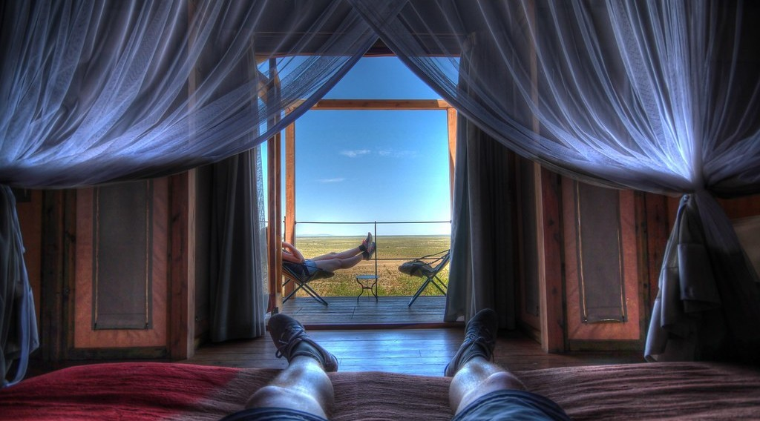
ECO. GEOGRAPHY — FORM 2 TECH
I. PROBLEMS FACED BY MAN
Activity 2
A bed with a mosquito net.
2026 / 2027
DGCAST GAROUA — GEOGRAPHY DEPARTMENT
Mr KAMDEM E. | 17
Notes:
Without the projector: show a real mosquito net in class.

Slide 18
ECO. GEOGRAPHY — FORM 2 TECH
I. PROBLEMS FACED BY MAN
Activity 2: Question
Why do people sleep under a net like this? Which disease does it prevent?
2026 / 2027
DGCAST GAROUA — GEOGRAPHY DEPARTMENT
Mr KAMDEM E. | 18

Slide 19
ECO. GEOGRAPHY — FORM 2 TECH
I. PROBLEMS FACED BY MAN
Answer
The net stops mosquitoes. It prevents malaria.
2026 / 2027
DGCAST GAROUA — GEOGRAPHY DEPARTMENT
Mr KAMDEM E. | 19

Slide 20

ECO. GEOGRAPHY — FORM 2 TECH
II. PROBLEMS CAUSED BY MAN
Activity 3
A lorry carries big logs in the East Region of Cameroon.
2026 / 2027
DGCAST GAROUA — GEOGRAPHY DEPARTMENT
Mr KAMDEM E. | 20
Notes:
Without the projector: ask learners where the wood of their school desks comes from.

Slide 21
ECO. GEOGRAPHY — FORM 2 TECH
II. PROBLEMS CAUSED BY MAN
Activity 3: Question
Where do these logs come from? What happens to the forest?
2026 / 2027
DGCAST GAROUA — GEOGRAPHY DEPARTMENT
Mr KAMDEM E. | 21

Slide 22
ECO. GEOGRAPHY — FORM 2 TECH
II. PROBLEMS CAUSED BY MAN
Answer
They come from the forest. The trees are cut: this is deforestation.
2026 / 2027
DGCAST GAROUA — GEOGRAPHY DEPARTMENT
Mr KAMDEM E. | 22

Slide 23
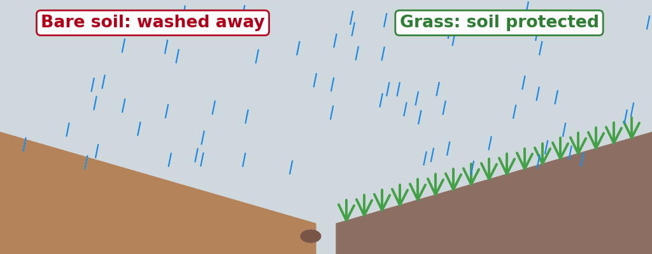
ECO. GEOGRAPHY — FORM 2 TECH
II. PROBLEMS CAUSED BY MAN
Activity 4
Animation: rain on bare soil (left) and on soil covered with plants (right).
2026 / 2027
DGCAST GAROUA — GEOGRAPHY DEPARTMENT
Mr KAMDEM E. | 23
Notes:
Without the projector: pour water on bare soil and on soil with grass.

Slide 24
ECO. GEOGRAPHY — FORM 2 TECH
II. PROBLEMS CAUSED BY MAN
Activity 4: Question
On which side does the rain wash the soil away? Why?
2026 / 2027
DGCAST GAROUA — GEOGRAPHY DEPARTMENT
Mr KAMDEM E. | 24

Slide 25
ECO. GEOGRAPHY — FORM 2 TECH
II. PROBLEMS CAUSED BY MAN
Answer
On the left, because the soil is bare. The plants protect the soil on the right.
2026 / 2027
DGCAST GAROUA — GEOGRAPHY DEPARTMENT
Mr KAMDEM E. | 25

Slide 26

ECO. GEOGRAPHY — FORM 2 TECH
III. ATTEMPTED SOLUTIONS
Activity 5
A girl holds a young tree to plant it.
2026 / 2027
DGCAST GAROUA — GEOGRAPHY DEPARTMENT
Mr KAMDEM E. | 26
Notes:
Without the projector: ask learners if they have ever planted a tree.

Slide 27
ECO. GEOGRAPHY — FORM 2 TECH
III. ATTEMPTED SOLUTIONS
Activity 5: Question
What is she going to do? How does it help the forest?
2026 / 2027
DGCAST GAROUA — GEOGRAPHY DEPARTMENT
Mr KAMDEM E. | 27

Slide 28
ECO. GEOGRAPHY — FORM 2 TECH
III. ATTEMPTED SOLUTIONS
Answer
She will plant the young tree. New trees bring the forest back.
2026 / 2027
DGCAST GAROUA — GEOGRAPHY DEPARTMENT
Mr KAMDEM E. | 28

Slide 29
ECO. GEOGRAPHY — FORM 2 TECH
BOARD SUMMARY
The Equatorial Region
Topic: Man in His Environment
Sub-topic: Natural Regions
Lesson 1: The Equatorial Region — Problems Faced, Problems Caused and Attempted Solutions
2026 / 2027
DGCAST GAROUA — GEOGRAPHY DEPARTMENT
Mr KAMDEM E. | 29
Notes:
Learners copy the board summary now. Give them enough time for each slide.

Slide 30
ECO. GEOGRAPHY — FORM 2 TECH
BOARD SUMMARY
I. Definitions
Deforestation: It is the cutting down of forests.
Soil erosion: It is the washing away of soil by rain or wind.
Reforestation: It is the planting of new trees.
Conservation: It is the protection of nature for the future.
2026 / 2027
DGCAST GAROUA — GEOGRAPHY DEPARTMENT
Mr KAMDEM E. | 30

Slide 31
ECO. GEOGRAPHY — FORM 2 TECH
BOARD SUMMARY
II. Problems Faced by Man (1/2)
The main problems are:
A. Transport: Heavy rain makes the roads muddy.
B. Diseases: Mosquitoes carry malaria.
C. The thick forest: It is hard to clear for farms and roads.
2026 / 2027
DGCAST GAROUA — GEOGRAPHY DEPARTMENT
Mr KAMDEM E. | 31

Slide 32
ECO. GEOGRAPHY — FORM 2 TECH
BOARD SUMMARY
II. Problems Faced by Man (2/2)
D. Poor soils: Rain washes the plant food out of the soil.
2026 / 2027
DGCAST GAROUA — GEOGRAPHY DEPARTMENT
Mr KAMDEM E. | 32

Slide 33
ECO. GEOGRAPHY — FORM 2 TECH
BOARD SUMMARY
III. Problems Caused by Man
The main problems are:
A. Deforestation: People cut too many trees.
B. Soil erosion: Rain washes away the bare soil.
C. Loss of animals: Gorillas and elephants become rare.
D. Water pollution: Mining makes the rivers dirty.
2026 / 2027
DGCAST GAROUA — GEOGRAPHY DEPARTMENT
Mr KAMDEM E. | 33

Slide 34
ECO. GEOGRAPHY — FORM 2 TECH
BOARD SUMMARY
IV. Attempted Solutions (1/2)
The main solutions are:
A. Reforestation: People plant new trees.
B. Protected areas: Parks like the Dja protect plants and animals.
C. Selective logging: Companies cut only some big trees.
2026 / 2027
DGCAST GAROUA — GEOGRAPHY DEPARTMENT
Mr KAMDEM E. | 34

Slide 35
ECO. GEOGRAPHY — FORM 2 TECH
BOARD SUMMARY
IV. Attempted Solutions (2/2)
D. Health care: The government gives mosquito nets.
2026 / 2027
DGCAST GAROUA — GEOGRAPHY DEPARTMENT
Mr KAMDEM E. | 35

Slide 36
ECO. GEOGRAPHY — FORM 2 TECH
FORMATIVE EVALUATION
Formative Evaluation 1
Give two problems faced by man in the forest region.
2026 / 2027
DGCAST GAROUA — GEOGRAPHY DEPARTMENT
Mr KAMDEM E. | 36

Slide 37
ECO. GEOGRAPHY — FORM 2 TECH
FORMATIVE EVALUATION
Expected Answer
Muddy roads and diseases like malaria.
2026 / 2027
DGCAST GAROUA — GEOGRAPHY DEPARTMENT
Mr KAMDEM E. | 37

Slide 38
ECO. GEOGRAPHY — FORM 2 TECH
FORMATIVE EVALUATION
Formative Evaluation 2
Give two solutions to deforestation.
2026 / 2027
DGCAST GAROUA — GEOGRAPHY DEPARTMENT
Mr KAMDEM E. | 38

Slide 39
ECO. GEOGRAPHY — FORM 2 TECH
FORMATIVE EVALUATION
Expected Answer
Planting new trees and creating protected areas.
2026 / 2027
DGCAST GAROUA — GEOGRAPHY DEPARTMENT
Mr KAMDEM E. | 39

Slide 40
ECO. GEOGRAPHY — FORM 2 TECH
REMEDIATION
Remediation
Fill in the blanks:
The cutting down of forests is called ______.
Mosquitoes carry a disease called ______.
The planting of new trees is called ______.
2026 / 2027
DGCAST GAROUA — GEOGRAPHY DEPARTMENT
Mr KAMDEM E. | 40
Notes:
Answers: 1. deforestation 2. malaria 3. reforestation

Slide 41
ECO. GEOGRAPHY — FORM 2 TECH
HOMEWORK
Homework
Observe the vegetation around your home in Garoua. Are there tall trees growing close together, or grasses with scattered trees? Write two sentences to describe it.
This prepares Lesson 2: The Tropical Grassland Region (location and climate).
2026 / 2027
DGCAST GAROUA — GEOGRAPHY DEPARTMENT
Mr KAMDEM E. | 41
Notes:
This homework prepares the next lesson.

Slide 42
ECO. GEOGRAPHY — FORM 2 TECH
BILINGUAL GAME
Bilingual Game (Jeu Bilingue)
English | Français
Deforestation | La déforestation
Soil erosion | L'érosion des sols
Biodiversity | La biodiversité
Poaching | Le braconnage
Reforestation | Le reboisement
Protected area | L'aire protégée
Conservation | La conservation
Mosquito net | La moustiquaire
2026 / 2027
DGCAST GAROUA — GEOGRAPHY DEPARTMENT
Mr KAMDEM E. | 42
Notes:
Say the English word; learners give the French word, then the reverse.

Slide 43
ECO. GEOGRAPHY — FORM 2 TECH
LOGBOOK
Official Logbook (1/2)
Module / Topic | Man in His Environment
Lesson Title | Lesson 1: The Equatorial Region — Problems Faced, Problems Caused and Attempted Solutions
Expected Learning Outcomes | Identify the problems that the Equatorial environment creates for people. Identify the problems that human activities cause to the Equatorial environment. Describe the solutions that have been attempted to solve these problems.
Competence | Learners are able to recognise the damage caused by cutting down trees around them and take simple actions to protect trees, soils and rivers.
2026 / 2027
DGCAST GAROUA — GEOGRAPHY DEPARTMENT
Mr KAMDEM E. | 43

Slide 44
ECO. GEOGRAPHY — FORM 2 TECH
LOGBOOK
Official Logbook (2/2)
Matter Taught | I. Definitions: Deforestation, Soil erosion, Reforestation, Conservation; II. Problems Faced by Man: Transport, Diseases, The thick forest, Poor soils; III. Problems Caused by Man: Deforestation, Soil erosion, Loss of animals, Water pollution; IV. Attempted Solutions: Reforestation, Protected areas, Selective logging, Health care.
Evaluation | Formative evaluation (3 questions) and remediation exercise.
Homework | Observe the vegetation around your home in Garoua. Are there tall trees growing close together, or grasses with scattered trees? Write two sentences to describe it.
Enrolment / Present / Absent | ____ / ____ / ____
Achievement | To be completed by the teacher after the lesson.
2026 / 2027
DGCAST GAROUA — GEOGRAPHY DEPARTMENT
Mr KAMDEM E. | 44

Slide 45
ECO. GEOGRAPHY — FORM 2 TECH
TEACHER'S NOTE
Teacher's Note
Timing: Set-up, recall 8 min | Situation 8 min | 5 activities 25 min | Board summary (copying) 30 min | Evaluation, remediation 10 min | Homework 4 min | Logbook 10 min | Spare 5 min
Dja Faunal Reserve: UNESCO World Heritage site since 1987. Forestry Law No. 94/01 of 20 January 1994 obliges logging companies to follow a management plan.
Activity 4 is an animation (GIF): it plays automatically in slide-show mode.
2026 / 2027
DGCAST GAROUA — GEOGRAPHY DEPARTMENT
Mr KAMDEM E. | 45

Slide 46
ECO. GEOGRAPHY — FORM 2 TECH
REFERENCES
References
Harmonised Progression Sheet, Economic Geography (5051), Form 2 — week 7.
Lesson 1 document: The Equatorial Region (teacher's file).
UNESCO: Dja Faunal Reserve (1987); Cameroon Forestry Law No. 94/01 of 20 January 1994.
Photo, Activity 1: “Cameroon - UN Women's Gender Road Project” by UN Women Gallery, CC BY-NC-ND 2.0, via Flickr (https://www.flickr.com/photos/51431730@N04/40672356003)
Photo, Activity 2: “On Vacation in Africa” by orkomedix, CC BY-NC-SA 2.0, via Flickr (https://www.flickr.com/photos/30717090@N06/6741038415)
Photo, Activity 3: “Logging truck, Cameroon” by World Resources, CC BY-NC-SA 2.0, via Flickr (https://www.flickr.com/photos/26107309@N05/4764354366)
Photo, Activity 5: “Haitian Students Breathe New Life into Depleted Pine Forest” by United Nations Photo, CC BY-NC-ND 2.0, via Flickr (https://www.flickr.com/photos/35483578@N03/5860275159)
Diagrams and animations: drawn for this lesson (DGCAST Geography Department).
2026 / 2027
DGCAST GAROUA — GEOGRAPHY DEPARTMENT
Mr KAMDEM E. | 46

