Slide 1

DIVINE GRACE COLLEGE OF ARTS, SCIENCE AND TECHNOLOGY
(DGCAST) — GAROUA | GEOGRAPHY DEPARTMENT
FORM 2 TECHNICAL — LESSON 3 (PART 1)
The Desert Regions: Location, Types and Characteristics
Mr KAMDEM EMMANUEL
Geography Teacher — PLEG
Academic Year 2026 / 2027
Notes:
Good morning, class. Today we study The Desert Regions, part 1: Location, Types and Characteristics.

Slide 2
ECO. GEOGRAPHY — FORM 2 TECH
CLASS INFO
Class, Chapter & Duration
Class | Form 2 Technical
Chapter | Economic Geography — Natural Regions: 3. Desert Regions
Duration | 2 periods (2 × 50 minutes)
2026 / 2027
DGCAST GAROUA — GEOGRAPHY DEPARTMENT
Mr KAMDEM E. | 2

Slide 3
ECO. GEOGRAPHY — FORM 2 TECH
IDENTIFICATION
Lesson Identification
Topic | Man in His Environment
Sub-topic | Natural Regions
Lesson | Lesson 3: The Desert Regions — Part 1: Location, Types and Characteristics
Notions / Concepts | Desert, hot desert, cold desert, erg, reg, hamada, trade winds, cold ocean current, rain shadow.
Syllabus focus | Location and types of deserts; general characteristics and causes of deserts.
Competence | Learners are able to find the deserts of the world on a map and explain why the Sahara, north of Cameroon, is so dry.
2026 / 2027
DGCAST GAROUA — GEOGRAPHY DEPARTMENT
Mr KAMDEM E. | 3

Slide 4
ECO. GEOGRAPHY — FORM 2 TECH
OBJECTIVES
Learning Objectives
By the end of the lesson, the learner should be able to:
Define a desert.
Locate the main deserts of the world.
Distinguish between hot and cold deserts, and between sandy, stony and rocky deserts.
Explain the causes of deserts.
2026 / 2027
DGCAST GAROUA — GEOGRAPHY DEPARTMENT
Mr KAMDEM E. | 4

Slide 5
ECO. GEOGRAPHY — FORM 2 TECH
RECALL
Recall
The Tropical Grassland lies between 5° and 15° north and south of the Equator.
Its drier part, the Sahel, is threatened by desertification.
North of the Sahel lies the largest hot desert in the world.
2026 / 2027
DGCAST GAROUA — GEOGRAPHY DEPARTMENT
Mr KAMDEM E. | 5
Notes:
Check the homework: three countries covered by the Sahara.

Slide 6
ECO. GEOGRAPHY — FORM 2 TECH
REAL-LIFE SITUATION
Real-Life Situation
In Garoua, Salma watches a film about the Sahara. She is surprised: the desert is not only sand. There are also plains of stones and bare rocky mountains.
2026 / 2027
DGCAST GAROUA — GEOGRAPHY DEPARTMENT
Mr KAMDEM E. | 6
Notes:
Read the situation slowly, twice.

Slide 7
ECO. GEOGRAPHY — FORM 2 TECH
REAL-LIFE SITUATION
Situation — Question 1
What is the problem in the situation?
2026 / 2027
DGCAST GAROUA — GEOGRAPHY DEPARTMENT
Mr KAMDEM E. | 7

Slide 8
ECO. GEOGRAPHY — FORM 2 TECH
REAL-LIFE SITUATION
Answer
Salma thought that the desert was only sand.
2026 / 2027
DGCAST GAROUA — GEOGRAPHY DEPARTMENT
Mr KAMDEM E. | 8

Slide 9
ECO. GEOGRAPHY — FORM 2 TECH
REAL-LIFE SITUATION
Situation — Question 2
What did she see in the film?
2026 / 2027
DGCAST GAROUA — GEOGRAPHY DEPARTMENT
Mr KAMDEM E. | 9

Slide 10
ECO. GEOGRAPHY — FORM 2 TECH
REAL-LIFE SITUATION
Answer
Sand, plains of stones and rocky mountains.
2026 / 2027
DGCAST GAROUA — GEOGRAPHY DEPARTMENT
Mr KAMDEM E. | 10

Slide 11
ECO. GEOGRAPHY — FORM 2 TECH
REAL-LIFE SITUATION
Situation — Question 3
Where can she learn more about deserts?
2026 / 2027
DGCAST GAROUA — GEOGRAPHY DEPARTMENT
Mr KAMDEM E. | 11

Slide 12
ECO. GEOGRAPHY — FORM 2 TECH
REAL-LIFE SITUATION
Possible Answer
In her atlas, her textbook and in this lesson.
2026 / 2027
DGCAST GAROUA — GEOGRAPHY DEPARTMENT
Mr KAMDEM E. | 12

Slide 13
ECO. GEOGRAPHY — FORM 2 TECH
JUSTIFICATION
Justification of the Lesson
This lesson helps us to know where deserts are and why they are dry.
2026 / 2027
DGCAST GAROUA — GEOGRAPHY DEPARTMENT
Mr KAMDEM E. | 13

Slide 14

ECO. GEOGRAPHY — FORM 2 TECH
I. DEFINITION AND LOCATION
Activity 1
Sand dunes in the Sahara.
2026 / 2027
DGCAST GAROUA — GEOGRAPHY DEPARTMENT
Mr KAMDEM E. | 14
Notes:
Without the projector: ask learners to describe the Sahara from films or pictures.

Slide 15
ECO. GEOGRAPHY — FORM 2 TECH
I. DEFINITION AND LOCATION
Activity 1: Question
This region gets less than 250 mm of rain per year. What do we call it?
2026 / 2027
DGCAST GAROUA — GEOGRAPHY DEPARTMENT
Mr KAMDEM E. | 15

Slide 16
ECO. GEOGRAPHY — FORM 2 TECH
I. DEFINITION AND LOCATION
Answer
A desert.
2026 / 2027
DGCAST GAROUA — GEOGRAPHY DEPARTMENT
Mr KAMDEM E. | 16

Slide 17

ECO. GEOGRAPHY — FORM 2 TECH
I. DEFINITION AND LOCATION
Activity 2
The main hot deserts of the world.
2026 / 2027
DGCAST GAROUA — GEOGRAPHY DEPARTMENT
Mr KAMDEM E. | 17
Notes:
Without the projector: draw the Equator and the two tropics on the board and place the Sahara.

Slide 18
ECO. GEOGRAPHY — FORM 2 TECH
I. DEFINITION AND LOCATION
Activity 2: Question
Near which lines are most hot deserts found?
2026 / 2027
DGCAST GAROUA — GEOGRAPHY DEPARTMENT
Mr KAMDEM E. | 18

Slide 19
ECO. GEOGRAPHY — FORM 2 TECH
I. DEFINITION AND LOCATION
Answer
Near the Tropic of Cancer and the Tropic of Capricorn.
2026 / 2027
DGCAST GAROUA — GEOGRAPHY DEPARTMENT
Mr KAMDEM E. | 19

Slide 20
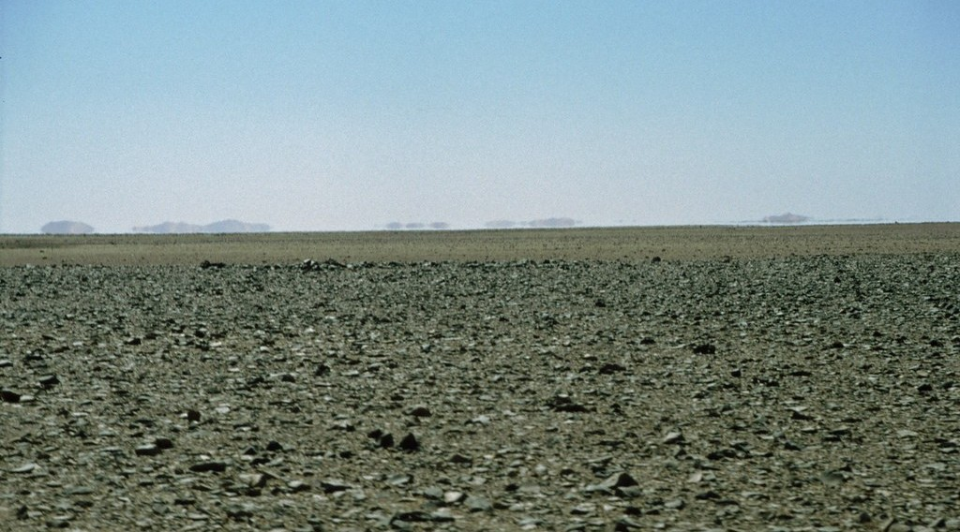
ECO. GEOGRAPHY — FORM 2 TECH
II. TYPES OF DESERTS
Activity 3
A desert covered with small stones.
2026 / 2027
DGCAST GAROUA — GEOGRAPHY DEPARTMENT
Mr KAMDEM E. | 20
Notes:
Without the projector: show a handful of sand and a handful of gravel.

Slide 21
ECO. GEOGRAPHY — FORM 2 TECH
II. TYPES OF DESERTS
Activity 3: Question
Is this desert made of sand? What is it made of?
2026 / 2027
DGCAST GAROUA — GEOGRAPHY DEPARTMENT
Mr KAMDEM E. | 21

Slide 22
ECO. GEOGRAPHY — FORM 2 TECH
II. TYPES OF DESERTS
Answer
No. It is made of stones: it is a stony desert (reg).
2026 / 2027
DGCAST GAROUA — GEOGRAPHY DEPARTMENT
Mr KAMDEM E. | 22

Slide 23
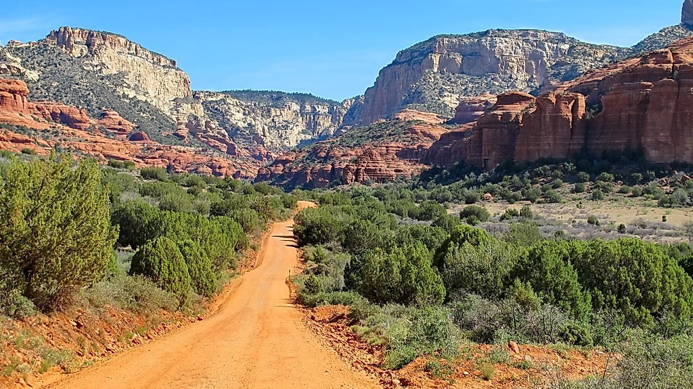
ECO. GEOGRAPHY — FORM 2 TECH
II. TYPES OF DESERTS
Activity 4
A desert of bare rock.
2026 / 2027
DGCAST GAROUA — GEOGRAPHY DEPARTMENT
Mr KAMDEM E. | 23
Notes:
Without the projector: describe the rocky hills of the Sahara (Hoggar, Tibesti).

Slide 24
ECO. GEOGRAPHY — FORM 2 TECH
II. TYPES OF DESERTS
Activity 4: Question
This desert is made of bare rock. What do we call it?
2026 / 2027
DGCAST GAROUA — GEOGRAPHY DEPARTMENT
Mr KAMDEM E. | 24

Slide 25
ECO. GEOGRAPHY — FORM 2 TECH
II. TYPES OF DESERTS
Answer
A rocky desert (hamada).
2026 / 2027
DGCAST GAROUA — GEOGRAPHY DEPARTMENT
Mr KAMDEM E. | 25

Slide 26
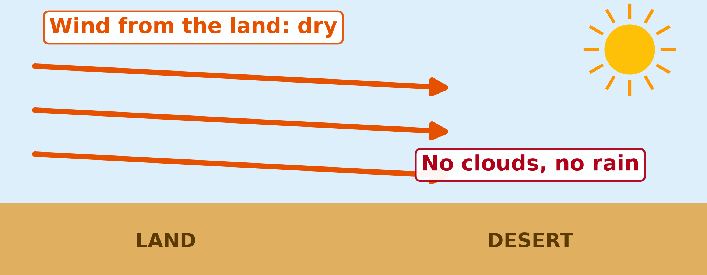
ECO. GEOGRAPHY — FORM 2 TECH
III. CAUSES OF DESERTS
Activity 5
The wind comes from the land, not from the sea.
2026 / 2027
DGCAST GAROUA — GEOGRAPHY DEPARTMENT
Mr KAMDEM E. | 26
Notes:
Without the projector: remind learners that the Harmattan is dry because it comes from the Sahara.

Slide 27
ECO. GEOGRAPHY — FORM 2 TECH
III. CAUSES OF DESERTS
Activity 5: Question
Why does this wind bring no rain?
2026 / 2027
DGCAST GAROUA — GEOGRAPHY DEPARTMENT
Mr KAMDEM E. | 27

Slide 28
ECO. GEOGRAPHY — FORM 2 TECH
III. CAUSES OF DESERTS
Answer
It comes from the land, so it is dry. There are no clouds.
2026 / 2027
DGCAST GAROUA — GEOGRAPHY DEPARTMENT
Mr KAMDEM E. | 28

Slide 29
ECO. GEOGRAPHY — FORM 2 TECH
BOARD SUMMARY
The Desert Regions
Topic: Man in His Environment
Sub-topic: Natural Regions
Lesson 3: The Desert Regions — Part 1: Location, Types and Characteristics
2026 / 2027
DGCAST GAROUA — GEOGRAPHY DEPARTMENT
Mr KAMDEM E. | 29
Notes:
Learners copy the board summary now. Give them enough time for each slide.

Slide 30
ECO. GEOGRAPHY — FORM 2 TECH
BOARD SUMMARY
I. Definitions
Desert: It is a region with less than 250 mm of rain per year and very few plants.
Erg: It is a sandy desert.
Reg: It is a stony desert.
Hamada: It is a rocky desert.
2026 / 2027
DGCAST GAROUA — GEOGRAPHY DEPARTMENT
Mr KAMDEM E. | 30

Slide 31
ECO. GEOGRAPHY — FORM 2 TECH
BOARD SUMMARY
II. Location (1/2)
Hot deserts are near the tropics:
A. Africa: The Sahara, the Kalahari and the Namib.
B. Asia: The Arabian Desert and the Thar Desert.
C. America and Australia: The Atacama, the Mojave and the Australian Desert.
2026 / 2027
DGCAST GAROUA — GEOGRAPHY DEPARTMENT
Mr KAMDEM E. | 31

Slide 32
ECO. GEOGRAPHY — FORM 2 TECH
BOARD SUMMARY
II. Location (2/2)
Copy the tropics and the main deserts.
2026 / 2027
DGCAST GAROUA — GEOGRAPHY DEPARTMENT
Mr KAMDEM E. | 32

Slide 33
ECO. GEOGRAPHY — FORM 2 TECH
BOARD SUMMARY
III. Types of Deserts
A. By temperature: Hot deserts (Sahara) and cold deserts (Gobi).
B. By surface: Sandy (erg), stony (reg) and rocky (hamada).
2026 / 2027
DGCAST GAROUA — GEOGRAPHY DEPARTMENT
Mr KAMDEM E. | 33

Slide 34
ECO. GEOGRAPHY — FORM 2 TECH
BOARD SUMMARY
IV. Causes of Deserts
Deserts are dry because of:
A. Dry winds: The trade winds come from the land.
B. Cold sea currents: They stop rain clouds (Namib).
C. Distance from the sea: Wet winds do not reach the centre.
D. Mountains: They stop the wet winds.
2026 / 2027
DGCAST GAROUA — GEOGRAPHY DEPARTMENT
Mr KAMDEM E. | 34

Slide 35
ECO. GEOGRAPHY — FORM 2 TECH
FORMATIVE EVALUATION
Formative Evaluation 1
What is a desert?
2026 / 2027
DGCAST GAROUA — GEOGRAPHY DEPARTMENT
Mr KAMDEM E. | 35

Slide 36
ECO. GEOGRAPHY — FORM 2 TECH
FORMATIVE EVALUATION
Expected Answer
A region with less than 250 mm of rain per year and very few plants.
2026 / 2027
DGCAST GAROUA — GEOGRAPHY DEPARTMENT
Mr KAMDEM E. | 36

Slide 37
ECO. GEOGRAPHY — FORM 2 TECH
FORMATIVE EVALUATION
Formative Evaluation 2
Name the three types of desert surface.
2026 / 2027
DGCAST GAROUA — GEOGRAPHY DEPARTMENT
Mr KAMDEM E. | 37

Slide 38
ECO. GEOGRAPHY — FORM 2 TECH
FORMATIVE EVALUATION
Expected Answer
Sandy (erg), stony (reg) and rocky (hamada).
2026 / 2027
DGCAST GAROUA — GEOGRAPHY DEPARTMENT
Mr KAMDEM E. | 38

Slide 39
ECO. GEOGRAPHY — FORM 2 TECH
REMEDIATION
Remediation
Fill in the blanks:
A sandy desert is called an ______.
A stony desert is called a ______.
The largest hot desert in the world is the ______.
2026 / 2027
DGCAST GAROUA — GEOGRAPHY DEPARTMENT
Mr KAMDEM E. | 39
Notes:
Answers: 1. erg 2. reg 3. Sahara

Slide 40
ECO. GEOGRAPHY — FORM 2 TECH
HOMEWORK
Homework
Think about the hottest days of March in Garoua. Are the nights also very hot, or cooler? Write two sentences about the difference between day and night.
This prepares Part 2: The Climate of Hot Deserts.
2026 / 2027
DGCAST GAROUA — GEOGRAPHY DEPARTMENT
Mr KAMDEM E. | 40
Notes:
This homework prepares the next lesson.

Slide 41
ECO. GEOGRAPHY — FORM 2 TECH
BILINGUAL GAME
Bilingual Game (Jeu Bilingue)
English | Français
Desert | Le désert
Hot desert | Le désert chaud
Cold desert | Le désert froid
Erg (sandy desert) | L'erg
Reg (stony desert) | Le reg
Rocky desert | La hamada
Trade winds | Les alizés
Ocean current | Le courant marin
2026 / 2027
DGCAST GAROUA — GEOGRAPHY DEPARTMENT
Mr KAMDEM E. | 41
Notes:
Say the English word; learners give the French word, then the reverse.

Slide 42
ECO. GEOGRAPHY — FORM 2 TECH
LOGBOOK
Official Logbook (1/2)
Module / Topic | Man in His Environment
Lesson Title | Lesson 3: The Desert Regions — Part 1: Location, Types and Characteristics
Expected Learning Outcomes | Define a desert. Locate the main deserts of the world. Distinguish between hot and cold deserts, and between sandy, stony and rocky deserts. Explain the causes of deserts.
Competence | Learners are able to find the deserts of the world on a map and explain why the Sahara, north of Cameroon, is so dry.
2026 / 2027
DGCAST GAROUA — GEOGRAPHY DEPARTMENT
Mr KAMDEM E. | 42

Slide 43
ECO. GEOGRAPHY — FORM 2 TECH
LOGBOOK
Official Logbook (2/2)
Matter Taught | I. Definitions: Desert, Erg, Reg, Hamada; II. Location: Africa, Asia, America and Australia; III. Types of Deserts: By temperature, By surface; IV. Causes of Deserts: Dry winds, Cold sea currents, Distance from the sea, Mountains.
Evaluation | Formative evaluation (3 questions) and remediation exercise.
Homework | Think about the hottest days of March in Garoua. Are the nights also very hot, or cooler? Write two sentences about the difference between day and night.
Enrolment / Present / Absent | ____ / ____ / ____
Achievement | To be completed by the teacher after the lesson.
2026 / 2027
DGCAST GAROUA — GEOGRAPHY DEPARTMENT
Mr KAMDEM E. | 43

Slide 44
ECO. GEOGRAPHY — FORM 2 TECH
TEACHER'S NOTE
Teacher's Note
Timing: Set-up, recall 8 min | Situation 8 min | 5 activities 25 min | Board summary (copying) 30 min | Evaluation, remediation 10 min | Homework 4 min | Logbook 10 min | Spare 5 min
2026 / 2027
DGCAST GAROUA — GEOGRAPHY DEPARTMENT
Mr KAMDEM E. | 44

Slide 45
ECO. GEOGRAPHY — FORM 2 TECH
REFERENCES
References
Harmonised Progression Sheet, Economic Geography (5051), Form 2.
Class textbook: The major biomes of the world (hot deserts).
Photo, Activity 1: “Desert trekking in Merzouga” by Antonio Cinotti , CC BY-NC-ND 2.0, via Flickr (https://www.flickr.com/photos/46378751@N02/15331399979)
Photo, Activity 3: “Libya 88” by motohakone, CC BY-NC-SA 2.0, via Flickr (https://www.flickr.com/photos/134157242@N08/42853720391)
Photo, Activity 4: “FR 525 on way to Loy Canyon - Sedona” by Al_HikesAZ, CC BY-NC 2.0, via Flickr (https://www.flickr.com/photos/7202153@N03/7200183096)
Diagrams and animations: drawn for this lesson (DGCAST Geography Department).
2026 / 2027
DGCAST GAROUA — GEOGRAPHY DEPARTMENT
Mr KAMDEM E. | 45

