Slide 1

DIVINE GRACE COLLEGE OF ARTS, SCIENCE AND TECHNOLOGY
(DGCAST) — GAROUA | GEOGRAPHY DEPARTMENT
FORM 2 TECHNICAL — LESSON 3 (PART 3)
The Desert Regions: Characteristics (Soils and Vegetation)
Mr KAMDEM EMMANUEL
Geography Teacher — PLEG
Academic Year 2026 / 2027
Notes:
Good morning, class. Today we study The Desert Regions, part 3: Characteristics (Soils and Vegetation).

Slide 2
ECO. GEOGRAPHY — FORM 2 TECH
CLASS INFO
Class, Chapter & Duration
Class | Form 2 Technical
Chapter | Economic Geography — Natural Regions: 3. Desert Regions
Duration | 2 periods (2 × 50 minutes)
2026 / 2027
DGCAST GAROUA — GEOGRAPHY DEPARTMENT
Mr KAMDEM E. | 2

Slide 3
ECO. GEOGRAPHY — FORM 2 TECH
IDENTIFICATION
Lesson Identification
Topic | Man in His Environment
Sub-topic | Natural Regions
Lesson | Lesson 3: The Desert Regions — Part 3: Characteristics (Soils and Vegetation)
Notions / Concepts | Xerophyte, succulent, ephemeral plant, desert soil, salinity, humus.
Syllabus focus | Characteristics of the soils and vegetation of hot deserts.
Competence | Learners are able to explain how plants survive with very little water, and to choose plants that resist drought for their homes.
2026 / 2027
DGCAST GAROUA — GEOGRAPHY DEPARTMENT
Mr KAMDEM E. | 3

Slide 4
ECO. GEOGRAPHY — FORM 2 TECH
OBJECTIVES
Learning Objectives
By the end of the lesson, the learner should be able to:
Describe the vegetation of hot deserts.
Explain how desert plants are adapted to the lack of water.
Describe the soils of hot deserts.
2026 / 2027
DGCAST GAROUA — GEOGRAPHY DEPARTMENT
Mr KAMDEM E. | 4

Slide 5
ECO. GEOGRAPHY — FORM 2 TECH
RECALL
Recall
Hot deserts receive less than 250 mm of rain per year.
Days are very hot, nights are cold, and the air is very dry.
Hot, dusty winds and sandstorms are common.
2026 / 2027
DGCAST GAROUA — GEOGRAPHY DEPARTMENT
Mr KAMDEM E. | 5
Notes:
Check the homework: adaptations of a cactus, an acacia or a date palm.

Slide 6
ECO. GEOGRAPHY — FORM 2 TECH
REAL-LIFE SITUATION
Real-Life Situation
Fanta planted a mango tree and a small cactus in front of her house in Garoua. She forgot to water them for three months. In March, the mango tree was dead, but the cactus was still green.
2026 / 2027
DGCAST GAROUA — GEOGRAPHY DEPARTMENT
Mr KAMDEM E. | 6
Notes:
Read the situation slowly, twice.

Slide 7
ECO. GEOGRAPHY — FORM 2 TECH
REAL-LIFE SITUATION
Situation — Question 1
What is the problem in the situation?
2026 / 2027
DGCAST GAROUA — GEOGRAPHY DEPARTMENT
Mr KAMDEM E. | 7

Slide 8
ECO. GEOGRAPHY — FORM 2 TECH
REAL-LIFE SITUATION
Answer
Fanta does not know why the cactus did not die.
2026 / 2027
DGCAST GAROUA — GEOGRAPHY DEPARTMENT
Mr KAMDEM E. | 8

Slide 9
ECO. GEOGRAPHY — FORM 2 TECH
REAL-LIFE SITUATION
Situation — Question 2
Which plant survived?
2026 / 2027
DGCAST GAROUA — GEOGRAPHY DEPARTMENT
Mr KAMDEM E. | 9

Slide 10
ECO. GEOGRAPHY — FORM 2 TECH
REAL-LIFE SITUATION
Answer
The cactus.
2026 / 2027
DGCAST GAROUA — GEOGRAPHY DEPARTMENT
Mr KAMDEM E. | 10

Slide 11
ECO. GEOGRAPHY — FORM 2 TECH
REAL-LIFE SITUATION
Situation — Question 3
How did it survive?
2026 / 2027
DGCAST GAROUA — GEOGRAPHY DEPARTMENT
Mr KAMDEM E. | 11

Slide 12
ECO. GEOGRAPHY — FORM 2 TECH
REAL-LIFE SITUATION
Possible Answer
It keeps water inside its thick stem.
2026 / 2027
DGCAST GAROUA — GEOGRAPHY DEPARTMENT
Mr KAMDEM E. | 12

Slide 13
ECO. GEOGRAPHY — FORM 2 TECH
JUSTIFICATION
Justification of the Lesson
This lesson helps us to know how desert plants live with little water.
2026 / 2027
DGCAST GAROUA — GEOGRAPHY DEPARTMENT
Mr KAMDEM E. | 13

Slide 14

ECO. GEOGRAPHY — FORM 2 TECH
I. VEGETATION
Activity 1
Plants in a desert.
2026 / 2027
DGCAST GAROUA — GEOGRAPHY DEPARTMENT
Mr KAMDEM E. | 14
Notes:
Without the projector: ask learners to imagine the Sahara after the Sahel.

Slide 15
ECO. GEOGRAPHY — FORM 2 TECH
I. VEGETATION
Activity 1: Question
Describe the plants. Why are they far apart?
2026 / 2027
DGCAST GAROUA — GEOGRAPHY DEPARTMENT
Mr KAMDEM E. | 15

Slide 16
ECO. GEOGRAPHY — FORM 2 TECH
I. VEGETATION
Answer
They are small and far apart, because there is very little water.
2026 / 2027
DGCAST GAROUA — GEOGRAPHY DEPARTMENT
Mr KAMDEM E. | 16

Slide 17
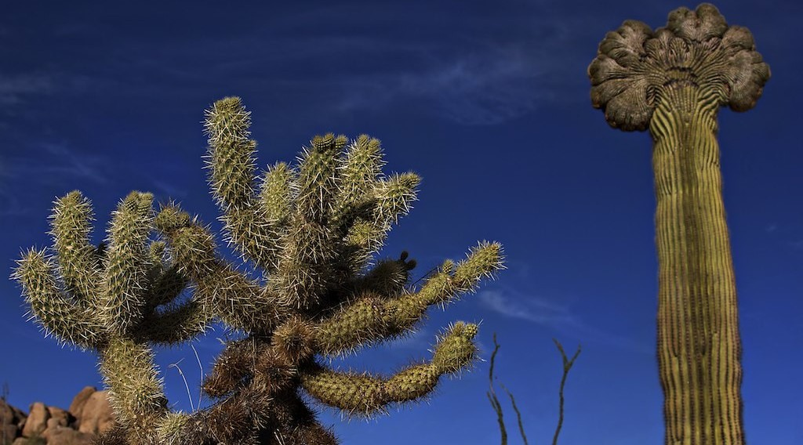
ECO. GEOGRAPHY — FORM 2 TECH
I. VEGETATION
Activity 2
A cactus.
2026 / 2027
DGCAST GAROUA — GEOGRAPHY DEPARTMENT
Mr KAMDEM E. | 17
Notes:
Without the projector: bring a cactus or an aloe plant to class.

Slide 18
ECO. GEOGRAPHY — FORM 2 TECH
I. VEGETATION
Activity 2: Question
The cactus has a thick stem and spines. How do they help it?
2026 / 2027
DGCAST GAROUA — GEOGRAPHY DEPARTMENT
Mr KAMDEM E. | 18

Slide 19
ECO. GEOGRAPHY — FORM 2 TECH
I. VEGETATION
Answer
The stem keeps water. The spines lose little water and protect it.
2026 / 2027
DGCAST GAROUA — GEOGRAPHY DEPARTMENT
Mr KAMDEM E. | 19

Slide 20
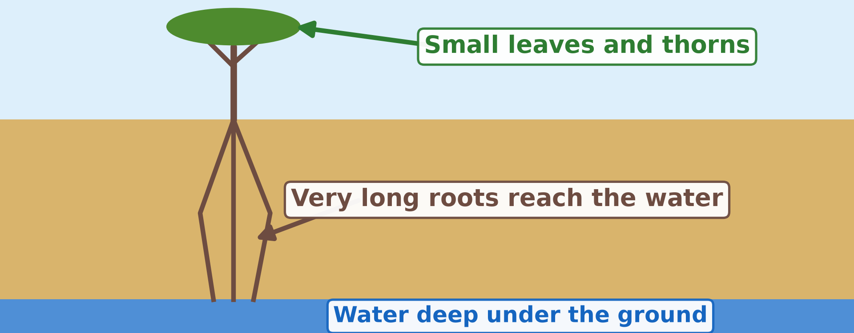
ECO. GEOGRAPHY — FORM 2 TECH
I. VEGETATION
Activity 3
An acacia in the desert.
2026 / 2027
DGCAST GAROUA — GEOGRAPHY DEPARTMENT
Mr KAMDEM E. | 20
Notes:
Without the projector: draw a small tree with very long roots on the board.

Slide 21
ECO. GEOGRAPHY — FORM 2 TECH
I. VEGETATION
Activity 3: Question
Why are the roots so long?
2026 / 2027
DGCAST GAROUA — GEOGRAPHY DEPARTMENT
Mr KAMDEM E. | 21

Slide 22
ECO. GEOGRAPHY — FORM 2 TECH
I. VEGETATION
Answer
To reach water deep under the ground.
2026 / 2027
DGCAST GAROUA — GEOGRAPHY DEPARTMENT
Mr KAMDEM E. | 22

Slide 23

ECO. GEOGRAPHY — FORM 2 TECH
II. SOILS
Activity 4
White salt on the soil of a desert.
2026 / 2027
DGCAST GAROUA — GEOGRAPHY DEPARTMENT
Mr KAMDEM E. | 23
Notes:
Without the projector: describe a pot of salty water left in the sun.

Slide 24
ECO. GEOGRAPHY — FORM 2 TECH
II. SOILS
Activity 4: Question
The sun dries the soil and leaves white salt. Is this soil good for crops?
2026 / 2027
DGCAST GAROUA — GEOGRAPHY DEPARTMENT
Mr KAMDEM E. | 24

Slide 25
ECO. GEOGRAPHY — FORM 2 TECH
II. SOILS
Answer
No. Salty soil is bad for crops.
2026 / 2027
DGCAST GAROUA — GEOGRAPHY DEPARTMENT
Mr KAMDEM E. | 25

Slide 26
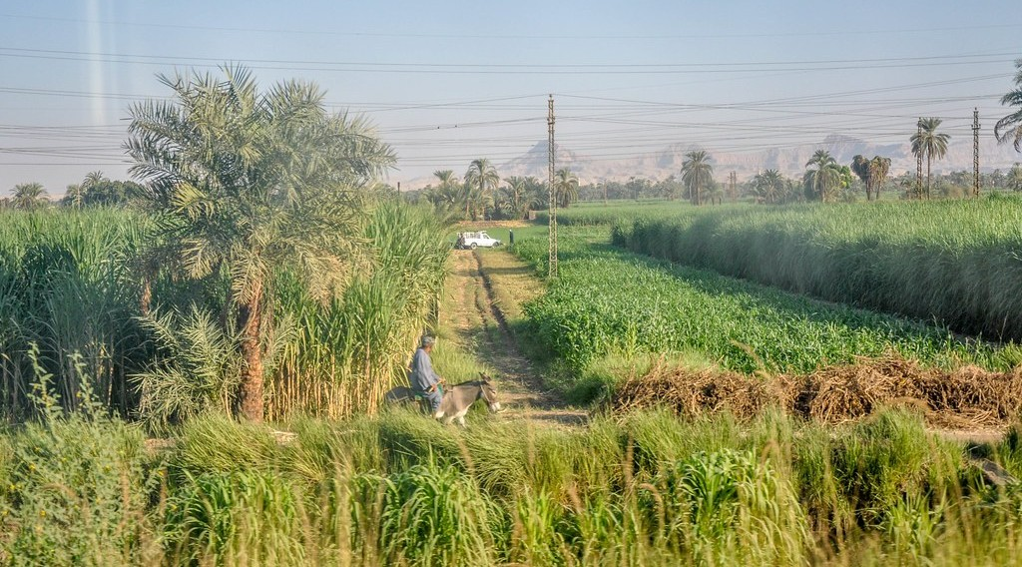
ECO. GEOGRAPHY — FORM 2 TECH
II. SOILS
Activity 5
Green fields near the River Nile, in Egypt.
2026 / 2027
DGCAST GAROUA — GEOGRAPHY DEPARTMENT
Mr KAMDEM E. | 26
Notes:
Without the projector: compare with the dry-season gardens along the Benue.

Slide 27
ECO. GEOGRAPHY — FORM 2 TECH
II. SOILS
Activity 5: Question
Why are the fields green here, in the middle of the desert?
2026 / 2027
DGCAST GAROUA — GEOGRAPHY DEPARTMENT
Mr KAMDEM E. | 27

Slide 28
ECO. GEOGRAPHY — FORM 2 TECH
II. SOILS
Answer
Water from the Nile makes the desert soil fertile.
2026 / 2027
DGCAST GAROUA — GEOGRAPHY DEPARTMENT
Mr KAMDEM E. | 28

Slide 29
ECO. GEOGRAPHY — FORM 2 TECH
BOARD SUMMARY
The Desert Regions
Topic: Man in His Environment
Sub-topic: Natural Regions
Lesson 3: The Desert Regions — Part 3: Characteristics (Soils and Vegetation)
2026 / 2027
DGCAST GAROUA — GEOGRAPHY DEPARTMENT
Mr KAMDEM E. | 29
Notes:
Learners copy the board summary now. Give them enough time for each slide.

Slide 30
ECO. GEOGRAPHY — FORM 2 TECH
BOARD SUMMARY
I. Definitions
Xerophyte: It is a plant that can live with very little water.
Humus: It is the black part of the soil made of dead plants.
2026 / 2027
DGCAST GAROUA — GEOGRAPHY DEPARTMENT
Mr KAMDEM E. | 30

Slide 31
ECO. GEOGRAPHY — FORM 2 TECH
BOARD SUMMARY
II. Vegetation
Desert plants are few. They are adapted in these ways:
A. Water storage: The cactus keeps water in its stem.
B. Small leaves or spines: They lose little water.
C. Long roots: They reach water deep down.
D. Short life: Some plants grow only after rain.
2026 / 2027
DGCAST GAROUA — GEOGRAPHY DEPARTMENT
Mr KAMDEM E. | 31

Slide 32
ECO. GEOGRAPHY — FORM 2 TECH
BOARD SUMMARY
III. Soils
A. Sandy or stony: They keep little water.
B. Little humus: There are few plants.
C. Salty: The sun leaves salt on top.
D. Fertile with water: Crops grow along the Nile.
2026 / 2027
DGCAST GAROUA — GEOGRAPHY DEPARTMENT
Mr KAMDEM E. | 32

Slide 33
ECO. GEOGRAPHY — FORM 2 TECH
FORMATIVE EVALUATION
Formative Evaluation 1
Give two ways desert plants are adapted.
2026 / 2027
DGCAST GAROUA — GEOGRAPHY DEPARTMENT
Mr KAMDEM E. | 33

Slide 34
ECO. GEOGRAPHY — FORM 2 TECH
FORMATIVE EVALUATION
Expected Answer
They keep water in their stems; they have long roots.
2026 / 2027
DGCAST GAROUA — GEOGRAPHY DEPARTMENT
Mr KAMDEM E. | 34

Slide 35
ECO. GEOGRAPHY — FORM 2 TECH
FORMATIVE EVALUATION
Formative Evaluation 2
Why do desert soils have little humus?
2026 / 2027
DGCAST GAROUA — GEOGRAPHY DEPARTMENT
Mr KAMDEM E. | 35

Slide 36
ECO. GEOGRAPHY — FORM 2 TECH
FORMATIVE EVALUATION
Expected Answer
Because there are few plants.
2026 / 2027
DGCAST GAROUA — GEOGRAPHY DEPARTMENT
Mr KAMDEM E. | 36

Slide 37
ECO. GEOGRAPHY — FORM 2 TECH
REMEDIATION
Remediation
Fill in the blanks:
A plant that lives with little water is a ______.
The cactus keeps water in its ______.
Desert soils are often ______ because the sun leaves salt.
2026 / 2027
DGCAST GAROUA — GEOGRAPHY DEPARTMENT
Mr KAMDEM E. | 37
Notes:
Answers: 1. xerophyte 2. stem 3. salty

Slide 38
ECO. GEOGRAPHY — FORM 2 TECH
HOMEWORK
Homework
Imagine you must spend one week in the Sahara. Write down three problems you would face and one way to solve each.
This prepares Part 4: Problems Faced and Adaptations.
2026 / 2027
DGCAST GAROUA — GEOGRAPHY DEPARTMENT
Mr KAMDEM E. | 38
Notes:
This homework prepares the next lesson.

Slide 39
ECO. GEOGRAPHY — FORM 2 TECH
BILINGUAL GAME
Bilingual Game (Jeu Bilingue)
English | Français
Cactus | Le cactus
Thorn | L'épine
Root | La racine
Stem | La tige
Leaf | La feuille
Seed | La graine
Salty soil | Le sol salé
Date palm | Le palmier dattier
2026 / 2027
DGCAST GAROUA — GEOGRAPHY DEPARTMENT
Mr KAMDEM E. | 39
Notes:
Say the English word; learners give the French word, then the reverse.

Slide 40
ECO. GEOGRAPHY — FORM 2 TECH
LOGBOOK
Official Logbook (1/2)
Module / Topic | Man in His Environment
Lesson Title | Lesson 3: The Desert Regions — Part 3: Characteristics (Soils and Vegetation)
Expected Learning Outcomes | Describe the vegetation of hot deserts. Explain how desert plants are adapted to the lack of water. Describe the soils of hot deserts.
Competence | Learners are able to explain how plants survive with very little water, and to choose plants that resist drought for their homes.
2026 / 2027
DGCAST GAROUA — GEOGRAPHY DEPARTMENT
Mr KAMDEM E. | 40

Slide 41
ECO. GEOGRAPHY — FORM 2 TECH
LOGBOOK
Official Logbook (2/2)
Matter Taught | I. Definitions: Xerophyte, Humus; II. Vegetation: Water storage, Small leaves or spines, Long roots, Short life; III. Soils: Sandy or stony, Little humus, Salty, Fertile with water.
Evaluation | Formative evaluation (3 questions) and remediation exercise.
Homework | Imagine you must spend one week in the Sahara. Write down three problems you would face and one way to solve each.
Enrolment / Present / Absent | ____ / ____ / ____
Achievement | To be completed by the teacher after the lesson.
2026 / 2027
DGCAST GAROUA — GEOGRAPHY DEPARTMENT
Mr KAMDEM E. | 41

Slide 42
ECO. GEOGRAPHY — FORM 2 TECH
TEACHER'S NOTE
Teacher's Note
Timing: Set-up, recall 8 min | Situation 8 min | 5 activities 25 min | Board summary (copying) 30 min | Evaluation, remediation 10 min | Homework 4 min | Logbook 10 min | Spare 5 min
2026 / 2027
DGCAST GAROUA — GEOGRAPHY DEPARTMENT
Mr KAMDEM E. | 42

Slide 43
ECO. GEOGRAPHY — FORM 2 TECH
REFERENCES
References
Harmonised Progression Sheet, Economic Geography (5051), Form 2.
Class textbook: The major biomes of the world (hot deserts).
Photo, Activity 1: “Saguaro and teddy bear cholla with mountains in background” by Martin LaBar, CC BY-NC 2.0, via Flickr (https://www.flickr.com/photos/32454422@N00/443523984)
Photo, Activity 2: “Crested Saguaro” by CEBImagery.com, CC BY-NC 2.0, via Flickr (https://www.flickr.com/photos/53098051@N02/5626437842)
Photo, Activity 4: “Salt” by Phillie Casablanca, CC BY 2.0, via Flickr (https://www.flickr.com/photos/19451080@N00/2052715618)
Photo, Activity 5: “View from the train - Arriving to Luxor from Aswan by train” by Jorge Lascar, CC BY 2.0, via Flickr (https://www.flickr.com/photos/8721758@N06/14075081580)
Diagrams and animations: drawn for this lesson (DGCAST Geography Department).
2026 / 2027
DGCAST GAROUA — GEOGRAPHY DEPARTMENT
Mr KAMDEM E. | 43

