Slide 1

DIVINE GRACE COLLEGE OF ARTS, SCIENCE AND TECHNOLOGY
(DGCAST) — GAROUA | GEOGRAPHY DEPARTMENT
FORM 2 TECHNICAL — LESSON 3 (PART 5)
The Desert Regions: Human Activities (Farming around Oases)
Mr KAMDEM EMMANUEL
Geography Teacher — PLEG
Academic Year 2026 / 2027
Notes:
Good morning, class. Today we study The Desert Regions, part 5: Human Activities (Farming around Oases).

Slide 2
ECO. GEOGRAPHY — FORM 2 TECH
CLASS INFO
Class, Chapter & Duration
Class | Form 2 Technical
Chapter | Economic Geography — Natural Regions: 3. Desert Regions
Duration | 2 periods (2 × 50 minutes)
2026 / 2027
DGCAST GAROUA — GEOGRAPHY DEPARTMENT
Mr KAMDEM E. | 2

Slide 3
ECO. GEOGRAPHY — FORM 2 TECH
IDENTIFICATION
Lesson Identification
Topic | Man in His Environment
Sub-topic | Natural Regions
Lesson | Lesson 3: The Desert Regions — Part 5: Human Activities (Farming around Oases)
Notions / Concepts | Oasis, water table, irrigation, shaduf, foggara, borehole, date palm.
Syllabus focus | Formation of oases and farming around oases; irrigation in hot deserts.
Competence | Learners are able to explain how water can be brought to crops in the dry season and use water carefully in farming.
2026 / 2027
DGCAST GAROUA — GEOGRAPHY DEPARTMENT
Mr KAMDEM E. | 3

Slide 4
ECO. GEOGRAPHY — FORM 2 TECH
OBJECTIVES
Learning Objectives
By the end of the lesson, the learner should be able to:
Explain how an oasis is formed.
Describe the crops grown in oases.
Describe the methods of irrigation used in deserts.
Identify the problems of oasis farming.
2026 / 2027
DGCAST GAROUA — GEOGRAPHY DEPARTMENT
Mr KAMDEM E. | 4

Slide 5
ECO. GEOGRAPHY — FORM 2 TECH
RECALL
Recall
Desert people face lack of water, extreme temperatures, sandstorms and poor soils.
They adapt through nomadism, camels, clothing, housing and wells.
2026 / 2027
DGCAST GAROUA — GEOGRAPHY DEPARTMENT
Mr KAMDEM E. | 5
Notes:
Check the homework: the name of an oasis and its country.

Slide 6
ECO. GEOGRAPHY — FORM 2 TECH
REAL-LIFE SITUATION
Real-Life Situation
In the middle of the Sahara, travellers see a green place with tall palm trees and gardens. All around, there is only sand. Musa wonders how crops can grow there.
2026 / 2027
DGCAST GAROUA — GEOGRAPHY DEPARTMENT
Mr KAMDEM E. | 6
Notes:
Read the situation slowly, twice.

Slide 7
ECO. GEOGRAPHY — FORM 2 TECH
REAL-LIFE SITUATION
Situation — Question 1
What is the problem in the situation?
2026 / 2027
DGCAST GAROUA — GEOGRAPHY DEPARTMENT
Mr KAMDEM E. | 7

Slide 8
ECO. GEOGRAPHY — FORM 2 TECH
REAL-LIFE SITUATION
Answer
Musa does not know how crops grow in the desert.
2026 / 2027
DGCAST GAROUA — GEOGRAPHY DEPARTMENT
Mr KAMDEM E. | 8

Slide 9
ECO. GEOGRAPHY — FORM 2 TECH
REAL-LIFE SITUATION
Situation — Question 2
What did the travellers see?
2026 / 2027
DGCAST GAROUA — GEOGRAPHY DEPARTMENT
Mr KAMDEM E. | 9

Slide 10
ECO. GEOGRAPHY — FORM 2 TECH
REAL-LIFE SITUATION
Answer
Palm trees and gardens in the middle of the sand.
2026 / 2027
DGCAST GAROUA — GEOGRAPHY DEPARTMENT
Mr KAMDEM E. | 10

Slide 11
ECO. GEOGRAPHY — FORM 2 TECH
REAL-LIFE SITUATION
Situation — Question 3
What do crops need to grow in the desert?
2026 / 2027
DGCAST GAROUA — GEOGRAPHY DEPARTMENT
Mr KAMDEM E. | 11

Slide 12
ECO. GEOGRAPHY — FORM 2 TECH
REAL-LIFE SITUATION
Possible Answer
Water.
2026 / 2027
DGCAST GAROUA — GEOGRAPHY DEPARTMENT
Mr KAMDEM E. | 12

Slide 13
ECO. GEOGRAPHY — FORM 2 TECH
JUSTIFICATION
Justification of the Lesson
This lesson helps us to know how people farm in the desert.
2026 / 2027
DGCAST GAROUA — GEOGRAPHY DEPARTMENT
Mr KAMDEM E. | 13

Slide 14
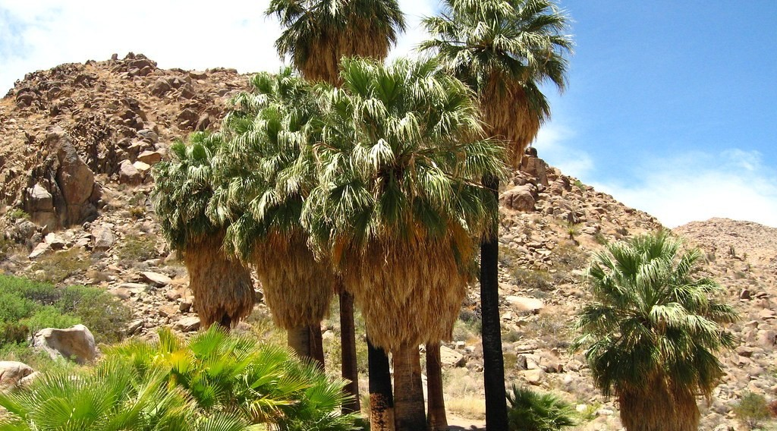
ECO. GEOGRAPHY — FORM 2 TECH
I. THE OASIS
Activity 1
An oasis in the Sahara.
2026 / 2027
DGCAST GAROUA — GEOGRAPHY DEPARTMENT
Mr KAMDEM E. | 14
Notes:
Without the projector: describe an oasis: palm trees and water in the middle of the sand.

Slide 15
ECO. GEOGRAPHY — FORM 2 TECH
I. THE OASIS
Activity 1: Question
What do we call this green place in the desert?
2026 / 2027
DGCAST GAROUA — GEOGRAPHY DEPARTMENT
Mr KAMDEM E. | 15

Slide 16
ECO. GEOGRAPHY — FORM 2 TECH
I. THE OASIS
Answer
An oasis.
2026 / 2027
DGCAST GAROUA — GEOGRAPHY DEPARTMENT
Mr KAMDEM E. | 16

Slide 17
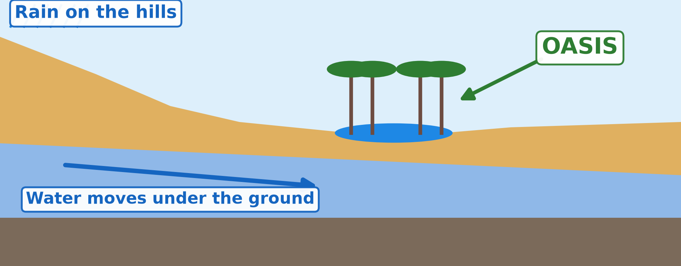
ECO. GEOGRAPHY — FORM 2 TECH
I. THE OASIS
Activity 2
How an oasis gets its water.
2026 / 2027
DGCAST GAROUA — GEOGRAPHY DEPARTMENT
Mr KAMDEM E. | 17
Notes:
Without the projector: draw the hills, the water under the ground and the oasis.

Slide 18
ECO. GEOGRAPHY — FORM 2 TECH
I. THE OASIS
Activity 2: Question
Where does the water of the oasis come from?
2026 / 2027
DGCAST GAROUA — GEOGRAPHY DEPARTMENT
Mr KAMDEM E. | 18

Slide 19
ECO. GEOGRAPHY — FORM 2 TECH
I. THE OASIS
Answer
From rain on far hills. It moves under the ground and comes up.
2026 / 2027
DGCAST GAROUA — GEOGRAPHY DEPARTMENT
Mr KAMDEM E. | 19

Slide 20
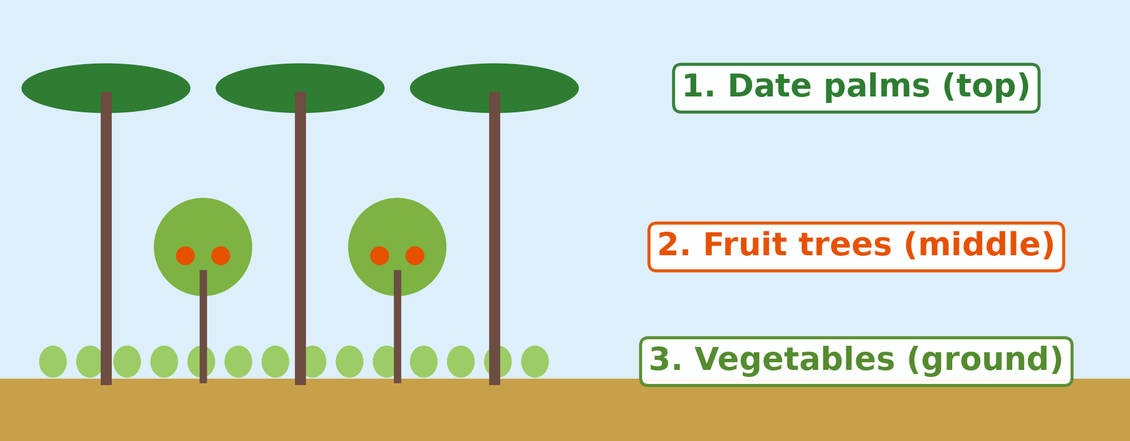
ECO. GEOGRAPHY — FORM 2 TECH
II. OASIS FARMING
Activity 3
The three layers of crops in an oasis.
2026 / 2027
DGCAST GAROUA — GEOGRAPHY DEPARTMENT
Mr KAMDEM E. | 20
Notes:
Without the projector: draw a palm tree, a small fruit tree and vegetables.

Slide 21
ECO. GEOGRAPHY — FORM 2 TECH
II. OASIS FARMING
Activity 3: Question
Name the three layers of crops. Why do farmers grow crops under the palms?
2026 / 2027
DGCAST GAROUA — GEOGRAPHY DEPARTMENT
Mr KAMDEM E. | 21

Slide 22
ECO. GEOGRAPHY — FORM 2 TECH
II. OASIS FARMING
Answer
Date palms, fruit trees, vegetables. The palms give shade and keep the soil wet.
2026 / 2027
DGCAST GAROUA — GEOGRAPHY DEPARTMENT
Mr KAMDEM E. | 22

Slide 23
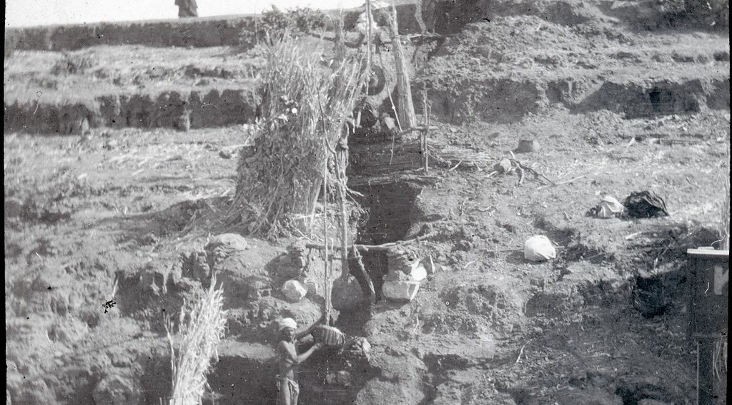
ECO. GEOGRAPHY — FORM 2 TECH
II. OASIS FARMING
Activity 4
A shaduf in Egypt.
2026 / 2027
DGCAST GAROUA — GEOGRAPHY DEPARTMENT
Mr KAMDEM E. | 23
Notes:
Without the projector: draw a shaduf: a pole, a weight and a bucket.

Slide 24
ECO. GEOGRAPHY — FORM 2 TECH
II. OASIS FARMING
Activity 4: Question
What does this farmer use to lift water from the river?
2026 / 2027
DGCAST GAROUA — GEOGRAPHY DEPARTMENT
Mr KAMDEM E. | 24

Slide 25
ECO. GEOGRAPHY — FORM 2 TECH
II. OASIS FARMING
Answer
A shaduf: a long pole with a bucket.
2026 / 2027
DGCAST GAROUA — GEOGRAPHY DEPARTMENT
Mr KAMDEM E. | 25

Slide 26

ECO. GEOGRAPHY — FORM 2 TECH
II. OASIS FARMING
Activity 5
Round fields watered by machines, seen from the sky.
2026 / 2027
DGCAST GAROUA — GEOGRAPHY DEPARTMENT
Mr KAMDEM E. | 26
Notes:
Without the projector: explain that a pump brings water from deep under the ground.

Slide 27
ECO. GEOGRAPHY — FORM 2 TECH
II. OASIS FARMING
Activity 5: Question
How do modern farmers get water in the desert?
2026 / 2027
DGCAST GAROUA — GEOGRAPHY DEPARTMENT
Mr KAMDEM E. | 27

Slide 28
ECO. GEOGRAPHY — FORM 2 TECH
II. OASIS FARMING
Answer
They pump water from deep wells (boreholes).
2026 / 2027
DGCAST GAROUA — GEOGRAPHY DEPARTMENT
Mr KAMDEM E. | 28

Slide 29
ECO. GEOGRAPHY — FORM 2 TECH
BOARD SUMMARY
The Desert Regions
Topic: Man in His Environment
Sub-topic: Natural Regions
Lesson 3: The Desert Regions — Part 5: Human Activities (Farming around Oases)
2026 / 2027
DGCAST GAROUA — GEOGRAPHY DEPARTMENT
Mr KAMDEM E. | 29
Notes:
Learners copy the board summary now. Give them enough time for each slide.

Slide 30
ECO. GEOGRAPHY — FORM 2 TECH
BOARD SUMMARY
I. Definitions
Oasis: It is a green place in the desert where there is water.
Shaduf: It is a pole with a bucket used to lift water.
Borehole: It is a deep well dug with machines.
2026 / 2027
DGCAST GAROUA — GEOGRAPHY DEPARTMENT
Mr KAMDEM E. | 30

Slide 31
ECO. GEOGRAPHY — FORM 2 TECH
BOARD SUMMARY
II. The Oasis (1/2)
A. Formation: Water from far hills comes up in the desert.
B. Examples: Siwa in Egypt and Tafilalt in Morocco.
2026 / 2027
DGCAST GAROUA — GEOGRAPHY DEPARTMENT
Mr KAMDEM E. | 31

Slide 32
ECO. GEOGRAPHY — FORM 2 TECH
BOARD SUMMARY
II. The Oasis (2/2)
Copy this simple drawing of an oasis.
2026 / 2027
DGCAST GAROUA — GEOGRAPHY DEPARTMENT
Mr KAMDEM E. | 32

Slide 33
ECO. GEOGRAPHY — FORM 2 TECH
BOARD SUMMARY
III. Farming around Oases
A. Three layers: Date palms, fruit trees and vegetables.
B. Irrigation: Wells, the shaduf and pumps.
C. The Nile: The Aswan Dam gives water all year.
D. Problems: Wells dry up and sand covers the fields.
2026 / 2027
DGCAST GAROUA — GEOGRAPHY DEPARTMENT
Mr KAMDEM E. | 33

Slide 34
ECO. GEOGRAPHY — FORM 2 TECH
FORMATIVE EVALUATION
Formative Evaluation 1
What is an oasis?
2026 / 2027
DGCAST GAROUA — GEOGRAPHY DEPARTMENT
Mr KAMDEM E. | 34

Slide 35
ECO. GEOGRAPHY — FORM 2 TECH
FORMATIVE EVALUATION
Expected Answer
A green place in the desert where there is water.
2026 / 2027
DGCAST GAROUA — GEOGRAPHY DEPARTMENT
Mr KAMDEM E. | 35

Slide 36
ECO. GEOGRAPHY — FORM 2 TECH
FORMATIVE EVALUATION
Formative Evaluation 2
Name two ways to get water in an oasis.
2026 / 2027
DGCAST GAROUA — GEOGRAPHY DEPARTMENT
Mr KAMDEM E. | 36

Slide 37
ECO. GEOGRAPHY — FORM 2 TECH
FORMATIVE EVALUATION
Expected Answer
Wells and the shaduf (or pumps).
2026 / 2027
DGCAST GAROUA — GEOGRAPHY DEPARTMENT
Mr KAMDEM E. | 37

Slide 38
ECO. GEOGRAPHY — FORM 2 TECH
REMEDIATION
Remediation
Fill in the blanks:
A green place with water in the desert is an ______.
The top layer of an oasis garden is the date ______.
A pole with a bucket for lifting water is a ______.
2026 / 2027
DGCAST GAROUA — GEOGRAPHY DEPARTMENT
Mr KAMDEM E. | 38
Notes:
Answers: 1. oasis 2. palm 3. shaduf

Slide 39
ECO. GEOGRAPHY — FORM 2 TECH
HOMEWORK
Homework
Look at a world map in your atlas. Find two countries located between 30° and 60° north of the Equator, and write their names.
This prepares Lesson 4: The Temperate Region.
2026 / 2027
DGCAST GAROUA — GEOGRAPHY DEPARTMENT
Mr KAMDEM E. | 39
Notes:
This homework prepares the next lesson.

Slide 40
ECO. GEOGRAPHY — FORM 2 TECH
BILINGUAL GAME
Bilingual Game (Jeu Bilingue)
English | Français
Oasis | L'oasis
Date | La datte
Irrigation | L'irrigation
Borehole | Le forage
Spring | La source
Water table | La nappe phréatique
Pump | La pompe
Dam | Le barrage
2026 / 2027
DGCAST GAROUA — GEOGRAPHY DEPARTMENT
Mr KAMDEM E. | 40
Notes:
Say the English word; learners give the French word, then the reverse.

Slide 41
ECO. GEOGRAPHY — FORM 2 TECH
LOGBOOK
Official Logbook (1/2)
Module / Topic | Man in His Environment
Lesson Title | Lesson 3: The Desert Regions — Part 5: Human Activities (Farming around Oases)
Expected Learning Outcomes | Explain how an oasis is formed. Describe the crops grown in oases. Describe the methods of irrigation used in deserts. Identify the problems of oasis farming.
Competence | Learners are able to explain how water can be brought to crops in the dry season and use water carefully in farming.
2026 / 2027
DGCAST GAROUA — GEOGRAPHY DEPARTMENT
Mr KAMDEM E. | 41

Slide 42
ECO. GEOGRAPHY — FORM 2 TECH
LOGBOOK
Official Logbook (2/2)
Matter Taught | I. Definitions: Oasis, Shaduf, Borehole; II. The Oasis: Formation, Examples; III. Farming around Oases: Three layers, Irrigation, The Nile, Problems.
Evaluation | Formative evaluation (3 questions) and remediation exercise.
Homework | Look at a world map in your atlas. Find two countries located between 30° and 60° north of the Equator, and write their names.
Enrolment / Present / Absent | ____ / ____ / ____
Achievement | To be completed by the teacher after the lesson.
2026 / 2027
DGCAST GAROUA — GEOGRAPHY DEPARTMENT
Mr KAMDEM E. | 42

Slide 43
ECO. GEOGRAPHY — FORM 2 TECH
TEACHER'S NOTE
Teacher's Note
Timing: Set-up, recall 8 min | Situation 8 min | 5 activities 25 min | Board summary (copying) 30 min | Evaluation, remediation 10 min | Homework 4 min | Logbook 10 min | Spare 5 min
2026 / 2027
DGCAST GAROUA — GEOGRAPHY DEPARTMENT
Mr KAMDEM E. | 43

Slide 44
ECO. GEOGRAPHY — FORM 2 TECH
REFERENCES
References
Harmonised Progression Sheet, Economic Geography (5051), Form 2.
Class textbook: The major biomes of the world (hot deserts).
Photo, Activity 1: “49 Palms Oasis; Twentynine Palms, CA” by Joshua Tree National Park, Public domain 1.0, via Flickr (https://www.flickr.com/photos/115357548@N08/12525367563)
Photo, Activity 4: “A Shadoof” by 10b travelling / Carsten ten Brink, CC BY-NC-ND 2.0, via Flickr (https://www.flickr.com/photos/77334245@N00/5908489998)
Photo, Activity 5: “Mid-West Agriculture” by Djof, CC BY-NC-SA 2.0, via Flickr (https://www.flickr.com/photos/10787942@N00/147222315)
Diagrams and animations: drawn for this lesson (DGCAST Geography Department).
2026 / 2027
DGCAST GAROUA — GEOGRAPHY DEPARTMENT
Mr KAMDEM E. | 44

