Slide 1

DIVINE GRACE COLLEGE OF ARTS, SCIENCE AND TECHNOLOGY
(DGCAST) — GAROUA | GEOGRAPHY DEPARTMENT
FORM 2 TECHNICAL — LESSON 4 (PART 1)
The Temperate Region: Location, Types and Characteristics (Climate)
Mr KAMDEM EMMANUEL
Geography Teacher — PLEG
Academic Year 2026 / 2027
Notes:
Good morning, class. Today we study The Temperate Region, part 1: Location, Types and Characteristics (Climate).

Slide 2
ECO. GEOGRAPHY — FORM 2 TECH
CLASS INFO
Class, Chapter & Duration
Class | Form 2 Technical
Chapter | Economic Geography — Natural Regions: 4. The Temperate Region
Duration | 2 periods (2 × 50 minutes)
2026 / 2027
DGCAST GAROUA — GEOGRAPHY DEPARTMENT
Mr KAMDEM E. | 2

Slide 3
ECO. GEOGRAPHY — FORM 2 TECH
IDENTIFICATION
Lesson Identification
Topic | Man in His Environment
Sub-topic | Natural Regions
Lesson | Lesson 4: The Temperate Region — Part 1: Location, Types and Characteristics (Climate)
Notions / Concepts | Temperate region, seasons, westerlies, Mediterranean climate, oceanic climate, continental climate.
Syllabus focus | Location and types of temperate regions; characteristics of the temperate climate.
Competence | Learners are able to explain why countries like France or England have four seasons and to prepare for a trip to a temperate country.
2026 / 2027
DGCAST GAROUA — GEOGRAPHY DEPARTMENT
Mr KAMDEM E. | 3

Slide 4
ECO. GEOGRAPHY — FORM 2 TECH
OBJECTIVES
Learning Objectives
By the end of the lesson, the learner should be able to:
Locate the temperate regions of the world.
Name the four seasons of the temperate region.
Describe the three main types of temperate climate.
2026 / 2027
DGCAST GAROUA — GEOGRAPHY DEPARTMENT
Mr KAMDEM E. | 4

Slide 5
ECO. GEOGRAPHY — FORM 2 TECH
RECALL
Recall
Hot deserts lie between 15° and 30° north and south of the Equator.
People farm in the desert thanks to oases and irrigation.
Beyond the deserts, towards the poles, the climate becomes cooler.
2026 / 2027
DGCAST GAROUA — GEOGRAPHY DEPARTMENT
Mr KAMDEM E. | 5
Notes:
Check the homework: two countries between 30° and 60° north.

Slide 6
ECO. GEOGRAPHY — FORM 2 TECH
REAL-LIFE SITUATION
Real-Life Situation
Aïssatou's brother is going to study in France in January. He packs only T-shirts and sandals. His mother says, "You need a thick coat, gloves and closed shoes. It is winter there."
2026 / 2027
DGCAST GAROUA — GEOGRAPHY DEPARTMENT
Mr KAMDEM E. | 6
Notes:
Read the situation slowly, twice.

Slide 7
ECO. GEOGRAPHY — FORM 2 TECH
REAL-LIFE SITUATION
Situation — Question 1
What is the problem in the situation?
2026 / 2027
DGCAST GAROUA — GEOGRAPHY DEPARTMENT
Mr KAMDEM E. | 7

Slide 8
ECO. GEOGRAPHY — FORM 2 TECH
REAL-LIFE SITUATION
Answer
The brother does not know that France is cold in January.
2026 / 2027
DGCAST GAROUA — GEOGRAPHY DEPARTMENT
Mr KAMDEM E. | 8

Slide 9
ECO. GEOGRAPHY — FORM 2 TECH
REAL-LIFE SITUATION
Situation — Question 2
What season is it in France in January?
2026 / 2027
DGCAST GAROUA — GEOGRAPHY DEPARTMENT
Mr KAMDEM E. | 9

Slide 10
ECO. GEOGRAPHY — FORM 2 TECH
REAL-LIFE SITUATION
Answer
Winter.
2026 / 2027
DGCAST GAROUA — GEOGRAPHY DEPARTMENT
Mr KAMDEM E. | 10

Slide 11
ECO. GEOGRAPHY — FORM 2 TECH
REAL-LIFE SITUATION
Situation — Question 3
What should he take?
2026 / 2027
DGCAST GAROUA — GEOGRAPHY DEPARTMENT
Mr KAMDEM E. | 11

Slide 12
ECO. GEOGRAPHY — FORM 2 TECH
REAL-LIFE SITUATION
Possible Answer
A thick coat, gloves and closed shoes.
2026 / 2027
DGCAST GAROUA — GEOGRAPHY DEPARTMENT
Mr KAMDEM E. | 12

Slide 13
ECO. GEOGRAPHY — FORM 2 TECH
JUSTIFICATION
Justification of the Lesson
This lesson helps us to know where the temperate regions are and their seasons.
2026 / 2027
DGCAST GAROUA — GEOGRAPHY DEPARTMENT
Mr KAMDEM E. | 13

Slide 14
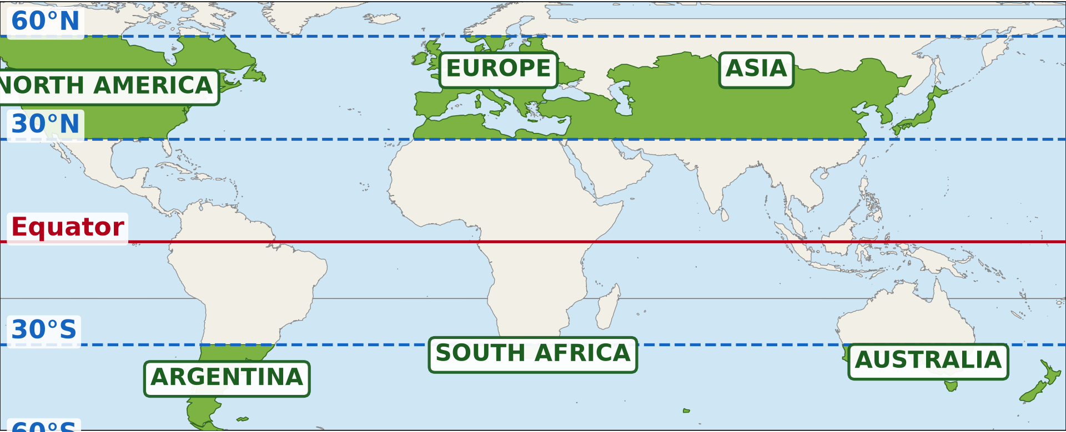
ECO. GEOGRAPHY — FORM 2 TECH
I. LOCATION
Activity 1
The temperate regions of the world (green).
2026 / 2027
DGCAST GAROUA — GEOGRAPHY DEPARTMENT
Mr KAMDEM E. | 14
Notes:
Without the projector: draw the Equator and the lines 30° and 60° on the board.

Slide 15
ECO. GEOGRAPHY — FORM 2 TECH
I. LOCATION
Activity 1: Question
Between which latitudes are the temperate regions?
2026 / 2027
DGCAST GAROUA — GEOGRAPHY DEPARTMENT
Mr KAMDEM E. | 15

Slide 16
ECO. GEOGRAPHY — FORM 2 TECH
I. LOCATION
Answer
Between 30° and 60° north and south of the Equator.
2026 / 2027
DGCAST GAROUA — GEOGRAPHY DEPARTMENT
Mr KAMDEM E. | 16

Slide 17

ECO. GEOGRAPHY — FORM 2 TECH
II. CLIMATE
Activity 2
The four seasons of the temperate region.
2026 / 2027
DGCAST GAROUA — GEOGRAPHY DEPARTMENT
Mr KAMDEM E. | 17
Notes:
Without the projector: write the four seasons on the board with one word for each.

Slide 18
ECO. GEOGRAPHY — FORM 2 TECH
II. CLIMATE
Activity 2: Question
How many seasons are there? Name them.
2026 / 2027
DGCAST GAROUA — GEOGRAPHY DEPARTMENT
Mr KAMDEM E. | 18

Slide 19
ECO. GEOGRAPHY — FORM 2 TECH
II. CLIMATE
Answer
Four: spring, summer, autumn and winter.
2026 / 2027
DGCAST GAROUA — GEOGRAPHY DEPARTMENT
Mr KAMDEM E. | 19

Slide 20
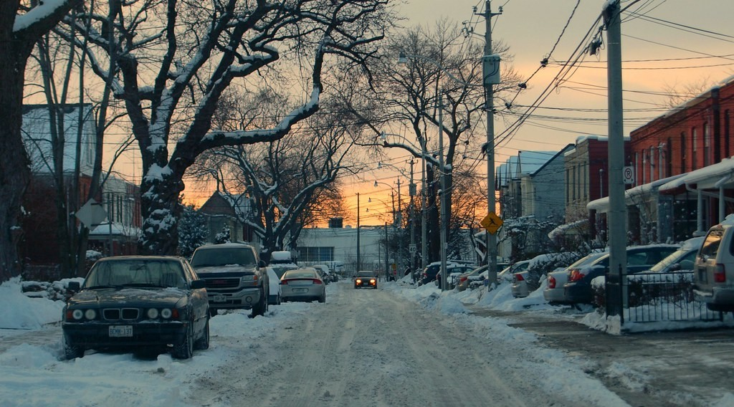
ECO. GEOGRAPHY — FORM 2 TECH
II. CLIMATE
Activity 3
A street in Europe in winter.
2026 / 2027
DGCAST GAROUA — GEOGRAPHY DEPARTMENT
Mr KAMDEM E. | 20
Notes:
Without the projector: describe snow: frozen rain that is white and very cold.

Slide 21
ECO. GEOGRAPHY — FORM 2 TECH
II. CLIMATE
Activity 3: Question
What covers the street? What must people wear?
2026 / 2027
DGCAST GAROUA — GEOGRAPHY DEPARTMENT
Mr KAMDEM E. | 21

Slide 22
ECO. GEOGRAPHY — FORM 2 TECH
II. CLIMATE
Answer
Snow. People wear thick coats, gloves and boots.
2026 / 2027
DGCAST GAROUA — GEOGRAPHY DEPARTMENT
Mr KAMDEM E. | 22

Slide 23

ECO. GEOGRAPHY — FORM 2 TECH
II. CLIMATE
Activity 4
The climate of London (England).
2026 / 2027
DGCAST GAROUA — GEOGRAPHY DEPARTMENT
Mr KAMDEM E. | 23
Notes:
Without the projector: write the temperature of London in January and July on the board.

Slide 24
ECO. GEOGRAPHY — FORM 2 TECH
II. CLIMATE
Activity 4: Question
Is it cold in winter in London? Does it rain every month?
2026 / 2027
DGCAST GAROUA — GEOGRAPHY DEPARTMENT
Mr KAMDEM E. | 24

Slide 25
ECO. GEOGRAPHY — FORM 2 TECH
II. CLIMATE
Answer
Yes, about 5 °C in winter. Yes, it rains every month.
2026 / 2027
DGCAST GAROUA — GEOGRAPHY DEPARTMENT
Mr KAMDEM E. | 25

Slide 26
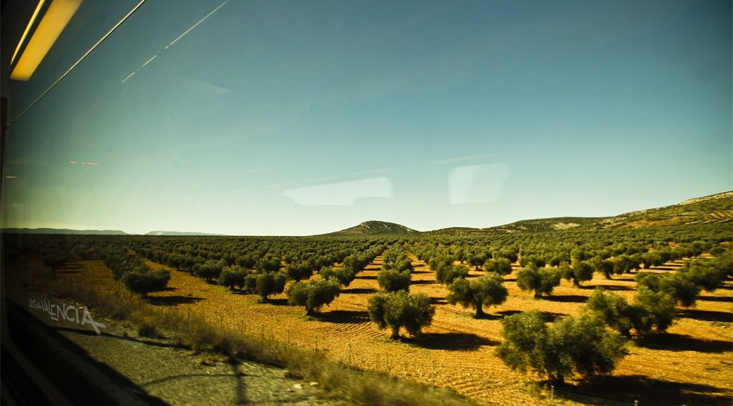
ECO. GEOGRAPHY — FORM 2 TECH
II. CLIMATE
Activity 5
Olive trees in a Mediterranean country in summer.
2026 / 2027
DGCAST GAROUA — GEOGRAPHY DEPARTMENT
Mr KAMDEM E. | 26
Notes:
Without the projector: name countries around the Mediterranean Sea: Spain, Italy, Greece.

Slide 27
ECO. GEOGRAPHY — FORM 2 TECH
II. CLIMATE
Activity 5: Question
Here, summers are hot and dry, winters are mild and wet. What type of climate is this?
2026 / 2027
DGCAST GAROUA — GEOGRAPHY DEPARTMENT
Mr KAMDEM E. | 27

Slide 28
ECO. GEOGRAPHY — FORM 2 TECH
II. CLIMATE
Answer
The Mediterranean climate.
2026 / 2027
DGCAST GAROUA — GEOGRAPHY DEPARTMENT
Mr KAMDEM E. | 28

Slide 29
ECO. GEOGRAPHY — FORM 2 TECH
BOARD SUMMARY
The Temperate Region
Topic: Man in His Environment
Sub-topic: Natural Regions
Lesson 4: The Temperate Region — Part 1: Location, Types and Characteristics (Climate)
2026 / 2027
DGCAST GAROUA — GEOGRAPHY DEPARTMENT
Mr KAMDEM E. | 29
Notes:
Learners copy the board summary now. Give them enough time for each slide.

Slide 30
ECO. GEOGRAPHY — FORM 2 TECH
BOARD SUMMARY
I. Definitions
Temperate region: It is a region between 30° and 60° with four seasons.
Season: It is a part of the year with its own weather.
Westerlies: They are winds that bring rain from the ocean.
2026 / 2027
DGCAST GAROUA — GEOGRAPHY DEPARTMENT
Mr KAMDEM E. | 30

Slide 31
ECO. GEOGRAPHY — FORM 2 TECH
BOARD SUMMARY
II. Location (1/2)
A. Northern Hemisphere: Europe, North America and Asia.
B. Southern Hemisphere: Argentina, South Africa, Australia and New Zealand.
2026 / 2027
DGCAST GAROUA — GEOGRAPHY DEPARTMENT
Mr KAMDEM E. | 31

Slide 32
ECO. GEOGRAPHY — FORM 2 TECH
BOARD SUMMARY
II. Location (2/2)
Copy the lines 30° and 60° and the temperate lands.
2026 / 2027
DGCAST GAROUA — GEOGRAPHY DEPARTMENT
Mr KAMDEM E. | 32

Slide 33
ECO. GEOGRAPHY — FORM 2 TECH
BOARD SUMMARY
III. Types of Climate
There are four seasons and three main climates:
A. Oceanic (British): Mild summers, cool winters, rain all year.
B. Mediterranean: Hot, dry summers and mild, wet winters.
C. Continental: Hot summers and very cold winters.
2026 / 2027
DGCAST GAROUA — GEOGRAPHY DEPARTMENT
Mr KAMDEM E. | 33

Slide 34
ECO. GEOGRAPHY — FORM 2 TECH
FORMATIVE EVALUATION
Formative Evaluation 1
Name the four seasons of the temperate region.
2026 / 2027
DGCAST GAROUA — GEOGRAPHY DEPARTMENT
Mr KAMDEM E. | 34

Slide 35
ECO. GEOGRAPHY — FORM 2 TECH
FORMATIVE EVALUATION
Expected Answer
Spring, summer, autumn and winter.
2026 / 2027
DGCAST GAROUA — GEOGRAPHY DEPARTMENT
Mr KAMDEM E. | 35

Slide 36
ECO. GEOGRAPHY — FORM 2 TECH
FORMATIVE EVALUATION
Formative Evaluation 2
Give one characteristic of the Mediterranean climate.
2026 / 2027
DGCAST GAROUA — GEOGRAPHY DEPARTMENT
Mr KAMDEM E. | 36

Slide 37
ECO. GEOGRAPHY — FORM 2 TECH
FORMATIVE EVALUATION
Expected Answer
Hot, dry summers (and mild, wet winters).
2026 / 2027
DGCAST GAROUA — GEOGRAPHY DEPARTMENT
Mr KAMDEM E. | 37

Slide 38
ECO. GEOGRAPHY — FORM 2 TECH
REMEDIATION
Remediation
Fill in the blanks:
The temperate region is between 30° and ______.
The cold season is called ______.
Hot, dry summers are found in the ______ climate.
2026 / 2027
DGCAST GAROUA — GEOGRAPHY DEPARTMENT
Mr KAMDEM E. | 38
Notes:
Answers: 1. 60° 2. winter 3. Mediterranean

Slide 39
ECO. GEOGRAPHY — FORM 2 TECH
HOMEWORK
Homework
Find a picture of a European forest in autumn in your textbook or on television. Describe the colour of the leaves and say what happens to them in winter.
This prepares Part 2: Soils and Vegetation of the Temperate Region.
2026 / 2027
DGCAST GAROUA — GEOGRAPHY DEPARTMENT
Mr KAMDEM E. | 39
Notes:
This homework prepares the next lesson.

Slide 40
ECO. GEOGRAPHY — FORM 2 TECH
BILINGUAL GAME
Bilingual Game (Jeu Bilingue)
English | Français
Temperate | Tempéré
Spring | Le printemps
Summer | L'été
Autumn | L'automne
Winter | L'hiver
Snow | La neige
Westerlies | Les vents d'ouest
Mediterranean | Méditerranéen
2026 / 2027
DGCAST GAROUA — GEOGRAPHY DEPARTMENT
Mr KAMDEM E. | 40
Notes:
Say the English word; learners give the French word, then the reverse.

Slide 41
ECO. GEOGRAPHY — FORM 2 TECH
LOGBOOK
Official Logbook (1/2)
Module / Topic | Man in His Environment
Lesson Title | Lesson 4: The Temperate Region — Part 1: Location, Types and Characteristics (Climate)
Expected Learning Outcomes | Locate the temperate regions of the world. Name the four seasons of the temperate region. Describe the three main types of temperate climate.
Competence | Learners are able to explain why countries like France or England have four seasons and to prepare for a trip to a temperate country.
2026 / 2027
DGCAST GAROUA — GEOGRAPHY DEPARTMENT
Mr KAMDEM E. | 41

Slide 42
ECO. GEOGRAPHY — FORM 2 TECH
LOGBOOK
Official Logbook (2/2)
Matter Taught | I. Definitions: Temperate region, Season, Westerlies; II. Location: Northern Hemisphere, Southern Hemisphere; III. Types of Climate: Oceanic (British), Mediterranean, Continental.
Evaluation | Formative evaluation (3 questions) and remediation exercise.
Homework | Find a picture of a European forest in autumn in your textbook or on television. Describe the colour of the leaves and say what happens to them in winter.
Enrolment / Present / Absent | ____ / ____ / ____
Achievement | To be completed by the teacher after the lesson.
2026 / 2027
DGCAST GAROUA — GEOGRAPHY DEPARTMENT
Mr KAMDEM E. | 42

Slide 43
ECO. GEOGRAPHY — FORM 2 TECH
TEACHER'S NOTE
Teacher's Note
Timing: Set-up, recall 8 min | Situation 8 min | 5 activities 25 min | Board summary (copying) 30 min | Evaluation, remediation 10 min | Homework 4 min | Logbook 10 min | Spare 5 min
London data (approximate normals): January 5 °C, July 19 °C, about 600 mm of rain spread over the year.
2026 / 2027
DGCAST GAROUA — GEOGRAPHY DEPARTMENT
Mr KAMDEM E. | 43

Slide 44
ECO. GEOGRAPHY — FORM 2 TECH
REFERENCES
References
Harmonised Progression Sheet, Economic Geography (5051), Form 2.
Class textbook: The major biomes of the world (temperate regions).
London climate normals: Met Office (via Wikipedia, "Climate of London").
Photo, Activity 3: “Toronto Winter Maintenance Budget” by MSVG, CC BY 2.0, via Flickr (https://www.flickr.com/photos/13907834@N00/5336969301)
Photo, Activity 5: “Oro Mediterraneo / Mediterranean Gold” by Cristy Valencia, CC BY 2.0, via Flickr (https://www.flickr.com/photos/24522216@N03/5927925845)
Diagrams and animations: drawn for this lesson (DGCAST Geography Department).
2026 / 2027
DGCAST GAROUA — GEOGRAPHY DEPARTMENT
Mr KAMDEM E. | 44

