Slide 1

DIVINE GRACE COLLEGE OF ARTS, SCIENCE AND TECHNOLOGY
(DGCAST) — GAROUA | GEOGRAPHY DEPARTMENT
FORM 2 TECHNICAL — LESSON 4 (PART 3)
The Temperate Region: Human Activities (Farming)
Mr KAMDEM EMMANUEL
Geography Teacher — PLEG
Academic Year 2026 / 2027
Notes:
Good morning, class. Today we study The Temperate Region, part 3: Human Activities (Farming).

Slide 2
ECO. GEOGRAPHY — FORM 2 TECH
CLASS INFO
Class, Chapter & Duration
Class | Form 2 Technical
Chapter | Economic Geography — Natural Regions: 4. The Temperate Region
Duration | 2 periods (2 × 50 minutes)
2026 / 2027
DGCAST GAROUA — GEOGRAPHY DEPARTMENT
Mr KAMDEM E. | 2

Slide 3
ECO. GEOGRAPHY — FORM 2 TECH
IDENTIFICATION
Lesson Identification
Topic | Man in His Environment
Sub-topic | Natural Regions
Lesson | Lesson 4: The Temperate Region — Part 3: Human Activities (Farming)
Notions / Concepts | Mixed farming, dairy farming, extensive grain farming, ranching, Mediterranean farming, mechanisation.
Syllabus focus | Farming in the temperate region.
Competence | Learners are able to explain where the imported flour, milk and meat sold in Garoua come from, and how they are produced.
2026 / 2027
DGCAST GAROUA — GEOGRAPHY DEPARTMENT
Mr KAMDEM E. | 3

Slide 4
ECO. GEOGRAPHY — FORM 2 TECH
OBJECTIVES
Learning Objectives
By the end of the lesson, the learner should be able to:
Describe the main types of farming in the temperate region.
Give examples of countries for each type of farming.
Explain why temperate farming is very productive.
2026 / 2027
DGCAST GAROUA — GEOGRAPHY DEPARTMENT
Mr KAMDEM E. | 4

Slide 5
ECO. GEOGRAPHY — FORM 2 TECH
RECALL
Recall
The temperate region has deciduous forests, coniferous forests, Mediterranean vegetation and grasslands.
Its brown forest soils and chernozems are very fertile.
2026 / 2027
DGCAST GAROUA — GEOGRAPHY DEPARTMENT
Mr KAMDEM E. | 5
Notes:
Check the homework: food products imported from temperate countries.

Slide 6
ECO. GEOGRAPHY — FORM 2 TECH
REAL-LIFE SITUATION
Real-Life Situation
In a shop in Garoua, Blaise sees wheat flour from France, milk powder from the Netherlands and olive oil from Spain. He wonders how these countries produce so much food.
2026 / 2027
DGCAST GAROUA — GEOGRAPHY DEPARTMENT
Mr KAMDEM E. | 6
Notes:
Read the situation slowly, twice.

Slide 7
ECO. GEOGRAPHY — FORM 2 TECH
REAL-LIFE SITUATION
Situation — Question 1
What is the problem in the situation?
2026 / 2027
DGCAST GAROUA — GEOGRAPHY DEPARTMENT
Mr KAMDEM E. | 7

Slide 8
ECO. GEOGRAPHY — FORM 2 TECH
REAL-LIFE SITUATION
Answer
Blaise does not know how these countries produce so much food.
2026 / 2027
DGCAST GAROUA — GEOGRAPHY DEPARTMENT
Mr KAMDEM E. | 8

Slide 9
ECO. GEOGRAPHY — FORM 2 TECH
REAL-LIFE SITUATION
Situation — Question 2
Name the three products and their countries.
2026 / 2027
DGCAST GAROUA — GEOGRAPHY DEPARTMENT
Mr KAMDEM E. | 9

Slide 10
ECO. GEOGRAPHY — FORM 2 TECH
REAL-LIFE SITUATION
Answer
Flour (France), milk (Netherlands), olive oil (Spain).
2026 / 2027
DGCAST GAROUA — GEOGRAPHY DEPARTMENT
Mr KAMDEM E. | 10

Slide 11
ECO. GEOGRAPHY — FORM 2 TECH
REAL-LIFE SITUATION
Situation — Question 3
What helps these farmers to produce a lot?
2026 / 2027
DGCAST GAROUA — GEOGRAPHY DEPARTMENT
Mr KAMDEM E. | 11

Slide 12
ECO. GEOGRAPHY — FORM 2 TECH
REAL-LIFE SITUATION
Possible Answer
Machines, good seeds and fertilisers.
2026 / 2027
DGCAST GAROUA — GEOGRAPHY DEPARTMENT
Mr KAMDEM E. | 12

Slide 13
ECO. GEOGRAPHY — FORM 2 TECH
JUSTIFICATION
Justification of the Lesson
This lesson helps us to know how farmers work in the temperate region.
2026 / 2027
DGCAST GAROUA — GEOGRAPHY DEPARTMENT
Mr KAMDEM E. | 13

Slide 14

ECO. GEOGRAPHY — FORM 2 TECH
I. TYPES OF FARMING
Activity 1
Cows on a farm with fields.
2026 / 2027
DGCAST GAROUA — GEOGRAPHY DEPARTMENT
Mr KAMDEM E. | 14
Notes:
Without the projector: ask learners if their family grows crops and keeps animals too.

Slide 15
ECO. GEOGRAPHY — FORM 2 TECH
I. TYPES OF FARMING
Activity 1: Question
This farmer grows crops and rears animals on the same farm. What is this type of farming?
2026 / 2027
DGCAST GAROUA — GEOGRAPHY DEPARTMENT
Mr KAMDEM E. | 15

Slide 16
ECO. GEOGRAPHY — FORM 2 TECH
I. TYPES OF FARMING
Answer
Mixed farming.
2026 / 2027
DGCAST GAROUA — GEOGRAPHY DEPARTMENT
Mr KAMDEM E. | 16

Slide 17
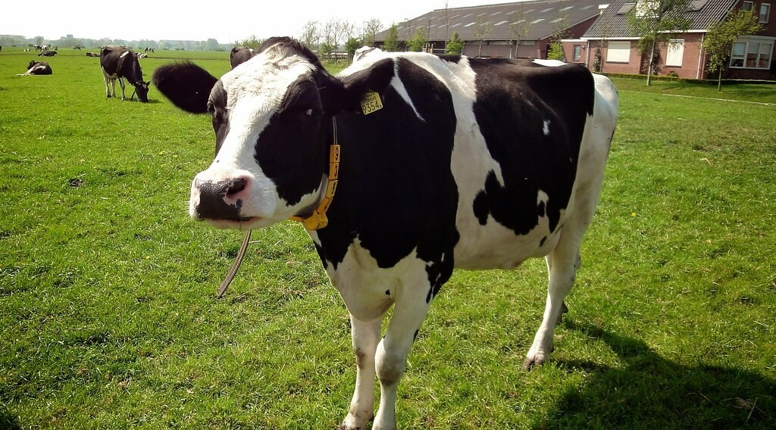
ECO. GEOGRAPHY — FORM 2 TECH
I. TYPES OF FARMING
Activity 2
Cows on a farm in the Netherlands.
2026 / 2027
DGCAST GAROUA — GEOGRAPHY DEPARTMENT
Mr KAMDEM E. | 17
Notes:
Without the projector: show a tin of powdered milk.

Slide 18
ECO. GEOGRAPHY — FORM 2 TECH
I. TYPES OF FARMING
Activity 2: Question
These cows are reared for milk, butter and cheese. What is this type of farming?
2026 / 2027
DGCAST GAROUA — GEOGRAPHY DEPARTMENT
Mr KAMDEM E. | 18

Slide 19
ECO. GEOGRAPHY — FORM 2 TECH
I. TYPES OF FARMING
Answer
Dairy farming.
2026 / 2027
DGCAST GAROUA — GEOGRAPHY DEPARTMENT
Mr KAMDEM E. | 19

Slide 20

ECO. GEOGRAPHY — FORM 2 TECH
I. TYPES OF FARMING
Activity 3
A big machine harvests wheat.
2026 / 2027
DGCAST GAROUA — GEOGRAPHY DEPARTMENT
Mr KAMDEM E. | 20
Notes:
Without the projector: compare with a farmer who harvests sorghum by hand.

Slide 21
ECO. GEOGRAPHY — FORM 2 TECH
I. TYPES OF FARMING
Activity 3: Question
Why can one farmer in Canada grow so much wheat?
2026 / 2027
DGCAST GAROUA — GEOGRAPHY DEPARTMENT
Mr KAMDEM E. | 21

Slide 22
ECO. GEOGRAPHY — FORM 2 TECH
I. TYPES OF FARMING
Answer
He uses big machines on a huge farm.
2026 / 2027
DGCAST GAROUA — GEOGRAPHY DEPARTMENT
Mr KAMDEM E. | 22

Slide 23
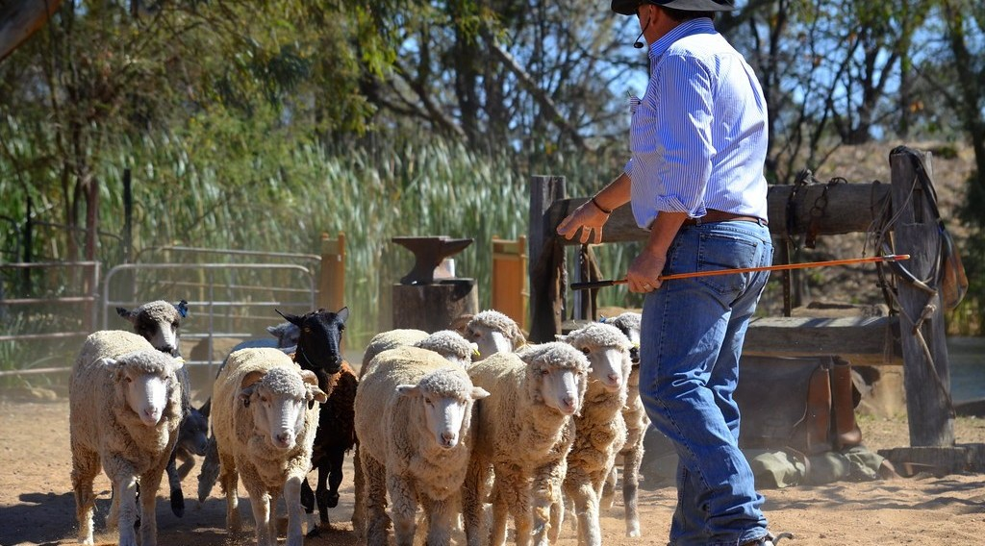
ECO. GEOGRAPHY — FORM 2 TECH
I. TYPES OF FARMING
Activity 4
A farmer with his sheep.
2026 / 2027
DGCAST GAROUA — GEOGRAPHY DEPARTMENT
Mr KAMDEM E. | 23
Notes:
Without the projector: compare with the ranches of the Adamawa plateau.

Slide 24
ECO. GEOGRAPHY — FORM 2 TECH
I. TYPES OF FARMING
Activity 4: Question
In Australia, sheep are reared on huge farms. What are these farms called?
2026 / 2027
DGCAST GAROUA — GEOGRAPHY DEPARTMENT
Mr KAMDEM E. | 24

Slide 25
ECO. GEOGRAPHY — FORM 2 TECH
I. TYPES OF FARMING
Answer
Ranches.
2026 / 2027
DGCAST GAROUA — GEOGRAPHY DEPARTMENT
Mr KAMDEM E. | 25

Slide 26
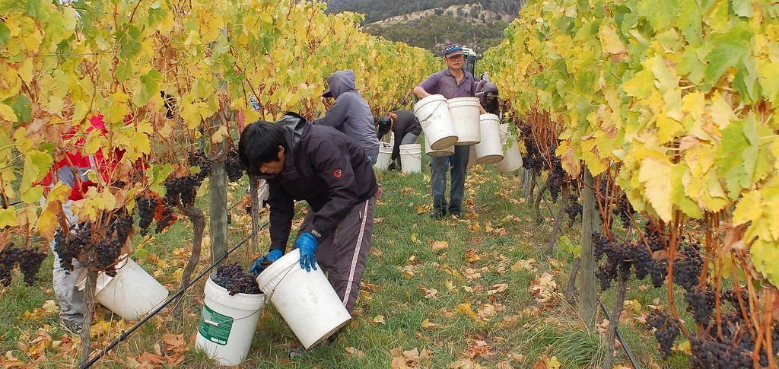
ECO. GEOGRAPHY — FORM 2 TECH
I. TYPES OF FARMING
Activity 5
Picking grapes in France.
2026 / 2027
DGCAST GAROUA — GEOGRAPHY DEPARTMENT
Mr KAMDEM E. | 26
Notes:
Without the projector: ask learners where oranges in the market come from.

Slide 27
ECO. GEOGRAPHY — FORM 2 TECH
I. TYPES OF FARMING
Activity 5: Question
Name two crops of Mediterranean farming.
2026 / 2027
DGCAST GAROUA — GEOGRAPHY DEPARTMENT
Mr KAMDEM E. | 27

Slide 28
ECO. GEOGRAPHY — FORM 2 TECH
I. TYPES OF FARMING
Answer
Grapes and olives (also oranges and wheat).
2026 / 2027
DGCAST GAROUA — GEOGRAPHY DEPARTMENT
Mr KAMDEM E. | 28

Slide 29
ECO. GEOGRAPHY — FORM 2 TECH
BOARD SUMMARY
The Temperate Region
Topic: Man in His Environment
Sub-topic: Natural Regions
Lesson 4: The Temperate Region — Part 3: Human Activities (Farming)
2026 / 2027
DGCAST GAROUA — GEOGRAPHY DEPARTMENT
Mr KAMDEM E. | 29
Notes:
Learners copy the board summary now. Give them enough time for each slide.

Slide 30
ECO. GEOGRAPHY — FORM 2 TECH
BOARD SUMMARY
I. Definitions
Mixed farming: It is growing crops and rearing animals on the same farm.
Dairy farming: It is rearing cows for milk.
Ranch: It is a very large farm for animals.
2026 / 2027
DGCAST GAROUA — GEOGRAPHY DEPARTMENT
Mr KAMDEM E. | 30

Slide 31
ECO. GEOGRAPHY — FORM 2 TECH
BOARD SUMMARY
II. Types of Farming
A. Mixed farming: England and France.
B. Dairy farming: The Netherlands and Denmark.
C. Grain farming: Wheat on the Prairies of Canada.
D. Ranching: Argentina and Australia.
E. Mediterranean farming: Olives, grapes and oranges.
2026 / 2027
DGCAST GAROUA — GEOGRAPHY DEPARTMENT
Mr KAMDEM E. | 31

Slide 32
ECO. GEOGRAPHY — FORM 2 TECH
BOARD SUMMARY
III. Characteristics
A. Machines: Few workers produce a lot.
B. Science: Good seeds and fertilisers.
C. Trade: Most products are sold.
2026 / 2027
DGCAST GAROUA — GEOGRAPHY DEPARTMENT
Mr KAMDEM E. | 32

Slide 33
ECO. GEOGRAPHY — FORM 2 TECH
FORMATIVE EVALUATION
Formative Evaluation 1
What is mixed farming?
2026 / 2027
DGCAST GAROUA — GEOGRAPHY DEPARTMENT
Mr KAMDEM E. | 33

Slide 34
ECO. GEOGRAPHY — FORM 2 TECH
FORMATIVE EVALUATION
Expected Answer
Growing crops and rearing animals on the same farm.
2026 / 2027
DGCAST GAROUA — GEOGRAPHY DEPARTMENT
Mr KAMDEM E. | 34

Slide 35
ECO. GEOGRAPHY — FORM 2 TECH
FORMATIVE EVALUATION
Formative Evaluation 2
Why do temperate farmers produce a lot?
2026 / 2027
DGCAST GAROUA — GEOGRAPHY DEPARTMENT
Mr KAMDEM E. | 35

Slide 36
ECO. GEOGRAPHY — FORM 2 TECH
FORMATIVE EVALUATION
Expected Answer
They use machines, good seeds and fertilisers.
2026 / 2027
DGCAST GAROUA — GEOGRAPHY DEPARTMENT
Mr KAMDEM E. | 36

Slide 37
ECO. GEOGRAPHY — FORM 2 TECH
REMEDIATION
Remediation
Fill in the blanks:
Rearing cows for milk is ______ farming.
A very large farm for animals is a ______.
Wheat is harvested by a big ______.
2026 / 2027
DGCAST GAROUA — GEOGRAPHY DEPARTMENT
Mr KAMDEM E. | 37
Notes:
Answers: 1. dairy 2. ranch 3. machine (combine harvester)

Slide 38
ECO. GEOGRAPHY — FORM 2 TECH
HOMEWORK
Homework
Ask an adult who has lived or travelled in Europe what difficulties people face in winter. Write down two of them.
This prepares Part 4: Problems Faced and Adaptations in the Temperate Region.
2026 / 2027
DGCAST GAROUA — GEOGRAPHY DEPARTMENT
Mr KAMDEM E. | 38
Notes:
This homework prepares the next lesson.

Slide 39
ECO. GEOGRAPHY — FORM 2 TECH
BILINGUAL GAME
Bilingual Game (Jeu Bilingue)
English | Français
Mixed farming | La polyculture-élevage
Dairy farming | L'élevage laitier
Wheat | Le blé
Ranch | Le ranch
Tractor | Le tracteur
Cooperative | La coopérative
Fertiliser | L'engrais
Grape | Le raisin
2026 / 2027
DGCAST GAROUA — GEOGRAPHY DEPARTMENT
Mr KAMDEM E. | 39
Notes:
Say the English word; learners give the French word, then the reverse.

Slide 40
ECO. GEOGRAPHY — FORM 2 TECH
LOGBOOK
Official Logbook (1/2)
Module / Topic | Man in His Environment
Lesson Title | Lesson 4: The Temperate Region — Part 3: Human Activities (Farming)
Expected Learning Outcomes | Describe the main types of farming in the temperate region. Give examples of countries for each type of farming. Explain why temperate farming is very productive.
Competence | Learners are able to explain where the imported flour, milk and meat sold in Garoua come from, and how they are produced.
2026 / 2027
DGCAST GAROUA — GEOGRAPHY DEPARTMENT
Mr KAMDEM E. | 40

Slide 41
ECO. GEOGRAPHY — FORM 2 TECH
LOGBOOK
Official Logbook (2/2)
Matter Taught | I. Definitions: Mixed farming, Dairy farming, Ranch; II. Types of Farming: Mixed farming, Dairy farming, Grain farming, Ranching, Mediterranean farming; III. Characteristics: Machines, Science, Trade.
Evaluation | Formative evaluation (3 questions) and remediation exercise.
Homework | Ask an adult who has lived or travelled in Europe what difficulties people face in winter. Write down two of them.
Enrolment / Present / Absent | ____ / ____ / ____
Achievement | To be completed by the teacher after the lesson.
2026 / 2027
DGCAST GAROUA — GEOGRAPHY DEPARTMENT
Mr KAMDEM E. | 41

Slide 42
ECO. GEOGRAPHY — FORM 2 TECH
TEACHER'S NOTE
Teacher's Note
Timing: Set-up, recall 8 min | Situation 8 min | 5 activities 25 min | Board summary (copying) 30 min | Evaluation, remediation 10 min | Homework 4 min | Logbook 10 min | Spare 5 min
2026 / 2027
DGCAST GAROUA — GEOGRAPHY DEPARTMENT
Mr KAMDEM E. | 42

Slide 43
ECO. GEOGRAPHY — FORM 2 TECH
REFERENCES
References
Harmonised Progression Sheet, Economic Geography (5051), Form 2.
Class textbook: The major biomes of the world (temperate regions).
Photo, Activity 1: “Timid” by tricky (rick harrison), CC BY-NC-SA 2.0, via Flickr (https://www.flickr.com/photos/81851211@N00/205287304)
Photo, Activity 2: “Koe 9354” by ednl, CC BY 2.0, via Flickr (https://www.flickr.com/photos/31392863@N04/5640329871)
Photo, Activity 3: “John Deere Combine” by SnoShuu, CC BY-NC-ND 2.0, via Flickr (https://www.flickr.com/photos/85888233@N00/2776467094)
Photo, Activity 4: “The Flock” by seefit, CC BY 2.0, via Flickr (https://www.flickr.com/photos/76574551@N00/20928299362)
Photo, Activity 5: “Stefano Lubiana Wines Tasmania harvest panorama” by stefano lubiana wines, CC BY 2.0, via Flickr (https://www.flickr.com/photos/50979249@N06/4688372740)
Diagrams and animations: drawn for this lesson (DGCAST Geography Department).
2026 / 2027
DGCAST GAROUA — GEOGRAPHY DEPARTMENT
Mr KAMDEM E. | 43

