Slide 1

DIVINE GRACE COLLEGE OF ARTS, SCIENCE AND TECHNOLOGY
(DGCAST) — GAROUA | GEOGRAPHY DEPARTMENT
FORM 2 TECHNICAL — LESSON 4 (PART 4)
The Temperate Region: Problems Faced and Adaptations
Mr KAMDEM EMMANUEL
Geography Teacher — PLEG
Academic Year 2026 / 2027
Notes:
Good morning, class. Today we study The Temperate Region, part 4: Problems Faced and Adaptations.

Slide 2
ECO. GEOGRAPHY — FORM 2 TECH
CLASS INFO
Class, Chapter & Duration
Class | Form 2 Technical
Chapter | Economic Geography — Natural Regions: 4. The Temperate Region
Duration | 2 periods (2 × 50 minutes)
2026 / 2027
DGCAST GAROUA — GEOGRAPHY DEPARTMENT
Mr KAMDEM E. | 2

Slide 3
ECO. GEOGRAPHY — FORM 2 TECH
IDENTIFICATION
Lesson Identification
Topic | Man in His Environment
Sub-topic | Natural Regions
Lesson | Lesson 4: The Temperate Region — Part 4: Problems Faced and Adaptations
Notions / Concepts | Frost, snow, short growing season, drought, forest fire, shelterbelt, greenhouse.
Syllabus focus | Problems faced in the temperate region and the adaptations of people.
Competence | Learners are able to explain how people adapt their houses, clothes and farming to a difficult climate, and apply this idea to their own environment.
2026 / 2027
DGCAST GAROUA — GEOGRAPHY DEPARTMENT
Mr KAMDEM E. | 3

Slide 4
ECO. GEOGRAPHY — FORM 2 TECH
OBJECTIVES
Learning Objectives
By the end of the lesson, the learner should be able to:
Identify the problems faced by people in the temperate region.
Describe how people adapt their houses, clothes and transport.
Describe how farmers adapt to the problems of the temperate climate.
2026 / 2027
DGCAST GAROUA — GEOGRAPHY DEPARTMENT
Mr KAMDEM E. | 4

Slide 5
ECO. GEOGRAPHY — FORM 2 TECH
RECALL
Recall
Temperate farming includes mixed, dairy, grain, ranching and Mediterranean farming.
It is very productive thanks to machines, science and cooperatives.
2026 / 2027
DGCAST GAROUA — GEOGRAPHY DEPARTMENT
Mr KAMDEM E. | 5
Notes:
Check the homework: difficulties of winter in Europe.

Slide 6
ECO. GEOGRAPHY — FORM 2 TECH
REAL-LIFE SITUATION
Real-Life Situation
In January, heavy snow falls on a village in Canada. The roads are blocked, the water pipes freeze and the farmer cannot take his cows out.
2026 / 2027
DGCAST GAROUA — GEOGRAPHY DEPARTMENT
Mr KAMDEM E. | 6
Notes:
Read the situation slowly, twice.

Slide 7
ECO. GEOGRAPHY — FORM 2 TECH
REAL-LIFE SITUATION
Situation — Question 1
What is the problem in the situation?
2026 / 2027
DGCAST GAROUA — GEOGRAPHY DEPARTMENT
Mr KAMDEM E. | 7

Slide 8
ECO. GEOGRAPHY — FORM 2 TECH
REAL-LIFE SITUATION
Answer
The snow blocks the roads and freezes the water pipes.
2026 / 2027
DGCAST GAROUA — GEOGRAPHY DEPARTMENT
Mr KAMDEM E. | 8

Slide 9
ECO. GEOGRAPHY — FORM 2 TECH
REAL-LIFE SITUATION
Situation — Question 2
Why can the cows not go out?
2026 / 2027
DGCAST GAROUA — GEOGRAPHY DEPARTMENT
Mr KAMDEM E. | 9

Slide 10
ECO. GEOGRAPHY — FORM 2 TECH
REAL-LIFE SITUATION
Answer
The grass is under the snow.
2026 / 2027
DGCAST GAROUA — GEOGRAPHY DEPARTMENT
Mr KAMDEM E. | 10

Slide 11
ECO. GEOGRAPHY — FORM 2 TECH
REAL-LIFE SITUATION
Situation — Question 3
What can the farmer give them?
2026 / 2027
DGCAST GAROUA — GEOGRAPHY DEPARTMENT
Mr KAMDEM E. | 11

Slide 12
ECO. GEOGRAPHY — FORM 2 TECH
REAL-LIFE SITUATION
Possible Answer
Hay that he stored in summer.
2026 / 2027
DGCAST GAROUA — GEOGRAPHY DEPARTMENT
Mr KAMDEM E. | 12

Slide 13
ECO. GEOGRAPHY — FORM 2 TECH
JUSTIFICATION
Justification of the Lesson
This lesson helps us to know the problems of the temperate region and how people adapt.
2026 / 2027
DGCAST GAROUA — GEOGRAPHY DEPARTMENT
Mr KAMDEM E. | 13

Slide 14
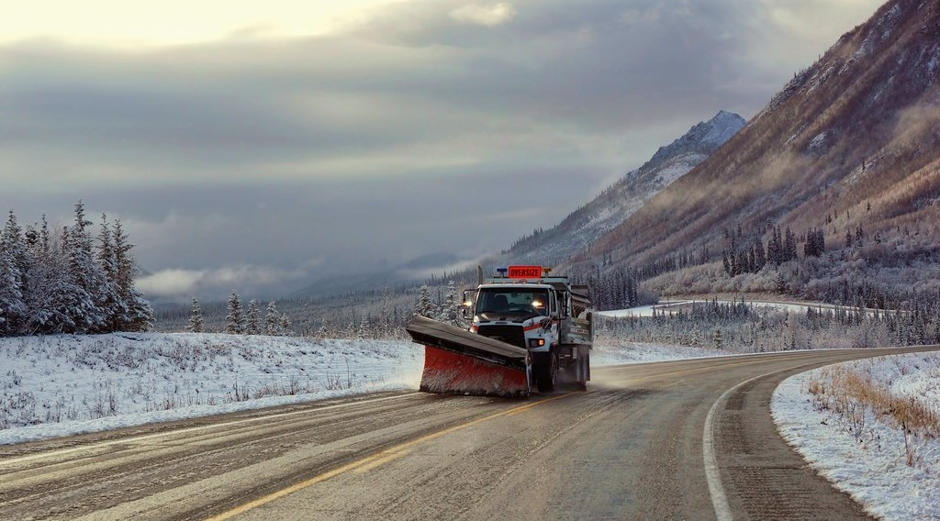
ECO. GEOGRAPHY — FORM 2 TECH
I. PROBLEMS FACED
Activity 1
A machine clears the snow from a road.
2026 / 2027
DGCAST GAROUA — GEOGRAPHY DEPARTMENT
Mr KAMDEM E. | 14
Notes:
Without the projector: describe a road covered with snow.

Slide 15
ECO. GEOGRAPHY — FORM 2 TECH
I. PROBLEMS FACED
Activity 1: Question
What problem does snow cause? How do people solve it?
2026 / 2027
DGCAST GAROUA — GEOGRAPHY DEPARTMENT
Mr KAMDEM E. | 15

Slide 16
ECO. GEOGRAPHY — FORM 2 TECH
I. PROBLEMS FACED
Answer
It blocks the roads. Machines clear the snow.
2026 / 2027
DGCAST GAROUA — GEOGRAPHY DEPARTMENT
Mr KAMDEM E. | 16

Slide 17
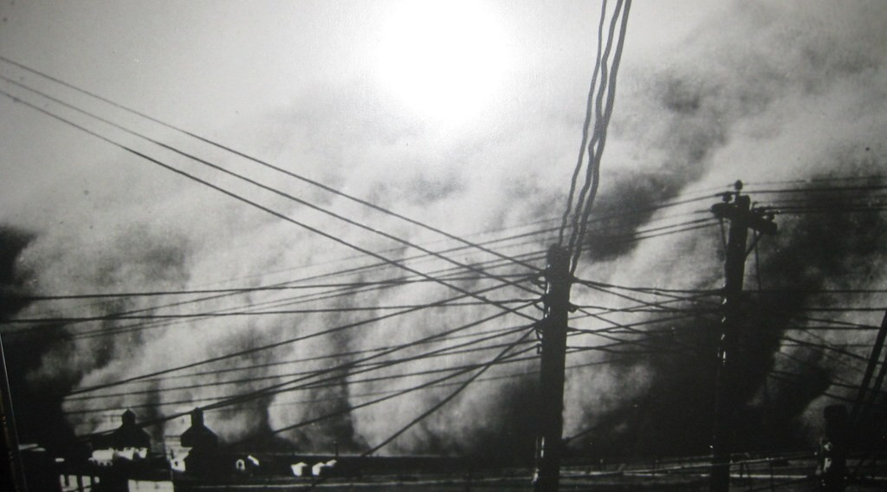
ECO. GEOGRAPHY — FORM 2 TECH
I. PROBLEMS FACED
Activity 2
A dust storm on a farm in the USA in the 1930s.
2026 / 2027
DGCAST GAROUA — GEOGRAPHY DEPARTMENT
Mr KAMDEM E. | 17
Notes:
Without the projector: compare with a very strong Harmattan.

Slide 18
ECO. GEOGRAPHY — FORM 2 TECH
I. PROBLEMS FACED
Activity 2: Question
The wind blew away the dry soil of the farms. What was this disaster called?
2026 / 2027
DGCAST GAROUA — GEOGRAPHY DEPARTMENT
Mr KAMDEM E. | 18

Slide 19
ECO. GEOGRAPHY — FORM 2 TECH
I. PROBLEMS FACED
Answer
The Dust Bowl.
2026 / 2027
DGCAST GAROUA — GEOGRAPHY DEPARTMENT
Mr KAMDEM E. | 19

Slide 20
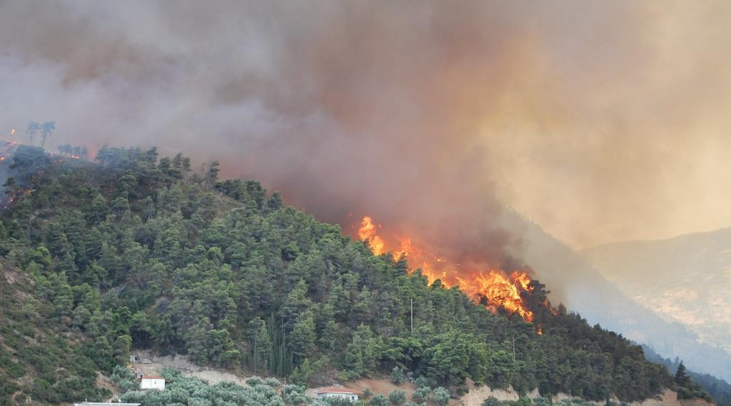
ECO. GEOGRAPHY — FORM 2 TECH
I. PROBLEMS FACED
Activity 3
A forest fire in Greece in summer.
2026 / 2027
DGCAST GAROUA — GEOGRAPHY DEPARTMENT
Mr KAMDEM E. | 20
Notes:
Without the projector: compare with bush fires in the savanna.

Slide 21
ECO. GEOGRAPHY — FORM 2 TECH
I. PROBLEMS FACED
Activity 3: Question
Why are there forest fires around the Mediterranean in summer?
2026 / 2027
DGCAST GAROUA — GEOGRAPHY DEPARTMENT
Mr KAMDEM E. | 21

Slide 22
ECO. GEOGRAPHY — FORM 2 TECH
I. PROBLEMS FACED
Answer
The summer is hot and dry, so plants burn easily.
2026 / 2027
DGCAST GAROUA — GEOGRAPHY DEPARTMENT
Mr KAMDEM E. | 22

Slide 23
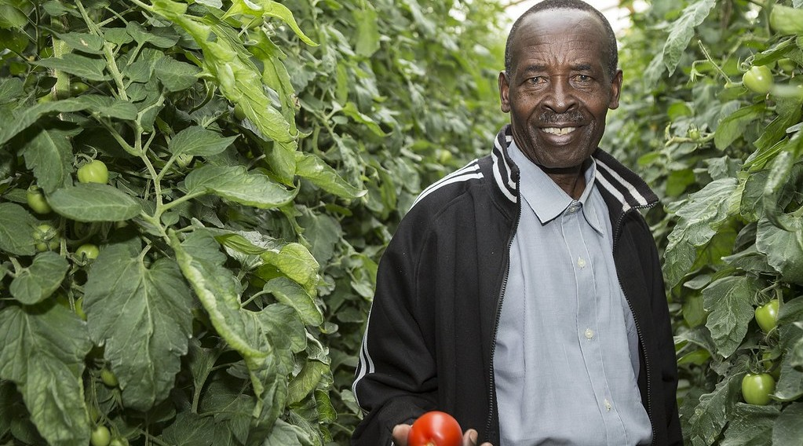
ECO. GEOGRAPHY — FORM 2 TECH
II. ADAPTATIONS
Activity 4
Vegetables grow inside a glass house.
2026 / 2027
DGCAST GAROUA — GEOGRAPHY DEPARTMENT
Mr KAMDEM E. | 23
Notes:
Without the projector: explain: a house of glass that keeps the heat of the sun.

Slide 24
ECO. GEOGRAPHY — FORM 2 TECH
II. ADAPTATIONS
Activity 4: Question
How can farmers grow vegetables when it is too cold outside?
2026 / 2027
DGCAST GAROUA — GEOGRAPHY DEPARTMENT
Mr KAMDEM E. | 24

Slide 25
ECO. GEOGRAPHY — FORM 2 TECH
II. ADAPTATIONS
Answer
They grow them in greenhouses, where it is warm.
2026 / 2027
DGCAST GAROUA — GEOGRAPHY DEPARTMENT
Mr KAMDEM E. | 25

Slide 26
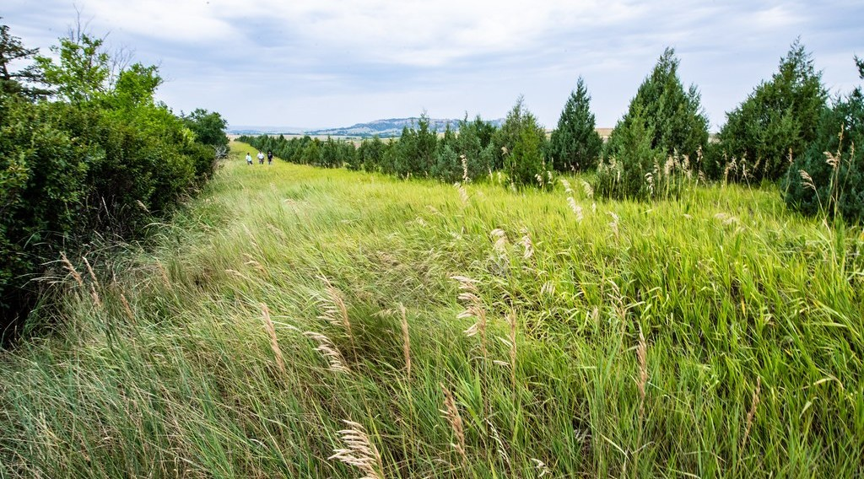
ECO. GEOGRAPHY — FORM 2 TECH
II. ADAPTATIONS
Activity 5
Lines of trees around fields.
2026 / 2027
DGCAST GAROUA — GEOGRAPHY DEPARTMENT
Mr KAMDEM E. | 26
Notes:
Without the projector: compare with trees planted against the Harmattan.

Slide 27
ECO. GEOGRAPHY — FORM 2 TECH
II. ADAPTATIONS
Activity 5: Question
Why do farmers plant lines of trees around their fields?
2026 / 2027
DGCAST GAROUA — GEOGRAPHY DEPARTMENT
Mr KAMDEM E. | 27

Slide 28
ECO. GEOGRAPHY — FORM 2 TECH
II. ADAPTATIONS
Answer
The trees stop the wind, so the soil is not blown away.
2026 / 2027
DGCAST GAROUA — GEOGRAPHY DEPARTMENT
Mr KAMDEM E. | 28

Slide 29
ECO. GEOGRAPHY — FORM 2 TECH
BOARD SUMMARY
The Temperate Region
Topic: Man in His Environment
Sub-topic: Natural Regions
Lesson 4: The Temperate Region — Part 4: Problems Faced and Adaptations
2026 / 2027
DGCAST GAROUA — GEOGRAPHY DEPARTMENT
Mr KAMDEM E. | 29
Notes:
Learners copy the board summary now. Give them enough time for each slide.

Slide 30
ECO. GEOGRAPHY — FORM 2 TECH
BOARD SUMMARY
I. Definitions
Greenhouse: It is a glass house where plants grow in the warmth.
Shelterbelt: It is a line of trees that stops the wind.
Frost: It is ice that forms when it is very cold.
2026 / 2027
DGCAST GAROUA — GEOGRAPHY DEPARTMENT
Mr KAMDEM E. | 30

Slide 31
ECO. GEOGRAPHY — FORM 2 TECH
BOARD SUMMARY
II. Problems Faced
A. Cold winters: Snow blocks roads and freezes pipes.
B. Short growing season: Crops grow only in summer.
C. Soil erosion: The wind blows away dry soil.
D. Forest fires: They burn Mediterranean forests.
E. Pollution: Fertilisers pollute rivers.
2026 / 2027
DGCAST GAROUA — GEOGRAPHY DEPARTMENT
Mr KAMDEM E. | 31

Slide 32
ECO. GEOGRAPHY — FORM 2 TECH
BOARD SUMMARY
III. Adaptations
A. Houses and clothes: Heating, thick walls and coats.
B. Transport: Machines clear the snow.
C. Farming: Greenhouses and stored hay.
D. Soil protection: Shelterbelts stop the wind.
2026 / 2027
DGCAST GAROUA — GEOGRAPHY DEPARTMENT
Mr KAMDEM E. | 32

Slide 33
ECO. GEOGRAPHY — FORM 2 TECH
FORMATIVE EVALUATION
Formative Evaluation 1
Give two problems of the temperate region.
2026 / 2027
DGCAST GAROUA — GEOGRAPHY DEPARTMENT
Mr KAMDEM E. | 33

Slide 34
ECO. GEOGRAPHY — FORM 2 TECH
FORMATIVE EVALUATION
Expected Answer
Cold winters with snow; soil erosion by wind.
2026 / 2027
DGCAST GAROUA — GEOGRAPHY DEPARTMENT
Mr KAMDEM E. | 34

Slide 35
ECO. GEOGRAPHY — FORM 2 TECH
FORMATIVE EVALUATION
Formative Evaluation 2
How can farmers grow vegetables in winter?
2026 / 2027
DGCAST GAROUA — GEOGRAPHY DEPARTMENT
Mr KAMDEM E. | 35

Slide 36
ECO. GEOGRAPHY — FORM 2 TECH
FORMATIVE EVALUATION
Expected Answer
In greenhouses.
2026 / 2027
DGCAST GAROUA — GEOGRAPHY DEPARTMENT
Mr KAMDEM E. | 36

Slide 37
ECO. GEOGRAPHY — FORM 2 TECH
REMEDIATION
Remediation
Fill in the blanks:
A glass house for plants is a ______.
A line of trees that stops the wind is a ______.
The 1930s disaster in the USA was the Dust ______.
2026 / 2027
DGCAST GAROUA — GEOGRAPHY DEPARTMENT
Mr KAMDEM E. | 37
Notes:
Answers: 1. greenhouse 2. shelterbelt 3. Bowl

Slide 38
ECO. GEOGRAPHY — FORM 2 TECH
HOMEWORK
Homework
List five jobs done by people in your family or neighbourhood (for example farmer, trader, teacher, mechanic, tailor).
This prepares Lesson 5: The Sectors of the Economy.
2026 / 2027
DGCAST GAROUA — GEOGRAPHY DEPARTMENT
Mr KAMDEM E. | 38
Notes:
This homework prepares the next lesson.

Slide 39
ECO. GEOGRAPHY — FORM 2 TECH
BILINGUAL GAME
Bilingual Game (Jeu Bilingue)
English | Français
Frost | Le gel
Snow | La neige
Greenhouse | La serre
Heating | Le chauffage
Forest fire | L'incendie de forêt
Flood | L'inondation
Shelterbelt | Le brise-vent
Pollution | La pollution
2026 / 2027
DGCAST GAROUA — GEOGRAPHY DEPARTMENT
Mr KAMDEM E. | 39
Notes:
Say the English word; learners give the French word, then the reverse.

Slide 40
ECO. GEOGRAPHY — FORM 2 TECH
LOGBOOK
Official Logbook (1/2)
Module / Topic | Man in His Environment
Lesson Title | Lesson 4: The Temperate Region — Part 4: Problems Faced and Adaptations
Expected Learning Outcomes | Identify the problems faced by people in the temperate region. Describe how people adapt their houses, clothes and transport. Describe how farmers adapt to the problems of the temperate climate.
Competence | Learners are able to explain how people adapt their houses, clothes and farming to a difficult climate, and apply this idea to their own environment.
2026 / 2027
DGCAST GAROUA — GEOGRAPHY DEPARTMENT
Mr KAMDEM E. | 40

Slide 41
ECO. GEOGRAPHY — FORM 2 TECH
LOGBOOK
Official Logbook (2/2)
Matter Taught | I. Definitions: Greenhouse, Shelterbelt, Frost; II. Problems Faced: Cold winters, Short growing season, Soil erosion, Forest fires, Pollution; III. Adaptations: Houses and clothes, Transport, Farming, Soil protection.
Evaluation | Formative evaluation (3 questions) and remediation exercise.
Homework | List five jobs done by people in your family or neighbourhood (for example farmer, trader, teacher, mechanic, tailor).
Enrolment / Present / Absent | ____ / ____ / ____
Achievement | To be completed by the teacher after the lesson.
2026 / 2027
DGCAST GAROUA — GEOGRAPHY DEPARTMENT
Mr KAMDEM E. | 41

Slide 42
ECO. GEOGRAPHY — FORM 2 TECH
TEACHER'S NOTE
Teacher's Note
Timing: Set-up, recall 8 min | Situation 8 min | 5 activities 25 min | Board summary (copying) 30 min | Evaluation, remediation 10 min | Homework 4 min | Logbook 10 min | Spare 5 min
2026 / 2027
DGCAST GAROUA — GEOGRAPHY DEPARTMENT
Mr KAMDEM E. | 42

Slide 43
ECO. GEOGRAPHY — FORM 2 TECH
REFERENCES
References
Harmonised Progression Sheet, Economic Geography (5051), Form 2.
Class textbook: The major biomes of the world (temperate regions).
Photo, Activity 1: “First Snowplow of the Season” by JLS Photography - Alaska, CC BY-NC-ND 2.0, via Flickr (https://www.flickr.com/photos/50830796@N04/37613240186)
Photo, Activity 2: “Dust Bowl 1935” by MyEyeSees, CC BY-NC-ND 2.0, via Flickr (https://www.flickr.com/photos/57884042@N00/3182214903)
Photo, Activity 3: “Forest Fires in Greece” by Lotus R, CC BY-SA 2.0, via Flickr (https://www.flickr.com/photos/66012345@N00/964251167)
Photo, Activity 4: “Inside the Greenhouse” by USAID_IMAGES, CC BY-NC-ND 2.0, via Flickr (https://www.flickr.com/photos/46658241@N06/15000160655)
Photo, Activity 5: “20210723-NRCS-LSC-0128” by USDAgov, Public domain 1.0, via Flickr (https://www.flickr.com/photos/41284017@N08/51526578960)
Diagrams and animations: drawn for this lesson (DGCAST Geography Department).
2026 / 2027
DGCAST GAROUA — GEOGRAPHY DEPARTMENT
Mr KAMDEM E. | 43

