Slide 1

DIVINE GRACE COLLEGE OF ARTS, SCIENCE AND TECHNOLOGY
(DGCAST) — GAROUA | GEOGRAPHY DEPARTMENT
FORM 2 TECHNICAL — LESSON 5 (PART 2)
The Sectors of the Economy: Formal and Informal Sectors of the Economy
Mr KAMDEM EMMANUEL
Geography Teacher — PLEG
Academic Year 2026 / 2027
Notes:
Good morning, class. Today we study The Sectors of the Economy, part 2: Formal and Informal Sectors of the Economy.

Slide 2
ECO. GEOGRAPHY — FORM 2 TECH
CLASS INFO
Class, Chapter & Duration
Class | Form 2 Technical
Chapter | Economic Geography — Sectors of the Economy
Duration | 2 periods (2 × 50 minutes)
2026 / 2027
DGCAST GAROUA — GEOGRAPHY DEPARTMENT
Mr KAMDEM E. | 2

Slide 3
ECO. GEOGRAPHY — FORM 2 TECH
IDENTIFICATION
Lesson Identification
Topic | Economic Activities
Sub-topic | Sectors of the Economy
Lesson | Lesson 5: The Sectors of the Economy — Part 2: Formal and Informal Sectors of the Economy
Notions / Concepts | Formal sector, informal sector, taxes, social security (CNPS), registration.
Syllabus focus | The formal and informal sectors of the economy: definitions, characteristics, advantages and problems.
Competence | Learners are able to tell whether a job around them belongs to the formal or informal sector and explain the advantages of registering a business.
2026 / 2027
DGCAST GAROUA — GEOGRAPHY DEPARTMENT
Mr KAMDEM E. | 3

Slide 4
ECO. GEOGRAPHY — FORM 2 TECH
OBJECTIVES
Learning Objectives
By the end of the lesson, the learner should be able to:
Define the formal and informal sectors.
Give the characteristics of each sector with examples from Cameroon.
Give the advantages and problems of the informal sector.
2026 / 2027
DGCAST GAROUA — GEOGRAPHY DEPARTMENT
Mr KAMDEM E. | 4

Slide 5
ECO. GEOGRAPHY — FORM 2 TECH
RECALL
Recall
The economy has four sectors: primary, secondary, tertiary and quaternary.
The primary sector extracts, the secondary transforms, the tertiary serves and the quaternary researches.
2026 / 2027
DGCAST GAROUA — GEOGRAPHY DEPARTMENT
Mr KAMDEM E. | 5
Notes:
Check the homework: difference between a company worker and a street worker.

Slide 6
ECO. GEOGRAPHY — FORM 2 TECH
REAL-LIFE SITUATION
Real-Life Situation
Mr Bello works in a bank in Garoua. He has a contract, a salary every month and a pension later. His neighbour Moussa is a moto-taxi driver. He has no contract, and his money changes every day.
2026 / 2027
DGCAST GAROUA — GEOGRAPHY DEPARTMENT
Mr KAMDEM E. | 6
Notes:
Read the situation slowly, twice.

Slide 7
ECO. GEOGRAPHY — FORM 2 TECH
REAL-LIFE SITUATION
Situation — Question 1
What is the problem in the situation?
2026 / 2027
DGCAST GAROUA — GEOGRAPHY DEPARTMENT
Mr KAMDEM E. | 7

Slide 8
ECO. GEOGRAPHY — FORM 2 TECH
REAL-LIFE SITUATION
Answer
Moussa has no contract and no regular money.
2026 / 2027
DGCAST GAROUA — GEOGRAPHY DEPARTMENT
Mr KAMDEM E. | 8

Slide 9
ECO. GEOGRAPHY — FORM 2 TECH
REAL-LIFE SITUATION
Situation — Question 2
What does Mr Bello have that Moussa does not have?
2026 / 2027
DGCAST GAROUA — GEOGRAPHY DEPARTMENT
Mr KAMDEM E. | 9

Slide 10
ECO. GEOGRAPHY — FORM 2 TECH
REAL-LIFE SITUATION
Answer
A contract, a monthly salary and a pension.
2026 / 2027
DGCAST GAROUA — GEOGRAPHY DEPARTMENT
Mr KAMDEM E. | 10

Slide 11
ECO. GEOGRAPHY — FORM 2 TECH
REAL-LIFE SITUATION
Situation — Question 3
What can Moussa do?
2026 / 2027
DGCAST GAROUA — GEOGRAPHY DEPARTMENT
Mr KAMDEM E. | 11

Slide 12
ECO. GEOGRAPHY — FORM 2 TECH
REAL-LIFE SITUATION
Possible Answer
Register his work and join the CNPS.
2026 / 2027
DGCAST GAROUA — GEOGRAPHY DEPARTMENT
Mr KAMDEM E. | 12

Slide 13
ECO. GEOGRAPHY — FORM 2 TECH
JUSTIFICATION
Justification of the Lesson
This lesson helps us to know the difference between the formal and the informal sector.
2026 / 2027
DGCAST GAROUA — GEOGRAPHY DEPARTMENT
Mr KAMDEM E. | 13

Slide 14
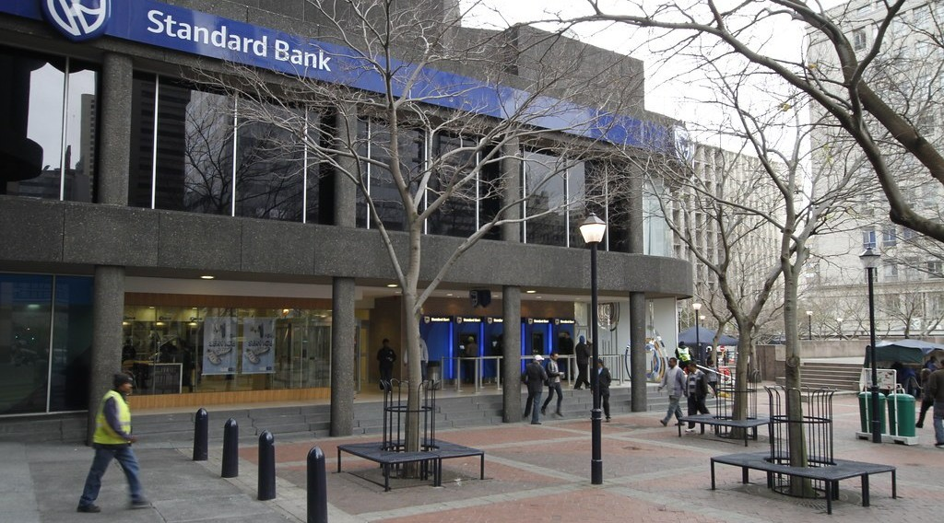
ECO. GEOGRAPHY — FORM 2 TECH
I. THE FORMAL SECTOR
Activity 1
A bank in an African city.
2026 / 2027
DGCAST GAROUA — GEOGRAPHY DEPARTMENT
Mr KAMDEM E. | 14
Notes:
Without the projector: ask learners to name a bank or company in Garoua.

Slide 15
ECO. GEOGRAPHY — FORM 2 TECH
I. THE FORMAL SECTOR
Activity 1: Question
The bank is registered and pays taxes. Which sector does it belong to?
2026 / 2027
DGCAST GAROUA — GEOGRAPHY DEPARTMENT
Mr KAMDEM E. | 15

Slide 16
ECO. GEOGRAPHY — FORM 2 TECH
I. THE FORMAL SECTOR
Answer
The formal sector.
2026 / 2027
DGCAST GAROUA — GEOGRAPHY DEPARTMENT
Mr KAMDEM E. | 16

Slide 17

ECO. GEOGRAPHY — FORM 2 TECH
I. THE FORMAL SECTOR
Activity 2
Workers in a food factory.
2026 / 2027
DGCAST GAROUA — GEOGRAPHY DEPARTMENT
Mr KAMDEM E. | 17
Notes:
Without the projector: ask learners who works for SODECOTON, a school or a hospital.

Slide 18
ECO. GEOGRAPHY — FORM 2 TECH
I. THE FORMAL SECTOR
Activity 2: Question
These workers have contracts and a salary. Give one advantage.
2026 / 2027
DGCAST GAROUA — GEOGRAPHY DEPARTMENT
Mr KAMDEM E. | 18

Slide 19
ECO. GEOGRAPHY — FORM 2 TECH
I. THE FORMAL SECTOR
Answer
They are paid every month and get a pension.
2026 / 2027
DGCAST GAROUA — GEOGRAPHY DEPARTMENT
Mr KAMDEM E. | 19

Slide 20

ECO. GEOGRAPHY — FORM 2 TECH
II. THE INFORMAL SECTOR
Activity 3
Moto-taxis in a Cameroonian town.
2026 / 2027
DGCAST GAROUA — GEOGRAPHY DEPARTMENT
Mr KAMDEM E. | 20
Notes:
Without the projector: use the situation of Moussa.

Slide 21
ECO. GEOGRAPHY — FORM 2 TECH
II. THE INFORMAL SECTOR
Activity 3: Question
Is the moto-taxi driver registered? Which sector is this?
2026 / 2027
DGCAST GAROUA — GEOGRAPHY DEPARTMENT
Mr KAMDEM E. | 21

Slide 22
ECO. GEOGRAPHY — FORM 2 TECH
II. THE INFORMAL SECTOR
Answer
Usually not. It is the informal sector.
2026 / 2027
DGCAST GAROUA — GEOGRAPHY DEPARTMENT
Mr KAMDEM E. | 22

Slide 23

ECO. GEOGRAPHY — FORM 2 TECH
II. THE INFORMAL SECTOR
Activity 4
A woman sells roasted maize in the street.
2026 / 2027
DGCAST GAROUA — GEOGRAPHY DEPARTMENT
Mr KAMDEM E. | 23
Notes:
Without the projector: ask learners about small traders in their area.

Slide 24
ECO. GEOGRAPHY — FORM 2 TECH
II. THE INFORMAL SECTOR
Activity 4: Question
Why do many young people work in the informal sector?
2026 / 2027
DGCAST GAROUA — GEOGRAPHY DEPARTMENT
Mr KAMDEM E. | 24

Slide 25
ECO. GEOGRAPHY — FORM 2 TECH
II. THE INFORMAL SECTOR
Answer
It is easy to start and needs little money.
2026 / 2027
DGCAST GAROUA — GEOGRAPHY DEPARTMENT
Mr KAMDEM E. | 25

Slide 26
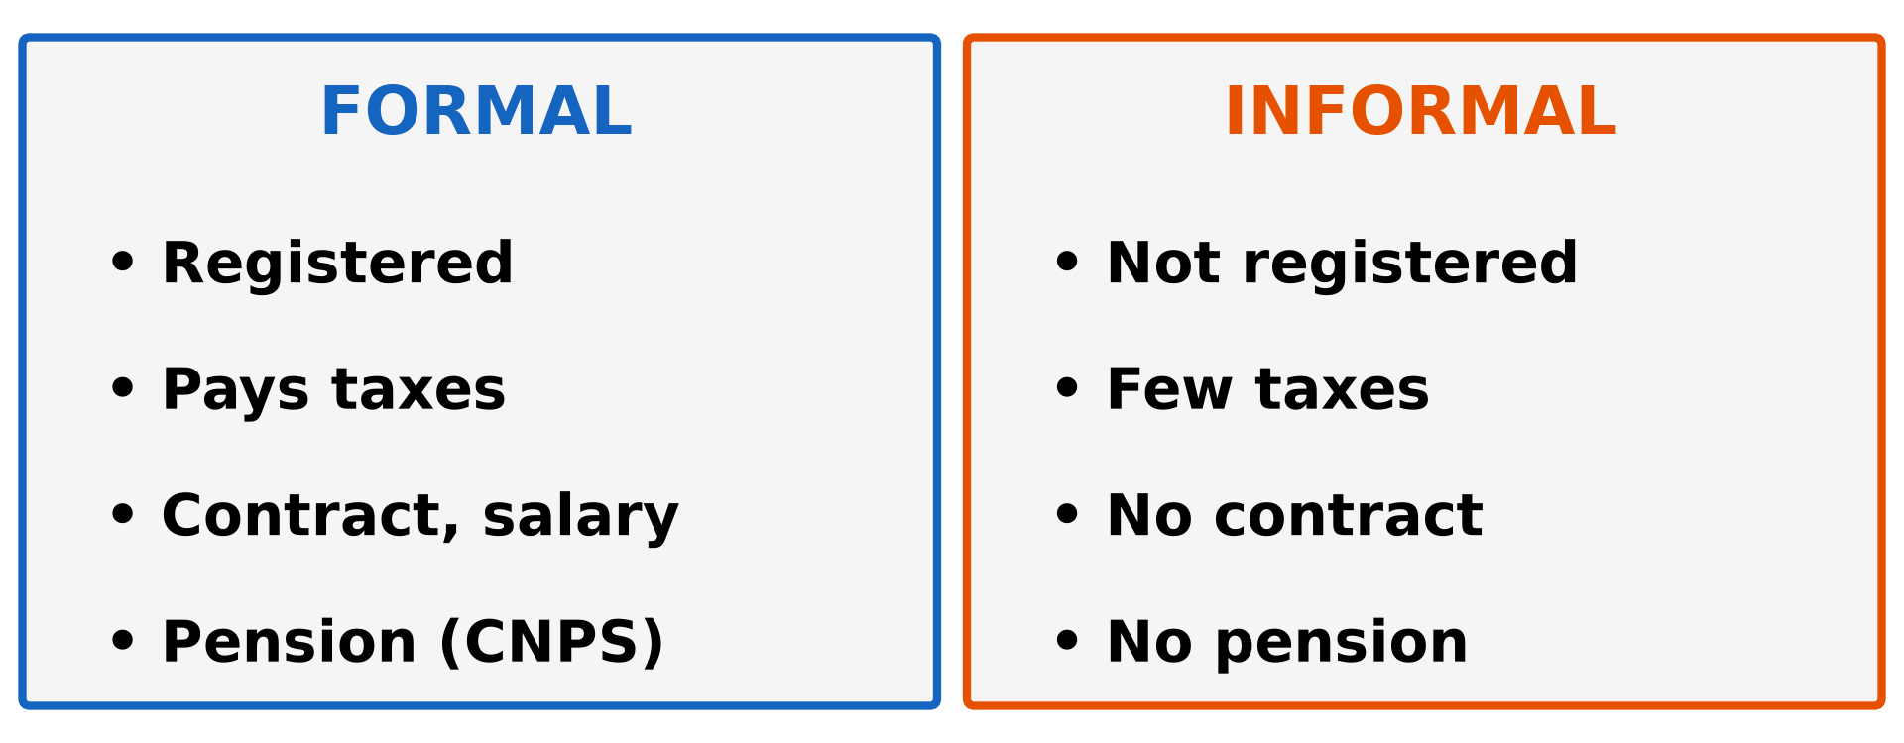
ECO. GEOGRAPHY — FORM 2 TECH
III. COMPARISON
Activity 5
Formal and informal sectors.
2026 / 2027
DGCAST GAROUA — GEOGRAPHY DEPARTMENT
Mr KAMDEM E. | 26
Notes:
Without the projector: draw the two columns on the board.

Slide 27
ECO. GEOGRAPHY — FORM 2 TECH
III. COMPARISON
Activity 5: Question
Give two problems of working in the informal sector.
2026 / 2027
DGCAST GAROUA — GEOGRAPHY DEPARTMENT
Mr KAMDEM E. | 27

Slide 28
ECO. GEOGRAPHY — FORM 2 TECH
III. COMPARISON
Answer
No contract and no pension. The money is not regular.
2026 / 2027
DGCAST GAROUA — GEOGRAPHY DEPARTMENT
Mr KAMDEM E. | 28

Slide 29
ECO. GEOGRAPHY — FORM 2 TECH
BOARD SUMMARY
The Sectors of the Economy
Topic: Economic Activities
Sub-topic: Sectors of the Economy
Lesson 5: The Sectors of the Economy — Part 2: Formal and Informal Sectors of the Economy
2026 / 2027
DGCAST GAROUA — GEOGRAPHY DEPARTMENT
Mr KAMDEM E. | 29
Notes:
Learners copy the board summary now. Give them enough time for each slide.

Slide 30
ECO. GEOGRAPHY — FORM 2 TECH
BOARD SUMMARY
I. Definitions
Formal sector: It is work that is registered and pays taxes.
Informal sector: It is small work that is not registered.
Pension: It is money paid to a worker after he stops working.
2026 / 2027
DGCAST GAROUA — GEOGRAPHY DEPARTMENT
Mr KAMDEM E. | 30

Slide 31
ECO. GEOGRAPHY — FORM 2 TECH
BOARD SUMMARY
II. The Formal Sector
A. Registration: Companies pay taxes.
B. Contracts: Workers get a monthly salary.
C. Protection: Workers join the CNPS.
D. Examples: SODECOTON, banks, schools and hospitals.
2026 / 2027
DGCAST GAROUA — GEOGRAPHY DEPARTMENT
Mr KAMDEM E. | 31

Slide 32
ECO. GEOGRAPHY — FORM 2 TECH
BOARD SUMMARY
III. The Informal Sector (1/2)
A. Examples: Moto-taxis, street sellers and mechanics.
B. Importance: It gives work to most people.
C. Problems: No contract and no pension.
D. Solutions: Register the work and join the CNPS.
2026 / 2027
DGCAST GAROUA — GEOGRAPHY DEPARTMENT
Mr KAMDEM E. | 32

Slide 33
ECO. GEOGRAPHY — FORM 2 TECH
BOARD SUMMARY
III. The Informal Sector (2/2)
Copy the table.
2026 / 2027
DGCAST GAROUA — GEOGRAPHY DEPARTMENT
Mr KAMDEM E. | 33

Slide 34
ECO. GEOGRAPHY — FORM 2 TECH
FORMATIVE EVALUATION
Formative Evaluation 1
What is the informal sector?
2026 / 2027
DGCAST GAROUA — GEOGRAPHY DEPARTMENT
Mr KAMDEM E. | 34

Slide 35
ECO. GEOGRAPHY — FORM 2 TECH
FORMATIVE EVALUATION
Expected Answer
Small work that is not registered with the state.
2026 / 2027
DGCAST GAROUA — GEOGRAPHY DEPARTMENT
Mr KAMDEM E. | 35

Slide 36
ECO. GEOGRAPHY — FORM 2 TECH
FORMATIVE EVALUATION
Formative Evaluation 2
Give one problem of informal workers.
2026 / 2027
DGCAST GAROUA — GEOGRAPHY DEPARTMENT
Mr KAMDEM E. | 36

Slide 37
ECO. GEOGRAPHY — FORM 2 TECH
FORMATIVE EVALUATION
Expected Answer
They have no pension (or no contract).
2026 / 2027
DGCAST GAROUA — GEOGRAPHY DEPARTMENT
Mr KAMDEM E. | 37

Slide 38
ECO. GEOGRAPHY — FORM 2 TECH
REMEDIATION
Remediation
Fill in the blanks:
Work that is registered and pays taxes is the ______ sector.
A moto-taxi driver usually works in the ______ sector.
Money paid after a worker stops working is a ______.
2026 / 2027
DGCAST GAROUA — GEOGRAPHY DEPARTMENT
Mr KAMDEM E. | 38
Notes:
Answers: 1. formal 2. informal 3. pension

Slide 39
ECO. GEOGRAPHY — FORM 2 TECH
HOMEWORK
Homework
List four products of farming, fishing, forestry or mining found in the Garoua market, and say where each comes from.
This prepares Part 3: The Primary Sector.
2026 / 2027
DGCAST GAROUA — GEOGRAPHY DEPARTMENT
Mr KAMDEM E. | 39
Notes:
This homework prepares the next lesson.

Slide 40
ECO. GEOGRAPHY — FORM 2 TECH
BILINGUAL GAME
Bilingual Game (Jeu Bilingue)
English | Français
Formal sector | Le secteur formel
Informal sector | Le secteur informel
Tax | L'impôt
Salary | Le salaire
Contract | Le contrat
Pension | La retraite (pension)
Street seller | Le vendeur ambulant
Registration | L'immatriculation
2026 / 2027
DGCAST GAROUA — GEOGRAPHY DEPARTMENT
Mr KAMDEM E. | 40
Notes:
Say the English word; learners give the French word, then the reverse.

Slide 41
ECO. GEOGRAPHY — FORM 2 TECH
LOGBOOK
Official Logbook (1/2)
Module / Topic | Economic Activities
Lesson Title | Lesson 5: The Sectors of the Economy — Part 2: Formal and Informal Sectors of the Economy
Expected Learning Outcomes | Define the formal and informal sectors. Give the characteristics of each sector with examples from Cameroon. Give the advantages and problems of the informal sector.
Competence | Learners are able to tell whether a job around them belongs to the formal or informal sector and explain the advantages of registering a business.
2026 / 2027
DGCAST GAROUA — GEOGRAPHY DEPARTMENT
Mr KAMDEM E. | 41

Slide 42
ECO. GEOGRAPHY — FORM 2 TECH
LOGBOOK
Official Logbook (2/2)
Matter Taught | I. Definitions: Formal sector, Informal sector, Pension; II. The Formal Sector: Registration, Contracts, Protection, Examples; III. The Informal Sector: Examples, Importance, Problems, Solutions.
Evaluation | Formative evaluation (3 questions) and remediation exercise.
Homework | List four products of farming, fishing, forestry or mining found in the Garoua market, and say where each comes from.
Enrolment / Present / Absent | ____ / ____ / ____
Achievement | To be completed by the teacher after the lesson.
2026 / 2027
DGCAST GAROUA — GEOGRAPHY DEPARTMENT
Mr KAMDEM E. | 42

Slide 43
ECO. GEOGRAPHY — FORM 2 TECH
TEACHER'S NOTE
Teacher's Note
Timing: Set-up, recall 8 min | Situation 8 min | 5 activities 25 min | Board summary (copying) 30 min | Evaluation, remediation 10 min | Homework 4 min | Logbook 10 min | Spare 5 min
CNPS: Caisse Nationale de Prévoyance Sociale (national social insurance fund). About 9 workers out of 10 in Cameroon work in the informal sector.
2026 / 2027
DGCAST GAROUA — GEOGRAPHY DEPARTMENT
Mr KAMDEM E. | 43

Slide 44
ECO. GEOGRAPHY — FORM 2 TECH
REFERENCES
References
Harmonised Progression Sheet, Economic Geography (5051), Form 2.
Institut National de la Statistique (INS), Enquêtes sur l'Emploi et le Secteur Informel (EESI).
Photo, Activity 1: “Thibault Square, Cape Town” by World Bank Photo Collection, CC BY-NC-ND 2.0, via Flickr (https://www.flickr.com/photos/10816734@N03/7825576852)
Photo, Activity 2: “Photo by USAID East Africa” by U.S. Agency for International Development, CC0 1.0, via rawpixel (https://www.rawpixel.com/image/4051097/image-public-domain-person-building)
Photo, Activity 3: “Cameroon - UN Women's Gender Road Project” by UN Women Gallery, CC BY-NC-ND 2.0, via Flickr (https://www.flickr.com/photos/51431730@N04/47586053052)
Photo, Activity 4: “Roadside vendor roasts maize cobs for sale in Timau” by CIMMYT, CC BY-NC 2.0, via Flickr (https://www.flickr.com/photos/44760652@N05/25375356457)
Diagrams and animations: drawn for this lesson (DGCAST Geography Department).
2026 / 2027
DGCAST GAROUA — GEOGRAPHY DEPARTMENT
Mr KAMDEM E. | 44

