Slide 1

DIVINE GRACE COLLEGE OF ARTS, SCIENCE AND TECHNOLOGY
(DGCAST) — GAROUA | GEOGRAPHY DEPARTMENT
FORM 2 TECHNICAL — LESSON 5 (PART 3)
The Sectors of the Economy: The Primary Sector (Definition and Examples)
Mr KAMDEM EMMANUEL
Geography Teacher — PLEG
Academic Year 2026 / 2027
Notes:
Good morning, class. Today we study The Sectors of the Economy, part 3: The Primary Sector (Definition and Examples).

Slide 2
ECO. GEOGRAPHY — FORM 2 TECH
CLASS INFO
Class, Chapter & Duration
Class | Form 2 Technical
Chapter | Economic Geography — Sectors of the Economy
Duration | 2 periods (2 × 50 minutes)
2026 / 2027
DGCAST GAROUA — GEOGRAPHY DEPARTMENT
Mr KAMDEM E. | 2

Slide 3
ECO. GEOGRAPHY — FORM 2 TECH
IDENTIFICATION
Lesson Identification
Topic | Economic Activities
Sub-topic | Sectors of the Economy
Lesson | Lesson 5: The Sectors of the Economy — Part 3: The Primary Sector (Definition and Examples)
Notions / Concepts | Primary sector, agriculture, livestock rearing, fishing, forestry, mining.
Syllabus focus | Definition and examples of the primary sector, with examples from Cameroon.
Competence | Learners are able to identify primary activities around them and explain their importance for food and exports.
2026 / 2027
DGCAST GAROUA — GEOGRAPHY DEPARTMENT
Mr KAMDEM E. | 3

Slide 4
ECO. GEOGRAPHY — FORM 2 TECH
OBJECTIVES
Learning Objectives
By the end of the lesson, the learner should be able to:
Define the primary sector.
Name the main primary activities.
Give examples of primary activities in Cameroon and explain their importance.
2026 / 2027
DGCAST GAROUA — GEOGRAPHY DEPARTMENT
Mr KAMDEM E. | 4

Slide 5
ECO. GEOGRAPHY — FORM 2 TECH
RECALL
Recall
The formal sector is registered and pays taxes; the informal sector is not registered.
Both sectors exist in primary, secondary and tertiary activities.
2026 / 2027
DGCAST GAROUA — GEOGRAPHY DEPARTMENT
Mr KAMDEM E. | 5
Notes:
Check the homework: primary products found in the Garoua market.

Slide 6
ECO. GEOGRAPHY — FORM 2 TECH
REAL-LIFE SITUATION
Real-Life Situation
In the Garoua market, Rahila sees maize from Pitoa, fish from the Lagdo lake, beef from the Adamawa and firewood from the bush. Her mother says, "All these come from nature."
2026 / 2027
DGCAST GAROUA — GEOGRAPHY DEPARTMENT
Mr KAMDEM E. | 6
Notes:
Read the situation slowly, twice.

Slide 7
ECO. GEOGRAPHY — FORM 2 TECH
REAL-LIFE SITUATION
Situation — Question 1
What is the problem in the situation?
2026 / 2027
DGCAST GAROUA — GEOGRAPHY DEPARTMENT
Mr KAMDEM E. | 7

Slide 8
ECO. GEOGRAPHY — FORM 2 TECH
REAL-LIFE SITUATION
Answer
Rahila wants to know how these products are grouped.
2026 / 2027
DGCAST GAROUA — GEOGRAPHY DEPARTMENT
Mr KAMDEM E. | 8

Slide 9
ECO. GEOGRAPHY — FORM 2 TECH
REAL-LIFE SITUATION
Situation — Question 2
Where does each product come from?
2026 / 2027
DGCAST GAROUA — GEOGRAPHY DEPARTMENT
Mr KAMDEM E. | 9

Slide 10
ECO. GEOGRAPHY — FORM 2 TECH
REAL-LIFE SITUATION
Answer
Maize from Pitoa, fish from Lagdo, beef from Adamawa, wood from the bush.
2026 / 2027
DGCAST GAROUA — GEOGRAPHY DEPARTMENT
Mr KAMDEM E. | 10

Slide 11
ECO. GEOGRAPHY — FORM 2 TECH
REAL-LIFE SITUATION
Situation — Question 3
What do they have in common?
2026 / 2027
DGCAST GAROUA — GEOGRAPHY DEPARTMENT
Mr KAMDEM E. | 11

Slide 12
ECO. GEOGRAPHY — FORM 2 TECH
REAL-LIFE SITUATION
Possible Answer
They are all taken from nature.
2026 / 2027
DGCAST GAROUA — GEOGRAPHY DEPARTMENT
Mr KAMDEM E. | 12

Slide 13
ECO. GEOGRAPHY — FORM 2 TECH
JUSTIFICATION
Justification of the Lesson
This lesson helps us to know the jobs that take products from nature.
2026 / 2027
DGCAST GAROUA — GEOGRAPHY DEPARTMENT
Mr KAMDEM E. | 13

Slide 14
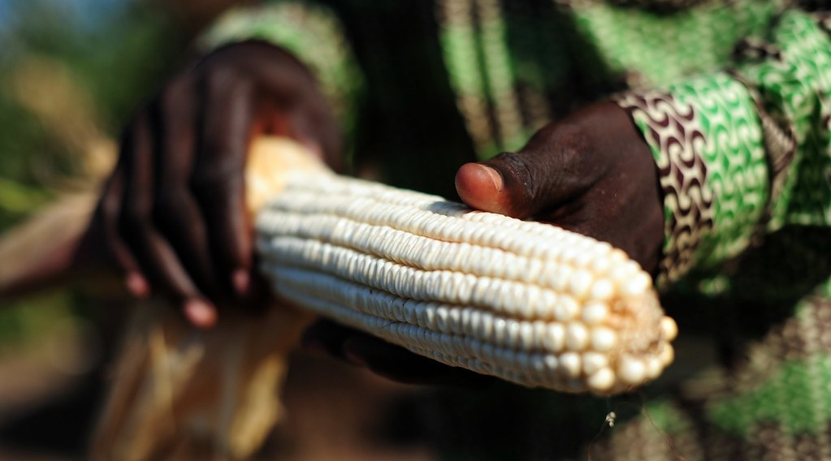
ECO. GEOGRAPHY — FORM 2 TECH
I. AGRICULTURE
Activity 1
A farmer holds a cob of maize.
2026 / 2027
DGCAST GAROUA — GEOGRAPHY DEPARTMENT
Mr KAMDEM E. | 14
Notes:
Without the projector: ask learners which crops their family grows.

Slide 15
ECO. GEOGRAPHY — FORM 2 TECH
I. AGRICULTURE
Activity 1: Question
The farmer takes food from nature. Which sector is this?
2026 / 2027
DGCAST GAROUA — GEOGRAPHY DEPARTMENT
Mr KAMDEM E. | 15

Slide 16
ECO. GEOGRAPHY — FORM 2 TECH
I. AGRICULTURE
Answer
The primary sector.
2026 / 2027
DGCAST GAROUA — GEOGRAPHY DEPARTMENT
Mr KAMDEM E. | 16

Slide 17

ECO. GEOGRAPHY — FORM 2 TECH
II. LIVESTOCK REARING
Activity 2
A cattle market.
2026 / 2027
DGCAST GAROUA — GEOGRAPHY DEPARTMENT
Mr KAMDEM E. | 17
Notes:
Without the projector: ask learners where cattle are sold in Garoua.

Slide 18
ECO. GEOGRAPHY — FORM 2 TECH
II. LIVESTOCK REARING
Activity 2: Question
Where do most cattle of Cameroon come from?
2026 / 2027
DGCAST GAROUA — GEOGRAPHY DEPARTMENT
Mr KAMDEM E. | 18

Slide 19
ECO. GEOGRAPHY — FORM 2 TECH
II. LIVESTOCK REARING
Answer
From the North and the Adamawa plateau.
2026 / 2027
DGCAST GAROUA — GEOGRAPHY DEPARTMENT
Mr KAMDEM E. | 19

Slide 20

ECO. GEOGRAPHY — FORM 2 TECH
III. FISHING
Activity 3
Fresh fish for sale.
2026 / 2027
DGCAST GAROUA — GEOGRAPHY DEPARTMENT
Mr KAMDEM E. | 20
Notes:
Without the projector: ask learners where the fish of the Garoua market comes from.

Slide 21
ECO. GEOGRAPHY — FORM 2 TECH
III. FISHING
Activity 3: Question
Name two places where people fish in Cameroon.
2026 / 2027
DGCAST GAROUA — GEOGRAPHY DEPARTMENT
Mr KAMDEM E. | 21

Slide 22
ECO. GEOGRAPHY — FORM 2 TECH
III. FISHING
Answer
The Lagdo lake and the sea at Kribi (also Limbe, Douala).
2026 / 2027
DGCAST GAROUA — GEOGRAPHY DEPARTMENT
Mr KAMDEM E. | 22

Slide 23

ECO. GEOGRAPHY — FORM 2 TECH
IV. FORESTRY
Activity 4
Logs from the forest of East Cameroon.
2026 / 2027
DGCAST GAROUA — GEOGRAPHY DEPARTMENT
Mr KAMDEM E. | 23
Notes:
Without the projector: ask learners what wood is used for.

Slide 24
ECO. GEOGRAPHY — FORM 2 TECH
IV. FORESTRY
Activity 4: Question
Which primary product comes from the forest?
2026 / 2027
DGCAST GAROUA — GEOGRAPHY DEPARTMENT
Mr KAMDEM E. | 24

Slide 25
ECO. GEOGRAPHY — FORM 2 TECH
IV. FORESTRY
Answer
Timber (wood).
2026 / 2027
DGCAST GAROUA — GEOGRAPHY DEPARTMENT
Mr KAMDEM E. | 25

Slide 26
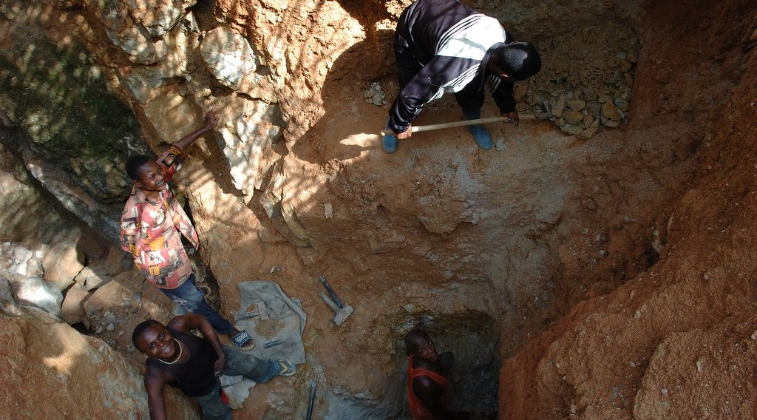
ECO. GEOGRAPHY — FORM 2 TECH
V. MINING
Activity 5
People dig for gold by hand.
2026 / 2027
DGCAST GAROUA — GEOGRAPHY DEPARTMENT
Mr KAMDEM E. | 26
Notes:
Without the projector: name minerals of Cameroon: oil, gold, bauxite, limestone.

Slide 27
ECO. GEOGRAPHY — FORM 2 TECH
V. MINING
Activity 5: Question
What are these people taking from the ground?
2026 / 2027
DGCAST GAROUA — GEOGRAPHY DEPARTMENT
Mr KAMDEM E. | 27

Slide 28
ECO. GEOGRAPHY — FORM 2 TECH
V. MINING
Answer
Gold. Taking minerals from the ground is mining.
2026 / 2027
DGCAST GAROUA — GEOGRAPHY DEPARTMENT
Mr KAMDEM E. | 28

Slide 29
ECO. GEOGRAPHY — FORM 2 TECH
BOARD SUMMARY
The Sectors of the Economy
Topic: Economic Activities
Sub-topic: Sectors of the Economy
Lesson 5: The Sectors of the Economy — Part 3: The Primary Sector (Definition and Examples)
2026 / 2027
DGCAST GAROUA — GEOGRAPHY DEPARTMENT
Mr KAMDEM E. | 29
Notes:
Learners copy the board summary now. Give them enough time for each slide.

Slide 30
ECO. GEOGRAPHY — FORM 2 TECH
BOARD SUMMARY
I. Definitions
Primary sector: It is the sector that takes products from nature.
Mining: It is taking minerals from the ground.
2026 / 2027
DGCAST GAROUA — GEOGRAPHY DEPARTMENT
Mr KAMDEM E. | 30

Slide 31
ECO. GEOGRAPHY — FORM 2 TECH
BOARD SUMMARY
II. Examples
A. Agriculture: Maize, cassava, cotton and cocoa.
B. Livestock rearing: Cattle in the North and Adamawa.
C. Fishing: Lagdo, Kribi and Limbe.
D. Forestry: Timber from the southern forests.
E. Mining: Oil, gold and limestone.
2026 / 2027
DGCAST GAROUA — GEOGRAPHY DEPARTMENT
Mr KAMDEM E. | 31

Slide 32
ECO. GEOGRAPHY — FORM 2 TECH
BOARD SUMMARY
III. Importance
A. Food: It feeds the people.
B. Jobs: It employs most people in villages.
C. Exports: Cameroon sells cocoa, cotton and timber.
2026 / 2027
DGCAST GAROUA — GEOGRAPHY DEPARTMENT
Mr KAMDEM E. | 32

Slide 33
ECO. GEOGRAPHY — FORM 2 TECH
FORMATIVE EVALUATION
Formative Evaluation 1
What is the primary sector?
2026 / 2027
DGCAST GAROUA — GEOGRAPHY DEPARTMENT
Mr KAMDEM E. | 33

Slide 34
ECO. GEOGRAPHY — FORM 2 TECH
FORMATIVE EVALUATION
Expected Answer
The sector that takes products from nature.
2026 / 2027
DGCAST GAROUA — GEOGRAPHY DEPARTMENT
Mr KAMDEM E. | 34

Slide 35
ECO. GEOGRAPHY — FORM 2 TECH
FORMATIVE EVALUATION
Formative Evaluation 2
Give three primary activities.
2026 / 2027
DGCAST GAROUA — GEOGRAPHY DEPARTMENT
Mr KAMDEM E. | 35

Slide 36
ECO. GEOGRAPHY — FORM 2 TECH
FORMATIVE EVALUATION
Expected Answer
Farming, fishing and mining (also rearing, forestry).
2026 / 2027
DGCAST GAROUA — GEOGRAPHY DEPARTMENT
Mr KAMDEM E. | 36

Slide 37
ECO. GEOGRAPHY — FORM 2 TECH
REMEDIATION
Remediation
Fill in the blanks:
Taking products from nature is the ______ sector.
Taking minerals from the ground is called ______.
Cutting trees for timber is called ______.
2026 / 2027
DGCAST GAROUA — GEOGRAPHY DEPARTMENT
Mr KAMDEM E. | 37
Notes:
Answers: 1. primary 2. mining 3. forestry (lumbering)

Slide 38
ECO. GEOGRAPHY — FORM 2 TECH
HOMEWORK
Homework
Find the names of two factories in Cameroon, and write what each one produces.
This prepares Part 4: The Secondary Sector.
2026 / 2027
DGCAST GAROUA — GEOGRAPHY DEPARTMENT
Mr KAMDEM E. | 38
Notes:
This homework prepares the next lesson.

Slide 39
ECO. GEOGRAPHY — FORM 2 TECH
BILINGUAL GAME
Bilingual Game (Jeu Bilingue)
English | Français
Agriculture | L'agriculture
Fishing | La pêche
Livestock rearing | L'élevage
Forestry | L'exploitation forestière
Mining | L'exploitation minière
Crude oil | Le pétrole brut
Timber | Le bois d'œuvre
Export | L'exportation
2026 / 2027
DGCAST GAROUA — GEOGRAPHY DEPARTMENT
Mr KAMDEM E. | 39
Notes:
Say the English word; learners give the French word, then the reverse.

Slide 40
ECO. GEOGRAPHY — FORM 2 TECH
LOGBOOK
Official Logbook (1/2)
Module / Topic | Economic Activities
Lesson Title | Lesson 5: The Sectors of the Economy — Part 3: The Primary Sector (Definition and Examples)
Expected Learning Outcomes | Define the primary sector. Name the main primary activities. Give examples of primary activities in Cameroon and explain their importance.
Competence | Learners are able to identify primary activities around them and explain their importance for food and exports.
2026 / 2027
DGCAST GAROUA — GEOGRAPHY DEPARTMENT
Mr KAMDEM E. | 40

Slide 41
ECO. GEOGRAPHY — FORM 2 TECH
LOGBOOK
Official Logbook (2/2)
Matter Taught | I. Definitions: Primary sector, Mining; II. Examples: Agriculture, Livestock rearing, Fishing, Forestry, Mining; III. Importance: Food, Jobs, Exports.
Evaluation | Formative evaluation (3 questions) and remediation exercise.
Homework | Find the names of two factories in Cameroon, and write what each one produces.
Enrolment / Present / Absent | ____ / ____ / ____
Achievement | To be completed by the teacher after the lesson.
2026 / 2027
DGCAST GAROUA — GEOGRAPHY DEPARTMENT
Mr KAMDEM E. | 41

Slide 42
ECO. GEOGRAPHY — FORM 2 TECH
TEACHER'S NOTE
Teacher's Note
Timing: Set-up, recall 8 min | Situation 8 min | 5 activities 25 min | Board summary (copying) 30 min | Evaluation, remediation 10 min | Homework 4 min | Logbook 10 min | Spare 5 min
2026 / 2027
DGCAST GAROUA — GEOGRAPHY DEPARTMENT
Mr KAMDEM E. | 42

Slide 43
ECO. GEOGRAPHY — FORM 2 TECH
REFERENCES
References
Harmonised Progression Sheet, Economic Geography (5051), Form 2.
Photo, Activity 1: “Ghana 15” by CIAT International Center for Tropical Agriculture, CC BY-NC-SA 2.0, via Flickr (https://www.flickr.com/photos/38476503@N08/5207540264)
Photo, Activity 2: “Discussing the price” by 10b travelling / Carsten ten Brink, CC BY-NC-ND 2.0, via Flickr (https://www.flickr.com/photos/77334245@N00/7313656038)
Photo, Activity 3: “Kenyan food, farming and landscapes” by CGIAR Climate, CC BY-NC-SA 2.0, via Flickr (https://www.flickr.com/photos/55227776@N04/14310899853)
Photo, Activity 4: “Logging truck, Cameroon” by World Resources, CC BY-NC-SA 2.0, via Flickr (https://www.flickr.com/photos/26107309@N05/4764354366)
Photo, Activity 5: “Mining in Kailo” by Julien Harneis, CC BY-SA 2.0, via Flickr (https://www.flickr.com/photos/16935515@N00/1872000955)
Diagrams and animations: drawn for this lesson (DGCAST Geography Department).
2026 / 2027
DGCAST GAROUA — GEOGRAPHY DEPARTMENT
Mr KAMDEM E. | 43

