Slide 1

DIVINE GRACE COLLEGE OF ARTS, SCIENCE AND TECHNOLOGY
(DGCAST) — GAROUA | GEOGRAPHY DEPARTMENT
FORM 2 TECHNICAL — LESSON 5 (PART 6)
The Sectors of the Economy: The Quaternary Sector (Definition and Examples)
Mr KAMDEM EMMANUEL
Geography Teacher — PLEG
Academic Year 2026 / 2027
Notes:
Good morning, class. Today we study The Sectors of the Economy, part 6: The Quaternary Sector (Definition and Examples).

Slide 2
ECO. GEOGRAPHY — FORM 2 TECH
CLASS INFO
Class, Chapter & Duration
Class | Form 2 Technical
Chapter | Economic Geography — Sectors of the Economy
Duration | 2 periods (2 × 50 minutes)
2026 / 2027
DGCAST GAROUA — GEOGRAPHY DEPARTMENT
Mr KAMDEM E. | 2

Slide 3
ECO. GEOGRAPHY — FORM 2 TECH
IDENTIFICATION
Lesson Identification
Topic | Economic Activities
Sub-topic | Sectors of the Economy
Lesson | Lesson 5: The Sectors of the Economy — Part 6: The Quaternary Sector (Definition and Examples)
Notions / Concepts | Quaternary sector, research, information and communication technology (ICT), knowledge economy.
Syllabus focus | Definition and examples of the quaternary sector.
Competence | Learners are able to explain how research and digital tools improve daily life and farming, and to use them responsibly.
2026 / 2027
DGCAST GAROUA — GEOGRAPHY DEPARTMENT
Mr KAMDEM E. | 3

Slide 4
ECO. GEOGRAPHY — FORM 2 TECH
OBJECTIVES
Learning Objectives
By the end of the lesson, the learner should be able to:
Define the quaternary sector.
Name the main quaternary activities.
Explain the importance of the quaternary sector for development.
2026 / 2027
DGCAST GAROUA — GEOGRAPHY DEPARTMENT
Mr KAMDEM E. | 4

Slide 5
ECO. GEOGRAPHY — FORM 2 TECH
RECALL
Recall
The tertiary sector provides services: trade, transport, banking, social services and tourism.
Services link producers to consumers.
2026 / 2027
DGCAST GAROUA — GEOGRAPHY DEPARTMENT
Mr KAMDEM E. | 5
Notes:
Check the homework: what a research centre does.

Slide 6
ECO. GEOGRAPHY — FORM 2 TECH
REAL-LIFE SITUATION
Real-Life Situation
For many years, drought destroyed the maize of farmers near Garoua. Then researchers created a new maize that grows fast and needs less water. Now the harvests are better.
2026 / 2027
DGCAST GAROUA — GEOGRAPHY DEPARTMENT
Mr KAMDEM E. | 6
Notes:
Read the situation slowly, twice.

Slide 7
ECO. GEOGRAPHY — FORM 2 TECH
REAL-LIFE SITUATION
Situation — Question 1
What was the problem in the situation?
2026 / 2027
DGCAST GAROUA — GEOGRAPHY DEPARTMENT
Mr KAMDEM E. | 7

Slide 8
ECO. GEOGRAPHY — FORM 2 TECH
REAL-LIFE SITUATION
Answer
Drought destroyed the maize.
2026 / 2027
DGCAST GAROUA — GEOGRAPHY DEPARTMENT
Mr KAMDEM E. | 8

Slide 9
ECO. GEOGRAPHY — FORM 2 TECH
REAL-LIFE SITUATION
Situation — Question 2
Who solved the problem?
2026 / 2027
DGCAST GAROUA — GEOGRAPHY DEPARTMENT
Mr KAMDEM E. | 9

Slide 10
ECO. GEOGRAPHY — FORM 2 TECH
REAL-LIFE SITUATION
Answer
Researchers, with a new maize.
2026 / 2027
DGCAST GAROUA — GEOGRAPHY DEPARTMENT
Mr KAMDEM E. | 10

Slide 11
ECO. GEOGRAPHY — FORM 2 TECH
REAL-LIFE SITUATION
Situation — Question 3
Which sector do researchers belong to?
2026 / 2027
DGCAST GAROUA — GEOGRAPHY DEPARTMENT
Mr KAMDEM E. | 11

Slide 12
ECO. GEOGRAPHY — FORM 2 TECH
REAL-LIFE SITUATION
Possible Answer
The quaternary sector.
2026 / 2027
DGCAST GAROUA — GEOGRAPHY DEPARTMENT
Mr KAMDEM E. | 12

Slide 13
ECO. GEOGRAPHY — FORM 2 TECH
JUSTIFICATION
Justification of the Lesson
This lesson helps us to know the jobs of knowledge and research.
2026 / 2027
DGCAST GAROUA — GEOGRAPHY DEPARTMENT
Mr KAMDEM E. | 13

Slide 14
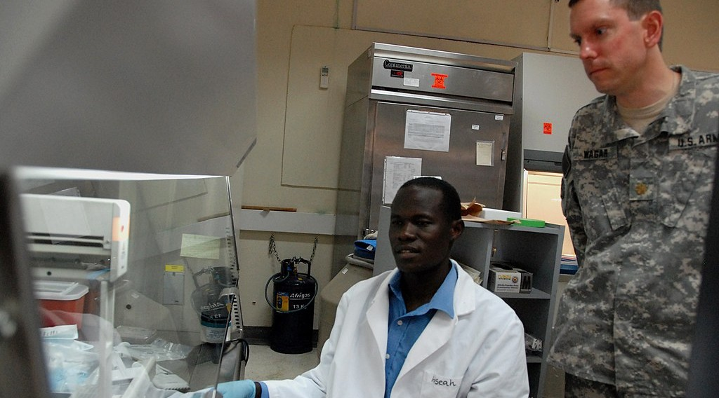
ECO. GEOGRAPHY — FORM 2 TECH
I. DEFINITION
Activity 1
Researchers at work.
2026 / 2027
DGCAST GAROUA — GEOGRAPHY DEPARTMENT
Mr KAMDEM E. | 14
Notes:
Without the projector: use the situation of the new maize.

Slide 15
ECO. GEOGRAPHY — FORM 2 TECH
I. DEFINITION
Activity 1: Question
Researchers create new knowledge. Which sector is this?
2026 / 2027
DGCAST GAROUA — GEOGRAPHY DEPARTMENT
Mr KAMDEM E. | 15

Slide 16
ECO. GEOGRAPHY — FORM 2 TECH
I. DEFINITION
Answer
The quaternary sector.
2026 / 2027
DGCAST GAROUA — GEOGRAPHY DEPARTMENT
Mr KAMDEM E. | 16

Slide 17

ECO. GEOGRAPHY — FORM 2 TECH
II. EXAMPLES
Activity 2
Researchers test new plants in a field.
2026 / 2027
DGCAST GAROUA — GEOGRAPHY DEPARTMENT
Mr KAMDEM E. | 17
Notes:
Without the projector: mention the IRAD station at Garoua.

Slide 18
ECO. GEOGRAPHY — FORM 2 TECH
II. EXAMPLES
Activity 2: Question
Give one research centre in Cameroon.
2026 / 2027
DGCAST GAROUA — GEOGRAPHY DEPARTMENT
Mr KAMDEM E. | 18

Slide 19
ECO. GEOGRAPHY — FORM 2 TECH
II. EXAMPLES
Answer
IRAD (research for farming). Also the universities.
2026 / 2027
DGCAST GAROUA — GEOGRAPHY DEPARTMENT
Mr KAMDEM E. | 19

Slide 20

ECO. GEOGRAPHY — FORM 2 TECH
II. EXAMPLES
Activity 3
A farmer uses a mobile phone.
2026 / 2027
DGCAST GAROUA — GEOGRAPHY DEPARTMENT
Mr KAMDEM E. | 20
Notes:
Without the projector: ask learners how their parents use phones for work.

Slide 21
ECO. GEOGRAPHY — FORM 2 TECH
II. EXAMPLES
Activity 3: Question
How does the phone help farmers and traders?
2026 / 2027
DGCAST GAROUA — GEOGRAPHY DEPARTMENT
Mr KAMDEM E. | 21

Slide 22
ECO. GEOGRAPHY — FORM 2 TECH
II. EXAMPLES
Answer
They get prices and weather news, and send money.
2026 / 2027
DGCAST GAROUA — GEOGRAPHY DEPARTMENT
Mr KAMDEM E. | 22

Slide 23
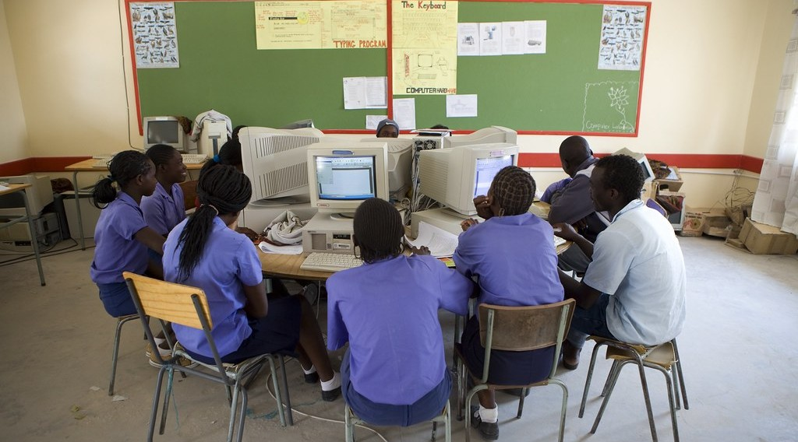
ECO. GEOGRAPHY — FORM 2 TECH
II. EXAMPLES
Activity 4
Students learn with computers.
2026 / 2027
DGCAST GAROUA — GEOGRAPHY DEPARTMENT
Mr KAMDEM E. | 23
Notes:
Without the projector: ask learners who uses a computer at home or at school.

Slide 24
ECO. GEOGRAPHY — FORM 2 TECH
II. EXAMPLES
Activity 4: Question
Name one job of information technology.
2026 / 2027
DGCAST GAROUA — GEOGRAPHY DEPARTMENT
Mr KAMDEM E. | 24

Slide 25
ECO. GEOGRAPHY — FORM 2 TECH
II. EXAMPLES
Answer
Making software, websites or phone apps.
2026 / 2027
DGCAST GAROUA — GEOGRAPHY DEPARTMENT
Mr KAMDEM E. | 25

Slide 26
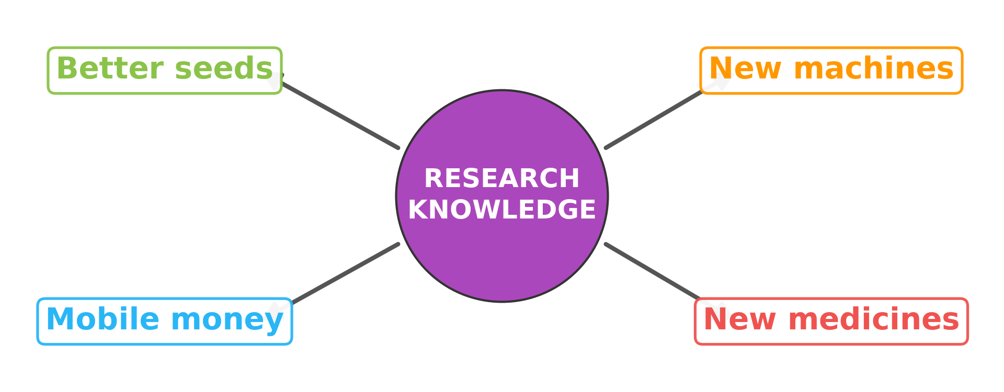
ECO. GEOGRAPHY — FORM 2 TECH
III. IMPORTANCE
Activity 5
Research helps all the other sectors.
2026 / 2027
DGCAST GAROUA — GEOGRAPHY DEPARTMENT
Mr KAMDEM E. | 26
Notes:
Without the projector: draw a circle with four arrows on the board.

Slide 27
ECO. GEOGRAPHY — FORM 2 TECH
III. IMPORTANCE
Activity 5: Question
How does research help the other sectors?
2026 / 2027
DGCAST GAROUA — GEOGRAPHY DEPARTMENT
Mr KAMDEM E. | 27

Slide 28
ECO. GEOGRAPHY — FORM 2 TECH
III. IMPORTANCE
Answer
Better seeds, new machines, new medicines and mobile money.
2026 / 2027
DGCAST GAROUA — GEOGRAPHY DEPARTMENT
Mr KAMDEM E. | 28

Slide 29
ECO. GEOGRAPHY — FORM 2 TECH
BOARD SUMMARY
The Sectors of the Economy
Topic: Economic Activities
Sub-topic: Sectors of the Economy
Lesson 5: The Sectors of the Economy — Part 6: The Quaternary Sector (Definition and Examples)
2026 / 2027
DGCAST GAROUA — GEOGRAPHY DEPARTMENT
Mr KAMDEM E. | 29
Notes:
Learners copy the board summary now. Give them enough time for each slide.

Slide 30
ECO. GEOGRAPHY — FORM 2 TECH
BOARD SUMMARY
I. Definitions
Quaternary sector: It is the sector of knowledge and research.
Research: It is careful work to find new knowledge.
ICT: It is computers, phones and the internet.
2026 / 2027
DGCAST GAROUA — GEOGRAPHY DEPARTMENT
Mr KAMDEM E. | 30

Slide 31
ECO. GEOGRAPHY — FORM 2 TECH
BOARD SUMMARY
II. Examples
A. Research: IRAD and the universities.
B. ICT: Software, websites and phone apps.
C. Advice: Experts help the government and companies.
2026 / 2027
DGCAST GAROUA — GEOGRAPHY DEPARTMENT
Mr KAMDEM E. | 31

Slide 32
ECO. GEOGRAPHY — FORM 2 TECH
BOARD SUMMARY
III. Importance (1/2)
A. Farming: Better seeds.
B. Industry: New machines.
C. Services: Mobile money and new medicines.
2026 / 2027
DGCAST GAROUA — GEOGRAPHY DEPARTMENT
Mr KAMDEM E. | 32

Slide 33
ECO. GEOGRAPHY — FORM 2 TECH
BOARD SUMMARY
III. Importance (2/2)
Copy this simple drawing.
2026 / 2027
DGCAST GAROUA — GEOGRAPHY DEPARTMENT
Mr KAMDEM E. | 33

Slide 34
ECO. GEOGRAPHY — FORM 2 TECH
FORMATIVE EVALUATION
Formative Evaluation 1
What is the quaternary sector?
2026 / 2027
DGCAST GAROUA — GEOGRAPHY DEPARTMENT
Mr KAMDEM E. | 34

Slide 35
ECO. GEOGRAPHY — FORM 2 TECH
FORMATIVE EVALUATION
Expected Answer
The sector of knowledge and research.
2026 / 2027
DGCAST GAROUA — GEOGRAPHY DEPARTMENT
Mr KAMDEM E. | 35

Slide 36
ECO. GEOGRAPHY — FORM 2 TECH
FORMATIVE EVALUATION
Formative Evaluation 2
Give one example of how research helps farmers.
2026 / 2027
DGCAST GAROUA — GEOGRAPHY DEPARTMENT
Mr KAMDEM E. | 36

Slide 37
ECO. GEOGRAPHY — FORM 2 TECH
FORMATIVE EVALUATION
Expected Answer
It gives better seeds that resist drought.
2026 / 2027
DGCAST GAROUA — GEOGRAPHY DEPARTMENT
Mr KAMDEM E. | 37

Slide 38
ECO. GEOGRAPHY — FORM 2 TECH
REMEDIATION
Remediation
Fill in the blanks:
The sector of knowledge and research is the ______ sector.
The research centre for farming in Cameroon is ______.
Computers, phones and the internet are called ______.
2026 / 2027
DGCAST GAROUA — GEOGRAPHY DEPARTMENT
Mr KAMDEM E. | 38
Notes:
Answers: 1. quaternary 2. IRAD 3. ICT

Slide 39
ECO. GEOGRAPHY — FORM 2 TECH
HOMEWORK
Homework
On a map of Africa in your atlas, find Cameroon and name the four oceans and seas that surround Africa.
This prepares Lesson 6: Africa (Introduction: location and physical characteristics).
2026 / 2027
DGCAST GAROUA — GEOGRAPHY DEPARTMENT
Mr KAMDEM E. | 39
Notes:
This homework prepares the next lesson.

Slide 40
ECO. GEOGRAPHY — FORM 2 TECH
BILINGUAL GAME
Bilingual Game (Jeu Bilingue)
English | Français
Research | La recherche
Researcher | Le chercheur
Knowledge | La connaissance
Information | L'information
Software | Le logiciel
Internet | L'internet
Expert | L'expert
Innovation | L'innovation
2026 / 2027
DGCAST GAROUA — GEOGRAPHY DEPARTMENT
Mr KAMDEM E. | 40
Notes:
Say the English word; learners give the French word, then the reverse.

Slide 41
ECO. GEOGRAPHY — FORM 2 TECH
LOGBOOK
Official Logbook (1/2)
Module / Topic | Economic Activities
Lesson Title | Lesson 5: The Sectors of the Economy — Part 6: The Quaternary Sector (Definition and Examples)
Expected Learning Outcomes | Define the quaternary sector. Name the main quaternary activities. Explain the importance of the quaternary sector for development.
Competence | Learners are able to explain how research and digital tools improve daily life and farming, and to use them responsibly.
2026 / 2027
DGCAST GAROUA — GEOGRAPHY DEPARTMENT
Mr KAMDEM E. | 41

Slide 42
ECO. GEOGRAPHY — FORM 2 TECH
LOGBOOK
Official Logbook (2/2)
Matter Taught | I. Definitions: Quaternary sector, Research, ICT; II. Examples: Research, ICT, Advice; III. Importance: Farming, Industry, Services.
Evaluation | Formative evaluation (3 questions) and remediation exercise.
Homework | On a map of Africa in your atlas, find Cameroon and name the four oceans and seas that surround Africa.
Enrolment / Present / Absent | ____ / ____ / ____
Achievement | To be completed by the teacher after the lesson.
2026 / 2027
DGCAST GAROUA — GEOGRAPHY DEPARTMENT
Mr KAMDEM E. | 42

Slide 43
ECO. GEOGRAPHY — FORM 2 TECH
TEACHER'S NOTE
Teacher's Note
Timing: Set-up, recall 8 min | Situation 8 min | 5 activities 25 min | Board summary (copying) 30 min | Evaluation, remediation 10 min | Homework 4 min | Logbook 10 min | Spare 5 min
IRAD: Institut de Recherche Agricole pour le Développement, with a regional centre at Garoua.
2026 / 2027
DGCAST GAROUA — GEOGRAPHY DEPARTMENT
Mr KAMDEM E. | 43

Slide 44
ECO. GEOGRAPHY — FORM 2 TECH
REFERENCES
References
Harmonised Progression Sheet, Economic Geography (5051), Form 2.
IRAD: Institut de Recherche Agricole pour le Développement (Cameroon).
Photo, Activity 1: “U.S. Army research unit marks four decades in Kenya, Africa - USAMRU-K” by US Army Africa, CC BY 2.0, via Flickr (https://www.flickr.com/photos/36281822@N08/4074611177)
Photo, Activity 2: “CIMMYT international wheat nurseries growing in Ecuador” by CIMMYT, CC BY-NC-SA 2.0, via Flickr (https://www.flickr.com/photos/44760652@N05/5958068839)
Photo, Activity 3: “Using mobile technology to give feedback about the crop trials” by Bioversity International, CC BY-NC-ND 2.0, via Flickr (https://www.flickr.com/photos/50383637@N07/15019002626)
Photo, Activity 4: “The Oneputa Combined School goes from Grade 1 through to Grade 10” by World Bank Photo Collection, CC BY-NC-ND 2.0, via Flickr (https://www.flickr.com/photos/10816734@N03/5321464442)
Diagrams and animations: drawn for this lesson (DGCAST Geography Department).
2026 / 2027
DGCAST GAROUA — GEOGRAPHY DEPARTMENT
Mr KAMDEM E. | 44

