Slide 1

DIVINE GRACE COLLEGE OF ARTS, SCIENCE AND TECHNOLOGY
(DGCAST) — GAROUA | GEOGRAPHY DEPARTMENT
FORM 2 TECHNICAL — LESSON 6 (PART 1)
Africa: Introduction (Location and Physical Characteristics)
Mr KAMDEM EMMANUEL
Geography Teacher — PLEG
Academic Year 2026 / 2027
Notes:
Good morning, class. Today we study Africa, part 1: Introduction (Location and Physical Characteristics).

Slide 2
ECO. GEOGRAPHY — FORM 2 TECH
CLASS INFO
Class, Chapter & Duration
Class | Form 2 Technical
Chapter | Economic Geography — Africa
Duration | 2 periods (2 × 50 minutes)
2026 / 2027
DGCAST GAROUA — GEOGRAPHY DEPARTMENT
Mr KAMDEM E. | 2

Slide 3
ECO. GEOGRAPHY — FORM 2 TECH
IDENTIFICATION
Lesson Identification
Topic | Regional Geography
Sub-topic | Africa
Lesson | Lesson 6: Africa — Part 1: Introduction (Location and Physical Characteristics)
Notions / Concepts | Continent, location, extreme points, Strait of Gibraltar, Suez Canal, plateau continent.
Syllabus focus | Introduction to Africa: location, size and general physical characteristics.
Competence | Learners are able to locate Africa and Cameroon on a world map and describe the position of Africa in relation to other continents.
2026 / 2027
DGCAST GAROUA — GEOGRAPHY DEPARTMENT
Mr KAMDEM E. | 3

Slide 4
ECO. GEOGRAPHY — FORM 2 TECH
OBJECTIVES
Learning Objectives
By the end of the lesson, the learner should be able to:
Locate Africa using latitudes, longitudes, oceans and seas.
Give the size and the extreme points of Africa.
Describe the general physical characteristics of Africa.
2026 / 2027
DGCAST GAROUA — GEOGRAPHY DEPARTMENT
Mr KAMDEM E. | 4

Slide 5
ECO. GEOGRAPHY — FORM 2 TECH
RECALL
Recall
The economy has four sectors: primary, secondary, tertiary and quaternary.
Most Africans work in the primary sector.
Today we begin the study of our continent, Africa.
2026 / 2027
DGCAST GAROUA — GEOGRAPHY DEPARTMENT
Mr KAMDEM E. | 5
Notes:
Check the homework: the oceans and seas that surround Africa.

Slide 6
ECO. GEOGRAPHY — FORM 2 TECH
REAL-LIFE SITUATION
Real-Life Situation
During a football tournament, a boy from Brazil asks Kevin: "Where exactly is Africa? Is it a country or a continent? Which seas are around it?"
2026 / 2027
DGCAST GAROUA — GEOGRAPHY DEPARTMENT
Mr KAMDEM E. | 6
Notes:
Read the situation slowly, twice.

Slide 7
ECO. GEOGRAPHY — FORM 2 TECH
REAL-LIFE SITUATION
Situation — Question 1
What is the problem in the situation?
2026 / 2027
DGCAST GAROUA — GEOGRAPHY DEPARTMENT
Mr KAMDEM E. | 7

Slide 8
ECO. GEOGRAPHY — FORM 2 TECH
REAL-LIFE SITUATION
Answer
The boy does not know where Africa is.
2026 / 2027
DGCAST GAROUA — GEOGRAPHY DEPARTMENT
Mr KAMDEM E. | 8

Slide 9
ECO. GEOGRAPHY — FORM 2 TECH
REAL-LIFE SITUATION
Situation — Question 2
Is Africa a country or a continent?
2026 / 2027
DGCAST GAROUA — GEOGRAPHY DEPARTMENT
Mr KAMDEM E. | 9

Slide 10
ECO. GEOGRAPHY — FORM 2 TECH
REAL-LIFE SITUATION
Answer
A continent, with 54 countries.
2026 / 2027
DGCAST GAROUA — GEOGRAPHY DEPARTMENT
Mr KAMDEM E. | 10

Slide 11
ECO. GEOGRAPHY — FORM 2 TECH
REAL-LIFE SITUATION
Situation — Question 3
How can Kevin show him?
2026 / 2027
DGCAST GAROUA — GEOGRAPHY DEPARTMENT
Mr KAMDEM E. | 11

Slide 12
ECO. GEOGRAPHY — FORM 2 TECH
REAL-LIFE SITUATION
Possible Answer
With a map or a globe.
2026 / 2027
DGCAST GAROUA — GEOGRAPHY DEPARTMENT
Mr KAMDEM E. | 12

Slide 13
ECO. GEOGRAPHY — FORM 2 TECH
JUSTIFICATION
Justification of the Lesson
This lesson helps us to know where Africa is and what its land looks like.
2026 / 2027
DGCAST GAROUA — GEOGRAPHY DEPARTMENT
Mr KAMDEM E. | 13

Slide 14

ECO. GEOGRAPHY — FORM 2 TECH
I. LOCATION AND SIZE
Activity 1
Africa and the seas around it.
2026 / 2027
DGCAST GAROUA — GEOGRAPHY DEPARTMENT
Mr KAMDEM E. | 14
Notes:
Without the projector: draw Africa on the board and write the four names around it.

Slide 15
ECO. GEOGRAPHY — FORM 2 TECH
I. LOCATION AND SIZE
Activity 1: Question
Name the oceans and seas around Africa.
2026 / 2027
DGCAST GAROUA — GEOGRAPHY DEPARTMENT
Mr KAMDEM E. | 15

Slide 16
ECO. GEOGRAPHY — FORM 2 TECH
I. LOCATION AND SIZE
Answer
The Atlantic Ocean, the Indian Ocean, the Mediterranean Sea and the Red Sea.
2026 / 2027
DGCAST GAROUA — GEOGRAPHY DEPARTMENT
Mr KAMDEM E. | 16

Slide 17
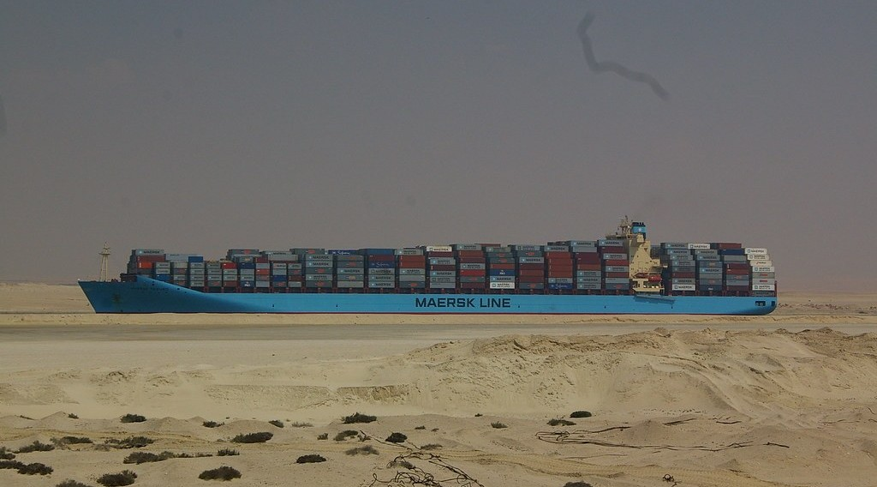
ECO. GEOGRAPHY — FORM 2 TECH
I. LOCATION AND SIZE
Activity 2
The Suez Canal in Egypt.
2026 / 2027
DGCAST GAROUA — GEOGRAPHY DEPARTMENT
Mr KAMDEM E. | 17
Notes:
Without the projector: explain: a canal is a river dug by people.

Slide 18
ECO. GEOGRAPHY — FORM 2 TECH
I. LOCATION AND SIZE
Activity 2: Question
The Suez Canal separates Africa from which continent?
2026 / 2027
DGCAST GAROUA — GEOGRAPHY DEPARTMENT
Mr KAMDEM E. | 18

Slide 19
ECO. GEOGRAPHY — FORM 2 TECH
I. LOCATION AND SIZE
Answer
From Asia.
2026 / 2027
DGCAST GAROUA — GEOGRAPHY DEPARTMENT
Mr KAMDEM E. | 19

Slide 20
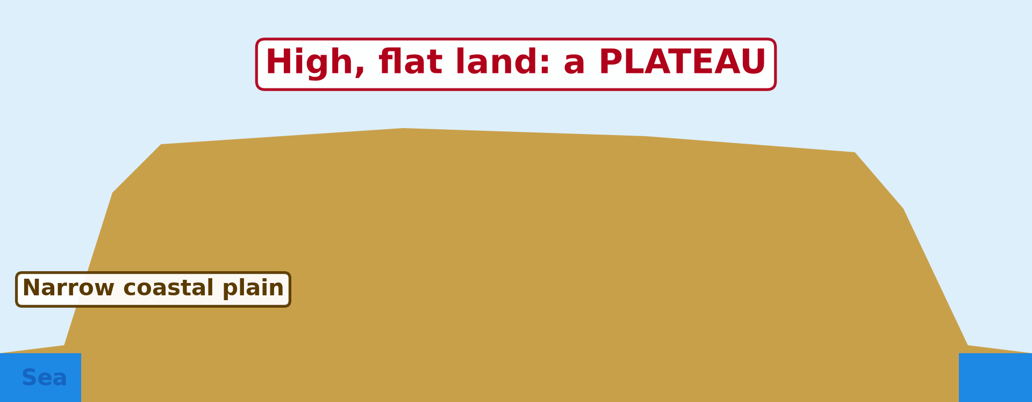
ECO. GEOGRAPHY — FORM 2 TECH
II. PHYSICAL CHARACTERISTICS
Activity 3
A cross-section of Africa.
2026 / 2027
DGCAST GAROUA — GEOGRAPHY DEPARTMENT
Mr KAMDEM E. | 20
Notes:
Without the projector: compare with the Adamawa plateau.

Slide 21
ECO. GEOGRAPHY — FORM 2 TECH
II. PHYSICAL CHARACTERISTICS
Activity 3: Question
Most of Africa is high, flat land. What do we call it?
2026 / 2027
DGCAST GAROUA — GEOGRAPHY DEPARTMENT
Mr KAMDEM E. | 21

Slide 22
ECO. GEOGRAPHY — FORM 2 TECH
II. PHYSICAL CHARACTERISTICS
Answer
A plateau.
2026 / 2027
DGCAST GAROUA — GEOGRAPHY DEPARTMENT
Mr KAMDEM E. | 22

Slide 23

ECO. GEOGRAPHY — FORM 2 TECH
II. PHYSICAL CHARACTERISTICS
Activity 4
Mount Kilimanjaro, Tanzania.
2026 / 2027
DGCAST GAROUA — GEOGRAPHY DEPARTMENT
Mr KAMDEM E. | 23
Notes:
Without the projector: compare with Mount Cameroon (4,095 m).

Slide 24
ECO. GEOGRAPHY — FORM 2 TECH
II. PHYSICAL CHARACTERISTICS
Activity 4: Question
This is the highest mountain of Africa. What is its name?
2026 / 2027
DGCAST GAROUA — GEOGRAPHY DEPARTMENT
Mr KAMDEM E. | 24

Slide 25
ECO. GEOGRAPHY — FORM 2 TECH
II. PHYSICAL CHARACTERISTICS
Answer
Kilimanjaro (5,895 m).
2026 / 2027
DGCAST GAROUA — GEOGRAPHY DEPARTMENT
Mr KAMDEM E. | 25

Slide 26
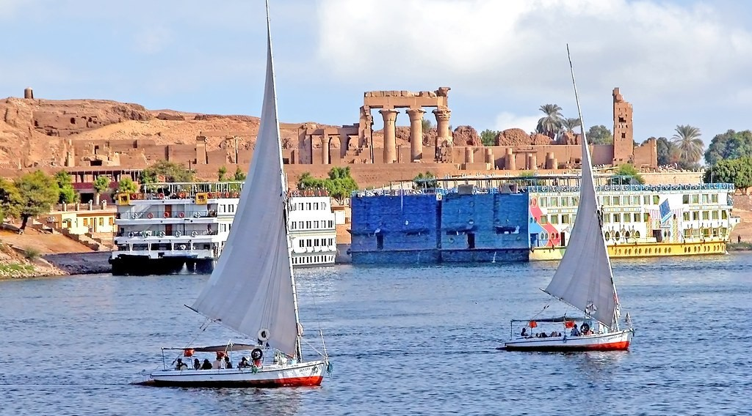
ECO. GEOGRAPHY — FORM 2 TECH
II. PHYSICAL CHARACTERISTICS
Activity 5
The River Nile in Egypt.
2026 / 2027
DGCAST GAROUA — GEOGRAPHY DEPARTMENT
Mr KAMDEM E. | 26
Notes:
Without the projector: find the Nile in the atlas.

Slide 27
ECO. GEOGRAPHY — FORM 2 TECH
II. PHYSICAL CHARACTERISTICS
Activity 5: Question
This is the longest river of Africa. What is its name?
2026 / 2027
DGCAST GAROUA — GEOGRAPHY DEPARTMENT
Mr KAMDEM E. | 27

Slide 28
ECO. GEOGRAPHY — FORM 2 TECH
II. PHYSICAL CHARACTERISTICS
Answer
The Nile (about 6,650 km).
2026 / 2027
DGCAST GAROUA — GEOGRAPHY DEPARTMENT
Mr KAMDEM E. | 28

Slide 29
ECO. GEOGRAPHY — FORM 2 TECH
BOARD SUMMARY
Africa
Topic: Regional Geography
Sub-topic: Africa
Lesson 6: Africa — Part 1: Introduction (Location and Physical Characteristics)
2026 / 2027
DGCAST GAROUA — GEOGRAPHY DEPARTMENT
Mr KAMDEM E. | 29
Notes:
Learners copy the board summary now. Give them enough time for each slide.

Slide 30
ECO. GEOGRAPHY — FORM 2 TECH
BOARD SUMMARY
I. Definitions
Continent: It is a very large area of land.
Plateau: It is a high, flat area of land.
Canal: It is a waterway dug by people.
2026 / 2027
DGCAST GAROUA — GEOGRAPHY DEPARTMENT
Mr KAMDEM E. | 30

Slide 31
ECO. GEOGRAPHY — FORM 2 TECH
BOARD SUMMARY
II. Location and Size (1/2)
A. Seas: Atlantic, Indian, Mediterranean and Red Sea.
B. The Equator: It crosses the middle of Africa.
C. Neighbours: Gibraltar (Europe) and Suez (Asia).
D. Size: About 30 million km² and 54 countries.
2026 / 2027
DGCAST GAROUA — GEOGRAPHY DEPARTMENT
Mr KAMDEM E. | 31

Slide 32
ECO. GEOGRAPHY — FORM 2 TECH
BOARD SUMMARY
II. Location and Size (2/2)
Copy the map of Africa and its seas.
2026 / 2027
DGCAST GAROUA — GEOGRAPHY DEPARTMENT
Mr KAMDEM E. | 32

Slide 33
ECO. GEOGRAPHY — FORM 2 TECH
BOARD SUMMARY
III. Physical Characteristics
A. A plateau: Most of Africa is high and flat.
B. Highest point: Kilimanjaro (5,895 m).
C. Longest river: The Nile.
D. Coast: It has few bays and few natural ports.
2026 / 2027
DGCAST GAROUA — GEOGRAPHY DEPARTMENT
Mr KAMDEM E. | 33

Slide 34
ECO. GEOGRAPHY — FORM 2 TECH
FORMATIVE EVALUATION
Formative Evaluation 1
Name the four seas and oceans around Africa.
2026 / 2027
DGCAST GAROUA — GEOGRAPHY DEPARTMENT
Mr KAMDEM E. | 34

Slide 35
ECO. GEOGRAPHY — FORM 2 TECH
FORMATIVE EVALUATION
Expected Answer
Atlantic, Indian, Mediterranean and Red Sea.
2026 / 2027
DGCAST GAROUA — GEOGRAPHY DEPARTMENT
Mr KAMDEM E. | 35

Slide 36
ECO. GEOGRAPHY — FORM 2 TECH
FORMATIVE EVALUATION
Formative Evaluation 2
What is the highest mountain of Africa?
2026 / 2027
DGCAST GAROUA — GEOGRAPHY DEPARTMENT
Mr KAMDEM E. | 36

Slide 37
ECO. GEOGRAPHY — FORM 2 TECH
FORMATIVE EVALUATION
Expected Answer
Kilimanjaro.
2026 / 2027
DGCAST GAROUA — GEOGRAPHY DEPARTMENT
Mr KAMDEM E. | 37

Slide 38
ECO. GEOGRAPHY — FORM 2 TECH
REMEDIATION
Remediation
Fill in the blanks:
Africa is a ______, not a country.
The longest river of Africa is the ______.
High, flat land is called a ______.
2026 / 2027
DGCAST GAROUA — GEOGRAPHY DEPARTMENT
Mr KAMDEM E. | 38
Notes:
Answers: 1. continent 2. Nile 3. plateau

Slide 39
ECO. GEOGRAPHY — FORM 2 TECH
HOMEWORK
Homework
Compare the climate of Douala, Garoua and Maroua. Which town is the wettest, and which is the driest? Ask an adult or use your textbook.
This prepares Part 2: Climate, Soils and Relief of Africa.
2026 / 2027
DGCAST GAROUA — GEOGRAPHY DEPARTMENT
Mr KAMDEM E. | 39
Notes:
This homework prepares the next lesson.

Slide 40
ECO. GEOGRAPHY — FORM 2 TECH
BILINGUAL GAME
Bilingual Game (Jeu Bilingue)
English | Français
Continent | Le continent
Ocean | L'océan
Sea | La mer
Strait | Le détroit
Canal | Le canal
Plateau | Le plateau
Coastline | Le littoral
Harbour | Le port naturel
2026 / 2027
DGCAST GAROUA — GEOGRAPHY DEPARTMENT
Mr KAMDEM E. | 40
Notes:
Say the English word; learners give the French word, then the reverse.

Slide 41
ECO. GEOGRAPHY — FORM 2 TECH
LOGBOOK
Official Logbook (1/2)
Module / Topic | Regional Geography
Lesson Title | Lesson 6: Africa — Part 1: Introduction (Location and Physical Characteristics)
Expected Learning Outcomes | Locate Africa using latitudes, longitudes, oceans and seas. Give the size and the extreme points of Africa. Describe the general physical characteristics of Africa.
Competence | Learners are able to locate Africa and Cameroon on a world map and describe the position of Africa in relation to other continents.
2026 / 2027
DGCAST GAROUA — GEOGRAPHY DEPARTMENT
Mr KAMDEM E. | 41

Slide 42
ECO. GEOGRAPHY — FORM 2 TECH
LOGBOOK
Official Logbook (2/2)
Matter Taught | I. Definitions: Continent, Plateau, Canal; II. Location and Size: Seas, The Equator, Neighbours, Size; III. Physical Characteristics: A plateau, Highest point, Longest river, Coast.
Evaluation | Formative evaluation (3 questions) and remediation exercise.
Homework | Compare the climate of Douala, Garoua and Maroua. Which town is the wettest, and which is the driest? Ask an adult or use your textbook.
Enrolment / Present / Absent | ____ / ____ / ____
Achievement | To be completed by the teacher after the lesson.
2026 / 2027
DGCAST GAROUA — GEOGRAPHY DEPARTMENT
Mr KAMDEM E. | 42

Slide 43
ECO. GEOGRAPHY — FORM 2 TECH
TEACHER'S NOTE
Teacher's Note
Timing: Set-up, recall 8 min | Situation 8 min | 5 activities 25 min | Board summary (copying) 30 min | Evaluation, remediation 10 min | Homework 4 min | Logbook 10 min | Spare 5 min
2026 / 2027
DGCAST GAROUA — GEOGRAPHY DEPARTMENT
Mr KAMDEM E. | 43

Slide 44
ECO. GEOGRAPHY — FORM 2 TECH
REFERENCES
References
Harmonised Progression Sheet, Economic Geography (5051), Form 2.
Photo, Activity 2: “MV Maersk Taikung” by tim.md, CC BY-NC-ND 2.0, via Flickr (https://www.flickr.com/photos/50299151@N00/3252980648)
Photo, Activity 4: “Kilimanjaro” by ian 1602, CC BY-NC 2.0, via Flickr (https://www.flickr.com/photos/98181641@N00/2179855841)
Photo, Activity 5: “Egypt-5B-023 - Approaching Aswan” by archer10 (Dennis), CC BY-SA 2.0, via Flickr (https://www.flickr.com/photos/22490717@N02/2217394088)
Diagrams and animations: drawn for this lesson (DGCAST Geography Department).
2026 / 2027
DGCAST GAROUA — GEOGRAPHY DEPARTMENT
Mr KAMDEM E. | 44

