Slide 1

DIVINE GRACE COLLEGE OF ARTS, SCIENCE AND TECHNOLOGY
(DGCAST) — GAROUA | GEOGRAPHY DEPARTMENT
FORM 2 TECHNICAL — LESSON 6 (PART 2)
Africa: Climate, Soils and Relief of Africa
Mr KAMDEM EMMANUEL
Geography Teacher — PLEG
Academic Year 2026 / 2027
Notes:
Good morning, class. Today we study Africa, part 2: Climate, Soils and Relief of Africa.

Slide 2
ECO. GEOGRAPHY — FORM 2 TECH
CLASS INFO
Class, Chapter & Duration
Class | Form 2 Technical
Chapter | Economic Geography — Africa
Duration | 2 periods (2 × 50 minutes)
2026 / 2027
DGCAST GAROUA — GEOGRAPHY DEPARTMENT
Mr KAMDEM E. | 2

Slide 3
ECO. GEOGRAPHY — FORM 2 TECH
IDENTIFICATION
Lesson Identification
Topic | Regional Geography
Sub-topic | Africa
Lesson | Lesson 6: Africa — Part 2: Climate, Soils and Relief of Africa
Notions / Concepts | Climatic zone, relief, plateau, basin, Rift Valley, fold mountains, volcanic mountains, ferrallitic and ferruginous soils.
Syllabus focus | Climate, soils and relief of Africa.
Competence | Learners are able to relate the climate and relief of a place in Africa to the activities that people practise there.
2026 / 2027
DGCAST GAROUA — GEOGRAPHY DEPARTMENT
Mr KAMDEM E. | 3

Slide 4
ECO. GEOGRAPHY — FORM 2 TECH
OBJECTIVES
Learning Objectives
By the end of the lesson, the learner should be able to:
Describe the main climatic zones of Africa.
Describe the main relief features of Africa.
Describe the main soils of Africa.
2026 / 2027
DGCAST GAROUA — GEOGRAPHY DEPARTMENT
Mr KAMDEM E. | 4

Slide 5
ECO. GEOGRAPHY — FORM 2 TECH
RECALL
Recall
Africa lies between 37°N and 35°S, and the Equator crosses its middle.
It is a plateau continent, with Kilimanjaro as its highest point and the Nile as its longest river.
2026 / 2027
DGCAST GAROUA — GEOGRAPHY DEPARTMENT
Mr KAMDEM E. | 5
Notes:
Check the homework: the wettest and driest towns of Cameroon.

Slide 6
ECO. GEOGRAPHY — FORM 2 TECH
REAL-LIFE SITUATION
Real-Life Situation
Douala gets about 4,000 mm of rain per year, Garoua about 1,000 mm and Maroua about 800 mm. On the Adamawa plateau, the air is cooler than in Garoua. Nadia wonders why.
2026 / 2027
DGCAST GAROUA — GEOGRAPHY DEPARTMENT
Mr KAMDEM E. | 6
Notes:
Read the situation slowly, twice.

Slide 7
ECO. GEOGRAPHY — FORM 2 TECH
REAL-LIFE SITUATION
Situation — Question 1
What is the problem in the situation?
2026 / 2027
DGCAST GAROUA — GEOGRAPHY DEPARTMENT
Mr KAMDEM E. | 7

Slide 8
ECO. GEOGRAPHY — FORM 2 TECH
REAL-LIFE SITUATION
Answer
Nadia does not know why the climate changes from place to place.
2026 / 2027
DGCAST GAROUA — GEOGRAPHY DEPARTMENT
Mr KAMDEM E. | 8

Slide 9
ECO. GEOGRAPHY — FORM 2 TECH
REAL-LIFE SITUATION
Situation — Question 2
Which town is the wettest?
2026 / 2027
DGCAST GAROUA — GEOGRAPHY DEPARTMENT
Mr KAMDEM E. | 9

Slide 10
ECO. GEOGRAPHY — FORM 2 TECH
REAL-LIFE SITUATION
Answer
Douala.
2026 / 2027
DGCAST GAROUA — GEOGRAPHY DEPARTMENT
Mr KAMDEM E. | 10

Slide 11
ECO. GEOGRAPHY — FORM 2 TECH
REAL-LIFE SITUATION
Situation — Question 3
Why is the Adamawa cooler?
2026 / 2027
DGCAST GAROUA — GEOGRAPHY DEPARTMENT
Mr KAMDEM E. | 11

Slide 12
ECO. GEOGRAPHY — FORM 2 TECH
REAL-LIFE SITUATION
Possible Answer
It is high: the higher we go, the cooler it is.
2026 / 2027
DGCAST GAROUA — GEOGRAPHY DEPARTMENT
Mr KAMDEM E. | 12

Slide 13
ECO. GEOGRAPHY — FORM 2 TECH
JUSTIFICATION
Justification of the Lesson
This lesson helps us to know the climate, relief and soils of Africa.
2026 / 2027
DGCAST GAROUA — GEOGRAPHY DEPARTMENT
Mr KAMDEM E. | 13

Slide 14

ECO. GEOGRAPHY — FORM 2 TECH
I. CLIMATE
Activity 1
The climates of Africa.
2026 / 2027
DGCAST GAROUA — GEOGRAPHY DEPARTMENT
Mr KAMDEM E. | 14
Notes:
Without the projector: draw the Equator and bands of climate on the board.

Slide 15
ECO. GEOGRAPHY — FORM 2 TECH
I. CLIMATE
Activity 1: Question
Which climate is found around the Equator? Which is near the tropics?
2026 / 2027
DGCAST GAROUA — GEOGRAPHY DEPARTMENT
Mr KAMDEM E. | 15

Slide 16
ECO. GEOGRAPHY — FORM 2 TECH
I. CLIMATE
Answer
Equatorial near the Equator; desert near the tropics.
2026 / 2027
DGCAST GAROUA — GEOGRAPHY DEPARTMENT
Mr KAMDEM E. | 16

Slide 17

ECO. GEOGRAPHY — FORM 2 TECH
I. CLIMATE
Activity 2
Tea on the cool highlands of Kenya.
2026 / 2027
DGCAST GAROUA — GEOGRAPHY DEPARTMENT
Mr KAMDEM E. | 17
Notes:
Without the projector: compare Garoua and Ngaoundéré.

Slide 18
ECO. GEOGRAPHY — FORM 2 TECH
I. CLIMATE
Activity 2: Question
Nairobi is near the Equator, but it is cool. Why?
2026 / 2027
DGCAST GAROUA — GEOGRAPHY DEPARTMENT
Mr KAMDEM E. | 18

Slide 19
ECO. GEOGRAPHY — FORM 2 TECH
I. CLIMATE
Answer
It is high. The higher the land, the cooler the air.
2026 / 2027
DGCAST GAROUA — GEOGRAPHY DEPARTMENT
Mr KAMDEM E. | 19

Slide 20
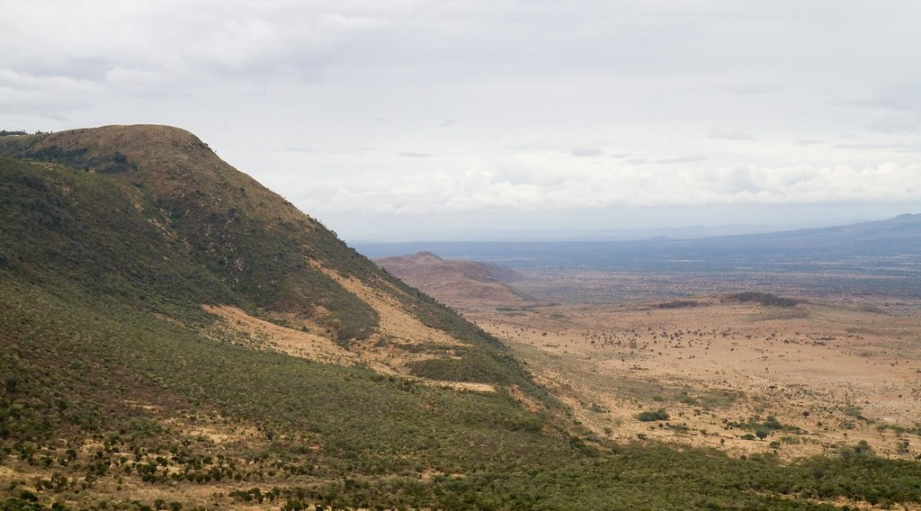
ECO. GEOGRAPHY — FORM 2 TECH
II. RELIEF
Activity 3
The Great Rift Valley in Kenya.
2026 / 2027
DGCAST GAROUA — GEOGRAPHY DEPARTMENT
Mr KAMDEM E. | 20
Notes:
Without the projector: show two books pushed apart with a pencil falling between them.

Slide 21
ECO. GEOGRAPHY — FORM 2 TECH
II. RELIEF
Activity 3: Question
The land has sunk between two lines of cracks. What is this valley called?
2026 / 2027
DGCAST GAROUA — GEOGRAPHY DEPARTMENT
Mr KAMDEM E. | 21

Slide 22
ECO. GEOGRAPHY — FORM 2 TECH
II. RELIEF
Answer
The Great Rift Valley.
2026 / 2027
DGCAST GAROUA — GEOGRAPHY DEPARTMENT
Mr KAMDEM E. | 22

Slide 23
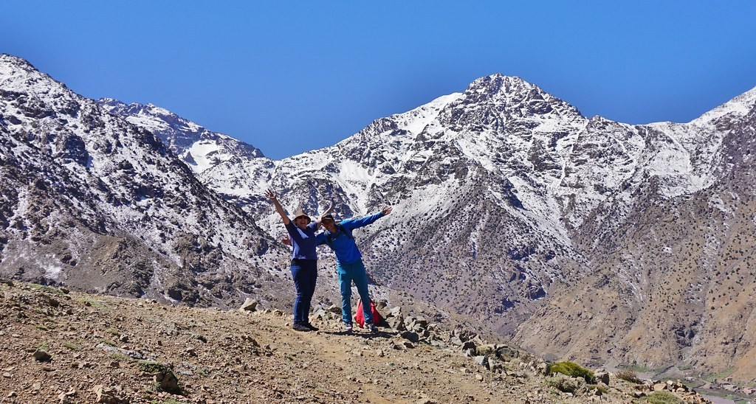
ECO. GEOGRAPHY — FORM 2 TECH
II. RELIEF
Activity 4
The Atlas Mountains in Morocco.
2026 / 2027
DGCAST GAROUA — GEOGRAPHY DEPARTMENT
Mr KAMDEM E. | 23
Notes:
Without the projector: fold a sheet of paper to show folding.

Slide 24
ECO. GEOGRAPHY — FORM 2 TECH
II. RELIEF
Activity 4: Question
These mountains were formed by folding. Name them.
2026 / 2027
DGCAST GAROUA — GEOGRAPHY DEPARTMENT
Mr KAMDEM E. | 24

Slide 25
ECO. GEOGRAPHY — FORM 2 TECH
II. RELIEF
Answer
The Atlas Mountains (also the Cape Ranges).
2026 / 2027
DGCAST GAROUA — GEOGRAPHY DEPARTMENT
Mr KAMDEM E. | 25

Slide 26
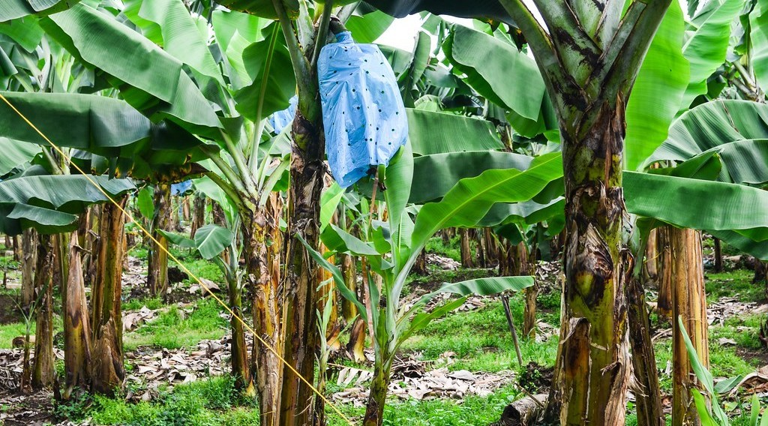
ECO. GEOGRAPHY — FORM 2 TECH
III. SOILS
Activity 5
A banana plantation.
2026 / 2027
DGCAST GAROUA — GEOGRAPHY DEPARTMENT
Mr KAMDEM E. | 26
Notes:
Without the projector: ask learners what grows around Buea and Limbe.

Slide 27
ECO. GEOGRAPHY — FORM 2 TECH
III. SOILS
Activity 5: Question
Near Mount Cameroon, farmers grow bananas and tea. Why are the soils there so fertile?
2026 / 2027
DGCAST GAROUA — GEOGRAPHY DEPARTMENT
Mr KAMDEM E. | 27

Slide 28
ECO. GEOGRAPHY — FORM 2 TECH
III. SOILS
Answer
They come from volcanic rocks.
2026 / 2027
DGCAST GAROUA — GEOGRAPHY DEPARTMENT
Mr KAMDEM E. | 28

Slide 29
ECO. GEOGRAPHY — FORM 2 TECH
BOARD SUMMARY
Africa
Topic: Regional Geography
Sub-topic: Africa
Lesson 6: Africa — Part 2: Climate, Soils and Relief of Africa
2026 / 2027
DGCAST GAROUA — GEOGRAPHY DEPARTMENT
Mr KAMDEM E. | 29
Notes:
Learners copy the board summary now. Give them enough time for each slide.

Slide 30
ECO. GEOGRAPHY — FORM 2 TECH
BOARD SUMMARY
I. Definitions
Relief: It is the shape of the land: high or low.
Rift valley: It is a long valley formed when land sinks.
Volcanic soil: It is a soil made from volcano rocks.
2026 / 2027
DGCAST GAROUA — GEOGRAPHY DEPARTMENT
Mr KAMDEM E. | 30

Slide 31
ECO. GEOGRAPHY — FORM 2 TECH
BOARD SUMMARY
II. Climate (1/2)
A. Equatorial: Hot and wet all year.
B. Tropical: A wet and a dry season.
C. Desert: Very little rain.
D. Mountain: Cooler because it is high.
2026 / 2027
DGCAST GAROUA — GEOGRAPHY DEPARTMENT
Mr KAMDEM E. | 31

Slide 32
ECO. GEOGRAPHY — FORM 2 TECH
BOARD SUMMARY
II. Climate (2/2)
Copy the main climate zones.
2026 / 2027
DGCAST GAROUA — GEOGRAPHY DEPARTMENT
Mr KAMDEM E. | 32

Slide 33
ECO. GEOGRAPHY — FORM 2 TECH
BOARD SUMMARY
III. Relief
A. Plateaux: High Africa in the south and east.
B. Basins: The Congo and Chad basins.
C. Mountains: Atlas (folded) and Kilimanjaro (volcano).
D. Rift Valley: It is in East Africa.
2026 / 2027
DGCAST GAROUA — GEOGRAPHY DEPARTMENT
Mr KAMDEM E. | 33

Slide 34
ECO. GEOGRAPHY — FORM 2 TECH
BOARD SUMMARY
IV. Soils
A. Red soils: In the forest and savanna.
B. Desert soils: Sandy and poor.
C. Volcanic soils: Very fertile (Mount Cameroon).
2026 / 2027
DGCAST GAROUA — GEOGRAPHY DEPARTMENT
Mr KAMDEM E. | 34

Slide 35
ECO. GEOGRAPHY — FORM 2 TECH
FORMATIVE EVALUATION
Formative Evaluation 1
Why is Nairobi cool though it is near the Equator?
2026 / 2027
DGCAST GAROUA — GEOGRAPHY DEPARTMENT
Mr KAMDEM E. | 35

Slide 36
ECO. GEOGRAPHY — FORM 2 TECH
FORMATIVE EVALUATION
Expected Answer
Because it is high.
2026 / 2027
DGCAST GAROUA — GEOGRAPHY DEPARTMENT
Mr KAMDEM E. | 36

Slide 37
ECO. GEOGRAPHY — FORM 2 TECH
FORMATIVE EVALUATION
Formative Evaluation 2
Why are the soils of Mount Cameroon fertile?
2026 / 2027
DGCAST GAROUA — GEOGRAPHY DEPARTMENT
Mr KAMDEM E. | 37

Slide 38
ECO. GEOGRAPHY — FORM 2 TECH
FORMATIVE EVALUATION
Expected Answer
They come from volcanic rocks.
2026 / 2027
DGCAST GAROUA — GEOGRAPHY DEPARTMENT
Mr KAMDEM E. | 38

Slide 39
ECO. GEOGRAPHY — FORM 2 TECH
REMEDIATION
Remediation
Fill in the blanks:
Around the Equator, the climate is ______.
The long valley of East Africa is the Great ______ Valley.
Soils made from volcano rocks are ______ soils.
2026 / 2027
DGCAST GAROUA — GEOGRAPHY DEPARTMENT
Mr KAMDEM E. | 39
Notes:
Answers: 1. equatorial 2. Rift 3. volcanic

Slide 40
ECO. GEOGRAPHY — FORM 2 TECH
HOMEWORK
Homework
Look at a map of Africa and write the names of three big rivers. Say into which ocean or sea each one flows.
This prepares Part 3: Vegetation and Drainage of Africa.
2026 / 2027
DGCAST GAROUA — GEOGRAPHY DEPARTMENT
Mr KAMDEM E. | 40
Notes:
This homework prepares the next lesson.

Slide 41
ECO. GEOGRAPHY — FORM 2 TECH
BILINGUAL GAME
Bilingual Game (Jeu Bilingue)
English | Français
Climate | Le climat
Relief | Le relief
Plateau | Le plateau
Basin | La cuvette (le bassin)
Rift Valley | La vallée du Rift
Volcano | Le volcan
Fertile | Fertile
Altitude | L'altitude
2026 / 2027
DGCAST GAROUA — GEOGRAPHY DEPARTMENT
Mr KAMDEM E. | 41
Notes:
Say the English word; learners give the French word, then the reverse.

Slide 42
ECO. GEOGRAPHY — FORM 2 TECH
LOGBOOK
Official Logbook (1/2)
Module / Topic | Regional Geography
Lesson Title | Lesson 6: Africa — Part 2: Climate, Soils and Relief of Africa
Expected Learning Outcomes | Describe the main climatic zones of Africa. Describe the main relief features of Africa. Describe the main soils of Africa.
Competence | Learners are able to relate the climate and relief of a place in Africa to the activities that people practise there.
2026 / 2027
DGCAST GAROUA — GEOGRAPHY DEPARTMENT
Mr KAMDEM E. | 42

Slide 43
ECO. GEOGRAPHY — FORM 2 TECH
LOGBOOK
Official Logbook (2/2)
Matter Taught | I. Definitions: Relief, Rift valley, Volcanic soil; II. Climate: Equatorial, Tropical, Desert, Mountain; III. Relief: Plateaux, Basins, Mountains, Rift Valley; IV. Soils: Red soils, Desert soils, Volcanic soils.
Evaluation | Formative evaluation (3 questions) and remediation exercise.
Homework | Look at a map of Africa and write the names of three big rivers. Say into which ocean or sea each one flows.
Enrolment / Present / Absent | ____ / ____ / ____
Achievement | To be completed by the teacher after the lesson.
2026 / 2027
DGCAST GAROUA — GEOGRAPHY DEPARTMENT
Mr KAMDEM E. | 43

Slide 44
ECO. GEOGRAPHY — FORM 2 TECH
TEACHER'S NOTE
Teacher's Note
Timing: Set-up, recall 8 min | Situation 8 min | 5 activities 25 min | Board summary (copying) 30 min | Evaluation, remediation 10 min | Homework 4 min | Logbook 10 min | Spare 5 min
2026 / 2027
DGCAST GAROUA — GEOGRAPHY DEPARTMENT
Mr KAMDEM E. | 44

Slide 45
ECO. GEOGRAPHY — FORM 2 TECH
REFERENCES
References
Harmonised Progression Sheet, Economic Geography (5051), Form 2.
Photo, Activity 2: “Carlo in the tea” by luigig, CC BY 2.0, via Flickr (https://www.flickr.com/photos/51035803402@N01/3175986747)
Photo, Activity 3: “Great Rift Valley” by GSAPP_SIDL, CC BY-NC-ND 2.0, via Flickr (https://www.flickr.com/photos/77974798@N04/7341392488)
Photo, Activity 4: “The Hills Are Alive - Morocco - Atlas Mountains - Mar 2018” by Gareth1953 All Right Now, CC BY 2.0, via Flickr (https://www.flickr.com/photos/40837632@N05/46588301775)
Photo, Activity 5: “20131110-DSC_4372” by jbdodane, CC BY-NC 2.0, via Flickr (https://www.flickr.com/photos/27998473@N02/11288779044)
Diagrams and animations: drawn for this lesson (DGCAST Geography Department).
2026 / 2027
DGCAST GAROUA — GEOGRAPHY DEPARTMENT
Mr KAMDEM E. | 45

