Slide 1

DIVINE GRACE COLLEGE OF ARTS, SCIENCE AND TECHNOLOGY
(DGCAST) — GAROUA | GEOGRAPHY DEPARTMENT
FORM 4 GEOGRAPHY — FURTHER STUDY 1
The Universe and the Moon
Mr KAMDEM EMMANUEL
Geography Teacher — PLEG
Academic Year 2026 / 2027
Notes:
Good morning, class. Today we do Further Study 1: the Universe and the Moon, and how the Moon affects our lives.

Slide 2
GEOGRAPHY — FORM 4
CLASS INFO
Class, Chapter & Duration
Class | Form 4
Chapter | The Earth as a Planet in the Solar System — The Earth as a Planet of the Solar System
Duration | 50 minutes
2026 / 2027
DGCAST GAROUA — GEOGRAPHY DEPARTMENT
Mr KAMDEM E. | 2

Slide 3
GEOGRAPHY — FORM 4
IDENTIFICATION
Lesson Identification
Topic | The Earth as a Planet in the Solar System
Sub-topic | The Earth as a Planet of the Solar System
Lesson | Further Study 1: The Universe and the Moon
Notions / Concepts | Universe, galaxy, star, satellite, phases of the Moon, tides.
Syllabus focus | Meaning and composition of the universe; links with planet Earth; the Moon: phases and impacts on the natural environment and on human activities.
Competence | Learners are able to recognise the phases of the Moon and to explain how the Moon affects tides, calendars and daily activities.
2026 / 2027
DGCAST GAROUA — GEOGRAPHY DEPARTMENT
Mr KAMDEM E. | 3

Slide 4
GEOGRAPHY — FORM 4
OBJECTIVES
Learning Objectives
By the end of the lesson, the learner should be able to:
Define the universe and a galaxy, and describe the place of the Earth in the universe.
Describe the phases of the Moon.
Explain the impacts of the Moon on the natural environment and on human activities.
2026 / 2027
DGCAST GAROUA — GEOGRAPHY DEPARTMENT
Mr KAMDEM E. | 4

Slide 5
GEOGRAPHY — FORM 4
RECALL
Recall
The Earth is an oblate spheroid.
Many proofs show that the Earth is round, such as the round shadow of the Earth on the Moon.
The Earth is one of the eight planets that move around the Sun.
2026 / 2027
DGCAST GAROUA — GEOGRAPHY DEPARTMENT
Mr KAMDEM E. | 5
Notes:
Check the homework: the drawings of the Moon. Ask learners why the shape changed.

Slide 6
GEOGRAPHY — FORM 4
REAL-LIFE SITUATION
Real-Life Situation
One evening, Hawaou sits outside with her grandmother. The full Moon lights up the compound. Grandmother says that people used to plant some crops according to the shape of the Moon. Hawaou wonders why the Moon changes its shape.
2026 / 2027
DGCAST GAROUA — GEOGRAPHY DEPARTMENT
Mr KAMDEM E. | 6
Notes:
Read the situation slowly, twice.

Slide 7
GEOGRAPHY — FORM 4
REAL-LIFE SITUATION
Situation — Question 1
What is the problem in the situation?
2026 / 2027
DGCAST GAROUA — GEOGRAPHY DEPARTMENT
Mr KAMDEM E. | 7

Slide 8
GEOGRAPHY — FORM 4
REAL-LIFE SITUATION
Answer
Hawaou does not know why the Moon changes its shape.
2026 / 2027
DGCAST GAROUA — GEOGRAPHY DEPARTMENT
Mr KAMDEM E. | 8

Slide 9
GEOGRAPHY — FORM 4
REAL-LIFE SITUATION
Situation — Question 2
What lights up the compound?
2026 / 2027
DGCAST GAROUA — GEOGRAPHY DEPARTMENT
Mr KAMDEM E. | 9

Slide 10
GEOGRAPHY — FORM 4
REAL-LIFE SITUATION
Answer
The full Moon.
2026 / 2027
DGCAST GAROUA — GEOGRAPHY DEPARTMENT
Mr KAMDEM E. | 10

Slide 11
GEOGRAPHY — FORM 4
REAL-LIFE SITUATION
Situation — Question 3
Where does the light of the Moon come from?
2026 / 2027
DGCAST GAROUA — GEOGRAPHY DEPARTMENT
Mr KAMDEM E. | 11

Slide 12
GEOGRAPHY — FORM 4
REAL-LIFE SITUATION
Possible Answer
From the Sun. The Moon has no light of its own.
2026 / 2027
DGCAST GAROUA — GEOGRAPHY DEPARTMENT
Mr KAMDEM E. | 12

Slide 13
GEOGRAPHY — FORM 4
JUSTIFICATION
Justification of the Lesson
This lesson helps us to know the universe, the Moon and its effects on our life.
2026 / 2027
DGCAST GAROUA — GEOGRAPHY DEPARTMENT
Mr KAMDEM E. | 13

Slide 14
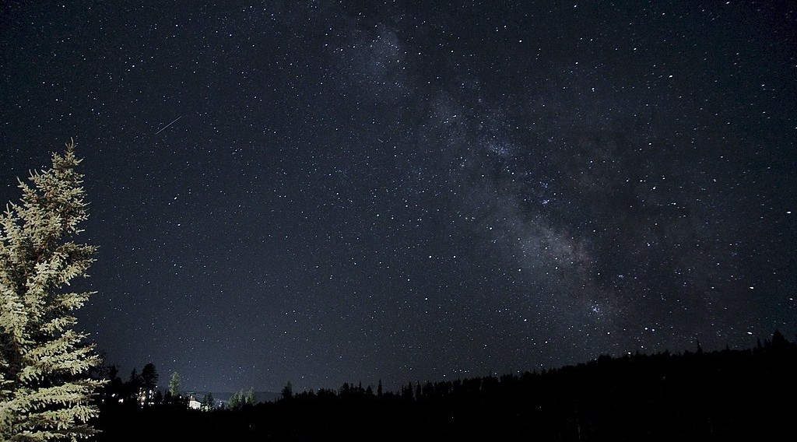
GEOGRAPHY — FORM 4
I. THE UNIVERSE
Activity 1
The Milky Way at night.
2026 / 2027
DGCAST GAROUA — GEOGRAPHY DEPARTMENT
Mr KAMDEM E. | 14
Notes:
Without the projector: ask learners to look at the night sky far from town lights.

Slide 15
GEOGRAPHY — FORM 4
I. THE UNIVERSE
Activity 1: Question
This band of light is made of billions of stars. What is it called?
2026 / 2027
DGCAST GAROUA — GEOGRAPHY DEPARTMENT
Mr KAMDEM E. | 15

Slide 16
GEOGRAPHY — FORM 4
I. THE UNIVERSE
Answer
The Milky Way, our galaxy.
2026 / 2027
DGCAST GAROUA — GEOGRAPHY DEPARTMENT
Mr KAMDEM E. | 16

Slide 17
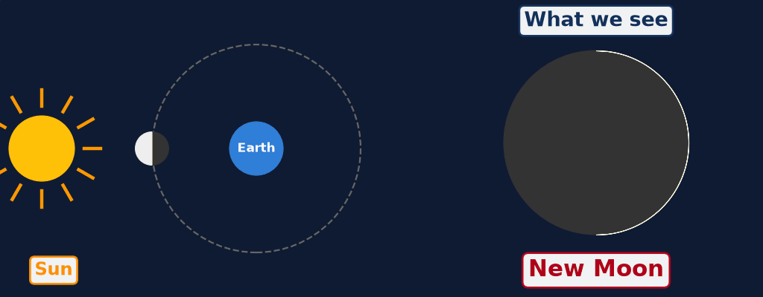
GEOGRAPHY — FORM 4
II. THE PHASES OF THE MOON
Activity 2
Animation: the Moon moves around the Earth.
2026 / 2027
DGCAST GAROUA — GEOGRAPHY DEPARTMENT
Mr KAMDEM E. | 17
Notes:
Without the projector: use a ball and a torch: move the ball around a learner's head.

Slide 18
GEOGRAPHY — FORM 4
II. THE PHASES OF THE MOON
Activity 2: Question
Why does the shape of the Moon seem to change?
2026 / 2027
DGCAST GAROUA — GEOGRAPHY DEPARTMENT
Mr KAMDEM E. | 18

Slide 19
GEOGRAPHY — FORM 4
II. THE PHASES OF THE MOON
Answer
The Sun lights half of the Moon. We see a different part of this lit half as the Moon moves.
2026 / 2027
DGCAST GAROUA — GEOGRAPHY DEPARTMENT
Mr KAMDEM E. | 19

Slide 20
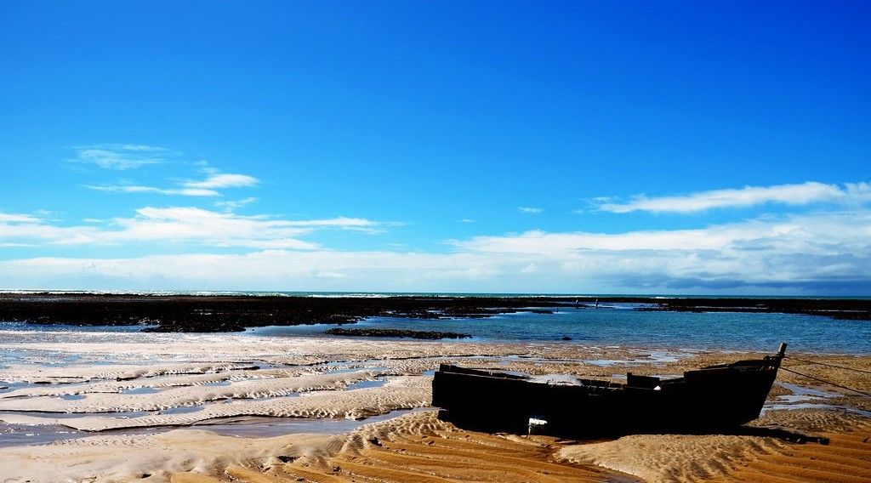
GEOGRAPHY — FORM 4
III. IMPACTS OF THE MOON
Activity 3
Boats on the sand when the sea is low.
2026 / 2027
DGCAST GAROUA — GEOGRAPHY DEPARTMENT
Mr KAMDEM E. | 20
Notes:
Without the projector: describe the beach at Kribi in the morning and in the evening.

Slide 21
GEOGRAPHY — FORM 4
III. IMPACTS OF THE MOON
Activity 3: Question
The sea goes down and comes back twice a day. What causes this?
2026 / 2027
DGCAST GAROUA — GEOGRAPHY DEPARTMENT
Mr KAMDEM E. | 21

Slide 22
GEOGRAPHY — FORM 4
III. IMPACTS OF THE MOON
Answer
The pull (gravity) of the Moon. This is the tide.
2026 / 2027
DGCAST GAROUA — GEOGRAPHY DEPARTMENT
Mr KAMDEM E. | 22

Slide 23
GEOGRAPHY — FORM 4
BOARD SUMMARY
The Universe and the Moon
Topic: The Earth as a Planet in the Solar System
Sub-topic: The Earth as a Planet of the Solar System
Further Study 1: The Universe and the Moon
2026 / 2027
DGCAST GAROUA — GEOGRAPHY DEPARTMENT
Mr KAMDEM E. | 23
Notes:
Learners copy the board summary now. Give them enough time for each slide.

Slide 24
GEOGRAPHY — FORM 4
BOARD SUMMARY
I. Definitions
Universe: It is all of space and everything in it.
Galaxy: It is a huge group of stars.
Satellite: It is a body that moves around a planet.
Phases of the Moon: They are the shapes of the Moon that we see.
2026 / 2027
DGCAST GAROUA — GEOGRAPHY DEPARTMENT
Mr KAMDEM E. | 24

Slide 25
GEOGRAPHY — FORM 4
BOARD SUMMARY
II. The Universe
A. Galaxies: Our galaxy is the Milky Way.
B. The Sun: It gives light and heat to the Earth.
C. The Moon: It is the satellite of the Earth.
2026 / 2027
DGCAST GAROUA — GEOGRAPHY DEPARTMENT
Mr KAMDEM E. | 25

Slide 26
GEOGRAPHY — FORM 4
BOARD SUMMARY
III. The Phases of the Moon (1/2)
A. New Moon: We do not see the Moon.
B. First quarter: We see the right half.
C. Full Moon: We see the whole Moon.
D. Last quarter: We see the left half.
2026 / 2027
DGCAST GAROUA — GEOGRAPHY DEPARTMENT
Mr KAMDEM E. | 26

Slide 27
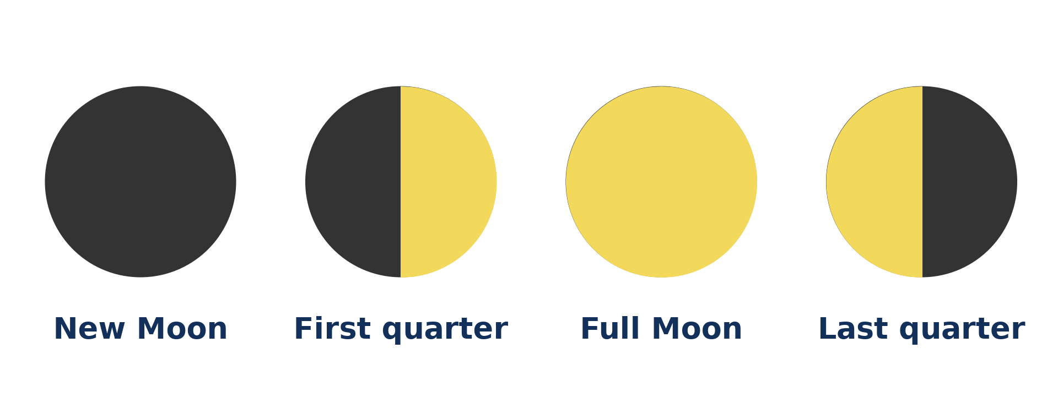
GEOGRAPHY — FORM 4
BOARD SUMMARY
III. The Phases of the Moon (2/2)
Copy the four main phases.
2026 / 2027
DGCAST GAROUA — GEOGRAPHY DEPARTMENT
Mr KAMDEM E. | 27

Slide 28
GEOGRAPHY — FORM 4
BOARD SUMMARY
IV. Impacts of the Moon
A. Tides: The Moon pulls the water of the sea.
B. Fishing: Fishermen use the times of the tide.
C. Calendar: Ramadan begins with the new Moon.
2026 / 2027
DGCAST GAROUA — GEOGRAPHY DEPARTMENT
Mr KAMDEM E. | 28

Slide 29
GEOGRAPHY — FORM 4
FORMATIVE EVALUATION
Formative Evaluation 1
What is a galaxy? Name our galaxy.
2026 / 2027
DGCAST GAROUA — GEOGRAPHY DEPARTMENT
Mr KAMDEM E. | 29

Slide 30
GEOGRAPHY — FORM 4
FORMATIVE EVALUATION
Expected Answer
A huge group of stars. Ours is the Milky Way.
2026 / 2027
DGCAST GAROUA — GEOGRAPHY DEPARTMENT
Mr KAMDEM E. | 30

Slide 31
GEOGRAPHY — FORM 4
FORMATIVE EVALUATION
Formative Evaluation 2
What causes the tides?
2026 / 2027
DGCAST GAROUA — GEOGRAPHY DEPARTMENT
Mr KAMDEM E. | 31

Slide 32
GEOGRAPHY — FORM 4
FORMATIVE EVALUATION
Expected Answer
The pull (gravity) of the Moon.
2026 / 2027
DGCAST GAROUA — GEOGRAPHY DEPARTMENT
Mr KAMDEM E. | 32

Slide 33
GEOGRAPHY — FORM 4
REMEDIATION
Remediation
Fill in the blanks:
Our galaxy is called the ______ Way.
When we see the whole Moon, it is the ______ Moon.
The rise and fall of the sea are called ______.
2026 / 2027
DGCAST GAROUA — GEOGRAPHY DEPARTMENT
Mr KAMDEM E. | 33
Notes:
Answers: 1. Milky 2. Full 3. tides

Slide 34
GEOGRAPHY — FORM 4
HOMEWORK
Homework
Look at a map of Cameroon in your atlas. Find the numbers written on the edges of the map and copy the numbers written near Garoua.
This prepares Lesson 2: Earth Divisions — Latitudes and Longitudes.
2026 / 2027
DGCAST GAROUA — GEOGRAPHY DEPARTMENT
Mr KAMDEM E. | 34
Notes:
This homework prepares the next lesson.

Slide 35
GEOGRAPHY — FORM 4
BILINGUAL GAME
Bilingual Game (Jeu Bilingue)
English | Français
Universe | L'univers
Galaxy | La galaxie
Star | L'étoile
Satellite | Le satellite
Full Moon | La pleine lune
New Moon | La nouvelle lune
Tide | La marée
Gravity | La gravité
2026 / 2027
DGCAST GAROUA — GEOGRAPHY DEPARTMENT
Mr KAMDEM E. | 35
Notes:
Say the English word; learners give the French word, then the reverse.

Slide 36
GEOGRAPHY — FORM 4
LOGBOOK
Official Logbook (1/2)
Module / Topic | The Earth as a Planet in the Solar System
Lesson Title | Further Study 1: The Universe and the Moon
Expected Learning Outcomes | Define the universe and a galaxy, and describe the place of the Earth in the universe. Describe the phases of the Moon. Explain the impacts of the Moon on the natural environment and on human activities.
Competence | Learners are able to recognise the phases of the Moon and to explain how the Moon affects tides, calendars and daily activities.
2026 / 2027
DGCAST GAROUA — GEOGRAPHY DEPARTMENT
Mr KAMDEM E. | 36

Slide 37
GEOGRAPHY — FORM 4
LOGBOOK
Official Logbook (2/2)
Matter Taught | I. Definitions: Universe, Galaxy, Satellite, Phases of the Moon; II. The Universe: Galaxies, The Sun, The Moon; III. The Phases of the Moon: New Moon, First quarter, Full Moon, Last quarter; IV. Impacts of the Moon: Tides, Fishing, Calendar.
Evaluation | Formative evaluation (3 questions) and remediation exercise.
Homework | Look at a map of Cameroon in your atlas. Find the numbers written on the edges of the map and copy the numbers written near Garoua.
Enrolment / Present / Absent | ____ / ____ / ____
Achievement | To be completed by the teacher after the lesson.
2026 / 2027
DGCAST GAROUA — GEOGRAPHY DEPARTMENT
Mr KAMDEM E. | 37

Slide 38
GEOGRAPHY — FORM 4
TEACHER'S NOTE
Teacher's Note
Timing: Set-up, recall 5 min | Situation 5 min | 3 activities 12 min | Board summary (copying) 15 min | Evaluation, homework 5 min | Logbook 5 min | Spare 3 min
Activity 2 is an animation (GIF): it plays automatically in slide-show mode.
2026 / 2027
DGCAST GAROUA — GEOGRAPHY DEPARTMENT
Mr KAMDEM E. | 38

Slide 39
GEOGRAPHY — FORM 4
REFERENCES
References
National Geography Syllabus (MINESEC), Form 4 — The Earth as a Planet in the Solar System.
Teacher's lesson notes (Form 4), checked and corrected where necessary.
Photo, Activity 1: “Telluride Milky Way Night Sky With Satellite Streak” by wienotfilms, CC BY-NC 2.0, via Flickr (https://www.flickr.com/photos/76583523@N05/14781116206)
Photo, Activity 3: “Praia de Itapororoca” by Rodrigo_Soldon, CC BY-ND 2.0, via Flickr (https://www.flickr.com/photos/8865243@N02/10838180494)
Diagrams and animations: drawn for this lesson (DGCAST Geography Department).
2026 / 2027
DGCAST GAROUA — GEOGRAPHY DEPARTMENT
Mr KAMDEM E. | 39

