Slide 1

DIVINE GRACE COLLEGE OF ARTS, SCIENCE AND TECHNOLOGY
(DGCAST) — GAROUA | GEOGRAPHY DEPARTMENT
FORM 4 GEOGRAPHY — LESSON 3
Great Circles and the International Date Line
Mr KAMDEM EMMANUEL
Geography Teacher — PLEG
Academic Year 2026 / 2027
Notes:
Good morning, class. Today we study Lesson 3: Great Circles and the International Date Line.

Slide 2
GEOGRAPHY — FORM 4
CLASS INFO
Class, Chapter & Duration
Class | Form 4
Chapter | The Earth as a Planet in the Solar System — Location and Time
Duration | 50 minutes
2026 / 2027
DGCAST GAROUA — GEOGRAPHY DEPARTMENT
Mr KAMDEM E. | 2

Slide 3
GEOGRAPHY — FORM 4
IDENTIFICATION
Lesson Identification
Topic | The Earth as a Planet in the Solar System
Sub-topic | Location and Time
Lesson | Lesson 3: Great Circles and the International Date Line
Notions / Concepts | Great circle, small circle, shortest route, date line.
Syllabus focus | Great circles and the International Date Line: meaning, illustrations and importance.
Competence | Learners are able to explain why aeroplanes follow curved routes, and why the date changes when people cross the Pacific Ocean.
2026 / 2027
DGCAST GAROUA — GEOGRAPHY DEPARTMENT
Mr KAMDEM E. | 3

Slide 4
GEOGRAPHY — FORM 4
OBJECTIVES
Learning Objectives
By the end of the lesson, the learner should be able to:
Define a great circle and a small circle, with examples.
Give the importance of great circles.
Describe the International Date Line and explain its importance.
2026 / 2027
DGCAST GAROUA — GEOGRAPHY DEPARTMENT
Mr KAMDEM E. | 4

Slide 5
GEOGRAPHY — FORM 4
RECALL
Recall
Latitudes are parallel lines; the Equator is the longest.
Longitudes meet at the poles.
The 180° meridian is opposite the Prime Meridian.
2026 / 2027
DGCAST GAROUA — GEOGRAPHY DEPARTMENT
Mr KAMDEM E. | 5
Notes:
Check the homework on the route of aeroplanes.

Slide 6
GEOGRAPHY — FORM 4
REAL-LIFE SITUATION
Real-Life Situation
On 31 December, Fatimé watches the news. In the afternoon, people in Australia are already celebrating the New Year. After midnight in Garoua, people in America are still waiting.
2026 / 2027
DGCAST GAROUA — GEOGRAPHY DEPARTMENT
Mr KAMDEM E. | 6
Notes:
Read the situation slowly, twice.

Slide 7
GEOGRAPHY — FORM 4
REAL-LIFE SITUATION
Situation — Question 1
What is the problem in the situation?
2026 / 2027
DGCAST GAROUA — GEOGRAPHY DEPARTMENT
Mr KAMDEM E. | 7

Slide 8
GEOGRAPHY — FORM 4
REAL-LIFE SITUATION
Answer
Fatimé does not understand why the New Year comes at different times.
2026 / 2027
DGCAST GAROUA — GEOGRAPHY DEPARTMENT
Mr KAMDEM E. | 8

Slide 9
GEOGRAPHY — FORM 4
REAL-LIFE SITUATION
Situation — Question 2
Which country celebrates first?
2026 / 2027
DGCAST GAROUA — GEOGRAPHY DEPARTMENT
Mr KAMDEM E. | 9

Slide 10
GEOGRAPHY — FORM 4
REAL-LIFE SITUATION
Answer
Australia (and New Zealand).
2026 / 2027
DGCAST GAROUA — GEOGRAPHY DEPARTMENT
Mr KAMDEM E. | 10

Slide 11
GEOGRAPHY — FORM 4
REAL-LIFE SITUATION
Situation — Question 3
Which line decides where a new day begins?
2026 / 2027
DGCAST GAROUA — GEOGRAPHY DEPARTMENT
Mr KAMDEM E. | 11

Slide 12
GEOGRAPHY — FORM 4
REAL-LIFE SITUATION
Possible Answer
The International Date Line.
2026 / 2027
DGCAST GAROUA — GEOGRAPHY DEPARTMENT
Mr KAMDEM E. | 12

Slide 13
GEOGRAPHY — FORM 4
JUSTIFICATION
Justification of the Lesson
This lesson helps us to know great circles and the line where each new day begins.
2026 / 2027
DGCAST GAROUA — GEOGRAPHY DEPARTMENT
Mr KAMDEM E. | 13

Slide 14
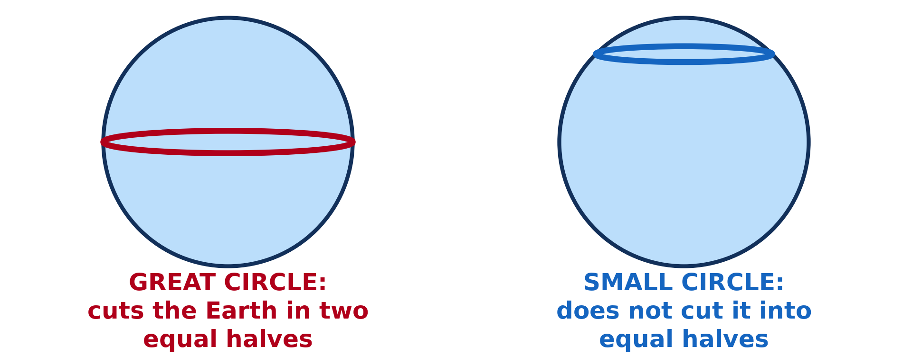
GEOGRAPHY — FORM 4
I. GREAT CIRCLES
Activity 1
A great circle and a small circle.
2026 / 2027
DGCAST GAROUA — GEOGRAPHY DEPARTMENT
Mr KAMDEM E. | 14
Notes:
Without the projector: cut an orange in two equal halves, then cut a small piece from the top.

Slide 15
GEOGRAPHY — FORM 4
I. GREAT CIRCLES
Activity 1: Question
Which circle cuts the Earth into two equal halves?
2026 / 2027
DGCAST GAROUA — GEOGRAPHY DEPARTMENT
Mr KAMDEM E. | 15

Slide 16
GEOGRAPHY — FORM 4
I. GREAT CIRCLES
Answer
The great circle, like the Equator.
2026 / 2027
DGCAST GAROUA — GEOGRAPHY DEPARTMENT
Mr KAMDEM E. | 16

Slide 17
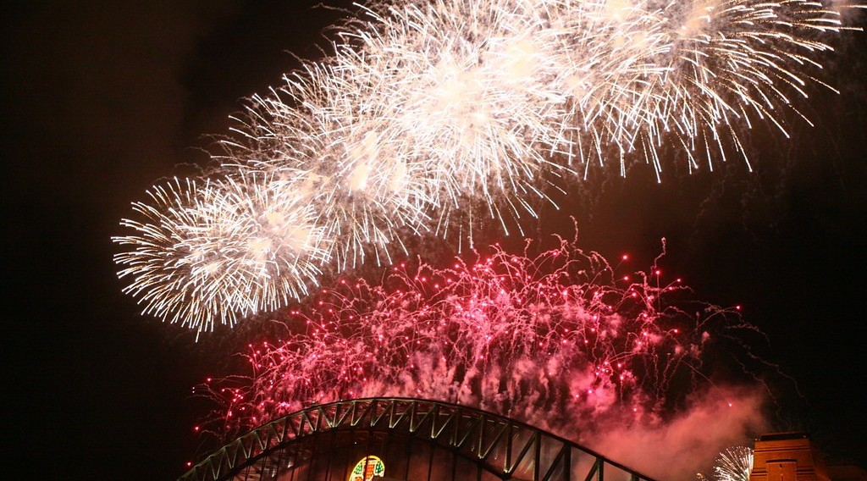
GEOGRAPHY — FORM 4
II. THE DATE LINE
Activity 2
New Year fireworks in Sydney, Australia.
2026 / 2027
DGCAST GAROUA — GEOGRAPHY DEPARTMENT
Mr KAMDEM E. | 17
Notes:
Without the projector: ask learners who has seen the New Year on television.

Slide 18
GEOGRAPHY — FORM 4
II. THE DATE LINE
Activity 2: Question
Why does Australia see the New Year before Cameroon?
2026 / 2027
DGCAST GAROUA — GEOGRAPHY DEPARTMENT
Mr KAMDEM E. | 18

Slide 19
GEOGRAPHY — FORM 4
II. THE DATE LINE
Answer
It is far to the east, near the Date Line, where each new day begins.
2026 / 2027
DGCAST GAROUA — GEOGRAPHY DEPARTMENT
Mr KAMDEM E. | 19

Slide 20

GEOGRAPHY — FORM 4
II. THE DATE LINE
Activity 3
The International Date Line in the Pacific Ocean.
2026 / 2027
DGCAST GAROUA — GEOGRAPHY DEPARTMENT
Mr KAMDEM E. | 20
Notes:
Without the projector: draw a line and write MONDAY on the left and SUNDAY on the right.

Slide 21
GEOGRAPHY — FORM 4
II. THE DATE LINE
Activity 3: Question
West of the line it is Monday. What day is it east of the line?
2026 / 2027
DGCAST GAROUA — GEOGRAPHY DEPARTMENT
Mr KAMDEM E. | 21

Slide 22
GEOGRAPHY — FORM 4
II. THE DATE LINE
Answer
Sunday: one day behind.
2026 / 2027
DGCAST GAROUA — GEOGRAPHY DEPARTMENT
Mr KAMDEM E. | 22

Slide 23
GEOGRAPHY — FORM 4
BOARD SUMMARY
Great Circles and the International Date Line
Topic: The Earth as a Planet in the Solar System
Sub-topic: Location and Time
Lesson 3: Great Circles and the International Date Line
2026 / 2027
DGCAST GAROUA — GEOGRAPHY DEPARTMENT
Mr KAMDEM E. | 23
Notes:
Learners copy the board summary now. Give them enough time for each slide.

Slide 24
GEOGRAPHY — FORM 4
BOARD SUMMARY
I. Definitions
Great circle: It is a circle that cuts the Earth into two equal halves.
Small circle: It is a circle that does not cut the Earth into equal halves.
International Date Line: It is the line where each new day begins.
2026 / 2027
DGCAST GAROUA — GEOGRAPHY DEPARTMENT
Mr KAMDEM E. | 24

Slide 25
GEOGRAPHY — FORM 4
BOARD SUMMARY
II. Great Circles (1/2)
A. Examples: The Equator and every meridian with its opposite.
B. Importance: A great circle is the shortest way between two places.
C. Use: Pilots and ships follow great circles.
2026 / 2027
DGCAST GAROUA — GEOGRAPHY DEPARTMENT
Mr KAMDEM E. | 25

Slide 26
GEOGRAPHY — FORM 4
BOARD SUMMARY
II. Great Circles (2/2)
Copy the two circles.
2026 / 2027
DGCAST GAROUA — GEOGRAPHY DEPARTMENT
Mr KAMDEM E. | 26

Slide 27
GEOGRAPHY — FORM 4
BOARD SUMMARY
III. The International Date Line
A. Place: It follows 180° in the Pacific Ocean.
B. Shape: It bends to avoid countries.
C. Going west: We add one day.
D. Going east: We remove one day.
2026 / 2027
DGCAST GAROUA — GEOGRAPHY DEPARTMENT
Mr KAMDEM E. | 27

Slide 28
GEOGRAPHY — FORM 4
FORMATIVE EVALUATION
Formative Evaluation 1
Is the Equator a great circle? Why?
2026 / 2027
DGCAST GAROUA — GEOGRAPHY DEPARTMENT
Mr KAMDEM E. | 28

Slide 29
GEOGRAPHY — FORM 4
FORMATIVE EVALUATION
Expected Answer
Yes. It cuts the Earth into two equal halves.
2026 / 2027
DGCAST GAROUA — GEOGRAPHY DEPARTMENT
Mr KAMDEM E. | 29

Slide 30
GEOGRAPHY — FORM 4
FORMATIVE EVALUATION
Formative Evaluation 2
What happens to the date when we cross the Date Line going west?
2026 / 2027
DGCAST GAROUA — GEOGRAPHY DEPARTMENT
Mr KAMDEM E. | 30

Slide 31
GEOGRAPHY — FORM 4
FORMATIVE EVALUATION
Expected Answer
We add one day.
2026 / 2027
DGCAST GAROUA — GEOGRAPHY DEPARTMENT
Mr KAMDEM E. | 31

Slide 32
GEOGRAPHY — FORM 4
REMEDIATION
Remediation
Fill in the blanks:
A circle that cuts the Earth into two equal halves is a ______ circle.
The International Date Line follows the ______ degree line.
Crossing the line going west, we ______ one day.
2026 / 2027
DGCAST GAROUA — GEOGRAPHY DEPARTMENT
Mr KAMDEM E. | 32
Notes:
Answers: 1. great 2. 180th 3. add

Slide 33
GEOGRAPHY — FORM 4
HOMEWORK
Homework
Bring an atlas, a ruler and a pencil to the next lesson. Find the map of Cameroon in your atlas.
This prepares Practical Work 1: Locate a Place on a Map.
2026 / 2027
DGCAST GAROUA — GEOGRAPHY DEPARTMENT
Mr KAMDEM E. | 33
Notes:
This homework prepares the next lesson.

Slide 34
GEOGRAPHY — FORM 4
BILINGUAL GAME
Bilingual Game (Jeu Bilingue)
English | Français
Great circle | Le grand cercle
Small circle | Le petit cercle
Shortest route | Le chemin le plus court
Date Line | La ligne de changement de date
Pacific Ocean | L'océan Pacifique
Date | La date
Day | Le jour
Traveller | Le voyageur
2026 / 2027
DGCAST GAROUA — GEOGRAPHY DEPARTMENT
Mr KAMDEM E. | 34
Notes:
Say the English word; learners give the French word, then the reverse.

Slide 35
GEOGRAPHY — FORM 4
LOGBOOK
Official Logbook (1/2)
Module / Topic | The Earth as a Planet in the Solar System
Lesson Title | Lesson 3: Great Circles and the International Date Line
Expected Learning Outcomes | Define a great circle and a small circle, with examples. Give the importance of great circles. Describe the International Date Line and explain its importance.
Competence | Learners are able to explain why aeroplanes follow curved routes, and why the date changes when people cross the Pacific Ocean.
2026 / 2027
DGCAST GAROUA — GEOGRAPHY DEPARTMENT
Mr KAMDEM E. | 35

Slide 36
GEOGRAPHY — FORM 4
LOGBOOK
Official Logbook (2/2)
Matter Taught | I. Definitions: Great circle, Small circle, International Date Line; II. Great Circles: Examples, Importance, Use; III. The International Date Line: Place, Shape, Going west, Going east.
Evaluation | Formative evaluation (3 questions) and remediation exercise.
Homework | Bring an atlas, a ruler and a pencil to the next lesson. Find the map of Cameroon in your atlas.
Enrolment / Present / Absent | ____ / ____ / ____
Achievement | To be completed by the teacher after the lesson.
2026 / 2027
DGCAST GAROUA — GEOGRAPHY DEPARTMENT
Mr KAMDEM E. | 36

Slide 37
GEOGRAPHY — FORM 4
TEACHER'S NOTE
Teacher's Note
Timing: Set-up, recall 5 min | Situation 5 min | 3 activities 12 min | Board summary (copying) 15 min | Evaluation, homework 5 min | Logbook 5 min | Spare 3 min
2026 / 2027
DGCAST GAROUA — GEOGRAPHY DEPARTMENT
Mr KAMDEM E. | 37

Slide 38
GEOGRAPHY — FORM 4
REFERENCES
References
National Geography Syllabus (MINESEC), Form 4 — The Earth as a Planet in the Solar System.
Teacher's lesson notes (Form 4), checked and corrected where necessary.
Photo, Activity 2: “New Year's Fireworks - Sydney Harbour” by Charlie Brewer, CC BY-NC-SA 2.0, via Flickr (https://www.flickr.com/photos/11827916@N00/2157381693)
Diagrams and animations: drawn for this lesson (DGCAST Geography Department).
2026 / 2027
DGCAST GAROUA — GEOGRAPHY DEPARTMENT
Mr KAMDEM E. | 38

