Slide 1

DIVINE GRACE COLLEGE OF ARTS, SCIENCE AND TECHNOLOGY
(DGCAST) — GAROUA | GEOGRAPHY DEPARTMENT
FORM 4 GEOGRAPHY — LESSON 4
Local Time, Standard Time and Time Zones
Mr KAMDEM EMMANUEL
Geography Teacher — PLEG
Academic Year 2026 / 2027
Notes:
Good morning, class. Today we study Lesson 4: Local Time, Standard Time and Time Zones.

Slide 2
GEOGRAPHY — FORM 4
CLASS INFO
Class, Chapter & Duration
Class | Form 4
Chapter | The Earth as a Planet in the Solar System — Location and Time
Duration | 50 minutes
2026 / 2027
DGCAST GAROUA — GEOGRAPHY DEPARTMENT
Mr KAMDEM E. | 2

Slide 3
GEOGRAPHY — FORM 4
IDENTIFICATION
Lesson Identification
Topic | The Earth as a Planet in the Solar System
Sub-topic | Location and Time
Lesson | Lesson 4: Local Time, Standard Time and Time Zones
Notions / Concepts | Local time, standard time, time zone, Greenwich Mean Time (GMT).
Syllabus focus | Local time, standard time and time zones: meaning, illustrations, reasons for time zones; why some countries have many time zones.
Competence | Learners are able to explain why the time is different in other countries, and to find the time of a match or a call abroad.
2026 / 2027
DGCAST GAROUA — GEOGRAPHY DEPARTMENT
Mr KAMDEM E. | 3

Slide 4
GEOGRAPHY — FORM 4
OBJECTIVES
Learning Objectives
By the end of the lesson, the learner should be able to:
Define local time and standard time.
Explain the meaning of time zones and why they exist.
Explain why some countries have many time zones.
2026 / 2027
DGCAST GAROUA — GEOGRAPHY DEPARTMENT
Mr KAMDEM E. | 4

Slide 5
GEOGRAPHY — FORM 4
RECALL
Recall
Longitudes measure the distance east or west of the Prime Meridian.
The Earth turns from west to east.
Garoua is at about 13° E.
2026 / 2027
DGCAST GAROUA — GEOGRAPHY DEPARTMENT
Mr KAMDEM E. | 5
Notes:
Check the homework: the time in Cameroon and in another country.

Slide 6
GEOGRAPHY — FORM 4
REAL-LIFE SITUATION
Real-Life Situation
The Indomitable Lions play a match in Brazil. The match starts at 3 p.m. in Brazil, but in Garoua we watch it at 7 p.m. Alima wonders why the time is not the same everywhere.
2026 / 2027
DGCAST GAROUA — GEOGRAPHY DEPARTMENT
Mr KAMDEM E. | 6
Notes:
Read the situation slowly, twice.

Slide 7
GEOGRAPHY — FORM 4
REAL-LIFE SITUATION
Situation — Question 1
What is the problem in the situation?
2026 / 2027
DGCAST GAROUA — GEOGRAPHY DEPARTMENT
Mr KAMDEM E. | 7

Slide 8
GEOGRAPHY — FORM 4
REAL-LIFE SITUATION
Answer
Alima does not know why Brazil and Garoua have different times.
2026 / 2027
DGCAST GAROUA — GEOGRAPHY DEPARTMENT
Mr KAMDEM E. | 8

Slide 9
GEOGRAPHY — FORM 4
REAL-LIFE SITUATION
Situation — Question 2
What is the time difference?
2026 / 2027
DGCAST GAROUA — GEOGRAPHY DEPARTMENT
Mr KAMDEM E. | 9

Slide 10
GEOGRAPHY — FORM 4
REAL-LIFE SITUATION
Answer
4 hours.
2026 / 2027
DGCAST GAROUA — GEOGRAPHY DEPARTMENT
Mr KAMDEM E. | 10

Slide 11
GEOGRAPHY — FORM 4
REAL-LIFE SITUATION
Situation — Question 3
Why is it later in Garoua?
2026 / 2027
DGCAST GAROUA — GEOGRAPHY DEPARTMENT
Mr KAMDEM E. | 11

Slide 12
GEOGRAPHY — FORM 4
REAL-LIFE SITUATION
Possible Answer
Garoua is east of Brazil. The Sun rises there first.
2026 / 2027
DGCAST GAROUA — GEOGRAPHY DEPARTMENT
Mr KAMDEM E. | 12

Slide 13
GEOGRAPHY — FORM 4
JUSTIFICATION
Justification of the Lesson
This lesson helps us to understand why time changes from place to place.
2026 / 2027
DGCAST GAROUA — GEOGRAPHY DEPARTMENT
Mr KAMDEM E. | 13

Slide 14

GEOGRAPHY — FORM 4
I. LOCAL TIME
Activity 1
15° of longitude = 1 hour.
2026 / 2027
DGCAST GAROUA — GEOGRAPHY DEPARTMENT
Mr KAMDEM E. | 14
Notes:
Without the projector: draw the time line on the board.

Slide 15
GEOGRAPHY — FORM 4
I. LOCAL TIME
Activity 1: Question
It is 12:00 at 0°. What time is it at 15° E and at 15° W?
2026 / 2027
DGCAST GAROUA — GEOGRAPHY DEPARTMENT
Mr KAMDEM E. | 15

Slide 16
GEOGRAPHY — FORM 4
I. LOCAL TIME
Answer
13:00 at 15° E, 11:00 at 15° W.
2026 / 2027
DGCAST GAROUA — GEOGRAPHY DEPARTMENT
Mr KAMDEM E. | 16

Slide 17

GEOGRAPHY — FORM 4
II. TIME ZONES
Activity 2
The time zones of the world.
2026 / 2027
DGCAST GAROUA — GEOGRAPHY DEPARTMENT
Mr KAMDEM E. | 17
Notes:
Without the projector: draw 24 strips on the board.

Slide 18
GEOGRAPHY — FORM 4
II. TIME ZONES
Activity 2: Question
How many time zones are there? In which one is Cameroon?
2026 / 2027
DGCAST GAROUA — GEOGRAPHY DEPARTMENT
Mr KAMDEM E. | 18

Slide 19
GEOGRAPHY — FORM 4
II. TIME ZONES
Answer
24 time zones. Cameroon is in GMT + 1.
2026 / 2027
DGCAST GAROUA — GEOGRAPHY DEPARTMENT
Mr KAMDEM E. | 19

Slide 20
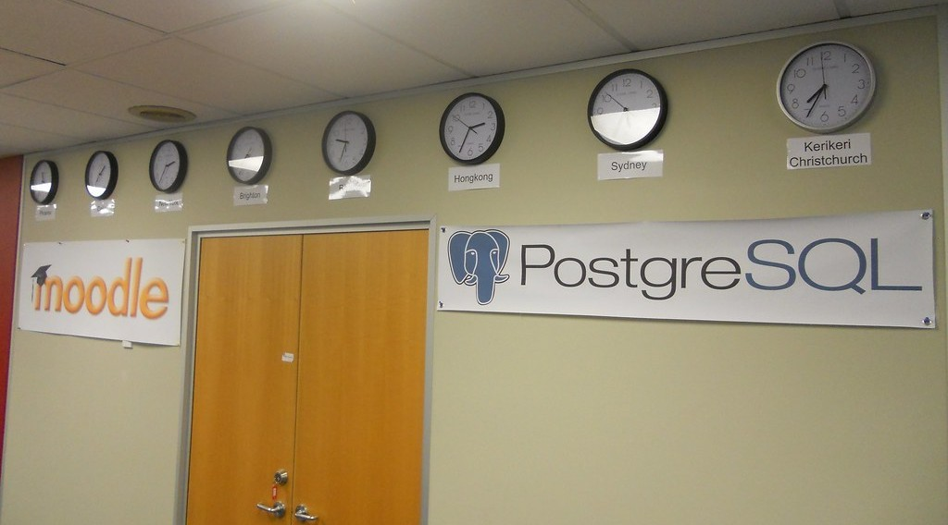
GEOGRAPHY — FORM 4
II. TIME ZONES
Activity 3
Clocks showing the time in different cities.
2026 / 2027
DGCAST GAROUA — GEOGRAPHY DEPARTMENT
Mr KAMDEM E. | 20
Notes:
Without the projector: ask learners to compare the time on a phone set to another country.

Slide 21
GEOGRAPHY — FORM 4
II. TIME ZONES
Activity 3: Question
Why do these clocks show different times?
2026 / 2027
DGCAST GAROUA — GEOGRAPHY DEPARTMENT
Mr KAMDEM E. | 21

Slide 22
GEOGRAPHY — FORM 4
II. TIME ZONES
Answer
Each city is in a different time zone.
2026 / 2027
DGCAST GAROUA — GEOGRAPHY DEPARTMENT
Mr KAMDEM E. | 22

Slide 23
GEOGRAPHY — FORM 4
BOARD SUMMARY
Local Time, Standard Time and Time Zones
Topic: The Earth as a Planet in the Solar System
Sub-topic: Location and Time
Lesson 4: Local Time, Standard Time and Time Zones
2026 / 2027
DGCAST GAROUA — GEOGRAPHY DEPARTMENT
Mr KAMDEM E. | 23
Notes:
Learners copy the board summary now. Give them enough time for each slide.

Slide 24
GEOGRAPHY — FORM 4
BOARD SUMMARY
I. Definitions
Local time: It is the time given by the Sun in a place.
Standard time: It is the official time of a country or zone.
Time zone: It is an area where people use the same time.
2026 / 2027
DGCAST GAROUA — GEOGRAPHY DEPARTMENT
Mr KAMDEM E. | 24

Slide 25
GEOGRAPHY — FORM 4
BOARD SUMMARY
II. Local and Standard Time (1/2)
A. The rule: 15° = 1 hour and 1° = 4 minutes.
B. East: Places to the east are ahead.
C. Cameroon: It uses West Africa Time (GMT + 1).
2026 / 2027
DGCAST GAROUA — GEOGRAPHY DEPARTMENT
Mr KAMDEM E. | 25

Slide 26
GEOGRAPHY — FORM 4
BOARD SUMMARY
II. Local and Standard Time (2/2)
Copy the time line.
2026 / 2027
DGCAST GAROUA — GEOGRAPHY DEPARTMENT
Mr KAMDEM E. | 26

Slide 27
GEOGRAPHY — FORM 4
BOARD SUMMARY
III. Time Zones
A. Number: There are 24 main time zones.
B. Width: Each zone is about 15° wide.
C. Big countries: Russia has 11 time zones.
2026 / 2027
DGCAST GAROUA — GEOGRAPHY DEPARTMENT
Mr KAMDEM E. | 27

Slide 28
GEOGRAPHY — FORM 4
FORMATIVE EVALUATION
Formative Evaluation 1
How many degrees does the Earth turn in one hour?
2026 / 2027
DGCAST GAROUA — GEOGRAPHY DEPARTMENT
Mr KAMDEM E. | 28

Slide 29
GEOGRAPHY — FORM 4
FORMATIVE EVALUATION
Expected Answer
15°.
2026 / 2027
DGCAST GAROUA — GEOGRAPHY DEPARTMENT
Mr KAMDEM E. | 29

Slide 30
GEOGRAPHY — FORM 4
FORMATIVE EVALUATION
Formative Evaluation 2
What is the standard time of Cameroon?
2026 / 2027
DGCAST GAROUA — GEOGRAPHY DEPARTMENT
Mr KAMDEM E. | 30

Slide 31
GEOGRAPHY — FORM 4
FORMATIVE EVALUATION
Expected Answer
West Africa Time, GMT + 1.
2026 / 2027
DGCAST GAROUA — GEOGRAPHY DEPARTMENT
Mr KAMDEM E. | 31

Slide 32
GEOGRAPHY — FORM 4
REMEDIATION
Remediation
Fill in the blanks:
The Earth turns ______ ° in one hour.
There are ______ main time zones.
Places to the east have a time that is ______.
2026 / 2027
DGCAST GAROUA — GEOGRAPHY DEPARTMENT
Mr KAMDEM E. | 32
Notes:
Answers: 1. 15 2. 24 3. ahead

Slide 33
GEOGRAPHY — FORM 4
HOMEWORK
Homework
Find the time in Garoua when it is 12 noon in London in winter (GMT). Then try: what time is it in a town at 45° E when it is 12 noon at 0°?
This prepares Practical Work 2: Calculation of Time and Date.
2026 / 2027
DGCAST GAROUA — GEOGRAPHY DEPARTMENT
Mr KAMDEM E. | 33
Notes:
This homework prepares the next lesson.

Slide 34
GEOGRAPHY — FORM 4
BILINGUAL GAME
Bilingual Game (Jeu Bilingue)
English | Français
Local time | L'heure locale
Standard time | L'heure légale
Time zone | Le fuseau horaire
Clock | L'horloge
Noon | Midi
Midnight | Minuit
Ahead | En avance
Behind | En retard
2026 / 2027
DGCAST GAROUA — GEOGRAPHY DEPARTMENT
Mr KAMDEM E. | 34
Notes:
Say the English word; learners give the French word, then the reverse.

Slide 35
GEOGRAPHY — FORM 4
LOGBOOK
Official Logbook (1/2)
Module / Topic | The Earth as a Planet in the Solar System
Lesson Title | Lesson 4: Local Time, Standard Time and Time Zones
Expected Learning Outcomes | Define local time and standard time. Explain the meaning of time zones and why they exist. Explain why some countries have many time zones.
Competence | Learners are able to explain why the time is different in other countries, and to find the time of a match or a call abroad.
2026 / 2027
DGCAST GAROUA — GEOGRAPHY DEPARTMENT
Mr KAMDEM E. | 35

Slide 36
GEOGRAPHY — FORM 4
LOGBOOK
Official Logbook (2/2)
Matter Taught | I. Definitions: Local time, Standard time, Time zone; II. Local and Standard Time: The rule, East, Cameroon; III. Time Zones: Number, Width, Big countries.
Evaluation | Formative evaluation (3 questions) and remediation exercise.
Homework | Find the time in Garoua when it is 12 noon in London in winter (GMT). Then try: what time is it in a town at 45° E when it is 12 noon at 0°?
Enrolment / Present / Absent | ____ / ____ / ____
Achievement | To be completed by the teacher after the lesson.
2026 / 2027
DGCAST GAROUA — GEOGRAPHY DEPARTMENT
Mr KAMDEM E. | 36

Slide 37
GEOGRAPHY — FORM 4
TEACHER'S NOTE
Teacher's Note
Timing: Set-up, recall 5 min | Situation 5 min | 3 activities 12 min | Board summary (copying) 15 min | Evaluation, homework 5 min | Logbook 5 min | Spare 3 min
2026 / 2027
DGCAST GAROUA — GEOGRAPHY DEPARTMENT
Mr KAMDEM E. | 37

Slide 38
GEOGRAPHY — FORM 4
REFERENCES
References
National Geography Syllabus (MINESEC), Form 4 — The Earth as a Planet in the Solar System.
Teacher's lesson notes (Form 4), checked and corrected where necessary.
Photo, Activity 3: “The world in our office - 2012-03-28” by 4nitsirk, CC BY-SA 2.0, via Flickr (https://www.flickr.com/photos/26223114@N02/7023309809)
Diagrams and animations: drawn for this lesson (DGCAST Geography Department).
2026 / 2027
DGCAST GAROUA — GEOGRAPHY DEPARTMENT
Mr KAMDEM E. | 38

