Slide 1

DIVINE GRACE COLLEGE OF ARTS, SCIENCE AND TECHNOLOGY
(DGCAST) — GAROUA | GEOGRAPHY DEPARTMENT
FORM 4 GEOGRAPHY — LESSON 5
The Rotation of the Earth
Mr KAMDEM EMMANUEL
Geography Teacher — PLEG
Academic Year 2026 / 2027
Notes:
Good morning, class. Today we study Lesson 5: The Rotation of the Earth.

Slide 2
GEOGRAPHY — FORM 4
CLASS INFO
Class, Chapter & Duration
Class | Form 4
Chapter | The Earth as a Planet in the Solar System — Location and Time
Duration | 50 minutes
2026 / 2027
DGCAST GAROUA — GEOGRAPHY DEPARTMENT
Mr KAMDEM E. | 2

Slide 3
GEOGRAPHY — FORM 4
IDENTIFICATION
Lesson Identification
Topic | The Earth as a Planet in the Solar System
Sub-topic | Location and Time
Lesson | Lesson 5: The Rotation of the Earth
Notions / Concepts | Axis, rotation, tides, deflection of winds and ocean currents.
Syllabus focus | Rotation: meaning, illustration and effects.
Competence | Learners are able to explain day and night, the rising of the Sun in the east, and the difference in time between places.
2026 / 2027
DGCAST GAROUA — GEOGRAPHY DEPARTMENT
Mr KAMDEM E. | 3

Slide 4
GEOGRAPHY — FORM 4
OBJECTIVES
Learning Objectives
By the end of the lesson, the learner should be able to:
Define rotation and the axis of the Earth.
Illustrate the rotation of the Earth.
Explain the effects of rotation.
2026 / 2027
DGCAST GAROUA — GEOGRAPHY DEPARTMENT
Mr KAMDEM E. | 4

Slide 5
GEOGRAPHY — FORM 4
RECALL
Recall
15° of longitude = 1 hour.
Places to the east are ahead in time.
Cameroon uses GMT + 1.
2026 / 2027
DGCAST GAROUA — GEOGRAPHY DEPARTMENT
Mr KAMDEM E. | 5
Notes:
Check the homework: times of sunrise and sunset.

Slide 6
GEOGRAPHY — FORM 4
REAL-LIFE SITUATION
Real-Life Situation
Every morning in Garoua, the first light appears in the east. In the evening, the Sun disappears in the west. Oumarou's little sister thinks that the Sun walks around the Earth.
2026 / 2027
DGCAST GAROUA — GEOGRAPHY DEPARTMENT
Mr KAMDEM E. | 6
Notes:
Read the situation slowly, twice.

Slide 7
GEOGRAPHY — FORM 4
REAL-LIFE SITUATION
Situation — Question 1
What is the problem in the situation?
2026 / 2027
DGCAST GAROUA — GEOGRAPHY DEPARTMENT
Mr KAMDEM E. | 7

Slide 8
GEOGRAPHY — FORM 4
REAL-LIFE SITUATION
Answer
The sister thinks that the Sun moves around the Earth every day.
2026 / 2027
DGCAST GAROUA — GEOGRAPHY DEPARTMENT
Mr KAMDEM E. | 8

Slide 9
GEOGRAPHY — FORM 4
REAL-LIFE SITUATION
Situation — Question 2
Where does the Sun rise and set?
2026 / 2027
DGCAST GAROUA — GEOGRAPHY DEPARTMENT
Mr KAMDEM E. | 9

Slide 10
GEOGRAPHY — FORM 4
REAL-LIFE SITUATION
Answer
It rises in the east and sets in the west.
2026 / 2027
DGCAST GAROUA — GEOGRAPHY DEPARTMENT
Mr KAMDEM E. | 10

Slide 11
GEOGRAPHY — FORM 4
REAL-LIFE SITUATION
Situation — Question 3
What really moves?
2026 / 2027
DGCAST GAROUA — GEOGRAPHY DEPARTMENT
Mr KAMDEM E. | 11

Slide 12
GEOGRAPHY — FORM 4
REAL-LIFE SITUATION
Possible Answer
The Earth turns on itself.
2026 / 2027
DGCAST GAROUA — GEOGRAPHY DEPARTMENT
Mr KAMDEM E. | 12

Slide 13
GEOGRAPHY — FORM 4
JUSTIFICATION
Justification of the Lesson
This lesson helps us to understand day and night.
2026 / 2027
DGCAST GAROUA — GEOGRAPHY DEPARTMENT
Mr KAMDEM E. | 13

Slide 14
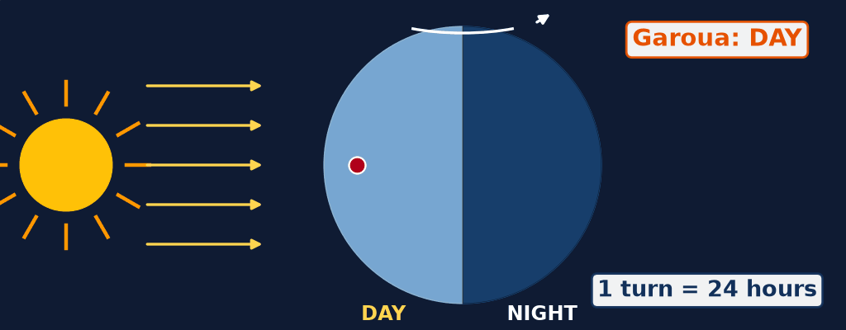
GEOGRAPHY — FORM 4
I. MEANING
Activity 1
Animation: the Earth turns on itself.
2026 / 2027
DGCAST GAROUA — GEOGRAPHY DEPARTMENT
Mr KAMDEM E. | 14
Notes:
Without the projector: turn a ball in front of a torch with a mark on it.

Slide 15
GEOGRAPHY — FORM 4
I. MEANING
Activity 1: Question
Watch Garoua (red dot). Why does it have day and then night?
2026 / 2027
DGCAST GAROUA — GEOGRAPHY DEPARTMENT
Mr KAMDEM E. | 15

Slide 16
GEOGRAPHY — FORM 4
I. MEANING
Answer
The Earth turns. Garoua faces the Sun (day), then turns away (night).
2026 / 2027
DGCAST GAROUA — GEOGRAPHY DEPARTMENT
Mr KAMDEM E. | 16

Slide 17

GEOGRAPHY — FORM 4
II. EFFECTS
Activity 2
The Sun low over the savanna.
2026 / 2027
DGCAST GAROUA — GEOGRAPHY DEPARTMENT
Mr KAMDEM E. | 17
Notes:
Without the projector: ask learners where the Sun rises in Garoua.

Slide 18
GEOGRAPHY — FORM 4
II. EFFECTS
Activity 2: Question
Why does the Sun seem to rise in the east?
2026 / 2027
DGCAST GAROUA — GEOGRAPHY DEPARTMENT
Mr KAMDEM E. | 18

Slide 19
GEOGRAPHY — FORM 4
II. EFFECTS
Answer
The Earth turns from west to east.
2026 / 2027
DGCAST GAROUA — GEOGRAPHY DEPARTMENT
Mr KAMDEM E. | 19

Slide 20

GEOGRAPHY — FORM 4
II. EFFECTS
Activity 3
A storm seen from space.
2026 / 2027
DGCAST GAROUA — GEOGRAPHY DEPARTMENT
Mr KAMDEM E. | 20
Notes:
Without the projector: describe water turning when it goes down a sink.

Slide 21
GEOGRAPHY — FORM 4
II. EFFECTS
Activity 3: Question
The winds of this storm turn in a circle. Which movement of the Earth makes them turn?
2026 / 2027
DGCAST GAROUA — GEOGRAPHY DEPARTMENT
Mr KAMDEM E. | 21

Slide 22
GEOGRAPHY — FORM 4
II. EFFECTS
Answer
The rotation of the Earth.
2026 / 2027
DGCAST GAROUA — GEOGRAPHY DEPARTMENT
Mr KAMDEM E. | 22

Slide 23
GEOGRAPHY — FORM 4
BOARD SUMMARY
The Rotation of the Earth
Topic: The Earth as a Planet in the Solar System
Sub-topic: Location and Time
Lesson 5: The Rotation of the Earth
2026 / 2027
DGCAST GAROUA — GEOGRAPHY DEPARTMENT
Mr KAMDEM E. | 23
Notes:
Learners copy the board summary now. Give them enough time for each slide.

Slide 24
GEOGRAPHY — FORM 4
BOARD SUMMARY
I. Definitions
Rotation: It is the turning of the Earth on its axis.
Axis: It is the line from the North Pole to the South Pole.
2026 / 2027
DGCAST GAROUA — GEOGRAPHY DEPARTMENT
Mr KAMDEM E. | 24

Slide 25
GEOGRAPHY — FORM 4
BOARD SUMMARY
II. Meaning of Rotation (1/2)
A. Direction: The Earth turns from west to east.
B. Time: One turn takes 24 hours.
C. Axis: It is tilted at 23½°.
2026 / 2027
DGCAST GAROUA — GEOGRAPHY DEPARTMENT
Mr KAMDEM E. | 25

Slide 26
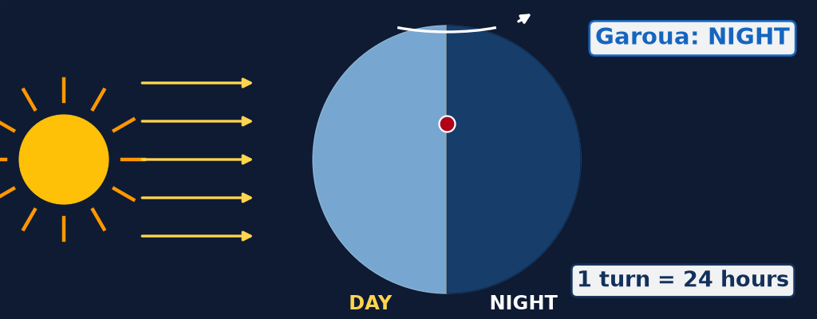
GEOGRAPHY — FORM 4
BOARD SUMMARY
II. Meaning of Rotation (2/2)
Copy the drawing: day and night.
2026 / 2027
DGCAST GAROUA — GEOGRAPHY DEPARTMENT
Mr KAMDEM E. | 26

Slide 27
GEOGRAPHY — FORM 4
BOARD SUMMARY
III. Effects of Rotation
A. Day and night: One side faces the Sun.
B. Sunrise in the east: The Earth turns to the east.
C. Time difference: Places to the east see the Sun first.
D. Winds: Winds and currents are bent.
E. Tides: There are two high tides a day.
2026 / 2027
DGCAST GAROUA — GEOGRAPHY DEPARTMENT
Mr KAMDEM E. | 27

Slide 28
GEOGRAPHY — FORM 4
FORMATIVE EVALUATION
Formative Evaluation 1
What is rotation?
2026 / 2027
DGCAST GAROUA — GEOGRAPHY DEPARTMENT
Mr KAMDEM E. | 28

Slide 29
GEOGRAPHY — FORM 4
FORMATIVE EVALUATION
Expected Answer
The turning of the Earth on its axis.
2026 / 2027
DGCAST GAROUA — GEOGRAPHY DEPARTMENT
Mr KAMDEM E. | 29

Slide 30
GEOGRAPHY — FORM 4
FORMATIVE EVALUATION
Formative Evaluation 2
Give two effects of rotation.
2026 / 2027
DGCAST GAROUA — GEOGRAPHY DEPARTMENT
Mr KAMDEM E. | 30

Slide 31
GEOGRAPHY — FORM 4
FORMATIVE EVALUATION
Expected Answer
Day and night; the Sun seems to rise in the east.
2026 / 2027
DGCAST GAROUA — GEOGRAPHY DEPARTMENT
Mr KAMDEM E. | 31

Slide 32
GEOGRAPHY — FORM 4
REMEDIATION
Remediation
Fill in the blanks:
The Earth turns on its ______.
One rotation takes ______ hours.
The Earth turns from west to ______.
2026 / 2027
DGCAST GAROUA — GEOGRAPHY DEPARTMENT
Mr KAMDEM E. | 32
Notes:
Answers: 1. axis 2. 24 3. east

Slide 33
GEOGRAPHY — FORM 4
HOMEWORK
Homework
Ask an elder in which months the rainy season and the dry season start in Garoua. Write the months down.
This prepares Lesson 6: The Revolution of the Earth.
2026 / 2027
DGCAST GAROUA — GEOGRAPHY DEPARTMENT
Mr KAMDEM E. | 33
Notes:
This homework prepares the next lesson.

Slide 34
GEOGRAPHY — FORM 4
BILINGUAL GAME
Bilingual Game (Jeu Bilingue)
English | Français
Rotation | La rotation
Axis | L'axe
Day | Le jour
Night | La nuit
Sunrise | Le lever du soleil
Sunset | Le coucher du soleil
Deflection | La déviation
Ocean current | Le courant marin
2026 / 2027
DGCAST GAROUA — GEOGRAPHY DEPARTMENT
Mr KAMDEM E. | 34
Notes:
Say the English word; learners give the French word, then the reverse.

Slide 35
GEOGRAPHY — FORM 4
LOGBOOK
Official Logbook (1/2)
Module / Topic | The Earth as a Planet in the Solar System
Lesson Title | Lesson 5: The Rotation of the Earth
Expected Learning Outcomes | Define rotation and the axis of the Earth. Illustrate the rotation of the Earth. Explain the effects of rotation.
Competence | Learners are able to explain day and night, the rising of the Sun in the east, and the difference in time between places.
2026 / 2027
DGCAST GAROUA — GEOGRAPHY DEPARTMENT
Mr KAMDEM E. | 35

Slide 36
GEOGRAPHY — FORM 4
LOGBOOK
Official Logbook (2/2)
Matter Taught | I. Definitions: Rotation, Axis; II. Meaning of Rotation: Direction, Time, Axis; III. Effects of Rotation: Day and night, Sunrise in the east, Time difference, Winds, Tides.
Evaluation | Formative evaluation (3 questions) and remediation exercise.
Homework | Ask an elder in which months the rainy season and the dry season start in Garoua. Write the months down.
Enrolment / Present / Absent | ____ / ____ / ____
Achievement | To be completed by the teacher after the lesson.
2026 / 2027
DGCAST GAROUA — GEOGRAPHY DEPARTMENT
Mr KAMDEM E. | 36

Slide 37
GEOGRAPHY — FORM 4
TEACHER'S NOTE
Teacher's Note
Timing: Set-up, recall 5 min | Situation 5 min | 3 activities 12 min | Board summary (copying) 15 min | Evaluation, homework 5 min | Logbook 5 min | Spare 3 min
Activity 1 is an animation (GIF): it plays automatically in slide-show mode.
2026 / 2027
DGCAST GAROUA — GEOGRAPHY DEPARTMENT
Mr KAMDEM E. | 37

Slide 38
GEOGRAPHY — FORM 4
REFERENCES
References
National Geography Syllabus (MINESEC), Form 4 — The Earth as a Planet in the Solar System.
Teacher's lesson notes (Form 4), checked and corrected where necessary.
Photo, Activity 2: “African Sunrise, Amboseli National Park” by Ray in Manila, CC BY 2.0, via Flickr (https://www.flickr.com/photos/21186555@N07/30385097358)
Photo, Activity 3: “NASA's Aqua Satellite Captures Hurricane Danielle” by NASA Goddard Photo and Video, CC BY 2.0, via nasa (https://www.flickr.com/photos/24662369@N07/4931591817)
Diagrams and animations: drawn for this lesson (DGCAST Geography Department).
2026 / 2027
DGCAST GAROUA — GEOGRAPHY DEPARTMENT
Mr KAMDEM E. | 38

