Slide 1

DIVINE GRACE COLLEGE OF ARTS, SCIENCE AND TECHNOLOGY
(DGCAST) — GAROUA | GEOGRAPHY DEPARTMENT
FORM 4 GEOGRAPHY — LESSON 8
Rocks
Mr KAMDEM EMMANUEL
Geography Teacher — PLEG
Academic Year 2026 / 2027
Notes:
Good morning, class. Today we study Lesson 8: Rocks.

Slide 2
GEOGRAPHY — FORM 4
CLASS INFO
Class, Chapter & Duration
Class | Form 4
Chapter | The Structure of the Earth: Building Processes and Impacts on Man — Internal Structure of the Earth
Duration | 50 minutes
2026 / 2027
DGCAST GAROUA — GEOGRAPHY DEPARTMENT
Mr KAMDEM E. | 2

Slide 3
GEOGRAPHY — FORM 4
IDENTIFICATION
Lesson Identification
Topic | The Structure of the Earth: Building Processes and Impacts on Man
Sub-topic | Internal Structure of the Earth
Lesson | Lesson 8: Rocks
Notions / Concepts | Igneous rock, sedimentary rock, metamorphic rock.
Syllabus focus | Definition; classification according to origin (igneous, sedimentary, metamorphic): characteristics and main examples of each type; the rock cycle (illustration only).
Competence | Learners are able to recognise the main types of rocks around them and to choose suitable rocks for building.
2026 / 2027
DGCAST GAROUA — GEOGRAPHY DEPARTMENT
Mr KAMDEM E. | 3

Slide 4
GEOGRAPHY — FORM 4
OBJECTIVES
Learning Objectives
By the end of the lesson, the learner should be able to:
Define a rock.
Classify rocks according to their origin.
Give the characteristics and examples of each type of rock.
Draw the rock cycle.
2026 / 2027
DGCAST GAROUA — GEOGRAPHY DEPARTMENT
Mr KAMDEM E. | 4

Slide 5
GEOGRAPHY — FORM 4
RECALL
Recall
The crust is the solid outer layer of the Earth.
The mantle is very hot rock that flows slowly.
Magma is molten rock under the ground.
2026 / 2027
DGCAST GAROUA — GEOGRAPHY DEPARTMENT
Mr KAMDEM E. | 5
Notes:
Check the homework: the stones collected by learners. Use them in Part II.

Slide 6
GEOGRAPHY — FORM 4
REAL-LIFE SITUATION
Real-Life Situation
In Garoua, a new mosque is built on hard grey stones with small crystals. Some walls are made of blocks with thin layers. Kadidja wonders why the stones are different.
2026 / 2027
DGCAST GAROUA — GEOGRAPHY DEPARTMENT
Mr KAMDEM E. | 6
Notes:
Read the situation slowly, twice.

Slide 7
GEOGRAPHY — FORM 4
REAL-LIFE SITUATION
Situation — Question 1
What is the problem in the situation?
2026 / 2027
DGCAST GAROUA — GEOGRAPHY DEPARTMENT
Mr KAMDEM E. | 7

Slide 8
GEOGRAPHY — FORM 4
REAL-LIFE SITUATION
Answer
Kadidja does not know why rocks are different.
2026 / 2027
DGCAST GAROUA — GEOGRAPHY DEPARTMENT
Mr KAMDEM E. | 8

Slide 9
GEOGRAPHY — FORM 4
REAL-LIFE SITUATION
Situation — Question 2
Describe the two kinds of stones.
2026 / 2027
DGCAST GAROUA — GEOGRAPHY DEPARTMENT
Mr KAMDEM E. | 9

Slide 10
GEOGRAPHY — FORM 4
REAL-LIFE SITUATION
Answer
Hard grey stones with crystals, and stones with layers.
2026 / 2027
DGCAST GAROUA — GEOGRAPHY DEPARTMENT
Mr KAMDEM E. | 10

Slide 11
GEOGRAPHY — FORM 4
REAL-LIFE SITUATION
Situation — Question 3
How are rocks grouped?
2026 / 2027
DGCAST GAROUA — GEOGRAPHY DEPARTMENT
Mr KAMDEM E. | 11

Slide 12
GEOGRAPHY — FORM 4
REAL-LIFE SITUATION
Possible Answer
By the way they were formed: igneous, sedimentary, metamorphic.
2026 / 2027
DGCAST GAROUA — GEOGRAPHY DEPARTMENT
Mr KAMDEM E. | 12

Slide 13
GEOGRAPHY — FORM 4
JUSTIFICATION
Justification of the Lesson
This lesson helps us to know the rocks around us.
2026 / 2027
DGCAST GAROUA — GEOGRAPHY DEPARTMENT
Mr KAMDEM E. | 13

Slide 14

GEOGRAPHY — FORM 4
I. IGNEOUS ROCKS
Activity 1
Big granite rocks.
2026 / 2027
DGCAST GAROUA — GEOGRAPHY DEPARTMENT
Mr KAMDEM E. | 14
Notes:
Without the projector: show a piece of granite from the school yard.

Slide 15
GEOGRAPHY — FORM 4
I. IGNEOUS ROCKS
Activity 1: Question
Granite has crystals. How was it formed?
2026 / 2027
DGCAST GAROUA — GEOGRAPHY DEPARTMENT
Mr KAMDEM E. | 15

Slide 16
GEOGRAPHY — FORM 4
I. IGNEOUS ROCKS
Answer
Hot magma cooled and became hard. It is an igneous rock.
2026 / 2027
DGCAST GAROUA — GEOGRAPHY DEPARTMENT
Mr KAMDEM E. | 16

Slide 17
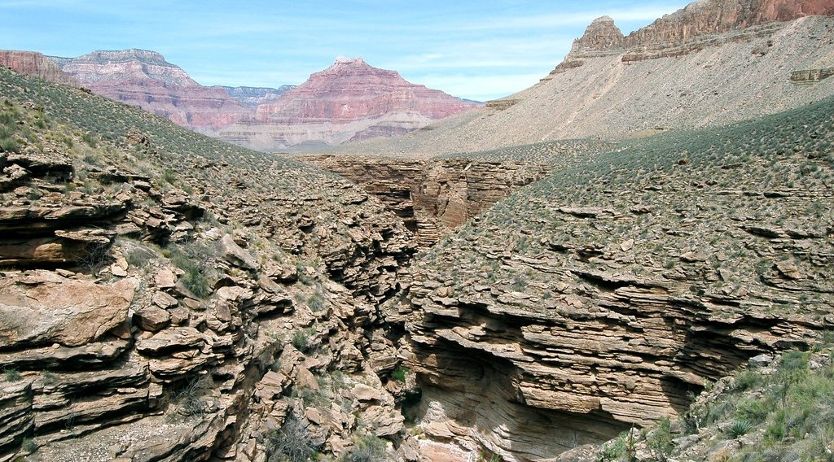
GEOGRAPHY — FORM 4
II. SEDIMENTARY ROCKS
Activity 2
A rock with layers.
2026 / 2027
DGCAST GAROUA — GEOGRAPHY DEPARTMENT
Mr KAMDEM E. | 17
Notes:
Without the projector: show layers in a cut road bank.

Slide 18
GEOGRAPHY — FORM 4
II. SEDIMENTARY ROCKS
Activity 2: Question
This rock has layers. How was it formed?
2026 / 2027
DGCAST GAROUA — GEOGRAPHY DEPARTMENT
Mr KAMDEM E. | 18

Slide 19
GEOGRAPHY — FORM 4
II. SEDIMENTARY ROCKS
Answer
Layers of sand and mud were pressed together. It is a sedimentary rock.
2026 / 2027
DGCAST GAROUA — GEOGRAPHY DEPARTMENT
Mr KAMDEM E. | 19

Slide 20
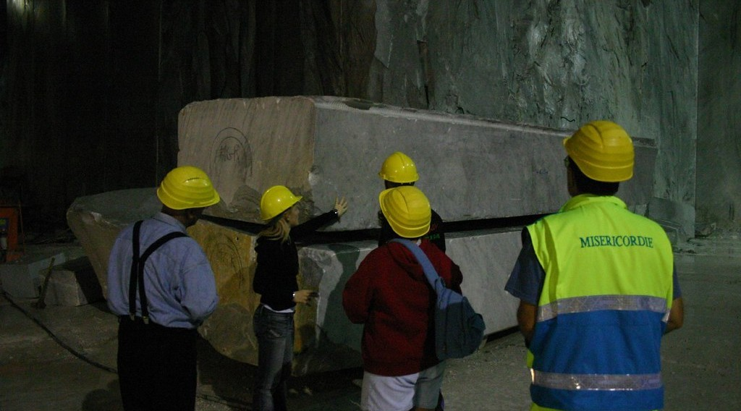
GEOGRAPHY — FORM 4
III. METAMORPHIC ROCKS
Activity 3
A block of marble in a quarry.
2026 / 2027
DGCAST GAROUA — GEOGRAPHY DEPARTMENT
Mr KAMDEM E. | 20
Notes:
Without the projector: show a marble tile.

Slide 21
GEOGRAPHY — FORM 4
III. METAMORPHIC ROCKS
Activity 3: Question
Marble was limestone. What changed it?
2026 / 2027
DGCAST GAROUA — GEOGRAPHY DEPARTMENT
Mr KAMDEM E. | 21

Slide 22
GEOGRAPHY — FORM 4
III. METAMORPHIC ROCKS
Answer
Great heat and pressure. It is a metamorphic rock.
2026 / 2027
DGCAST GAROUA — GEOGRAPHY DEPARTMENT
Mr KAMDEM E. | 22

Slide 23
GEOGRAPHY — FORM 4
BOARD SUMMARY
Rocks
Topic: The Structure of the Earth: Building Processes and Impacts on Man
Sub-topic: Internal Structure of the Earth
Lesson 8: Rocks
2026 / 2027
DGCAST GAROUA — GEOGRAPHY DEPARTMENT
Mr KAMDEM E. | 23
Notes:
Learners copy the board summary now. Give them enough time for each slide.

Slide 24
GEOGRAPHY — FORM 4
BOARD SUMMARY
I. Definitions
Rock: It is a hard natural material of the crust.
Magma: It is melted rock under the ground.
Fossil: It is the mark of an old plant or animal in a rock.
2026 / 2027
DGCAST GAROUA — GEOGRAPHY DEPARTMENT
Mr KAMDEM E. | 24

Slide 25
GEOGRAPHY — FORM 4
BOARD SUMMARY
II. Types of Rocks
A. Igneous: Formed when magma cools (granite, basalt).
B. Sedimentary: Formed from layers (sandstone, limestone).
C. Metamorphic: Changed by heat and pressure (marble).
D. Fossils: They are found in sedimentary rocks.
2026 / 2027
DGCAST GAROUA — GEOGRAPHY DEPARTMENT
Mr KAMDEM E. | 25

Slide 26
GEOGRAPHY — FORM 4
BOARD SUMMARY
III. The Rock Cycle (1/2)
Meaning: One type of rock can become another type.
2026 / 2027
DGCAST GAROUA — GEOGRAPHY DEPARTMENT
Mr KAMDEM E. | 26

Slide 27
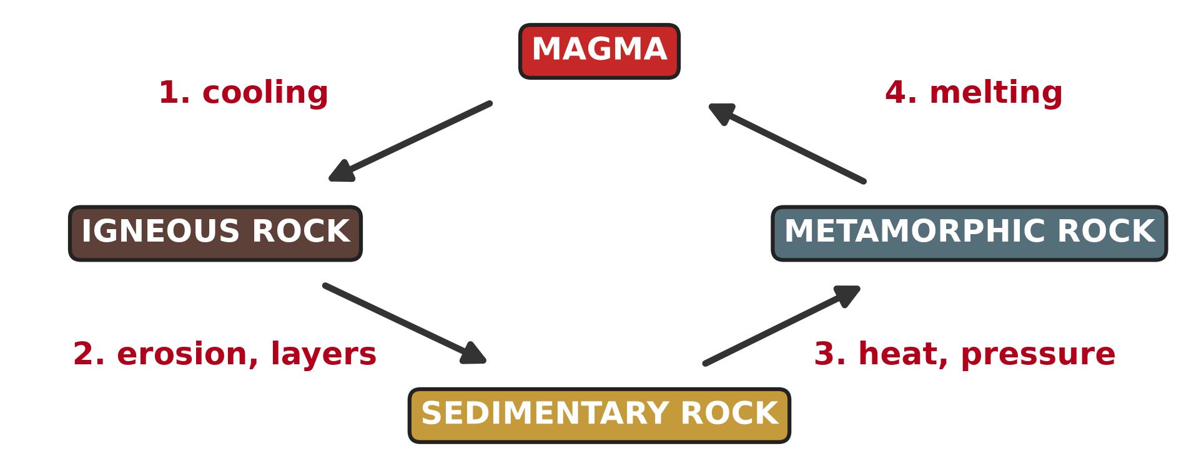
GEOGRAPHY — FORM 4
BOARD SUMMARY
III. The Rock Cycle (2/2)
Copy the rock cycle.
2026 / 2027
DGCAST GAROUA — GEOGRAPHY DEPARTMENT
Mr KAMDEM E. | 27

Slide 28
GEOGRAPHY — FORM 4
FORMATIVE EVALUATION
Formative Evaluation 1
How are igneous rocks formed?
2026 / 2027
DGCAST GAROUA — GEOGRAPHY DEPARTMENT
Mr KAMDEM E. | 28

Slide 29
GEOGRAPHY — FORM 4
FORMATIVE EVALUATION
Expected Answer
When magma or lava cools and becomes hard.
2026 / 2027
DGCAST GAROUA — GEOGRAPHY DEPARTMENT
Mr KAMDEM E. | 29

Slide 30
GEOGRAPHY — FORM 4
FORMATIVE EVALUATION
Formative Evaluation 2
Give one example of a metamorphic rock.
2026 / 2027
DGCAST GAROUA — GEOGRAPHY DEPARTMENT
Mr KAMDEM E. | 30

Slide 31
GEOGRAPHY — FORM 4
FORMATIVE EVALUATION
Expected Answer
Marble (or slate, gneiss).
2026 / 2027
DGCAST GAROUA — GEOGRAPHY DEPARTMENT
Mr KAMDEM E. | 31

Slide 32
GEOGRAPHY — FORM 4
REMEDIATION
Remediation
Fill in the blanks:
Granite is an ______ rock.
Rocks formed from layers are ______ rocks.
Heat and pressure make ______ rocks.
2026 / 2027
DGCAST GAROUA — GEOGRAPHY DEPARTMENT
Mr KAMDEM E. | 32
Notes:
Answers: 1. igneous 2. sedimentary 3. metamorphic

Slide 33
GEOGRAPHY — FORM 4
HOMEWORK
Homework
Look at a map of the world. Cut out, or trace, Africa and South America and try to fit their coasts together. Write what you notice.
This prepares Lesson 9: The Theory of Continental Drift.
2026 / 2027
DGCAST GAROUA — GEOGRAPHY DEPARTMENT
Mr KAMDEM E. | 33
Notes:
This homework prepares the next lesson.

Slide 34
GEOGRAPHY — FORM 4
BILINGUAL GAME
Bilingual Game (Jeu Bilingue)
English | Français
Rock | La roche
Mineral | Le minéral
Igneous rock | La roche magmatique
Sedimentary rock | La roche sédimentaire
Metamorphic rock | La roche métamorphique
Fossil | Le fossile
Layer | La couche / la strate
Rock cycle | Le cycle des roches
2026 / 2027
DGCAST GAROUA — GEOGRAPHY DEPARTMENT
Mr KAMDEM E. | 34
Notes:
Say the English word; learners give the French word, then the reverse.

Slide 35
GEOGRAPHY — FORM 4
LOGBOOK
Official Logbook (1/2)
Module / Topic | The Structure of the Earth: Building Processes and Impacts on Man
Lesson Title | Lesson 8: Rocks
Expected Learning Outcomes | Define a rock. Classify rocks according to their origin. Give the characteristics and examples of each type of rock. Draw the rock cycle.
Competence | Learners are able to recognise the main types of rocks around them and to choose suitable rocks for building.
2026 / 2027
DGCAST GAROUA — GEOGRAPHY DEPARTMENT
Mr KAMDEM E. | 35

Slide 36
GEOGRAPHY — FORM 4
LOGBOOK
Official Logbook (2/2)
Matter Taught | I. Definitions: Rock, Magma, Fossil; II. Types of Rocks: Igneous, Sedimentary, Metamorphic, Fossils; III. The Rock Cycle: Meaning.
Evaluation | Formative evaluation (3 questions) and remediation exercise.
Homework | Look at a map of the world. Cut out, or trace, Africa and South America and try to fit their coasts together. Write what you notice.
Enrolment / Present / Absent | ____ / ____ / ____
Achievement | To be completed by the teacher after the lesson.
2026 / 2027
DGCAST GAROUA — GEOGRAPHY DEPARTMENT
Mr KAMDEM E. | 36

Slide 37
GEOGRAPHY — FORM 4
TEACHER'S NOTE
Teacher's Note
Timing: Set-up, recall 5 min | Situation 5 min | 3 activities 12 min | Board summary (copying) 15 min | Evaluation, homework 5 min | Logbook 5 min | Spare 3 min
2026 / 2027
DGCAST GAROUA — GEOGRAPHY DEPARTMENT
Mr KAMDEM E. | 37

Slide 38
GEOGRAPHY — FORM 4
REFERENCES
References
National Geography Syllabus (MINESEC), Form 4 — The Structure of the Earth: Building Processes and Impacts on Man.
Teacher's lesson notes (Form 4), checked and corrected where necessary.
Photo, Activity 1: “Sunset over Pyramid Rock” by Mark Wassell, CC BY-NC-ND 2.0, via Flickr (https://www.flickr.com/photos/61520356@N07/6515411027)
Photo, Activity 2: “Grand Canyon: Tapeats Sandstone 0283” by Grand Canyon NPS, CC BY 2.0, via Flickr (https://www.flickr.com/photos/50693818@N08/8238057843)
Photo, Activity 3: “Marble quarry, Carrara” by Russell Carman, CC BY-NC-SA 2.0, via Flickr (https://www.flickr.com/photos/11328254@N02/2095886412)
Diagrams and animations: drawn for this lesson (DGCAST Geography Department).
2026 / 2027
DGCAST GAROUA — GEOGRAPHY DEPARTMENT
Mr KAMDEM E. | 38

