Slide 1

DIVINE GRACE COLLEGE OF ARTS, SCIENCE AND TECHNOLOGY
(DGCAST) — GAROUA | GEOGRAPHY DEPARTMENT
FORM 4 GEOGRAPHY — LESSON 13
Earthquakes
Mr KAMDEM EMMANUEL
Geography Teacher — PLEG
Academic Year 2026 / 2027
Notes:
Good morning, class. Today we study Lesson 13: Earthquakes.

Slide 2
GEOGRAPHY — FORM 4
CLASS INFO
Class, Chapter & Duration
Class | Form 4
Chapter | The Structure of the Earth: Building Processes and Impacts on Man — Seismic Activities and Man
Duration | 50 minutes
2026 / 2027
DGCAST GAROUA — GEOGRAPHY DEPARTMENT
Mr KAMDEM E. | 2

Slide 3
GEOGRAPHY — FORM 4
IDENTIFICATION
Lesson Identification
Topic | The Structure of the Earth: Building Processes and Impacts on Man
Sub-topic | Seismic Activities and Man
Lesson | Lesson 13: Earthquakes
Notions / Concepts | Seismicity, focus, epicentre, magnitude, resources, hazards.
Syllabus focus | Definition; causes; manifestation; impact on man; adaptation and mitigation.
Competence | Learners are able to explain what causes earthquakes and to apply safety rules (drop, cover and hold on) during an earthquake.
2026 / 2027
DGCAST GAROUA — GEOGRAPHY DEPARTMENT
Mr KAMDEM E. | 3

Slide 4
GEOGRAPHY — FORM 4
OBJECTIVES
Learning Objectives
By the end of the lesson, the learner should be able to:
Define an earthquake, its focus and its epicentre.
Explain the causes of earthquakes.
Describe how earthquakes are measured and how they appear.
Explain their impact on man and suggest adaptation and mitigation measures.
2026 / 2027
DGCAST GAROUA — GEOGRAPHY DEPARTMENT
Mr KAMDEM E. | 4

Slide 5
GEOGRAPHY — FORM 4
RECALL
Recall
The plates move against each other at their margins.
Volcanic eruptions can cause the ground to shake.
Conservative margins have strong earthquakes.
2026 / 2027
DGCAST GAROUA — GEOGRAPHY DEPARTMENT
Mr KAMDEM E. | 5
Notes:
Check the homework: experiences of ground shaking.

Slide 6
GEOGRAPHY — FORM 4
REAL-LIFE SITUATION
Real-Life Situation
On the news, Ismaïla sees that an earthquake in Morocco in September 2023 destroyed many villages. Thousands of people died. He wonders what makes the ground shake.
2026 / 2027
DGCAST GAROUA — GEOGRAPHY DEPARTMENT
Mr KAMDEM E. | 6
Notes:
Read the situation slowly, twice.

Slide 7
GEOGRAPHY — FORM 4
REAL-LIFE SITUATION
Situation — Question 1
What is the problem in the situation?
2026 / 2027
DGCAST GAROUA — GEOGRAPHY DEPARTMENT
Mr KAMDEM E. | 7

Slide 8
GEOGRAPHY — FORM 4
REAL-LIFE SITUATION
Answer
Ismaïla does not know what makes the ground shake.
2026 / 2027
DGCAST GAROUA — GEOGRAPHY DEPARTMENT
Mr KAMDEM E. | 8

Slide 9
GEOGRAPHY — FORM 4
REAL-LIFE SITUATION
Situation — Question 2
What did the earthquake destroy?
2026 / 2027
DGCAST GAROUA — GEOGRAPHY DEPARTMENT
Mr KAMDEM E. | 9

Slide 10
GEOGRAPHY — FORM 4
REAL-LIFE SITUATION
Answer
Villages and houses.
2026 / 2027
DGCAST GAROUA — GEOGRAPHY DEPARTMENT
Mr KAMDEM E. | 10

Slide 11
GEOGRAPHY — FORM 4
REAL-LIFE SITUATION
Situation — Question 3
Why do so many people die?
2026 / 2027
DGCAST GAROUA — GEOGRAPHY DEPARTMENT
Mr KAMDEM E. | 11

Slide 12
GEOGRAPHY — FORM 4
REAL-LIFE SITUATION
Possible Answer
Their houses fall on them.
2026 / 2027
DGCAST GAROUA — GEOGRAPHY DEPARTMENT
Mr KAMDEM E. | 12

Slide 13
GEOGRAPHY — FORM 4
JUSTIFICATION
Justification of the Lesson
This lesson helps us to know earthquakes and how to reduce their damage.
2026 / 2027
DGCAST GAROUA — GEOGRAPHY DEPARTMENT
Mr KAMDEM E. | 13

Slide 14
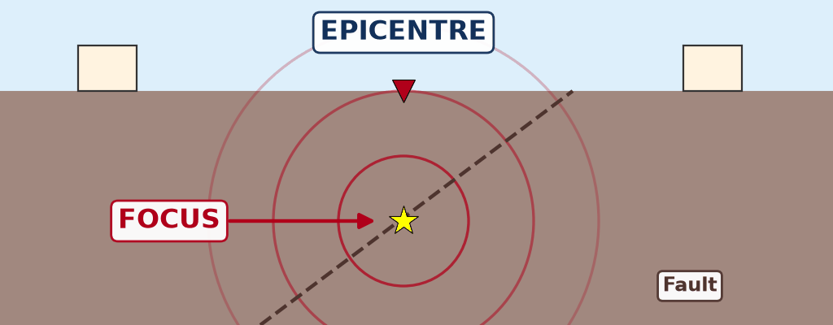
GEOGRAPHY — FORM 4
I. MEANING
Activity 1
Animation: the waves of an earthquake.
2026 / 2027
DGCAST GAROUA — GEOGRAPHY DEPARTMENT
Mr KAMDEM E. | 14
Notes:
Without the projector: drop a stone in water: the waves spread in circles.

Slide 15
GEOGRAPHY — FORM 4
I. MEANING
Activity 1: Question
Where does the earthquake start? What is the point just above it?
2026 / 2027
DGCAST GAROUA — GEOGRAPHY DEPARTMENT
Mr KAMDEM E. | 15

Slide 16
GEOGRAPHY — FORM 4
I. MEANING
Answer
It starts at the focus. The point above is the epicentre.
2026 / 2027
DGCAST GAROUA — GEOGRAPHY DEPARTMENT
Mr KAMDEM E. | 16

Slide 17
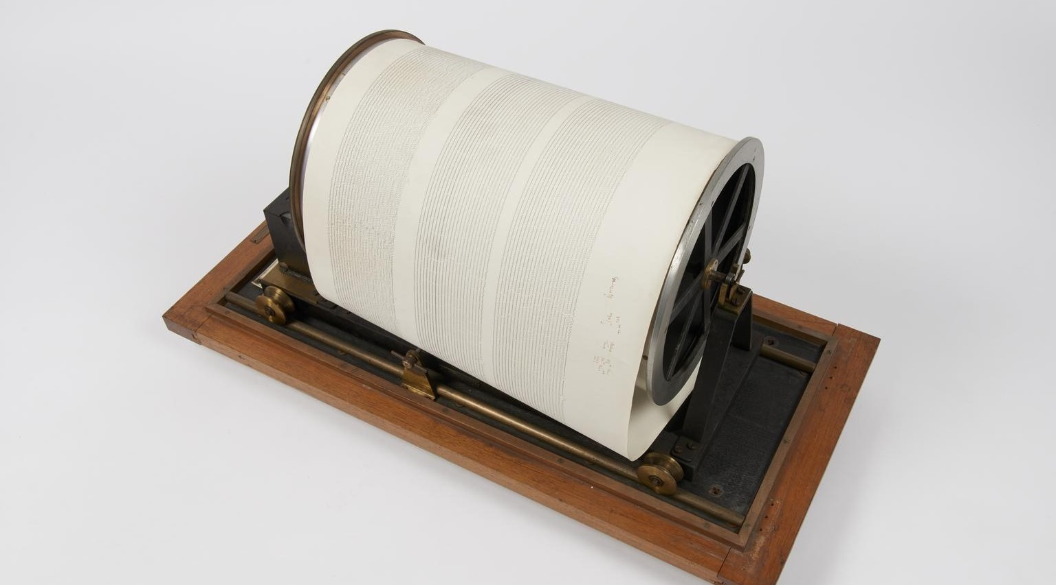
GEOGRAPHY — FORM 4
II. MEASUREMENT
Activity 2
A seismograph.
2026 / 2027
DGCAST GAROUA — GEOGRAPHY DEPARTMENT
Mr KAMDEM E. | 17
Notes:
Without the projector: draw a zigzag line on the board.

Slide 18
GEOGRAPHY — FORM 4
II. MEASUREMENT
Activity 2: Question
What does this instrument do?
2026 / 2027
DGCAST GAROUA — GEOGRAPHY DEPARTMENT
Mr KAMDEM E. | 18

Slide 19
GEOGRAPHY — FORM 4
II. MEASUREMENT
Answer
It records the shaking of the ground.
2026 / 2027
DGCAST GAROUA — GEOGRAPHY DEPARTMENT
Mr KAMDEM E. | 19

Slide 20

GEOGRAPHY — FORM 4
III. IMPACT
Activity 3
Houses destroyed by an earthquake.
2026 / 2027
DGCAST GAROUA — GEOGRAPHY DEPARTMENT
Mr KAMDEM E. | 20
Notes:
Without the projector: ask learners how houses could be made stronger.

Slide 21
GEOGRAPHY — FORM 4
III. IMPACT
Activity 3: Question
What is the main cause of death during an earthquake?
2026 / 2027
DGCAST GAROUA — GEOGRAPHY DEPARTMENT
Mr KAMDEM E. | 21

Slide 22
GEOGRAPHY — FORM 4
III. IMPACT
Answer
Buildings fall on people.
2026 / 2027
DGCAST GAROUA — GEOGRAPHY DEPARTMENT
Mr KAMDEM E. | 22

Slide 23
GEOGRAPHY — FORM 4
BOARD SUMMARY
Earthquakes
Topic: The Structure of the Earth: Building Processes and Impacts on Man
Sub-topic: Seismic Activities and Man
Lesson 13: Earthquakes
2026 / 2027
DGCAST GAROUA — GEOGRAPHY DEPARTMENT
Mr KAMDEM E. | 23
Notes:
Learners copy the board summary now. Give them enough time for each slide.

Slide 24
GEOGRAPHY — FORM 4
BOARD SUMMARY
I. Definitions
Earthquake: It is a sudden shaking of the ground.
Focus: It is the point under the ground where it starts.
Epicentre: It is the point on the surface above the focus.
2026 / 2027
DGCAST GAROUA — GEOGRAPHY DEPARTMENT
Mr KAMDEM E. | 24

Slide 25
GEOGRAPHY — FORM 4
BOARD SUMMARY
II. Causes (1/2)
A. Plates: Plates move along faults (main cause).
B. Volcanoes: Eruptions shake the ground.
C. People: Mines and big dams.
2026 / 2027
DGCAST GAROUA — GEOGRAPHY DEPARTMENT
Mr KAMDEM E. | 25

Slide 26
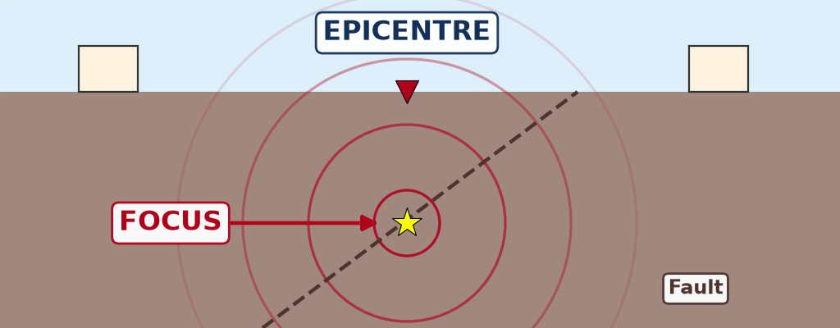
GEOGRAPHY — FORM 4
BOARD SUMMARY
II. Causes (2/2)
Copy the focus and the epicentre.
2026 / 2027
DGCAST GAROUA — GEOGRAPHY DEPARTMENT
Mr KAMDEM E. | 26

Slide 27
GEOGRAPHY — FORM 4
BOARD SUMMARY
III. Measurement
A. Seismograph: It records the waves.
B. Richter scale: It measures the strength.
2026 / 2027
DGCAST GAROUA — GEOGRAPHY DEPARTMENT
Mr KAMDEM E. | 27

Slide 28
GEOGRAPHY — FORM 4
BOARD SUMMARY
IV. Impact and Protection
A. Impact: Deaths, destroyed houses and roads.
B. Strong buildings: They resist the shaking.
C. Education: People learn what to do.
2026 / 2027
DGCAST GAROUA — GEOGRAPHY DEPARTMENT
Mr KAMDEM E. | 28

Slide 29
GEOGRAPHY — FORM 4
FORMATIVE EVALUATION
Formative Evaluation 1
What is the epicentre?
2026 / 2027
DGCAST GAROUA — GEOGRAPHY DEPARTMENT
Mr KAMDEM E. | 29

Slide 30
GEOGRAPHY — FORM 4
FORMATIVE EVALUATION
Expected Answer
The point on the surface above the focus.
2026 / 2027
DGCAST GAROUA — GEOGRAPHY DEPARTMENT
Mr KAMDEM E. | 30

Slide 31
GEOGRAPHY — FORM 4
FORMATIVE EVALUATION
Formative Evaluation 2
How do countries like Japan reduce the damage?
2026 / 2027
DGCAST GAROUA — GEOGRAPHY DEPARTMENT
Mr KAMDEM E. | 31

Slide 32
GEOGRAPHY — FORM 4
FORMATIVE EVALUATION
Expected Answer
They build houses that resist earthquakes.
2026 / 2027
DGCAST GAROUA — GEOGRAPHY DEPARTMENT
Mr KAMDEM E. | 32

Slide 33
GEOGRAPHY — FORM 4
REMEDIATION
Remediation
Fill in the blanks:
A sudden shaking of the ground is an ______.
The instrument that records earthquakes is the ______.
The point under the ground where it starts is the ______.
2026 / 2027
DGCAST GAROUA — GEOGRAPHY DEPARTMENT
Mr KAMDEM E. | 33
Notes:
Answers: 1. earthquake 2. seismograph 3. focus

Slide 34
GEOGRAPHY — FORM 4
HOMEWORK
Homework
After the next rain, look at the side of a road or a slope. Write what the running water did to the soil, and where the soil went.
This prepares Lesson 14: Denudation.
2026 / 2027
DGCAST GAROUA — GEOGRAPHY DEPARTMENT
Mr KAMDEM E. | 34
Notes:
This homework prepares the next lesson.

Slide 35
GEOGRAPHY — FORM 4
BILINGUAL GAME
Bilingual Game (Jeu Bilingue)
English | Français
Earthquake | Le séisme / le tremblement de terre
Focus | Le foyer / hypocentre
Epicentre | L'épicentre
Seismograph | Le sismographe
Magnitude | La magnitude
Tsunami | Le tsunami
Fault | La faille
Collapse | L'effondrement
2026 / 2027
DGCAST GAROUA — GEOGRAPHY DEPARTMENT
Mr KAMDEM E. | 35
Notes:
Say the English word; learners give the French word, then the reverse.

Slide 36
GEOGRAPHY — FORM 4
LOGBOOK
Official Logbook (1/2)
Module / Topic | The Structure of the Earth: Building Processes and Impacts on Man
Lesson Title | Lesson 13: Earthquakes
Expected Learning Outcomes | Define an earthquake, its focus and its epicentre. Explain the causes of earthquakes. Describe how earthquakes are measured and how they appear. Explain their impact on man and suggest adaptation and mitigation measures.
Competence | Learners are able to explain what causes earthquakes and to apply safety rules (drop, cover and hold on) during an earthquake.
2026 / 2027
DGCAST GAROUA — GEOGRAPHY DEPARTMENT
Mr KAMDEM E. | 36

Slide 37
GEOGRAPHY — FORM 4
LOGBOOK
Official Logbook (2/2)
Matter Taught | I. Definitions: Earthquake, Focus, Epicentre; II. Causes: Plates, Volcanoes, People; III. Measurement: Seismograph, Richter scale; IV. Impact and Protection: Impact, Strong buildings, Education.
Evaluation | Formative evaluation (3 questions) and remediation exercise.
Homework | After the next rain, look at the side of a road or a slope. Write what the running water did to the soil, and where the soil went.
Enrolment / Present / Absent | ____ / ____ / ____
Achievement | To be completed by the teacher after the lesson.
2026 / 2027
DGCAST GAROUA — GEOGRAPHY DEPARTMENT
Mr KAMDEM E. | 37

Slide 38
GEOGRAPHY — FORM 4
TEACHER'S NOTE
Teacher's Note
Timing: Set-up, recall 5 min | Situation 5 min | 3 activities 12 min | Board summary (copying) 15 min | Evaluation, homework 5 min | Logbook 5 min | Spare 3 min
Activity 1 is an animation (GIF): it plays automatically in slide-show mode.
2026 / 2027
DGCAST GAROUA — GEOGRAPHY DEPARTMENT
Mr KAMDEM E. | 38

Slide 39
GEOGRAPHY — FORM 4
REFERENCES
References
National Geography Syllabus (MINESEC), Form 4 — The Structure of the Earth: Building Processes and Impacts on Man.
Teacher's lesson notes (Form 4), checked and corrected where necessary.
USGS Earthquake Hazards Program: magnitude and intensity.
Photo, Activity 2: “Recording drum from Golitsyn seismograph” by Galitzin, Boris; Masing, Hugo, CC BY-NC-SA 4.0, via sciencemuseum (https://collection.sciencemuseumgroup.org.uk/objects/co8647018/recording-drum-from-golitsyn-seismograph)
Photo, Activity 3: “Collapsed buildings in earthquake-hit Chautara, Nepal” by DFID - UK Department for International Development, CC BY 2.0, via Flickr (https://www.flickr.com/photos/14214150@N02/16693413433)
Diagrams and animations: drawn for this lesson (DGCAST Geography Department).
2026 / 2027
DGCAST GAROUA — GEOGRAPHY DEPARTMENT
Mr KAMDEM E. | 39

