Slide 1

DIVINE GRACE COLLEGE OF ARTS, SCIENCE AND TECHNOLOGY
(DGCAST) — GAROUA | GEOGRAPHY DEPARTMENT
FORM 4 GEOGRAPHY — LESSON 16
Physical Weathering Processes and Products
Mr KAMDEM EMMANUEL
Geography Teacher — PLEG
Academic Year 2026 / 2027
Notes:
Good morning, class. Today we study Lesson 16: Physical Weathering Processes and Products.

Slide 2
GEOGRAPHY — FORM 4
CLASS INFO
Class, Chapter & Duration
Class | Form 4
Chapter | Denudation Processes, Landforms and Impacts on Man — Weathering Processes: The Products and Impacts on Man
Duration | 50 minutes
2026 / 2027
DGCAST GAROUA — GEOGRAPHY DEPARTMENT
Mr KAMDEM E. | 2

Slide 3
GEOGRAPHY — FORM 4
IDENTIFICATION
Lesson Identification
Topic | Denudation Processes, Landforms and Impacts on Man
Sub-topic | Weathering Processes: The Products and Impacts on Man
Lesson | Lesson 16: Physical Weathering Processes and Products
Notions / Concepts | Temperature changes, frost action, slaking, unloading.
Syllabus focus | Thermal shattering; frost shattering; alternate wetting and drying; pressure release; physically induced biological weathering.
Competence | Learners are able to explain why rocks and walls crack in the sun or break under roots, and to protect buildings from these effects.
2026 / 2027
DGCAST GAROUA — GEOGRAPHY DEPARTMENT
Mr KAMDEM E. | 3

Slide 4
GEOGRAPHY — FORM 4
OBJECTIVES
Learning Objectives
By the end of the lesson, the learner should be able to:
Define physical weathering.
Explain the processes of physical weathering.
Name the products of each process.
2026 / 2027
DGCAST GAROUA — GEOGRAPHY DEPARTMENT
Mr KAMDEM E. | 4

Slide 5
GEOGRAPHY — FORM 4
RECALL
Recall
Weathering is the breaking down of rocks in their place.
Physical weathering breaks rocks without changing their minerals.
Climate is the main factor of weathering.
2026 / 2027
DGCAST GAROUA — GEOGRAPHY DEPARTMENT
Mr KAMDEM E. | 5
Notes:
Check the homework: the rock at 1 p.m. and at 7 p.m.

Slide 6
GEOGRAPHY — FORM 4
REAL-LIFE SITUATION
Real-Life Situation
In the dry season, Yaya walks past a big granite rock. At midday, it is too hot to touch. Its outer surface peels off in thin layers, like an onion.
2026 / 2027
DGCAST GAROUA — GEOGRAPHY DEPARTMENT
Mr KAMDEM E. | 6
Notes:
Read the situation slowly, twice.

Slide 7
GEOGRAPHY — FORM 4
REAL-LIFE SITUATION
Situation — Question 1
What is the problem in the situation?
2026 / 2027
DGCAST GAROUA — GEOGRAPHY DEPARTMENT
Mr KAMDEM E. | 7

Slide 8
GEOGRAPHY — FORM 4
REAL-LIFE SITUATION
Answer
Yaya does not know why the rock peels off.
2026 / 2027
DGCAST GAROUA — GEOGRAPHY DEPARTMENT
Mr KAMDEM E. | 8

Slide 9
GEOGRAPHY — FORM 4
REAL-LIFE SITUATION
Situation — Question 2
When is the rock very hot?
2026 / 2027
DGCAST GAROUA — GEOGRAPHY DEPARTMENT
Mr KAMDEM E. | 9

Slide 10
GEOGRAPHY — FORM 4
REAL-LIFE SITUATION
Answer
At midday, in the dry season.
2026 / 2027
DGCAST GAROUA — GEOGRAPHY DEPARTMENT
Mr KAMDEM E. | 10

Slide 11
GEOGRAPHY — FORM 4
REAL-LIFE SITUATION
Situation — Question 3
What happens at night?
2026 / 2027
DGCAST GAROUA — GEOGRAPHY DEPARTMENT
Mr KAMDEM E. | 11

Slide 12
GEOGRAPHY — FORM 4
REAL-LIFE SITUATION
Possible Answer
The rock cools down.
2026 / 2027
DGCAST GAROUA — GEOGRAPHY DEPARTMENT
Mr KAMDEM E. | 12

Slide 13
GEOGRAPHY — FORM 4
JUSTIFICATION
Justification of the Lesson
This lesson helps us to know how rocks break into pieces.
2026 / 2027
DGCAST GAROUA — GEOGRAPHY DEPARTMENT
Mr KAMDEM E. | 13

Slide 14
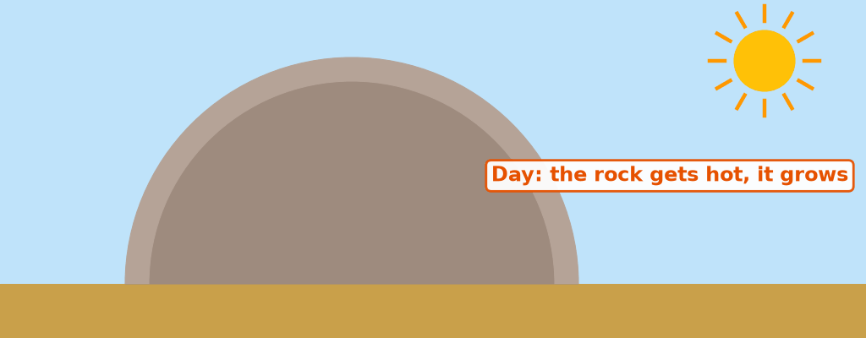
GEOGRAPHY — FORM 4
I. THERMAL SHATTERING
Activity 1
Animation: heating by day, cooling at night.
2026 / 2027
DGCAST GAROUA — GEOGRAPHY DEPARTMENT
Mr KAMDEM E. | 14
Notes:
Without the projector: compare with a glass that breaks when hot water is poured in it.

Slide 15
GEOGRAPHY — FORM 4
I. THERMAL SHATTERING
Activity 1: Question
What happens to the outer layer of the rock after many days and nights?
2026 / 2027
DGCAST GAROUA — GEOGRAPHY DEPARTMENT
Mr KAMDEM E. | 15

Slide 16
GEOGRAPHY — FORM 4
I. THERMAL SHATTERING
Answer
It cracks and peels off.
2026 / 2027
DGCAST GAROUA — GEOGRAPHY DEPARTMENT
Mr KAMDEM E. | 16

Slide 17

GEOGRAPHY — FORM 4
I. THERMAL SHATTERING
Activity 2
Round granite rocks in a hot, dry area.
2026 / 2027
DGCAST GAROUA — GEOGRAPHY DEPARTMENT
Mr KAMDEM E. | 17
Notes:
Without the projector: ask learners about big granite rocks near Garoua.

Slide 18
GEOGRAPHY — FORM 4
I. THERMAL SHATTERING
Activity 2: Question
These granite rocks lost their outer layers again and again. What do we call this peeling of rock?
2026 / 2027
DGCAST GAROUA — GEOGRAPHY DEPARTMENT
Mr KAMDEM E. | 18

Slide 19
GEOGRAPHY — FORM 4
I. THERMAL SHATTERING
Answer
Exfoliation (onion weathering).
2026 / 2027
DGCAST GAROUA — GEOGRAPHY DEPARTMENT
Mr KAMDEM E. | 19

Slide 20

GEOGRAPHY — FORM 4
II. OTHER PROCESSES
Activity 3
Tree roots in a cracked rock.
2026 / 2027
DGCAST GAROUA — GEOGRAPHY DEPARTMENT
Mr KAMDEM E. | 20
Notes:
Without the projector: show a road cracked by tree roots.

Slide 21
GEOGRAPHY — FORM 4
II. OTHER PROCESSES
Activity 3: Question
How do the roots break the rock?
2026 / 2027
DGCAST GAROUA — GEOGRAPHY DEPARTMENT
Mr KAMDEM E. | 21

Slide 22
GEOGRAPHY — FORM 4
II. OTHER PROCESSES
Answer
They grow bigger in the cracks and push the rock apart.
2026 / 2027
DGCAST GAROUA — GEOGRAPHY DEPARTMENT
Mr KAMDEM E. | 22

Slide 23
GEOGRAPHY — FORM 4
BOARD SUMMARY
Physical Weathering Processes and Products
Topic: Denudation Processes, Landforms and Impacts on Man
Sub-topic: Weathering Processes: The Products and Impacts on Man
Lesson 16: Physical Weathering Processes and Products
2026 / 2027
DGCAST GAROUA — GEOGRAPHY DEPARTMENT
Mr KAMDEM E. | 23
Notes:
Learners copy the board summary now. Give them enough time for each slide.

Slide 24
GEOGRAPHY — FORM 4
BOARD SUMMARY
I. Definitions
Physical weathering: It is the breaking of rocks into pieces without changing them.
Exfoliation: It is the peeling of rock in thin layers.
2026 / 2027
DGCAST GAROUA — GEOGRAPHY DEPARTMENT
Mr KAMDEM E. | 24

Slide 25
GEOGRAPHY — FORM 4
BOARD SUMMARY
II. Processes and Products (1/2)
A. Heating and cooling: Rocks peel off (exfoliation).
B. Frost: Water freezes in cracks and breaks rocks.
C. Wetting and drying: Clay rocks crumble.
D. Roots and animals: They open cracks.
E. Release of pressure: Granite cracks in layers.
2026 / 2027
DGCAST GAROUA — GEOGRAPHY DEPARTMENT
Mr KAMDEM E. | 25

Slide 26
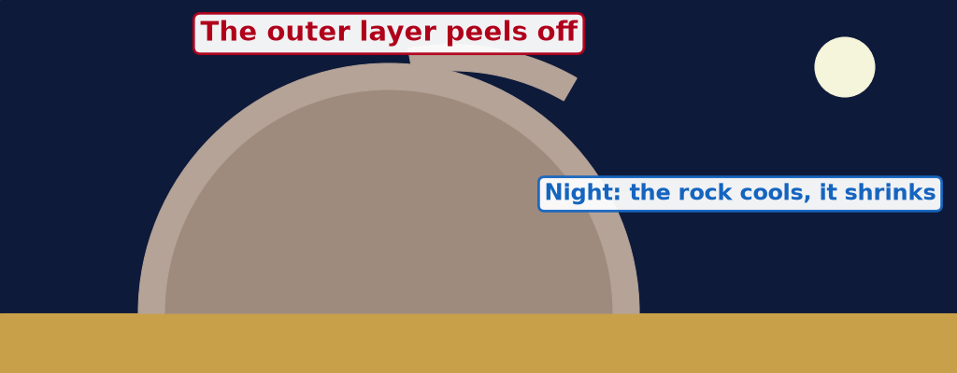
GEOGRAPHY — FORM 4
BOARD SUMMARY
II. Processes and Products (2/2)
Copy the peeling rock.
2026 / 2027
DGCAST GAROUA — GEOGRAPHY DEPARTMENT
Mr KAMDEM E. | 26

Slide 27
GEOGRAPHY — FORM 4
FORMATIVE EVALUATION
Formative Evaluation 1
Why does granite peel off in hot deserts?
2026 / 2027
DGCAST GAROUA — GEOGRAPHY DEPARTMENT
Mr KAMDEM E. | 27

Slide 28
GEOGRAPHY — FORM 4
FORMATIVE EVALUATION
Expected Answer
It gets hot by day and cold at night, again and again.
2026 / 2027
DGCAST GAROUA — GEOGRAPHY DEPARTMENT
Mr KAMDEM E. | 28

Slide 29
GEOGRAPHY — FORM 4
FORMATIVE EVALUATION
Formative Evaluation 2
How do roots break rocks?
2026 / 2027
DGCAST GAROUA — GEOGRAPHY DEPARTMENT
Mr KAMDEM E. | 29

Slide 30
GEOGRAPHY — FORM 4
FORMATIVE EVALUATION
Expected Answer
They grow in cracks and push the rock apart.
2026 / 2027
DGCAST GAROUA — GEOGRAPHY DEPARTMENT
Mr KAMDEM E. | 30

Slide 31
GEOGRAPHY — FORM 4
REMEDIATION
Remediation
Fill in the blanks:
The peeling of rock like an onion is ______.
Water that freezes in cracks causes ______ shattering.
Physical weathering does not change the ______ of the rock.
2026 / 2027
DGCAST GAROUA — GEOGRAPHY DEPARTMENT
Mr KAMDEM E. | 31
Notes:
Answers: 1. exfoliation 2. frost 3. minerals

Slide 32
GEOGRAPHY — FORM 4
HOMEWORK
Homework
Look at an old iron gate, a roofing sheet or a nail left in the rain. Write what happened to it and what colour it became.
This prepares Lesson 17: Chemical Weathering Processes and Products.
2026 / 2027
DGCAST GAROUA — GEOGRAPHY DEPARTMENT
Mr KAMDEM E. | 32
Notes:
This homework prepares the next lesson.

Slide 33
GEOGRAPHY — FORM 4
BILINGUAL GAME
Bilingual Game (Jeu Bilingue)
English | Français
Exfoliation | L'exfoliation / la desquamation
Frost | Le gel
Crack | La fissure
To expand | Se dilater
To contract | Se contracter
Scree | L'éboulis
Root | La racine
Pressure release | La décompression
2026 / 2027
DGCAST GAROUA — GEOGRAPHY DEPARTMENT
Mr KAMDEM E. | 33
Notes:
Say the English word; learners give the French word, then the reverse.

Slide 34
GEOGRAPHY — FORM 4
LOGBOOK
Official Logbook (1/2)
Module / Topic | Denudation Processes, Landforms and Impacts on Man
Lesson Title | Lesson 16: Physical Weathering Processes and Products
Expected Learning Outcomes | Define physical weathering. Explain the processes of physical weathering. Name the products of each process.
Competence | Learners are able to explain why rocks and walls crack in the sun or break under roots, and to protect buildings from these effects.
2026 / 2027
DGCAST GAROUA — GEOGRAPHY DEPARTMENT
Mr KAMDEM E. | 34

Slide 35
GEOGRAPHY — FORM 4
LOGBOOK
Official Logbook (2/2)
Matter Taught | I. Definitions: Physical weathering, Exfoliation; II. Processes and Products: Heating and cooling, Frost, Wetting and drying, Roots and animals, Release of pressure.
Evaluation | Formative evaluation (3 questions) and remediation exercise.
Homework | Look at an old iron gate, a roofing sheet or a nail left in the rain. Write what happened to it and what colour it became.
Enrolment / Present / Absent | ____ / ____ / ____
Achievement | To be completed by the teacher after the lesson.
2026 / 2027
DGCAST GAROUA — GEOGRAPHY DEPARTMENT
Mr KAMDEM E. | 35

Slide 36
GEOGRAPHY — FORM 4
TEACHER'S NOTE
Teacher's Note
Timing: Set-up, recall 5 min | Situation 5 min | 3 activities 12 min | Board summary (copying) 15 min | Evaluation, homework 5 min | Logbook 5 min | Spare 3 min
Activity 1 is an animation (GIF): it plays automatically in slide-show mode.
2026 / 2027
DGCAST GAROUA — GEOGRAPHY DEPARTMENT
Mr KAMDEM E. | 36

Slide 37
GEOGRAPHY — FORM 4
REFERENCES
References
National Geography Syllabus (MINESEC), Form 4 — Denudation Processes, Landforms and Impacts on Man.
Teacher's lesson notes (Form 4), checked and corrected where necessary.
Photo, Activity 2: “Sunset over Pyramid Rock” by Mark Wassell, CC BY-NC-ND 2.0, via Flickr (https://www.flickr.com/photos/61520356@N07/6515411027)
Photo, Activity 3: “Stones 'n' Roots” by erix!, CC BY 2.0, via Flickr (https://www.flickr.com/photos/68387408@N00/55692423)
Diagrams and animations: drawn for this lesson (DGCAST Geography Department).
2026 / 2027
DGCAST GAROUA — GEOGRAPHY DEPARTMENT
Mr KAMDEM E. | 37

