Slide 1

DIVINE GRACE COLLEGE OF ARTS, SCIENCE AND TECHNOLOGY
(DGCAST) — GAROUA | GEOGRAPHY DEPARTMENT
FORM 4 GEOGRAPHY — LESSON 21
The Lower Course of a River
Mr KAMDEM EMMANUEL
Geography Teacher — PLEG
Academic Year 2026 / 2027
Notes:
Good morning, class. Today we study Lesson 21: The Lower Course of a River.

Slide 2
GEOGRAPHY — FORM 4
CLASS INFO
Class, Chapter & Duration
Class | Form 4
Chapter | Denudation Processes, Landforms and Impacts on Man — The Work of Rivers on the Landscape and Impacts on Man
Duration | 50 minutes
2026 / 2027
DGCAST GAROUA — GEOGRAPHY DEPARTMENT
Mr KAMDEM E. | 2

Slide 3
GEOGRAPHY — FORM 4
IDENTIFICATION
Lesson Identification
Topic | Denudation Processes, Landforms and Impacts on Man
Sub-topic | The Work of Rivers on the Landscape and Impacts on Man
Lesson | Lesson 21: The Lower Course of a River
Notions / Concepts | Levees, ox-bow lakes, deltas, braided channels.
Syllabus focus | Main characteristics and processes of the lower course; landforms of the lower course.
Competence | Learners are able to recognise the landforms made by river deposition and to explain why they are good for farming but exposed to floods.
2026 / 2027
DGCAST GAROUA — GEOGRAPHY DEPARTMENT
Mr KAMDEM E. | 3

Slide 4
GEOGRAPHY — FORM 4
OBJECTIVES
Learning Objectives
By the end of the lesson, the learner should be able to:
Describe the main characteristics and processes of the lower course.
Explain the formation of floodplains, levees, ox-bow lakes, deltas and braided channels.
Give examples of these landforms.
2026 / 2027
DGCAST GAROUA — GEOGRAPHY DEPARTMENT
Mr KAMDEM E. | 4

Slide 5
GEOGRAPHY — FORM 4
RECALL
Recall
In the middle course, meanders form by erosion and deposition.
The river carries fine mud in suspension.
Deposition happens where the water is slow.
2026 / 2027
DGCAST GAROUA — GEOGRAPHY DEPARTMENT
Mr KAMDEM E. | 5
Notes:
Check the homework: drawings of the Niger or Nile Delta.

Slide 6
GEOGRAPHY — FORM 4
REAL-LIFE SITUATION
Real-Life Situation
In the dry season, Oumar sees many sandbanks in the Benue at Garoua. The water splits into small channels. He wonders where all this sand comes from.
2026 / 2027
DGCAST GAROUA — GEOGRAPHY DEPARTMENT
Mr KAMDEM E. | 6
Notes:
Read the situation slowly, twice.

Slide 7
GEOGRAPHY — FORM 4
REAL-LIFE SITUATION
Situation — Question 1
What is the problem in the situation?
2026 / 2027
DGCAST GAROUA — GEOGRAPHY DEPARTMENT
Mr KAMDEM E. | 7

Slide 8
GEOGRAPHY — FORM 4
REAL-LIFE SITUATION
Answer
Oumar does not know where the sandbanks come from.
2026 / 2027
DGCAST GAROUA — GEOGRAPHY DEPARTMENT
Mr KAMDEM E. | 8

Slide 9
GEOGRAPHY — FORM 4
REAL-LIFE SITUATION
Situation — Question 2
What did the river do with its sand?
2026 / 2027
DGCAST GAROUA — GEOGRAPHY DEPARTMENT
Mr KAMDEM E. | 9

Slide 10
GEOGRAPHY — FORM 4
REAL-LIFE SITUATION
Answer
It dropped it (deposition).
2026 / 2027
DGCAST GAROUA — GEOGRAPHY DEPARTMENT
Mr KAMDEM E. | 10

Slide 11
GEOGRAPHY — FORM 4
REAL-LIFE SITUATION
Situation — Question 3
Why does the river drop its load?
2026 / 2027
DGCAST GAROUA — GEOGRAPHY DEPARTMENT
Mr KAMDEM E. | 11

Slide 12
GEOGRAPHY — FORM 4
REAL-LIFE SITUATION
Possible Answer
The water is slow and there is less water.
2026 / 2027
DGCAST GAROUA — GEOGRAPHY DEPARTMENT
Mr KAMDEM E. | 12

Slide 13
GEOGRAPHY — FORM 4
JUSTIFICATION
Justification of the Lesson
This lesson helps us to know the landforms of the lower course.
2026 / 2027
DGCAST GAROUA — GEOGRAPHY DEPARTMENT
Mr KAMDEM E. | 13

Slide 14
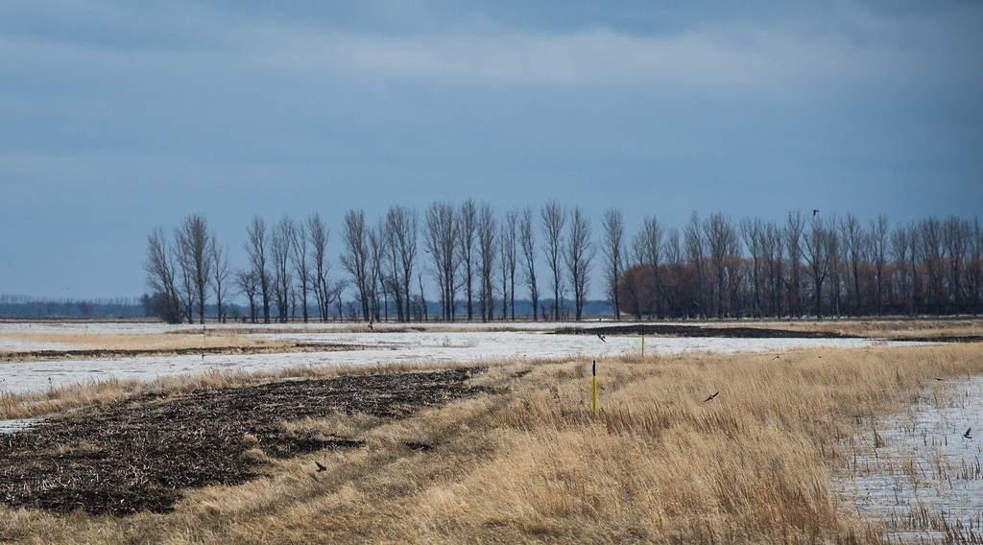
GEOGRAPHY — FORM 4
I. FLOODPLAIN
Activity 1
Flat land beside a river, covered by flood water.
2026 / 2027
DGCAST GAROUA — GEOGRAPHY DEPARTMENT
Mr KAMDEM E. | 14
Notes:
Without the projector: describe the flat land along the Benue.

Slide 15
GEOGRAPHY — FORM 4
I. FLOODPLAIN
Activity 1: Question
This flat land is covered by the river in floods. What is it called?
2026 / 2027
DGCAST GAROUA — GEOGRAPHY DEPARTMENT
Mr KAMDEM E. | 15

Slide 16
GEOGRAPHY — FORM 4
I. FLOODPLAIN
Answer
A floodplain.
2026 / 2027
DGCAST GAROUA — GEOGRAPHY DEPARTMENT
Mr KAMDEM E. | 16

Slide 17
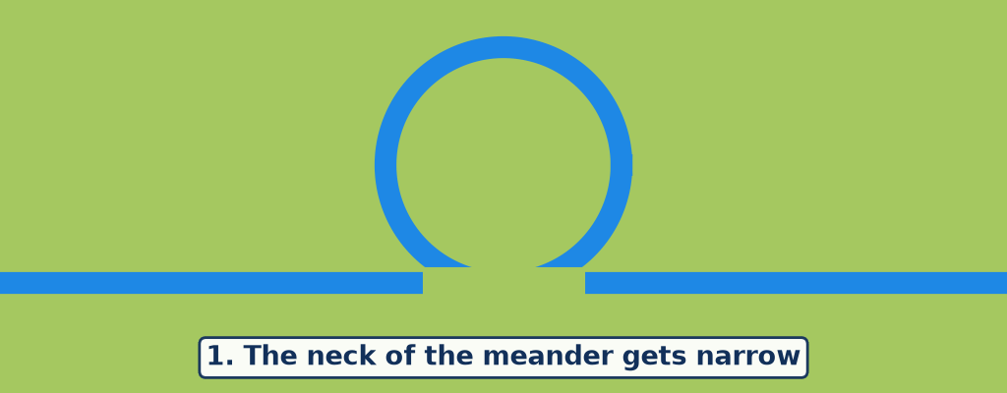
GEOGRAPHY — FORM 4
II. OX-BOW LAKE
Activity 2
Animation: an ox-bow lake forms.
2026 / 2027
DGCAST GAROUA — GEOGRAPHY DEPARTMENT
Mr KAMDEM E. | 17
Notes:
Without the projector: draw the three steps on the board.

Slide 18
GEOGRAPHY — FORM 4
II. OX-BOW LAKE
Activity 2: Question
How does an ox-bow lake form?
2026 / 2027
DGCAST GAROUA — GEOGRAPHY DEPARTMENT
Mr KAMDEM E. | 18

Slide 19
GEOGRAPHY — FORM 4
II. OX-BOW LAKE
Answer
The river cuts through the neck of a meander and leaves the old bend.
2026 / 2027
DGCAST GAROUA — GEOGRAPHY DEPARTMENT
Mr KAMDEM E. | 19

Slide 20
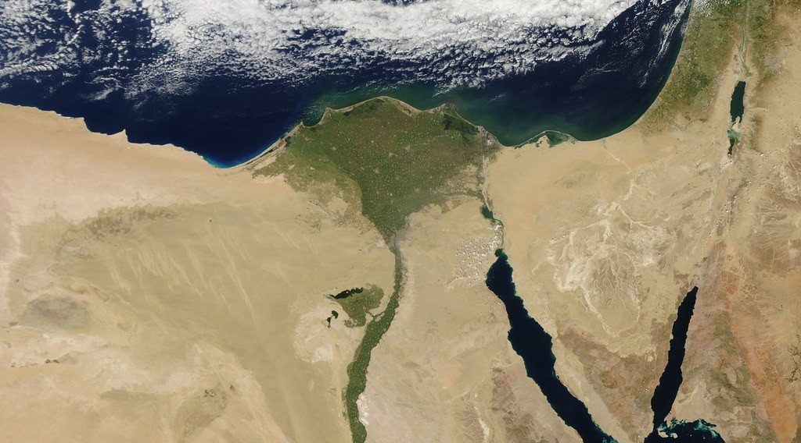
GEOGRAPHY — FORM 4
III. DELTA
Activity 3
The Nile Delta seen from space.
2026 / 2027
DGCAST GAROUA — GEOGRAPHY DEPARTMENT
Mr KAMDEM E. | 20
Notes:
Without the projector: draw a triangle at the mouth of a river.

Slide 21
GEOGRAPHY — FORM 4
III. DELTA
Activity 3: Question
The river drops its load at the sea. What landform is this?
2026 / 2027
DGCAST GAROUA — GEOGRAPHY DEPARTMENT
Mr KAMDEM E. | 21

Slide 22
GEOGRAPHY — FORM 4
III. DELTA
Answer
A delta.
2026 / 2027
DGCAST GAROUA — GEOGRAPHY DEPARTMENT
Mr KAMDEM E. | 22

Slide 23
GEOGRAPHY — FORM 4
BOARD SUMMARY
The Lower Course of a River
Topic: Denudation Processes, Landforms and Impacts on Man
Sub-topic: The Work of Rivers on the Landscape and Impacts on Man
Lesson 21: The Lower Course of a River
2026 / 2027
DGCAST GAROUA — GEOGRAPHY DEPARTMENT
Mr KAMDEM E. | 23
Notes:
Learners copy the board summary now. Give them enough time for each slide.

Slide 24
GEOGRAPHY — FORM 4
BOARD SUMMARY
I. Definitions
Lower course: It is the flat part of a river near its mouth.
Floodplain: It is flat land covered by floods.
Ox-bow lake: It is an old meander cut off from the river.
Delta: It is land made by a river at its mouth.
2026 / 2027
DGCAST GAROUA — GEOGRAPHY DEPARTMENT
Mr KAMDEM E. | 24

Slide 25
GEOGRAPHY — FORM 4
BOARD SUMMARY
II. Characteristics
A. Slope: Almost flat.
B. Water: Slow and wide.
C. Main work: The river drops its load.
2026 / 2027
DGCAST GAROUA — GEOGRAPHY DEPARTMENT
Mr KAMDEM E. | 25

Slide 26
GEOGRAPHY — FORM 4
BOARD SUMMARY
III. Landforms (1/2)
A. Floodplain and levees: Mud is dropped in floods.
B. Ox-bow lakes: Old bends cut off.
C. Delta: Like the Nile and the Niger.
D. Braided channels: Sandbanks split the river.
2026 / 2027
DGCAST GAROUA — GEOGRAPHY DEPARTMENT
Mr KAMDEM E. | 26

Slide 27
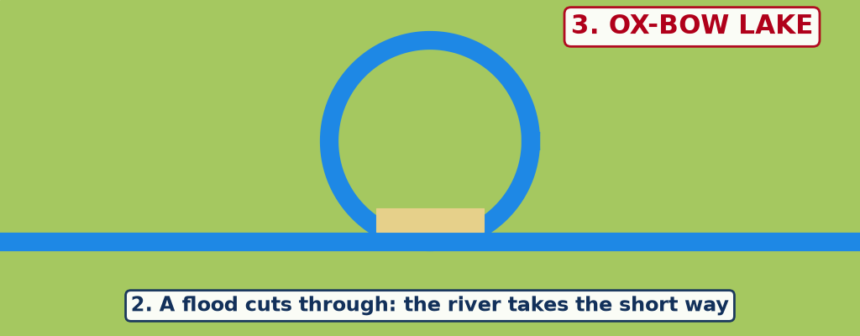
GEOGRAPHY — FORM 4
BOARD SUMMARY
III. Landforms (2/2)
Copy the ox-bow lake.
2026 / 2027
DGCAST GAROUA — GEOGRAPHY DEPARTMENT
Mr KAMDEM E. | 27

Slide 28
GEOGRAPHY — FORM 4
FORMATIVE EVALUATION
Formative Evaluation 1
What is the main work of the river in its lower course?
2026 / 2027
DGCAST GAROUA — GEOGRAPHY DEPARTMENT
Mr KAMDEM E. | 28

Slide 29
GEOGRAPHY — FORM 4
FORMATIVE EVALUATION
Expected Answer
Deposition.
2026 / 2027
DGCAST GAROUA — GEOGRAPHY DEPARTMENT
Mr KAMDEM E. | 29

Slide 30
GEOGRAPHY — FORM 4
FORMATIVE EVALUATION
Formative Evaluation 2
Give one example of a delta.
2026 / 2027
DGCAST GAROUA — GEOGRAPHY DEPARTMENT
Mr KAMDEM E. | 30

Slide 31
GEOGRAPHY — FORM 4
FORMATIVE EVALUATION
Expected Answer
The Nile Delta (or the Niger Delta).
2026 / 2027
DGCAST GAROUA — GEOGRAPHY DEPARTMENT
Mr KAMDEM E. | 31

Slide 32
GEOGRAPHY — FORM 4
REMEDIATION
Remediation
Fill in the blanks:
Flat land covered by floods is a ______.
An old meander cut off is an ______ lake.
Land made by a river at its mouth is a ______.
2026 / 2027
DGCAST GAROUA — GEOGRAPHY DEPARTMENT
Mr KAMDEM E. | 32
Notes:
Answers: 1. floodplain 2. ox-bow 3. delta

Slide 33
GEOGRAPHY — FORM 4
HOMEWORK
Homework
Ask two people who live or farm near the Benue: what are the advantages of the river, and what problems do the floods cause? Write their answers.
This prepares Lesson 22: Man and Floodplain Interactions.
2026 / 2027
DGCAST GAROUA — GEOGRAPHY DEPARTMENT
Mr KAMDEM E. | 33
Notes:
This homework prepares the next lesson.

Slide 34
GEOGRAPHY — FORM 4
BILINGUAL GAME
Bilingual Game (Jeu Bilingue)
English | Français
Floodplain | La plaine d'inondation
Levee | La levée / le bourrelet
Ox-bow lake | Le bras mort / lac en croissant
Delta | Le delta
Distributary | Le défluent
Alluvium | L'alluvion
Braided channel | Le chenal en tresses
Flood | L'inondation / la crue
2026 / 2027
DGCAST GAROUA — GEOGRAPHY DEPARTMENT
Mr KAMDEM E. | 34
Notes:
Say the English word; learners give the French word, then the reverse.

Slide 35
GEOGRAPHY — FORM 4
LOGBOOK
Official Logbook (1/2)
Module / Topic | Denudation Processes, Landforms and Impacts on Man
Lesson Title | Lesson 21: The Lower Course of a River
Expected Learning Outcomes | Describe the main characteristics and processes of the lower course. Explain the formation of floodplains, levees, ox-bow lakes, deltas and braided channels. Give examples of these landforms.
Competence | Learners are able to recognise the landforms made by river deposition and to explain why they are good for farming but exposed to floods.
2026 / 2027
DGCAST GAROUA — GEOGRAPHY DEPARTMENT
Mr KAMDEM E. | 35

Slide 36
GEOGRAPHY — FORM 4
LOGBOOK
Official Logbook (2/2)
Matter Taught | I. Definitions: Lower course, Floodplain, Ox-bow lake, Delta; II. Characteristics: Slope, Water, Main work; III. Landforms: Floodplain and levees, Ox-bow lakes, Delta, Braided channels.
Evaluation | Formative evaluation (3 questions) and remediation exercise.
Homework | Ask two people who live or farm near the Benue: what are the advantages of the river, and what problems do the floods cause? Write their answers.
Enrolment / Present / Absent | ____ / ____ / ____
Achievement | To be completed by the teacher after the lesson.
2026 / 2027
DGCAST GAROUA — GEOGRAPHY DEPARTMENT
Mr KAMDEM E. | 36

Slide 37
GEOGRAPHY — FORM 4
TEACHER'S NOTE
Teacher's Note
Timing: Set-up, recall 5 min | Situation 5 min | 3 activities 12 min | Board summary (copying) 15 min | Evaluation, homework 5 min | Logbook 5 min | Spare 3 min
Activity 2 is an animation (GIF): it plays automatically in slide-show mode.
2026 / 2027
DGCAST GAROUA — GEOGRAPHY DEPARTMENT
Mr KAMDEM E. | 37

Slide 38
GEOGRAPHY — FORM 4
REFERENCES
References
National Geography Syllabus (MINESEC), Form 4 — Denudation Processes, Landforms and Impacts on Man.
Teacher's lesson notes (Form 4), checked and corrected where necessary.
Photo, Activity 1: “20130501-NRCS-LSC-0605” by USDAgov, Public domain 1.0, via Flickr (https://www.flickr.com/photos/41284017@N08/8725089904)
Photo, Activity 3: “Egypt” by NASA Goddard Photo and Video, CC BY 2.0, via nasa (https://www.flickr.com/photos/24662369@N07/5635018418)
Diagrams and animations: drawn for this lesson (DGCAST Geography Department).
2026 / 2027
DGCAST GAROUA — GEOGRAPHY DEPARTMENT
Mr KAMDEM E. | 38

