Slide 1

DIVINE GRACE COLLEGE OF ARTS, SCIENCE AND TECHNOLOGY
(DGCAST) — GAROUA | GEOGRAPHY DEPARTMENT
FORM 4 GEOGRAPHY — LESSON 22
Man and Floodplain Interactions
Mr KAMDEM EMMANUEL
Geography Teacher — PLEG
Academic Year 2026 / 2027
Notes:
Good morning, class. Today we study Lesson 22: Man and Floodplain Interactions.

Slide 2
GEOGRAPHY — FORM 4
CLASS INFO
Class, Chapter & Duration
Class | Form 4
Chapter | Denudation Processes, Landforms and Impacts on Man — The Work of Rivers on the Landscape and Impacts on Man
Duration | 50 minutes
2026 / 2027
DGCAST GAROUA — GEOGRAPHY DEPARTMENT
Mr KAMDEM E. | 2

Slide 3
GEOGRAPHY — FORM 4
IDENTIFICATION
Lesson Identification
Topic | Denudation Processes, Landforms and Impacts on Man
Sub-topic | The Work of Rivers on the Landscape and Impacts on Man
Lesson | Lesson 22: Man and Floodplain Interactions
Notions / Concepts | Floodplain, resource, hazard.
Syllabus focus | Importance of rivers and floodplains to man; problems of living in floodplains; solutions to the problems of living in floodplains.
Competence | Learners are able to use the resources of a river safely and to take measures against floods in their community.
2026 / 2027
DGCAST GAROUA — GEOGRAPHY DEPARTMENT
Mr KAMDEM E. | 3

Slide 4
GEOGRAPHY — FORM 4
OBJECTIVES
Learning Objectives
By the end of the lesson, the learner should be able to:
Explain the importance of rivers and floodplains to man.
Describe the problems of living on floodplains.
Suggest solutions to these problems.
2026 / 2027
DGCAST GAROUA — GEOGRAPHY DEPARTMENT
Mr KAMDEM E. | 4

Slide 5
GEOGRAPHY — FORM 4
RECALL
Recall
A floodplain is a wide, flat area covered with alluvium.
Levees are raised banks built during floods.
Deposition is dominant in the lower course.
2026 / 2027
DGCAST GAROUA — GEOGRAPHY DEPARTMENT
Mr KAMDEM E. | 5
Notes:
Check the homework: advantages and problems of the Benue.

Slide 6
GEOGRAPHY — FORM 4
REAL-LIFE SITUATION
Real-Life Situation
In September, the Benue is very high at Garoua. In 2012, heavy rain and water from the Lagdo Dam flooded many villages. Farms and houses were destroyed.
2026 / 2027
DGCAST GAROUA — GEOGRAPHY DEPARTMENT
Mr KAMDEM E. | 6
Notes:
Read the situation slowly, twice.

Slide 7
GEOGRAPHY — FORM 4
REAL-LIFE SITUATION
Situation — Question 1
What is the problem in the situation?
2026 / 2027
DGCAST GAROUA — GEOGRAPHY DEPARTMENT
Mr KAMDEM E. | 7

Slide 8
GEOGRAPHY — FORM 4
REAL-LIFE SITUATION
Answer
Floods destroyed farms and houses.
2026 / 2027
DGCAST GAROUA — GEOGRAPHY DEPARTMENT
Mr KAMDEM E. | 8

Slide 9
GEOGRAPHY — FORM 4
REAL-LIFE SITUATION
Situation — Question 2
What caused the flood of 2012?
2026 / 2027
DGCAST GAROUA — GEOGRAPHY DEPARTMENT
Mr KAMDEM E. | 9

Slide 10
GEOGRAPHY — FORM 4
REAL-LIFE SITUATION
Answer
Heavy rain and water released from the Lagdo Dam.
2026 / 2027
DGCAST GAROUA — GEOGRAPHY DEPARTMENT
Mr KAMDEM E. | 10

Slide 11
GEOGRAPHY — FORM 4
REAL-LIFE SITUATION
Situation — Question 3
Why do people live near the river?
2026 / 2027
DGCAST GAROUA — GEOGRAPHY DEPARTMENT
Mr KAMDEM E. | 11

Slide 12
GEOGRAPHY — FORM 4
REAL-LIFE SITUATION
Possible Answer
The soil is fertile and there is water.
2026 / 2027
DGCAST GAROUA — GEOGRAPHY DEPARTMENT
Mr KAMDEM E. | 12

Slide 13
GEOGRAPHY — FORM 4
JUSTIFICATION
Justification of the Lesson
This lesson helps us to know the advantages and dangers of living near rivers.
2026 / 2027
DGCAST GAROUA — GEOGRAPHY DEPARTMENT
Mr KAMDEM E. | 13

Slide 14

GEOGRAPHY — FORM 4
I. IMPORTANCE
Activity 1
A woman in a rice field.
2026 / 2027
DGCAST GAROUA — GEOGRAPHY DEPARTMENT
Mr KAMDEM E. | 14
Notes:
Without the projector: ask learners what grows along the Benue.

Slide 15
GEOGRAPHY — FORM 4
I. IMPORTANCE
Activity 1: Question
Why are floodplains good for farming?
2026 / 2027
DGCAST GAROUA — GEOGRAPHY DEPARTMENT
Mr KAMDEM E. | 15

Slide 16
GEOGRAPHY — FORM 4
I. IMPORTANCE
Answer
The soil is fertile (alluvium) and there is water.
2026 / 2027
DGCAST GAROUA — GEOGRAPHY DEPARTMENT
Mr KAMDEM E. | 16

Slide 17

GEOGRAPHY — FORM 4
II. PROBLEMS
Activity 2
A flooded street.
2026 / 2027
DGCAST GAROUA — GEOGRAPHY DEPARTMENT
Mr KAMDEM E. | 17
Notes:
Without the projector: ask learners to describe the flood of 2012.

Slide 18
GEOGRAPHY — FORM 4
II. PROBLEMS
Activity 2: Question
What problems do floods cause?
2026 / 2027
DGCAST GAROUA — GEOGRAPHY DEPARTMENT
Mr KAMDEM E. | 18

Slide 19
GEOGRAPHY — FORM 4
II. PROBLEMS
Answer
They destroy houses and crops, and bring diseases.
2026 / 2027
DGCAST GAROUA — GEOGRAPHY DEPARTMENT
Mr KAMDEM E. | 19

Slide 20
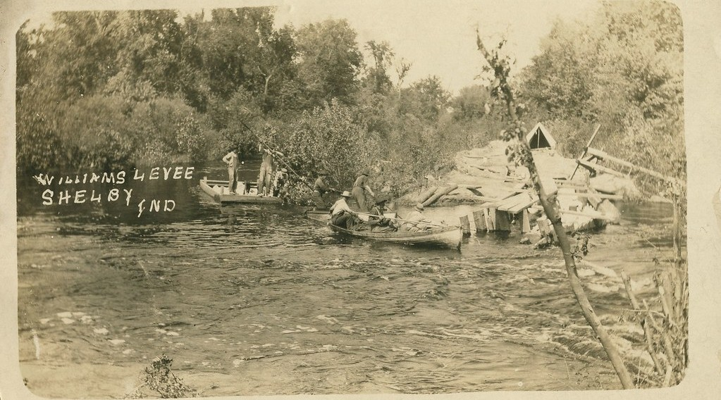
GEOGRAPHY — FORM 4
III. SOLUTIONS
Activity 3
A dyke (levee) along a river, USA, 1912.
2026 / 2027
DGCAST GAROUA — GEOGRAPHY DEPARTMENT
Mr KAMDEM E. | 20
Notes:
Without the projector: describe sandbags put along a river.

Slide 21
GEOGRAPHY — FORM 4
III. SOLUTIONS
Activity 3: Question
How does this bank protect the land?
2026 / 2027
DGCAST GAROUA — GEOGRAPHY DEPARTMENT
Mr KAMDEM E. | 21

Slide 22
GEOGRAPHY — FORM 4
III. SOLUTIONS
Answer
It stops the river from flooding the land.
2026 / 2027
DGCAST GAROUA — GEOGRAPHY DEPARTMENT
Mr KAMDEM E. | 22

Slide 23
GEOGRAPHY — FORM 4
BOARD SUMMARY
Man and Floodplain Interactions
Topic: Denudation Processes, Landforms and Impacts on Man
Sub-topic: The Work of Rivers on the Landscape and Impacts on Man
Lesson 22: Man and Floodplain Interactions
2026 / 2027
DGCAST GAROUA — GEOGRAPHY DEPARTMENT
Mr KAMDEM E. | 23
Notes:
Learners copy the board summary now. Give them enough time for each slide.

Slide 24
GEOGRAPHY — FORM 4
BOARD SUMMARY
I. Definitions
Flood: It is when water covers land that is usually dry.
Dyke: It is a high bank built to stop floods.
Alluvium: It is the fertile mud dropped by a river.
2026 / 2027
DGCAST GAROUA — GEOGRAPHY DEPARTMENT
Mr KAMDEM E. | 24

Slide 25
GEOGRAPHY — FORM 4
BOARD SUMMARY
II. Importance of Floodplains
A. Farming: Fertile soil for rice and onions.
B. Water: For drinking and fishing.
C. Energy: The Lagdo Dam gives electricity.
2026 / 2027
DGCAST GAROUA — GEOGRAPHY DEPARTMENT
Mr KAMDEM E. | 25

Slide 26
GEOGRAPHY — FORM 4
BOARD SUMMARY
III. Problems
A. Floods: They destroy houses and crops.
B. Diseases: Cholera and malaria.
C. Deaths: People and animals drown.
2026 / 2027
DGCAST GAROUA — GEOGRAPHY DEPARTMENT
Mr KAMDEM E. | 26

Slide 27
GEOGRAPHY — FORM 4
BOARD SUMMARY
IV. Solutions
A. Dykes and dams: They control the water.
B. Warnings: Radio messages before floods.
C. Safe places: Build houses far from the river.
D. Trees: They hold the soil.
2026 / 2027
DGCAST GAROUA — GEOGRAPHY DEPARTMENT
Mr KAMDEM E. | 27

Slide 28
GEOGRAPHY — FORM 4
FORMATIVE EVALUATION
Formative Evaluation 1
Give one advantage of living on a floodplain.
2026 / 2027
DGCAST GAROUA — GEOGRAPHY DEPARTMENT
Mr KAMDEM E. | 28

Slide 29
GEOGRAPHY — FORM 4
FORMATIVE EVALUATION
Expected Answer
The soil is fertile.
2026 / 2027
DGCAST GAROUA — GEOGRAPHY DEPARTMENT
Mr KAMDEM E. | 29

Slide 30
GEOGRAPHY — FORM 4
FORMATIVE EVALUATION
Formative Evaluation 2
Give two solutions to floods.
2026 / 2027
DGCAST GAROUA — GEOGRAPHY DEPARTMENT
Mr KAMDEM E. | 30

Slide 31
GEOGRAPHY — FORM 4
FORMATIVE EVALUATION
Expected Answer
Build dykes and give flood warnings.
2026 / 2027
DGCAST GAROUA — GEOGRAPHY DEPARTMENT
Mr KAMDEM E. | 31

Slide 32
GEOGRAPHY — FORM 4
REMEDIATION
Remediation
Fill in the blanks:
Fertile mud dropped by a river is ______.
A high bank built to stop floods is a ______.
In 2012, water from the ______ Dam flooded villages.
2026 / 2027
DGCAST GAROUA — GEOGRAPHY DEPARTMENT
Mr KAMDEM E. | 32
Notes:
Answers: 1. alluvium 2. dyke 3. Lagdo

Slide 33
GEOGRAPHY — FORM 4
HOMEWORK
Homework
Watch the wind blowing on the water of the Benue or of a big basin of water. Write how the waves form and in which direction they move.
This prepares Lesson 23: Wave Action in Coastal Areas.
2026 / 2027
DGCAST GAROUA — GEOGRAPHY DEPARTMENT
Mr KAMDEM E. | 33
Notes:
This homework prepares the next lesson.

Slide 34
GEOGRAPHY — FORM 4
BILINGUAL GAME
Bilingual Game (Jeu Bilingue)
English | Français
Resource | La ressource
Hazard | L'aléa
Dam | Le barrage
Irrigation | L'irrigation
Hydroelectricity | L'hydroélectricité
Warning | L'alerte
Zoning | Le zonage
Displaced person | La personne déplacée
2026 / 2027
DGCAST GAROUA — GEOGRAPHY DEPARTMENT
Mr KAMDEM E. | 34
Notes:
Say the English word; learners give the French word, then the reverse.

Slide 35
GEOGRAPHY — FORM 4
LOGBOOK
Official Logbook (1/2)
Module / Topic | Denudation Processes, Landforms and Impacts on Man
Lesson Title | Lesson 22: Man and Floodplain Interactions
Expected Learning Outcomes | Explain the importance of rivers and floodplains to man. Describe the problems of living on floodplains. Suggest solutions to these problems.
Competence | Learners are able to use the resources of a river safely and to take measures against floods in their community.
2026 / 2027
DGCAST GAROUA — GEOGRAPHY DEPARTMENT
Mr KAMDEM E. | 35

Slide 36
GEOGRAPHY — FORM 4
LOGBOOK
Official Logbook (2/2)
Matter Taught | I. Definitions: Flood, Dyke, Alluvium; II. Importance of Floodplains: Farming, Water, Energy; III. Problems: Floods, Diseases, Deaths; IV. Solutions: Dykes and dams, Warnings, Safe places, Trees.
Evaluation | Formative evaluation (3 questions) and remediation exercise.
Homework | Watch the wind blowing on the water of the Benue or of a big basin of water. Write how the waves form and in which direction they move.
Enrolment / Present / Absent | ____ / ____ / ____
Achievement | To be completed by the teacher after the lesson.
2026 / 2027
DGCAST GAROUA — GEOGRAPHY DEPARTMENT
Mr KAMDEM E. | 36

Slide 37
GEOGRAPHY — FORM 4
TEACHER'S NOTE
Teacher's Note
Timing: Set-up, recall 5 min | Situation 5 min | 3 activities 12 min | Board summary (copying) 15 min | Evaluation, homework 5 min | Logbook 5 min | Spare 3 min
2026 / 2027
DGCAST GAROUA — GEOGRAPHY DEPARTMENT
Mr KAMDEM E. | 37

Slide 38
GEOGRAPHY — FORM 4
REFERENCES
References
National Geography Syllabus (MINESEC), Form 4 — Denudation Processes, Landforms and Impacts on Man.
Teacher's lesson notes (Form 4), checked and corrected where necessary.
Photo, Activity 1: “A woman harvesting rice, Barotse floodplain, Zambia. Photo by Georgina” by WorldFish, CC BY-NC-ND 2.0, via Flickr (https://www.flickr.com/photos/61545321@N06/7848727138)
Photo, Activity 2: “Flood in Accra” by Stig Nygaard, CC BY 2.0, via Flickr (https://www.flickr.com/photos/10259776@N00/181742000)
Photo, Activity 3: “Williams Levee on Kankakee River near Shelby, Indiana, May 1912” by Shook Photos, CC BY 2.0, via Flickr (https://www.flickr.com/photos/24724221@N07/18458778016)
Diagrams and animations: drawn for this lesson (DGCAST Geography Department).
2026 / 2027
DGCAST GAROUA — GEOGRAPHY DEPARTMENT
Mr KAMDEM E. | 38

