Slide 1

DIVINE GRACE COLLEGE OF ARTS, SCIENCE AND TECHNOLOGY
(DGCAST) — GAROUA | GEOGRAPHY DEPARTMENT
FORM 4 GEOGRAPHY — LESSON 24
Main Erosional Processes and Features of Wave Action
Mr KAMDEM EMMANUEL
Geography Teacher — PLEG
Academic Year 2026 / 2027
Notes:
Good morning, class. Today we study Lesson 24: Main Erosional Processes and Features of Wave Action.

Slide 2
GEOGRAPHY — FORM 4
CLASS INFO
Class, Chapter & Duration
Class | Form 4
Chapter | Denudation Processes, Landforms and Impacts on Man — Wave Action along the Coast and Impacts on Man
Duration | 50 minutes
2026 / 2027
DGCAST GAROUA — GEOGRAPHY DEPARTMENT
Mr KAMDEM E. | 2

Slide 3
GEOGRAPHY — FORM 4
IDENTIFICATION
Lesson Identification
Topic | Denudation Processes, Landforms and Impacts on Man
Sub-topic | Wave Action along the Coast and Impacts on Man
Lesson | Lesson 24: Main Erosional Processes and Features of Wave Action
Notions / Concepts | Capes and bays, cliffs, wave-cut platforms, caves, arches, stacks and stumps.
Syllabus focus | Erosional processes of waves; erosional features (use local examples).
Competence | Learners are able to recognise and explain the landforms of a rocky coast, and to respect the dangers of cliffs and caves.
2026 / 2027
DGCAST GAROUA — GEOGRAPHY DEPARTMENT
Mr KAMDEM E. | 3

Slide 4
GEOGRAPHY — FORM 4
OBJECTIVES
Learning Objectives
By the end of the lesson, the learner should be able to:
Explain the four erosional processes of waves.
Explain the formation of capes and bays, cliffs and wave-cut platforms.
Explain the formation of caves, arches, stacks and stumps.
2026 / 2027
DGCAST GAROUA — GEOGRAPHY DEPARTMENT
Mr KAMDEM E. | 4

Slide 5
GEOGRAPHY — FORM 4
RECALL
Recall
Destructive waves erode the coast.
The backwash of destructive waves is stronger than the swash.
Rivers erode by hydraulic action, abrasion, attrition and solution.
2026 / 2027
DGCAST GAROUA — GEOGRAPHY DEPARTMENT
Mr KAMDEM E. | 5
Notes:
Check the homework: drawings of the coast of Limbe or Kribi.

Slide 6
GEOGRAPHY — FORM 4
REAL-LIFE SITUATION
Real-Life Situation
On holiday in Limbe, Rahila sees big waves crash against the rocky coast. At the bottom of a rock face, the waves have cut a hollow and small caves.
2026 / 2027
DGCAST GAROUA — GEOGRAPHY DEPARTMENT
Mr KAMDEM E. | 6
Notes:
Read the situation slowly, twice.

Slide 7
GEOGRAPHY — FORM 4
REAL-LIFE SITUATION
Situation — Question 1
What is the problem in the situation?
2026 / 2027
DGCAST GAROUA — GEOGRAPHY DEPARTMENT
Mr KAMDEM E. | 7

Slide 8
GEOGRAPHY — FORM 4
REAL-LIFE SITUATION
Answer
Rahila wonders how waves can cut hard rock.
2026 / 2027
DGCAST GAROUA — GEOGRAPHY DEPARTMENT
Mr KAMDEM E. | 8

Slide 9
GEOGRAPHY — FORM 4
REAL-LIFE SITUATION
Situation — Question 2
What did the waves make?
2026 / 2027
DGCAST GAROUA — GEOGRAPHY DEPARTMENT
Mr KAMDEM E. | 9

Slide 10
GEOGRAPHY — FORM 4
REAL-LIFE SITUATION
Answer
A hollow and small caves.
2026 / 2027
DGCAST GAROUA — GEOGRAPHY DEPARTMENT
Mr KAMDEM E. | 10

Slide 11
GEOGRAPHY — FORM 4
REAL-LIFE SITUATION
Situation — Question 3
What will happen to the caves after many years?
2026 / 2027
DGCAST GAROUA — GEOGRAPHY DEPARTMENT
Mr KAMDEM E. | 11

Slide 12
GEOGRAPHY — FORM 4
REAL-LIFE SITUATION
Possible Answer
They will become arches and then stacks.
2026 / 2027
DGCAST GAROUA — GEOGRAPHY DEPARTMENT
Mr KAMDEM E. | 12

Slide 13
GEOGRAPHY — FORM 4
JUSTIFICATION
Justification of the Lesson
This lesson helps us to know the landforms made by wave erosion.
2026 / 2027
DGCAST GAROUA — GEOGRAPHY DEPARTMENT
Mr KAMDEM E. | 13

Slide 14
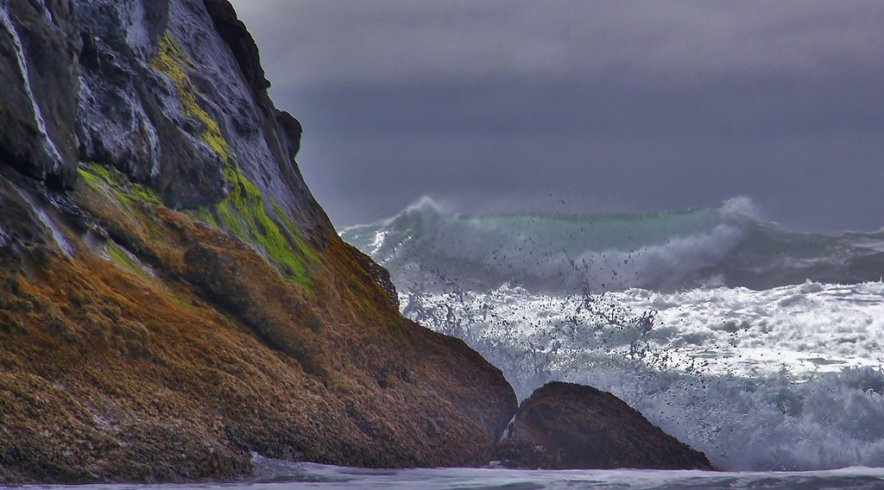
GEOGRAPHY — FORM 4
I. CLIFFS
Activity 1
Waves hit a cliff.
2026 / 2027
DGCAST GAROUA — GEOGRAPHY DEPARTMENT
Mr KAMDEM E. | 14
Notes:
Without the projector: draw a rock with a hollow at the bottom.

Slide 15
GEOGRAPHY — FORM 4
I. CLIFFS
Activity 1: Question
How do waves make a cliff?
2026 / 2027
DGCAST GAROUA — GEOGRAPHY DEPARTMENT
Mr KAMDEM E. | 15

Slide 16
GEOGRAPHY — FORM 4
I. CLIFFS
Answer
They cut the bottom of the rock; the top falls; a steep cliff is left.
2026 / 2027
DGCAST GAROUA — GEOGRAPHY DEPARTMENT
Mr KAMDEM E. | 16

Slide 17
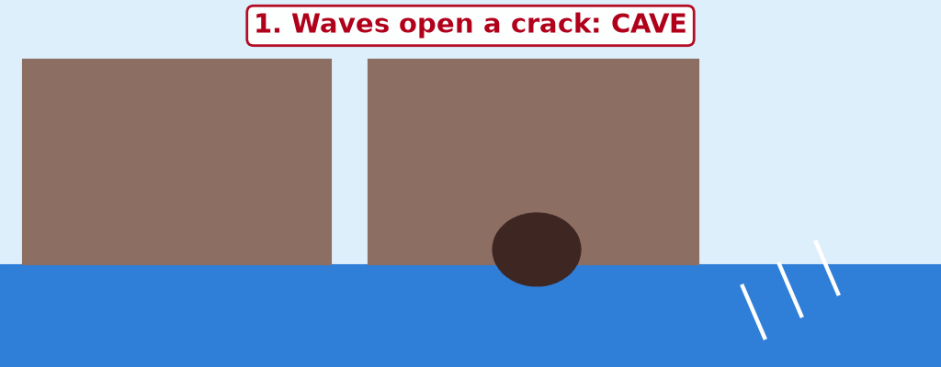
GEOGRAPHY — FORM 4
II. CAVE, ARCH, STACK
Activity 2
Animation: a headland is worn away.
2026 / 2027
DGCAST GAROUA — GEOGRAPHY DEPARTMENT
Mr KAMDEM E. | 17
Notes:
Without the projector: draw the four steps on the board.

Slide 18
GEOGRAPHY — FORM 4
II. CAVE, ARCH, STACK
Activity 2: Question
Put in order: stack, cave, stump, arch.
2026 / 2027
DGCAST GAROUA — GEOGRAPHY DEPARTMENT
Mr KAMDEM E. | 18

Slide 19
GEOGRAPHY — FORM 4
II. CAVE, ARCH, STACK
Answer
Cave, arch, stack, stump.
2026 / 2027
DGCAST GAROUA — GEOGRAPHY DEPARTMENT
Mr KAMDEM E. | 19

Slide 20
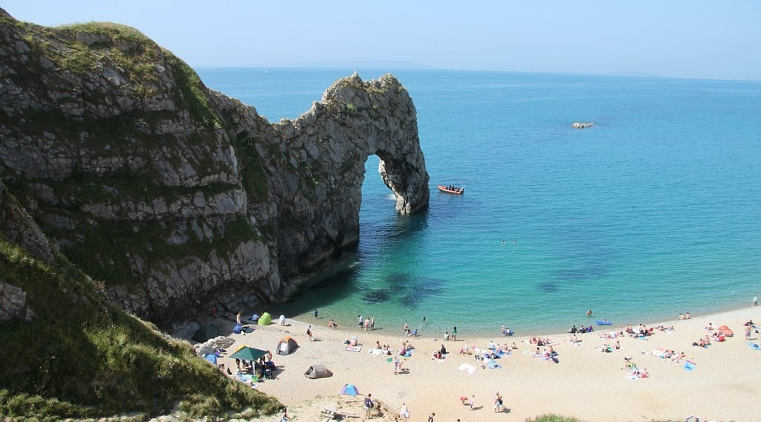
GEOGRAPHY — FORM 4
II. CAVE, ARCH, STACK
Activity 3
A rock with a hole through it, on the coast.
2026 / 2027
DGCAST GAROUA — GEOGRAPHY DEPARTMENT
Mr KAMDEM E. | 20
Notes:
Without the projector: use the drawing on the board.

Slide 21
GEOGRAPHY — FORM 4
II. CAVE, ARCH, STACK
Activity 3: Question
The waves have cut a hole right through the rock. What is it called?
2026 / 2027
DGCAST GAROUA — GEOGRAPHY DEPARTMENT
Mr KAMDEM E. | 21

Slide 22
GEOGRAPHY — FORM 4
II. CAVE, ARCH, STACK
Answer
An arch.
2026 / 2027
DGCAST GAROUA — GEOGRAPHY DEPARTMENT
Mr KAMDEM E. | 22

Slide 23
GEOGRAPHY — FORM 4
BOARD SUMMARY
Main Erosional Processes and Features of Wave Action
Topic: Denudation Processes, Landforms and Impacts on Man
Sub-topic: Wave Action along the Coast and Impacts on Man
Lesson 24: Main Erosional Processes and Features of Wave Action
2026 / 2027
DGCAST GAROUA — GEOGRAPHY DEPARTMENT
Mr KAMDEM E. | 23
Notes:
Learners copy the board summary now. Give them enough time for each slide.

Slide 24
GEOGRAPHY — FORM 4
BOARD SUMMARY
I. Definitions
Cliff: It is a steep rock face on the coast.
Cave: It is a hole cut by waves in a cliff.
Arch: It is a cave that goes through a headland.
Stack: It is a pillar of rock left in the sea.
2026 / 2027
DGCAST GAROUA — GEOGRAPHY DEPARTMENT
Mr KAMDEM E. | 24

Slide 25
GEOGRAPHY — FORM 4
BOARD SUMMARY
II. Erosional Processes
A. Hydraulic action: The force of waves breaks rock.
B. Abrasion: Stones hit the cliff.
C. Attrition: Stones become small and round.
D. Solution: Sea water dissolves some rocks.
2026 / 2027
DGCAST GAROUA — GEOGRAPHY DEPARTMENT
Mr KAMDEM E. | 25

Slide 26
GEOGRAPHY — FORM 4
BOARD SUMMARY
III. Erosional Features (1/2)
A. Capes and bays: Hard rock stays; soft rock goes.
B. Cliff and platform: Waves cut the bottom of the rock.
C. Cave to stump: Cave, arch, stack, stump.
2026 / 2027
DGCAST GAROUA — GEOGRAPHY DEPARTMENT
Mr KAMDEM E. | 26

Slide 27
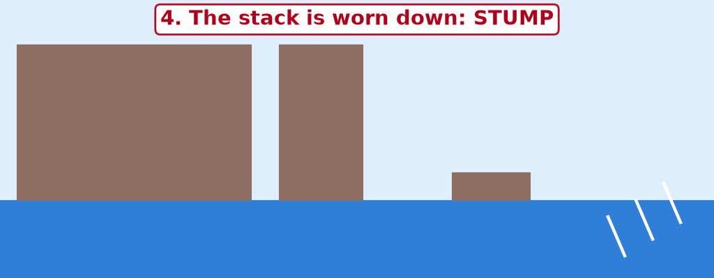
GEOGRAPHY — FORM 4
BOARD SUMMARY
III. Erosional Features (2/2)
Copy the cave, the arch, the stack and the stump.
2026 / 2027
DGCAST GAROUA — GEOGRAPHY DEPARTMENT
Mr KAMDEM E. | 27

Slide 28
GEOGRAPHY — FORM 4
FORMATIVE EVALUATION
Formative Evaluation 1
Put in order: arch, stump, cave, stack.
2026 / 2027
DGCAST GAROUA — GEOGRAPHY DEPARTMENT
Mr KAMDEM E. | 28

Slide 29
GEOGRAPHY — FORM 4
FORMATIVE EVALUATION
Expected Answer
Cave, arch, stack, stump.
2026 / 2027
DGCAST GAROUA — GEOGRAPHY DEPARTMENT
Mr KAMDEM E. | 29

Slide 30
GEOGRAPHY — FORM 4
FORMATIVE EVALUATION
Formative Evaluation 2
What is hydraulic action?
2026 / 2027
DGCAST GAROUA — GEOGRAPHY DEPARTMENT
Mr KAMDEM E. | 30

Slide 31
GEOGRAPHY — FORM 4
FORMATIVE EVALUATION
Expected Answer
The force of the waves breaking the rock.
2026 / 2027
DGCAST GAROUA — GEOGRAPHY DEPARTMENT
Mr KAMDEM E. | 31

Slide 32
GEOGRAPHY — FORM 4
REMEDIATION
Remediation
Fill in the blanks:
A steep rock face on the coast is a ______.
A cave that goes through a headland becomes an ______.
A pillar of rock in the sea is a ______.
2026 / 2027
DGCAST GAROUA — GEOGRAPHY DEPARTMENT
Mr KAMDEM E. | 32
Notes:
Answers: 1. cliff 2. arch 3. stack

Slide 33
GEOGRAPHY — FORM 4
HOMEWORK
Homework
Put some sand at one end of a tray of water and make waves from one corner. Write where the sand moves.
This prepares Lesson 25: Main Depositional Features of Wave Action.
2026 / 2027
DGCAST GAROUA — GEOGRAPHY DEPARTMENT
Mr KAMDEM E. | 33
Notes:
This homework prepares the next lesson.

Slide 34
GEOGRAPHY — FORM 4
BILINGUAL GAME
Bilingual Game (Jeu Bilingue)
English | Français
Cliff | La falaise
Cape / headland | Le cap
Bay | La baie
Cave | La grotte
Arch | L'arche
Stack | L'aiguille / le stack
Wave-cut platform | La plate-forme d'abrasion
Notch | L'encoche
2026 / 2027
DGCAST GAROUA — GEOGRAPHY DEPARTMENT
Mr KAMDEM E. | 34
Notes:
Say the English word; learners give the French word, then the reverse.

Slide 35
GEOGRAPHY — FORM 4
LOGBOOK
Official Logbook (1/2)
Module / Topic | Denudation Processes, Landforms and Impacts on Man
Lesson Title | Lesson 24: Main Erosional Processes and Features of Wave Action
Expected Learning Outcomes | Explain the four erosional processes of waves. Explain the formation of capes and bays, cliffs and wave-cut platforms. Explain the formation of caves, arches, stacks and stumps.
Competence | Learners are able to recognise and explain the landforms of a rocky coast, and to respect the dangers of cliffs and caves.
2026 / 2027
DGCAST GAROUA — GEOGRAPHY DEPARTMENT
Mr KAMDEM E. | 35

Slide 36
GEOGRAPHY — FORM 4
LOGBOOK
Official Logbook (2/2)
Matter Taught | I. Definitions: Cliff, Cave, Arch, Stack; II. Erosional Processes: Hydraulic action, Abrasion, Attrition, Solution; III. Erosional Features: Capes and bays, Cliff and platform, Cave to stump.
Evaluation | Formative evaluation (3 questions) and remediation exercise.
Homework | Put some sand at one end of a tray of water and make waves from one corner. Write where the sand moves.
Enrolment / Present / Absent | ____ / ____ / ____
Achievement | To be completed by the teacher after the lesson.
2026 / 2027
DGCAST GAROUA — GEOGRAPHY DEPARTMENT
Mr KAMDEM E. | 36

Slide 37
GEOGRAPHY — FORM 4
TEACHER'S NOTE
Teacher's Note
Timing: Set-up, recall 5 min | Situation 5 min | 3 activities 12 min | Board summary (copying) 15 min | Evaluation, homework 5 min | Logbook 5 min | Spare 3 min
Activity 2 is an animation (GIF): it plays automatically in slide-show mode.
2026 / 2027
DGCAST GAROUA — GEOGRAPHY DEPARTMENT
Mr KAMDEM E. | 37

Slide 38
GEOGRAPHY — FORM 4
REFERENCES
References
National Geography Syllabus (MINESEC), Form 4 — Denudation Processes, Landforms and Impacts on Man.
Teacher's lesson notes (Form 4), checked and corrected where necessary.
Photo, Activity 1: “Forces of Nature” by liquidcrash, CC BY-SA 2.0, via Flickr (https://www.flickr.com/photos/124320023@N06/13938903780)
Photo, Activity 3: “Jurassic Coast Coastal Landform - Sea Arch - Durdle Door” by Richard Allaway, CC BY 2.0, via Flickr (https://www.flickr.com/photos/16287002@N00/9503598134)
Diagrams and animations: drawn for this lesson (DGCAST Geography Department).
2026 / 2027
DGCAST GAROUA — GEOGRAPHY DEPARTMENT
Mr KAMDEM E. | 38

