Slide 1

DIVINE GRACE COLLEGE OF ARTS, SCIENCE AND TECHNOLOGY
(DGCAST) — GAROUA | GEOGRAPHY DEPARTMENT
FORM 4 GEOGRAPHY — LESSON 31
Weather and Climate
Mr KAMDEM EMMANUEL
Geography Teacher — PLEG
Academic Year 2026 / 2027
Notes:
Good morning, class. Today we study Lesson 31: Weather and Climate.

Slide 2
GEOGRAPHY — FORM 4
CLASS INFO
Class, Chapter & Duration
Class | Form 4
Chapter | Module 3: Weather and Climate — Adaptation to Climatic Excesses
Duration | 50 minutes
2026 / 2027
DGCAST GAROUA — GEOGRAPHY DEPARTMENT
Mr KAMDEM E. | 2

Slide 3
GEOGRAPHY — FORM 4
IDENTIFICATION
Lesson Identification
Topic | The Earth-Atmosphere System
Sub-topic | Measurement of Weather Elements
Lesson | Lesson 31: Weather and Climate
Notions / Concepts | Weather, weather instruments.
Syllabus focus | Definition of weather and climate; definition of a weather station; classification of weather elements, instruments and measurements; their isolines.
Competence | Learners are able to read a simple weather forecast and use it to plan daily activities such as farming or travel.
2026 / 2027
DGCAST GAROUA — GEOGRAPHY DEPARTMENT
Mr KAMDEM E. | 3

Slide 4
GEOGRAPHY — FORM 4
OBJECTIVES
Learning Objectives
By the end of the lesson, the learner should be able to:
Define weather and climate and distinguish between them.
Define a weather station.
Name the weather elements with their instruments, units and isolines.
2026 / 2027
DGCAST GAROUA — GEOGRAPHY DEPARTMENT
Mr KAMDEM E. | 4

Slide 5
GEOGRAPHY — FORM 4
RECALL
Recall
The atmosphere has four layers; weather takes place in the troposphere.
Temperature falls with height in the troposphere.
The ozone layer protects us from ultraviolet rays.
2026 / 2027
DGCAST GAROUA — GEOGRAPHY DEPARTMENT
Mr KAMDEM E. | 5
Notes:
Check the homework: information given by a weather forecast.

Slide 6
GEOGRAPHY — FORM 4
REAL-LIFE SITUATION
Real-Life Situation
On Monday morning, it rains in Garoua, so Idrissa takes an umbrella. His cousin in Paris says: "But Garoua has a hot climate. Why do you need an umbrella?"
2026 / 2027
DGCAST GAROUA — GEOGRAPHY DEPARTMENT
Mr KAMDEM E. | 6
Notes:
Read the situation slowly, twice.

Slide 7
GEOGRAPHY — FORM 4
REAL-LIFE SITUATION
Situation — Question 1
What is the problem in the situation?
2026 / 2027
DGCAST GAROUA — GEOGRAPHY DEPARTMENT
Mr KAMDEM E. | 7

Slide 8
GEOGRAPHY — FORM 4
REAL-LIFE SITUATION
Answer
The cousin mixes up weather and climate.
2026 / 2027
DGCAST GAROUA — GEOGRAPHY DEPARTMENT
Mr KAMDEM E. | 8

Slide 9
GEOGRAPHY — FORM 4
REAL-LIFE SITUATION
Situation — Question 2
What is the weather in Garoua on Monday?
2026 / 2027
DGCAST GAROUA — GEOGRAPHY DEPARTMENT
Mr KAMDEM E. | 9

Slide 10
GEOGRAPHY — FORM 4
REAL-LIFE SITUATION
Answer
Cloudy and rainy.
2026 / 2027
DGCAST GAROUA — GEOGRAPHY DEPARTMENT
Mr KAMDEM E. | 10

Slide 11
GEOGRAPHY — FORM 4
REAL-LIFE SITUATION
Situation — Question 3
What is the climate of Garoua?
2026 / 2027
DGCAST GAROUA — GEOGRAPHY DEPARTMENT
Mr KAMDEM E. | 11

Slide 12
GEOGRAPHY — FORM 4
REAL-LIFE SITUATION
Possible Answer
Hot, with a wet and a dry season.
2026 / 2027
DGCAST GAROUA — GEOGRAPHY DEPARTMENT
Mr KAMDEM E. | 12

Slide 13
GEOGRAPHY — FORM 4
JUSTIFICATION
Justification of the Lesson
This lesson helps us to know the difference between weather and climate.
2026 / 2027
DGCAST GAROUA — GEOGRAPHY DEPARTMENT
Mr KAMDEM E. | 13

Slide 14

GEOGRAPHY — FORM 4
I. DEFINITIONS
Activity 1
A rainy afternoon.
2026 / 2027
DGCAST GAROUA — GEOGRAPHY DEPARTMENT
Mr KAMDEM E. | 14
Notes:
Without the projector: ask learners to describe the weather today.

Slide 15
GEOGRAPHY — FORM 4
I. DEFINITIONS
Activity 1: Question
The condition of the air today is rainy. Is this the weather or the climate?
2026 / 2027
DGCAST GAROUA — GEOGRAPHY DEPARTMENT
Mr KAMDEM E. | 15

Slide 16
GEOGRAPHY — FORM 4
I. DEFINITIONS
Answer
The weather.
2026 / 2027
DGCAST GAROUA — GEOGRAPHY DEPARTMENT
Mr KAMDEM E. | 16

Slide 17

GEOGRAPHY — FORM 4
II. THE WEATHER STATION
Activity 2
A weather station.
2026 / 2027
DGCAST GAROUA — GEOGRAPHY DEPARTMENT
Mr KAMDEM E. | 17
Notes:
Without the projector: mention the weather station at Garoua airport.

Slide 18
GEOGRAPHY — FORM 4
II. THE WEATHER STATION
Activity 2: Question
What do people do in this place?
2026 / 2027
DGCAST GAROUA — GEOGRAPHY DEPARTMENT
Mr KAMDEM E. | 18

Slide 19
GEOGRAPHY — FORM 4
II. THE WEATHER STATION
Answer
They measure the weather every day.
2026 / 2027
DGCAST GAROUA — GEOGRAPHY DEPARTMENT
Mr KAMDEM E. | 19

Slide 20
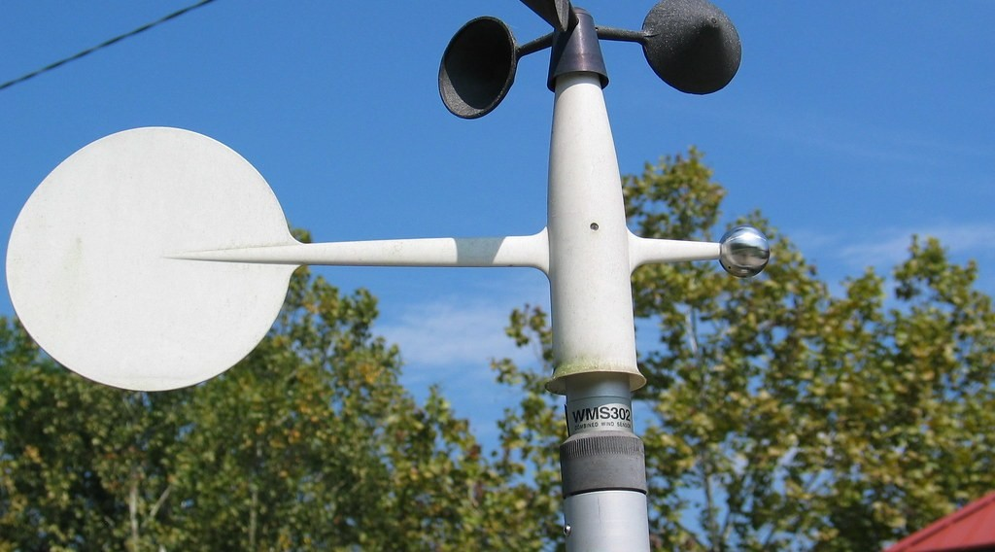
GEOGRAPHY — FORM 4
III. INSTRUMENTS
Activity 3
Instruments that measure the wind.
2026 / 2027
DGCAST GAROUA — GEOGRAPHY DEPARTMENT
Mr KAMDEM E. | 20
Notes:
Without the projector: make a paper wind vane.

Slide 21
GEOGRAPHY — FORM 4
III. INSTRUMENTS
Activity 3: Question
Which instrument measures wind speed? Which one shows wind direction?
2026 / 2027
DGCAST GAROUA — GEOGRAPHY DEPARTMENT
Mr KAMDEM E. | 21

Slide 22
GEOGRAPHY — FORM 4
III. INSTRUMENTS
Answer
The anemometer (speed); the wind vane (direction).
2026 / 2027
DGCAST GAROUA — GEOGRAPHY DEPARTMENT
Mr KAMDEM E. | 22

Slide 23
GEOGRAPHY — FORM 4
BOARD SUMMARY
Weather and Climate
Topic: The Earth-Atmosphere System
Sub-topic: Measurement of Weather Elements
Lesson 31: Weather and Climate
2026 / 2027
DGCAST GAROUA — GEOGRAPHY DEPARTMENT
Mr KAMDEM E. | 23
Notes:
Learners copy the board summary now. Give them enough time for each slide.

Slide 24
GEOGRAPHY — FORM 4
BOARD SUMMARY
I. Definitions (1/2)
Weather: It is the condition of the air at a place today.
Climate: It is the average weather of a place over about 30 years.
Weather station: It is a place where the weather is measured.
2026 / 2027
DGCAST GAROUA — GEOGRAPHY DEPARTMENT
Mr KAMDEM E. | 24

Slide 25
GEOGRAPHY — FORM 4
BOARD SUMMARY
I. Definitions (2/2)
Isoline: It is a line joining places with the same value.
2026 / 2027
DGCAST GAROUA — GEOGRAPHY DEPARTMENT
Mr KAMDEM E. | 25

Slide 26
GEOGRAPHY — FORM 4
BOARD SUMMARY
II. Instruments (1/2)
A. Thermometer: temperature (°C).
B. Rain gauge: rainfall (mm).
C. Wind vane and anemometer: wind.
D. Barometer: air pressure.
2026 / 2027
DGCAST GAROUA — GEOGRAPHY DEPARTMENT
Mr KAMDEM E. | 26

Slide 27

GEOGRAPHY — FORM 4
BOARD SUMMARY
II. Instruments (2/2)
Copy the table of instruments.
2026 / 2027
DGCAST GAROUA — GEOGRAPHY DEPARTMENT
Mr KAMDEM E. | 27

Slide 28
GEOGRAPHY — FORM 4
FORMATIVE EVALUATION
Formative Evaluation 1
What is the difference between weather and climate?
2026 / 2027
DGCAST GAROUA — GEOGRAPHY DEPARTMENT
Mr KAMDEM E. | 28

Slide 29
GEOGRAPHY — FORM 4
FORMATIVE EVALUATION
Expected Answer
Weather is today; climate is the average over about 30 years.
2026 / 2027
DGCAST GAROUA — GEOGRAPHY DEPARTMENT
Mr KAMDEM E. | 29

Slide 30
GEOGRAPHY — FORM 4
FORMATIVE EVALUATION
Formative Evaluation 2
Which instrument measures rainfall?
2026 / 2027
DGCAST GAROUA — GEOGRAPHY DEPARTMENT
Mr KAMDEM E. | 30

Slide 31
GEOGRAPHY — FORM 4
FORMATIVE EVALUATION
Expected Answer
The rain gauge.
2026 / 2027
DGCAST GAROUA — GEOGRAPHY DEPARTMENT
Mr KAMDEM E. | 31

Slide 32
GEOGRAPHY — FORM 4
REMEDIATION
Remediation
Fill in the blanks:
The condition of the air today is the ______.
The average weather over 30 years is the ______.
Wind speed is measured with an ______.
2026 / 2027
DGCAST GAROUA — GEOGRAPHY DEPARTMENT
Mr KAMDEM E. | 32
Notes:
Answers: 1. weather 2. climate 3. anemometer

Slide 33
GEOGRAPHY — FORM 4
HOMEWORK
Homework
Put one bottle of water in the sun and another in the shade for one hour. Touch both and write down which is hotter and why.
This prepares Lesson 32: Weather Elements — Atmospheric Temperatures.
2026 / 2027
DGCAST GAROUA — GEOGRAPHY DEPARTMENT
Mr KAMDEM E. | 33
Notes:
This homework prepares the next lesson.

Slide 34
GEOGRAPHY — FORM 4
BILINGUAL GAME
Bilingual Game (Jeu Bilingue)
English | Français
Weather | Le temps
Climate | Le climat
Weather station | La station météorologique
Thermometer | Le thermomètre
Rain gauge | Le pluviomètre
Anemometer | L'anémomètre
Wind vane | La girouette
Barometer | Le baromètre
2026 / 2027
DGCAST GAROUA — GEOGRAPHY DEPARTMENT
Mr KAMDEM E. | 34
Notes:
Say the English word; learners give the French word, then the reverse.

Slide 35
GEOGRAPHY — FORM 4
LOGBOOK
Official Logbook (1/2)
Module / Topic | The Earth-Atmosphere System
Lesson Title | Lesson 31: Weather and Climate
Expected Learning Outcomes | Define weather and climate and distinguish between them. Define a weather station. Name the weather elements with their instruments, units and isolines.
Competence | Learners are able to read a simple weather forecast and use it to plan daily activities such as farming or travel.
2026 / 2027
DGCAST GAROUA — GEOGRAPHY DEPARTMENT
Mr KAMDEM E. | 35

Slide 36
GEOGRAPHY — FORM 4
LOGBOOK
Official Logbook (2/2)
Matter Taught | I. Definitions: Weather, Climate, Weather station, Isoline; II. Instruments: Thermometer, Rain gauge, Wind vane and anemometer, Barometer.
Evaluation | Formative evaluation (3 questions) and remediation exercise.
Homework | Put one bottle of water in the sun and another in the shade for one hour. Touch both and write down which is hotter and why.
Enrolment / Present / Absent | ____ / ____ / ____
Achievement | To be completed by the teacher after the lesson.
2026 / 2027
DGCAST GAROUA — GEOGRAPHY DEPARTMENT
Mr KAMDEM E. | 36

Slide 37
GEOGRAPHY — FORM 4
TEACHER'S NOTE
Teacher's Note
Timing: Set-up, recall 5 min | Situation 5 min | 3 activities 12 min | Board summary (copying) 15 min | Evaluation, homework 5 min | Logbook 5 min | Spare 3 min
2026 / 2027
DGCAST GAROUA — GEOGRAPHY DEPARTMENT
Mr KAMDEM E. | 37

Slide 38
GEOGRAPHY — FORM 4
REFERENCES
References
National Geography Syllabus (MINESEC), Form 4 — Module 3: Weather and Climate.
Teacher's lesson notes (f4.docx), checked and corrected where necessary.
Photo, Activity 1: “When it rains in Africa!” by Martin_Heigan, CC BY-NC-ND 2.0, via Flickr (https://www.flickr.com/photos/97303475@N00/31286250004)
Photo, Activity 2: “Adelaide. Urrbrae. The weather station at the Waite campus of the Univ” by denisbin, CC BY-ND 2.0, via Flickr (https://www.flickr.com/photos/82134796@N03/49865994827)
Photo, Activity 3: “3-cup anemometer installed at Thomas More College measures horizontal ” by FondriestEnv, CC BY-NC 2.0, via Flickr (https://www.flickr.com/photos/67593579@N07/6334536635)
Diagrams and animations: drawn for this lesson (DGCAST Geography Department).
2026 / 2027
DGCAST GAROUA — GEOGRAPHY DEPARTMENT
Mr KAMDEM E. | 38

