Slide 1

DIVINE GRACE COLLEGE OF ARTS, SCIENCE AND TECHNOLOGY
(DGCAST) — GAROUA | GEOGRAPHY DEPARTMENT
FORM 4 GEOGRAPHY — LESSON 32
Weather Elements: Atmospheric Temperatures
Mr KAMDEM EMMANUEL
Geography Teacher — PLEG
Academic Year 2026 / 2027
Notes:
Good morning, class. Today we study Lesson 32: Weather Elements: Atmospheric Temperatures.

Slide 2
GEOGRAPHY — FORM 4
CLASS INFO
Class, Chapter & Duration
Class | Form 4
Chapter | Module 3: Weather and Climate — Adaptation to Climatic Excesses
Duration | 50 minutes
2026 / 2027
DGCAST GAROUA — GEOGRAPHY DEPARTMENT
Mr KAMDEM E. | 2

Slide 3
GEOGRAPHY — FORM 4
IDENTIFICATION
Lesson Identification
Topic | The Earth-Atmosphere System
Sub-topic | Measurement of Weather Elements
Lesson | Lesson 32: Weather Elements: Atmospheric Temperatures
Notions / Concepts | Temperature, thermometer, Stevenson screen.
Syllabus focus | Meaning of atmospheric temperature; measurement and presentation; siting of the Stevenson screen.
Competence | Learners are able to measure the temperature of the air correctly and calculate daily means and ranges.
2026 / 2027
DGCAST GAROUA — GEOGRAPHY DEPARTMENT
Mr KAMDEM E. | 3

Slide 4
GEOGRAPHY — FORM 4
OBJECTIVES
Learning Objectives
By the end of the lesson, the learner should be able to:
Define atmospheric temperature.
Describe how temperature is measured and calculate mean and range.
Describe the Stevenson screen and the rules for siting it.
2026 / 2027
DGCAST GAROUA — GEOGRAPHY DEPARTMENT
Mr KAMDEM E. | 4

Slide 5
GEOGRAPHY — FORM 4
RECALL
Recall
Weather is the condition of the atmosphere at a given time; climate is the average over 30 years.
Each weather element has its instrument, unit and isoline.
Temperature is measured with a thermometer, in °C.
2026 / 2027
DGCAST GAROUA — GEOGRAPHY DEPARTMENT
Mr KAMDEM E. | 5
Notes:
Check the homework: the bottle in the sun and the bottle in the shade.

Slide 6
GEOGRAPHY — FORM 4
REAL-LIFE SITUATION
Real-Life Situation
Ali puts his thermometer in the sun on the concrete and reads 45 °C. Bouba hangs his in the shade of a tree and reads 36 °C. They wonder which reading is correct.
2026 / 2027
DGCAST GAROUA — GEOGRAPHY DEPARTMENT
Mr KAMDEM E. | 6
Notes:
Read the situation slowly, twice.

Slide 7
GEOGRAPHY — FORM 4
REAL-LIFE SITUATION
Situation — Question 1
What is the problem in the situation?
2026 / 2027
DGCAST GAROUA — GEOGRAPHY DEPARTMENT
Mr KAMDEM E. | 7

Slide 8
GEOGRAPHY — FORM 4
REAL-LIFE SITUATION
Answer
The two readings are different.
2026 / 2027
DGCAST GAROUA — GEOGRAPHY DEPARTMENT
Mr KAMDEM E. | 8

Slide 9
GEOGRAPHY — FORM 4
REAL-LIFE SITUATION
Situation — Question 2
Which reading is correct?
2026 / 2027
DGCAST GAROUA — GEOGRAPHY DEPARTMENT
Mr KAMDEM E. | 9

Slide 10
GEOGRAPHY — FORM 4
REAL-LIFE SITUATION
Answer
Bouba's, in the shade.
2026 / 2027
DGCAST GAROUA — GEOGRAPHY DEPARTMENT
Mr KAMDEM E. | 10

Slide 11
GEOGRAPHY — FORM 4
REAL-LIFE SITUATION
Situation — Question 3
Where should a thermometer be placed?
2026 / 2027
DGCAST GAROUA — GEOGRAPHY DEPARTMENT
Mr KAMDEM E. | 11

Slide 12
GEOGRAPHY — FORM 4
REAL-LIFE SITUATION
Possible Answer
In the shade, in a Stevenson screen.
2026 / 2027
DGCAST GAROUA — GEOGRAPHY DEPARTMENT
Mr KAMDEM E. | 12

Slide 13
GEOGRAPHY — FORM 4
JUSTIFICATION
Justification of the Lesson
This lesson helps us to measure the temperature of the air correctly.
2026 / 2027
DGCAST GAROUA — GEOGRAPHY DEPARTMENT
Mr KAMDEM E. | 13

Slide 14
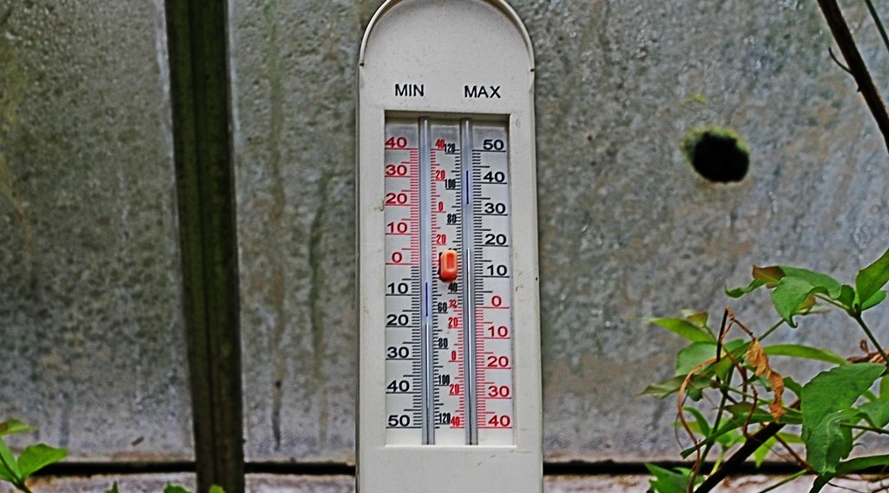
GEOGRAPHY — FORM 4
I. MEASUREMENT
Activity 1
A thermometer that shows the highest and the lowest temperature.
2026 / 2027
DGCAST GAROUA — GEOGRAPHY DEPARTMENT
Mr KAMDEM E. | 14
Notes:
Without the projector: draw a U-shaped thermometer.

Slide 15
GEOGRAPHY — FORM 4
I. MEASUREMENT
Activity 1: Question
What does this thermometer record?
2026 / 2027
DGCAST GAROUA — GEOGRAPHY DEPARTMENT
Mr KAMDEM E. | 15

Slide 16
GEOGRAPHY — FORM 4
I. MEASUREMENT
Answer
The maximum and the minimum temperature of the day.
2026 / 2027
DGCAST GAROUA — GEOGRAPHY DEPARTMENT
Mr KAMDEM E. | 16

Slide 17
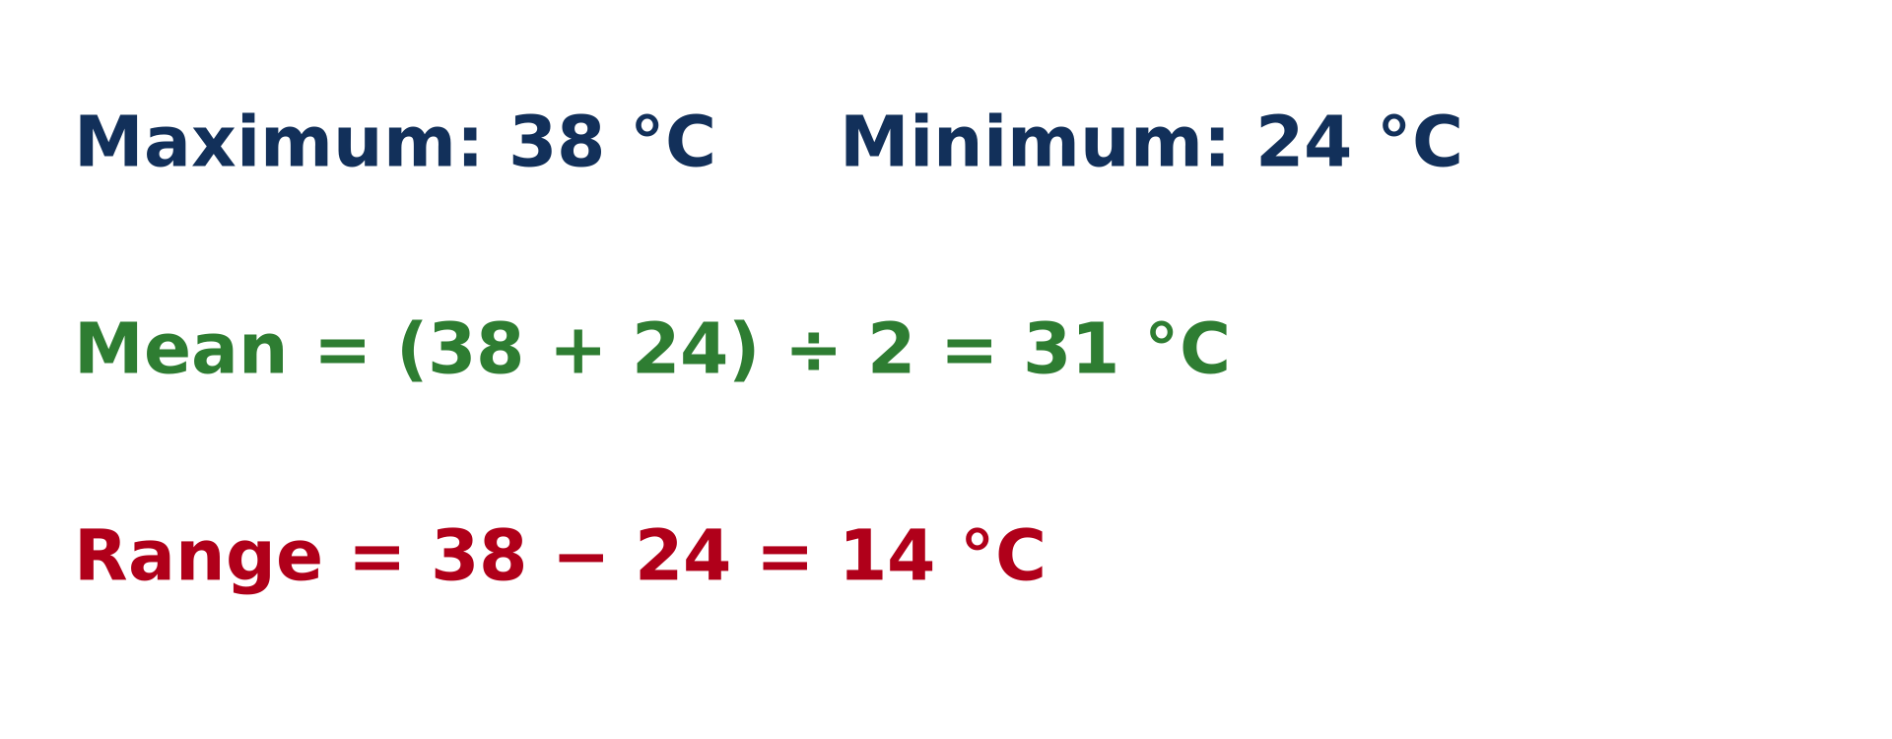
GEOGRAPHY — FORM 4
II. CALCULATIONS
Activity 2
A worked example.
2026 / 2027
DGCAST GAROUA — GEOGRAPHY DEPARTMENT
Mr KAMDEM E. | 17
Notes:
Without the projector: write the example on the board.

Slide 18
GEOGRAPHY — FORM 4
II. CALCULATIONS
Activity 2: Question
Maximum 38 °C, minimum 24 °C. Find the mean and the range.
2026 / 2027
DGCAST GAROUA — GEOGRAPHY DEPARTMENT
Mr KAMDEM E. | 18

Slide 19
GEOGRAPHY — FORM 4
II. CALCULATIONS
Answer
Mean: 31 °C. Range: 14 °C.
2026 / 2027
DGCAST GAROUA — GEOGRAPHY DEPARTMENT
Mr KAMDEM E. | 19

Slide 20

GEOGRAPHY — FORM 4
III. THE STEVENSON SCREEN
Activity 3
A Stevenson screen.
2026 / 2027
DGCAST GAROUA — GEOGRAPHY DEPARTMENT
Mr KAMDEM E. | 20
Notes:
Without the projector: describe a white wooden box on legs.

Slide 21
GEOGRAPHY — FORM 4
III. THE STEVENSON SCREEN
Activity 3: Question
Why is this box white with openings on the sides?
2026 / 2027
DGCAST GAROUA — GEOGRAPHY DEPARTMENT
Mr KAMDEM E. | 21

Slide 22
GEOGRAPHY — FORM 4
III. THE STEVENSON SCREEN
Answer
White reflects the sun; the openings let the air pass.
2026 / 2027
DGCAST GAROUA — GEOGRAPHY DEPARTMENT
Mr KAMDEM E. | 22

Slide 23
GEOGRAPHY — FORM 4
BOARD SUMMARY
Weather Elements: Atmospheric Temperatures
Topic: The Earth-Atmosphere System
Sub-topic: Measurement of Weather Elements
Lesson 32: Weather Elements: Atmospheric Temperatures
2026 / 2027
DGCAST GAROUA — GEOGRAPHY DEPARTMENT
Mr KAMDEM E. | 23
Notes:
Learners copy the board summary now. Give them enough time for each slide.

Slide 24
GEOGRAPHY — FORM 4
BOARD SUMMARY
I. Definitions
Temperature: It is how hot or cold the air is.
Mean daily temperature: It is (maximum + minimum) ÷ 2.
Daily range: It is maximum − minimum.
2026 / 2027
DGCAST GAROUA — GEOGRAPHY DEPARTMENT
Mr KAMDEM E. | 24

Slide 25
GEOGRAPHY — FORM 4
BOARD SUMMARY
II. Measurement
A. Thermometer: It gives the temperature now.
B. Six's thermometer: It gives the maximum and minimum.
C. Example: Mean 31 °C, range 14 °C.
2026 / 2027
DGCAST GAROUA — GEOGRAPHY DEPARTMENT
Mr KAMDEM E. | 25

Slide 26
GEOGRAPHY — FORM 4
BOARD SUMMARY
III. The Stevenson Screen
A. White: It reflects the sunlight.
B. Open sides: The air moves freely.
C. Siting: On grass, in the open, about 1.2 m high.
2026 / 2027
DGCAST GAROUA — GEOGRAPHY DEPARTMENT
Mr KAMDEM E. | 26

Slide 27
GEOGRAPHY — FORM 4
FORMATIVE EVALUATION
Formative Evaluation 1
Maximum 34 °C, minimum 20 °C. What is the mean?
2026 / 2027
DGCAST GAROUA — GEOGRAPHY DEPARTMENT
Mr KAMDEM E. | 27

Slide 28
GEOGRAPHY — FORM 4
FORMATIVE EVALUATION
Expected Answer
27 °C.
2026 / 2027
DGCAST GAROUA — GEOGRAPHY DEPARTMENT
Mr KAMDEM E. | 28

Slide 29
GEOGRAPHY — FORM 4
FORMATIVE EVALUATION
Formative Evaluation 2
Why is the Stevenson screen painted white?
2026 / 2027
DGCAST GAROUA — GEOGRAPHY DEPARTMENT
Mr KAMDEM E. | 29

Slide 30
GEOGRAPHY — FORM 4
FORMATIVE EVALUATION
Expected Answer
To reflect the sunlight.
2026 / 2027
DGCAST GAROUA — GEOGRAPHY DEPARTMENT
Mr KAMDEM E. | 30

Slide 31
GEOGRAPHY — FORM 4
REMEDIATION
Remediation
Fill in the blanks:
The highest and lowest temperatures are recorded by the ______ thermometer.
Mean = (maximum + minimum) ÷ ______.
Thermometers are kept in a ______ screen.
2026 / 2027
DGCAST GAROUA — GEOGRAPHY DEPARTMENT
Mr KAMDEM E. | 31
Notes:
Answers: 1. Six's 2. 2 3. Stevenson

Slide 32
GEOGRAPHY — FORM 4
HOMEWORK
Homework
Wet a piece of cloth and hang it outside in the morning and in the afternoon. Note how long it takes to dry each time.
This prepares Lesson 33: Other Weather Elements (humidity, wind, pressure, sunshine).
2026 / 2027
DGCAST GAROUA — GEOGRAPHY DEPARTMENT
Mr KAMDEM E. | 32
Notes:
This homework prepares the next lesson.

Slide 33
GEOGRAPHY — FORM 4
BILINGUAL GAME
Bilingual Game (Jeu Bilingue)
English | Français
Temperature | La température
Maximum | Le maximum
Minimum | Le minimum
Range | L'amplitude
Mean | La moyenne
Stevenson screen | L'abri météorologique
Shade | L'ombre
Isotherm | L'isotherme
2026 / 2027
DGCAST GAROUA — GEOGRAPHY DEPARTMENT
Mr KAMDEM E. | 33
Notes:
Say the English word; learners give the French word, then the reverse.

Slide 34
GEOGRAPHY — FORM 4
LOGBOOK
Official Logbook (1/2)
Module / Topic | The Earth-Atmosphere System
Lesson Title | Lesson 32: Weather Elements: Atmospheric Temperatures
Expected Learning Outcomes | Define atmospheric temperature. Describe how temperature is measured and calculate mean and range. Describe the Stevenson screen and the rules for siting it.
Competence | Learners are able to measure the temperature of the air correctly and calculate daily means and ranges.
2026 / 2027
DGCAST GAROUA — GEOGRAPHY DEPARTMENT
Mr KAMDEM E. | 34

Slide 35
GEOGRAPHY — FORM 4
LOGBOOK
Official Logbook (2/2)
Matter Taught | I. Definitions: Temperature, Mean daily temperature, Daily range; II. Measurement: Thermometer, Six's thermometer, Example; III. The Stevenson Screen: White, Open sides, Siting.
Evaluation | Formative evaluation (3 questions) and remediation exercise.
Homework | Wet a piece of cloth and hang it outside in the morning and in the afternoon. Note how long it takes to dry each time.
Enrolment / Present / Absent | ____ / ____ / ____
Achievement | To be completed by the teacher after the lesson.
2026 / 2027
DGCAST GAROUA — GEOGRAPHY DEPARTMENT
Mr KAMDEM E. | 35

Slide 36
GEOGRAPHY — FORM 4
TEACHER'S NOTE
Teacher's Note
Timing: Set-up, recall 5 min | Situation 5 min | 3 activities 12 min | Board summary (copying) 15 min | Evaluation, homework 5 min | Logbook 5 min | Spare 3 min
2026 / 2027
DGCAST GAROUA — GEOGRAPHY DEPARTMENT
Mr KAMDEM E. | 36

Slide 37
GEOGRAPHY — FORM 4
REFERENCES
References
National Geography Syllabus (MINESEC), Form 4 — Module 3: Weather and Climate.
Teacher's lesson notes (f4.docx), checked and corrected where necessary.
WMO Guide to Instruments and Methods of Observation (WMO-No. 8).
Photo, Activity 1: “maximum minimum thermometer” by Leo Reynolds, CC BY-NC-SA 2.0, via Flickr (https://www.flickr.com/photos/49968232@N00/7928521796)
Photo, Activity 3: “Adelaide. Urrbrae. The weather station at the Waite campus of the Univ” by denisbin, CC BY-ND 2.0, via Flickr (https://www.flickr.com/photos/82134796@N03/49865994827)
Diagrams and animations: drawn for this lesson (DGCAST Geography Department).
2026 / 2027
DGCAST GAROUA — GEOGRAPHY DEPARTMENT
Mr KAMDEM E. | 37

