Slide 1

DIVINE GRACE COLLEGE OF ARTS, SCIENCE AND TECHNOLOGY
(DGCAST) — GAROUA | GEOGRAPHY DEPARTMENT
FORM 4 GEOGRAPHY — LESSON 33
Weather Elements: Humidity, Wind, Pressure and Sunshine
Mr KAMDEM EMMANUEL
Geography Teacher — PLEG
Academic Year 2026 / 2027
Notes:
Good morning, class. Today we study Lesson 33: Weather Elements: Humidity, Wind, Pressure and Sunshine.

Slide 2
GEOGRAPHY — FORM 4
CLASS INFO
Class, Chapter & Duration
Class | Form 4
Chapter | Module 3: Weather and Climate — Adaptation to Climatic Excesses
Duration | 50 minutes
2026 / 2027
DGCAST GAROUA — GEOGRAPHY DEPARTMENT
Mr KAMDEM E. | 2

Slide 3
GEOGRAPHY — FORM 4
IDENTIFICATION
Lesson Identification
Topic | The Earth-Atmosphere System
Sub-topic | Measurement of Weather Elements
Lesson | Lesson 33: Weather Elements: Humidity, Wind, Pressure and Sunshine
Notions / Concepts | Humidity, wind direction, wind speed, atmospheric pressure, sunshine.
Syllabus focus | Atmospheric humidity; wind direction; wind speed; atmospheric pressure; amount of sunshine.
Competence | Learners are able to observe the humidity, wind and sky and predict simple changes in the weather around them.
2026 / 2027
DGCAST GAROUA — GEOGRAPHY DEPARTMENT
Mr KAMDEM E. | 3

Slide 4
GEOGRAPHY — FORM 4
OBJECTIVES
Learning Objectives
By the end of the lesson, the learner should be able to:
Define humidity and relative humidity, and name their instrument.
Describe how wind direction and wind speed are measured.
Define atmospheric pressure and sunshine and name their instruments.
2026 / 2027
DGCAST GAROUA — GEOGRAPHY DEPARTMENT
Mr KAMDEM E. | 4

Slide 5
GEOGRAPHY — FORM 4
RECALL
Recall
Temperature is measured with a thermometer inside a Stevenson screen.
Mean daily temperature = (maximum + minimum) ÷ 2.
Temperature data is shown with isotherms.
2026 / 2027
DGCAST GAROUA — GEOGRAPHY DEPARTMENT
Mr KAMDEM E. | 5
Notes:
Check the homework: drying time of a wet cloth.

Slide 6
GEOGRAPHY — FORM 4
REAL-LIFE SITUATION
Real-Life Situation
In August, Hadja's washing takes a whole day to dry and the air feels heavy. In January, during the Harmattan, the same clothes dry in less than one hour.
2026 / 2027
DGCAST GAROUA — GEOGRAPHY DEPARTMENT
Mr KAMDEM E. | 6
Notes:
Read the situation slowly, twice.

Slide 7
GEOGRAPHY — FORM 4
REAL-LIFE SITUATION
Situation — Question 1
What is the problem in the situation?
2026 / 2027
DGCAST GAROUA — GEOGRAPHY DEPARTMENT
Mr KAMDEM E. | 7

Slide 8
GEOGRAPHY — FORM 4
REAL-LIFE SITUATION
Answer
Hadja does not know why clothes dry slowly in August.
2026 / 2027
DGCAST GAROUA — GEOGRAPHY DEPARTMENT
Mr KAMDEM E. | 8

Slide 9
GEOGRAPHY — FORM 4
REAL-LIFE SITUATION
Situation — Question 2
When do clothes dry fast?
2026 / 2027
DGCAST GAROUA — GEOGRAPHY DEPARTMENT
Mr KAMDEM E. | 9

Slide 10
GEOGRAPHY — FORM 4
REAL-LIFE SITUATION
Answer
In January, during the Harmattan.
2026 / 2027
DGCAST GAROUA — GEOGRAPHY DEPARTMENT
Mr KAMDEM E. | 10

Slide 11
GEOGRAPHY — FORM 4
REAL-LIFE SITUATION
Situation — Question 3
Why?
2026 / 2027
DGCAST GAROUA — GEOGRAPHY DEPARTMENT
Mr KAMDEM E. | 11

Slide 12
GEOGRAPHY — FORM 4
REAL-LIFE SITUATION
Possible Answer
The air is dry: there is little water vapour.
2026 / 2027
DGCAST GAROUA — GEOGRAPHY DEPARTMENT
Mr KAMDEM E. | 12

Slide 13
GEOGRAPHY — FORM 4
JUSTIFICATION
Justification of the Lesson
This lesson helps us to know humidity, wind, pressure and sunshine.
2026 / 2027
DGCAST GAROUA — GEOGRAPHY DEPARTMENT
Mr KAMDEM E. | 13

Slide 14
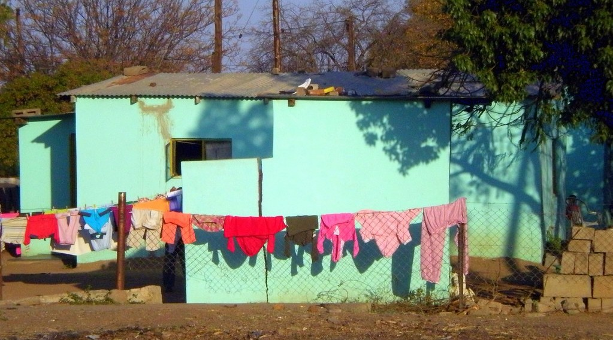
GEOGRAPHY — FORM 4
I. HUMIDITY
Activity 1
Clothes drying on a line.
2026 / 2027
DGCAST GAROUA — GEOGRAPHY DEPARTMENT
Mr KAMDEM E. | 14
Notes:
Without the projector: use the situation of Hadja.

Slide 15
GEOGRAPHY — FORM 4
I. HUMIDITY
Activity 1: Question
Why do clothes dry slowly when the air is wet?
2026 / 2027
DGCAST GAROUA — GEOGRAPHY DEPARTMENT
Mr KAMDEM E. | 15

Slide 16
GEOGRAPHY — FORM 4
I. HUMIDITY
Answer
The air already has a lot of water vapour (high humidity).
2026 / 2027
DGCAST GAROUA — GEOGRAPHY DEPARTMENT
Mr KAMDEM E. | 16

Slide 17

GEOGRAPHY — FORM 4
II. WIND
Activity 2
A windsock at an airport.
2026 / 2027
DGCAST GAROUA — GEOGRAPHY DEPARTMENT
Mr KAMDEM E. | 17
Notes:
Without the projector: hold a piece of cloth in the wind.

Slide 18
GEOGRAPHY — FORM 4
II. WIND
Activity 2: Question
What does the windsock show? Why is it useful for pilots?
2026 / 2027
DGCAST GAROUA — GEOGRAPHY DEPARTMENT
Mr KAMDEM E. | 18

Slide 19
GEOGRAPHY — FORM 4
II. WIND
Answer
The direction and the force of the wind. Planes take off against the wind.
2026 / 2027
DGCAST GAROUA — GEOGRAPHY DEPARTMENT
Mr KAMDEM E. | 19

Slide 20

GEOGRAPHY — FORM 4
III. PRESSURE
Activity 3
A barometer.
2026 / 2027
DGCAST GAROUA — GEOGRAPHY DEPARTMENT
Mr KAMDEM E. | 20
Notes:
Without the projector: explain that air has weight.

Slide 21
GEOGRAPHY — FORM 4
III. PRESSURE
Activity 3: Question
What does a barometer measure? What if it falls quickly?
2026 / 2027
DGCAST GAROUA — GEOGRAPHY DEPARTMENT
Mr KAMDEM E. | 21

Slide 22
GEOGRAPHY — FORM 4
III. PRESSURE
Answer
Air pressure. A quick fall means rain or a storm.
2026 / 2027
DGCAST GAROUA — GEOGRAPHY DEPARTMENT
Mr KAMDEM E. | 22

Slide 23
GEOGRAPHY — FORM 4
BOARD SUMMARY
Weather Elements: Humidity, Wind, Pressure and Sunshine
Topic: The Earth-Atmosphere System
Sub-topic: Measurement of Weather Elements
Lesson 33: Weather Elements: Humidity, Wind, Pressure and Sunshine
2026 / 2027
DGCAST GAROUA — GEOGRAPHY DEPARTMENT
Mr KAMDEM E. | 23
Notes:
Learners copy the board summary now. Give them enough time for each slide.

Slide 24
GEOGRAPHY — FORM 4
BOARD SUMMARY
I. Definitions
Humidity: It is the amount of water vapour in the air.
Wind: It is air that moves.
Air pressure: It is the weight of the air.
2026 / 2027
DGCAST GAROUA — GEOGRAPHY DEPARTMENT
Mr KAMDEM E. | 24

Slide 25
GEOGRAPHY — FORM 4
BOARD SUMMARY
II. Humidity
A. Instrument: The hygrometer (wet and dry bulbs).
B. Unit: Percent (%).
C. Garoua: High in August, low in January.
2026 / 2027
DGCAST GAROUA — GEOGRAPHY DEPARTMENT
Mr KAMDEM E. | 25

Slide 26
GEOGRAPHY — FORM 4
BOARD SUMMARY
III. Wind, Pressure and Sunshine
A. Wind direction: Wind vane; named from where it comes.
B. Wind speed: Anemometer.
C. Pressure: Barometer (millibars).
D. Sunshine: Sunshine recorder (hours).
2026 / 2027
DGCAST GAROUA — GEOGRAPHY DEPARTMENT
Mr KAMDEM E. | 26

Slide 27
GEOGRAPHY — FORM 4
FORMATIVE EVALUATION
Formative Evaluation 1
What is humidity?
2026 / 2027
DGCAST GAROUA — GEOGRAPHY DEPARTMENT
Mr KAMDEM E. | 27

Slide 28
GEOGRAPHY — FORM 4
FORMATIVE EVALUATION
Expected Answer
The amount of water vapour in the air.
2026 / 2027
DGCAST GAROUA — GEOGRAPHY DEPARTMENT
Mr KAMDEM E. | 28

Slide 29
GEOGRAPHY — FORM 4
FORMATIVE EVALUATION
Formative Evaluation 2
The Harmattan blows from the north-east. What is its name as a wind direction?
2026 / 2027
DGCAST GAROUA — GEOGRAPHY DEPARTMENT
Mr KAMDEM E. | 29

Slide 30
GEOGRAPHY — FORM 4
FORMATIVE EVALUATION
Expected Answer
A north-easterly wind.
2026 / 2027
DGCAST GAROUA — GEOGRAPHY DEPARTMENT
Mr KAMDEM E. | 30

Slide 31
GEOGRAPHY — FORM 4
REMEDIATION
Remediation
Fill in the blanks:
Humidity is measured with a ______.
Air pressure is measured with a ______.
A wind is named after the direction it comes ______.
2026 / 2027
DGCAST GAROUA — GEOGRAPHY DEPARTMENT
Mr KAMDEM E. | 31
Notes:
Answers: 1. hygrometer 2. barometer 3. from

Slide 32
GEOGRAPHY — FORM 4
HOMEWORK
Homework
Early tomorrow morning, look at the grass, leaves or cars near your house. Write down whether you see drops of water on them, and where you think the water came from.
This prepares Lesson 34: Condensation.
2026 / 2027
DGCAST GAROUA — GEOGRAPHY DEPARTMENT
Mr KAMDEM E. | 32
Notes:
This homework prepares the next lesson.

Slide 33
GEOGRAPHY — FORM 4
BILINGUAL GAME
Bilingual Game (Jeu Bilingue)
English | Français
Humidity | L'humidité
Hygrometer | L'hygromètre
Wind direction | La direction du vent
Wind speed | La vitesse du vent
Pressure | La pression
Barometer | Le baromètre
Sunshine | L'ensoleillement
Isobar | L'isobare
2026 / 2027
DGCAST GAROUA — GEOGRAPHY DEPARTMENT
Mr KAMDEM E. | 33
Notes:
Say the English word; learners give the French word, then the reverse.

Slide 34
GEOGRAPHY — FORM 4
LOGBOOK
Official Logbook (1/2)
Module / Topic | The Earth-Atmosphere System
Lesson Title | Lesson 33: Weather Elements: Humidity, Wind, Pressure and Sunshine
Expected Learning Outcomes | Define humidity and relative humidity, and name their instrument. Describe how wind direction and wind speed are measured. Define atmospheric pressure and sunshine and name their instruments.
Competence | Learners are able to observe the humidity, wind and sky and predict simple changes in the weather around them.
2026 / 2027
DGCAST GAROUA — GEOGRAPHY DEPARTMENT
Mr KAMDEM E. | 34

Slide 35
GEOGRAPHY — FORM 4
LOGBOOK
Official Logbook (2/2)
Matter Taught | I. Definitions: Humidity, Wind, Air pressure; II. Humidity: Instrument, Unit, Garoua; III. Wind, Pressure and Sunshine: Wind direction, Wind speed, Pressure, Sunshine.
Evaluation | Formative evaluation (3 questions) and remediation exercise.
Homework | Early tomorrow morning, look at the grass, leaves or cars near your house. Write down whether you see drops of water on them, and where you think the water came from.
Enrolment / Present / Absent | ____ / ____ / ____
Achievement | To be completed by the teacher after the lesson.
2026 / 2027
DGCAST GAROUA — GEOGRAPHY DEPARTMENT
Mr KAMDEM E. | 35

Slide 36
GEOGRAPHY — FORM 4
TEACHER'S NOTE
Teacher's Note
Timing: Set-up, recall 5 min | Situation 5 min | 3 activities 12 min | Board summary (copying) 15 min | Evaluation, homework 5 min | Logbook 5 min | Spare 3 min
2026 / 2027
DGCAST GAROUA — GEOGRAPHY DEPARTMENT
Mr KAMDEM E. | 36

Slide 37
GEOGRAPHY — FORM 4
REFERENCES
References
National Geography Syllabus (MINESEC), Form 4 — Module 3: Weather and Climate.
Teacher's lesson notes (f4.docx), checked and corrected where necessary.
Photo, Activity 1: “Bright Blue Home” by Clav, CC BY-NC-SA 2.0, via Flickr (https://www.flickr.com/photos/37005711@N00/2797194021)
Photo, Activity 2: “Windsock” by Wajahat Mahmood, CC BY-SA 2.0, via Flickr (https://www.flickr.com/photos/26116471@N03/6613272897)
Photo, Activity 3: “Aneroid Barometer, with dial designed by Sir Napier Shaw, 1914” by Negretti & Zambra; Shaw, Sir Napier, CC BY-NC-SA 4.0, via sciencemuseum (https://collection.sciencemuseumgroup.org.uk/objects/co54459/aneroid-barometer-with-dial-designed-by-sir-napier-shaw-1914)
Diagrams and animations: drawn for this lesson (DGCAST Geography Department).
2026 / 2027
DGCAST GAROUA — GEOGRAPHY DEPARTMENT
Mr KAMDEM E. | 37

