Slide 1

DIVINE GRACE COLLEGE OF ARTS, SCIENCE AND TECHNOLOGY
(DGCAST) — GAROUA | GEOGRAPHY DEPARTMENT
FORM 4 GEOGRAPHY — LESSON 34
Condensation
Mr KAMDEM EMMANUEL
Geography Teacher — PLEG
Academic Year 2026 / 2027
Notes:
Good morning, class. Today we study Lesson 34: Condensation.

Slide 2
GEOGRAPHY — FORM 4
CLASS INFO
Class, Chapter & Duration
Class | Form 4
Chapter | Module 3: Weather and Climate — Adaptation to Climatic Excesses
Duration | 50 minutes
2026 / 2027
DGCAST GAROUA — GEOGRAPHY DEPARTMENT
Mr KAMDEM E. | 2

Slide 3
GEOGRAPHY — FORM 4
IDENTIFICATION
Lesson Identification
Topic | The Earth-Atmosphere System
Sub-topic | Forms of Condensation
Lesson | Lesson 34: Condensation
Notions / Concepts | Drizzle, precipitation, hail, cloud, fog, dew, mist.
Syllabus focus | Meaning of condensation; forms of condensation.
Competence | Learners are able to explain the drops of water that appear on cold objects, grass and windows, and to drive or walk carefully in fog.
2026 / 2027
DGCAST GAROUA — GEOGRAPHY DEPARTMENT
Mr KAMDEM E. | 3

Slide 4
GEOGRAPHY — FORM 4
OBJECTIVES
Learning Objectives
By the end of the lesson, the learner should be able to:
Define condensation, saturation and dew point.
State the conditions necessary for condensation.
Describe the forms of condensation near the ground and in the atmosphere.
2026 / 2027
DGCAST GAROUA — GEOGRAPHY DEPARTMENT
Mr KAMDEM E. | 4

Slide 5
GEOGRAPHY — FORM 4
RECALL
Recall
Humidity is the amount of water vapour in the air.
It is measured with a hygrometer and given in percent.
Warm air can hold more water vapour than cold air.
2026 / 2027
DGCAST GAROUA — GEOGRAPHY DEPARTMENT
Mr KAMDEM E. | 5
Notes:
Check the homework: drops of water seen early in the morning.

Slide 6
GEOGRAPHY — FORM 4
REAL-LIFE SITUATION
Real-Life Situation
On a hot afternoon, Yaya takes a cold bottle out of the refrigerator. After a few minutes, drops of water cover the outside of the bottle. The bottle is closed.
2026 / 2027
DGCAST GAROUA — GEOGRAPHY DEPARTMENT
Mr KAMDEM E. | 6
Notes:
Read the situation slowly, twice.

Slide 7
GEOGRAPHY — FORM 4
REAL-LIFE SITUATION
Situation — Question 1
What is the problem in the situation?
2026 / 2027
DGCAST GAROUA — GEOGRAPHY DEPARTMENT
Mr KAMDEM E. | 7

Slide 8
GEOGRAPHY — FORM 4
REAL-LIFE SITUATION
Answer
Yaya does not know where the drops come from.
2026 / 2027
DGCAST GAROUA — GEOGRAPHY DEPARTMENT
Mr KAMDEM E. | 8

Slide 9
GEOGRAPHY — FORM 4
REAL-LIFE SITUATION
Situation — Question 2
Where is the water from?
2026 / 2027
DGCAST GAROUA — GEOGRAPHY DEPARTMENT
Mr KAMDEM E. | 9

Slide 10
GEOGRAPHY — FORM 4
REAL-LIFE SITUATION
Answer
From the water vapour in the air.
2026 / 2027
DGCAST GAROUA — GEOGRAPHY DEPARTMENT
Mr KAMDEM E. | 10

Slide 11
GEOGRAPHY — FORM 4
REAL-LIFE SITUATION
Situation — Question 3
What changed it into drops?
2026 / 2027
DGCAST GAROUA — GEOGRAPHY DEPARTMENT
Mr KAMDEM E. | 11

Slide 12
GEOGRAPHY — FORM 4
REAL-LIFE SITUATION
Possible Answer
The cold bottle cooled the air.
2026 / 2027
DGCAST GAROUA — GEOGRAPHY DEPARTMENT
Mr KAMDEM E. | 12

Slide 13
GEOGRAPHY — FORM 4
JUSTIFICATION
Justification of the Lesson
This lesson helps us to understand how clouds, fog and dew form.
2026 / 2027
DGCAST GAROUA — GEOGRAPHY DEPARTMENT
Mr KAMDEM E. | 13

Slide 14
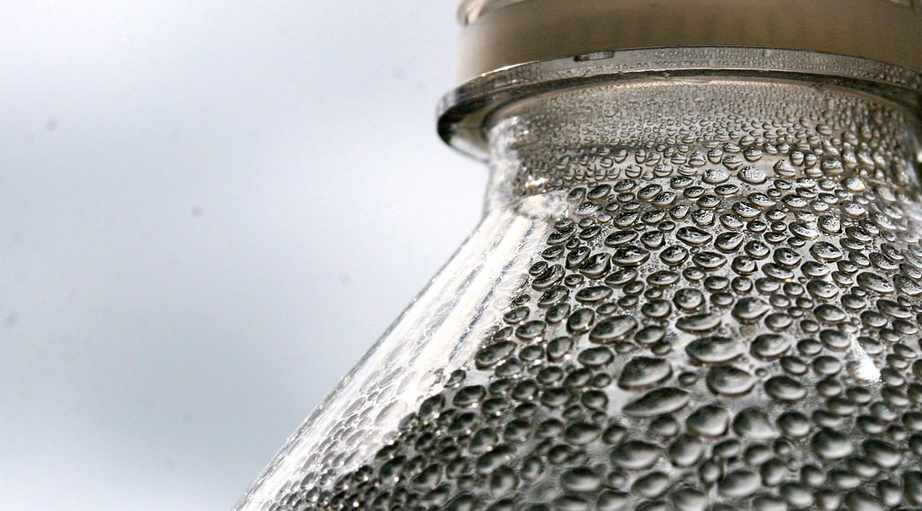
GEOGRAPHY — FORM 4
I. MEANING
Activity 1
Drops of water on a cold bottle.
2026 / 2027
DGCAST GAROUA — GEOGRAPHY DEPARTMENT
Mr KAMDEM E. | 14
Notes:
Without the projector: bring a cold bottle to class.

Slide 15
GEOGRAPHY — FORM 4
I. MEANING
Activity 1: Question
What do we call the change of water vapour into drops of water?
2026 / 2027
DGCAST GAROUA — GEOGRAPHY DEPARTMENT
Mr KAMDEM E. | 15

Slide 16
GEOGRAPHY — FORM 4
I. MEANING
Answer
Condensation.
2026 / 2027
DGCAST GAROUA — GEOGRAPHY DEPARTMENT
Mr KAMDEM E. | 16

Slide 17
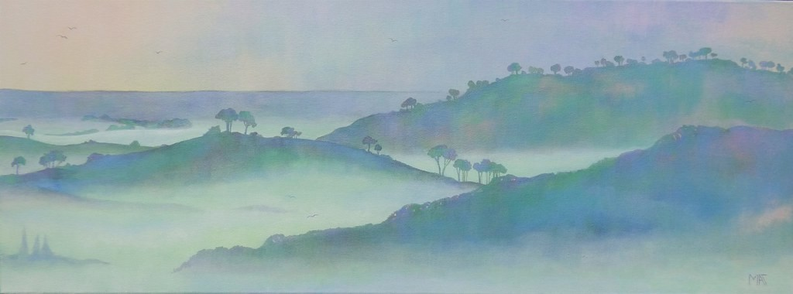
GEOGRAPHY — FORM 4
II. FORMS
Activity 2
Fog in the valleys in the morning.
2026 / 2027
DGCAST GAROUA — GEOGRAPHY DEPARTMENT
Mr KAMDEM E. | 17
Notes:
Without the projector: describe a foggy morning on the Adamawa plateau.

Slide 18
GEOGRAPHY — FORM 4
II. FORMS
Activity 2: Question
What is fog?
2026 / 2027
DGCAST GAROUA — GEOGRAPHY DEPARTMENT
Mr KAMDEM E. | 18

Slide 19
GEOGRAPHY — FORM 4
II. FORMS
Answer
A cloud at ground level.
2026 / 2027
DGCAST GAROUA — GEOGRAPHY DEPARTMENT
Mr KAMDEM E. | 19

Slide 20

GEOGRAPHY — FORM 4
II. FORMS
Activity 3
A very tall storm cloud.
2026 / 2027
DGCAST GAROUA — GEOGRAPHY DEPARTMENT
Mr KAMDEM E. | 20
Notes:
Without the projector: draw a very tall cloud with a flat top.

Slide 21
GEOGRAPHY — FORM 4
II. FORMS
Activity 3: Question
This cloud brings heavy rain and thunder. What is it called?
2026 / 2027
DGCAST GAROUA — GEOGRAPHY DEPARTMENT
Mr KAMDEM E. | 21

Slide 22
GEOGRAPHY — FORM 4
II. FORMS
Answer
A cumulonimbus cloud.
2026 / 2027
DGCAST GAROUA — GEOGRAPHY DEPARTMENT
Mr KAMDEM E. | 22

Slide 23
GEOGRAPHY — FORM 4
BOARD SUMMARY
Condensation
Topic: The Earth-Atmosphere System
Sub-topic: Forms of Condensation
Lesson 34: Condensation
2026 / 2027
DGCAST GAROUA — GEOGRAPHY DEPARTMENT
Mr KAMDEM E. | 23
Notes:
Learners copy the board summary now. Give them enough time for each slide.

Slide 24
GEOGRAPHY — FORM 4
BOARD SUMMARY
I. Definitions
Condensation: It is the change of water vapour into water.
Dew point: It is the temperature at which condensation starts.
Fog: It is a cloud at ground level.
2026 / 2027
DGCAST GAROUA — GEOGRAPHY DEPARTMENT
Mr KAMDEM E. | 24

Slide 25
GEOGRAPHY — FORM 4
BOARD SUMMARY
II. Conditions
A. Moist air: The air has water vapour.
B. Cooling: The air cools to the dew point.
C. Small particles: Dust helps drops to form.
2026 / 2027
DGCAST GAROUA — GEOGRAPHY DEPARTMENT
Mr KAMDEM E. | 25

Slide 26
GEOGRAPHY — FORM 4
BOARD SUMMARY
III. Forms of Condensation
A. Dew: Drops on grass in the morning.
B. Fog and mist: Clouds at ground level.
C. Clouds: Cumulus, stratus, cirrus, cumulonimbus.
D. Frost: Ice when it is very cold.
2026 / 2027
DGCAST GAROUA — GEOGRAPHY DEPARTMENT
Mr KAMDEM E. | 26

Slide 27
GEOGRAPHY — FORM 4
FORMATIVE EVALUATION
Formative Evaluation 1
What is condensation?
2026 / 2027
DGCAST GAROUA — GEOGRAPHY DEPARTMENT
Mr KAMDEM E. | 27

Slide 28
GEOGRAPHY — FORM 4
FORMATIVE EVALUATION
Expected Answer
The change of water vapour into water.
2026 / 2027
DGCAST GAROUA — GEOGRAPHY DEPARTMENT
Mr KAMDEM E. | 28

Slide 29
GEOGRAPHY — FORM 4
FORMATIVE EVALUATION
Formative Evaluation 2
Which cloud brings thunderstorms?
2026 / 2027
DGCAST GAROUA — GEOGRAPHY DEPARTMENT
Mr KAMDEM E. | 29

Slide 30
GEOGRAPHY — FORM 4
FORMATIVE EVALUATION
Expected Answer
The cumulonimbus.
2026 / 2027
DGCAST GAROUA — GEOGRAPHY DEPARTMENT
Mr KAMDEM E. | 30

Slide 31
GEOGRAPHY — FORM 4
REMEDIATION
Remediation
Fill in the blanks:
Water vapour becoming water is ______.
Drops on grass in the morning are ______.
A cloud at ground level is ______.
2026 / 2027
DGCAST GAROUA — GEOGRAPHY DEPARTMENT
Mr KAMDEM E. | 31
Notes:
Answers: 1. condensation 2. dew 3. fog

Slide 32
GEOGRAPHY — FORM 4
HOMEWORK
Homework
During the next rain, put an empty tin with straight sides in an open place. After the rain, measure the depth of water in it with a ruler, in millimetres.
This prepares Lesson 35: Precipitation.
2026 / 2027
DGCAST GAROUA — GEOGRAPHY DEPARTMENT
Mr KAMDEM E. | 32
Notes:
This homework prepares the next lesson.

Slide 33
GEOGRAPHY — FORM 4
BILINGUAL GAME
Bilingual Game (Jeu Bilingue)
English | Français
Condensation | La condensation
Water vapour | La vapeur d'eau
Dew point | Le point de rosée
Dew | La rosée
Frost | Le givre
Fog | Le brouillard
Mist | La brume
Cloud | Le nuage
2026 / 2027
DGCAST GAROUA — GEOGRAPHY DEPARTMENT
Mr KAMDEM E. | 33
Notes:
Say the English word; learners give the French word, then the reverse.

Slide 34
GEOGRAPHY — FORM 4
LOGBOOK
Official Logbook (1/2)
Module / Topic | The Earth-Atmosphere System
Lesson Title | Lesson 34: Condensation
Expected Learning Outcomes | Define condensation, saturation and dew point. State the conditions necessary for condensation. Describe the forms of condensation near the ground and in the atmosphere.
Competence | Learners are able to explain the drops of water that appear on cold objects, grass and windows, and to drive or walk carefully in fog.
2026 / 2027
DGCAST GAROUA — GEOGRAPHY DEPARTMENT
Mr KAMDEM E. | 34

Slide 35
GEOGRAPHY — FORM 4
LOGBOOK
Official Logbook (2/2)
Matter Taught | I. Definitions: Condensation, Dew point, Fog; II. Conditions: Moist air, Cooling, Small particles; III. Forms of Condensation: Dew, Fog and mist, Clouds, Frost.
Evaluation | Formative evaluation (3 questions) and remediation exercise.
Homework | During the next rain, put an empty tin with straight sides in an open place. After the rain, measure the depth of water in it with a ruler, in millimetres.
Enrolment / Present / Absent | ____ / ____ / ____
Achievement | To be completed by the teacher after the lesson.
2026 / 2027
DGCAST GAROUA — GEOGRAPHY DEPARTMENT
Mr KAMDEM E. | 35

Slide 36
GEOGRAPHY — FORM 4
TEACHER'S NOTE
Teacher's Note
Timing: Set-up, recall 5 min | Situation 5 min | 3 activities 12 min | Board summary (copying) 15 min | Evaluation, homework 5 min | Logbook 5 min | Spare 3 min
2026 / 2027
DGCAST GAROUA — GEOGRAPHY DEPARTMENT
Mr KAMDEM E. | 36

Slide 37
GEOGRAPHY — FORM 4
REFERENCES
References
National Geography Syllabus (MINESEC), Form 4 — Module 3: Weather and Climate.
Teacher's lesson notes (f4.docx), checked and corrected where necessary.
Photo, Activity 1: “water bottle” by Muffet, CC BY 2.0, via Flickr (https://www.flickr.com/photos/53133240@N00/542497582)
Photo, Activity 2: “Mist” by Art by MarkAC, CC BY-SA 2.0, via Flickr (https://www.flickr.com/photos/60580775@N08/40783321332)
Photo, Activity 3: “06172012 Sunday evening pulse storms/cumulonimbi” by StormRider93 | Into the Storm, CC BY-NC-ND 2.0, via Flickr (https://www.flickr.com/photos/65232104@N04/7395715628)
Diagrams and animations: drawn for this lesson (DGCAST Geography Department).
2026 / 2027
DGCAST GAROUA — GEOGRAPHY DEPARTMENT
Mr KAMDEM E. | 37

