Slide 1
FORM 3
GEOGRAPHY
Lesson 13
Earthquakes
Notes:
Good morning, class, and welcome to our geography lesson. I am your geography teacher, Madam Che. Today we are starting Lesson 13: Earthquakes.

Slide 2
CLASS INFO
Class, Chapter and Duration
Class | Form 3
Chapter | The Structure of the Earth: Building Processes and Impacts on Man — Seismic Activities and Man
Duration | 50 minutes
Notes:
This lesson is for Form 3. It belongs to The Structure of the Earth: Building Processes and Impacts on Man — Seismic Activities and Man. We shall need 50 minutes to cover it.

Slide 3
IDENTIFICATION
Lesson Identification
Topic | The Structure of the Earth: Building Processes and Impacts on Man
Sub-topic | Seismic Activities and Man
Lesson | Lesson 13: Earthquakes
Notions / Concepts | Seismicity, focus, epicentre, magnitude, resources, hazards.
Syllabus focus | Definition; causes; manifestation; impact on man; adaptation and mitigation.
Competence | Learners are able to explain what causes earthquakes and to apply safety rules (drop, cover and hold on) during an earthquake.
Notes:
Our topic is The Structure of the Earth: Building Processes and Impacts on Man, and the sub-topic is Seismic Activities and Man. The key notions we shall use today are: seismicity, focus, epicentre, magnitude, resources, hazards. At the end, you should be able to do this: learners are able to explain what causes earthquakes and to apply safety rules (drop, cover and hold on) during an earthquake.

Slide 4

HOMEWORK CORRECTION
Correction of the Homework
Question (Lesson 12: The Impact of Volcanicity on Man):
Define an earthquake.
Notes:
Before we start the new lesson, let us correct the homework I gave you at the end of Lesson 12: The Impact of Volcanicity on Man. The question was: Define an earthquake. Take out your exercise books.

Slide 5
HOMEWORK CORRECTION
Correction: Possible Answer
It is a sudden shaking of the ground.
Notes:
Here is a good answer. It is a sudden shaking of the ground. Compare it with your own answer and correct your work in red.

Slide 6
LESSON PLAN
Lesson Plan
Correction of the homework
Objectives and recall
Real-life situation and action to take
Learning activities
Board summary
Evaluation, remediation and homework
Notes:
Here is the plan of our lesson today. First, we shall correct the homework. Then we shall look at the objectives and recall what you already know. After that, we shall study a situation from real life and the action to take, and do the learning activities. Finally, we shall copy the board summary, do the evaluation and the remediation, and I will give you the homework.

Slide 7
OBJECTIVES
Objectives
By the end of this lesson, you should be able to:
Define an earthquake, its focus and its epicentre.
Explain the causes of earthquakes.
Notes:
Take your time to copy this part; we will continue together.

Slide 8
OBJECTIVES
Objectives (continued)
Describe how earthquakes are measured and how they appear.
Explain their impact on man and suggest adaptation and mitigation measures.
Notes:
By the end of this lesson, you should be able to do four things. Number 1: define an earthquake, its focus and its epicentre. Number 2: explain the causes of earthquakes. Number 3: describe how earthquakes are measured and how they appear. Number 4: explain their impact on man and suggest adaptation and mitigation measures.

Slide 9
PREVIOUS KNOWLEDGE
Previous Knowledge
The plates move against each other at their margins.
Volcanic eruptions can cause the ground to shake.
Conservative margins have strong earthquakes.
Notes:
Let us first remember what you already know. The plates move against each other at their margins. Volcanic eruptions can cause the ground to shake. Conservative margins have strong earthquakes. Keep this in mind, because we shall build on it today.

Slide 10
REAL-LIFE SITUATION
Situation in Real Life
On the news, Patrick sees that an earthquake in Morocco in September 2023 destroyed many villages and killed thousands of people. He asks: "What makes the ground shake like this, and how can people protect themselves?"
Notes:
Listen carefully to this situation from real life. On the news, Patrick sees that an earthquake in Morocco in September 2023 destroyed many villages and killed thousands of people. He asks: "What makes the ground shake like this, and how can people protect themselves?" Think about it, because I am going to ask you some questions.

Slide 11
REAL-LIFE SITUATION
Situation: Question 1
What is the problem in the situation?
Notes:
Question 1: What is the problem in the situation? Think for a moment, then raise your hand to answer.

Slide 12
REAL-LIFE SITUATION
Answer
Patrick does not know what causes earthquakes and how people can protect themselves.
Notes:
Good. Patrick does not know what causes earthquakes and how people can protect themselves.

Slide 13
REAL-LIFE SITUATION
Situation: Question 2
What did the earthquake destroy?
Notes:
Question 2: What did the earthquake destroy? Think for a moment, then raise your hand to answer.

Slide 14
REAL-LIFE SITUATION
Answer
Villages and houses.
Notes:
Good. Villages and houses.

Slide 15
REAL-LIFE SITUATION
Situation: Question 3
Why do so many people die?
Notes:
Question 3: Why do so many people die? Think for a moment, then raise your hand to answer.

Slide 16
REAL-LIFE SITUATION
Possible Answer
Their houses fall on them.
Notes:
Good. Their houses fall on them.

Slide 17
ACTION TO TAKE
Action to Take
Know what to do during an earthquake: take cover, protect your head and stay away from walls and windows.
Notes:
From this situation, the action we are working towards in this lesson is the following: know what to do during an earthquake: take cover, protect your head and stay away from walls and windows.

Slide 18
JUSTIFICATION
Justification of the Lesson
This lesson helps us to know earthquakes and how to reduce their damage.
Notes:
Why is this lesson important for you? This lesson helps us to know earthquakes and how to reduce their damage.

Slide 19
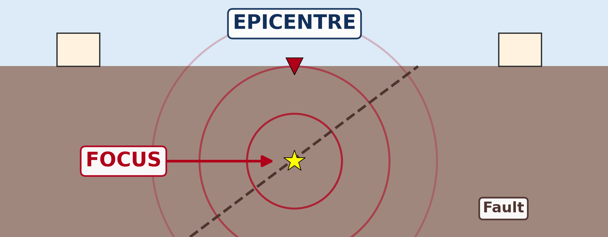
DEFINITIONS
Activity 1
Animation: the waves of an earthquake.
Notes:
Activity 1. Look carefully at this animation: animation: the waves of an earthquake. Watch the animation to the end; it will play again.

Slide 20
DEFINITIONS
Activity 1: Question 1
Where does the earthquake start?
Notes:
Here is the question for Activity 1: Where does the earthquake start? Take one minute to think and write your answer in your rough notebook.

Slide 21
DEFINITIONS
Activity 1: Answer 1
At the focus.
Notes:
Let us check the answer together. At the focus.

Slide 22
DEFINITIONS
Activity 1: Question 2
What is the point on the surface just above it?
Notes:
Here is the next question: What is the point on the surface just above it? Take one minute to think and write your answer in your rough notebook.

Slide 23
DEFINITIONS
Activity 1: Answer 2
The epicentre.
Notes:
Let us check the answer together. The epicentre.

Slide 24
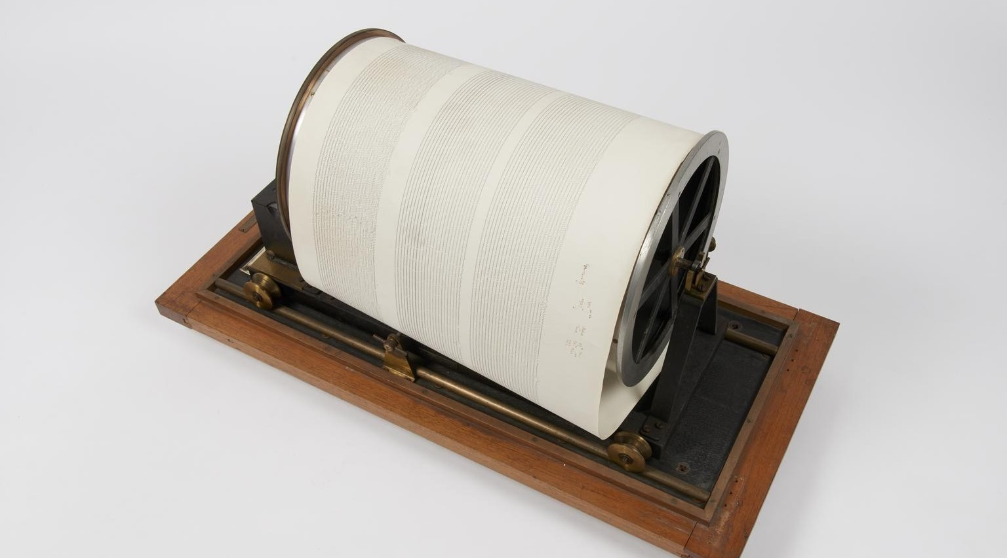
2. MANIFESTATION
Activity 2
A seismograph.
Notes:
Activity 2. Look carefully at this picture: a seismograph. Observe every detail before I ask the question.

Slide 25
2. MANIFESTATION
Activity 2: Question
What does this instrument record?
Notes:
Here is the question for Activity 2: What does this instrument record? Take one minute to think and write your answer in your rough notebook.

Slide 26
2. MANIFESTATION
Activity 2: Answer
The shaking (seismic waves) of the ground.
Notes:
Let us check the answer together. The shaking (seismic waves) of the ground.

Slide 27
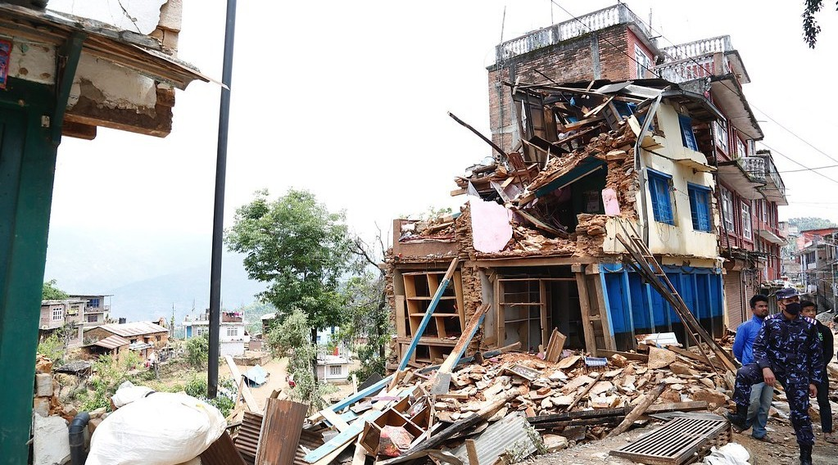
3. IMPACT ON MAN
Activity 3
Houses destroyed by an earthquake.
Notes:
Activity 3. Look carefully at this picture: houses destroyed by an earthquake. Observe every detail before I ask the question.

Slide 28
3. IMPACT ON MAN
Activity 3: Question
What is the main cause of death during an earthquake?
Notes:
Here is the question for Activity 3: What is the main cause of death during an earthquake? Take one minute to think and write your answer in your rough notebook.

Slide 29
3. IMPACT ON MAN
Activity 3: Answer
Buildings fall on people.
Notes:
Let us check the answer together. Buildings fall on people.

Slide 30
BOARD SUMMARY
Board Summary
Topic: The Structure of the Earth: Building Processes and Impacts on Man
Sub-topic: Seismic Activities and Man
Lesson 13: Earthquakes
Notes:
Now we are going to copy the board summary. Write the title and the headings neatly in your notebooks. I will give you enough time for each slide, so do not rush.

Slide 31
BOARD SUMMARY
DEFINITIONS
The key terms of this lesson are defined as follows:
Earthquake: It is a sudden shaking or vibration of the crust of the Earth.
Focus: It is the point under the ground where the earthquake starts.
Notes:
Let us copy the definitions. The key terms of this lesson are defined as follows. On this slide we have Earthquake and Focus. Write each point on a new line, with the key term first, and explain it in your own words when we revise. When you finish, we go to the next slide.

Slide 32
BOARD SUMMARY
DEFINITIONS (continued)
Epicentre: It is the point on the surface directly above the focus, where the shaking is strongest.
Seismic waves: They are the shock waves that spread out from the focus.
Notes:
We continue with the definitions. On this slide we have Epicentre and Seismic waves. Write each point on a new line, with the key term first, and explain it in your own words when we revise.

Slide 33
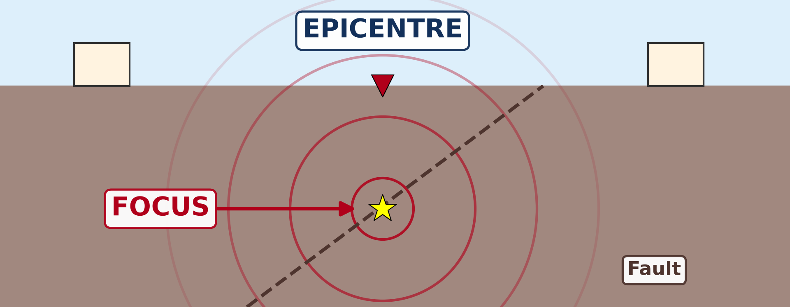
BOARD SUMMARY
1. Causes of Earthquakes
Earthquakes have the following causes:
Plate movements: The sudden movement of plates along faults is the main cause of earthquakes.
Illustration: focus and epicentre
Notes:
Let us copy Causes of Earthquakes. Earthquakes have the following causes. Copy the point on Plate movements on the left, then draw the diagram on the right: focus and epicentre. Give it a title and label it clearly.

Slide 34
BOARD SUMMARY
1. Causes of Earthquakes
Volcanic eruptions: Rising magma and eruptions shake the ground around volcanoes.
Collapse: The collapse of caves or old mines shakes the ground.
Human activities: Mining, nuclear tests, explosions and the weight of big dams can cause small earthquakes.
Notes:
We continue with Causes of Earthquakes. On this slide we have Volcanic eruptions, Collapse and Human activities. Write each point on a new line, with the key term first, and explain it in your own words when we revise.

Slide 35
BOARD SUMMARY
2. Manifestation of Earthquakes
Earthquakes show themselves and are measured as follows:
Shaking and cracks: The ground shakes, cracks open and buildings sway or fall.
Notes:
Let us copy Manifestation of Earthquakes. Earthquakes show themselves and are measured as follows. On this slide we have Shaking and cracks. Write each point on a new line, with the key term first, and explain it in your own words when we revise.

Slide 36
BOARD SUMMARY
2. Manifestation of Earthquakes
Seismograph: It is an instrument that records the seismic waves.
Illustration: a seismograph
Notes:
Copy the point on Seismograph on the left, then draw the diagram on the right: a seismograph. Give it a title and label it clearly.

Slide 37
BOARD SUMMARY
2. Manifestation of Earthquakes
Richter scale: It measures the strength (magnitude) of an earthquake, usually from 1 to 9.
Aftershocks: Smaller earthquakes often follow the main shock.
Notes:
We continue with Manifestation of Earthquakes. On this slide we have Richter scale and Aftershocks. Write each point on a new line, with the key term first, and explain it in your own words when we revise.

Slide 38
BOARD SUMMARY
3. Impact on Man
Earthquakes affect people in the following ways:
Loss of life: Falling buildings kill and injure many people.
Illustration: houses destroyed by an earthquake
Notes:
Let us copy Impact on Man. Earthquakes affect people in the following ways. Copy the point on Loss of life on the left, then draw the diagram on the right: houses destroyed by an earthquake. Give it a title and label it clearly.

Slide 39
BOARD SUMMARY
3. Impact on Man
Destruction of property: Houses, roads, bridges, pipes and power lines are destroyed.
Fires and diseases: Broken gas pipes cause fires, and dirty water spreads diseases.
Notes:
We continue with Impact on Man. On this slide we have Destruction of property and Fires and diseases. Write each point on a new line, with the key term first, and explain it in your own words when we revise.

Slide 40
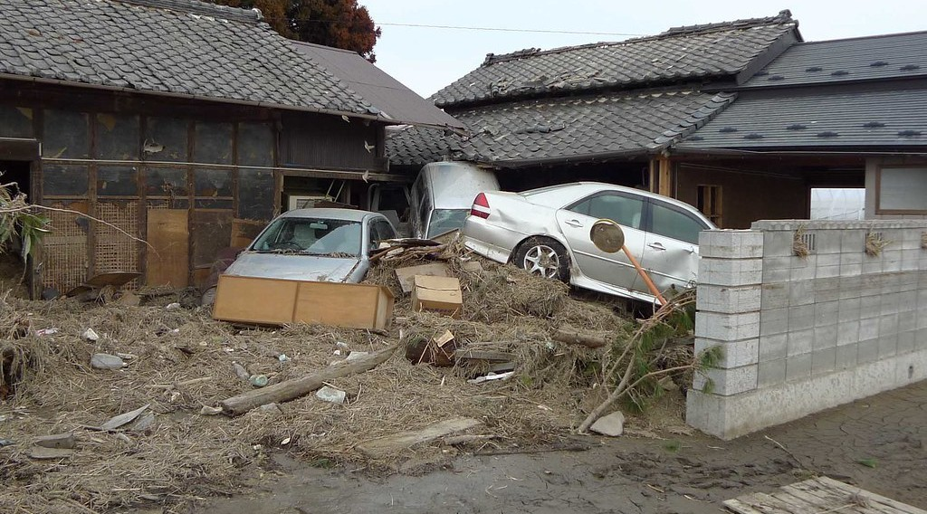
BOARD SUMMARY
3. Impact on Man
Tsunamis and landslides: Earthquakes under the sea cause tsunamis, and on slopes they cause landslides.
Illustration: a tsunami
Notes:
Copy the point on Tsunamis and landslides on the left, then draw the diagram on the right: a tsunami. Give it a title and label it clearly.

Slide 41
BOARD SUMMARY
3. Impact on Man
Economic losses: Rebuilding costs a lot of money, and many people lose their jobs and homes.
Notes:
We continue with Impact on Man. On this slide we have Economic losses. Write each point on a new line, with the key term first, and explain it in your own words when we revise.

Slide 42
BOARD SUMMARY
4. Adaptation and Mitigation
People reduce the damage of earthquakes with the following measures:
Strong buildings: Buildings designed to resist shaking reduce deaths, as in Japan.
Land-use planning: People avoid building on faults and on loose, unstable ground.
Notes:
Let us copy Adaptation and Mitigation. People reduce the damage of earthquakes with the following measures. On this slide we have Strong buildings and Land-use planning. Write each point on a new line, with the key term first, and explain it in your own words when we revise. When you finish, we go to the next slide.

Slide 43
BOARD SUMMARY
4. Adaptation and Mitigation (continued)
Monitoring and warning: Seismographs watch active zones, and warning systems alert people.
Education and drills: People learn to take cover under a table and protect their heads.
Notes:
We continue with Adaptation and Mitigation. On this slide we have Monitoring and warning and Education and drills. Write each point on a new line, with the key term first, and explain it in your own words when we revise. When you finish, we go to the next slide.

Slide 44
BOARD SUMMARY
4. Adaptation and Mitigation (continued)
Emergency services: Rescue teams, hospitals and emergency supplies are prepared in advance.
Notes:
We continue with Adaptation and Mitigation. On this slide we have Emergency services. Write each point on a new line, with the key term first, and explain it in your own words when we revise.

Slide 45
FORMATIVE EVALUATION
Evaluation 1
What is the epicentre?
Notes:
Now let us check what you have understood. Question 1: What is the epicentre? Answer in your exercise book.

Slide 46
FORMATIVE EVALUATION
Expected Answer
The point on the surface above the focus.
Notes:
The expected answer is: the point on the surface above the focus. If you got it right, well done.

Slide 47
FORMATIVE EVALUATION
Evaluation 2
How do countries like Japan reduce the damage?
Notes:
Now let us check what you have understood. Question 2: How do countries like Japan reduce the damage? Answer in your exercise book.

Slide 48
FORMATIVE EVALUATION
Expected Answer
They build houses that resist earthquakes.
Notes:
The expected answer is: they build houses that resist earthquakes. If you got it right, well done.

Slide 49
REMEDIATION
Remediation
Fill in the blanks:
A sudden shaking of the ground is an ______.
The instrument that records earthquakes is the ______.
Notes:
Take your time to copy this part; we will continue together.

Slide 50
REMEDIATION
Remediation (continued)
The point under the ground where it starts is the ______.
Notes:
For those who need more practice, fill in the blanks in your exercise book. The answers are: number 1, earthquake; number 2, seismograph; number 3, focus.

Slide 51
HOMEWORK
Homework
Name the three processes of denudation.
Notes:
For your homework: Name the three processes of denudation. We shall correct it at the beginning of our next lesson.

Slide 52
NEXT LESSON
Next Lesson
Our next lesson will be on:
Lesson 14: Denudation
Notes:
Our next lesson will be on Lesson 14: Denudation. Thank you for your attention, and see you next time.

Slide 53
BILINGUAL GAME
Bilingual Game (Jeu Bilingue)
English | Français
Earthquake | Le séisme / le tremblement de terre
Focus | Le foyer / hypocentre
Epicentre | L'épicentre
Seismograph | Le sismographe
Magnitude | La magnitude
Tsunami | Le tsunami
Fault | La faille
Collapse | L'effondrement
Notes:
Let us play the bilingual game. I say a word in English, and you give me the French word. Then we do the reverse.

Slide 54
LOGBOOK
Official Logbook (1/2)
Module / Topic | The Structure of the Earth: Building Processes and Impacts on Man
Lesson Title | Lesson 13: Earthquakes
Expected Learning Outcomes | Define an earthquake, its focus and its epicentre. Explain the causes of earthquakes. Describe how earthquakes are measured and how they appear. Explain their impact on man and suggest adaptation and mitigation measures.
Competence | Learners are able to explain what causes earthquakes and to apply safety rules (drop, cover and hold on) during an earthquake.
Notes:
I record this information in the official logbook of the class after the lesson.

Slide 55
LOGBOOK
Official Logbook (2/2)
Matter Taught | DEFINITIONS; Causes of Earthquakes; Manifestation of Earthquakes; Impact on Man; Adaptation and Mitigation.
Evaluation | Formative evaluation and remediation exercise.
Homework | Name the three processes of denudation.
Enrolment / Present / Absent | ____ / ____ / ____
Achievement | To be completed after the lesson.
Notes:
I complete the second page of the logbook: the matter taught, the evaluation, the homework and the attendance.

Slide 56
TEACHER'S NOTE
Teacher's Note
Timing: Homework correction, plan, objectives 4 min | Recall, situation, action 6 min | 3 activities 12 min | Board summary (copying) 15 min | Evaluation, remediation 5 min | Homework, next lesson 3 min | Logbook 5 min
Activity 1 is an animation (GIF): it plays automatically in slide-show mode.
Without the projector (Activity 1): drop a stone in water: the waves spread in circles.
Without the projector (Activity 2): draw a zigzag line on the board.
Without the projector (Activity 3): ask learners how houses could be made stronger.
Notes:
This slide is for me, the teacher: it gives the timing of the lesson and what to do if the projector is not available.

Slide 57
REFERENCES
References
National Geography Syllabus (MINESEC), Form 3 — The Structure of the Earth: Building Processes and Impacts on Man.
Teacher's lesson notes (Form 3), checked and corrected where necessary.
USGS Earthquake Hazards Program: magnitude and intensity.
Photo, Activity 2: “Recording drum from Golitsyn seismograph” by Galitzin, Boris; Masing, Hugo, CC BY-NC-SA 4.0, via sciencemuseum (https://collection.sciencemuseumgroup.org.uk/objects/co8647018/recording-drum-from-golitsyn-seismograph)
Photo, Activity 3: “Collapsed buildings in earthquake-hit Chautara, Nepal” by DFID - UK Department for International Development, CC BY 2.0, via Flickr (https://www.flickr.com/photos/14214150@N02/16693413433)
Photo, board summary (Tsunamis and landslides): “Tsunami damage” by robertodevido, CC BY-NC-ND 2.0, via Flickr (https://www.flickr.com/photos/63082042@N00/5531541425)
Diagrams and animations: drawn for this lesson (Geography Department).
Notes:
These are the references and picture credits used to prepare this lesson.

