Slide 1
FORM 3
GEOGRAPHY
Lesson 28
Depositional Features of Wind Action
Notes:
Good morning, class, and welcome to our geography lesson. I am your geography teacher, Madam Che. Today we are starting Lesson 28: Depositional Features of Wind Action.

Slide 2
CLASS INFO
Class, Chapter and Duration
Class | Form 3
Chapter | Denudation Processes, Landforms and Impacts on Man — Hot Desert Landscapes: Wind Action and Human Adaptation
Duration | 50 minutes
Notes:
This lesson is for Form 3. It belongs to Denudation Processes, Landforms and Impacts on Man — Hot Desert Landscapes: Wind Action and Human Adaptation. We shall need 50 minutes to cover it.

Slide 3
IDENTIFICATION
Lesson Identification
Topic | Denudation Processes, Landforms and Impacts on Man
Sub-topic | Hot Desert Landscapes: Wind Action and Human Adaptation
Lesson | Lesson 28: Depositional Features of Wind Action
Notions / Concepts | Barchans and seif dunes.
Syllabus focus | Depositional features of wind action; sand dunes (barchans and seif dunes).
Competence | Learners are able to explain why sand and dust pile up behind walls, stones and bushes, and to recognise barchan and seif dunes.
Notes:
Our topic is Denudation Processes, Landforms and Impacts on Man, and the sub-topic is Hot Desert Landscapes: Wind Action and Human Adaptation. The key notions we shall use today are: barchans and seif dunes. At the end, you should be able to do this: learners are able to explain why sand and dust pile up behind walls, stones and bushes, and to recognise barchan and seif dunes.

Slide 4

HOMEWORK CORRECTION
Correction of the Homework
Question (Lesson 27: Semi-Arid and Desert Landscapes):
Name the two types of sand dunes.
Notes:
Before we start the new lesson, let us correct the homework I gave you at the end of Lesson 27: Semi-Arid and Desert Landscapes. The question was: Name the two types of sand dunes. Take out your exercise books.

Slide 5
HOMEWORK CORRECTION
Correction: Possible Answer
Barchans and seif dunes.
Notes:
Here is a good answer. Barchans and seif dunes. Compare it with your own answer and correct your work in red.

Slide 6
LESSON PLAN
Lesson Plan
Correction of the homework
Objectives and recall
Real-life situation and action to take
Learning activities
Board summary
Evaluation, remediation and homework
Notes:
Here is the plan of our lesson today. First, we shall correct the homework. Then we shall look at the objectives and recall what you already know. After that, we shall study a situation from real life and the action to take, and do the learning activities. Finally, we shall copy the board summary, do the evaluation and the remediation, and I will give you the homework.

Slide 7
OBJECTIVES
Objectives
By the end of this lesson, you should be able to:
Explain why the wind deposits the sand and dust it carries.
Describe the structure and movement of a sand dune.
Notes:
Take your time to copy this part; we will continue together.

Slide 8
OBJECTIVES
Objectives (continued)
Distinguish between barchan and seif dunes, and define loess.
Notes:
By the end of this lesson, you should be able to do three things. Number 1: explain why the wind deposits the sand and dust it carries. Number 2: describe the structure and movement of a sand dune. Number 3: distinguish between barchan and seif dunes, and define loess.

Slide 9
PREVIOUS KNOWLEDGE
Previous Knowledge
Wind erodes the land by deflation, abrasion and attrition.
Wind erosion forms rock pedestals, zeugen, yardangs and inselbergs.
The sand and dust removed by the wind must be dropped somewhere.
Notes:
Let us first remember what you already know. Wind erodes the land by deflation, abrasion and attrition. Wind erosion forms rock pedestals, zeugen, yardangs and inselbergs. The sand and dust removed by the wind must be dropped somewhere. Keep this in mind, because we shall build on it today.

Slide 10
REAL-LIFE SITUATION
Situation in Real Life
After a windy Harmattan day, Chantal sweeps her compound. The sand has piled up only in some places: at the foot of a wall, behind a stone and around a bush. She asks: "Why does the wind drop its sand in these places, and what does it build in the desert?"
Notes:
Listen carefully to this situation from real life. After a windy Harmattan day, Chantal sweeps her compound. The sand has piled up only in some places: at the foot of a wall, behind a stone and around a bush. She asks: "Why does the wind drop its sand in these places, and what does it build in the desert?" Think about it, because I am going to ask you some questions.

Slide 11
REAL-LIFE SITUATION
Situation: Question 1
What is the problem in the situation?
Notes:
Question 1: What is the problem in the situation? Think for a moment, then raise your hand to answer.

Slide 12
REAL-LIFE SITUATION
Answer
Chantal does not know why the wind drops sand in some places and what it builds in deserts.
Notes:
Good. Chantal does not know why the wind drops sand in some places and what it builds in deserts.

Slide 13
REAL-LIFE SITUATION
Situation: Question 2
Where did the sand pile up?
Notes:
Question 2: Where did the sand pile up? Think for a moment, then raise your hand to answer.

Slide 14
REAL-LIFE SITUATION
Answer
At the foot of a wall, behind a stone and around a bush.
Notes:
Good. At the foot of a wall, behind a stone and around a bush.

Slide 15
REAL-LIFE SITUATION
Situation: Question 3
Why did the wind drop the sand there?
Notes:
Question 3: Why did the wind drop the sand there? Think for a moment, then raise your hand to answer.

Slide 16
REAL-LIFE SITUATION
Possible Answer
The obstacles slowed down the wind.
Notes:
Good. The obstacles slowed down the wind.

Slide 17
ACTION TO TAKE
Action to Take
Plant trees and hedges to stop moving sand.
Notes:
From this situation, the action we are working towards in this lesson is the following: plant trees and hedges to stop moving sand.

Slide 18
JUSTIFICATION
Justification of the Lesson
This lesson helps us to know the landforms made when the wind drops sand.
Notes:
Why is this lesson important for you? This lesson helps us to know the landforms made when the wind drops sand.

Slide 19
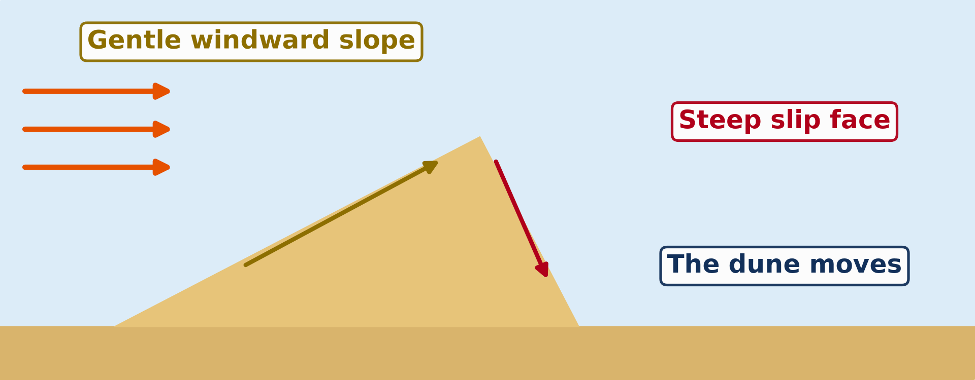
1. DEPOSITIONAL FEATURES
Activity 1
Animation: a sand dune moves.
Notes:
Activity 1. Look carefully at this animation: animation: a sand dune moves. Watch the animation to the end; it will play again.

Slide 20
1. DEPOSITIONAL FEATURES
Activity 1: Question 1
Which slope of the dune faces the wind?
Notes:
Here is the question for Activity 1: Which slope of the dune faces the wind? Take one minute to think and write your answer in your rough notebook.

Slide 21
1. DEPOSITIONAL FEATURES
Activity 1: Answer 1
The windward slope.
Notes:
Let us check the answer together. The windward slope.

Slide 22
1. DEPOSITIONAL FEATURES
Activity 1: Question 2
Is it gentle or steep?
Notes:
Here is the next question: Is it gentle or steep? Take one minute to think and write your answer in your rough notebook.

Slide 23
1. DEPOSITIONAL FEATURES
Activity 1: Answer 2
Gentle.
Notes:
Let us check the answer together. Gentle.

Slide 24
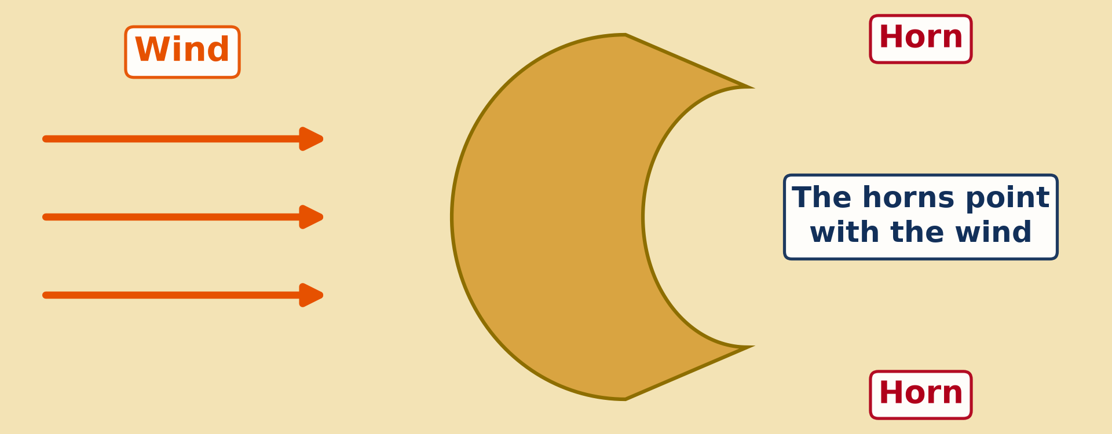
2. DUNES
Activity 2
A crescent-shaped dune seen from above.
Notes:
Activity 2. Look carefully at this diagram: a crescent-shaped dune seen from above. Observe every detail before I ask the question.

Slide 25
2. DUNES
Activity 2: Question
What is this crescent-shaped dune called?
Notes:
Here is the question for Activity 2: What is this crescent-shaped dune called? Take one minute to think and write your answer in your rough notebook.

Slide 26
2. DUNES
Activity 2: Answer
A barchan.
Notes:
Let us check the answer together. A barchan.

Slide 27
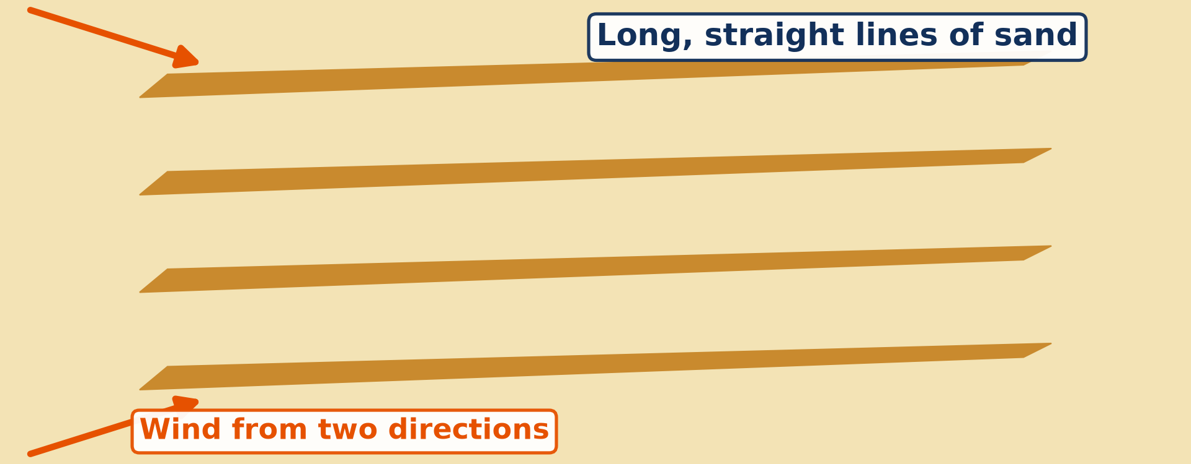
2. DUNES
Activity 3
Long, narrow dunes.
Notes:
Activity 3. Look carefully at this diagram: long, narrow dunes. Observe every detail before I ask the question.

Slide 28
2. DUNES
Activity 3: Question
What do we call these long, narrow dunes?
Notes:
Here is the question for Activity 3: What do we call these long, narrow dunes? Take one minute to think and write your answer in your rough notebook.

Slide 29
2. DUNES
Activity 3: Answer
Seif dunes.
Notes:
Let us check the answer together. Seif dunes.

Slide 30
BOARD SUMMARY
Board Summary
Topic: Denudation Processes, Landforms and Impacts on Man
Sub-topic: Hot Desert Landscapes: Wind Action and Human Adaptation
Lesson 28: Depositional Features of Wind Action
Notes:
Now we are going to copy the board summary. Write the title and the headings neatly in your notebooks. I will give you enough time for each slide, so do not rush.

Slide 31
BOARD SUMMARY
DEFINITIONS
The key terms of this lesson are defined as follows:
Wind deposition: It is the dropping of the sand and dust carried by the wind.
Sand dune: It is a hill or ridge of sand built by the wind.
Notes:
Let us copy the definitions. The key terms of this lesson are defined as follows. On this slide we have Wind deposition and Sand dune. Write each point on a new line, with the key term first, and explain it in your own words when we revise.

Slide 32
BOARD SUMMARY
1. Depositional Features of Wind Action
A) Causes of Deposition
The wind deposits its load for the following reasons:
Fall in wind speed: The wind slows down and can no longer carry the sand.
Obstacles: A rock, a bush or a wall stops the wind, and the sand piles up behind it.
Notes:
Let us copy Causes of Deposition. The wind deposits its load for the following reasons. On this slide we have Fall in wind speed and Obstacles. Write each point on a new line, with the key term first, and explain it in your own words when we revise. When you finish, we go to the next slide.

Slide 33
BOARD SUMMARY
1. Depositional Features of Wind Action
A) Causes of Deposition (continued)
Wet sand: Damp sand sticks together and the wind cannot lift it.
Notes:
We continue with Causes of Deposition. On this slide we have Wet sand. Write each point on a new line, with the key term first, and explain it in your own words when we revise.

Slide 34
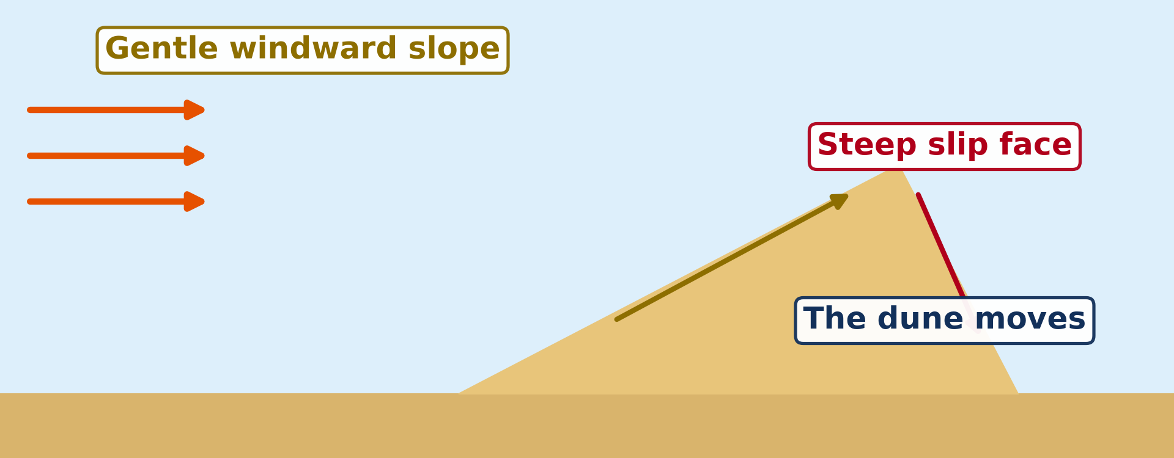
BOARD SUMMARY
1. Depositional Features of Wind Action
B) Features of Deposition
Wind deposition forms the following features:
Sand dunes: They are hills of sand with a gentle windward slope and a steep slip face.
Illustration: how a dune moves
Notes:
Let us copy Features of Deposition. Wind deposition forms the following features. Copy the point on Sand dunes on the left, then draw the diagram on the right: how a dune moves. Give it a title and label it clearly.

Slide 35
BOARD SUMMARY
1. Depositional Features of Wind Action
B) Features of Deposition
Sand sheets: They are wide, flat spreads of sand.
Ripples: They are small waves of sand on the surface of sand sheets and dunes.
Loess: It is a thick layer of fine, fertile dust deposited far from the desert.
Notes:
We continue with Features of Deposition. On this slide we have Sand sheets, Ripples and Loess. Write each point on a new line, with the key term first, and explain it in your own words when we revise.

Slide 36
BOARD SUMMARY
2. Dunes
The main types of sand dunes are the following:
Barchans: They are crescent-shaped dunes whose horns point in the direction of the wind. They form where the wind blows from one direction and sand is limited.
Illustration: a barchan
Notes:
Let us copy Dunes. The main types of sand dunes are the following. Copy the point on Barchans on the left, then draw the diagram on the right: a barchan. Give it a title and label it clearly.

Slide 37
BOARD SUMMARY
2. Dunes
Seif dunes: They are long, narrow, straight ridges of sand lying parallel to the wind. They form where winds blow from two slightly different directions.
Illustration: seif dunes
Notes:
Copy the point on Seif dunes on the left, then draw the diagram on the right: seif dunes. Give it a title and label it clearly.

Slide 38
FORMATIVE EVALUATION
Evaluation 1
Why does the wind drop its sand behind a wall?
Notes:
Now let us check what you have understood. Question 1: Why does the wind drop its sand behind a wall? Answer in your exercise book.

Slide 39
FORMATIVE EVALUATION
Expected Answer
The wall slows the wind.
Notes:
The expected answer is: the wall slows the wind. If you got it right, well done.

Slide 40
FORMATIVE EVALUATION
Evaluation 2
What is a barchan?
Notes:
Now let us check what you have understood. Question 2: What is a barchan? Answer in your exercise book.

Slide 41
FORMATIVE EVALUATION
Expected Answer
A dune shaped like a crescent.
Notes:
The expected answer is: a dune shaped like a crescent. If you got it right, well done.

Slide 42
REMEDIATION
Remediation
Fill in the blanks:
A hill of sand made by the wind is a sand ______.
A crescent-shaped dune is a ______.
Long, straight dunes are ______ dunes.
Notes:
For those who need more practice, fill in the blanks in your exercise book. The answers are: number 1, dune; number 2, barchan; number 3, seif.

Slide 43
HOMEWORK
Homework
Give two resources of hot deserts.
Notes:
For your homework: Give two resources of hot deserts. We shall correct it at the beginning of our next lesson.

Slide 44
NEXT LESSON
Next Lesson
Our next lesson will be on:
Lesson 29: Man in the Hot Desert Environments
Notes:
Our next lesson will be on Lesson 29: Man in the Hot Desert Environments. Thank you for your attention, and see you next time.

Slide 45
BILINGUAL GAME
Bilingual Game (Jeu Bilingue)
English | Français
Deposition | Le dépôt (l'accumulation)
Sand dune | La dune de sable
Barchan | La barkhane
Seif dune | Le sif (dune longitudinale)
Windward | Au vent
Leeward | Sous le vent
Slip face | La face d'avalanche
Loess | Le lœss
Notes:
Let us play the bilingual game. I say a word in English, and you give me the French word. Then we do the reverse.

Slide 46
LOGBOOK
Official Logbook (1/2)
Module / Topic | Denudation Processes, Landforms and Impacts on Man
Lesson Title | Lesson 28: Depositional Features of Wind Action
Expected Learning Outcomes | Explain why the wind deposits the sand and dust it carries. Describe the structure and movement of a sand dune. Distinguish between barchan and seif dunes, and define loess.
Competence | Learners are able to explain why sand and dust pile up behind walls, stones and bushes, and to recognise barchan and seif dunes.
Notes:
I record this information in the official logbook of the class after the lesson.

Slide 47
LOGBOOK
Official Logbook (2/2)
Matter Taught | DEFINITIONS; Causes of Deposition; Features of Deposition; Dunes.
Evaluation | Formative evaluation and remediation exercise.
Homework | Give two resources of hot deserts.
Enrolment / Present / Absent | ____ / ____ / ____
Achievement | To be completed after the lesson.
Notes:
I complete the second page of the logbook: the matter taught, the evaluation, the homework and the attendance.

Slide 48
TEACHER'S NOTE
Teacher's Note
Timing: Homework correction, plan, objectives 4 min | Recall, situation, action 6 min | 3 activities 12 min | Board summary (copying) 15 min | Evaluation, remediation 5 min | Homework, next lesson 3 min | Logbook 5 min
Activity 1 is an animation (GIF): it plays automatically in slide-show mode.
Without the projector (Activity 1): draw a dune with an arrow for the wind.
Without the projector (Activity 2): draw a crescent on the board.
Without the projector (Activity 3): draw long lines of sand.
Notes:
This slide is for me, the teacher: it gives the timing of the lesson and what to do if the projector is not available.

Slide 49
REFERENCES
References
National Geography Syllabus (MINESEC), Form 3 — Denudation processes, landforms and impacts on man — Lesson 28.
Teacher's lesson notes, Lesson 28 (f4.docx).
Dune diagrams: teacher's images (dune profile, seif) and a barchan diagram redrawn with the horns pointing downwind.
Diagrams and animations: drawn for this lesson (Geography Department).
Notes:
These are the references and picture credits used to prepare this lesson.

