Slide 1
FORM 3
GEOGRAPHY
Lesson 30
The Atmosphere
Notes:
Good morning, class, and welcome to our geography lesson. I am your geography teacher, Madam Che. Today we are starting Lesson 30: The Atmosphere.

Slide 2
CLASS INFO
Class, Chapter and Duration
Class | Form 3
Chapter | Module 3: Weather and Climate — Adaptation to Climatic Excesses
Duration | 50 minutes
Notes:
This lesson is for Form 3. It belongs to Module 3: Weather and Climate — Adaptation to Climatic Excesses. We shall need 50 minutes to cover it.

Slide 3
IDENTIFICATION
Lesson Identification
Topic | The Earth-Atmosphere System
Sub-topic | The Atmosphere
Lesson | Lesson 30: The Atmosphere
Notions / Concepts | Atmosphere, ozone layer, depletion.
Syllabus focus | Definition of the atmosphere; structure (illustration of the main layers only); thermal structure in the troposphere and the stratosphere; ozone layer depletion.
Competence | Learners are able to protect themselves from strong sun rays and to avoid products that damage the ozone layer.
Notes:
Our topic is The Earth-Atmosphere System, and the sub-topic is The Atmosphere. The key notions we shall use today are: atmosphere, ozone layer, depletion. At the end, you should be able to do this: learners are able to protect themselves from strong sun rays and to avoid products that damage the ozone layer.

Slide 4

HOMEWORK CORRECTION
Correction of the Homework
Question (Lesson 29: Man in the Hot Desert Environments):
Name the four main layers of the atmosphere.
Notes:
Before we start the new lesson, let us correct the homework I gave you at the end of Lesson 29: Man in the Hot Desert Environments. The question was: Name the four main layers of the atmosphere. Take out your exercise books.

Slide 5
HOMEWORK CORRECTION
Correction: Possible Answer
The troposphere, the stratosphere, the mesosphere and the thermosphere.
Notes:
Here is a good answer. The troposphere, the stratosphere, the mesosphere and the thermosphere. Compare it with your own answer and correct your work in red.

Slide 6
LESSON PLAN
Lesson Plan
Correction of the homework
Objectives and recall
Real-life situation and action to take
Learning activities
Board summary
Evaluation, remediation and homework
Notes:
Here is the plan of our lesson today. First, we shall correct the homework. Then we shall look at the objectives and recall what you already know. After that, we shall study a situation from real life and the action to take, and do the learning activities. Finally, we shall copy the board summary, do the evaluation and the remediation, and I will give you the homework.

Slide 7
OBJECTIVES
Objectives
By the end of this lesson, you should be able to:
Define the atmosphere.
Identify the main layers of the atmosphere on a diagram.
Notes:
Take your time to copy this part; we will continue together.

Slide 8
OBJECTIVES
Objectives (continued)
Describe how temperature changes in the troposphere and the stratosphere.
Explain the causes, effects and solutions of ozone layer depletion.
Notes:
By the end of this lesson, you should be able to do four things. Number 1: define the atmosphere. Number 2: identify the main layers of the atmosphere on a diagram. Number 3: describe how temperature changes in the troposphere and the stratosphere. Number 4: explain the causes, effects and solutions of ozone layer depletion.

Slide 9
PREVIOUS KNOWLEDGE
Previous Knowledge
Hot deserts have very dry air, clear skies and a large daily temperature range.
People adapt to heat and dryness with clothing, housing and water supply.
Today we begin a new module: weather and climate.
Notes:
Let us first remember what you already know. Hot deserts have very dry air, clear skies and a large daily temperature range. People adapt to heat and dryness with clothing, housing and water supply. Today we begin a new module: weather and climate. Keep this in mind, because we shall build on it today.

Slide 10
REAL-LIFE SITUATION
Situation in Real Life
Laure flies from Douala to Paris. The pilot says: "We are at 11,000 metres. The temperature outside is minus 50 degrees." She is surprised, because the plane is closer to the Sun. She asks: "What is this air around the Earth made of, and why is it so cold up there?"
Notes:
Listen carefully to this situation from real life. Laure flies from Douala to Paris. The pilot says: "We are at 11,000 metres. The temperature outside is minus 50 degrees." She is surprised, because the plane is closer to the Sun. She asks: "What is this air around the Earth made of, and why is it so cold up there?" Think about it, because I am going to ask you some questions.

Slide 11
REAL-LIFE SITUATION
Situation: Question 1
What is the problem in the situation?
Notes:
Question 1: What is the problem in the situation? Think for a moment, then raise your hand to answer.

Slide 12
REAL-LIFE SITUATION
Answer
Laure does not understand what the atmosphere is and why it is colder higher up.
Notes:
Good. Laure does not understand what the atmosphere is and why it is colder higher up.

Slide 13
REAL-LIFE SITUATION
Situation: Question 2
What is the temperature outside the plane?
Notes:
Question 2: What is the temperature outside the plane? Think for a moment, then raise your hand to answer.

Slide 14
REAL-LIFE SITUATION
Answer
Minus 50 °C.
Notes:
Good. Minus 50 °C.

Slide 15
REAL-LIFE SITUATION
Situation: Question 3
In which layer of air does the plane fly?
Notes:
Question 3: In which layer of air does the plane fly? Think for a moment, then raise your hand to answer.

Slide 16
REAL-LIFE SITUATION
Possible Answer
In the upper troposphere.
Notes:
Good. In the upper troposphere.

Slide 17
ACTION TO TAKE
Action to Take
Protect the ozone layer by avoiding products with CFCs.
Notes:
From this situation, the action we are working towards in this lesson is the following: protect the ozone layer by avoiding products with CFCs.

Slide 18
JUSTIFICATION
Justification of the Lesson
This lesson helps us to know the layer of air around the Earth.
Notes:
Why is this lesson important for you? This lesson helps us to know the layer of air around the Earth.

Slide 19
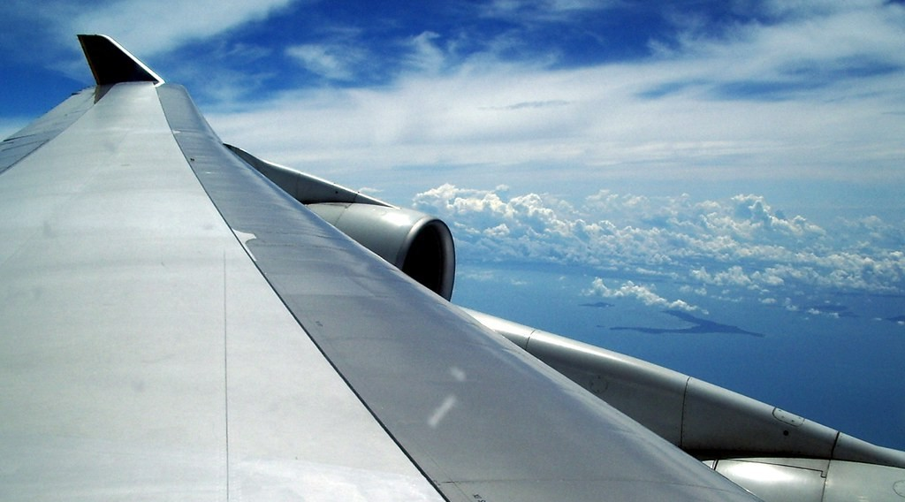
DEFINITIONS
Activity 1
The view from an aeroplane.
Notes:
Activity 1. Look carefully at this picture: the view from an aeroplane. Observe every detail before I ask the question.

Slide 20
DEFINITIONS
Activity 1: Question
The plane flies in the layer of air around the Earth. What is this layer called?
Notes:
Here is the question for Activity 1: The plane flies in the layer of air around the Earth. What is this layer called? Take one minute to think and write your answer in your rough notebook.

Slide 21
DEFINITIONS
Activity 1: Answer
The atmosphere.
Notes:
Let us check the answer together. The atmosphere.

Slide 22
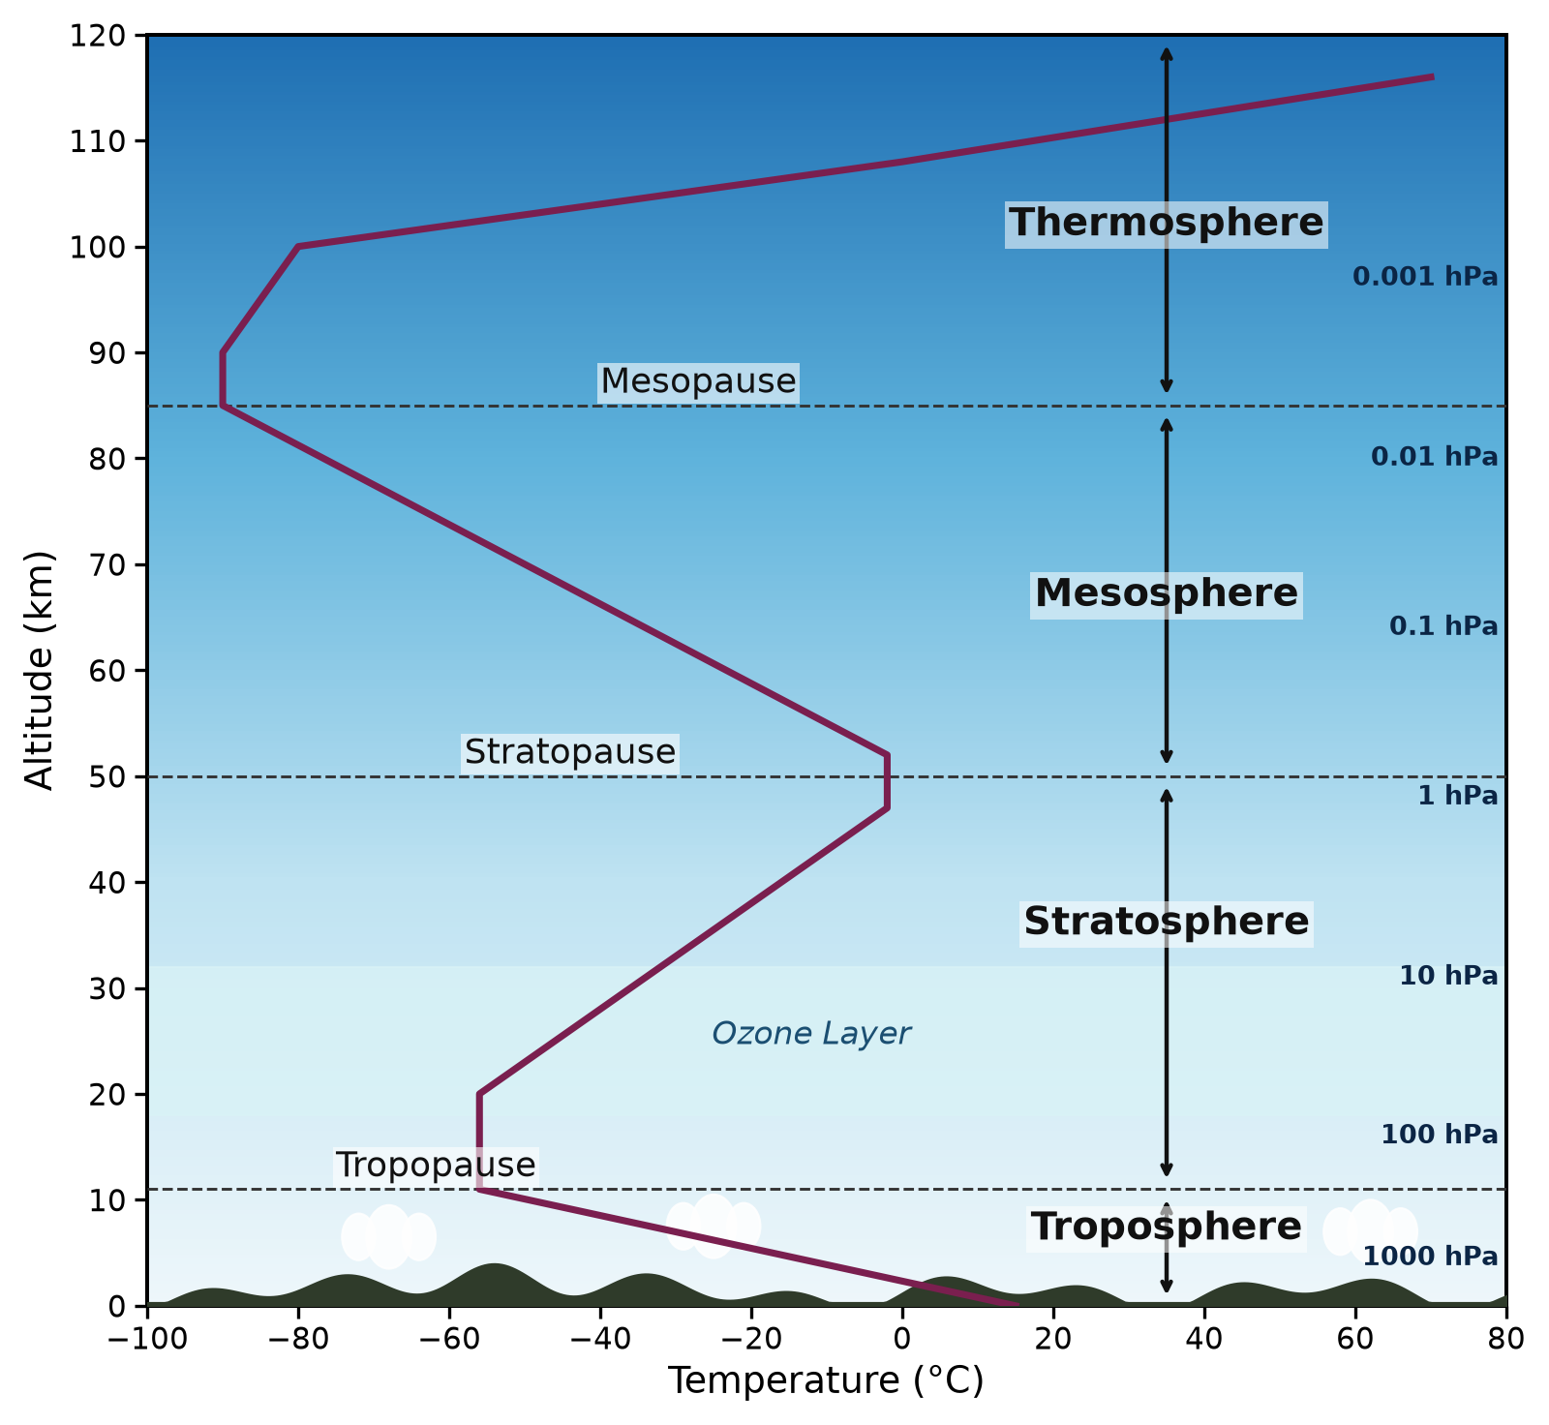
1. STRUCTURE OF THE ATMOSPHERE
Activity 2
The layers of the atmosphere.
Notes:
Activity 2. Look carefully at this picture: the layers of the atmosphere. Observe every detail before I ask the question.

Slide 23
1. STRUCTURE OF THE ATMOSPHERE
Activity 2: Question
In which layer do clouds, rain and wind form?
Notes:
Here is the question for Activity 2: In which layer do clouds, rain and wind form? Take one minute to think and write your answer in your rough notebook.

Slide 24
1. STRUCTURE OF THE ATMOSPHERE
Activity 2: Answer
In the troposphere, the lowest layer.
Notes:
Let us check the answer together. In the troposphere, the lowest layer.

Slide 25
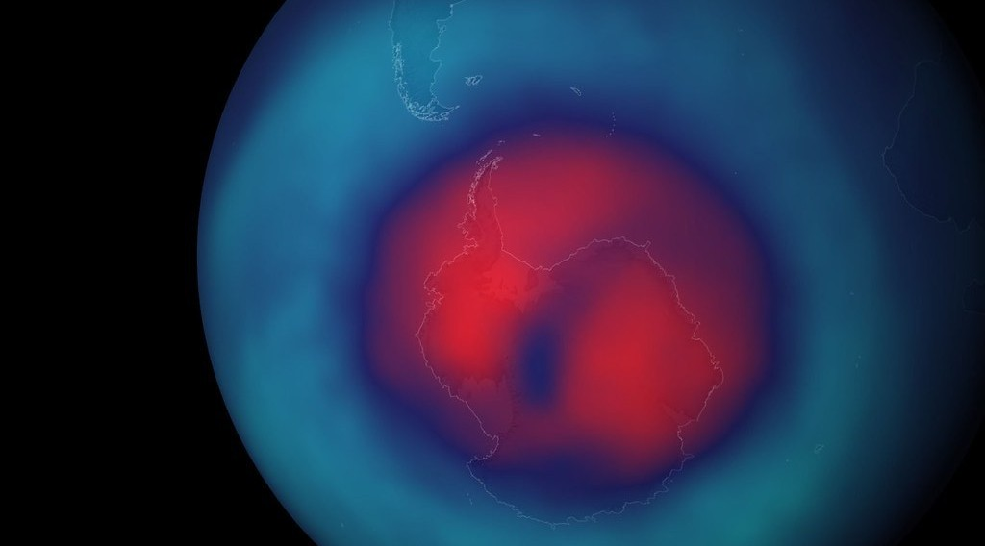
3. OZONE LAYER DEPLETION
Activity 3
The ozone hole over Antarctica.
Notes:
Activity 3. Look carefully at this picture: the ozone hole over Antarctica. Observe every detail before I ask the question.

Slide 26
3. OZONE LAYER DEPLETION
Activity 3: Question
The ozone layer protects us from harmful rays of the Sun. What has damaged it?
Notes:
Here is the question for Activity 3: The ozone layer protects us from harmful rays of the Sun. What has damaged it? Take one minute to think and write your answer in your rough notebook.

Slide 27
3. OZONE LAYER DEPLETION
Activity 3: Answer
Chemicals called CFCs, from old fridges, air conditioners and sprays.
Notes:
Let us check the answer together. Chemicals called CFCs, from old fridges, air conditioners and sprays.

Slide 28
BOARD SUMMARY
Board Summary
Topic: The Earth-Atmosphere System
Sub-topic: The Atmosphere
Lesson 30: The Atmosphere
Notes:
Now we are going to copy the board summary. Write the title and the headings neatly in your notebooks. I will give you enough time for each slide, so do not rush.

Slide 29
BOARD SUMMARY
DEFINITIONS
The key terms of this lesson are defined as follows:
Atmosphere: It is the layer of gases (air) that surrounds the Earth and is held by gravity.
Notes:
Let us copy the definitions. The key terms of this lesson are defined as follows. On this slide we have Atmosphere. Write each point on a new line, with the key term first, and explain it in your own words when we revise. When you finish, we go to the next slide.

Slide 30
BOARD SUMMARY
DEFINITIONS (continued)
Ozone layer: It is a layer of ozone gas in the stratosphere that absorbs the harmful ultraviolet rays of the Sun.
Ozone depletion: It is the thinning of the ozone layer.
Notes:
We continue with the definitions. On this slide we have Ozone layer and Ozone depletion. Write each point on a new line, with the key term first, and explain it in your own words when we revise.

Slide 31
BOARD SUMMARY
1. Structure of the Atmosphere
The atmosphere has the following main layers:
Troposphere: It is the lowest layer, from 0 to about 12 km, where clouds, rain and weather occur.
Illustration: the layers of the atmosphere
Notes:
Let us copy Structure of the Atmosphere. The atmosphere has the following main layers. Copy the point on Troposphere on the left, then draw the diagram on the right: the layers of the atmosphere. Give it a title and label it clearly.

Slide 32
BOARD SUMMARY
1. Structure of the Atmosphere
Stratosphere: It is the layer from about 12 to 50 km, which contains the ozone layer.
Mesosphere: It is the layer from about 50 to 85 km, which is the coldest.
Thermosphere: It is the upper layer above about 85 km, where the air is very thin.
Notes:
We continue with Structure of the Atmosphere. On this slide we have Stratosphere, Mesosphere and Thermosphere. Write each point on a new line, with the key term first, and explain it in your own words when we revise.

Slide 33
BOARD SUMMARY
2. Thermal Structure in the Troposphere and the Stratosphere
Temperature changes with height as follows:
Troposphere: Temperature falls with height by about 6.5 °C per 1,000 m, because the air is heated from the ground.
Illustration: temperature and height in the atmosphere
Notes:
Let us copy Thermal Structure in the Troposphere and the Stratosphere. Temperature changes with height as follows. Copy the point on Troposphere on the left, then draw the diagram on the right: temperature and height in the atmosphere. Give it a title and label it clearly.

Slide 34
BOARD SUMMARY
2. Thermal Structure in the Troposphere and the Stratosphere
Tropopause: At the top of the troposphere, temperature stops falling, at about −55 °C.
Stratosphere: Temperature rises with height, because the ozone absorbs the rays of the Sun.
Notes:
We continue with Thermal Structure in the Troposphere and the Stratosphere. On this slide we have Tropopause and Stratosphere. Write each point on a new line, with the key term first, and explain it in your own words when we revise.

Slide 35
BOARD SUMMARY
3. Ozone Layer Depletion
A) Causes
The ozone layer is destroyed by the following gases:
CFCs: They come from old fridges, air conditioners, sprays and foams.
Illustration: the ozone hole
Notes:
Let us copy Causes. The ozone layer is destroyed by the following gases. Copy the point on CFCs on the left, then draw the diagram on the right: the ozone hole. Give it a title and label it clearly.

Slide 36
BOARD SUMMARY
3. Ozone Layer Depletion
A) Causes
Halons: They come from some fire extinguishers.
Other chemicals: Some pesticides and solvents also destroy ozone.
Notes:
We continue with Causes. On this slide we have Halons and Other chemicals. Write each point on a new line, with the key term first, and explain it in your own words when we revise.

Slide 37
BOARD SUMMARY
3. Ozone Layer Depletion
B) Effects on People
More ultraviolet rays reach the ground and cause the following effects on people:
Skin cancer: The rays burn and damage the skin.
Eye diseases: They cause cataracts, which can lead to blindness.
Notes:
Let us copy Effects on People. More ultraviolet rays reach the ground and cause the following effects on people. On this slide we have Skin cancer and Eye diseases. Write each point on a new line, with the key term first, and explain it in your own words when we revise. When you finish, we go to the next slide.

Slide 38
BOARD SUMMARY
3. Ozone Layer Depletion
B) Effects on People (continued)
Weak immunity: The body defends itself less well against diseases.
Notes:
We continue with Effects on People. On this slide we have Weak immunity. Write each point on a new line, with the key term first, and explain it in your own words when we revise.

Slide 39
BOARD SUMMARY
3. Ozone Layer Depletion
C) Effects on Nature
More ultraviolet rays cause the following effects on nature:
Damage to crops: Plants grow less well and yields fall.
Damage to plankton: Plankton dies, so fish have less food.
Notes:
Let us copy Effects on Nature. More ultraviolet rays cause the following effects on nature. On this slide we have Damage to crops and Damage to plankton. Write each point on a new line, with the key term first, and explain it in your own words when we revise. When you finish, we go to the next slide.

Slide 40
BOARD SUMMARY
3. Ozone Layer Depletion
C) Effects on Nature (continued)
Harm to animals: Animals also suffer from eye and skin diseases.
Notes:
We continue with Effects on Nature. On this slide we have Harm to animals. Write each point on a new line, with the key term first, and explain it in your own words when we revise.

Slide 41
BOARD SUMMARY
3. Ozone Layer Depletion
D) Solutions
The ozone layer is protected by the following solutions:
The Montreal Protocol (1987): It banned CFCs in almost all countries.
Safe recycling: Old fridges and air conditioners must be recycled safely.
Notes:
Let us copy Solutions. The ozone layer is protected by the following solutions. On this slide we have The Montreal Protocol (1987) and Safe recycling. Write each point on a new line, with the key term first, and explain it in your own words when we revise. When you finish, we go to the next slide.

Slide 42
BOARD SUMMARY
3. Ozone Layer Depletion
D) Solutions (continued)
Ozone-friendly products: People should buy products labelled "CFC-free".
Notes:
We continue with Solutions. On this slide we have Ozone-friendly products. Write each point on a new line, with the key term first, and explain it in your own words when we revise.

Slide 43
FORMATIVE EVALUATION
Evaluation 1
In which layer does the weather happen?
Notes:
Now let us check what you have understood. Question 1: In which layer does the weather happen? Answer in your exercise book.

Slide 44
FORMATIVE EVALUATION
Expected Answer
In the troposphere.
Notes:
The expected answer is: in the troposphere. If you got it right, well done.

Slide 45
FORMATIVE EVALUATION
Evaluation 2
What is the role of the ozone layer?
Notes:
Now let us check what you have understood. Question 2: What is the role of the ozone layer? Answer in your exercise book.

Slide 46
FORMATIVE EVALUATION
Expected Answer
It stops harmful rays from the Sun.
Notes:
The expected answer is: it stops harmful rays from the Sun. If you got it right, well done.

Slide 47
REMEDIATION
Remediation
Fill in the blanks:
The layer of air around the Earth is the ______.
Clouds and rain form in the ______.
The ozone layer is in the ______.
Notes:
For those who need more practice, fill in the blanks in your exercise book. The answers are: number 1, atmosphere; number 2, troposphere; number 3, stratosphere.

Slide 48
HOMEWORK
Homework
Distinguish weather from climate.
Notes:
For your homework: Distinguish weather from climate. We shall correct it at the beginning of our next lesson.

Slide 49
NEXT LESSON
Next Lesson
Our next lesson will be on:
Lesson 31: Weather and Climate
Notes:
Our next lesson will be on Lesson 31: Weather and Climate. Thank you for your attention, and see you next time.

Slide 50
BILINGUAL GAME
Bilingual Game (Jeu Bilingue)
English | Français
Atmosphere | L'atmosphère
Layer | La couche
Troposphere | La troposphère
Stratosphere | La stratosphère
Ozone layer | La couche d'ozone
Ultraviolet rays | Les rayons ultraviolets
Depletion | L'appauvrissement
Altitude | L'altitude
Notes:
Let us play the bilingual game. I say a word in English, and you give me the French word. Then we do the reverse.

Slide 51
LOGBOOK
Official Logbook (1/2)
Module / Topic | The Earth-Atmosphere System
Lesson Title | Lesson 30: The Atmosphere
Expected Learning Outcomes | Define the atmosphere. Identify the main layers of the atmosphere on a diagram. Describe how temperature changes in the troposphere and the stratosphere. Explain the causes, effects and solutions of ozone layer depletion.
Competence | Learners are able to protect themselves from strong sun rays and to avoid products that damage the ozone layer.
Notes:
I record this information in the official logbook of the class after the lesson.

Slide 52
LOGBOOK
Official Logbook (2/2)
Matter Taught | DEFINITIONS; Structure of the Atmosphere; Thermal Structure in the Troposphere and the Stratosphere; Causes; Effects on People; Effects on Nature; Solutions.
Evaluation | Formative evaluation and remediation exercise.
Homework | Distinguish weather from climate.
Enrolment / Present / Absent | ____ / ____ / ____
Achievement | To be completed after the lesson.
Notes:
I complete the second page of the logbook: the matter taught, the evaluation, the homework and the attendance.

Slide 53
TEACHER'S NOTE
Teacher's Note
Timing: Homework correction, plan, objectives 4 min | Recall, situation, action 6 min | 3 activities 12 min | Board summary (copying) 15 min | Evaluation, remediation 5 min | Homework, next lesson 3 min | Logbook 5 min
Without the projector (Activity 1): ask who has travelled by plane.
Without the projector (Activity 2): draw four bands on the board.
Without the projector (Activity 3): describe an old fridge with its gas.
Notes:
This slide is for me, the teacher: it gives the timing of the lesson and what to do if the projector is not available.

Slide 54
REFERENCES
References
National Geography Syllabus (MINESEC), Form 3 — Module 3: Weather and Climate.
Teacher's lesson notes (f4.docx), checked and corrected where necessary.
UNEP / WMO Scientific Assessment of Ozone Depletion (2022).
Photo, Activity 1: “flying” by { pranav }, CC BY 2.0, via Flickr (https://www.flickr.com/photos/29220600@N08/3469129491)
Photo, Activity 3: “Sauron's Eye” by sjrankin, CC BY-NC 2.0, via Flickr (https://www.flickr.com/photos/24354425@N03/15252220086)
Diagrams and animations: drawn for this lesson (Geography Department).
Notes:
These are the references and picture credits used to prepare this lesson.

