Slide 1
FORM 3
GEOGRAPHY
Lesson 35
Precipitation
Notes:
Good morning, class, and welcome to our geography lesson. I am your geography teacher, Madam Che. Today we are starting Lesson 35: Precipitation.

Slide 2
CLASS INFO
Class, Chapter and Duration
Class | Form 3
Chapter | Module 3: Weather and Climate — Adaptation to Climatic Excesses
Duration | 50 minutes
Notes:
This lesson is for Form 3. It belongs to Module 3: Weather and Climate — Adaptation to Climatic Excesses. We shall need 50 minutes to cover it.

Slide 3
IDENTIFICATION
Lesson Identification
Topic | The Earth-Atmosphere System
Sub-topic | Forms of Condensation
Lesson | Lesson 35: Precipitation
Notions / Concepts | Rain gauge, pluviometer, convectional, orographic, frontal.
Syllabus focus | Definition of precipitation; measurement; types of rainfall.
Competence | Learners are able to measure the rain that falls at home or at school and explain why some places receive more rain than others.
Notes:
Our topic is The Earth-Atmosphere System, and the sub-topic is Forms of Condensation. The key notions we shall use today are: rain gauge, pluviometer, convectional, orographic, frontal. At the end, you should be able to do this: learners are able to measure the rain that falls at home or at school and explain why some places receive more rain than others.

Slide 4

HOMEWORK CORRECTION
Correction of the Homework
Question (Lesson 34: Condensation):
Name the three types of rainfall.
Notes:
Before we start the new lesson, let us correct the homework I gave you at the end of Lesson 34: Condensation. The question was: Name the three types of rainfall. Take out your exercise books.

Slide 5
HOMEWORK CORRECTION
Correction: Possible Answer
Convectional, relief (orographic) and frontal rainfall.
Notes:
Here is a good answer. Convectional, relief (orographic) and frontal rainfall. Compare it with your own answer and correct your work in red.

Slide 6
LESSON PLAN
Lesson Plan
Correction of the homework
Objectives and recall
Real-life situation and action to take
Learning activities
Board summary
Evaluation, remediation and homework
Notes:
Here is the plan of our lesson today. First, we shall correct the homework. Then we shall look at the objectives and recall what you already know. After that, we shall study a situation from real life and the action to take, and do the learning activities. Finally, we shall copy the board summary, do the evaluation and the remediation, and I will give you the homework.

Slide 7
OBJECTIVES
Objectives
By the end of this lesson, you should be able to:
Define precipitation and name its forms.
Describe how rainfall is measured with a rain gauge.
Explain the three types of rainfall.
Notes:
By the end of this lesson, you should be able to do three things. Number 1: define precipitation and name its forms. Number 2: describe how rainfall is measured with a rain gauge. Number 3: explain the three types of rainfall.

Slide 8
PREVIOUS KNOWLEDGE
Previous Knowledge
Condensation is the change of water vapour into liquid water.
It happens when saturated air is cooled to its dew point.
Clouds are tiny droplets formed by condensation.
Notes:
Let us first remember what you already know. Condensation is the change of water vapour into liquid water. It happens when saturated air is cooled to its dew point. Clouds are tiny droplets formed by condensation. Keep this in mind, because we shall build on it today.

Slide 9
REAL-LIFE SITUATION
Situation in Real Life
In September, Emmanuel's home town has short, heavy afternoon storms. Emmanuel's cousin in Buea, on the slopes of Mount Cameroon, says that it rains there for many days without stopping. Emmanuel asks: "Why does it rain differently in the two towns, and how do we measure the rain?"
Notes:
Listen carefully to this situation from real life. In September, Emmanuel's home town has short, heavy afternoon storms. Emmanuel's cousin in Buea, on the slopes of Mount Cameroon, says that it rains there for many days without stopping. Emmanuel asks: "Why does it rain differently in the two towns, and how do we measure the rain?" Think about it, because I am going to ask you some questions.

Slide 10
REAL-LIFE SITUATION
Situation: Question 1
What is the problem in the situation?
Notes:
Question 1: What is the problem in the situation? Think for a moment, then raise your hand to answer.

Slide 11
REAL-LIFE SITUATION
Answer
Emmanuel does not know why rain differs from place to place and how rain is measured.
Notes:
Good. Emmanuel does not know why rain differs from place to place and how rain is measured.

Slide 12
REAL-LIFE SITUATION
Situation: Question 2
Describe the rain in Emmanuel's home town.
Notes:
Question 2: Describe the rain in Emmanuel's home town. Think for a moment, then raise your hand to answer.

Slide 13
REAL-LIFE SITUATION
Answer
Short, heavy afternoon storms.
Notes:
Good. Short, heavy afternoon storms.

Slide 14
REAL-LIFE SITUATION
Situation: Question 3
Why does Buea receive so much rain?
Notes:
Question 3: Why does Buea receive so much rain? Think for a moment, then raise your hand to answer.

Slide 15
REAL-LIFE SITUATION
Possible Answer
Moist sea air is forced up Mount Cameroon and cools.
Notes:
Good. Moist sea air is forced up Mount Cameroon and cools.

Slide 16
ACTION TO TAKE
Action to Take
Measure and record rainfall to plan farming.
Notes:
From this situation, the action we are working towards in this lesson is the following: measure and record rainfall to plan farming.

Slide 17
JUSTIFICATION
Justification of the Lesson
This lesson helps us to know how rain forms and how it is measured.
Notes:
Why is this lesson important for you? This lesson helps us to know how rain forms and how it is measured.

Slide 18
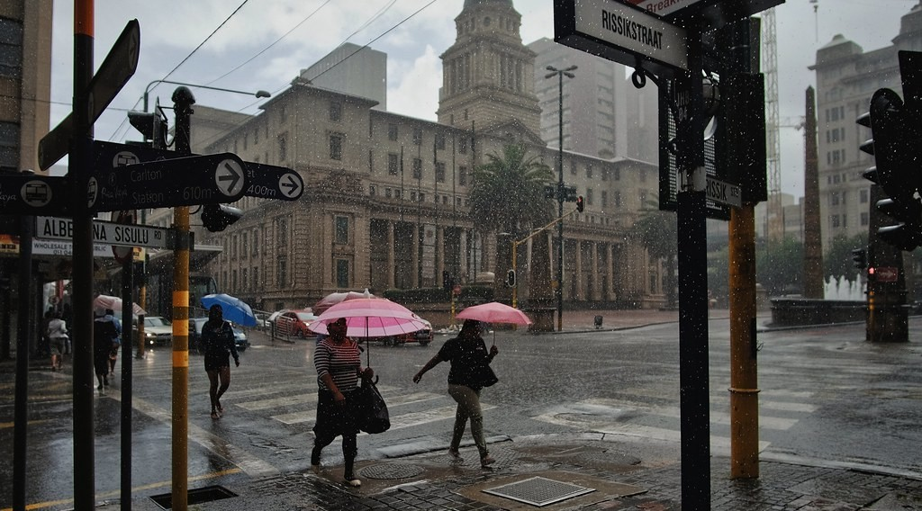
DEFINITIONS
Activity 1
Heavy rain.
Notes:
Activity 1. Look carefully at this picture: heavy rain. Observe every detail before I ask the question.

Slide 19
DEFINITIONS
Activity 1: Question
Rain, hail and snow all fall from clouds. What is their general name?
Notes:
Here is the question for Activity 1: Rain, hail and snow all fall from clouds. What is their general name? Take one minute to think and write your answer in your rough notebook.

Slide 20
DEFINITIONS
Activity 1: Answer
Precipitation.
Notes:
Let us check the answer together. Precipitation.

Slide 21
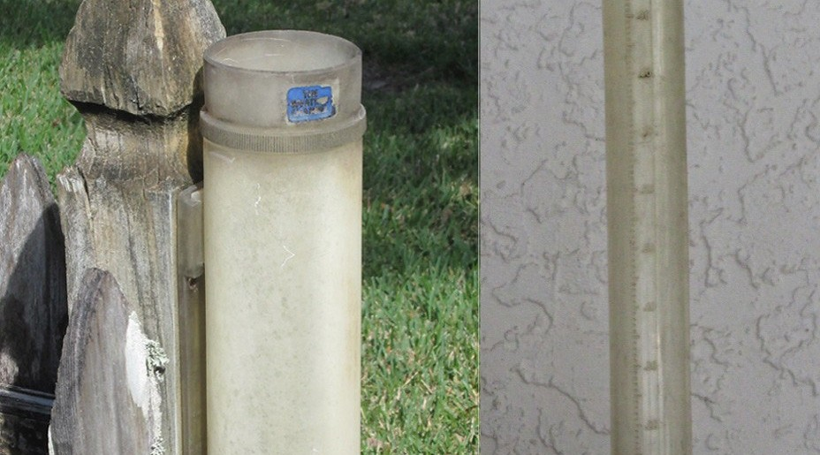
1. MEASUREMENT
Activity 2
An instrument in an open place.
Notes:
Activity 2. Look carefully at this picture: an instrument in an open place. Observe every detail before I ask the question.

Slide 22
1. MEASUREMENT
Activity 2: Question 1
What does this instrument measure?
Notes:
Here is the question for Activity 2: What does this instrument measure? Take one minute to think and write your answer in your rough notebook.

Slide 23
1. MEASUREMENT
Activity 2: Answer 1
Rainfall.
Notes:
Let us check the answer together. Rainfall.

Slide 24
1. MEASUREMENT
Activity 2: Question 2
In which unit?
Notes:
Here is the next question: In which unit? Take one minute to think and write your answer in your rough notebook.

Slide 25
1. MEASUREMENT
Activity 2: Answer 2
In millimetres (mm).
Notes:
Let us check the answer together. In millimetres (mm).

Slide 26
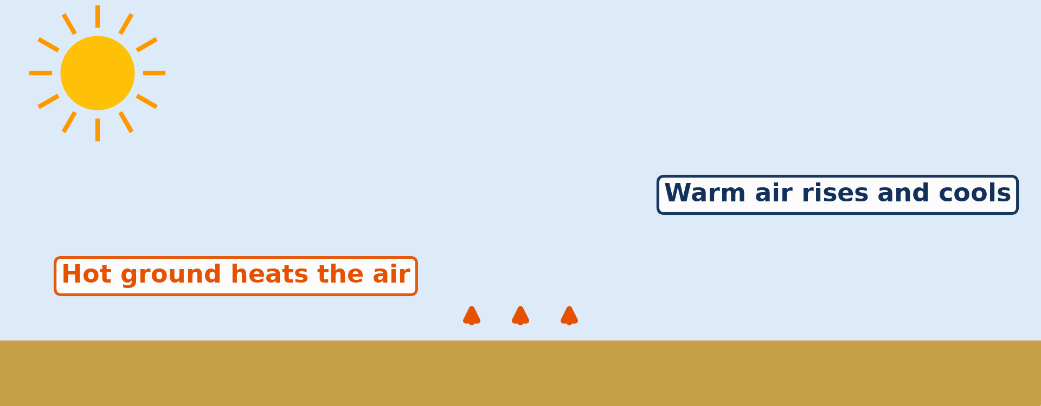
2. TYPES OF RAINFALL
Activity 3
Animation: hot air rises.
Notes:
Activity 3. Look carefully at this animation: animation: hot air rises. Watch the animation to the end; it will play again.

Slide 27
2. TYPES OF RAINFALL
Activity 3: Question
The hot ground heats the air, which rises and makes storms. What type of rain is this?
Notes:
Here is the question for Activity 3: The hot ground heats the air, which rises and makes storms. What type of rain is this? Take one minute to think and write your answer in your rough notebook.

Slide 28
2. TYPES OF RAINFALL
Activity 3: Answer
Convectional rain.
Notes:
Let us check the answer together. Convectional rain.

Slide 29
BOARD SUMMARY
Board Summary
Topic: The Earth-Atmosphere System
Sub-topic: Forms of Condensation
Lesson 35: Precipitation
Notes:
Now we are going to copy the board summary. Write the title and the headings neatly in your notebooks. I will give you enough time for each slide, so do not rush.

Slide 30
BOARD SUMMARY
DEFINITIONS
The key terms of this lesson are defined as follows:
Precipitation: It is any form of water that falls from clouds to the ground.
Rain: It is drops of liquid water that fall from clouds.
Notes:
Let us copy the definitions. The key terms of this lesson are defined as follows. On this slide we have Precipitation and Rain. Write each point on a new line, with the key term first, and explain it in your own words when we revise. When you finish, we go to the next slide.

Slide 31
BOARD SUMMARY
DEFINITIONS (continued)
Hail: It is balls of ice that fall from cumulonimbus clouds.
Snow: It is ice crystals that fall when the air is below 0 °C.
Drizzle: It is very small drops of rain that fall slowly.
Notes:
We continue with the definitions. On this slide we have Hail, Snow and Drizzle. Write each point on a new line, with the key term first, and explain it in your own words when we revise.

Slide 32
BOARD SUMMARY
1. Measurement of Rainfall
Rainfall is measured as follows:
Rain gauge (pluviometer): It collects rain in a funnel and a container placed in an open place.
Illustration: a rain gauge
Notes:
Let us copy Measurement of Rainfall. Rainfall is measured as follows. Copy the point on Rain gauge (pluviometer) on the left, then draw the diagram on the right: a rain gauge. Give it a title and label it clearly.

Slide 33
BOARD SUMMARY
1. Measurement of Rainfall
Reading: The water is poured into a measuring cylinder and read in millimetres every day.
Siting: The rim stands about 30 cm above the ground, away from trees and buildings.
Notes:
We continue with Measurement of Rainfall. On this slide we have Reading and Siting. Write each point on a new line, with the key term first, and explain it in your own words when we revise. When you finish, we go to the next slide.

Slide 34
BOARD SUMMARY
1. Measurement of Rainfall (continued)
Presentation: Daily rainfall is added to get monthly and annual totals, shown on bar graphs and maps with isohyets.
Notes:
We continue with Measurement of Rainfall. On this slide we have Presentation. Write each point on a new line, with the key term first, and explain it in your own words when we revise.

Slide 35
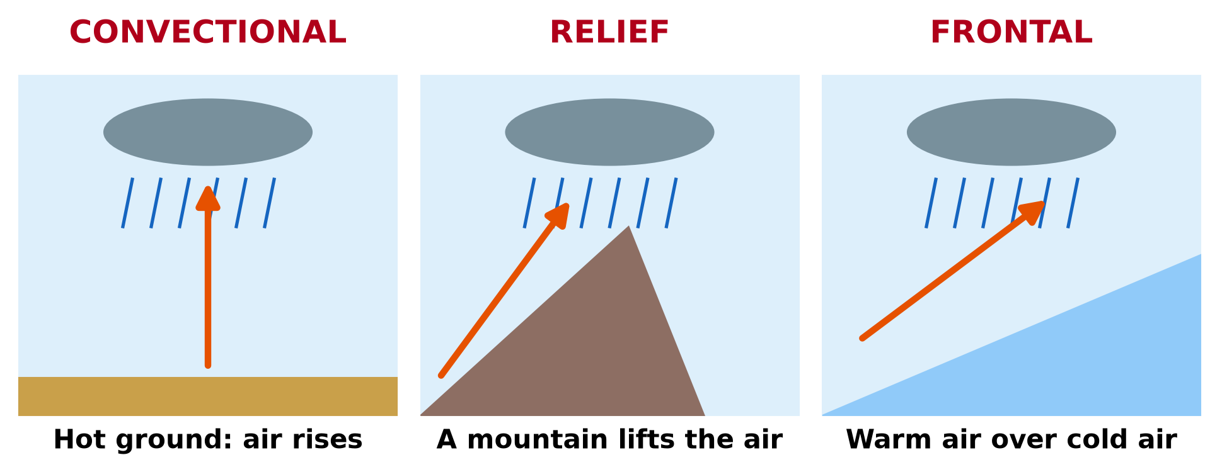
BOARD SUMMARY
2. Types of Rainfall
There are three types of rainfall:
Convectional rainfall: The hot ground heats the air, which rises, cools and forms cumulonimbus clouds that give heavy afternoon storms, as in many towns of Cameroon.
Illustration: types of rainfall
Notes:
Let us copy Types of Rainfall. There are three types of rainfall. Copy the point on Convectional rainfall on the left, then draw the diagram on the right: types of rainfall. Give it a title and label it clearly.

Slide 36
BOARD SUMMARY
2. Types of Rainfall
Relief (orographic) rainfall: Moist air is forced up a mountain, cools and gives rain on the windward side, as in Buea and Debundscha.
Frontal (cyclonic) rainfall: Warm, moist air rises over cold air, cools and gives long, steady rain, as in Europe.
Notes:
We continue with Types of Rainfall. On this slide we have Relief (orographic) rainfall and Frontal (cyclonic) rainfall. Write each point on a new line, with the key term first, and explain it in your own words when we revise.

Slide 37
FORMATIVE EVALUATION
Evaluation 1
Which instrument measures rainfall?
Notes:
Now let us check what you have understood. Question 1: Which instrument measures rainfall? Answer in your exercise book.

Slide 38
FORMATIVE EVALUATION
Expected Answer
The rain gauge.
Notes:
The expected answer is: the rain gauge. If you got it right, well done.

Slide 39
FORMATIVE EVALUATION
Evaluation 2
Why does Buea receive a lot of rain?
Notes:
Now let us check what you have understood. Question 2: Why does Buea receive a lot of rain? Answer in your exercise book.

Slide 40
FORMATIVE EVALUATION
Expected Answer
Mount Cameroon forces wet air to rise (relief rain).
Notes:
The expected answer is: mount Cameroon forces wet air to rise (relief rain). If you got it right, well done.

Slide 41
REMEDIATION
Remediation
Fill in the blanks:
Water falling from clouds is ______.
Balls of ice falling from clouds are ______.
Rain caused by a mountain is ______ rain.
Notes:
For those who need more practice, fill in the blanks in your exercise book. The answers are: number 1, precipitation; number 2, hail; number 3, relief.

Slide 42
HOMEWORK
Homework
Name the pressure belt found at the Equator.
Notes:
For your homework: Name the pressure belt found at the Equator. We shall correct it at the beginning of our next lesson.

Slide 43
NEXT LESSON
Next Lesson
Our next lesson will be on:
Lesson 36: Pressure Belts and Planetary Winds
Notes:
Our next lesson will be on Lesson 36: Pressure Belts and Planetary Winds. Thank you for your attention, and see you next time.

Slide 44
BILINGUAL GAME
Bilingual Game (Jeu Bilingue)
English | Français
Precipitation | Les précipitations
Rain | La pluie
Drizzle | La bruine
Hail | La grêle
Rain gauge | Le pluviomètre
Convectional rain | La pluie de convection
Relief rain | La pluie orographique
Rain shadow | L'abri pluviométrique
Notes:
Let us play the bilingual game. I say a word in English, and you give me the French word. Then we do the reverse.

Slide 45
LOGBOOK
Official Logbook (1/2)
Module / Topic | The Earth-Atmosphere System
Lesson Title | Lesson 35: Precipitation
Expected Learning Outcomes | Define precipitation and name its forms. Describe how rainfall is measured with a rain gauge. Explain the three types of rainfall.
Competence | Learners are able to measure the rain that falls at home or at school and explain why some places receive more rain than others.
Notes:
I record this information in the official logbook of the class after the lesson.

Slide 46
LOGBOOK
Official Logbook (2/2)
Matter Taught | DEFINITIONS; Measurement of Rainfall; Types of Rainfall.
Evaluation | Formative evaluation and remediation exercise.
Homework | Name the pressure belt found at the Equator.
Enrolment / Present / Absent | ____ / ____ / ____
Achievement | To be completed after the lesson.
Notes:
I complete the second page of the logbook: the matter taught, the evaluation, the homework and the attendance.

Slide 47
TEACHER'S NOTE
Teacher's Note
Timing: Homework correction, plan, objectives 4 min | Recall, situation, action 6 min | 3 activities 12 min | Board summary (copying) 15 min | Evaluation, remediation 5 min | Homework, next lesson 3 min | Logbook 5 min
Activity 3 is an animation (GIF): it plays automatically in slide-show mode.
Without the projector (Activity 1): list forms of water falling from the sky.
Without the projector (Activity 2): use a straight-sided tin.
Without the projector (Activity 3): describe afternoon storms in your town.
Notes:
This slide is for me, the teacher: it gives the timing of the lesson and what to do if the projector is not available.

Slide 48
REFERENCES
References
National Geography Syllabus (MINESEC), Form 3 — Module 3: Weather and Climate.
Teacher's lesson notes (f4.docx), checked and corrected where necessary.
Photo, Activity 1: “Heavy rain. Johannesburg, South Africa” by varfolomeev, CC BY-NC 2.0, via Flickr (https://www.flickr.com/photos/45427632@N02/49745935146)
Photo, Activity 2: “Sarasota - Rain Gauge (in 23rd Year)” by roger4336, CC BY-SA 2.0, via Flickr (https://www.flickr.com/photos/24736216@N07/8370429863)
Diagrams and animations: drawn for this lesson (Geography Department).
Notes:
These are the references and picture credits used to prepare this lesson.

