Slide 1
FORM 3
GEOGRAPHY
Lesson 40
Global Warming
Notes:
Good morning, class, and welcome to our geography lesson. I am your geography teacher, Madam Che. Today we are starting Lesson 40: Global Warming.

Slide 2
CLASS INFO
Class, Chapter and Duration
Class | Form 3
Chapter | Module 3: Weather and Climate — Adaptation to Climatic Excesses
Duration | 50 minutes
Notes:
This lesson is for Form 3. It belongs to Module 3: Weather and Climate — Adaptation to Climatic Excesses. We shall need 50 minutes to cover it.

Slide 3
IDENTIFICATION
Lesson Identification
Topic | Management of Climate and Hydrological Related Hazards
Sub-topic | Hydro-climatic Hazards
Lesson | Lesson 40: Global Warming
Notions / Concepts | Climate variability, greenhouse gases.
Syllabus focus | Definition; causes (natural and human); effects; adaptations and mitigations.
Competence | Learners are able to take simple actions against global warming, such as planting trees and saving energy, and to adapt to hotter, drier seasons.
Notes:
Our topic is Management of Climate and Hydrological Related Hazards, and the sub-topic is Hydro-climatic Hazards. The key notions we shall use today are: climate variability, greenhouse gases. At the end, you should be able to do this: learners are able to take simple actions against global warming, such as planting trees and saving energy, and to adapt to hotter, drier seasons.

Slide 4

HOMEWORK CORRECTION
Correction of the Homework
Question (Lesson 39: The Hydrological Cycle):
Name two greenhouse gases.
Notes:
Before we start the new lesson, let us correct the homework I gave you at the end of Lesson 39: The Hydrological Cycle. The question was: Name two greenhouse gases. Take out your exercise books.

Slide 5
HOMEWORK CORRECTION
Correction: Possible Answer
Carbon dioxide and methane.
Notes:
Here is a good answer. Carbon dioxide and methane. Compare it with your own answer and correct your work in red.

Slide 6
LESSON PLAN
Lesson Plan
Correction of the homework
Objectives and recall
Real-life situation and action to take
Learning activities
Board summary
Evaluation, remediation and homework
Notes:
Here is the plan of our lesson today. First, we shall correct the homework. Then we shall look at the objectives and recall what you already know. After that, we shall study a situation from real life and the action to take, and do the learning activities. Finally, we shall copy the board summary, do the evaluation and the remediation, and I will give you the homework.

Slide 7
OBJECTIVES
Objectives
By the end of this lesson, you should be able to:
Define global warming, the greenhouse effect and greenhouse gases.
Explain the natural and human causes of global warming.
Notes:
Take your time to copy this part; we will continue together.

Slide 8
OBJECTIVES
Objectives (continued)
Describe its effects.
Propose adaptation and mitigation measures.
Notes:
By the end of this lesson, you should be able to do four things. Number 1: define global warming, the greenhouse effect and greenhouse gases. Number 2: explain the natural and human causes of global warming. Number 3: describe its effects. Number 4: propose adaptation and mitigation measures.

Slide 9
PREVIOUS KNOWLEDGE
Previous Knowledge
The hydrological cycle moves water between the oceans, the air and the land.
Temperature depends on factors such as latitude, altitude and cloud cover.
Human activities can make cities warmer.
Notes:
Let us first remember what you already know. The hydrological cycle moves water between the oceans, the air and the land. Temperature depends on factors such as latitude, altitude and cloud cover. Human activities can make cities warmer. Keep this in mind, because we shall build on it today.

Slide 10
REAL-LIFE SITUATION
Situation in Real Life
Papa Joseph, 70 years old, says that when he was young, the rains came on time every year and the hot months were less hot. Today the heat is stronger and the rains are irregular. His grandson asks: "Why is the Earth getting hotter, and what can we do about it?"
Notes:
Listen carefully to this situation from real life. Papa Joseph, 70 years old, says that when he was young, the rains came on time every year and the hot months were less hot. Today the heat is stronger and the rains are irregular. His grandson asks: "Why is the Earth getting hotter, and what can we do about it?" Think about it, because I am going to ask you some questions.

Slide 11
REAL-LIFE SITUATION
Situation: Question 1
What is the problem in the situation?
Notes:
Question 1: What is the problem in the situation? Think for a moment, then raise your hand to answer.

Slide 12
REAL-LIFE SITUATION
Answer
The grandson does not know why the climate is getting hotter and what can be done.
Notes:
Good. The grandson does not know why the climate is getting hotter and what can be done.

Slide 13
REAL-LIFE SITUATION
Situation: Question 2
What has changed according to Papa Joseph?
Notes:
Question 2: What has changed according to Papa Joseph? Think for a moment, then raise your hand to answer.

Slide 14
REAL-LIFE SITUATION
Answer
The heat is stronger and the rains are irregular.
Notes:
Good. The heat is stronger and the rains are irregular.

Slide 15
REAL-LIFE SITUATION
Situation: Question 3
What is this general rise in temperature called?
Notes:
Question 3: What is this general rise in temperature called? Think for a moment, then raise your hand to answer.

Slide 16
REAL-LIFE SITUATION
Possible Answer
Global warming.
Notes:
Good. Global warming.

Slide 17
ACTION TO TAKE
Action to Take
Plant trees, save energy and avoid burning waste.
Notes:
From this situation, the action we are working towards in this lesson is the following: plant trees, save energy and avoid burning waste.

Slide 18
JUSTIFICATION
Justification of the Lesson
This lesson helps us to understand global warming and what we can do.
Notes:
Why is this lesson important for you? This lesson helps us to understand global warming and what we can do.

Slide 19
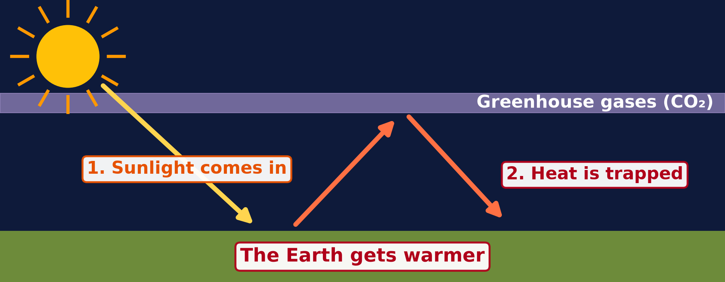
DEFINITIONS
Activity 1
The greenhouse effect.
Notes:
Activity 1. Look carefully at this diagram: the greenhouse effect. Observe every detail before I ask the question.

Slide 20
DEFINITIONS
Activity 1: Question
How do greenhouse gases warm the Earth?
Notes:
Here is the question for Activity 1: How do greenhouse gases warm the Earth? Take one minute to think and write your answer in your rough notebook.

Slide 21
DEFINITIONS
Activity 1: Answer
They trap the heat, like a blanket.
Notes:
Let us check the answer together. They trap the heat, like a blanket.

Slide 22
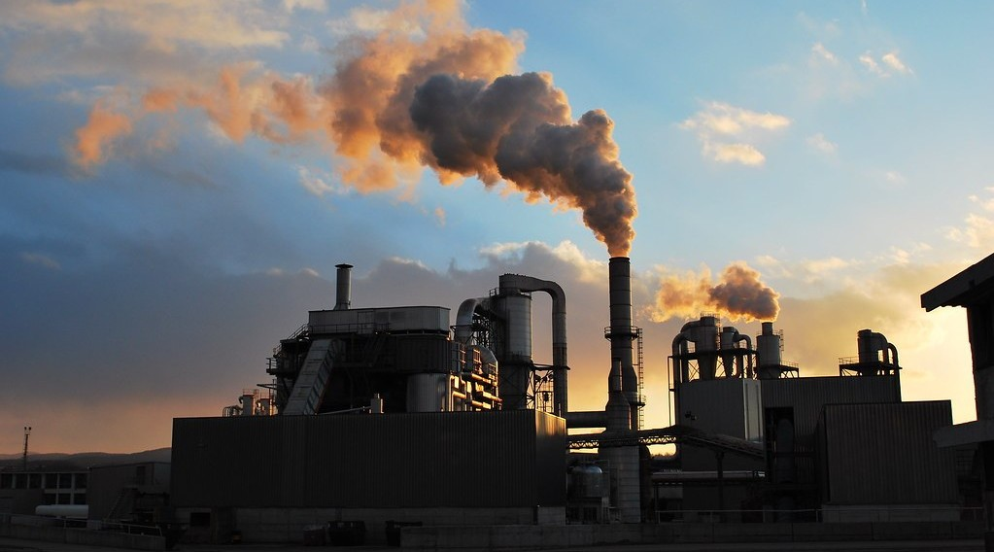
1. CAUSES
Activity 2
Smoke from an exhaust pipe.
Notes:
Activity 2. Look carefully at this picture: smoke from an exhaust pipe. Observe every detail before I ask the question.

Slide 23
1. CAUSES
Activity 2: Question
Which gas comes out when we burn petrol, diesel and coal?
Notes:
Here is the question for Activity 2: Which gas comes out when we burn petrol, diesel and coal? Take one minute to think and write your answer in your rough notebook.

Slide 24
1. CAUSES
Activity 2: Answer
Carbon dioxide (CO₂).
Notes:
Let us check the answer together. Carbon dioxide (CO₂).

Slide 25
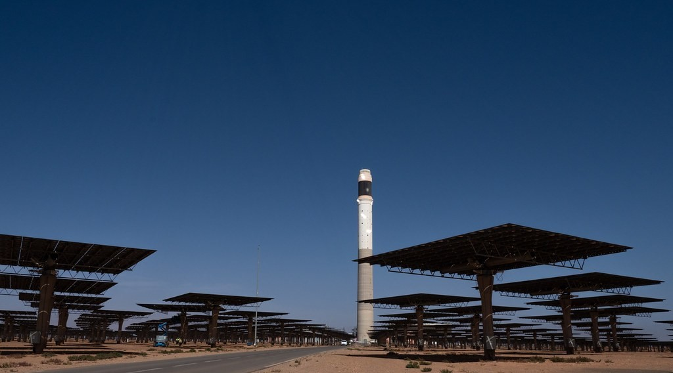
3. ADAPTATION AND MITIGATION
Activity 3
Solar panels.
Notes:
Activity 3. Look carefully at this picture: solar panels. Observe every detail before I ask the question.

Slide 26
3. ADAPTATION AND MITIGATION
Activity 3: Question
How do solar panels help against global warming?
Notes:
Here is the question for Activity 3: How do solar panels help against global warming? Take one minute to think and write your answer in your rough notebook.

Slide 27
3. ADAPTATION AND MITIGATION
Activity 3: Answer
They make electricity without burning fuel.
Notes:
Let us check the answer together. They make electricity without burning fuel.

Slide 28
BOARD SUMMARY
Board Summary
Topic: Management of Climate and Hydrological Related Hazards
Sub-topic: Hydro-climatic Hazards
Lesson 40: Global Warming
Notes:
Now we are going to copy the board summary. Write the title and the headings neatly in your notebooks. I will give you enough time for each slide, so do not rush.

Slide 29
BOARD SUMMARY
DEFINITIONS
The key terms of this lesson are defined as follows:
Global warming: It is the rise of the average temperature of the Earth's surface and atmosphere.
Notes:
Let us copy the definitions. The key terms of this lesson are defined as follows. On this slide we have Global warming. Write each point on a new line, with the key term first, and explain it in your own words when we revise. When you finish, we go to the next slide.

Slide 30
BOARD SUMMARY
DEFINITIONS (continued)
Greenhouse effect: It is the trapping of the Earth's heat by some gases in the atmosphere.
Greenhouse gases: They are gases such as carbon dioxide, methane and nitrous oxide that trap heat.
Notes:
We continue with the definitions. On this slide we have Greenhouse effect and Greenhouse gases. Write each point on a new line, with the key term first, and explain it in your own words when we revise.

Slide 31
BOARD SUMMARY
1. Causes of Global Warming
A) Human Causes
Human activities cause global warming as follows:
Burning fossil fuels: Cars, factories and power stations burn petrol, diesel, gas and coal and release carbon dioxide.
Illustration: exhaust smoke
Notes:
Let us copy Human Causes. Human activities cause global warming as follows. Copy the point on Burning fossil fuels on the left, then draw the diagram on the right: exhaust smoke. Give it a title and label it clearly.

Slide 32
BOARD SUMMARY
1. Causes of Global Warming
A) Human Causes
Deforestation and bush fires: Cutting and burning trees releases carbon dioxide and leaves fewer plants to absorb it.
Agriculture: Cattle and rice fields release methane, and fertilisers release nitrous oxide.
Notes:
We continue with Human Causes. On this slide we have Deforestation and bush fires and Agriculture. Write each point on a new line, with the key term first, and explain it in your own words when we revise. When you finish, we go to the next slide.

Slide 33
BOARD SUMMARY
1. Causes of Global Warming
A) Human Causes (continued)
Waste: Rotting rubbish in dumps releases methane.
Notes:
We continue with Human Causes. On this slide we have Waste. Write each point on a new line, with the key term first, and explain it in your own words when we revise.

Slide 34
BOARD SUMMARY
1. Causes of Global Warming
B) Natural Causes
Natural factors also change the temperature of the Earth:
Changes in the Sun: The energy given out by the Sun changes slightly over time.
Volcanic eruptions: Eruptions release gases, including carbon dioxide.
Notes:
Let us copy Natural Causes. Natural factors also change the temperature of the Earth. On this slide we have Changes in the Sun and Volcanic eruptions. Write each point on a new line, with the key term first, and explain it in your own words when we revise.

Slide 35
BOARD SUMMARY
1. Causes of Global Warming
B) Natural Causes
Natural greenhouse effect: Water vapour and natural carbon dioxide keep the Earth warm enough for life.
Illustration: the greenhouse effect
Notes:
Copy the point on Natural greenhouse effect on the left, then draw the diagram on the right: the greenhouse effect. Give it a title and label it clearly.

Slide 36
BOARD SUMMARY
2. Effects of Global Warming
Global warming has the following effects:
Extreme weather: Heat waves, droughts, storms and floods become more frequent.
Sea-level rise: Melting ice and warmer water raise the sea level and threaten Douala and Limbe.
Notes:
Let us copy Effects of Global Warming. Global warming has the following effects. On this slide we have Extreme weather and Sea-level rise. Write each point on a new line, with the key term first, and explain it in your own words when we revise. When you finish, we go to the next slide.

Slide 37
BOARD SUMMARY
2. Effects of Global Warming (continued)
Farming and food: Irregular rains and heat reduce harvests.
Water and health: Lakes such as Lake Chad shrink, and diseases such as malaria spread.
Loss of plants and animals: Some species cannot adapt and disappear.
Notes:
We continue with Effects of Global Warming. On this slide we have Farming and food, Water and health and Loss of plants and animals. Write each point on a new line, with the key term first, and explain it in your own words when we revise.

Slide 38
BOARD SUMMARY
3. Adaptation and Mitigation
People respond to global warming with the following measures:
Clean energy (mitigation): Solar, wind and hydro-electric power reduce carbon dioxide.
Illustration: solar panels
Notes:
Let us copy Adaptation and Mitigation. People respond to global warming with the following measures. Copy the point on Clean energy (mitigation) on the left, then draw the diagram on the right: solar panels. Give it a title and label it clearly.

Slide 39
BOARD SUMMARY
3. Adaptation and Mitigation
Tree planting (mitigation): Trees absorb carbon dioxide, as in reforestation projects.
Saving energy (mitigation): Improved stoves, public transport and less burning of waste reduce emissions.
Notes:
We continue with Adaptation and Mitigation. On this slide we have Tree planting (mitigation) and Saving energy (mitigation). Write each point on a new line, with the key term first, and explain it in your own words when we revise. When you finish, we go to the next slide.

Slide 40
BOARD SUMMARY
3. Adaptation and Mitigation (continued)
New farming methods (adaptation): Drought-resistant seeds, irrigation and changed planting dates help farmers.
Protection (adaptation): Dykes, early warnings and building away from coasts and rivers protect people.
Notes:
We continue with Adaptation and Mitigation. On this slide we have New farming methods (adaptation) and Protection (adaptation). Write each point on a new line, with the key term first, and explain it in your own words when we revise.

Slide 41
FORMATIVE EVALUATION
Evaluation 1
Give one human cause of global warming.
Notes:
Now let us check what you have understood. Question 1: Give one human cause of global warming. Answer in your exercise book.

Slide 42
FORMATIVE EVALUATION
Expected Answer
Burning petrol and diesel (or deforestation).
Notes:
The expected answer is: burning petrol and diesel (or deforestation). If you got it right, well done.

Slide 43
FORMATIVE EVALUATION
Evaluation 2
What is the difference between mitigation and adaptation?
Notes:
Now let us check what you have understood. Question 2: What is the difference between mitigation and adaptation? Answer in your exercise book.

Slide 44
FORMATIVE EVALUATION
Expected Answer
Mitigation reduces the causes; adaptation lives with the changes.
Notes:
The expected answer is: mitigation reduces the causes; adaptation lives with the changes. If you got it right, well done.

Slide 45
REMEDIATION
Remediation
Fill in the blanks:
The rise of the temperature of the Earth is global ______.
The main greenhouse gas is ______.
Planting trees is a form of ______.
Notes:
For those who need more practice, fill in the blanks in your exercise book. The answers are: number 1, warming; number 2, carbon dioxide (CO₂); number 3, mitigation.

Slide 46
HOMEWORK
Homework
Define desertification.
Notes:
For your homework: Define desertification. We shall correct it at the beginning of our next lesson.

Slide 47
NEXT LESSON
Next Lesson
Our next lesson will be on:
Lesson 41: Floods, Droughts and Desertification
Notes:
Our next lesson will be on Lesson 41: Floods, Droughts and Desertification. Thank you for your attention, and see you next time.

Slide 48
BILINGUAL GAME
Bilingual Game (Jeu Bilingue)
English | Français
Global warming | Le réchauffement climatique
Greenhouse effect | L'effet de serre
Greenhouse gas | Le gaz à effet de serre
Carbon dioxide | Le dioxyde de carbone
Climate variability | La variabilité climatique
Mitigation | L'atténuation
Adaptation | L'adaptation
Sea level | Le niveau de la mer
Notes:
Let us play the bilingual game. I say a word in English, and you give me the French word. Then we do the reverse.

Slide 49
LOGBOOK
Official Logbook (1/2)
Module / Topic | Management of Climate and Hydrological Related Hazards
Lesson Title | Lesson 40: Global Warming
Expected Learning Outcomes | Define global warming, the greenhouse effect and greenhouse gases. Explain the natural and human causes of global warming. Describe its effects. Propose adaptation and mitigation measures.
Competence | Learners are able to take simple actions against global warming, such as planting trees and saving energy, and to adapt to hotter, drier seasons.
Notes:
I record this information in the official logbook of the class after the lesson.

Slide 50
LOGBOOK
Official Logbook (2/2)
Matter Taught | DEFINITIONS; Human Causes; Natural Causes; Effects of Global Warming; Adaptation and Mitigation.
Evaluation | Formative evaluation and remediation exercise.
Homework | Define desertification.
Enrolment / Present / Absent | ____ / ____ / ____
Achievement | To be completed after the lesson.
Notes:
I complete the second page of the logbook: the matter taught, the evaluation, the homework and the attendance.

Slide 51
TEACHER'S NOTE
Teacher's Note
Timing: Homework correction, plan, objectives 4 min | Recall, situation, action 6 min | 3 activities 12 min | Board summary (copying) 15 min | Evaluation, remediation 5 min | Homework, next lesson 3 min | Logbook 5 min
Without the projector (Activity 1): compare with a closed car in the sun.
Without the projector (Activity 2): show smoke from a motorbike.
Without the projector (Activity 3): ask who has a solar lamp.
Notes:
This slide is for me, the teacher: it gives the timing of the lesson and what to do if the projector is not available.

Slide 52
REFERENCES
References
National Geography Syllabus (MINESEC), Form 3 — Module 3: Weather and Climate.
Teacher's lesson notes (f4.docx), checked and corrected where necessary.
IPCC Sixth Assessment Report (2021–2023).
UNFCCC: Paris Agreement (2015).
Photo, Activity 2: “image replaced (thanks Anne :) )” by why 137, CC BY 2.0, via Flickr (https://www.flickr.com/photos/78752351@N03/8464430910)
Photo, Activity 3: “Noor Ouarzazate III Solar Plant” by Richard Allaway, CC BY 2.0, via Flickr (https://www.flickr.com/photos/16287002@N00/52769922684)
Diagrams and animations: drawn for this lesson (Geography Department).
Notes:
These are the references and picture credits used to prepare this lesson.

