Slide 1
FORM 3
GEOGRAPHY
Lesson 42
Water Scarcity
Notes:
Good morning, class, and welcome to our geography lesson. I am your geography teacher, Madam Che. Today we are starting Lesson 42: Water Scarcity.

Slide 2
CLASS INFO
Class, Chapter and Duration
Class | Form 3
Chapter | Module 3: Weather and Climate — Adaptation to Climatic Excesses
Duration | 50 minutes
Notes:
This lesson is for Form 3. It belongs to Module 3: Weather and Climate — Adaptation to Climatic Excesses. We shall need 50 minutes to cover it.

Slide 3
IDENTIFICATION
Lesson Identification
Topic | Management of Climate and Hydrological Related Hazards
Sub-topic | Hydro-climatic Hazards
Lesson | Lesson 42: Water Scarcity
Notions / Concepts | Water stress, storage tanks, boreholes, dams, reservoirs.
Syllabus focus | Meaning; causes; effects; water conservation methods.
Competence | Learners are able to save water at home and at school, and to collect and store rainwater for the dry season.
Notes:
Our topic is Management of Climate and Hydrological Related Hazards, and the sub-topic is Hydro-climatic Hazards. The key notions we shall use today are: water stress, storage tanks, boreholes, dams, reservoirs. At the end, you should be able to do this: learners are able to save water at home and at school, and to collect and store rainwater for the dry season.

Slide 4

HOMEWORK CORRECTION
Correction of the Homework
Question (Lesson 41: Floods, Droughts and Desertification):
Give two causes of water scarcity.
Notes:
Before we start the new lesson, let us correct the homework I gave you at the end of Lesson 41: Floods, Droughts and Desertification. The question was: Give two causes of water scarcity. Take out your exercise books.

Slide 5
HOMEWORK CORRECTION
Correction: Possible Answer
A long dry season and population growth (also pollution and waste).
Notes:
Here is a good answer. A long dry season and population growth (also pollution and waste). Compare it with your own answer and correct your work in red.

Slide 6
LESSON PLAN
Lesson Plan
Correction of the homework
Objectives and recall
Real-life situation and action to take
Learning activities
Board summary
Evaluation, remediation and homework
Notes:
Here is the plan of our lesson today. First, we shall correct the homework. Then we shall look at the objectives and recall what you already know. After that, we shall study a situation from real life and the action to take, and do the learning activities. Finally, we shall copy the board summary, do the evaluation and the remediation, and I will give you the homework.

Slide 7
OBJECTIVES
Objectives
By the end of this lesson, you should be able to:
Define water scarcity and water stress.
Explain the causes of water scarcity.
Describe its effects.
Describe methods of water conservation.
Notes:
By the end of this lesson, you should be able to do four things. Number 1: define water scarcity and water stress. Number 2: explain the causes of water scarcity. Number 3: describe its effects. Number 4: describe methods of water conservation.

Slide 8
PREVIOUS KNOWLEDGE
Previous Knowledge
Floods cover dry land; droughts are long periods of low rainfall.
Desertification turns dry land into desert.
Storing water helps people to face droughts.
Notes:
Let us first remember what you already know. Floods cover dry land; droughts are long periods of low rainfall. Desertification turns dry land into desert. Storing water helps people to face droughts. Keep this in mind, because we shall build on it today.

Slide 9
REAL-LIFE SITUATION
Situation in Real Life
Every year in March, the taps in Chantal's neighbourhood run dry for several days. Women and children queue for hours at the borehole, and water sellers raise their prices. Chantal asks: "Why is there not enough water, and how can we save it?"
Notes:
Listen carefully to this situation from real life. Every year in March, the taps in Chantal's neighbourhood run dry for several days. Women and children queue for hours at the borehole, and water sellers raise their prices. Chantal asks: "Why is there not enough water, and how can we save it?" Think about it, because I am going to ask you some questions.

Slide 10
REAL-LIFE SITUATION
Situation: Question 1
What is the problem in the situation?
Notes:
Question 1: What is the problem in the situation? Think for a moment, then raise your hand to answer.

Slide 11
REAL-LIFE SITUATION
Answer
The neighbourhood lacks water, and Chantal does not know the causes or how to save water.
Notes:
Good. The neighbourhood lacks water, and Chantal does not know the causes or how to save water.

Slide 12
REAL-LIFE SITUATION
Situation: Question 2
When do the taps run dry?
Notes:
Question 2: When do the taps run dry? Think for a moment, then raise your hand to answer.

Slide 13
REAL-LIFE SITUATION
Answer
In March, in the dry season.
Notes:
Good. In March, in the dry season.

Slide 14
REAL-LIFE SITUATION
Situation: Question 3
What do water sellers do?
Notes:
Question 3: What do water sellers do? Think for a moment, then raise your hand to answer.

Slide 15
REAL-LIFE SITUATION
Possible Answer
They raise their prices.
Notes:
Good. They raise their prices.

Slide 16
ACTION TO TAKE
Action to Take
Close taps, repair leaks and collect rainwater.
Notes:
From this situation, the action we are working towards in this lesson is the following: close taps, repair leaks and collect rainwater.

Slide 17
JUSTIFICATION
Justification of the Lesson
This lesson helps us to understand water scarcity and how to save water.
Notes:
Why is this lesson important for you? This lesson helps us to understand water scarcity and how to save water.

Slide 18
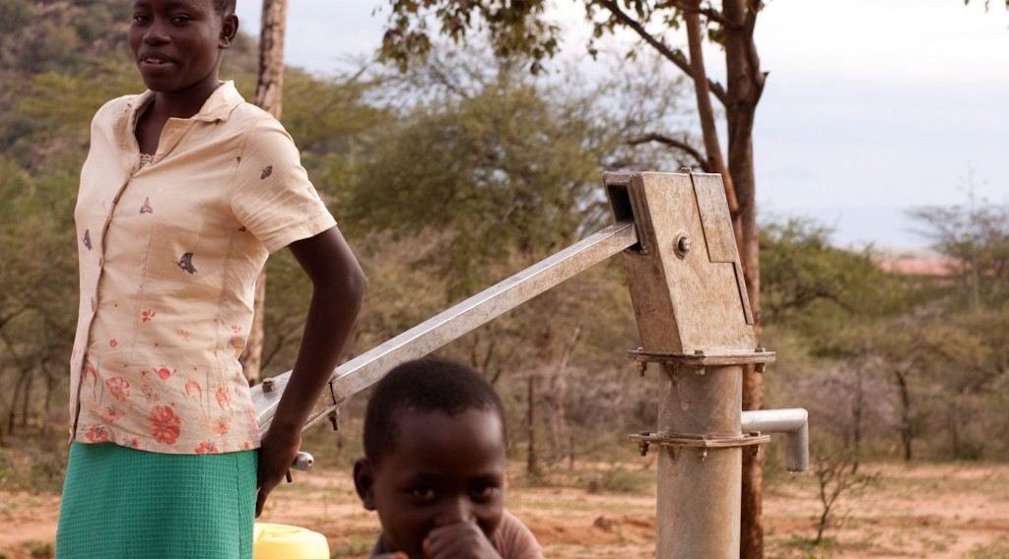
DEFINITIONS
Activity 1
People queue at a borehole.
Notes:
Activity 1. Look carefully at this picture: people queue at a borehole. Observe every detail before I ask the question.

Slide 19
DEFINITIONS
Activity 1: Question
There is not enough clean water for everyone. What is this situation called?
Notes:
Here is the question for Activity 1: There is not enough clean water for everyone. What is this situation called? Take one minute to think and write your answer in your rough notebook.

Slide 20
DEFINITIONS
Activity 1: Answer
Water scarcity.
Notes:
Let us check the answer together. Water scarcity.

Slide 21
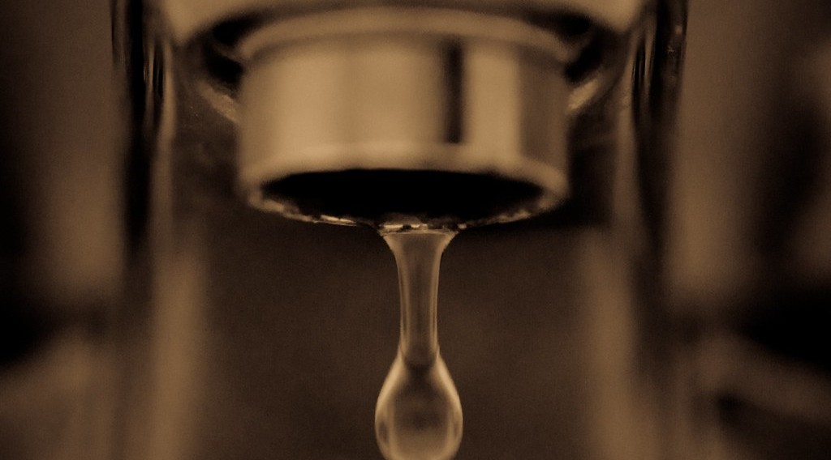
1. CAUSES
Activity 2
A leaking tap.
Notes:
Activity 2. Look carefully at this picture: a leaking tap. Observe every detail before I ask the question.

Slide 22
1. CAUSES
Activity 2: Question
How does this tap make water scarcer?
Notes:
Here is the question for Activity 2: How does this tap make water scarcer? Take one minute to think and write your answer in your rough notebook.

Slide 23
1. CAUSES
Activity 2: Answer
It wastes water all day.
Notes:
Let us check the answer together. It wastes water all day.

Slide 24
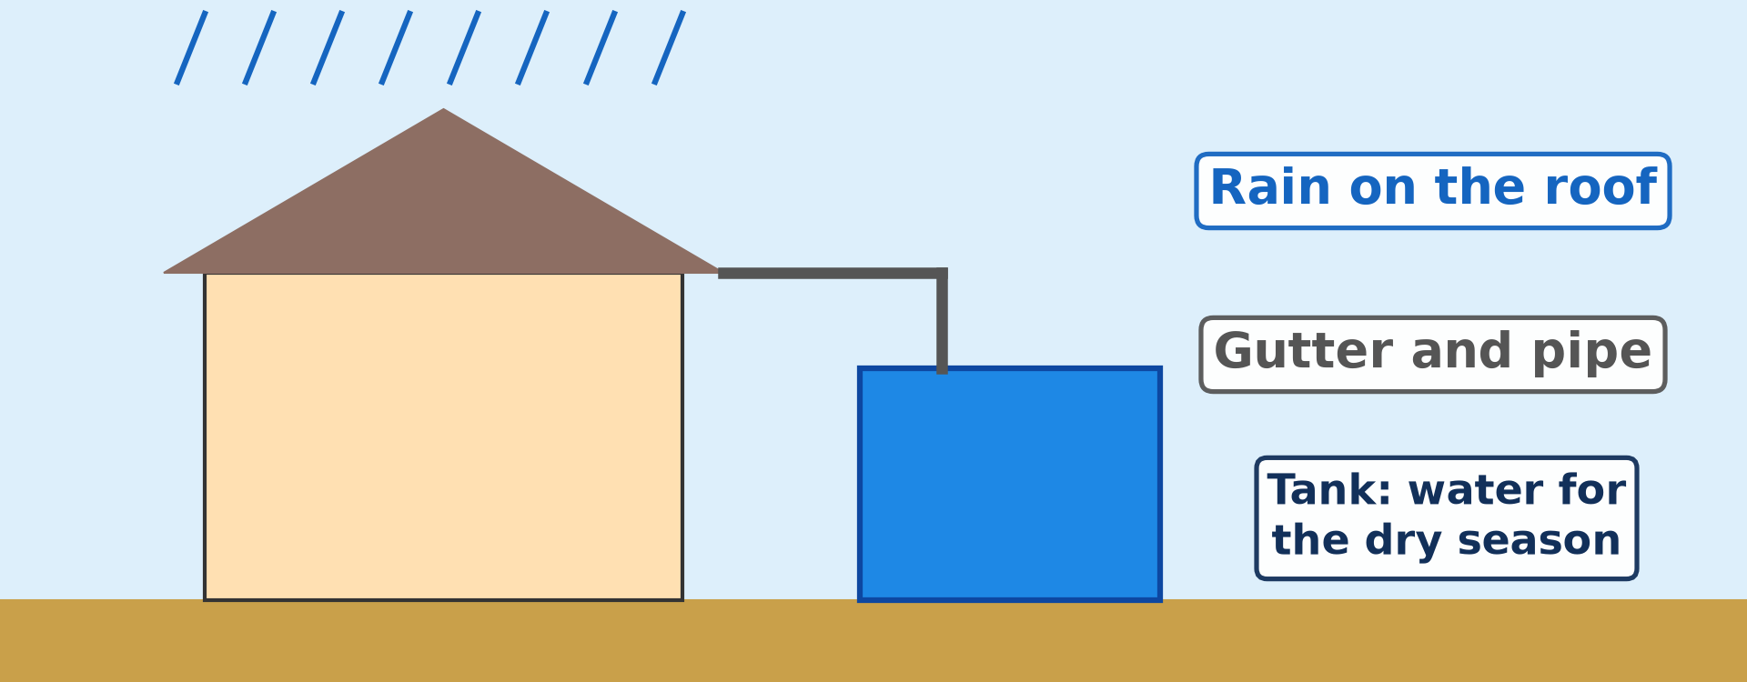
3. WATER CONSERVATION METHODS
Activity 3
Water from a roof.
Notes:
Activity 3. Look carefully at this diagram: water from a roof. Observe every detail before I ask the question.

Slide 25
3. WATER CONSERVATION METHODS
Activity 3: Question
How can a family keep water for the dry season?
Notes:
Here is the question for Activity 3: How can a family keep water for the dry season? Take one minute to think and write your answer in your rough notebook.

Slide 26
3. WATER CONSERVATION METHODS
Activity 3: Answer
By collecting rain water from the roof in a tank.
Notes:
Let us check the answer together. By collecting rain water from the roof in a tank.

Slide 27
BOARD SUMMARY
Board Summary
Topic: Management of Climate and Hydrological Related Hazards
Sub-topic: Hydro-climatic Hazards
Lesson 42: Water Scarcity
Notes:
Now we are going to copy the board summary. Write the title and the headings neatly in your notebooks. I will give you enough time for each slide, so do not rush.

Slide 28
BOARD SUMMARY
DEFINITIONS
The key terms of this lesson are defined as follows:
Water scarcity: It is the lack of enough clean water to meet the needs of people.
Water stress: It is a situation where the demand for water is higher than the available supply.
Notes:
Let us copy the definitions. The key terms of this lesson are defined as follows. On this slide we have Water scarcity and Water stress. Write each point on a new line, with the key term first, and explain it in your own words when we revise. When you finish, we go to the next slide.

Slide 29
BOARD SUMMARY
DEFINITIONS (continued)
Water conservation: It is the careful use and protection of water to avoid waste.
Notes:
We continue with the definitions. On this slide we have Water conservation. Write each point on a new line, with the key term first, and explain it in your own words when we revise.

Slide 30
BOARD SUMMARY
1. Causes of Water Scarcity
Water scarcity has the following causes:
Climate: A long dry season, droughts and high evaporation reduce water supply.
Notes:
Let us copy Causes of Water Scarcity. Water scarcity has the following causes. On this slide we have Climate. Write each point on a new line, with the key term first, and explain it in your own words when we revise.

Slide 31
BOARD SUMMARY
1. Causes of Water Scarcity
Population growth: Towns such as Yaoundé and Douala grow fast, and demand becomes higher than supply.
Illustration: a queue at a borehole
Notes:
Copy the point on Population growth on the left, then draw the diagram on the right: a queue at a borehole. Give it a title and label it clearly.

Slide 32
BOARD SUMMARY
1. Causes of Water Scarcity
Pollution: Rubbish, sewage and chemicals make rivers and wells unfit to drink.
Notes:
We continue with Causes of Water Scarcity. On this slide we have Pollution. Write each point on a new line, with the key term first, and explain it in your own words when we revise.

Slide 33
BOARD SUMMARY
1. Causes of Water Scarcity
Waste: Leaking pipes and taps, and careless use, waste a lot of water.
Illustration: a leaking tap
Notes:
Copy the point on Waste on the left, then draw the diagram on the right: a leaking tap. Give it a title and label it clearly.

Slide 34
BOARD SUMMARY
1. Causes of Water Scarcity
Poor networks: Old pipes, too few boreholes and power cuts at pumping stations limit supply.
Notes:
We continue with Causes of Water Scarcity. On this slide we have Poor networks. Write each point on a new line, with the key term first, and explain it in your own words when we revise.

Slide 35
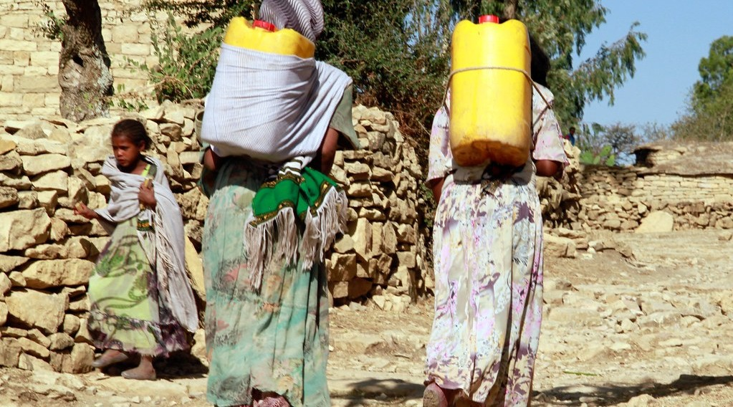
BOARD SUMMARY
2. Effects of Water Scarcity
Water scarcity has the following effects:
Loss of time: Women and children walk long distances and queue for hours.
Illustration: fetching water
Notes:
Let us copy Effects of Water Scarcity. Water scarcity has the following effects. Copy the point on Loss of time on the left, then draw the diagram on the right: fetching water. Give it a title and label it clearly.

Slide 36
BOARD SUMMARY
2. Effects of Water Scarcity
Diseases: Dirty water causes cholera, typhoid and diarrhoea.
High cost: Water sellers raise prices, and poor families spend more.
Schooling: Children miss classes to fetch water.
Notes:
We continue with Effects of Water Scarcity. On this slide we have Diseases, High cost and Schooling. Write each point on a new line, with the key term first, and explain it in your own words when we revise. When you finish, we go to the next slide.

Slide 37
BOARD SUMMARY
2. Effects of Water Scarcity (continued)
Farming and conflicts: Crops and animals suffer, and people quarrel over water points.
Notes:
We continue with Effects of Water Scarcity. On this slide we have Farming and conflicts. Write each point on a new line, with the key term first, and explain it in your own words when we revise.

Slide 38
BOARD SUMMARY
3. Water Conservation Methods
Water can be conserved in the following ways:
At home: We repair leaks, close taps and reuse water, for example for plants.
Notes:
Let us copy Water Conservation Methods. Water can be conserved in the following ways. On this slide we have At home. Write each point on a new line, with the key term first, and explain it in your own words when we revise.

Slide 39
BOARD SUMMARY
3. Water Conservation Methods
Rainwater harvesting: Rain water is collected from roofs and stored in tanks.
Illustration: rainwater harvesting
Notes:
Copy the point on Rainwater harvesting on the left, then draw the diagram on the right: rainwater harvesting. Give it a title and label it clearly.

Slide 40
BOARD SUMMARY
3. Water Conservation Methods
In farming: Drip irrigation and mulching give water directly to plants and reduce evaporation.
Protecting sources: Wells and rivers are kept clean, and trees are planted around sources.
Notes:
We continue with Water Conservation Methods. On this slide we have In farming and Protecting sources. Write each point on a new line, with the key term first, and explain it in your own words when we revise. When you finish, we go to the next slide.

Slide 41
BOARD SUMMARY
3. Water Conservation Methods (continued)
Large projects: Dams, reservoirs and new boreholes store and supply water.
Notes:
We continue with Water Conservation Methods. On this slide we have Large projects. Write each point on a new line, with the key term first, and explain it in your own words when we revise.

Slide 42
FORMATIVE EVALUATION
Evaluation 1
Give two effects of water scarcity.
Notes:
Now let us check what you have understood. Question 1: Give two effects of water scarcity. Answer in your exercise book.

Slide 43
FORMATIVE EVALUATION
Expected Answer
Long queues and diseases like cholera.
Notes:
The expected answer is: long queues and diseases like cholera. If you got it right, well done.

Slide 44
FORMATIVE EVALUATION
Evaluation 2
Give two ways of saving water at home.
Notes:
Now let us check what you have understood. Question 2: Give two ways of saving water at home. Answer in your exercise book.

Slide 45
FORMATIVE EVALUATION
Expected Answer
Repair leaks and close taps.
Notes:
The expected answer is: repair leaks and close taps. If you got it right, well done.

Slide 46
REMEDIATION
Remediation
Fill in the blanks:
Not enough clean water is water ______.
Using water carefully is water ______.
Rain water can be stored in a ______.
Notes:
For those who need more practice, fill in the blanks in your exercise book. The answers are: number 1, scarcity; number 2, conservation; number 3, tank.

Slide 47
HOMEWORK
Homework
Give three ways to conserve water at home.
Notes:
For your homework: Give three ways to conserve water at home. We shall correct it at the beginning of our next lesson.

Slide 48
BILINGUAL GAME
Bilingual Game (Jeu Bilingue)
English | Français
Water scarcity | La pénurie d'eau
Water stress | Le stress hydrique
Storage tank | La citerne
Borehole | Le forage
Dam | Le barrage
Reservoir | Le réservoir
Leak | La fuite
To save water | Économiser l'eau
Notes:
Let us play the bilingual game. I say a word in English, and you give me the French word. Then we do the reverse.

Slide 49
LOGBOOK
Official Logbook (1/2)
Module / Topic | Management of Climate and Hydrological Related Hazards
Lesson Title | Lesson 42: Water Scarcity
Expected Learning Outcomes | Define water scarcity and water stress. Explain the causes of water scarcity. Describe its effects. Describe methods of water conservation.
Competence | Learners are able to save water at home and at school, and to collect and store rainwater for the dry season.
Notes:
I record this information in the official logbook of the class after the lesson.

Slide 50
LOGBOOK
Official Logbook (2/2)
Matter Taught | DEFINITIONS; Causes of Water Scarcity; Effects of Water Scarcity; Water Conservation Methods.
Evaluation | Formative evaluation and remediation exercise.
Homework | Give three ways to conserve water at home.
Enrolment / Present / Absent | ____ / ____ / ____
Achievement | To be completed after the lesson.
Notes:
I complete the second page of the logbook: the matter taught, the evaluation, the homework and the attendance.

Slide 51
TEACHER'S NOTE
Teacher's Note
Timing: Homework correction, plan, objectives 4 min | Recall, situation, action 6 min | 3 activities 12 min | Board summary (copying) 15 min | Evaluation, remediation 5 min | Homework, next lesson 3 min | Logbook 5 min
Without the projector (Activity 1): ask learners where their family gets water.
Without the projector (Activity 2): count the drops from a tap in one minute.
Without the projector (Activity 3): draw a house with a gutter and a tank.
Notes:
This slide is for me, the teacher: it gives the timing of the lesson and what to do if the projector is not available.

Slide 52
REFERENCES
References
National Geography Syllabus (MINESEC), Form 3 — Module 3: Weather and Climate.
Teacher's lesson notes (f4.docx), checked and corrected where necessary.
UN-Water: Water scarcity (Falkenmark indicator).
Photo, Activity 1: “i'll fight you for it...” by the apostrophe, CC BY-NC-SA 2.0, via Flickr (https://www.flickr.com/photos/66441426@N00/4019192363)
Photo, Activity 2: “Drip” by jronaldlee, CC BY 2.0, via Flickr (https://www.flickr.com/photos/37176760@N06/5996590138)
Photo, board summary (Loss of time): “Women fetch water in Kilte-Awlaelo woreda, Tigray” by UNICEF Ethiopia, CC BY-NC-ND 2.0, via Flickr (https://www.flickr.com/photos/86783452@N02/14056445728)
Diagrams and animations: drawn for this lesson (Geography Department).
Notes:
These are the references and picture credits used to prepare this lesson.

