Slide 1
FORM 3
GEOGRAPHY
Lesson 11 (Part 2)
Extrusive Features of Volcanicity
Notes:
Good morning, class, and welcome to our geography lesson. I am your geography teacher, Madam Che. Today we are starting Lesson 11 (Part 2): Extrusive Features of Volcanicity.

Slide 2
CLASS INFO
Class, Chapter and Duration
Class | Form 3
Chapter | The Structure of the Earth: Building Processes and Impacts on Man — Volcanoes
Duration | 50 minutes
Notes:
This lesson is for Form 3. It belongs to The Structure of the Earth: Building Processes and Impacts on Man — Volcanoes. We shall need 50 minutes to cover it.

Slide 3
IDENTIFICATION
Lesson Identification
Topic | The Structure of the Earth: Building Processes and Impacts on Man
Sub-topic | Volcanoes
Lesson | Lesson 11 (Part 2): Extrusive Features of Volcanicity
Notions / Concepts | Extrusive features, lava cone, ash and cinder cone, composite cone, crater, caldera.
Syllabus focus | Extrusive features of volcanicity: lava cones, ash and cinder cones, composite cones, craters and calderas, volcanic mountains.
Competence | Learners are able to name the extrusive features of volcanicity and to recognise them on pictures and diagrams.
Notes:
Our topic is The Structure of the Earth: Building Processes and Impacts on Man, and the sub-topic is Volcanoes. The key notions we shall use today are: extrusive features, lava cone, ash and cinder cone, composite cone, crater, caldera. At the end, you should be able to do this: learners are able to name the extrusive features of volcanicity and to recognise them on pictures and diagrams.

Slide 4

HOMEWORK CORRECTION
Correction of the Homework
Question (Lesson 11 (Part 1): Volcanoes):
Name one active volcano and one extinct volcano of Cameroon.
Notes:
Before we start the new lesson, let us correct the homework I gave you at the end of Lesson 11 (Part 1): Volcanoes. The question was: Name one active volcano and one extinct volcano of Cameroon. Take out your exercise books.

Slide 5
HOMEWORK CORRECTION
Correction: Possible Answer
Active: Mount Cameroon. Extinct: Mount Manengouba (or the Bambouto Mountains).
Notes:
Here is a good answer. Active: Mount Cameroon. Extinct: Mount Manengouba (or the Bambouto Mountains). Compare it with your own answer and correct your work in red.

Slide 6
LESSON PLAN
Lesson Plan
Correction of the homework
Objectives and recall
Real-life situation and action to take
Learning activities
Board summary
Evaluation, remediation and homework
Notes:
Here is the plan of our lesson today. First, we shall correct the homework. Then we shall look at the objectives and recall what you already know. After that, we shall study a situation from real life and the action to take, and do the learning activities. Finally, we shall copy the board summary, do the evaluation and the remediation, and I will give you the homework.

Slide 7
OBJECTIVES
Objectives
By the end of this lesson, you should be able to:
Define extrusive features.
Name the main extrusive features.
Recognise the extrusive features on diagrams and pictures.
Notes:
By the end of this lesson, you should be able to do three things. Number 1: define extrusive features. Number 2: name the main extrusive features. Number 3: recognise the extrusive features on diagrams and pictures.

Slide 8
PREVIOUS KNOWLEDGE
Previous Knowledge
A volcano is an opening in the crust where magma comes out.
Lava is magma that reaches the surface.
Mount Cameroon is an active volcano.
Notes:
Let us first remember what you already know. A volcano is an opening in the crust where magma comes out. Lava is magma that reaches the surface. Mount Cameroon is an active volcano. Keep this in mind, because we shall build on it today.

Slide 9
REAL-LIFE SITUATION
Situation in Real Life
During a school trip to Buea, a group of pupils sees Mount Cameroon.
On its slopes there are many small hills, and a guide explains that they are small volcanic cones.
Further north, on Mount Manengouba, the pupils see a huge basin with two lakes.
Notes:
Take your time to copy this part; we will continue together.

Slide 10
REAL-LIFE SITUATION
Situation in Real Life (continued)
They ask: "What are these shapes, and how do they form?"
Notes:
Listen carefully to this situation from real life. During a school trip to Buea, a group of pupils sees Mount Cameroon. On its slopes there are many small hills, and a guide explains that they are small volcanic cones. Further north, on Mount Manengouba, the pupils see a huge basin with two lakes. They ask: "What are these shapes, and how do they form?" Think about it, because I am going to ask you some questions.

Slide 11
REAL-LIFE SITUATION
Situation: Question 1
What is the problem in the situation?
Notes:
Question 1: What is the problem in the situation? Think for a moment, then raise your hand to answer.

Slide 12
REAL-LIFE SITUATION
Answer
The pupils do not know the names of the shapes built by volcanoes.
Notes:
Good. The pupils do not know the names of the shapes built by volcanoes.

Slide 13
REAL-LIFE SITUATION
Situation: Question 2
What do the pupils see on the slopes of Mount Cameroon?
Notes:
Question 2: What do the pupils see on the slopes of Mount Cameroon? Think for a moment, then raise your hand to answer.

Slide 14
REAL-LIFE SITUATION
Answer
Many small volcanic cones.
Notes:
Good. Many small volcanic cones.

Slide 15
REAL-LIFE SITUATION
Situation: Question 3
What do they see on Mount Manengouba?
Notes:
Question 3: What do they see on Mount Manengouba? Think for a moment, then raise your hand to answer.

Slide 16
REAL-LIFE SITUATION
Possible Answer
A huge basin with two lakes.
Notes:
Good. A huge basin with two lakes.

Slide 17
ACTION TO TAKE
Action to Take
Recognise the extrusive features of the volcanoes around us.
Notes:
From this situation, the action we are working towards in this lesson is the following: recognise the extrusive features of the volcanoes around us.

Slide 18
JUSTIFICATION
Justification of the Lesson
This lesson helps us to recognise the shapes that lava and ash build on the surface of the Earth.
Notes:
Why is this lesson important for you? This lesson helps us to recognise the shapes that lava and ash build on the surface of the Earth.

Slide 19
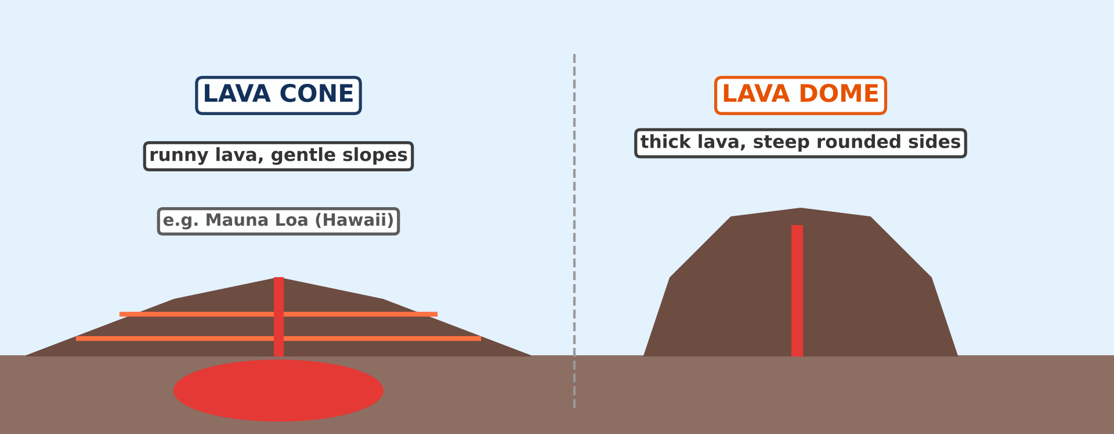
1. EXTRUSIVE FEATURES
Activity 1
A lava cone and a lava dome.
Notes:
Activity 1. Look carefully at this diagram: a lava cone and a lava dome. Observe every detail before I ask the question.

Slide 20
1. EXTRUSIVE FEATURES
Activity 1: Question
What kind of lava builds a broad cone with gentle slopes?
Notes:
Here is the question for Activity 1: What kind of lava builds a broad cone with gentle slopes? Take one minute to think and write your answer in your rough notebook.

Slide 21
1. EXTRUSIVE FEATURES
Activity 1: Answer
Runny lava.
Notes:
Let us check the answer together. Runny lava.

Slide 22
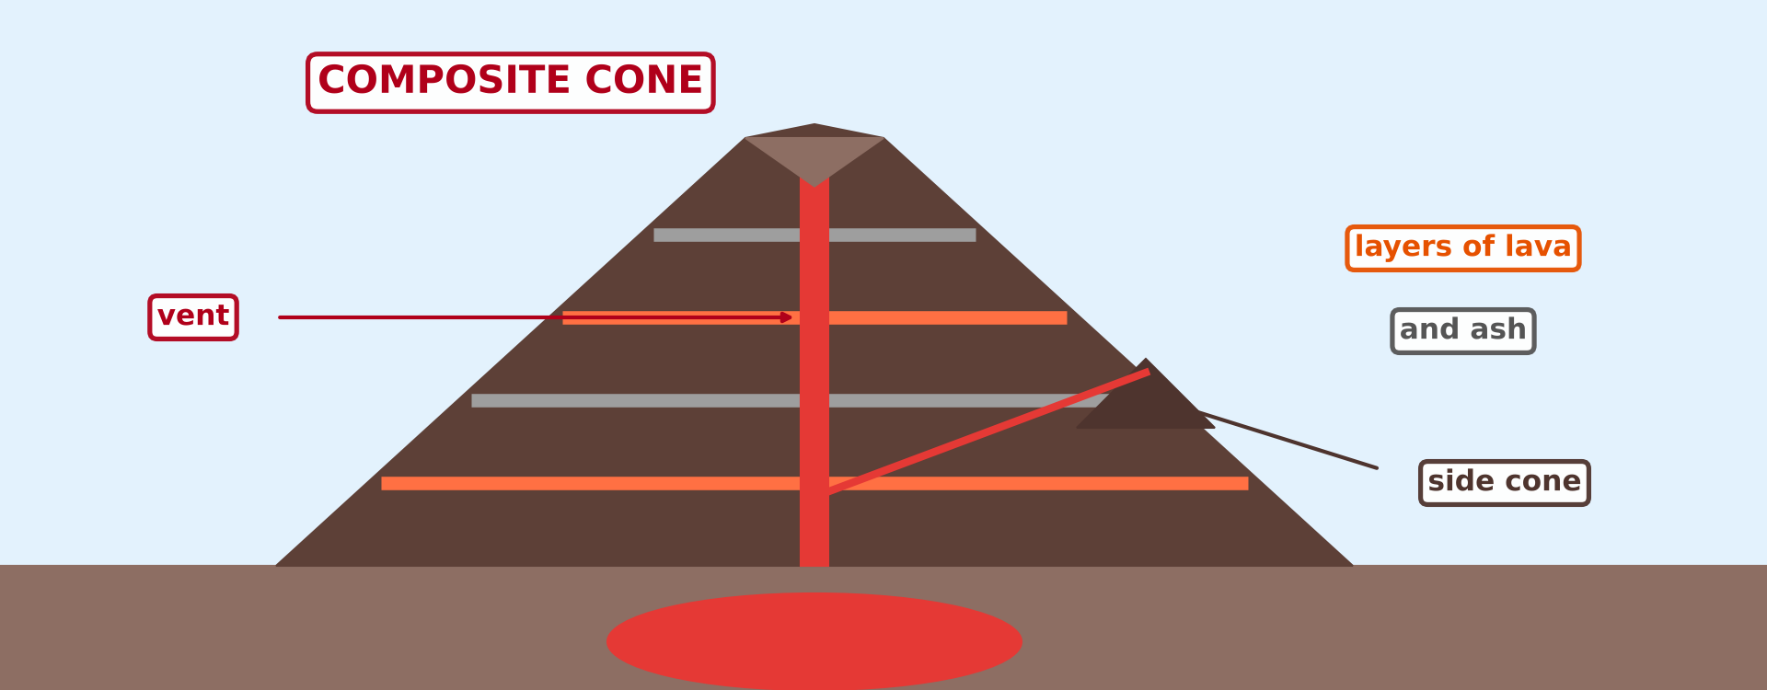
2. EXTRUSIVE FEATURES
Activity 2
A composite cone.
Notes:
Activity 2. Look carefully at this diagram: a composite cone. Observe every detail before I ask the question.

Slide 23
2. EXTRUSIVE FEATURES
Activity 2: Question
What is a composite cone made of?
Notes:
Here is the question for Activity 2: What is a composite cone made of? Take one minute to think and write your answer in your rough notebook.

Slide 24
2. EXTRUSIVE FEATURES
Activity 2: Answer
Alternate layers of lava and ash.
Notes:
Let us check the answer together. Alternate layers of lava and ash.

Slide 25
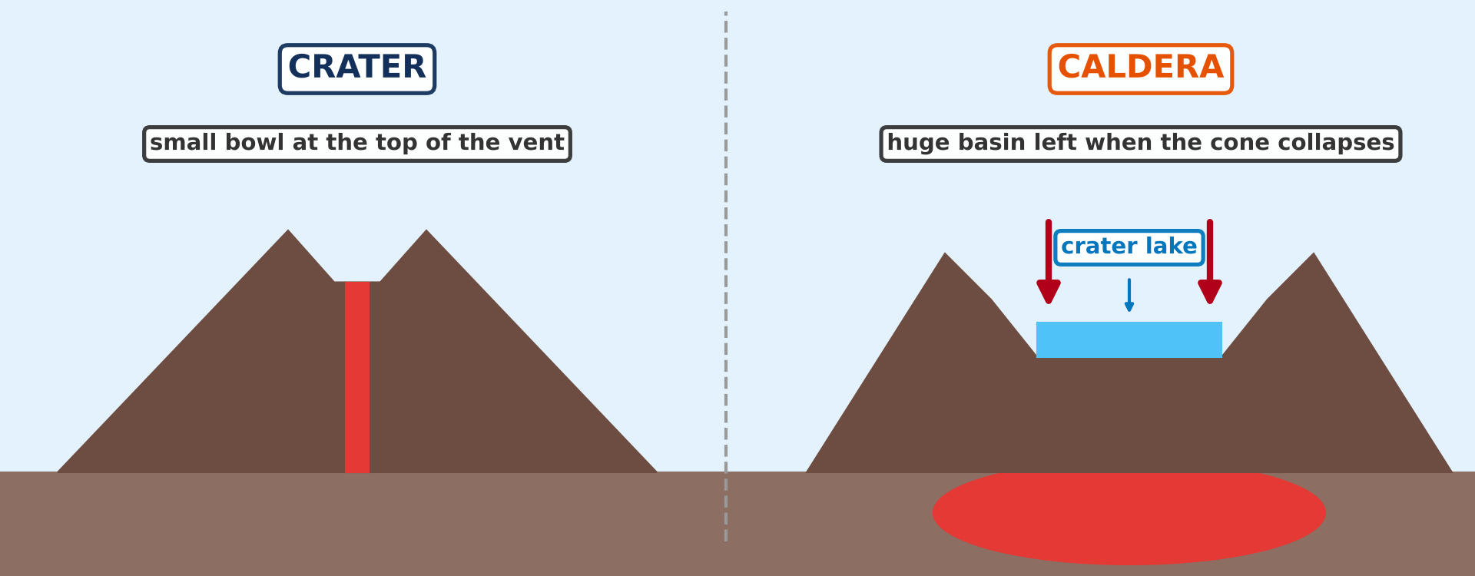
3. EXTRUSIVE FEATURES
Activity 3
A crater and a caldera.
Notes:
Activity 3. Look carefully at this diagram: a crater and a caldera. Observe every detail before I ask the question.

Slide 26
3. EXTRUSIVE FEATURES
Activity 3: Question
Which of the two is the huge basin?
Notes:
Here is the question for Activity 3: Which of the two is the huge basin? Take one minute to think and write your answer in your rough notebook.

Slide 27
3. EXTRUSIVE FEATURES
Activity 3: Answer
The caldera.
Notes:
Let us check the answer together. The caldera.

Slide 28
BOARD SUMMARY
Board Summary
Topic: The Structure of the Earth: Building Processes and Impacts on Man
Sub-topic: Volcanoes
Lesson 11 (Part 2): Extrusive Features of Volcanicity
Notes:
Now we are going to copy the board summary. Write the title and the headings neatly in your notebooks. I will give you enough time for each slide, so do not rush.

Slide 29
BOARD SUMMARY
DEFINITIONS
The key terms of this lesson are defined as follows:
Extrusive features: They are landforms made by lava, ash and gases that come out onto the surface.
Lava: It is magma that comes out onto the surface.
Notes:
Let us copy the definitions. The key terms of this lesson are defined as follows. On this slide we have Extrusive features and Lava. Write each point on a new line, with the key term first, and explain it in your own words when we revise. When you finish, we go to the next slide.

Slide 30
BOARD SUMMARY
DEFINITIONS (continued)
Crater: It is the round hollow at the top of the vent of a volcano.
Caldera: It is a very large basin left when the top of a volcano collapses.
Notes:
We continue with the definitions. On this slide we have Crater and Caldera. Write each point on a new line, with the key term first, and explain it in your own words when we revise.

Slide 31
BOARD SUMMARY
1. Extrusive Features
The main extrusive features are the following:
Lava cones: They are broad cones with gentle slopes built by runny lava, like Mauna Loa in Hawaii.
Notes:
Let us copy Extrusive Features. The main extrusive features are the following. Copy the point on Lava cones. The figure is on the next slide.

Slide 32
BOARD SUMMARY
1. Extrusive Features
Figure 1: Lava cones and lava domes
Notes:
Now draw Figure 1 in your notebook: lava cones and lava domes. Give it a title and label it clearly.

Slide 33
BOARD SUMMARY
1. Extrusive Features
Ash and cinder cones: They are small, steep cones of loose ash, many of them on the slopes of Mount Cameroon.
Notes:
Copy the point on Ash and cinder cones. The figure is on the next slide.

Slide 34
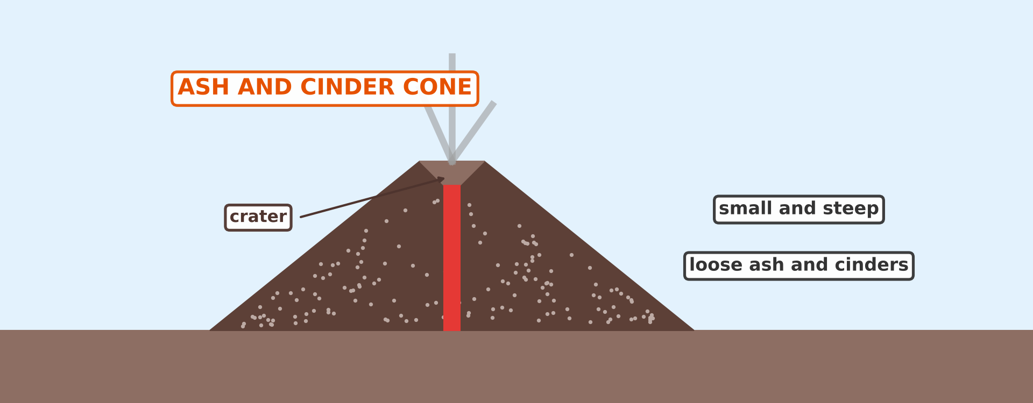
BOARD SUMMARY
1. Extrusive Features
Figure 2: An ash and cinder cone
Notes:
Now draw Figure 2 in your notebook: an ash and cinder cone. Give it a title and label it clearly.

Slide 35
BOARD SUMMARY
1. Extrusive Features
Composite cones: They are high cones of alternate layers of lava and ash, like Mount Cameroon and Mount Fuji.
Notes:
Copy the point on Composite cones. The figure is on the next slide.

Slide 36
BOARD SUMMARY
1. Extrusive Features
Figure 3: A composite cone
Notes:
Now draw Figure 3 in your notebook: a composite cone. Give it a title and label it clearly.

Slide 37
BOARD SUMMARY
1. Extrusive Features
Craters and calderas: A crater is a small hollow at the top of the vent, and a caldera is a huge basin, like those of Manengouba and Bambouto.
Notes:
Copy the point on Craters and calderas. The figure is on the next slide.

Slide 38
BOARD SUMMARY
1. Extrusive Features
Figure 4: A crater and a caldera
Notes:
Now draw Figure 4 in your notebook: a crater and a caldera. Give it a title and label it clearly.

Slide 39
BOARD SUMMARY
1. Extrusive Features
Volcanic mountains: They are large mountains built by many eruptions, like Mount Kilimanjaro.
Notes:
Copy the point on Volcanic mountains. The figure is on the next slide.

Slide 40
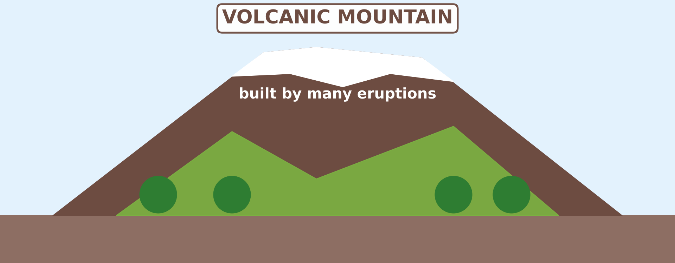
BOARD SUMMARY
1. Extrusive Features
Figure 5: A volcanic mountain
Notes:
Now draw Figure 5 in your notebook: a volcanic mountain. Give it a title and label it clearly.

Slide 41
BOARD SUMMARY
1. Extrusive Features
Lava plateaux: They are wide, flat highlands built by runny lava, like the Deccan Plateau in India.
Notes:
Copy the point on Lava plateaux. The figure is on the next slide.

Slide 42
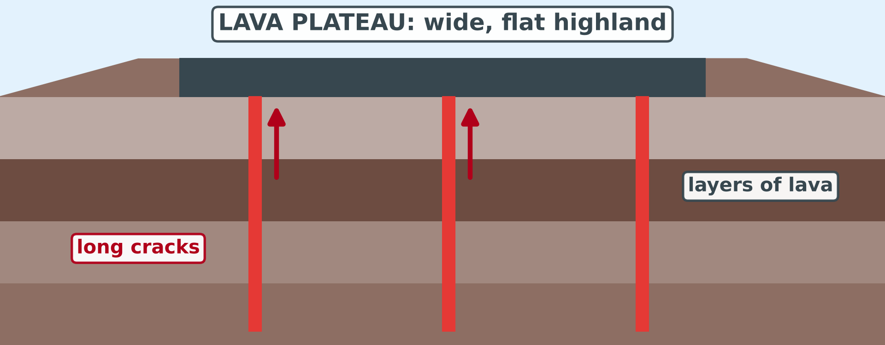
BOARD SUMMARY
1. Extrusive Features
Figure 6: A lava plateau
Notes:
Now draw Figure 6 in your notebook: a lava plateau. Give it a title and label it clearly.

Slide 43
FORMATIVE EVALUATION
Evaluation 1
What are extrusive features?
Notes:
Now let us check what you have understood. Question 1: What are extrusive features? Answer in your exercise book.

Slide 44
FORMATIVE EVALUATION
Expected Answer
They are landforms made by lava, ash and gases that come out onto the surface.
Notes:
The expected answer is: they are landforms made by lava, ash and gases that come out onto the surface. If you got it right, well done.

Slide 45
FORMATIVE EVALUATION
Evaluation 2
Name two extrusive features.
Notes:
Now let us check what you have understood. Question 2: Name two extrusive features. Answer in your exercise book.

Slide 46
FORMATIVE EVALUATION
Expected Answer
A lava cone and a composite cone (or an ash and cinder cone, a caldera).
Notes:
The expected answer is: a lava cone and a composite cone (or an ash and cinder cone, a caldera). If you got it right, well done.

Slide 47
FORMATIVE EVALUATION
Evaluation 3
Distinguish a crater from a caldera.
Notes:
Now let us check what you have understood. Question 3: Distinguish a crater from a caldera. Answer in your exercise book.

Slide 48
FORMATIVE EVALUATION
Expected Answer
A crater is a small hollow at the top of the vent; a caldera is a huge basin left when the volcano collapses.
Notes:
The expected answer is: a crater is a small hollow at the top of the vent; a caldera is a huge basin left when the volcano collapses. If you got it right, well done.

Slide 49
REMEDIATION
Remediation
Fill in the blanks:
Lava, ash and gases build ______ features on the surface.
A cone built of layers of lava and ash is a ______ cone.
Notes:
Take your time to copy this part; we will continue together.

Slide 50
REMEDIATION
Remediation (continued)
A huge basin left when a volcano collapses is a ______.
Notes:
For those who need more practice, fill in the blanks in your exercise book. The answers are: number 1, extrusive; number 2, composite; number 3, caldera.

Slide 51
HOMEWORK
Homework
Draw and label a crater and a caldera.
Notes:
For your homework: Draw and label a crater and a caldera. We shall correct it at the beginning of our next lesson.

Slide 52
NEXT LESSON
Next Lesson
Our next lesson will be on:
Lesson 11 (Part 3): Intrusive Features of Volcanicity
Notes:
Our next lesson will be on Lesson 11 (Part 3): Intrusive Features of Volcanicity. Thank you for your attention, and see you next time.

Slide 53
BILINGUAL GAME
Bilingual Game (Jeu Bilingue)
English | Français
Lava cone | Le cône de lave
Ash cone | Le cône de cendres
Composite cone | Le cône composite
Crater | Le cratère
Caldera | La caldeira
Crater lake | Le lac de cratère
Lava plateau | Le plateau de lave
Volcanic mountain | La montagne volcanique
Notes:
Let us play the bilingual game. I say a word in English, and you give me the French word. Then we do the reverse.

Slide 54
LOGBOOK
Official Logbook (1/2)
Module / Topic | The Structure of the Earth: Building Processes and Impacts on Man
Lesson Title | Lesson 11 (Part 2): Extrusive Features of Volcanicity
Expected Learning Outcomes | Define extrusive features. Name the main extrusive features. Recognise the extrusive features on diagrams and pictures.
Competence | Learners are able to name the extrusive features of volcanicity and to recognise them on pictures and diagrams.
Notes:
I record this information in the official logbook of the class after the lesson.

Slide 55
LOGBOOK
Official Logbook (2/2)
Matter Taught | DEFINITIONS; Extrusive Features.
Evaluation | Formative evaluation and remediation exercise.
Homework | Draw and label a crater and a caldera.
Enrolment / Present / Absent | ____ / ____ / ____
Achievement | To be completed after the lesson.
Notes:
I complete the second page of the logbook: the matter taught, the evaluation, the homework and the attendance.

Slide 56
TEACHER'S NOTE
Teacher's Note
Timing: Homework correction, plan, objectives 4 min | Recall, situation, action 6 min | 3 activities 12 min | Board summary (copying) 15 min | Evaluation, remediation 5 min | Homework, next lesson 3 min | Logbook 5 min
Old syllabus, Lesson 19: the extrusive features are cited and illustrated, not developed. Each feature has one sentence and one figure.
Without the projector (Activity 1): draw a broad cone and a steep dome on the board.
Without the projector (Activity 2): draw a cone with layers on the board.
Without the projector (Activity 3): draw a small crater and a big caldera on the board.
Notes:
This slide is for me, the teacher: it gives the timing of the lesson and what to do if the projector is not available.

Slide 57
REFERENCES
References
National Geography Syllabus (MINESEC), Form 3 — The Structure of the Earth: Building Processes and Impacts on Man.
Teacher's lesson notes (Form 3), checked and corrected where necessary.
Global Volcanism Program (Smithsonian): Mount Cameroon.
Old National Geography Syllabus (MINESEC/IGE/IP-SS), Form 3 — Lesson 19: Extrusive Features (used as an outline).
Diagrams and animations: drawn for this lesson (Geography Department).
Notes:
These are the references and picture credits used to prepare this lesson.

