Slide 1
FORM 3
GEOGRAPHY
Lesson 11 (Part 3)
Intrusive Features of Volcanicity
Notes:
Good morning, class, and welcome to our geography lesson. I am your geography teacher, Madam Che. Today we are starting Lesson 11 (Part 3): Intrusive Features of Volcanicity.

Slide 2
CLASS INFO
Class, Chapter and Duration
Class | Form 3
Chapter | The Structure of the Earth: Building Processes and Impacts on Man — Volcanoes
Duration | 50 minutes
Notes:
This lesson is for Form 3. It belongs to The Structure of the Earth: Building Processes and Impacts on Man — Volcanoes. We shall need 50 minutes to cover it.

Slide 3
IDENTIFICATION
Lesson Identification
Topic | The Structure of the Earth: Building Processes and Impacts on Man
Sub-topic | Volcanoes
Lesson | Lesson 11 (Part 3): Intrusive Features of Volcanicity
Notions / Concepts | Intrusive features, dyke, sill, laccolith, lopolith, phacolith, batholith, volcanic plug.
Syllabus focus | Intrusive features of volcanicity (illustration only): dyke, sill, laccolith, lopolith, phacolith, batholith and volcanic plug.
Competence | Learners are able to name the intrusive features and to recognise them on a diagram.
Notes:
Our topic is The Structure of the Earth: Building Processes and Impacts on Man, and the sub-topic is Volcanoes. The key notions we shall use today are: intrusive features, dyke, sill, laccolith, lopolith, phacolith, batholith, volcanic plug. At the end, you should be able to do this: learners are able to name the intrusive features and to recognise them on a diagram.

Slide 4

HOMEWORK CORRECTION
Correction of the Homework
Question (Lesson 11 (Part 2): Extrusive Features of Volcanicity):
Draw and label a crater and a caldera.
Notes:
Before we start the new lesson, let us correct the homework I gave you at the end of Lesson 11 (Part 2): Extrusive Features of Volcanicity. The question was: Draw and label a crater and a caldera. Take out your exercise books.

Slide 5
HOMEWORK CORRECTION
Correction: Possible Answer
A crater is a small bowl at the top of the vent. A caldera is a huge basin left when the volcano collapses.
Notes:
Here is a good answer. A crater is a small bowl at the top of the vent. A caldera is a huge basin left when the volcano collapses. Compare it with your own answer and correct your work in red.

Slide 6
LESSON PLAN
Lesson Plan
Correction of the homework
Objectives and recall
Real-life situation and action to take
Learning activities
Board summary
Evaluation, remediation and homework
Notes:
Here is the plan of our lesson today. First, we shall correct the homework. Then we shall look at the objectives and recall what you already know. After that, we shall study a situation from real life and the action to take, and do the learning activities. Finally, we shall copy the board summary, do the evaluation and the remediation, and I will give you the homework.

Slide 7
OBJECTIVES
Objectives
By the end of this lesson, you should be able to:
Define intrusive features.
Name the main intrusive features.
Recognise the intrusive features on a diagram.
Notes:
By the end of this lesson, you should be able to do three things. Number 1: define intrusive features. Number 2: name the main intrusive features. Number 3: recognise the intrusive features on a diagram.

Slide 8
PREVIOUS KNOWLEDGE
Previous Knowledge
Magma is molten rock under the ground.
Extrusive features are made by lava on the surface.
Erosion slowly removes the rocks at the surface.
Notes:
Let us first remember what you already know. Magma is molten rock under the ground. Extrusive features are made by lava on the surface. Erosion slowly removes the rocks at the surface. Keep this in mind, because we shall build on it today.

Slide 9
REAL-LIFE SITUATION
Situation in Real Life
On a school trip to the Far North, a group of pupils sees the tall rocky hills of Rhumsiki, which stand alone in the plain.
A guide explains that they are the hard cores of old volcanoes, and that the volcanoes themselves have disappeared.
Notes:
Take your time to copy this part; we will continue together.

Slide 10
REAL-LIFE SITUATION
Situation in Real Life (continued)
The pupils ask: "How can a volcano leave only a rock behind?"
Notes:
Listen carefully to this situation from real life. On a school trip to the Far North, a group of pupils sees the tall rocky hills of Rhumsiki, which stand alone in the plain. A guide explains that they are the hard cores of old volcanoes, and that the volcanoes themselves have disappeared. The pupils ask: "How can a volcano leave only a rock behind?" Think about it, because I am going to ask you some questions.

Slide 11
REAL-LIFE SITUATION
Situation: Question 1
What is the problem in the situation?
Notes:
Question 1: What is the problem in the situation? Think for a moment, then raise your hand to answer.

Slide 12
REAL-LIFE SITUATION
Answer
The pupils do not understand how an old volcano can leave only a rocky hill.
Notes:
Good. The pupils do not understand how an old volcano can leave only a rocky hill.

Slide 13
REAL-LIFE SITUATION
Situation: Question 2
What do the tall rocky hills of Rhumsiki stand in?
Notes:
Question 2: What do the tall rocky hills of Rhumsiki stand in? Think for a moment, then raise your hand to answer.

Slide 14
REAL-LIFE SITUATION
Answer
They stand alone in the plain.
Notes:
Good. They stand alone in the plain.

Slide 15
REAL-LIFE SITUATION
Situation: Question 3
What has disappeared, according to the guide?
Notes:
Question 3: What has disappeared, according to the guide? Think for a moment, then raise your hand to answer.

Slide 16
REAL-LIFE SITUATION
Possible Answer
The old volcanoes themselves.
Notes:
Good. The old volcanoes themselves.

Slide 17
ACTION TO TAKE
Action to Take
Recognise the intrusive features when we see rocky hills and walls of rock.
Notes:
From this situation, the action we are working towards in this lesson is the following: recognise the intrusive features when we see rocky hills and walls of rock.

Slide 18
JUSTIFICATION
Justification of the Lesson
This lesson helps us to recognise the features that magma makes inside the Earth's crust.
Notes:
Why is this lesson important for you? This lesson helps us to recognise the features that magma makes inside the Earth's crust.

Slide 19
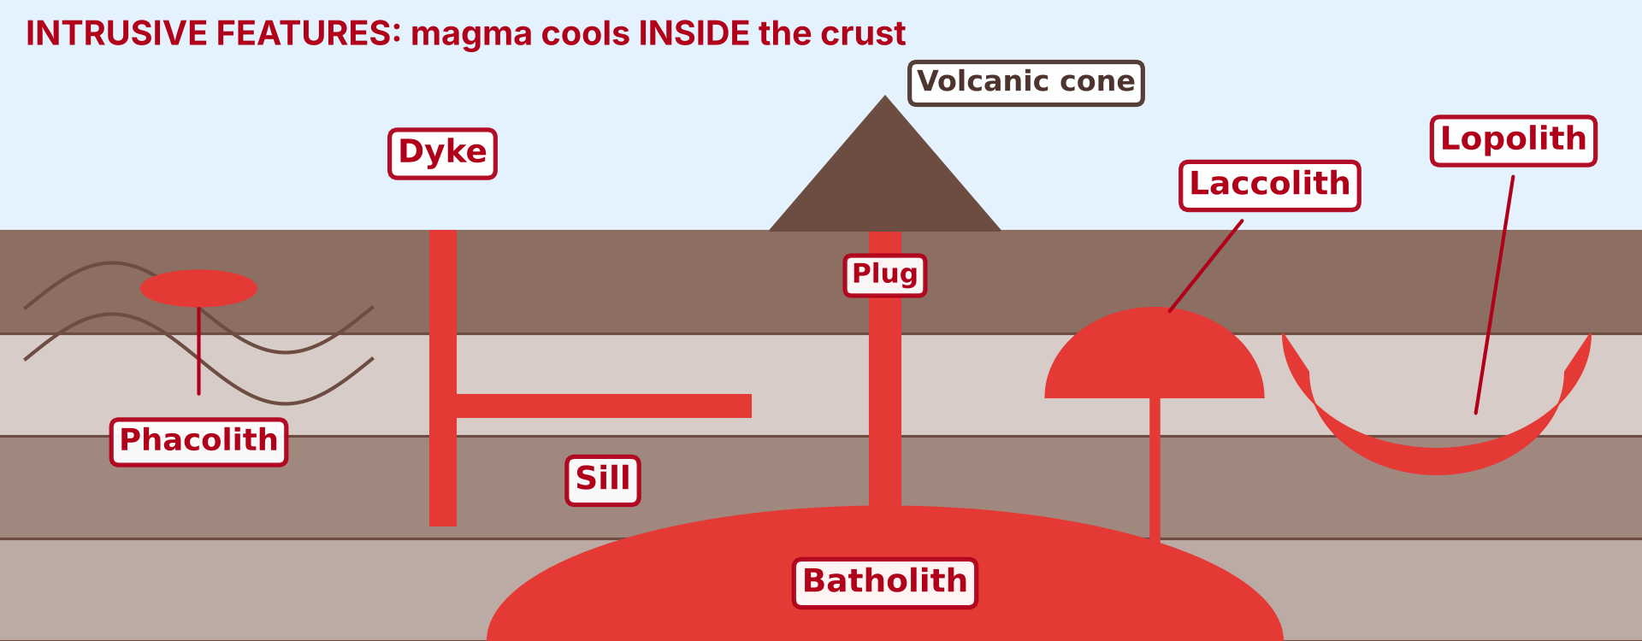
1. INTRUSIVE FEATURES
Activity 1
Intrusive features: magma cools inside the crust.
Notes:
Activity 1. Look carefully at this diagram: intrusive features: magma cools inside the crust. Observe every detail before I ask the question.

Slide 20
1. INTRUSIVE FEATURES
Activity 1: Question
Where does the magma cool to form intrusive features?
Notes:
Here is the question for Activity 1: Where does the magma cool to form intrusive features? Take one minute to think and write your answer in your rough notebook.

Slide 21
1. INTRUSIVE FEATURES
Activity 1: Answer
Inside the crust.
Notes:
Let us check the answer together. Inside the crust.

Slide 22
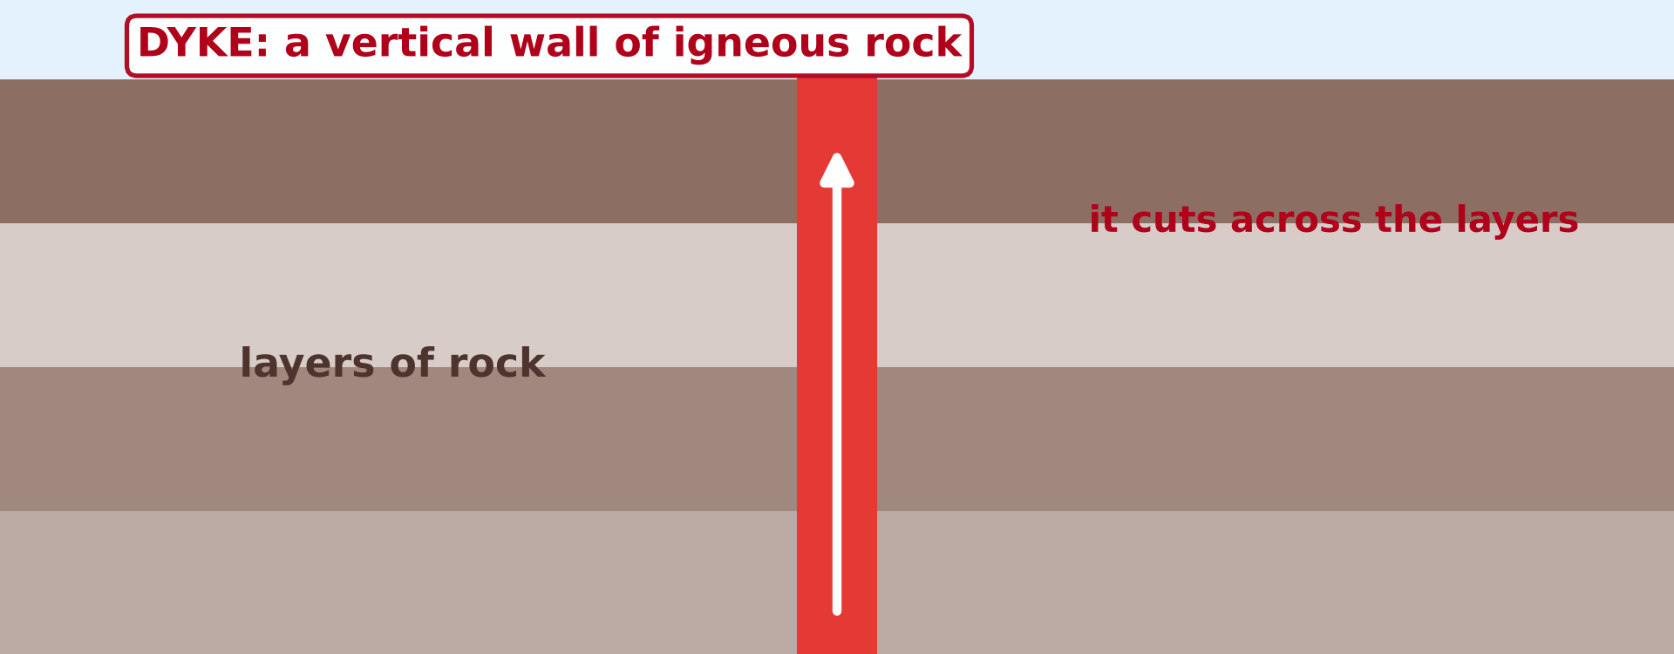
2. INTRUSIVE FEATURES
Activity 2
A dyke.
Notes:
Activity 2. Look carefully at this diagram: a dyke. Observe every detail before I ask the question.

Slide 23
2. INTRUSIVE FEATURES
Activity 2: Question
Is this wall of igneous rock vertical or horizontal?
Notes:
Here is the question for Activity 2: Is this wall of igneous rock vertical or horizontal? Take one minute to think and write your answer in your rough notebook.

Slide 24
2. INTRUSIVE FEATURES
Activity 2: Answer
Vertical: it is a dyke.
Notes:
Let us check the answer together. Vertical: it is a dyke.

Slide 25
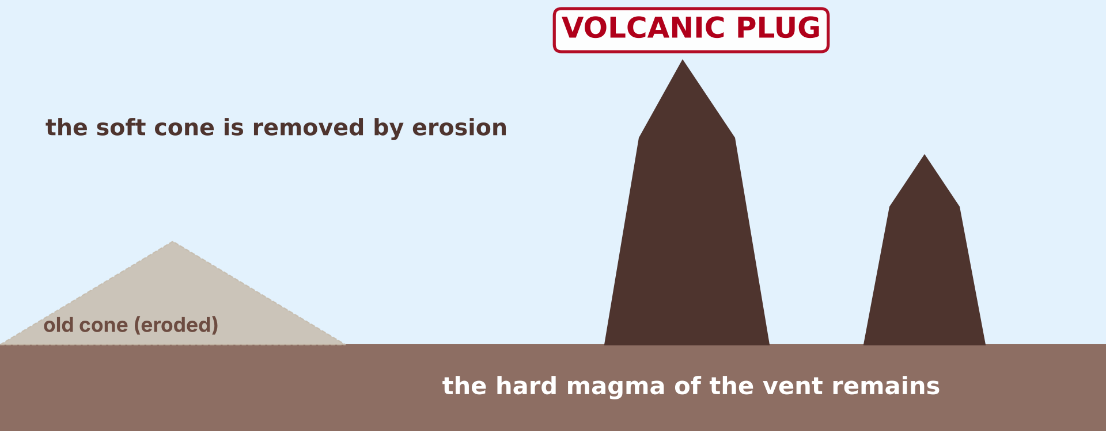
3. INTRUSIVE FEATURES
Activity 3
A volcanic plug.
Notes:
Activity 3. Look carefully at this diagram: a volcanic plug. Observe every detail before I ask the question.

Slide 26
3. INTRUSIVE FEATURES
Activity 3: Question
Why do the rocky hills of Rhumsiki stand alone in the plain?
Notes:
Here is the question for Activity 3: Why do the rocky hills of Rhumsiki stand alone in the plain? Take one minute to think and write your answer in your rough notebook.

Slide 27
3. INTRUSIVE FEATURES
Activity 3: Answer
They are hard volcanic plugs that remain after erosion removed the soft cone.
Notes:
Let us check the answer together. They are hard volcanic plugs that remain after erosion removed the soft cone.

Slide 28
BOARD SUMMARY
Board Summary
Topic: The Structure of the Earth: Building Processes and Impacts on Man
Sub-topic: Volcanoes
Lesson 11 (Part 3): Intrusive Features of Volcanicity
Notes:
Now we are going to copy the board summary. Write the title and the headings neatly in your notebooks. I will give you enough time for each slide, so do not rush.

Slide 29
BOARD SUMMARY
DEFINITIONS
The key terms of this lesson are defined as follows:
Intrusive features: They are landforms made by magma that cools inside the crust.
Igneous rock: It is a rock formed when magma or lava cools and hardens.
Notes:
Let us copy the definitions. The key terms of this lesson are defined as follows. On this slide we have Intrusive features and Igneous rock. Write each point on a new line, with the key term first, and explain it in your own words when we revise.

Slide 30
BOARD SUMMARY
1. Intrusive Features
The main intrusive features are the following:
Dyke: It is a vertical sheet of igneous rock that cuts across the layers of rock.
Notes:
Let us copy Intrusive Features. The main intrusive features are the following. Copy the point on Dyke. The figure is on the next slide.

Slide 31
BOARD SUMMARY
1. Intrusive Features
Figure 1: A dyke
Notes:
Now draw Figure 1 in your notebook: a dyke. Give it a title and label it clearly.

Slide 32
BOARD SUMMARY
1. Intrusive Features
Sill: It is a horizontal sheet of igneous rock between two layers of rock.
Laccolith: It is a dome-shaped mass of igneous rock that pushes up the layers above it.
Notes:
We continue with Intrusive Features. On this slide we have Sill and Laccolith. Write each point on a new line, with the key term first, and explain it in your own words when we revise. When you finish, we go to the next slide.

Slide 33
BOARD SUMMARY
1. Intrusive Features (continued)
Lopolith: It is a saucer-shaped mass of igneous rock that sinks into the layers below it.
Phacolith: It is a lens-shaped mass of igneous rock in the crest or the trough of a fold.
Notes:
We continue with Intrusive Features. On this slide we have Lopolith and Phacolith. Write each point on a new line, with the key term first, and explain it in your own words when we revise. When you finish, we go to the next slide.

Slide 34
BOARD SUMMARY
1. Intrusive Features (continued)
Batholith: It is a huge mass of igneous rock, often granite, deep in the crust.
Notes:
We continue with Intrusive Features. On this slide we have Batholith. Write each point on a new line, with the key term first, and explain it in your own words when we revise.

Slide 35
BOARD SUMMARY
1. Intrusive Features
Volcanic plug: It is the hard magma in the vent of an old volcano, like Rhumsiki in northern Cameroon.
Notes:
Copy the point on Volcanic plug. The figure is on the next slide.

Slide 36
BOARD SUMMARY
1. Intrusive Features
Figure 2: A volcanic plug
Notes:
Now draw Figure 2 in your notebook: a volcanic plug. Give it a title and label it clearly.

Slide 37
BOARD SUMMARY
1. Intrusive Features
Figure 3: Intrusive features
Notes:
Now draw Figure 3 in your notebook: intrusive features. Give it a title and label it clearly.

Slide 38
FORMATIVE EVALUATION
Evaluation 1
What are intrusive features?
Notes:
Now let us check what you have understood. Question 1: What are intrusive features? Answer in your exercise book.

Slide 39
FORMATIVE EVALUATION
Expected Answer
They are landforms made by magma that cools inside the crust.
Notes:
The expected answer is: they are landforms made by magma that cools inside the crust. If you got it right, well done.

Slide 40
FORMATIVE EVALUATION
Evaluation 2
Name two intrusive features.
Notes:
Now let us check what you have understood. Question 2: Name two intrusive features. Answer in your exercise book.

Slide 41
FORMATIVE EVALUATION
Expected Answer
A dyke and a sill (or a laccolith, a batholith, a volcanic plug).
Notes:
The expected answer is: a dyke and a sill (or a laccolith, a batholith, a volcanic plug). If you got it right, well done.

Slide 42
FORMATIVE EVALUATION
Evaluation 3
What is a dyke?
Notes:
Now let us check what you have understood. Question 3: What is a dyke? Answer in your exercise book.

Slide 43
FORMATIVE EVALUATION
Expected Answer
It is a vertical sheet of igneous rock that cuts across the layers of rock.
Notes:
The expected answer is: it is a vertical sheet of igneous rock that cuts across the layers of rock. If you got it right, well done.

Slide 44
REMEDIATION
Remediation
Fill in the blanks:
Intrusive features form when magma cools ______ the crust.
A vertical sheet of igneous rock is a ______.
Notes:
Take your time to copy this part; we will continue together.

Slide 45
REMEDIATION
Remediation (continued)
A horizontal sheet of igneous rock is a ______.
Notes:
For those who need more practice, fill in the blanks in your exercise book. The answers are: number 1, inside; number 2, dyke; number 3, sill.

Slide 46
HOMEWORK
Homework
Give one danger and one advantage of volcanoes.
Notes:
For your homework: Give one danger and one advantage of volcanoes. We shall correct it at the beginning of our next lesson.

Slide 47
NEXT LESSON
Next Lesson
Our next lesson will be on:
Lesson 12: The Impact of Volcanicity on Man
Notes:
Our next lesson will be on Lesson 12: The Impact of Volcanicity on Man. Thank you for your attention, and see you next time.

Slide 48
BILINGUAL GAME
Bilingual Game (Jeu Bilingue)
English | Français
Intrusive feature | La forme intrusive
Dyke | Le dyke
Sill | Le sill
Laccolith | Le laccolite
Batholith | Le batholite
Volcanic plug | Le culot volcanique
Granite | Le granite
Erosion | L'érosion
Notes:
Let us play the bilingual game. I say a word in English, and you give me the French word. Then we do the reverse.

Slide 49
LOGBOOK
Official Logbook (1/2)
Module / Topic | The Structure of the Earth: Building Processes and Impacts on Man
Lesson Title | Lesson 11 (Part 3): Intrusive Features of Volcanicity
Expected Learning Outcomes | Define intrusive features. Name the main intrusive features. Recognise the intrusive features on a diagram.
Competence | Learners are able to name the intrusive features and to recognise them on a diagram.
Notes:
I record this information in the official logbook of the class after the lesson.

Slide 50
LOGBOOK
Official Logbook (2/2)
Matter Taught | DEFINITIONS; Intrusive Features.
Evaluation | Formative evaluation and remediation exercise.
Homework | Give one danger and one advantage of volcanoes.
Enrolment / Present / Absent | ____ / ____ / ____
Achievement | To be completed after the lesson.
Notes:
I complete the second page of the logbook: the matter taught, the evaluation, the homework and the attendance.

Slide 51
TEACHER'S NOTE
Teacher's Note
Timing: Homework correction, plan, objectives 4 min | Recall, situation, action 6 min | 3 activities 12 min | Board summary (copying) 15 min | Evaluation, remediation 5 min | Homework, next lesson 3 min | Logbook 5 min
Old syllabus, Lesson 17: the intrusive features are given by illustration only (a generalised diagram), without explaining their formation. Each feature has one short sentence, to help the pupils to recognise it.
Without the projector (Activity 1): draw layers of rock with a vertical wall and a horizontal sheet.
Without the projector (Activity 2): describe a wall of rock that cuts across the layers.
Without the projector (Activity 3): describe the rocky hills of Rhumsiki.
Notes:
This slide is for me, the teacher: it gives the timing of the lesson and what to do if the projector is not available.

Slide 52
REFERENCES
References
National Geography Syllabus (MINESEC), Form 3 — The Structure of the Earth: Building Processes and Impacts on Man.
Teacher's lesson notes (Form 3), checked and corrected where necessary.
Global Volcanism Program (Smithsonian): Mount Cameroon.
Old National Geography Syllabus (MINESEC/IGE/IP-SS), Form 3 — Lesson 17: Intrusive Features (used as an outline).
Diagrams and animations: drawn for this lesson (Geography Department).
Notes:
These are the references and picture credits used to prepare this lesson.

