Slide 1
FORM 4
GEOGRAPHY
Lesson 9
The Theories of the Earth's Structure: Continental Drift
Notes:
Good morning, class, and welcome to our geography lesson. I am your geography teacher, Mr Kamdem. Today we are starting Lesson 9: The Theories of the Earth's Structure: Continental Drift.

Slide 2
CLASS INFO
Class, Chapter and Duration
Class | Form 4
Chapter | The Structure of the Earth: Building Processes and Impacts on Man — Structure of the Earth
Duration | 50 minutes
Notes:
This lesson is for Form 4. It belongs to The Structure of the Earth: Building Processes and Impacts on Man — Structure of the Earth. We shall need 50 minutes to cover it.

Slide 3
IDENTIFICATION
Lesson Identification
Topic | The Structure of the Earth: Building Processes and Impacts on Man
Sub-topic | Structure of the Earth
Lesson | Lesson 9: The Theories of the Earth's Structure: Continental Drift
Notions / Concepts | Continental drift, Pangaea, Laurasia, Gondwanaland.
Syllabus focus | Main idea; illustration of drifting; evidence.
Competence | Learners are able to explain, with map evidence, that the continents have moved, and to read the shape of the continents on a world map.
Notes:
Our topic is The Structure of the Earth: Building Processes and Impacts on Man, and the sub-topic is Structure of the Earth. The key notions we shall use today are: continental drift, Pangaea, Laurasia, Gondwanaland. At the end, you should be able to do this: learners are able to explain, with map evidence, that the continents have moved, and to read the shape of the continents on a world map.

Slide 4

HOMEWORK CORRECTION
Correction of the Homework
Question (Lesson 8: Rocks):
Look at a map of the world. Cut out, or trace, Africa and South America and try to fit their coasts together. Write what you notice.
Notes:
Before we start the new lesson, let us correct the homework I gave you at the end of Lesson 8: Rocks. The question was: Look at a map of the world. Cut out, or trace, Africa and South America and try to fit their coasts together. Write what you notice. Take out your exercise books.

Slide 5
HOMEWORK CORRECTION
Correction: Possible Answer
The east coast of South America fits into the west coast of Africa like pieces of a jigsaw puzzle: the two continents were once joined.
Notes:
Here is a good answer. The east coast of South America fits into the west coast of Africa like pieces of a jigsaw puzzle: the two continents were once joined. Compare it with your own answer and correct your work in red.

Slide 6
LESSON PLAN
Lesson Plan
Correction of the homework
Objectives and recall
Real-life situation and action to take
Learning activities
Board summary
Evaluation, remediation and homework
Notes:
Here is the plan of our lesson today. First, we shall correct the homework. Then we shall look at the objectives and recall what you already know. After that, we shall study a situation from real life and the action to take, and do the learning activities. Finally, we shall copy the board summary, do the evaluation and the remediation, and I will give you the homework.

Slide 7
OBJECTIVES
Objectives
By the end of this lesson, you should be able to:
State the main idea of the theory of continental drift.
Illustrate the drifting of the continents.
Notes:
Take your time to copy this part; we will continue together.

Slide 8
OBJECTIVES
Objectives (continued)
Explain the evidence for continental drift.
Notes:
By the end of this lesson, you should be able to do three things. Number 1: state the main idea of the theory of continental drift. Number 2: illustrate the drifting of the continents. Number 3: explain the evidence for continental drift.

Slide 9
PREVIOUS KNOWLEDGE
Previous Knowledge
The crust is broken and lies on the very hot mantle.
The mantle flows very slowly.
Fossils are found mainly in sedimentary rocks.
Notes:
Let us first remember what you already know. The crust is broken and lies on the very hot mantle. The mantle flows very slowly. Fossils are found mainly in sedimentary rocks. Keep this in mind, because we shall build on it today.

Slide 10
REAL-LIFE SITUATION
Situation in Real Life
Djibrilla looks at a world map. The coast of Africa and the coast of South America look like two pieces of a puzzle, although the Atlantic Ocean separates them. He asks: "Were these two continents once joined, and how could they move apart?"
Notes:
Listen carefully to this situation from real life. Djibrilla looks at a world map. The coast of Africa and the coast of South America look like two pieces of a puzzle, although the Atlantic Ocean separates them. He asks: "Were these two continents once joined, and how could they move apart?" Think about it, because I am going to ask you some questions.

Slide 11
REAL-LIFE SITUATION
Situation: Question 1
What is the problem in the situation?
Notes:
Question 1: What is the problem in the situation? Think for a moment, then raise your hand to answer.

Slide 12
REAL-LIFE SITUATION
Answer
Djibrilla wonders whether Africa and South America were once joined and how they moved apart.
Notes:
Good. Djibrilla wonders whether Africa and South America were once joined and how they moved apart.

Slide 13
REAL-LIFE SITUATION
Situation: Question 2
What does he notice?
Notes:
Question 2: What does he notice? Think for a moment, then raise your hand to answer.

Slide 14
REAL-LIFE SITUATION
Answer
The two coasts fit together like a puzzle.
Notes:
Good. The two coasts fit together like a puzzle.

Slide 15
REAL-LIFE SITUATION
Situation: Question 3
Who first explained this?
Notes:
Question 3: Who first explained this? Think for a moment, then raise your hand to answer.

Slide 16
REAL-LIFE SITUATION
Possible Answer
Alfred Wegener, in 1912.
Notes:
Good. Alfred Wegener, in 1912.

Slide 17
ACTION TO TAKE
Action to Take
Use maps and evidence to explain how the continents moved.
Notes:
From this situation, the action we are working towards in this lesson is the following: use maps and evidence to explain how the continents moved.

Slide 18
JUSTIFICATION
Justification of the Lesson
This lesson helps us to understand that the continents move.
Notes:
Why is this lesson important for you? This lesson helps us to understand that the continents move.

Slide 19

1. MAIN IDEA
Activity 1
Animation: closing the Atlantic Ocean.
Notes:
Activity 1. Look carefully at this animation: animation: closing the Atlantic Ocean. Watch the animation to the end; it will play again.

Slide 20
1. MAIN IDEA
Activity 1: Question
What happens when we bring South America near Africa?
Notes:
Here is the question for Activity 1: What happens when we bring South America near Africa? Take one minute to think and write your answer in your rough notebook.

Slide 21
1. MAIN IDEA
Activity 1: Answer
The two coasts fit together like pieces of a puzzle.
Notes:
Let us check the answer together. The two coasts fit together like pieces of a puzzle.

Slide 22
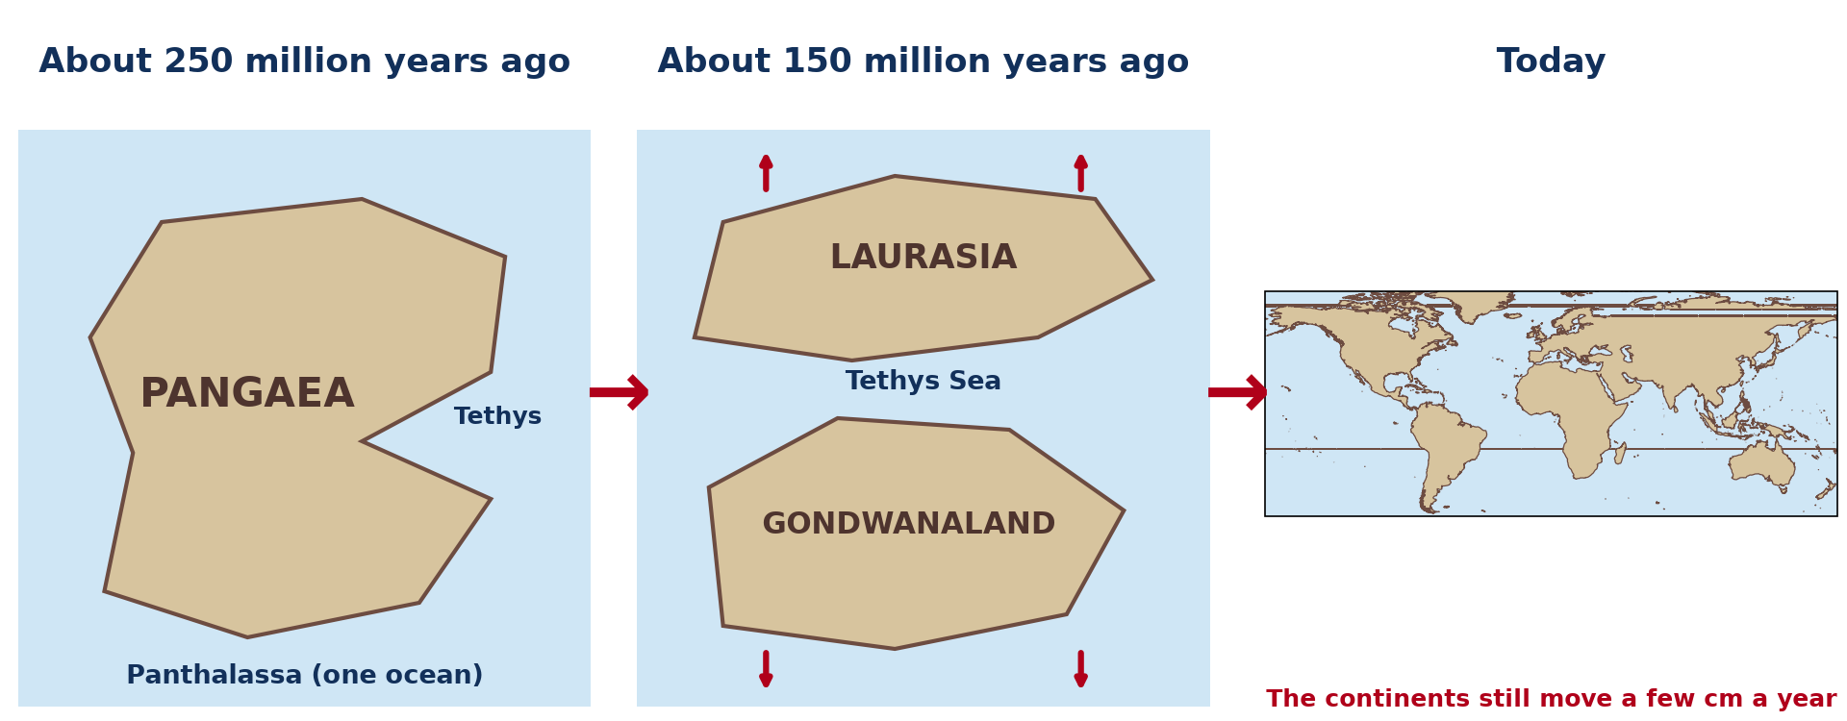
2. ILLUSTRATION OF DRIFTING
Activity 2
The break-up of Pangaea.
Notes:
Activity 2. Look carefully at this diagram: the break-up of Pangaea. Observe every detail before I ask the question.

Slide 23
2. ILLUSTRATION OF DRIFTING
Activity 2: Question 1
What was the name of the single continent of long ago?
Notes:
Here is the question for Activity 2: What was the name of the single continent of long ago? Take one minute to think and write your answer in your rough notebook.

Slide 24
2. ILLUSTRATION OF DRIFTING
Activity 2: Answer 1
Pangaea.
Notes:
Let us check the answer together. Pangaea.

Slide 25
2. ILLUSTRATION OF DRIFTING
Activity 2: Question 2
Into which two parts did it split first?
Notes:
Here is the next question: Into which two parts did it split first? Take one minute to think and write your answer in your rough notebook.

Slide 26
2. ILLUSTRATION OF DRIFTING
Activity 2: Answer 2
Laurasia in the north and Gondwanaland in the south.
Notes:
Let us check the answer together. Laurasia in the north and Gondwanaland in the south.

Slide 27
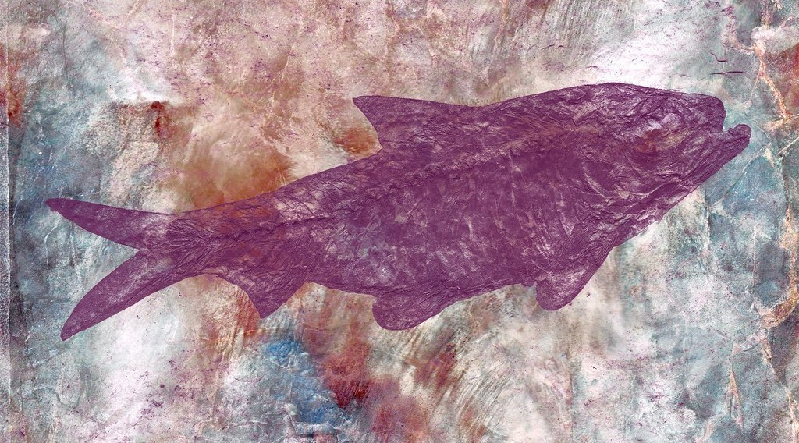
3. EVIDENCE
Activity 3
A fossil in rock.
Notes:
Activity 3. Look carefully at this picture: a fossil in rock. Observe every detail before I ask the question.

Slide 28
3. EVIDENCE
Activity 3: Question
Fossils of the same small reptile, Mesosaurus, are found in Brazil and in southern Africa. What does this prove?
Notes:
Here is the question for Activity 3: Fossils of the same small reptile, Mesosaurus, are found in Brazil and in southern Africa. What does this prove? Take one minute to think and write your answer in your rough notebook.

Slide 29
3. EVIDENCE
Activity 3: Answer
The two continents were once joined: this small animal could not swim across the ocean.
Notes:
Let us check the answer together. The two continents were once joined: this small animal could not swim across the ocean.

Slide 30
BOARD SUMMARY
Board Summary
Topic: The Structure of the Earth: Building Processes and Impacts on Man
Sub-topic: Structure of the Earth
Lesson 9: The Theories of the Earth's Structure: Continental Drift
Notes:
Now we are going to copy the board summary. Write the title and the headings neatly in your notebooks. I will give you enough time for each slide, so do not rush.

Slide 31
BOARD SUMMARY
DEFINITIONS
The key terms of this lesson are defined as follows:
Continental drift: It is the theory that the continents were once joined and have slowly moved apart.
Pangaea: It is the single super-continent that existed about 250 million years ago.
Notes:
Let us copy the definitions. The key terms of this lesson are defined as follows. On this slide we have Continental drift and Pangaea. Write each point on a new line, with the key term first, and explain it in your own words when we revise. When you finish, we go to the next slide.

Slide 32
BOARD SUMMARY
DEFINITIONS (continued)
Panthalassa: It is the single ocean that surrounded Pangaea.
Notes:
We continue with the definitions. On this slide we have Panthalassa. Write each point on a new line, with the key term first, and explain it in your own words when we revise.

Slide 33
BOARD SUMMARY
1. Main Idea of the Theory
The main idea of the theory of continental drift is the following:
Author: The theory was proposed by the German scientist Alfred Wegener in 1912.
One super-continent: All the continents once formed one big land mass, Pangaea, surrounded by one ocean, Panthalassa.
Notes:
Let us copy Main Idea of the Theory. The main idea of the theory of continental drift is the following. On this slide we have Author and One super-continent. Write each point on a new line, with the key term first, and explain it in your own words when we revise. When you finish, we go to the next slide.

Slide 34
BOARD SUMMARY
1. Main Idea of the Theory (continued)
Slow drifting: Pangaea broke up, and its pieces slowly drifted to their present positions.
Notes:
We continue with Main Idea of the Theory. On this slide we have Slow drifting. Write each point on a new line, with the key term first, and explain it in your own words when we revise.

Slide 35
BOARD SUMMARY
2. Illustration of Drifting
The continents drifted in the following stages:
About 250 million years ago: All the land formed one continent, Pangaea.
Illustration: the break-up of Pangaea
Notes:
Let us copy Illustration of Drifting. The continents drifted in the following stages. Copy the point on About 250 million years ago on the left, then draw the diagram on the right: the break-up of Pangaea. Give it a title and label it clearly.

Slide 36
BOARD SUMMARY
2. Illustration of Drifting
About 200 to 150 million years ago: Pangaea split into Laurasia in the north and Gondwanaland in the south, separated by the Tethys Sea.
Notes:
We continue with Illustration of Drifting. On this slide we have About 200 to 150 million years ago. Write each point on a new line, with the key term first, and explain it in your own words when we revise. When you finish, we go to the next slide.

Slide 37
BOARD SUMMARY
2. Illustration of Drifting (continued)
Later: Laurasia gave North America, Europe and Asia, while Gondwanaland gave South America, Africa, India, Australia and Antarctica.
Today: The continents still move a few centimetres each year.
Notes:
We continue with Illustration of Drifting. On this slide we have Later and Today. Write each point on a new line, with the key term first, and explain it in your own words when we revise.

Slide 38
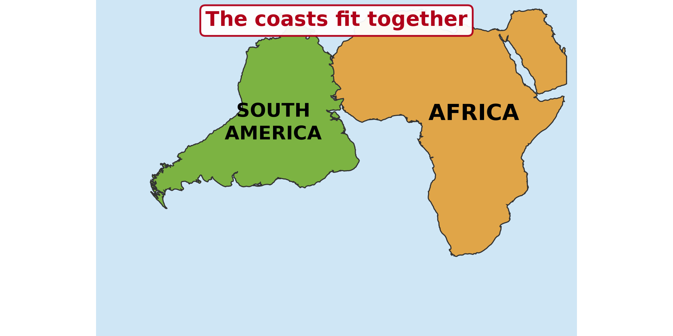
BOARD SUMMARY
3. Evidence of Continental Drift
The following evidence supports the theory:
Jigsaw fit: The coasts of Africa and South America fit together like a puzzle.
Illustration: the jigsaw fit of the continents
Notes:
Let us copy Evidence of Continental Drift. The following evidence supports the theory. Copy the point on Jigsaw fit on the left, then draw the diagram on the right: the jigsaw fit of the continents. Give it a title and label it clearly.

Slide 39
BOARD SUMMARY
3. Evidence of Continental Drift
Fossils: The same fossils of plants and animals, such as Mesosaurus, are found on continents now separated by oceans.
Illustration: a fossil
Notes:
Copy the point on Fossils on the left, then draw the diagram on the right: a fossil. Give it a title and label it clearly.

Slide 40
BOARD SUMMARY
3. Evidence of Continental Drift
Rocks and mountains: The same types and ages of rocks and mountain chains continue from one continent to another.
Ancient ice marks: Marks of old glaciers are found in hot lands such as Africa, India and Australia.
Notes:
We continue with Evidence of Continental Drift. On this slide we have Rocks and mountains and Ancient ice marks. Write each point on a new line, with the key term first, and explain it in your own words when we revise. When you finish, we go to the next slide.

Slide 41
BOARD SUMMARY
3. Evidence of Continental Drift (continued)
Coal in cold lands: Coal, formed from tropical forests, is found in Antarctica.
Notes:
We continue with Evidence of Continental Drift. On this slide we have Coal in cold lands. Write each point on a new line, with the key term first, and explain it in your own words when we revise.

Slide 42
FORMATIVE EVALUATION
Evaluation 1
What is Pangaea?
Notes:
Now let us check what you have understood. Question 1: What is Pangaea? Answer in your exercise book.

Slide 43
FORMATIVE EVALUATION
Expected Answer
The single big continent of long ago.
Notes:
The expected answer is: the single big continent of long ago. If you got it right, well done.

Slide 44
FORMATIVE EVALUATION
Evaluation 2
Give two pieces of evidence for continental drift.
Notes:
Now let us check what you have understood. Question 2: Give two pieces of evidence for continental drift. Answer in your exercise book.

Slide 45
FORMATIVE EVALUATION
Expected Answer
The jigsaw fit and the same fossils on both continents.
Notes:
The expected answer is: the jigsaw fit and the same fossils on both continents. If you got it right, well done.

Slide 46
REMEDIATION
Remediation
Fill in the blanks:
The theory of continental drift was given by ______.
The single big continent was called ______.
Notes:
Take your time to copy this part; we will continue together.

Slide 47
REMEDIATION
Remediation (continued)
Africa and South America fit like a ______.
Notes:
For those who need more practice, fill in the blanks in your exercise book. The answers are: number 1, Wegener; number 2, Pangaea; number 3, puzzle (jigsaw).

Slide 48
HOMEWORK
Homework
Listen to the news or ask an adult about a recent earthquake or volcanic eruption in the world. Write the name of the country and what happened.
Notes:
For your homework: Listen to the news or ask an adult about a recent earthquake or volcanic eruption in the world. Write the name of the country and what happened. We shall correct it at the beginning of our next lesson.

Slide 49
NEXT LESSON
Next Lesson
Our next lesson will be on:
Lesson 10: Plate Tectonics
Notes:
Our next lesson will be on Lesson 10: Plate Tectonics. Thank you for your attention, and see you next time.

Slide 50
BILINGUAL GAME
Bilingual Game (Jeu Bilingue)
English | Français
Continental drift | La dérive des continents
Continent | Le continent
Evidence | La preuve
Fossil | Le fossile
Coast | La côte
Ice sheet | L'inlandsis / la calotte glaciaire
Puzzle | Le puzzle
To move apart | S'éloigner
Notes:
Let us play the bilingual game. I say a word in English, and you give me the French word. Then we do the reverse.

Slide 51
LOGBOOK
Official Logbook (1/2)
Module / Topic | The Structure of the Earth: Building Processes and Impacts on Man
Lesson Title | Lesson 9: The Theories of the Earth's Structure: Continental Drift
Expected Learning Outcomes | State the main idea of the theory of continental drift. Illustrate the drifting of the continents. Explain the evidence for continental drift.
Competence | Learners are able to explain, with map evidence, that the continents have moved, and to read the shape of the continents on a world map.
Notes:
I record this information in the official logbook of the class after the lesson.

Slide 52
LOGBOOK
Official Logbook (2/2)
Matter Taught | DEFINITIONS; Main Idea of the Theory; Illustration of Drifting; Evidence of Continental Drift.
Evaluation | Formative evaluation and remediation exercise.
Homework | Listen to the news or ask an adult about a recent earthquake or volcanic eruption in the world. Write the name of the country and what happened.
Enrolment / Present / Absent | ____ / ____ / ____
Achievement | To be completed after the lesson.
Notes:
I complete the second page of the logbook: the matter taught, the evaluation, the homework and the attendance.

Slide 53
TEACHER'S NOTE
Teacher's Note
Timing: Homework correction, plan, objectives 4 min | Recall, situation, action 6 min | 3 activities 12 min | Board summary (copying) 15 min | Evaluation, remediation 5 min | Homework, next lesson 3 min | Logbook 5 min
Activity 1 is an animation (GIF): it plays automatically in slide-show mode.
Without the projector (Activity 1): cut a paper map of the two continents and fit them.
Without the projector (Activity 2): draw the three stages on the board.
Without the projector (Activity 3): explain that Mesosaurus lived in fresh water.
Notes:
This slide is for me, the teacher: it gives the timing of the lesson and what to do if the projector is not available.

Slide 54
REFERENCES
References
National Geography Syllabus (MINESEC), Form 4 — The Structure of the Earth: Building Processes and Impacts on Man.
Teacher's lesson notes (Form 4), checked and corrected where necessary.
Photo, Activity 3: “Marble Skin Fish Fossil” by Bold Frontiers, CC BY 2.0, via Flickr (https://www.flickr.com/photos/82955120@N05/14091612527)
Diagrams and animations: drawn for this lesson (Geography Department).
Notes:
These are the references and picture credits used to prepare this lesson.

