Slide 1
FORM 4
GEOGRAPHY
Lesson 10
Plate Tectonics
Notes:
Good morning, class, and welcome to our geography lesson. I am your geography teacher, Mr Kamdem. Today we are starting Lesson 10: Plate Tectonics.

Slide 2
CLASS INFO
Class, Chapter and Duration
Class | Form 4
Chapter | The Structure of the Earth: Building Processes and Impacts on Man — Structure of the Earth
Duration | 50 minutes
Notes:
This lesson is for Form 4. It belongs to The Structure of the Earth: Building Processes and Impacts on Man — Structure of the Earth. We shall need 50 minutes to cover it.

Slide 3
IDENTIFICATION
Lesson Identification
Topic | The Structure of the Earth: Building Processes and Impacts on Man
Sub-topic | Structure of the Earth
Lesson | Lesson 10: Plate Tectonics
Notions / Concepts | Plate tectonics, plates, plate margins.
Syllabus focus | Definition; main ideas (geometric and kinetic); plates and plate margins and main landforms.
Competence | Learners are able to explain why earthquakes and volcanoes happen in some regions of the world, using a map of plates.
Notes:
Our topic is The Structure of the Earth: Building Processes and Impacts on Man, and the sub-topic is Structure of the Earth. The key notions we shall use today are: plate tectonics, plates, plate margins. At the end, you should be able to do this: learners are able to explain why earthquakes and volcanoes happen in some regions of the world, using a map of plates.

Slide 4

HOMEWORK CORRECTION
Correction of the Homework
Question (Lesson 9: The Theories of the Earth's Structure: Continental Drift):
Listen to the news or ask an adult about a recent earthquake or volcanic eruption in the world. Write the name of the country and what happened.
Notes:
Before we start the new lesson, let us correct the homework I gave you at the end of Lesson 9: The Theories of the Earth's Structure: Continental Drift. The question was: Listen to the news or ask an adult about a recent earthquake or volcanic eruption in the world. Write the name of the country and what happened. Take out your exercise books.

Slide 5
HOMEWORK CORRECTION
Correction: Possible Answer
Answers vary. Example: an earthquake in Turkey in 2023 destroyed many buildings and killed thousands of people.
Notes:
Here is a good answer. Answers vary. Example: an earthquake in Turkey in 2023 destroyed many buildings and killed thousands of people. Compare it with your own answer and correct your work in red.

Slide 6
LESSON PLAN
Lesson Plan
Correction of the homework
Objectives and recall
Real-life situation and action to take
Learning activities
Board summary
Evaluation, remediation and homework
Notes:
Here is the plan of our lesson today. First, we shall correct the homework. Then we shall look at the objectives and recall what you already know. After that, we shall study a situation from real life and the action to take, and do the learning activities. Finally, we shall copy the board summary, do the evaluation and the remediation, and I will give you the homework.

Slide 7
OBJECTIVES
Objectives
By the end of this lesson, you should be able to:
Define plate tectonics.
Explain the geometric and kinetic ideas of the theory.
Notes:
Take your time to copy this part; we will continue together.

Slide 8
OBJECTIVES
Objectives (continued)
Describe the plates, the plate margins and their main landforms.
Notes:
By the end of this lesson, you should be able to do three things. Number 1: define plate tectonics. Number 2: explain the geometric and kinetic ideas of the theory. Number 3: describe the plates, the plate margins and their main landforms.

Slide 9
PREVIOUS KNOWLEDGE
Previous Knowledge
The continents were once joined in Pangaea.
The mantle is very hot rock that flows slowly.
Wegener could not explain what moves the continents.
Notes:
Let us first remember what you already know. The continents were once joined in Pangaea. The mantle is very hot rock that flows slowly. Wegener could not explain what moves the continents. Keep this in mind, because we shall build on it today.

Slide 10
REAL-LIFE SITUATION
Situation in Real Life
On television, Mariam sees an earthquake in Japan and a volcano in Italy, while the ground in Garoua feels safe. She knows that Mount Cameroon is also an active volcano. She asks: "Why do earthquakes and volcanoes happen in some places and not in others?"
Notes:
Listen carefully to this situation from real life. On television, Mariam sees an earthquake in Japan and a volcano in Italy, while the ground in Garoua feels safe. She knows that Mount Cameroon is also an active volcano. She asks: "Why do earthquakes and volcanoes happen in some places and not in others?" Think about it, because I am going to ask you some questions.

Slide 11
REAL-LIFE SITUATION
Situation: Question 1
What is the problem in the situation?
Notes:
Question 1: What is the problem in the situation? Think for a moment, then raise your hand to answer.

Slide 12
REAL-LIFE SITUATION
Answer
Mariam does not know why earthquakes and volcanoes happen only in some places.
Notes:
Good. Mariam does not know why earthquakes and volcanoes happen only in some places.

Slide 13
REAL-LIFE SITUATION
Situation: Question 2
Name one active volcano in Cameroon.
Notes:
Question 2: Name one active volcano in Cameroon. Think for a moment, then raise your hand to answer.

Slide 14
REAL-LIFE SITUATION
Answer
Mount Cameroon.
Notes:
Good. Mount Cameroon.

Slide 15
REAL-LIFE SITUATION
Situation: Question 3
Where do most earthquakes and volcanoes happen?
Notes:
Question 3: Where do most earthquakes and volcanoes happen? Think for a moment, then raise your hand to answer.

Slide 16
REAL-LIFE SITUATION
Possible Answer
At the edges of the plates.
Notes:
Good. At the edges of the plates.

Slide 17
ACTION TO TAKE
Action to Take
Use the theory of plate tectonics to explain earthquakes and volcanoes.
Notes:
From this situation, the action we are working towards in this lesson is the following: use the theory of plate tectonics to explain earthquakes and volcanoes.

Slide 18
JUSTIFICATION
Justification of the Lesson
This lesson helps us to know the plates of the Earth and how they move.
Notes:
Why is this lesson important for you? This lesson helps us to know the plates of the Earth and how they move.

Slide 19

1. MAIN IDEAS
Activity 1
The main plates of the Earth.
Notes:
Activity 1. Look carefully at this diagram: the main plates of the Earth. Observe every detail before I ask the question.

Slide 20
1. MAIN IDEAS
Activity 1: Question
On which plate is Cameroon?
Notes:
Here is the question for Activity 1: On which plate is Cameroon? Take one minute to think and write your answer in your rough notebook.

Slide 21
1. MAIN IDEAS
Activity 1: Answer
On the African Plate.
Notes:
Let us check the answer together. On the African Plate.

Slide 22
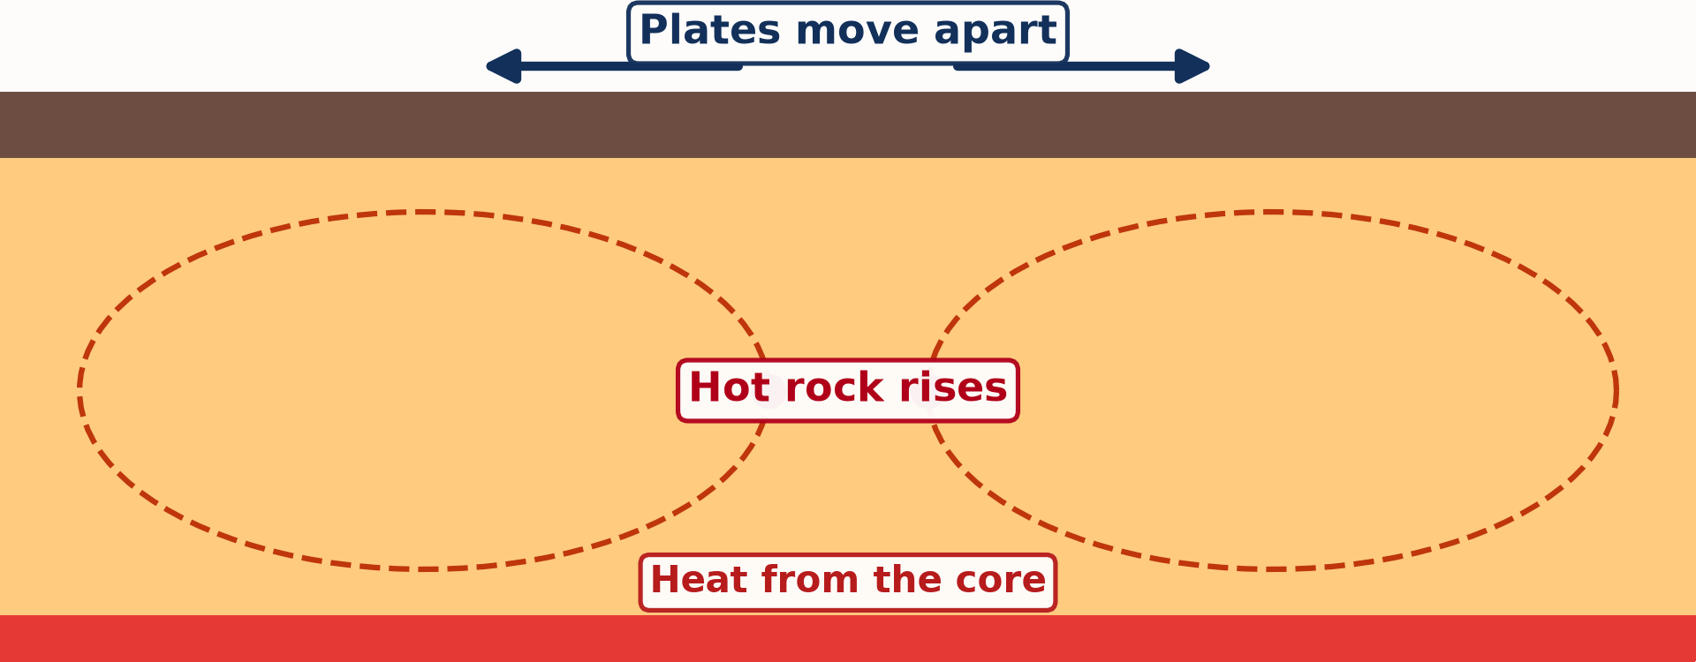
1. MAIN IDEAS
Activity 2
Animation: convection currents in the mantle.
Notes:
Activity 2. Look carefully at this animation: animation: convection currents in the mantle. Watch the animation to the end; it will play again.

Slide 23
1. MAIN IDEAS
Activity 2: Question
What makes the plates move?
Notes:
Here is the question for Activity 2: What makes the plates move? Take one minute to think and write your answer in your rough notebook.

Slide 24
1. MAIN IDEAS
Activity 2: Answer
Convection currents in the hot mantle.
Notes:
Let us check the answer together. Convection currents in the hot mantle.

Slide 25

3. PLATE MARGINS AND LANDFORMS
Activity 3
Animation: plates move apart (left) and together (right).
Notes:
Activity 3. Look carefully at this animation: animation: plates move apart (left) and together (right). Watch the animation to the end; it will play again.

Slide 26
3. PLATE MARGINS AND LANDFORMS
Activity 3: Question 1
What rises when two plates move apart?
Notes:
Here is the question for Activity 3: What rises when two plates move apart? Take one minute to think and write your answer in your rough notebook.

Slide 27
3. PLATE MARGINS AND LANDFORMS
Activity 3: Answer 1
Magma rises and forms new crust.
Notes:
Let us check the answer together. Magma rises and forms new crust.

Slide 28
3. PLATE MARGINS AND LANDFORMS
Activity 3: Question 2
What happens to one plate when two plates move together?
Notes:
Here is the next question: What happens to one plate when two plates move together? Take one minute to think and write your answer in your rough notebook.

Slide 29
3. PLATE MARGINS AND LANDFORMS
Activity 3: Answer 2
It sinks under the other plate.
Notes:
Let us check the answer together. It sinks under the other plate.

Slide 30
BOARD SUMMARY
Board Summary
Topic: The Structure of the Earth: Building Processes and Impacts on Man
Sub-topic: Structure of the Earth
Lesson 10: Plate Tectonics
Notes:
Now we are going to copy the board summary. Write the title and the headings neatly in your notebooks. I will give you enough time for each slide, so do not rush.

Slide 31
BOARD SUMMARY
DEFINITIONS
The key terms of this lesson are defined as follows:
Plate tectonics: It is the theory that the outer shell of the Earth is broken into rigid plates that move slowly.
Plate: It is a large, rigid piece of the crust and the upper mantle.
Notes:
Let us copy the definitions. The key terms of this lesson are defined as follows. On this slide we have Plate tectonics and Plate. Write each point on a new line, with the key term first, and explain it in your own words when we revise. When you finish, we go to the next slide.

Slide 32
BOARD SUMMARY
DEFINITIONS (continued)
Plate margin: It is the edge where two plates meet.
Notes:
We continue with the definitions. On this slide we have Plate margin. Write each point on a new line, with the key term first, and explain it in your own words when we revise.

Slide 33
BOARD SUMMARY
1. Main Ideas of the Theory
The theory of plate tectonics has two main ideas:
The geometric idea: The outer shell of the Earth is divided into seven major plates and many smaller ones that fit together like a puzzle.
Illustration: the major plates
Notes:
Let us copy Main Ideas of the Theory. The theory of plate tectonics has two main ideas. Copy the point on The geometric idea on the left, then draw the diagram on the right: the major plates. Give it a title and label it clearly.

Slide 34
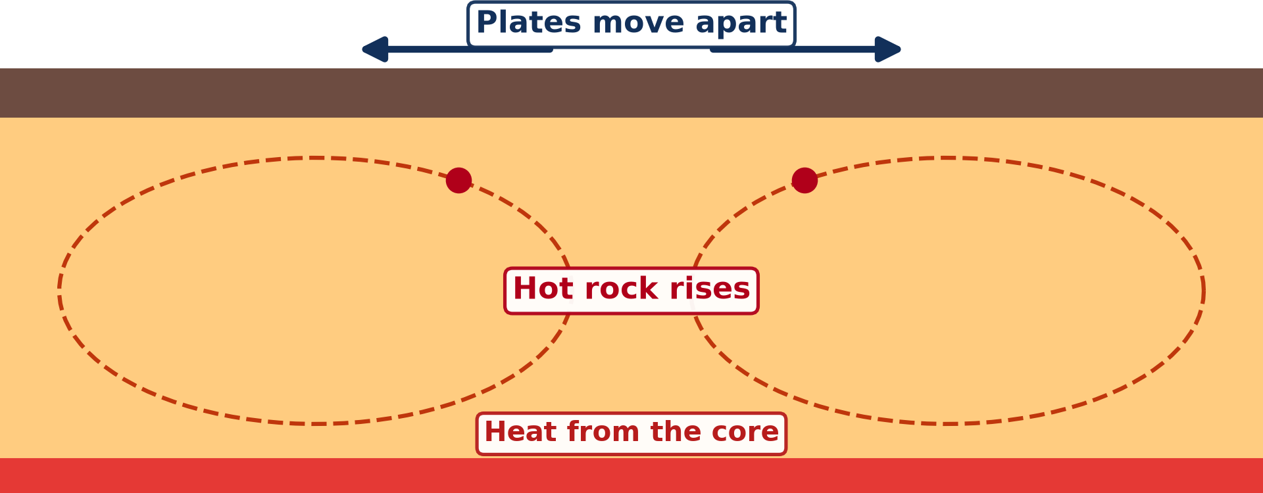
BOARD SUMMARY
1. Main Ideas of the Theory
The kinetic idea: The plates move 2 to 10 centimetres a year, pushed by convection currents in the mantle.
Illustration: convection currents in the mantle
Notes:
Copy the point on The kinetic idea on the left, then draw the diagram on the right: convection currents in the mantle. Give it a title and label it clearly.

Slide 35
BOARD SUMMARY
2. The Plates
The major plates of the Earth are the following:
The African Plate: It carries Africa, including Cameroon.
The Eurasian Plate: It carries Europe and most of Asia.
Notes:
Let us copy The Plates. The major plates of the Earth are the following. On this slide we have The African Plate and The Eurasian Plate. Write each point on a new line, with the key term first, and explain it in your own words when we revise. When you finish, we go to the next slide.

Slide 36
BOARD SUMMARY
2. The Plates (continued)
The American Plates: The North American and South American Plates carry the Americas.
The Pacific Plate: It is the largest plate and lies under the Pacific Ocean.
The Indo-Australian and Antarctic Plates: They carry India, Australia and Antarctica.
Notes:
We continue with The Plates. On this slide we have The American Plates, The Pacific Plate and The Indo-Australian and Antarctic Plates. Write each point on a new line, with the key term first, and explain it in your own words when we revise.

Slide 37
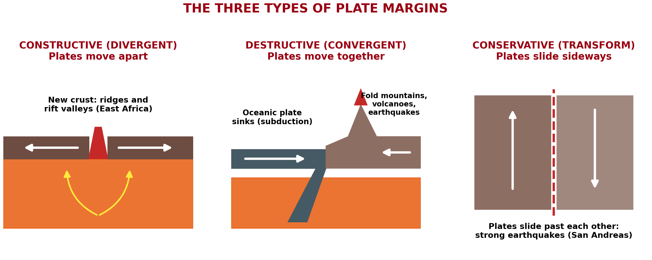
BOARD SUMMARY
3. Plate Margins and Main Landforms
The margins where plates meet are of three types:
Constructive (divergent) margins: Plates move apart and magma rises to form new crust. Landforms: ocean ridges and rift valleys, such as the East African Rift Valley.
Illustration: the three types of plate margins
Notes:
Let us copy Plate Margins and Main Landforms. The margins where plates meet are of three types. Copy the point on Constructive (divergent) margins on the left, then draw the diagram on the right: the three types of plate margins. Give it a title and label it clearly.

Slide 38
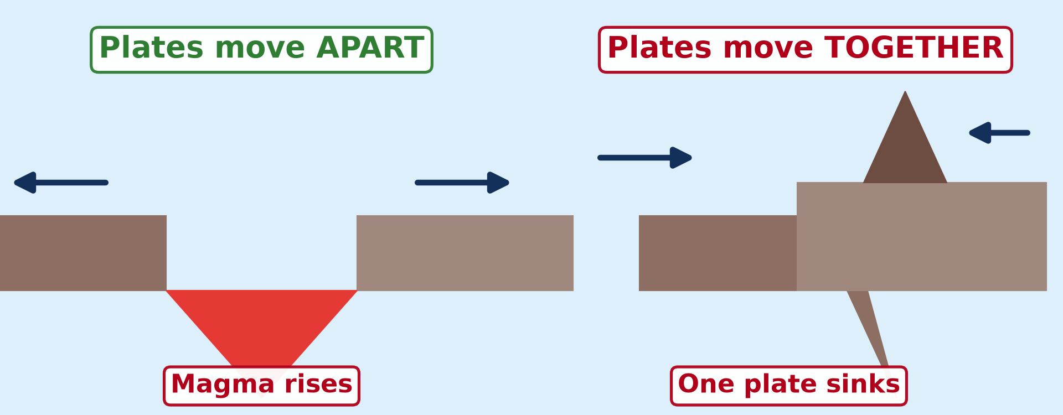
BOARD SUMMARY
3. Plate Margins and Main Landforms
Destructive (convergent) margins: Plates move together and one sinks under the other. Landforms: fold mountains, ocean trenches and volcanoes.
Illustration: plates move apart and together
Notes:
Copy the point on Destructive (convergent) margins on the left, then draw the diagram on the right: plates move apart and together. Give it a title and label it clearly.

Slide 39
BOARD SUMMARY
3. Plate Margins and Main Landforms
Conservative (transform) margins: Plates slide past each other and no crust is made or destroyed. Landforms: faults, with strong earthquakes, such as the San Andreas Fault.
Notes:
We continue with Plate Margins and Main Landforms. On this slide we have Conservative (transform) margins. Write each point on a new line, with the key term first, and explain it in your own words when we revise.

Slide 40
FORMATIVE EVALUATION
Evaluation 1
What is a plate?
Notes:
Now let us check what you have understood. Question 1: What is a plate? Answer in your exercise book.

Slide 41
FORMATIVE EVALUATION
Expected Answer
A large piece of the crust.
Notes:
The expected answer is: a large piece of the crust. If you got it right, well done.

Slide 42
FORMATIVE EVALUATION
Evaluation 2
What happens at a destructive margin?
Notes:
Now let us check what you have understood. Question 2: What happens at a destructive margin? Answer in your exercise book.

Slide 43
FORMATIVE EVALUATION
Expected Answer
Plates move together and one sinks under the other.
Notes:
The expected answer is: plates move together and one sinks under the other. If you got it right, well done.

Slide 44
REMEDIATION
Remediation
Fill in the blanks:
Cameroon is on the ______ Plate.
At a constructive margin, plates move ______.
At a conservative margin, plates slide ______ by side.
Notes:
For those who need more practice, fill in the blanks in your exercise book. The answers are: number 1, African; number 2, apart; number 3, side.

Slide 45
HOMEWORK
Homework
Ask your parents or read about Mount Cameroon: when did it last erupt, and what did the lava do?
Notes:
For your homework: Ask your parents or read about Mount Cameroon: when did it last erupt, and what did the lava do? We shall correct it at the beginning of our next lesson.

Slide 46
NEXT LESSON
Next Lesson
Our next lesson will be on:
Lesson 11: Volcanoes
Notes:
Our next lesson will be on Lesson 11: Volcanoes. Thank you for your attention, and see you next time.

Slide 47
BILINGUAL GAME
Bilingual Game (Jeu Bilingue)
English | Français
Plate | La plaque
Plate margin | La limite de plaques
Subduction | La subduction
Ridge | La dorsale
Rift valley | La vallée du rift
Fold mountains | Les montagnes plissées
Convection current | Le courant de convection
Fault | La faille
Notes:
Let us play the bilingual game. I say a word in English, and you give me the French word. Then we do the reverse.

Slide 48
LOGBOOK
Official Logbook (1/2)
Module / Topic | The Structure of the Earth: Building Processes and Impacts on Man
Lesson Title | Lesson 10: Plate Tectonics
Expected Learning Outcomes | Define plate tectonics. Explain the geometric and kinetic ideas of the theory. Describe the plates, the plate margins and their main landforms.
Competence | Learners are able to explain why earthquakes and volcanoes happen in some regions of the world, using a map of plates.
Notes:
I record this information in the official logbook of the class after the lesson.

Slide 49
LOGBOOK
Official Logbook (2/2)
Matter Taught | DEFINITIONS; Main Ideas of the Theory; The Plates; Plate Margins and Main Landforms.
Evaluation | Formative evaluation and remediation exercise.
Homework | Ask your parents or read about Mount Cameroon: when did it last erupt, and what did the lava do?
Enrolment / Present / Absent | ____ / ____ / ____
Achievement | To be completed after the lesson.
Notes:
I complete the second page of the logbook: the matter taught, the evaluation, the homework and the attendance.

Slide 50
TEACHER'S NOTE
Teacher's Note
Timing: Homework correction, plan, objectives 4 min | Recall, situation, action 6 min | 3 activities 12 min | Board summary (copying) 15 min | Evaluation, remediation 5 min | Homework, next lesson 3 min | Logbook 5 min
Activities 2 and 3 are animations (GIF): it plays automatically in slide-show mode.
Without the projector (Activity 1): break a biscuit into pieces: the pieces are like the plates.
Without the projector (Activity 2): watch rice move in boiling water.
Without the projector (Activity 3): move two books apart, then push them together.
Notes:
This slide is for me, the teacher: it gives the timing of the lesson and what to do if the projector is not available.

Slide 51
REFERENCES
References
National Geography Syllabus (MINESEC), Form 4 — The Structure of the Earth: Building Processes and Impacts on Man.
Teacher's lesson notes (Form 4), checked and corrected where necessary.
Plate boundaries: Bird (2003), PB2002 model.
Diagrams and animations: drawn for this lesson (Geography Department).
Notes:
These are the references and picture credits used to prepare this lesson.

