Slide 1
FORM 1
GEOGRAPHY
Lesson 7
The Atmosphere
Notes:
Good morning, class, and welcome to our geography lesson. I am your geography teacher, Mr Kamdem. Today we are starting Lesson 7: The Atmosphere.

Slide 2
CLASS INFO
Class, Chapter and Duration
Class | Form 1
Chapter | Module 3: Protection from the Wrath of Nature
Duration | 2 periods (2 × 50 minutes)
Notes:
This lesson is for Form 1. It belongs to Module 3: Protection from the Wrath of Nature. We shall need 2 periods to cover it.

Slide 3
IDENTIFICATION
Lesson Identification
Topic | Protection against the Wrath of Nature
Sub-topic | Climatic Disturbances
Lesson | Lesson 7: The Atmosphere
Notions / Concepts | The atmosphere, ozone layer, global warming, greenhouse effect.
Syllabus focus | Definition; composition; structure.
Competence | Learners are able to describe the composition and layers of the atmosphere and explain why it must be protected.
Notes:
Our topic is Protection against the Wrath of Nature, and the sub-topic is Climatic Disturbances. The key notions we shall use today are: the atmosphere, ozone layer, global warming, greenhouse effect. At the end, you should be able to do this: learners are able to describe the composition and layers of the atmosphere and explain why it must be protected.

Slide 4

HOMEWORK CORRECTION
Correction of the Homework
Question (Practical Work 5: Solid Waste Management):
At home, sort the waste of one day into two groups and write what you found in each group.
Notes:
Before we start the new lesson, let us correct the homework I gave you at the end of Practical Work 5: Solid Waste Management. The question was: At home, sort the waste of one day into two groups and write what you found in each group. Take out your exercise books.

Slide 5
HOMEWORK CORRECTION
Correction: Possible Answer
Biodegradable: peelings of cassava and plantain, leftover food, leaves, paper. Non-biodegradable: plastic sachets and bottles, tins, broken glass.
Notes:
Here is a good answer. Biodegradable: peelings of cassava and plantain, leftover food, leaves, paper. Non-biodegradable: plastic sachets and bottles, tins, broken glass. Compare it with your own answer and correct your work in red.

Slide 6
LESSON PLAN
Lesson Plan
Correction of the homework
Objectives and recall
Real-life situation and action to take
Learning activities
Board summary
Evaluation, remediation and homework
Notes:
Here is the plan of our lesson today. First, we shall correct the homework. Then we shall look at the objectives and recall what you already know. After that, we shall study a situation from real life and the action to take, and do the learning activities. Finally, we shall copy the board summary, do the evaluation and the remediation, and I will give you the homework.

Slide 7
OBJECTIVES
Objectives
By the end of this lesson, you should be able to:
Define the atmosphere.
Give the composition of the atmosphere.
Sketch and describe the structure of the atmosphere.
Notes:
By the end of this lesson, you should be able to do three things. Number 1: define the atmosphere. Number 2: give the composition of the atmosphere. Number 3: sketch and describe the structure of the atmosphere.

Slide 8
PREVIOUS KNOWLEDGE
Previous Knowledge
The Earth is covered by land, water and air.
We breathe oxygen.
Clouds and rain form in the sky.
Notes:
Let us first remember what you already know. The Earth is covered by land, water and air. We breathe oxygen. Clouds and rain form in the sky. Keep this in mind, because we shall build on it today.

Slide 9
REAL-LIFE SITUATION
Situation in Real Life
During a flight from Garoua to Douala, Salif looks through the window. The plane is far above the clouds and the sky is very clear. Salif asks the flight attendant: "What is this air around the Earth made of, and are there layers in it?"
Notes:
Listen carefully to this situation from real life. During a flight from Garoua to Douala, Salif looks through the window. The plane is far above the clouds and the sky is very clear. Salif asks the flight attendant: "What is this air around the Earth made of, and are there layers in it?" Think about it, because I am going to ask you some questions.

Slide 10
REAL-LIFE SITUATION
Situation: Question 1
What is the problem in the situation?
Notes:
Question 1: What is the problem in the situation? Think for a moment, then raise your hand to answer.

Slide 11
REAL-LIFE SITUATION
Answer
Salif does not know what the air around the Earth is made of and whether it has layers.
Notes:
Good. Salif does not know what the air around the Earth is made of and whether it has layers.

Slide 12
REAL-LIFE SITUATION
Situation: Question 2
Where are the clouds?
Notes:
Question 2: Where are the clouds? Think for a moment, then raise your hand to answer.

Slide 13
REAL-LIFE SITUATION
Answer
Below the plane, in the lowest layer of the air.
Notes:
Good. Below the plane, in the lowest layer of the air.

Slide 14
REAL-LIFE SITUATION
Situation: Question 3
What is the name of the layer of air around the Earth?
Notes:
Question 3: What is the name of the layer of air around the Earth? Think for a moment, then raise your hand to answer.

Slide 15
REAL-LIFE SITUATION
Possible Answer
The atmosphere.
Notes:
Good. The atmosphere.

Slide 16
ACTION TO TAKE
Action to Take
Protect the air: avoid burning plastics and tyres.
Notes:
From this situation, the action we are working towards in this lesson is the following: protect the air: avoid burning plastics and tyres.

Slide 17
JUSTIFICATION
Justification of the Lesson
This lesson helps us to know the air that protects life on the Earth.
Notes:
Why is this lesson important for you? This lesson helps us to know the air that protects life on the Earth.

Slide 18

1. MEANING
Activity 1
The sky seen from an aeroplane.
Notes:
Activity 1. Look carefully at this picture: the sky seen from an aeroplane. Observe every detail before I ask the question.

Slide 19
1. MEANING
Activity 1: Question
What surrounds the Earth above the ground?
Notes:
Here is the question for Activity 1: What surrounds the Earth above the ground? Take one minute to think and write your answer in your rough notebook.

Slide 20
1. MEANING
Activity 1: Answer
A layer of air called the atmosphere.
Notes:
Let us check the answer together. A layer of air called the atmosphere.

Slide 21
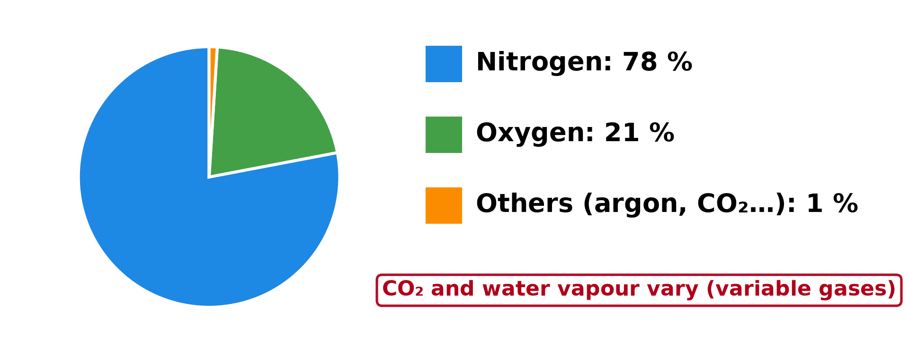
2. COMPOSITION
Activity 2
The gases of the air.
Notes:
Activity 2. Look carefully at this diagram: the gases of the air. Observe every detail before I ask the question.

Slide 22
2. COMPOSITION
Activity 2: Question
Which gas forms most of the air?
Notes:
Here is the question for Activity 2: Which gas forms most of the air? Take one minute to think and write your answer in your rough notebook.

Slide 23
2. COMPOSITION
Activity 2: Answer
Nitrogen, about 78 % of the air.
Notes:
Let us check the answer together. Nitrogen, about 78 % of the air.

Slide 24
2. COMPOSITION
Activity 3
The gases of the air.
Notes:
Activity 3. Look carefully at this diagram: the gases of the air. Observe every detail before I ask the question.

Slide 25
2. COMPOSITION
Activity 3: Question
Which gas do we breathe to live?
Notes:
Here is the question for Activity 3: Which gas do we breathe to live? Take one minute to think and write your answer in your rough notebook.

Slide 26
2. COMPOSITION
Activity 3: Answer
Oxygen, about 21 % of the air.
Notes:
Let us check the answer together. Oxygen, about 21 % of the air.

Slide 27

3. STRUCTURE
Activity 4
A big storm cloud.
Notes:
Activity 4. Look carefully at this picture: a big storm cloud. Observe every detail before I ask the question.

Slide 28
3. STRUCTURE
Activity 4: Question
In which part of the atmosphere do clouds, rain and wind occur?
Notes:
Here is the question for Activity 4: In which part of the atmosphere do clouds, rain and wind occur? Take one minute to think and write your answer in your rough notebook.

Slide 29
3. STRUCTURE
Activity 4: Answer
In the lowest layer, the troposphere.
Notes:
Let us check the answer together. In the lowest layer, the troposphere.

Slide 30

3. STRUCTURE
Activity 5
The ozone hole over the South Pole.
Notes:
Activity 5. Look carefully at this picture: the ozone hole over the South Pole. Observe every detail before I ask the question.

Slide 31
3. STRUCTURE
Activity 5: Question
Why is the ozone layer important?
Notes:
Here is the question for Activity 5: Why is the ozone layer important? Take one minute to think and write your answer in your rough notebook.

Slide 32
3. STRUCTURE
Activity 5: Answer
It stops the harmful rays of the Sun that cause skin cancer and eye diseases.
Notes:
Let us check the answer together. It stops the harmful rays of the Sun that cause skin cancer and eye diseases.

Slide 33
BOARD SUMMARY
Board Summary
Topic: Protection against the Wrath of Nature
Sub-topic: Climatic Disturbances
Lesson 7: The Atmosphere
Notes:
Now we are going to copy the board summary. Write the title and the headings neatly in your notebooks. I will give you enough time for each slide, so do not rush.

Slide 34
BOARD SUMMARY
DEFINITIONS
The key terms of this lesson are defined as follows:
Atmosphere: It is the layer of air that surrounds the Earth and protects life.
Ozone layer: It is a layer of ozone gas in the atmosphere that stops harmful rays of the Sun.
Notes:
Let us copy the definitions. The key terms of this lesson are defined as follows. On this slide we have Atmosphere and Ozone layer. Write each point on a new line, with the key term first, and explain it in your own words when we revise.

Slide 35
BOARD SUMMARY
1. Composition of the Atmosphere
The atmosphere is made up of the following elements:
Nitrogen: It forms about 78 % of the air.
Illustration: the gases of the air
Notes:
Let us copy Composition of the Atmosphere. The atmosphere is made up of the following elements. Copy the point on Nitrogen on the left, then draw the diagram on the right: the gases of the air. Give it a title and label it clearly.

Slide 36
BOARD SUMMARY
1. Composition of the Atmosphere
Oxygen: It forms about 21 % of the air. People and animals breathe it.
Carbon dioxide: It forms a very small part of the air. Plants use it to make food.
Water vapour, dust and other gases: They form the rest of the air and help to form clouds.
Notes:
We continue with Composition of the Atmosphere. On this slide we have Oxygen, Carbon dioxide and Water vapour, dust and other gases. Write each point on a new line, with the key term first, and explain it in your own words when we revise.

Slide 37

BOARD SUMMARY
2. Structure of the Atmosphere
The atmosphere has the following layers:
Troposphere: It is the lowest layer, up to about 12 km. Weather occurs in it.
Illustration: the layers of the atmosphere
Notes:
Let us copy Structure of the Atmosphere. The atmosphere has the following layers. Copy the point on Troposphere on the left, then draw the diagram on the right: the layers of the atmosphere. Give it a title and label it clearly.

Slide 38
BOARD SUMMARY
2. Structure of the Atmosphere
Stratosphere: It lies between about 12 and 50 km and contains the ozone layer.
Illustration: the ozone layer seen from space
Notes:
Copy the point on Stratosphere on the left, then draw the diagram on the right: the ozone layer seen from space. Give it a title and label it clearly.

Slide 39
BOARD SUMMARY
2. Structure of the Atmosphere
Mesosphere: It lies between about 50 and 85 km and is very cold.
Notes:
We continue with Structure of the Atmosphere. On this slide we have Mesosphere. Write each point on a new line, with the key term first, and explain it in your own words when we revise.

Slide 40
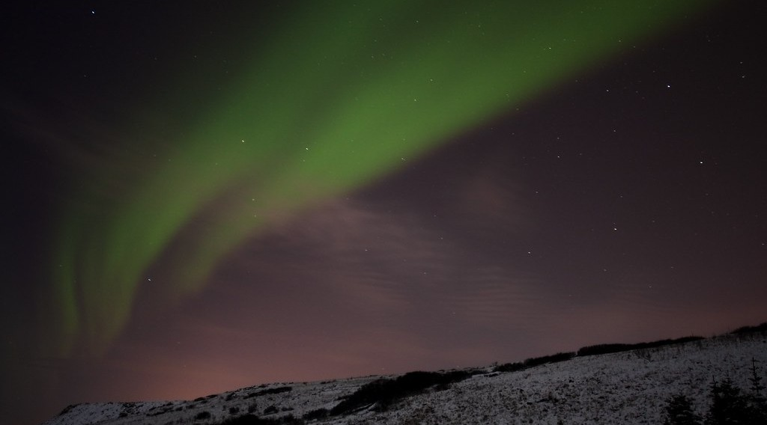
BOARD SUMMARY
2. Structure of the Atmosphere
Thermosphere: It is the upper layer, above 85 km, where lights called auroras appear.
Illustration: an aurora
Notes:
Copy the point on Thermosphere on the left, then draw the diagram on the right: an aurora. Give it a title and label it clearly.

Slide 41
FORMATIVE EVALUATION
Evaluation 1
What is the atmosphere?
Notes:
Now let us check what you have understood. Question 1: What is the atmosphere? Answer in your exercise book.

Slide 42
FORMATIVE EVALUATION
Expected Answer
The layer of air around the Earth.
Notes:
The expected answer is: the layer of air around the Earth. If you got it right, well done.

Slide 43
FORMATIVE EVALUATION
Evaluation 2
In which layer is the ozone layer?
Notes:
Now let us check what you have understood. Question 2: In which layer is the ozone layer? Answer in your exercise book.

Slide 44
FORMATIVE EVALUATION
Expected Answer
In the stratosphere.
Notes:
The expected answer is: in the stratosphere. If you got it right, well done.

Slide 45
REMEDIATION
Remediation
Fill in the blanks:
The gas that forms 78 % of the air is ______.
Weather occurs in the ______.
The ozone layer is in the ______.
Notes:
For those who need more practice, fill in the blanks in your exercise book. The answers are: number 1, nitrogen; number 2, troposphere; number 3, stratosphere.

Slide 46
HOMEWORK
Homework
Draw and label the four layers of the atmosphere.
Notes:
For your homework: Draw and label the four layers of the atmosphere. We shall correct it at the beginning of our next lesson.

Slide 47
NEXT LESSON
Next Lesson
Our next lesson will be on:
Lesson 8: Atmospheric Circulation
Notes:
Our next lesson will be on Lesson 8: Atmospheric Circulation. Thank you for your attention, and see you next time.

Slide 48
BILINGUAL GAME
Bilingual Game (Jeu Bilingue)
English | Français
Atmosphere | L'atmosphère
Air | L'air
Oxygen | L'oxygène
Layer | La couche
Ozone | L'ozone
Cloud | Le nuage
Notes:
Let us play the bilingual game. I say a word in English, and you give me the French word. Then we do the reverse.

Slide 49
LOGBOOK
Official Logbook (1/2)
Module / Topic | Protection against the Wrath of Nature
Lesson Title | Lesson 7: The Atmosphere
Expected Learning Outcomes | Define the atmosphere. Give the composition of the atmosphere. Sketch and describe the structure of the atmosphere.
Competence | Learners are able to describe the composition and layers of the atmosphere and explain why it must be protected.
Notes:
I record this information in the official logbook of the class after the lesson.

Slide 50
LOGBOOK
Official Logbook (2/2)
Matter Taught | DEFINITIONS; Composition of the Atmosphere; Structure of the Atmosphere.
Evaluation | Formative evaluation and remediation exercise.
Homework | Draw and label the four layers of the atmosphere.
Enrolment / Present / Absent | ____ / ____ / ____
Achievement | To be completed after the lesson.
Notes:
I complete the second page of the logbook: the matter taught, the evaluation, the homework and the attendance.

Slide 51
TEACHER'S NOTE
Teacher's Note
Timing: Homework correction, plan, objectives 8 min | Recall, situation, action 10 min | 5 activities 30 min | Board summary (copying) 30 min | Evaluation, remediation 10 min | Homework, next lesson 5 min | Logbook 7 min
Without the projector (Activity 1): ask learners to breathe deeply: we breathe the atmosphere.
Without the projector (Activity 2): draw a pie chart on the board.
Without the projector (Activity 3): breathe in and out.
Without the projector (Activity 4): describe the clouds seen today.
Without the projector (Activity 5): explain the hole in the ozone layer.
Notes:
This slide is for me, the teacher: it gives the timing of the lesson and what to do if the projector is not available.

Slide 52
REFERENCES
References
Geography Syllabus, Forms I–V, MINESEC (2023) — Form 1, Module 3: Protection from the Wrath of Nature.
Photo, Activity 1: “flying” by { pranav }, CC BY 2.0, via Flickr (https://www.flickr.com/photos/29220600@N08/3469129491)
Photo, Activity 4: “06172012 Sunday evening pulse storms/cumulonimbi” by StormRider93 | Into the Storm, CC BY-NC-ND 2.0, via Flickr (https://www.flickr.com/photos/65232104@N04/7395715628)
Photo, Activity 5: “Sauron's Eye” by sjrankin, CC BY-NC 2.0, via Flickr (https://www.flickr.com/photos/24354425@N03/15252220086)
Photo, board summary (Thermosphere): “Aurora Borealis” by Haukur H., CC BY-NC-ND 2.0, via Flickr (https://www.flickr.com/photos/34699962@N04/3256810738)
Diagrams and animations: drawn for this lesson (Geography Department).
Notes:
These are the references and picture credits used to prepare this lesson.

