Slide 1

DIVINE GRACE COLLEGE OF ARTS, SCIENCE AND TECHNOLOGY
(DGCAST) — GAROUA | GEOGRAPHY DEPARTMENT
LOWER SIXTH ARTS — HYDROLOGY — LESSON 24
The Drainage Basin as an Open System
Mr KAMDEM EMMANUEL
Geography Teacher — PLEG
Academic Year 2026 / 2027
Notes:
Good morning, class. Today we study Lesson 24: The Drainage Basin as an Open System.

Slide 2
GEOGRAPHY — LOWER SIXTH ARTS
CLASS INFO
Class, Chapter & Duration
Class | Lower Sixth Arts
Chapter | Module 1: Understanding and managing atmospheric and hydrological phenomena and hazards across the world in general and Cameroon in particular
Duration | 2 periods (2 × 50 minutes)
2026 / 2027
DGCAST GAROUA — GEOGRAPHY DEPARTMENT
Mr KAMDEM E. | 2

Slide 3
GEOGRAPHY — LOWER SIXTH ARTS
IDENTIFICATION
Lesson Identification
Topic | Global Water in Storage and Circulation
Sub-topic | The Hydrological Cycle
Lesson | Lesson 24: The Drainage Basin as an Open System
Notions / Concepts | Drainage basin, watershed, source, tributary, confluence, mouth, open system, input, output, throughflow.
Syllabus focus | Concept of a drainage basin; inputs, outputs, stores and flows of the basin hydrological cycle.
Competence | Learners are able to describe a drainage basin and explain how water enters, is stored, moves and leaves it.
2026 / 2027
DGCAST GAROUA — GEOGRAPHY DEPARTMENT
Mr KAMDEM E. | 3

Slide 4
GEOGRAPHY — LOWER SIXTH ARTS
OBJECTIVES
Learning Objectives
By the end of the lesson, the learner should be able to:
Define a drainage basin and its parts.
Explain why a basin is an open system.
Describe its inputs, stores, flows and outputs.
2026 / 2027
DGCAST GAROUA — GEOGRAPHY DEPARTMENT
Mr KAMDEM E. | 4

Slide 5
GEOGRAPHY — LOWER SIXTH ARTS
RECALL
Recall
The global water cycle is a closed system.
Rivers flow from their source to their mouth.
2026 / 2027
DGCAST GAROUA — GEOGRAPHY DEPARTMENT
Mr KAMDEM E. | 5

Slide 6
GEOGRAPHY — LOWER SIXTH ARTS
REAL-LIFE SITUATION
Real-Life Situation
After heavy rain on the Adamawa Plateau, the Sanaga rises at Nachtigal days later, far away. Learners wonder how rain on hills far away reaches the river.
2026 / 2027
DGCAST GAROUA — GEOGRAPHY DEPARTMENT
Mr KAMDEM E. | 6
Notes:
Read the situation slowly, twice.

Slide 7
GEOGRAPHY — LOWER SIXTH ARTS
REAL-LIFE SITUATION
Situation — Question 1
What is the problem in the situation?
2026 / 2027
DGCAST GAROUA — GEOGRAPHY DEPARTMENT
Mr KAMDEM E. | 7

Slide 8
GEOGRAPHY — LOWER SIXTH ARTS
REAL-LIFE SITUATION
Answer
Learners do not know how rain reaches a river.
2026 / 2027
DGCAST GAROUA — GEOGRAPHY DEPARTMENT
Mr KAMDEM E. | 8

Slide 9
GEOGRAPHY — LOWER SIXTH ARTS
REAL-LIFE SITUATION
Situation — Question 2
What do we call the area drained by a river?
2026 / 2027
DGCAST GAROUA — GEOGRAPHY DEPARTMENT
Mr KAMDEM E. | 9

Slide 10
GEOGRAPHY — LOWER SIXTH ARTS
REAL-LIFE SITUATION
Answer
A drainage basin.
2026 / 2027
DGCAST GAROUA — GEOGRAPHY DEPARTMENT
Mr KAMDEM E. | 10

Slide 11
GEOGRAPHY — LOWER SIXTH ARTS
REAL-LIFE SITUATION
Situation — Question 3
Is the drainage basin a closed system?
2026 / 2027
DGCAST GAROUA — GEOGRAPHY DEPARTMENT
Mr KAMDEM E. | 11

Slide 12
GEOGRAPHY — LOWER SIXTH ARTS
REAL-LIFE SITUATION
Possible Answer
No, it is an open system: water enters and leaves.
2026 / 2027
DGCAST GAROUA — GEOGRAPHY DEPARTMENT
Mr KAMDEM E. | 12

Slide 13
GEOGRAPHY — LOWER SIXTH ARTS
JUSTIFICATION
Justification of the Lesson
This lesson helps us to understand how a river basin works, which is needed to manage floods and water supply.
2026 / 2027
DGCAST GAROUA — GEOGRAPHY DEPARTMENT
Mr KAMDEM E. | 13

Slide 14
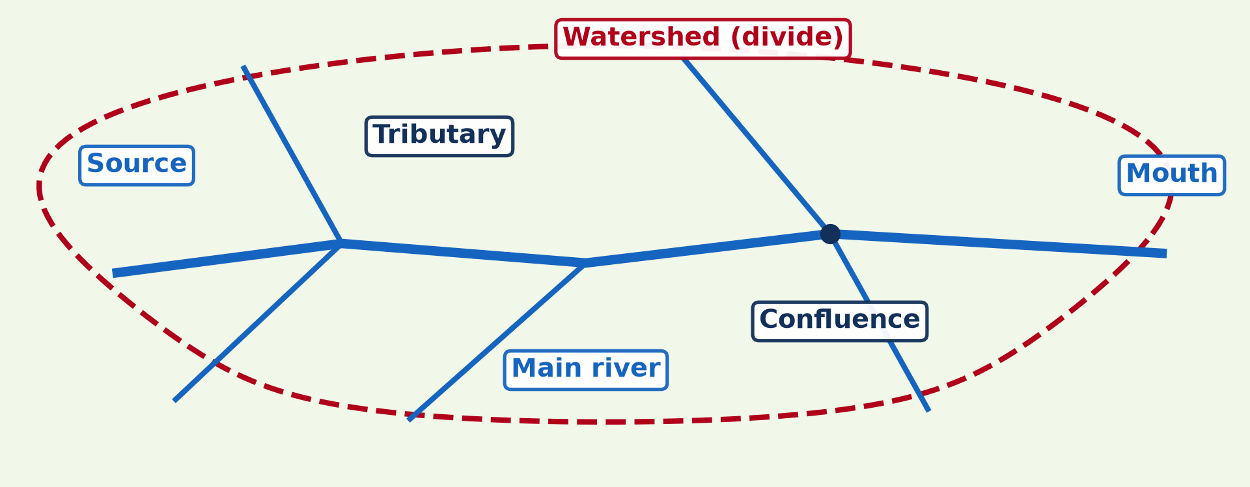
GEOGRAPHY — LOWER SIXTH ARTS
I. THE DRAINAGE BASIN
Activity 1
The parts of a drainage basin.
2026 / 2027
DGCAST GAROUA — GEOGRAPHY DEPARTMENT
Mr KAMDEM E. | 14
Notes:
Without the projector: draw a basin with a main river and tributaries.

Slide 15
GEOGRAPHY — LOWER SIXTH ARTS
I. THE DRAINAGE BASIN
Activity 1: Question
What is the line that separates two drainage basins?
2026 / 2027
DGCAST GAROUA — GEOGRAPHY DEPARTMENT
Mr KAMDEM E. | 15

Slide 16
GEOGRAPHY — LOWER SIXTH ARTS
I. THE DRAINAGE BASIN
Answer
The watershed (divide).
2026 / 2027
DGCAST GAROUA — GEOGRAPHY DEPARTMENT
Mr KAMDEM E. | 16

Slide 17
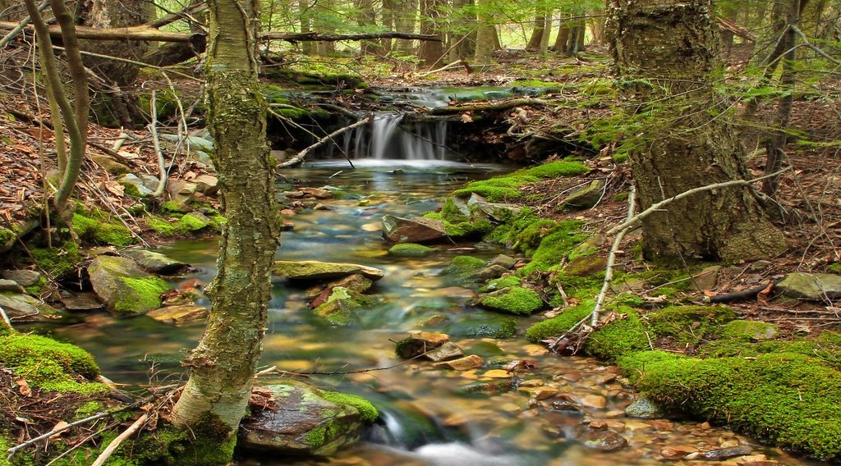
GEOGRAPHY — LOWER SIXTH ARTS
I. THE DRAINAGE BASIN
Activity 2
A small stream near its source.
2026 / 2027
DGCAST GAROUA — GEOGRAPHY DEPARTMENT
Mr KAMDEM E. | 17
Notes:
Without the projector: name tributaries of the Sanaga (Mbam, Lom).

Slide 18
GEOGRAPHY — LOWER SIXTH ARTS
I. THE DRAINAGE BASIN
Activity 2: Question
Where does a river begin? What joins it on the way?
2026 / 2027
DGCAST GAROUA — GEOGRAPHY DEPARTMENT
Mr KAMDEM E. | 18

Slide 19
GEOGRAPHY — LOWER SIXTH ARTS
I. THE DRAINAGE BASIN
Answer
At its source; tributaries join it at confluences.
2026 / 2027
DGCAST GAROUA — GEOGRAPHY DEPARTMENT
Mr KAMDEM E. | 19

Slide 20

GEOGRAPHY — LOWER SIXTH ARTS
II. AN OPEN SYSTEM
Activity 3
Inputs, stores and outputs.
2026 / 2027
DGCAST GAROUA — GEOGRAPHY DEPARTMENT
Mr KAMDEM E. | 20
Notes:
Without the projector: draw three boxes.

Slide 21
GEOGRAPHY — LOWER SIXTH ARTS
II. AN OPEN SYSTEM
Activity 3: Question
What is the input and what are the outputs of a drainage basin?
2026 / 2027
DGCAST GAROUA — GEOGRAPHY DEPARTMENT
Mr KAMDEM E. | 21

Slide 22
GEOGRAPHY — LOWER SIXTH ARTS
II. AN OPEN SYSTEM
Answer
Input: precipitation. Outputs: evapotranspiration and runoff.
2026 / 2027
DGCAST GAROUA — GEOGRAPHY DEPARTMENT
Mr KAMDEM E. | 22

Slide 23
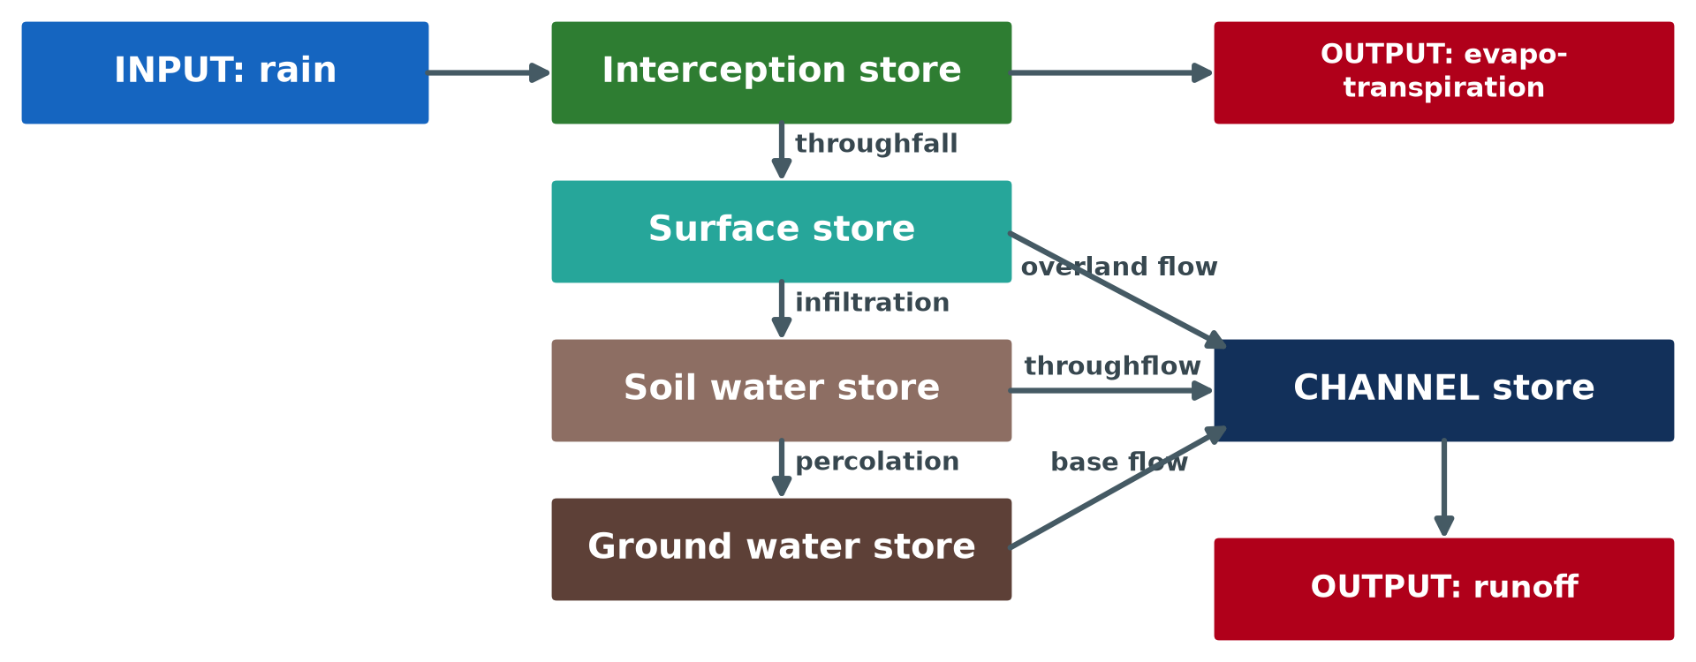
GEOGRAPHY — LOWER SIXTH ARTS
III. STORES AND FLOWS
Activity 4
Stores and flows in a drainage basin.
2026 / 2027
DGCAST GAROUA — GEOGRAPHY DEPARTMENT
Mr KAMDEM E. | 23
Notes:
Without the projector: pour water on soil in a bottle.

Slide 24
GEOGRAPHY — LOWER SIXTH ARTS
III. STORES AND FLOWS
Activity 4: Question
Name the flows that carry water from the surface to the ground water.
2026 / 2027
DGCAST GAROUA — GEOGRAPHY DEPARTMENT
Mr KAMDEM E. | 24

Slide 25
GEOGRAPHY — LOWER SIXTH ARTS
III. STORES AND FLOWS
Answer
Infiltration (into the soil) and percolation (into the rock).
2026 / 2027
DGCAST GAROUA — GEOGRAPHY DEPARTMENT
Mr KAMDEM E. | 25

Slide 26

GEOGRAPHY — LOWER SIXTH ARTS
III. STORES AND FLOWS
Activity 5
The Sanaga at the Nachtigal falls.
2026 / 2027
DGCAST GAROUA — GEOGRAPHY DEPARTMENT
Mr KAMDEM E. | 26
Notes:
Without the projector: describe a river after rain.

Slide 27
GEOGRAPHY — LOWER SIXTH ARTS
III. STORES AND FLOWS
Activity 5: Question
Which store is the river? How does water reach it?
2026 / 2027
DGCAST GAROUA — GEOGRAPHY DEPARTMENT
Mr KAMDEM E. | 27

Slide 28
GEOGRAPHY — LOWER SIXTH ARTS
III. STORES AND FLOWS
Answer
The channel store; by overland flow, throughflow and base flow.
2026 / 2027
DGCAST GAROUA — GEOGRAPHY DEPARTMENT
Mr KAMDEM E. | 28

Slide 29
GEOGRAPHY — LOWER SIXTH ARTS
BOARD SUMMARY
The Drainage Basin as an Open System
Topic: Global Water in Storage and Circulation
Sub-topic: The Hydrological Cycle
Lesson 24: The Drainage Basin as an Open System
2026 / 2027
DGCAST GAROUA — GEOGRAPHY DEPARTMENT
Mr KAMDEM E. | 29
Notes:
Learners copy the board summary now. Give them enough time for each slide.

Slide 30
GEOGRAPHY — LOWER SIXTH ARTS
BOARD SUMMARY
I. Definitions (1/2)
Drainage basin: It is the area of land drained by a river and its tributaries.
Watershed: It is the high line that separates two drainage basins.
Open system: It is a system where matter and energy enter and leave.
2026 / 2027
DGCAST GAROUA — GEOGRAPHY DEPARTMENT
Mr KAMDEM E. | 30

Slide 31
GEOGRAPHY — LOWER SIXTH ARTS
BOARD SUMMARY
I. Definitions (2/2)
Throughflow: It is water moving sideways through the soil to the river.
2026 / 2027
DGCAST GAROUA — GEOGRAPHY DEPARTMENT
Mr KAMDEM E. | 31

Slide 32
GEOGRAPHY — LOWER SIXTH ARTS
BOARD SUMMARY
II. The Drainage Basin
A. Parts: A basin has a source, a main river, tributaries, confluences and a mouth. The watershed forms its edge.
B. Open system: Water enters as precipitation and leaves as evapotranspiration and runoff. The amount stored changes with the seasons.
2026 / 2027
DGCAST GAROUA — GEOGRAPHY DEPARTMENT
Mr KAMDEM E. | 32

Slide 33
GEOGRAPHY — LOWER SIXTH ARTS
BOARD SUMMARY
III. Inputs, Stores, Flows, Outputs (1/3)
A. Input and stores: Precipitation is the input. Water is stored on plants (interception), on the surface, in the soil, in rocks and in the channel.
B. Flows: Water moves by throughfall, infiltration, percolation, overland flow, throughflow and base flow. These flows carry water to the river.
2026 / 2027
DGCAST GAROUA — GEOGRAPHY DEPARTMENT
Mr KAMDEM E. | 33

Slide 34
GEOGRAPHY — LOWER SIXTH ARTS
BOARD SUMMARY
III. Inputs, Stores, Flows, Outputs (2/3)
C. Outputs: Water leaves by evapotranspiration to the air. It also leaves as river runoff to the sea.
2026 / 2027
DGCAST GAROUA — GEOGRAPHY DEPARTMENT
Mr KAMDEM E. | 34

Slide 35
GEOGRAPHY — LOWER SIXTH ARTS
BOARD SUMMARY
III. Inputs, Stores, Flows, Outputs (3/3)
Copy the system diagram.
2026 / 2027
DGCAST GAROUA — GEOGRAPHY DEPARTMENT
Mr KAMDEM E. | 35

Slide 36
GEOGRAPHY — LOWER SIXTH ARTS
FORMATIVE EVALUATION
Formative Evaluation 1
Why is a drainage basin an open system?
2026 / 2027
DGCAST GAROUA — GEOGRAPHY DEPARTMENT
Mr KAMDEM E. | 36

Slide 37
GEOGRAPHY — LOWER SIXTH ARTS
FORMATIVE EVALUATION
Expected Answer
Water enters as precipitation and leaves as evapotranspiration and runoff.
2026 / 2027
DGCAST GAROUA — GEOGRAPHY DEPARTMENT
Mr KAMDEM E. | 37

Slide 38
GEOGRAPHY — LOWER SIXTH ARTS
FORMATIVE EVALUATION
Formative Evaluation 2
Name three stores in a drainage basin.
2026 / 2027
DGCAST GAROUA — GEOGRAPHY DEPARTMENT
Mr KAMDEM E. | 38

Slide 39
GEOGRAPHY — LOWER SIXTH ARTS
FORMATIVE EVALUATION
Expected Answer
Interception, soil water, ground water (also surface and channel).
2026 / 2027
DGCAST GAROUA — GEOGRAPHY DEPARTMENT
Mr KAMDEM E. | 39

Slide 40
GEOGRAPHY — LOWER SIXTH ARTS
REMEDIATION
Remediation
Fill in the blanks:
The edge of a drainage basin is the ______.
Water moving into the soil is ______.
Water moving through the soil to the river is ______.
2026 / 2027
DGCAST GAROUA — GEOGRAPHY DEPARTMENT
Mr KAMDEM E. | 40
Notes:
Answers: 1. watershed 2. infiltration 3. throughflow

Slide 41
GEOGRAPHY — LOWER SIXTH ARTS
HOMEWORK
Homework
Draw the drainage basin of a stream near your school and label its parts.
This prepares Lesson 25: Human Activities and the Hydrological Cycle.
2026 / 2027
DGCAST GAROUA — GEOGRAPHY DEPARTMENT
Mr KAMDEM E. | 41
Notes:
This homework prepares the next lesson.

Slide 42
GEOGRAPHY — LOWER SIXTH ARTS
BILINGUAL GAME
Bilingual Game (Jeu Bilingue)
English | Français
Drainage basin | Le bassin versant
Watershed | La ligne de partage des eaux
Tributary | L'affluent
Confluence | La confluence
Mouth | L'embouchure
Source | La source
2026 / 2027
DGCAST GAROUA — GEOGRAPHY DEPARTMENT
Mr KAMDEM E. | 42
Notes:
Say the English word; learners give the French word, then the reverse.

Slide 43
GEOGRAPHY — LOWER SIXTH ARTS
LOGBOOK
Official Logbook (1/2)
Module / Topic | Global Water in Storage and Circulation
Lesson Title | Lesson 24: The Drainage Basin as an Open System
Expected Learning Outcomes | Define a drainage basin and its parts. Explain why a basin is an open system. Describe its inputs, stores, flows and outputs.
Competence | Learners are able to describe a drainage basin and explain how water enters, is stored, moves and leaves it.
2026 / 2027
DGCAST GAROUA — GEOGRAPHY DEPARTMENT
Mr KAMDEM E. | 43

Slide 44
GEOGRAPHY — LOWER SIXTH ARTS
LOGBOOK
Official Logbook (2/2)
Matter Taught | I. Definitions: Drainage basin, Watershed, Open system, Throughflow; II. The Drainage Basin: Parts, Open system; III. Inputs, Stores, Flows, Outputs: Input and stores, Flows, Outputs.
Evaluation | Formative evaluation (3 questions) and remediation exercise.
Homework | Draw the drainage basin of a stream near your school and label its parts.
Enrolment / Present / Absent | ____ / ____ / ____
Achievement | To be completed by the teacher after the lesson.
2026 / 2027
DGCAST GAROUA — GEOGRAPHY DEPARTMENT
Mr KAMDEM E. | 44

Slide 45
GEOGRAPHY — LOWER SIXTH ARTS
TEACHER'S NOTE
Teacher's Note
Timing: Set-up, recall 8 min | Situation 8 min | 5 activities 30 min | Board summary (copying) 30 min | Evaluation, remediation 10 min | Homework, logbook 9 min | Spare 5 min
2026 / 2027
DGCAST GAROUA — GEOGRAPHY DEPARTMENT
Mr KAMDEM E. | 45

Slide 46
GEOGRAPHY — LOWER SIXTH ARTS
REFERENCES
References
National Geography Syllabus, Sixth Forms (Lower & Upper Sixth), MINESEC/IGE/IP-SS, August 2019 — Module 1 (Meteorology, Climatology & Hydrology).
Photo, Activity 2: “Cherry Run (Headwaters) (3)” by Nicholas_T, CC BY 2.0, via Flickr (https://www.flickr.com/photos/14922165@N00/8690621015)
Photo, Activity 5: “Chutes de Natchigal” by friel, CC BY-NC-SA 2.0, via Flickr (https://www.flickr.com/photos/91702411@N00/2692932)
Diagrams and animations: drawn for this lesson (DGCAST Geography Department).
2026 / 2027
DGCAST GAROUA — GEOGRAPHY DEPARTMENT
Mr KAMDEM E. | 46

