Slide 1

DIVINE GRACE COLLEGE OF ARTS, SCIENCE AND TECHNOLOGY
(DGCAST) — GAROUA | GEOGRAPHY DEPARTMENT
LOWER SIXTH ARTS — HYDROLOGY — PRACTICAL WORK 1
Plotting and Analysing Storm Hydrographs and River Regimes
Mr KAMDEM EMMANUEL
Geography Teacher — PLEG
Academic Year 2026 / 2027
Notes:
Good morning, class. Today we study Practical Work 1: Plotting and Analysing Storm Hydrographs and River Regimes.

Slide 2
GEOGRAPHY — LOWER SIXTH ARTS
CLASS INFO
Class, Chapter & Duration
Class | Lower Sixth Arts
Chapter | Module 1: Understanding and managing atmospheric and hydrological phenomena and hazards across the world in general and Cameroon in particular
Duration | 2 periods (2 × 50 minutes)
2026 / 2027
DGCAST GAROUA — GEOGRAPHY DEPARTMENT
Mr KAMDEM E. | 2

Slide 3
GEOGRAPHY — LOWER SIXTH ARTS
IDENTIFICATION
Lesson Identification
Topic | Hydrology
Sub-topic | Hydrological Problems
Lesson | Practical Work 1: Plotting and Analysing Storm Hydrographs and River Regimes
Notions / Concepts | Discharge data, hydrograph, regime graph, lag time, peak flow, low flow.
Syllabus focus | Plot discharge data; interpret peak and low flows; identify regimes and their factors; uses of hydrographs in engineering.
Competence | Learners are able to plot and interpret storm hydrographs and regime graphs.
2026 / 2027
DGCAST GAROUA — GEOGRAPHY DEPARTMENT
Mr KAMDEM E. | 3

Slide 4
GEOGRAPHY — LOWER SIXTH ARTS
OBJECTIVES
Learning Objectives
By the end of the lesson, the learner should be able to:
Plot a storm hydrograph from data.
Calculate lag time and read peak discharge.
Plot and interpret a regime graph and give the uses of hydrographs.
2026 / 2027
DGCAST GAROUA — GEOGRAPHY DEPARTMENT
Mr KAMDEM E. | 4

Slide 5
GEOGRAPHY — LOWER SIXTH ARTS
RECALL
Recall
A storm hydrograph shows discharge after a storm.
A regime graph shows discharge over a year.
2026 / 2027
DGCAST GAROUA — GEOGRAPHY DEPARTMENT
Mr KAMDEM E. | 5

Slide 6
GEOGRAPHY — LOWER SIXTH ARTS
REAL-LIFE SITUATION
Real-Life Situation
The Ministry of Water wants to build a small dam on a stream in the West Region. An engineer gives the class a table of rainfall and discharge after a storm and asks them to draw and read the graph.
2026 / 2027
DGCAST GAROUA — GEOGRAPHY DEPARTMENT
Mr KAMDEM E. | 6
Notes:
Read the situation slowly, twice.

Slide 7
GEOGRAPHY — LOWER SIXTH ARTS
REAL-LIFE SITUATION
Situation — Question 1
What is the problem in the situation?
2026 / 2027
DGCAST GAROUA — GEOGRAPHY DEPARTMENT
Mr KAMDEM E. | 7

Slide 8
GEOGRAPHY — LOWER SIXTH ARTS
REAL-LIFE SITUATION
Answer
The data must be plotted and interpreted.
2026 / 2027
DGCAST GAROUA — GEOGRAPHY DEPARTMENT
Mr KAMDEM E. | 8

Slide 9
GEOGRAPHY — LOWER SIXTH ARTS
REAL-LIFE SITUATION
Situation — Question 2
What graph will the class draw?
2026 / 2027
DGCAST GAROUA — GEOGRAPHY DEPARTMENT
Mr KAMDEM E. | 9

Slide 10
GEOGRAPHY — LOWER SIXTH ARTS
REAL-LIFE SITUATION
Answer
A storm hydrograph.
2026 / 2027
DGCAST GAROUA — GEOGRAPHY DEPARTMENT
Mr KAMDEM E. | 10

Slide 11
GEOGRAPHY — LOWER SIXTH ARTS
REAL-LIFE SITUATION
Situation — Question 3
Why does the engineer need it?
2026 / 2027
DGCAST GAROUA — GEOGRAPHY DEPARTMENT
Mr KAMDEM E. | 11

Slide 12
GEOGRAPHY — LOWER SIXTH ARTS
REAL-LIFE SITUATION
Possible Answer
To know the highest flood the dam must resist.
2026 / 2027
DGCAST GAROUA — GEOGRAPHY DEPARTMENT
Mr KAMDEM E. | 12

Slide 13
GEOGRAPHY — LOWER SIXTH ARTS
JUSTIFICATION
Justification of the Lesson
This practical work helps us to use graphs to understand floods and river flow.
2026 / 2027
DGCAST GAROUA — GEOGRAPHY DEPARTMENT
Mr KAMDEM E. | 13

Slide 14
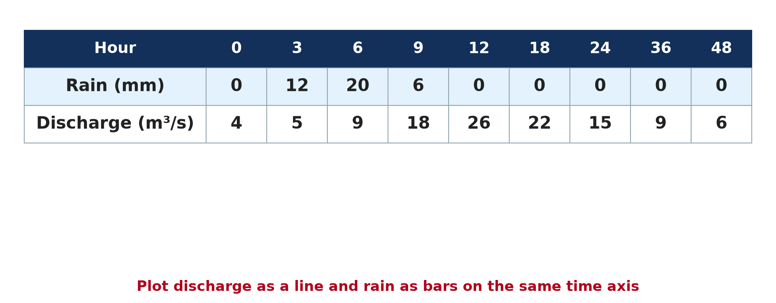
GEOGRAPHY — LOWER SIXTH ARTS
I. THE DATA
Activity 1
Rainfall and discharge after a storm.
2026 / 2027
DGCAST GAROUA — GEOGRAPHY DEPARTMENT
Mr KAMDEM E. | 14
Notes:
Without the projector: copy the table on the board.

Slide 15
GEOGRAPHY — LOWER SIXTH ARTS
I. THE DATA
Activity 1: Question
At what hour is rain heaviest? At what hour is discharge highest?
2026 / 2027
DGCAST GAROUA — GEOGRAPHY DEPARTMENT
Mr KAMDEM E. | 15

Slide 16
GEOGRAPHY — LOWER SIXTH ARTS
I. THE DATA
Answer
Rain at hour 6; discharge at hour 12.
2026 / 2027
DGCAST GAROUA — GEOGRAPHY DEPARTMENT
Mr KAMDEM E. | 16

Slide 17
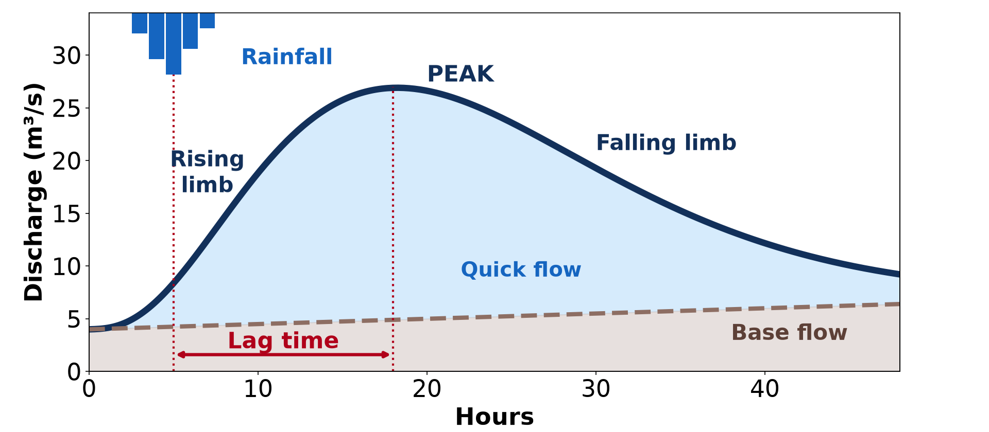
GEOGRAPHY — LOWER SIXTH ARTS
II. PLOTTING
Activity 2
The storm hydrograph drawn from data.
2026 / 2027
DGCAST GAROUA — GEOGRAPHY DEPARTMENT
Mr KAMDEM E. | 17
Notes:
Without the projector: plot the points on graph paper.

Slide 18
GEOGRAPHY — LOWER SIXTH ARTS
II. PLOTTING
Activity 2: Question
Using the table, what is the lag time?
2026 / 2027
DGCAST GAROUA — GEOGRAPHY DEPARTMENT
Mr KAMDEM E. | 18

Slide 19
GEOGRAPHY — LOWER SIXTH ARTS
II. PLOTTING
Answer
12 − 6 = 6 hours.
2026 / 2027
DGCAST GAROUA — GEOGRAPHY DEPARTMENT
Mr KAMDEM E. | 19

Slide 20
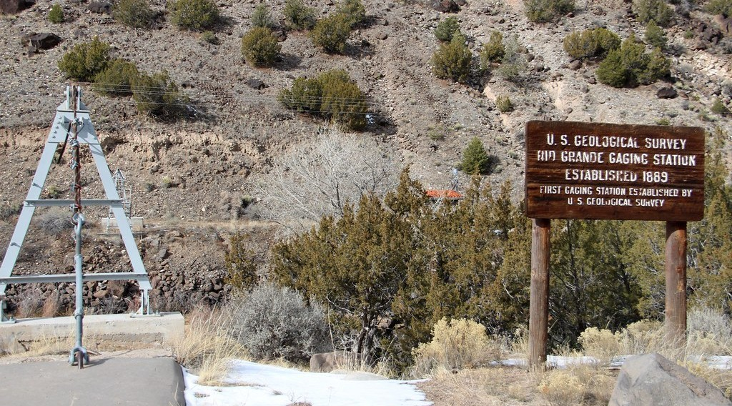
GEOGRAPHY — LOWER SIXTH ARTS
II. PLOTTING
Activity 3
A gauging station that records discharge.
2026 / 2027
DGCAST GAROUA — GEOGRAPHY DEPARTMENT
Mr KAMDEM E. | 20
Notes:
Without the projector: explain a staff gauge.

Slide 21
GEOGRAPHY — LOWER SIXTH ARTS
II. PLOTTING
Activity 3: Question
How are discharge data collected?
2026 / 2027
DGCAST GAROUA — GEOGRAPHY DEPARTMENT
Mr KAMDEM E. | 21

Slide 22
GEOGRAPHY — LOWER SIXTH ARTS
II. PLOTTING
Answer
At gauging stations that measure water level and velocity.
2026 / 2027
DGCAST GAROUA — GEOGRAPHY DEPARTMENT
Mr KAMDEM E. | 22

Slide 23
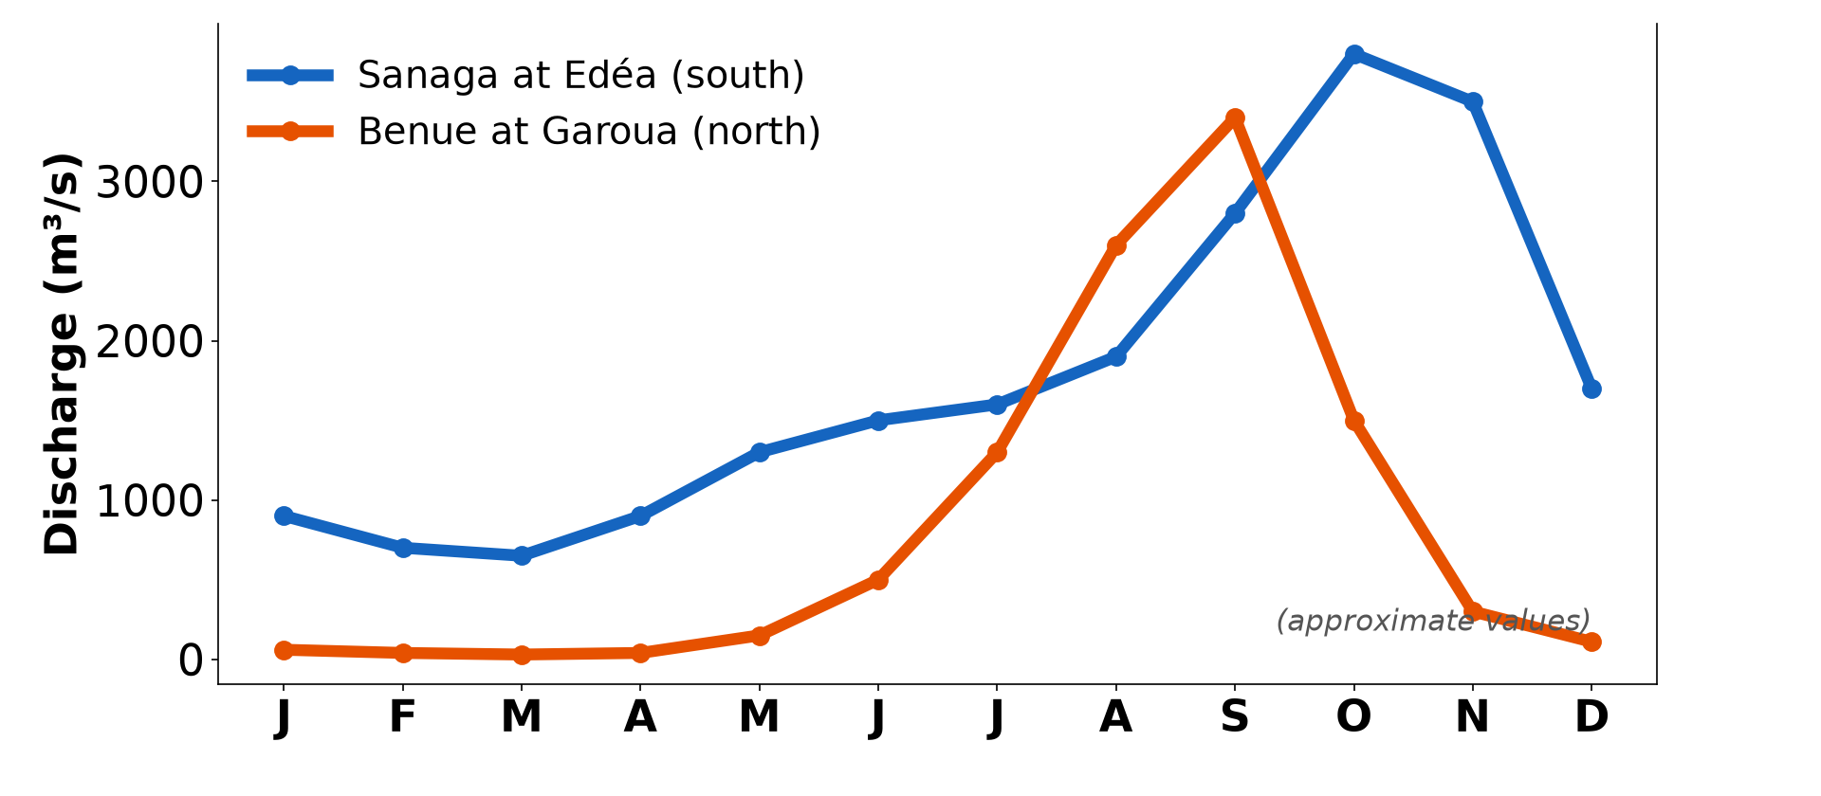
GEOGRAPHY — LOWER SIXTH ARTS
III. REGIME GRAPHS
Activity 4
Regime graphs of two rivers.
2026 / 2027
DGCAST GAROUA — GEOGRAPHY DEPARTMENT
Mr KAMDEM E. | 23
Notes:
Without the projector: plot monthly data.

Slide 24
GEOGRAPHY — LOWER SIXTH ARTS
III. REGIME GRAPHS
Activity 4: Question
What type of regime does the Benue have? What problem does its low flow cause?
2026 / 2027
DGCAST GAROUA — GEOGRAPHY DEPARTMENT
Mr KAMDEM E. | 24

Slide 25
GEOGRAPHY — LOWER SIXTH ARTS
III. REGIME GRAPHS
Answer
A simple tropical regime; boats cannot reach Garoua and water is scarce.
2026 / 2027
DGCAST GAROUA — GEOGRAPHY DEPARTMENT
Mr KAMDEM E. | 25

Slide 26

GEOGRAPHY — LOWER SIXTH ARTS
IV. USES
Activity 5
A dam spillway.
2026 / 2027
DGCAST GAROUA — GEOGRAPHY DEPARTMENT
Mr KAMDEM E. | 26
Notes:
Without the projector: list uses of hydrographs.

Slide 27
GEOGRAPHY — LOWER SIXTH ARTS
IV. USES
Activity 5: Question
Why do engineers study hydrographs before building a dam?
2026 / 2027
DGCAST GAROUA — GEOGRAPHY DEPARTMENT
Mr KAMDEM E. | 27

Slide 28
GEOGRAPHY — LOWER SIXTH ARTS
IV. USES
Answer
To design the spillway for the highest floods and plan water storage.
2026 / 2027
DGCAST GAROUA — GEOGRAPHY DEPARTMENT
Mr KAMDEM E. | 28

Slide 29
GEOGRAPHY — LOWER SIXTH ARTS
BOARD SUMMARY
Plotting and Analysing Storm Hydrographs and River Regimes
Topic: Hydrology
Sub-topic: Hydrological Problems
Practical Work 1: Plotting and Analysing Storm Hydrographs and River Regimes
2026 / 2027
DGCAST GAROUA — GEOGRAPHY DEPARTMENT
Mr KAMDEM E. | 29
Notes:
Learners copy the board summary now. Give them enough time for each slide.

Slide 30
GEOGRAPHY — LOWER SIXTH ARTS
BOARD SUMMARY
I. Definitions
Hydrograph: It is a graph of river discharge against time.
Peak flow: It is the highest discharge on the graph.
Low flow: It is the lowest discharge, usually in the dry season.
2026 / 2027
DGCAST GAROUA — GEOGRAPHY DEPARTMENT
Mr KAMDEM E. | 30

Slide 31
GEOGRAPHY — LOWER SIXTH ARTS
BOARD SUMMARY
II. Method (1/2)
A. Storm hydrograph: Put time on the horizontal axis and discharge on the vertical axis. Draw rain as bars and discharge as a line.
B. Reading: Mark the peak rain and the peak discharge. Calculate the lag time and describe the rising and falling limbs.
2026 / 2027
DGCAST GAROUA — GEOGRAPHY DEPARTMENT
Mr KAMDEM E. | 31

Slide 32
GEOGRAPHY — LOWER SIXTH ARTS
BOARD SUMMARY
II. Method (2/2)
C. Regime graph: Plot the mean monthly discharge for a year. Identify the high-water and low-water months.
2026 / 2027
DGCAST GAROUA — GEOGRAPHY DEPARTMENT
Mr KAMDEM E. | 32

Slide 33
GEOGRAPHY — LOWER SIXTH ARTS
BOARD SUMMARY
III. Interpretation and Uses (1/2)
A. Interpretation: Link the shape of the graph to rain, soil, slopes and land use. Name the regime type and its factors.
B. Water problems: Areas with long low-water periods face shortages. Areas with flashy floods face flood damage.
2026 / 2027
DGCAST GAROUA — GEOGRAPHY DEPARTMENT
Mr KAMDEM E. | 33

Slide 34
GEOGRAPHY — LOWER SIXTH ARTS
BOARD SUMMARY
III. Interpretation and Uses (2/2)
C. Uses in engineering: Hydrographs help to design dams, bridges and flood defences. They also help to plan irrigation and water supply.
2026 / 2027
DGCAST GAROUA — GEOGRAPHY DEPARTMENT
Mr KAMDEM E. | 34

Slide 35
GEOGRAPHY — LOWER SIXTH ARTS
FORMATIVE EVALUATION
Formative Evaluation 1
Rain peaks at hour 3 and discharge at hour 9. What is the lag time?
2026 / 2027
DGCAST GAROUA — GEOGRAPHY DEPARTMENT
Mr KAMDEM E. | 35

Slide 36
GEOGRAPHY — LOWER SIXTH ARTS
FORMATIVE EVALUATION
Expected Answer
6 hours.
2026 / 2027
DGCAST GAROUA — GEOGRAPHY DEPARTMENT
Mr KAMDEM E. | 36

Slide 37
GEOGRAPHY — LOWER SIXTH ARTS
FORMATIVE EVALUATION
Formative Evaluation 2
Give two uses of hydrographs in engineering.
2026 / 2027
DGCAST GAROUA — GEOGRAPHY DEPARTMENT
Mr KAMDEM E. | 37

Slide 38
GEOGRAPHY — LOWER SIXTH ARTS
FORMATIVE EVALUATION
Expected Answer
Designing dams and bridges (also flood defences, irrigation).
2026 / 2027
DGCAST GAROUA — GEOGRAPHY DEPARTMENT
Mr KAMDEM E. | 38

Slide 39
GEOGRAPHY — LOWER SIXTH ARTS
REMEDIATION
Remediation
Fill in the blanks:
Discharge is plotted on the ______ axis.
Rain is drawn as ______.
The time between peak rain and peak discharge is the ______.
2026 / 2027
DGCAST GAROUA — GEOGRAPHY DEPARTMENT
Mr KAMDEM E. | 39
Notes:
Answers: 1. vertical 2. bars 3. lag time

Slide 40
GEOGRAPHY — LOWER SIXTH ARTS
HOMEWORK
Homework
Plot the storm hydrograph from the table on graph paper and describe it in five sentences.
This prepares Practical Work 2: Drainage Basin Morphometry.
2026 / 2027
DGCAST GAROUA — GEOGRAPHY DEPARTMENT
Mr KAMDEM E. | 40
Notes:
This homework prepares the next lesson.

Slide 41
GEOGRAPHY — LOWER SIXTH ARTS
BILINGUAL GAME
Bilingual Game (Jeu Bilingue)
English | Français
Graph | Le graphique
Axis | L'axe
Data | Les données
Peak flow | Le débit de pointe
Low flow | L'étiage
Engineer | L'ingénieur
2026 / 2027
DGCAST GAROUA — GEOGRAPHY DEPARTMENT
Mr KAMDEM E. | 41
Notes:
Say the English word; learners give the French word, then the reverse.

Slide 42
GEOGRAPHY — LOWER SIXTH ARTS
LOGBOOK
Official Logbook (1/2)
Module / Topic | Hydrology
Lesson Title | Practical Work 1: Plotting and Analysing Storm Hydrographs and River Regimes
Expected Learning Outcomes | Plot a storm hydrograph from data. Calculate lag time and read peak discharge. Plot and interpret a regime graph and give the uses of hydrographs.
Competence | Learners are able to plot and interpret storm hydrographs and regime graphs.
2026 / 2027
DGCAST GAROUA — GEOGRAPHY DEPARTMENT
Mr KAMDEM E. | 42

Slide 43
GEOGRAPHY — LOWER SIXTH ARTS
LOGBOOK
Official Logbook (2/2)
Matter Taught | I. Definitions: Hydrograph, Peak flow, Low flow; II. Method: Storm hydrograph, Reading, Regime graph; III. Interpretation and Uses: Interpretation, Water problems, Uses in engineering.
Evaluation | Formative evaluation (3 questions) and remediation exercise.
Homework | Plot the storm hydrograph from the table on graph paper and describe it in five sentences.
Enrolment / Present / Absent | ____ / ____ / ____
Achievement | To be completed by the teacher after the lesson.
2026 / 2027
DGCAST GAROUA — GEOGRAPHY DEPARTMENT
Mr KAMDEM E. | 43

Slide 44
GEOGRAPHY — LOWER SIXTH ARTS
TEACHER'S NOTE
Teacher's Note
Timing: Set-up, recall 8 min | Situation 8 min | 5 activities 30 min | Board summary (copying) 30 min | Evaluation, remediation 10 min | Homework, logbook 9 min | Spare 5 min
2026 / 2027
DGCAST GAROUA — GEOGRAPHY DEPARTMENT
Mr KAMDEM E. | 44

Slide 45
GEOGRAPHY — LOWER SIXTH ARTS
REFERENCES
References
National Geography Syllabus, Sixth Forms (Lower & Upper Sixth), MINESEC/IGE/IP-SS, August 2019 — Module 1 (Meteorology, Climatology & Hydrology).
Photo, Activity 3: “Embudo Stream Gaging Station (Rio Arriba County, New Mexico)” by cmh2315fl, CC BY-NC 2.0, via Flickr (https://www.flickr.com/photos/21953562@N07/32142798192)
Photo, Activity 5: “Fontana Dam Spillway” by Frank Kehren, CC BY-NC-ND 2.0, via Flickr (https://www.flickr.com/photos/77759596@N00/9256852611)
Diagrams and animations: drawn for this lesson (DGCAST Geography Department).
2026 / 2027
DGCAST GAROUA — GEOGRAPHY DEPARTMENT
Mr KAMDEM E. | 45

