Slide 1
FORM 4
GEOGRAPHY
Lesson 17
Chemical Weathering Processes and Products
Notes:
Good morning, class, and welcome to our geography lesson. I am your geography teacher, Mr Kamdem. Today we are starting Lesson 17: Chemical Weathering Processes and Products.

Slide 2
CLASS INFO
Class, Chapter and Duration
Class | Form 4
Chapter | Denudation Processes, Landforms and Impacts on Man — Weathering Processes: The Products and Impacts on Man
Duration | 50 minutes
Notes:
This lesson is for Form 4. It belongs to Denudation Processes, Landforms and Impacts on Man — Weathering Processes: The Products and Impacts on Man. We shall need 50 minutes to cover it.

Slide 3
IDENTIFICATION
Lesson Identification
Topic | Denudation Processes, Landforms and Impacts on Man
Sub-topic | Weathering Processes: The Products and Impacts on Man
Lesson | Lesson 17: Chemical Weathering Processes and Products
Notions / Concepts | Solution, carbonation, hydrolysis, oxidation, hydration, chemically induced biological weathering.
Syllabus focus | Processes and products of chemical weathering: solution, carbonation, hydrolysis, oxidation, hydration and chemically induced biological weathering.
Competence | Learners are able to explain why rocks rot and soils become red or clayey, and to protect metal and cement from the effects of water and air.
Notes:
Our topic is Denudation Processes, Landforms and Impacts on Man, and the sub-topic is Weathering Processes: The Products and Impacts on Man. The key notions we shall use today are: solution, carbonation, hydrolysis, oxidation, hydration, chemically induced biological weathering. At the end, you should be able to do this: learners are able to explain why rocks rot and soils become red or clayey, and to protect metal and cement from the effects of water and air.

Slide 4

HOMEWORK CORRECTION
Correction of the Homework
Question (Lesson 16: Physical Weathering Processes and Products):
Look at an old iron gate, a roofing sheet or a nail left in the rain. Write what happened to it and what colour it became.
Notes:
Before we start the new lesson, let us correct the homework I gave you at the end of Lesson 16: Physical Weathering Processes and Products. The question was: Look at an old iron gate, a roofing sheet or a nail left in the rain. Write what happened to it and what colour it became. Take out your exercise books.

Slide 5
HOMEWORK CORRECTION
Correction: Possible Answer
The iron became rusty: it turned reddish-brown and weak, and pieces flake off. This is oxidation, a form of chemical weathering.
Notes:
Here is a good answer. The iron became rusty: it turned reddish-brown and weak, and pieces flake off. This is oxidation, a form of chemical weathering. Compare it with your own answer and correct your work in red.

Slide 6
LESSON PLAN
Lesson Plan
Correction of the homework
Objectives and recall
Real-life situation and action to take
Learning activities
Board summary
Evaluation, remediation and homework
Notes:
Here is the plan of our lesson today. First, we shall correct the homework. Then we shall look at the objectives and recall what you already know. After that, we shall study a situation from real life and the action to take, and do the learning activities. Finally, we shall copy the board summary, do the evaluation and the remediation, and I will give you the homework.

Slide 7
OBJECTIVES
Objectives
By the end of this lesson, you should be able to:
Define chemical weathering.
Explain the main processes of chemical weathering.
Name the products of each process.
Notes:
By the end of this lesson, you should be able to do three things. Number 1: define chemical weathering. Number 2: explain the main processes of chemical weathering. Number 3: name the products of each process.

Slide 8
PREVIOUS KNOWLEDGE
Previous Knowledge
Physical weathering breaks rocks without changing their minerals.
Thermal shattering is common in hot, dry areas.
Chemical weathering is fastest in hot, wet climates.
Notes:
Let us first remember what you already know. Physical weathering breaks rocks without changing their minerals. Thermal shattering is common in hot, dry areas. Chemical weathering is fastest in hot, wet climates. Keep this in mind, because we shall build on it today.

Slide 9
REAL-LIFE SITUATION
Situation in Real Life
In the rainy season, Kaltouma sees that the old metal gate of her compound is reddish-brown and crumbles, while a new gate still shines. Around Garoua, many soils are also red. She asks: "How do rain and air change the gate and the rocks, and why are our soils red?"
Notes:
Listen carefully to this situation from real life. In the rainy season, Kaltouma sees that the old metal gate of her compound is reddish-brown and crumbles, while a new gate still shines. Around Garoua, many soils are also red. She asks: "How do rain and air change the gate and the rocks, and why are our soils red?" Think about it, because I am going to ask you some questions.

Slide 10
REAL-LIFE SITUATION
Situation: Question 1
What is the problem in the situation?
Notes:
Question 1: What is the problem in the situation? Think for a moment, then raise your hand to answer.

Slide 11
REAL-LIFE SITUATION
Answer
Kaltouma does not know how water and air change metals and rocks.
Notes:
Good. Kaltouma does not know how water and air change metals and rocks.

Slide 12
REAL-LIFE SITUATION
Situation: Question 2
What colour is the old gate?
Notes:
Question 2: What colour is the old gate? Think for a moment, then raise your hand to answer.

Slide 13
REAL-LIFE SITUATION
Answer
Reddish-brown (rusty).
Notes:
Good. Reddish-brown (rusty).

Slide 14
REAL-LIFE SITUATION
Situation: Question 3
What do rain and air do to rocks?
Notes:
Question 3: What do rain and air do to rocks? Think for a moment, then raise your hand to answer.

Slide 15
REAL-LIFE SITUATION
Possible Answer
They change their minerals, so the rocks rot: this is chemical weathering.
Notes:
Good. They change their minerals, so the rocks rot: this is chemical weathering.

Slide 16
ACTION TO TAKE
Action to Take
Explain the red soils and caves around us by chemical weathering.
Notes:
From this situation, the action we are working towards in this lesson is the following: explain the red soils and caves around us by chemical weathering.

Slide 17
JUSTIFICATION
Justification of the Lesson
This lesson helps us to know how rain and air change rocks.
Notes:
Why is this lesson important for you? This lesson helps us to know how rain and air change rocks.

Slide 18

4. OXIDATION
Activity 1
Rusty iron.
Notes:
Activity 1. Look carefully at this picture: rusty iron. Observe every detail before I ask the question.

Slide 19
4. OXIDATION
Activity 1: Question
Rain and air make iron red and weak. What is this process called?
Notes:
Here is the question for Activity 1: Rain and air make iron red and weak. What is this process called? Take one minute to think and write your answer in your rough notebook.

Slide 20
4. OXIDATION
Activity 1: Answer
Oxidation.
Notes:
Let us check the answer together. Oxidation.

Slide 21

4. OXIDATION
Activity 2
A red soil.
Notes:
Activity 2. Look carefully at this picture: a red soil. Observe every detail before I ask the question.

Slide 22
4. OXIDATION
Activity 2: Question
Why are many soils around Garoua red?
Notes:
Here is the question for Activity 2: Why are many soils around Garoua red? Take one minute to think and write your answer in your rough notebook.

Slide 23
4. OXIDATION
Activity 2: Answer
The iron in the rocks and soil has been oxidised (rusted).
Notes:
Let us check the answer together. The iron in the rocks and soil has been oxidised (rusted).

Slide 24
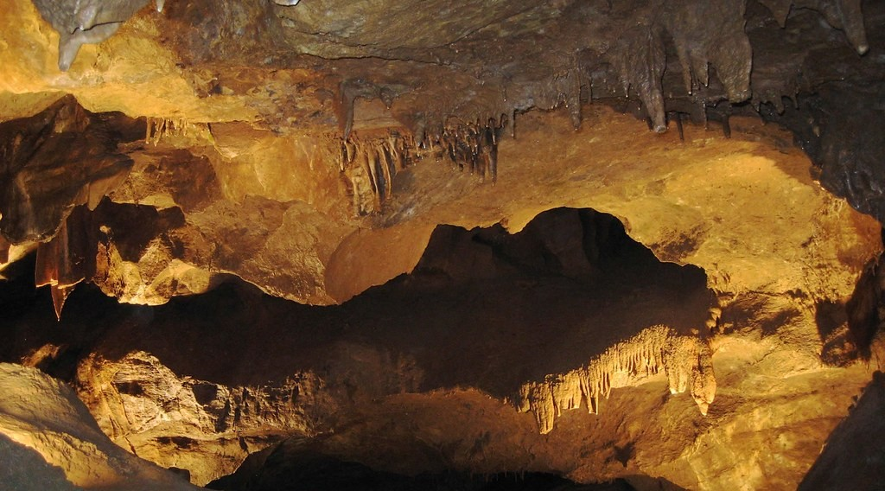
2. CARBONATION
Activity 3
A limestone cave.
Notes:
Activity 3. Look carefully at this picture: a limestone cave. Observe every detail before I ask the question.

Slide 25
2. CARBONATION
Activity 3: Question
Rain water slowly dissolves limestone. What forms after a very long time?
Notes:
Here is the question for Activity 3: Rain water slowly dissolves limestone. What forms after a very long time? Take one minute to think and write your answer in your rough notebook.

Slide 26
2. CARBONATION
Activity 3: Answer
Caves, with stalactites and stalagmites.
Notes:
Let us check the answer together. Caves, with stalactites and stalagmites.

Slide 27
BOARD SUMMARY
Board Summary
Topic: Denudation Processes, Landforms and Impacts on Man
Sub-topic: Weathering Processes: The Products and Impacts on Man
Lesson 17: Chemical Weathering Processes and Products
Notes:
Now we are going to copy the board summary. Write the title and the headings neatly in your notebooks. I will give you enough time for each slide, so do not rush.

Slide 28
BOARD SUMMARY
DEFINITIONS
The key terms of this lesson are defined as follows:
Chemical weathering: It is the decay of rocks by a chemical change in their minerals, mainly by water and air.
Notes:
Let us copy the definitions. The key terms of this lesson are defined as follows. On this slide we have Chemical weathering. Write each point on a new line, with the key term first, and explain it in your own words when we revise.

Slide 29
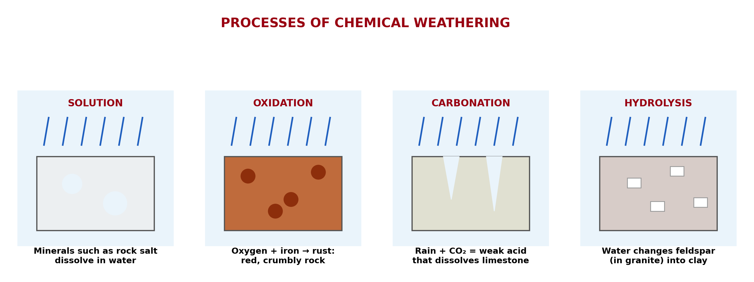
BOARD SUMMARY
1. Solution
Solution works as follows:
Process: Water dissolves soluble minerals such as rock salt and gypsum.
Illustration: processes of chemical weathering
Notes:
Let us copy Solution. Solution works as follows. Copy the point on Process on the left, then draw the diagram on the right: processes of chemical weathering. Give it a title and label it clearly.

Slide 30
BOARD SUMMARY
1. Solution
Products: The minerals are carried away in the water, and hollows and holes are left in the rock.
Notes:
We continue with Solution. On this slide we have Products. Write each point on a new line, with the key term first, and explain it in your own words when we revise.

Slide 31
BOARD SUMMARY
2. Carbonation
Carbonation works as follows:
Process: Rain water absorbs carbon dioxide and becomes a weak acid that dissolves limestone.
Illustration: a limestone cave
Notes:
Let us copy Carbonation. Carbonation works as follows. Copy the point on Process on the left, then draw the diagram on the right: a limestone cave. Give it a title and label it clearly.

Slide 32
BOARD SUMMARY
2. Carbonation
Products: Caves, stalactites, stalagmites and grooves in limestone areas.
Notes:
We continue with Carbonation. On this slide we have Products. Write each point on a new line, with the key term first, and explain it in your own words when we revise.

Slide 33
BOARD SUMMARY
3. Hydrolysis
Hydrolysis works as follows:
Process: Water reacts with the feldspar of granite and changes it into clay.
Products: Clay (kaolin) and loose quartz sand, so granite crumbles.
Notes:
Let us copy Hydrolysis. Hydrolysis works as follows. On this slide we have Process and Products. Write each point on a new line, with the key term first, and explain it in your own words when we revise.

Slide 34
BOARD SUMMARY
4. Oxidation
Oxidation works as follows:
Process: Oxygen in air and water reacts with the iron in rocks, as rust forms on iron.
Illustration: rusty iron
Notes:
Let us copy Oxidation. Oxidation works as follows. Copy the point on Process on the left, then draw the diagram on the right: rusty iron. Give it a title and label it clearly.

Slide 35
BOARD SUMMARY
4. Oxidation
Products: Red, yellow or brown crumbly rock and red soils, such as the lateritic soils of Cameroon.
Illustration: a red soil
Notes:
Copy the point on Products on the left, then draw the diagram on the right: a red soil. Give it a title and label it clearly.

Slide 36
BOARD SUMMARY
5. Hydration
Hydration works as follows:
Process: Some minerals take in water, swell and put pressure on the rock.
Products: The rock becomes softer, cracks and breaks into pieces.
Notes:
Let us copy Hydration. Hydration works as follows. On this slide we have Process and Products. Write each point on a new line, with the key term first, and explain it in your own words when we revise.

Slide 37
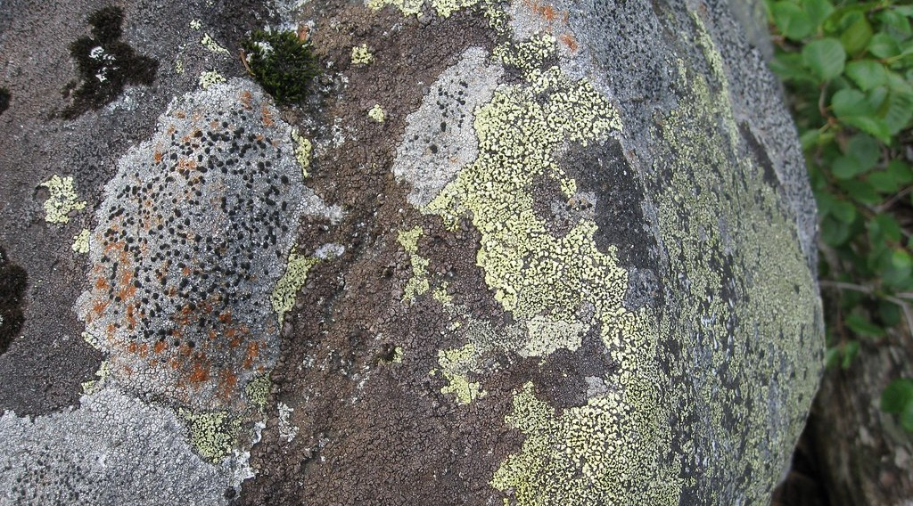
BOARD SUMMARY
6. Chemically Induced Biological Weathering
Living things weather rocks chemically as follows:
Process: Rotting plants, lichens, mosses and bacteria produce acids that attack the minerals of rocks.
Illustration: lichens on a rock
Notes:
Let us copy Chemically Induced Biological Weathering. Living things weather rocks chemically as follows. Copy the point on Process on the left, then draw the diagram on the right: lichens on a rock. Give it a title and label it clearly.

Slide 38
BOARD SUMMARY
6. Chemically Induced Biological Weathering
Products: Rotten, crumbly rock and humus that forms soil.
Notes:
We continue with Chemically Induced Biological Weathering. On this slide we have Products. Write each point on a new line, with the key term first, and explain it in your own words when we revise.

Slide 39
FORMATIVE EVALUATION
Evaluation 1
Why are the soils of Garoua red?
Notes:
Now let us check what you have understood. Question 1: Why are the soils of Garoua red? Answer in your exercise book.

Slide 40
FORMATIVE EVALUATION
Expected Answer
The iron in them is oxidised.
Notes:
The expected answer is: the iron in them is oxidised. If you got it right, well done.

Slide 41
FORMATIVE EVALUATION
Evaluation 2
What does carbonation produce in limestone?
Notes:
Now let us check what you have understood. Question 2: What does carbonation produce in limestone? Answer in your exercise book.

Slide 42
FORMATIVE EVALUATION
Expected Answer
Caves.
Notes:
The expected answer is: caves. If you got it right, well done.

Slide 43
REMEDIATION
Remediation
Fill in the blanks:
The rusting of iron in rocks is ______.
Rain water dissolves limestone by ______.
Granite changes into clay by ______.
Notes:
For those who need more practice, fill in the blanks in your exercise book. The answers are: number 1, oxidation; number 2, carbonation; number 3, hydrolysis.

Slide 44
HOMEWORK
Homework
Ask a farmer in your family where the soil of his farm comes from, and ask if he has seen rocks fall or roads blocked after heavy rain. Write his answers.
Notes:
For your homework: Ask a farmer in your family where the soil of his farm comes from, and ask if he has seen rocks fall or roads blocked after heavy rain. Write his answers. We shall correct it at the beginning of our next lesson.

Slide 45
NEXT LESSON
Next Lesson
Our next lesson will be on:
Further Study 2: The Impact of Weathering on the Environment
Notes:
Our next lesson will be on Further Study 2: The Impact of Weathering on the Environment. Thank you for your attention, and see you next time.

Slide 46
BILINGUAL GAME
Bilingual Game (Jeu Bilingue)
English | Français
Solution | La dissolution
Oxidation | L'oxydation
Carbonation | La carbonatation
Hydrolysis | L'hydrolyse
Hydration | L'hydratation
Rust | La rouille
Clay | L'argile
Limestone | Le calcaire
Notes:
Let us play the bilingual game. I say a word in English, and you give me the French word. Then we do the reverse.

Slide 47
LOGBOOK
Official Logbook (1/2)
Module / Topic | Denudation Processes, Landforms and Impacts on Man
Lesson Title | Lesson 17: Chemical Weathering Processes and Products
Expected Learning Outcomes | Define chemical weathering. Explain the main processes of chemical weathering. Name the products of each process.
Competence | Learners are able to explain why rocks rot and soils become red or clayey, and to protect metal and cement from the effects of water and air.
Notes:
I record this information in the official logbook of the class after the lesson.

Slide 48
LOGBOOK
Official Logbook (2/2)
Matter Taught | DEFINITIONS; Solution; Carbonation; Hydrolysis; Oxidation; Hydration; Chemically Induced Biological Weathering.
Evaluation | Formative evaluation and remediation exercise.
Homework | Ask a farmer in your family where the soil of his farm comes from, and ask if he has seen rocks fall or roads blocked after heavy rain. Write his answers.
Enrolment / Present / Absent | ____ / ____ / ____
Achievement | To be completed after the lesson.
Notes:
I complete the second page of the logbook: the matter taught, the evaluation, the homework and the attendance.

Slide 49
TEACHER'S NOTE
Teacher's Note
Timing: Homework correction, plan, objectives 4 min | Recall, situation, action 6 min | 3 activities 12 min | Board summary (copying) 15 min | Evaluation, remediation 5 min | Homework, next lesson 3 min | Logbook 5 min
Without the projector (Activity 1): show a rusty nail.
Without the projector (Activity 2): show red soil from the school yard.
Without the projector (Activity 3): drop vinegar on chalk: it fizzes and dissolves.
Notes:
This slide is for me, the teacher: it gives the timing of the lesson and what to do if the projector is not available.

Slide 50
REFERENCES
References
National Geography Syllabus (MINESEC), Form 4 — Denudation Processes, Landforms and Impacts on Man.
Teacher's lesson notes (Form 4), checked and corrected where necessary.
Photo, Activity 1: “Lock down!” by ViNo Gv, CC BY 2.0, via Flickr (https://www.flickr.com/photos/38217093@N03/20143584561)
Photo, Activity 2: “in the middle of nowhere, morocco” by mariusz kluzniak, CC BY-NC-ND 2.0, via Flickr (https://www.flickr.com/photos/39997856@N03/8398997251)
Photo, Activity 3: “Songam Cave” by D-Stanley, CC BY 2.0, via Flickr (https://www.flickr.com/photos/79721788@N00/5063216873)
Photo, board summary (Process): “Lichens on rock - Mason Lake” by brewbooks, CC BY-SA 2.0, via Flickr (https://www.flickr.com/photos/93452909@N00/2924427336)
Diagrams and animations: drawn for this lesson (Geography Department).
Notes:
These are the references and picture credits used to prepare this lesson.

