Slide 1
FORM 4
GEOGRAPHY
Lesson 21
The Lower Course of a River
Notes:
Good morning, class, and welcome to our geography lesson. I am your geography teacher, Mr Kamdem. Today we are starting Lesson 21: The Lower Course of a River.

Slide 2
CLASS INFO
Class, Chapter and Duration
Class | Form 4
Chapter | Denudation Processes, Landforms and Impacts on Man — The Work of Rivers on the Landscape and Impacts on Man
Duration | 50 minutes
Notes:
This lesson is for Form 4. It belongs to Denudation Processes, Landforms and Impacts on Man — The Work of Rivers on the Landscape and Impacts on Man. We shall need 50 minutes to cover it.

Slide 3
IDENTIFICATION
Lesson Identification
Topic | Denudation Processes, Landforms and Impacts on Man
Sub-topic | The Work of Rivers on the Landscape and Impacts on Man
Lesson | Lesson 21: The Lower Course of a River
Notions / Concepts | Levees, ox-bow lakes, deltas, braided channels.
Syllabus focus | Main characteristics and processes of the lower course; landforms of the lower course.
Competence | Learners are able to recognise the landforms made by river deposition and to explain why they are good for farming but exposed to floods.
Notes:
Our topic is Denudation Processes, Landforms and Impacts on Man, and the sub-topic is The Work of Rivers on the Landscape and Impacts on Man. The key notions we shall use today are: levees, ox-bow lakes, deltas, braided channels. At the end, you should be able to do this: learners are able to recognise the landforms made by river deposition and to explain why they are good for farming but exposed to floods.

Slide 4

HOMEWORK CORRECTION
Correction of the Homework
Question (Lesson 20: The Middle Course of a River):
Look at a map of the Niger Delta or the Nile Delta in your atlas. Draw its shape and name the sea it reaches.
Notes:
Before we start the new lesson, let us correct the homework I gave you at the end of Lesson 20: The Middle Course of a River. The question was: Look at a map of the Niger Delta or the Nile Delta in your atlas. Draw its shape and name the sea it reaches. Take out your exercise books.

Slide 5
HOMEWORK CORRECTION
Correction: Possible Answer
A delta is shaped like a triangle or a fan of land with many channels. The Niger Delta reaches the Gulf of Guinea (Atlantic Ocean); the Nile Delta reaches the Mediterranean Sea.
Notes:
Here is a good answer. A delta is shaped like a triangle or a fan of land with many channels. The Niger Delta reaches the Gulf of Guinea (Atlantic Ocean); the Nile Delta reaches the Mediterranean Sea. Compare it with your own answer and correct your work in red.

Slide 6
LESSON PLAN
Lesson Plan
Correction of the homework
Objectives and recall
Real-life situation and action to take
Learning activities
Board summary
Evaluation, remediation and homework
Notes:
Here is the plan of our lesson today. First, we shall correct the homework. Then we shall look at the objectives and recall what you already know. After that, we shall study a situation from real life and the action to take, and do the learning activities. Finally, we shall copy the board summary, do the evaluation and the remediation, and I will give you the homework.

Slide 7
OBJECTIVES
Objectives
By the end of this lesson, you should be able to:
Describe the main characteristics and processes of the lower course.
Explain the formation of floodplains, levees, ox-bow lakes, deltas and braided channels.
Notes:
Take your time to copy this part; we will continue together.

Slide 8
OBJECTIVES
Objectives (continued)
Give examples of these landforms.
Notes:
By the end of this lesson, you should be able to do three things. Number 1: describe the main characteristics and processes of the lower course. Number 2: explain the formation of floodplains, levees, ox-bow lakes, deltas and braided channels. Number 3: give examples of these landforms.

Slide 9
PREVIOUS KNOWLEDGE
Previous Knowledge
In the middle course, meanders form by erosion and deposition.
The river carries fine mud in suspension.
Deposition happens where the water is slow.
Notes:
Let us first remember what you already know. In the middle course, meanders form by erosion and deposition. The river carries fine mud in suspension. Deposition happens where the water is slow. Keep this in mind, because we shall build on it today.

Slide 10
REAL-LIFE SITUATION
Situation in Real Life
In the dry season, Oumar sees many sandbanks in the Benue at Garoua, and the water splits into small channels. In the rainy season, the river covers the flat land around it. He asks: "Where does all this sand come from, and what does the river build near its mouth?"
Notes:
Listen carefully to this situation from real life. In the dry season, Oumar sees many sandbanks in the Benue at Garoua, and the water splits into small channels. In the rainy season, the river covers the flat land around it. He asks: "Where does all this sand come from, and what does the river build near its mouth?" Think about it, because I am going to ask you some questions.

Slide 11
REAL-LIFE SITUATION
Situation: Question 1
What is the problem in the situation?
Notes:
Question 1: What is the problem in the situation? Think for a moment, then raise your hand to answer.

Slide 12
REAL-LIFE SITUATION
Answer
Oumar does not know where the sand comes from and what landforms the river builds in its lower course.
Notes:
Good. Oumar does not know where the sand comes from and what landforms the river builds in its lower course.

Slide 13
REAL-LIFE SITUATION
Situation: Question 2
What does he see in the dry season?
Notes:
Question 2: What does he see in the dry season? Think for a moment, then raise your hand to answer.

Slide 14
REAL-LIFE SITUATION
Answer
Sandbanks and small channels.
Notes:
Good. Sandbanks and small channels.

Slide 15
REAL-LIFE SITUATION
Situation: Question 3
What happens in the rainy season?
Notes:
Question 3: What happens in the rainy season? Think for a moment, then raise your hand to answer.

Slide 16
REAL-LIFE SITUATION
Possible Answer
The river floods the flat land around it.
Notes:
Good. The river floods the flat land around it.

Slide 17
ACTION TO TAKE
Action to Take
Farm floodplains wisely and prepare for floods.
Notes:
From this situation, the action we are working towards in this lesson is the following: farm floodplains wisely and prepare for floods.

Slide 18
JUSTIFICATION
Justification of the Lesson
This lesson helps us to know the landforms of the lower course.
Notes:
Why is this lesson important for you? This lesson helps us to know the landforms of the lower course.

Slide 19
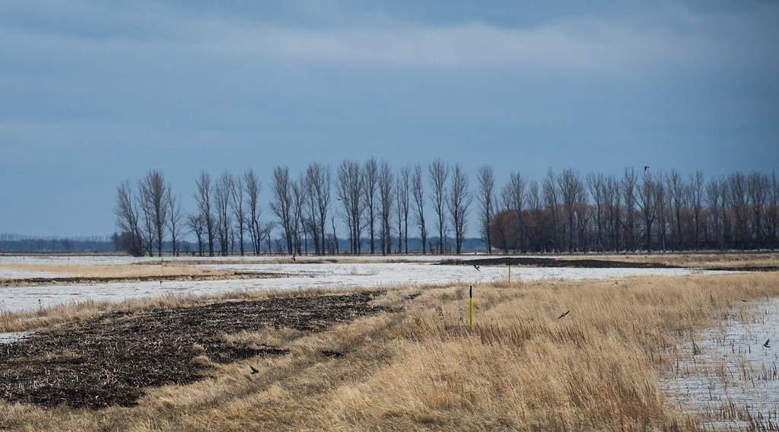
2. LANDFORMS OF THE LOWER COURSE
Activity 1
Flat land beside a river.
Notes:
Activity 1. Look carefully at this picture: flat land beside a river. Observe every detail before I ask the question.

Slide 20
2. LANDFORMS OF THE LOWER COURSE
Activity 1: Question
This flat land is covered by the river during floods. What is it called?
Notes:
Here is the question for Activity 1: This flat land is covered by the river during floods. What is it called? Take one minute to think and write your answer in your rough notebook.

Slide 21
2. LANDFORMS OF THE LOWER COURSE
Activity 1: Answer
A floodplain.
Notes:
Let us check the answer together. A floodplain.

Slide 22
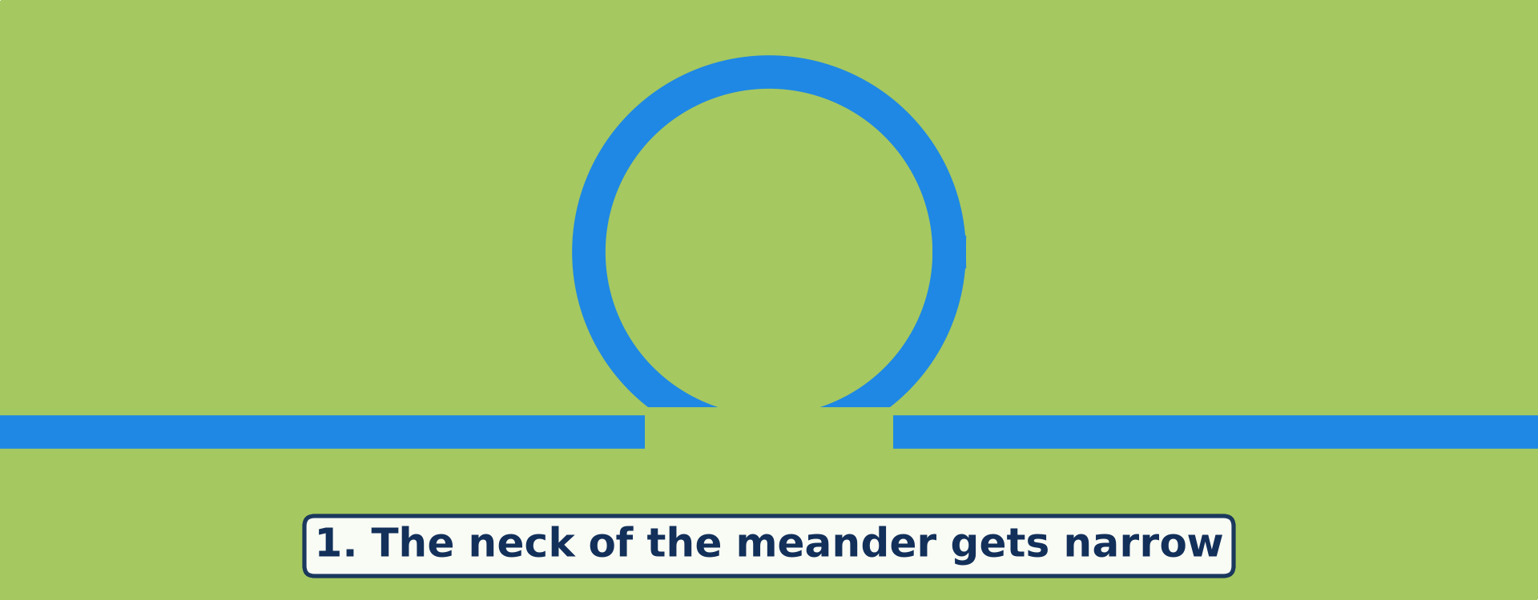
2. LANDFORMS OF THE LOWER COURSE
Activity 2
Animation: the formation of an ox-bow lake.
Notes:
Activity 2. Look carefully at this animation: animation: the formation of an ox-bow lake. Watch the animation to the end; it will play again.

Slide 23
2. LANDFORMS OF THE LOWER COURSE
Activity 2: Question
How does an ox-bow lake form?
Notes:
Here is the question for Activity 2: How does an ox-bow lake form? Take one minute to think and write your answer in your rough notebook.

Slide 24
2. LANDFORMS OF THE LOWER COURSE
Activity 2: Answer
The river cuts through the neck of a meander and leaves the old bend as a lake.
Notes:
Let us check the answer together. The river cuts through the neck of a meander and leaves the old bend as a lake.

Slide 25
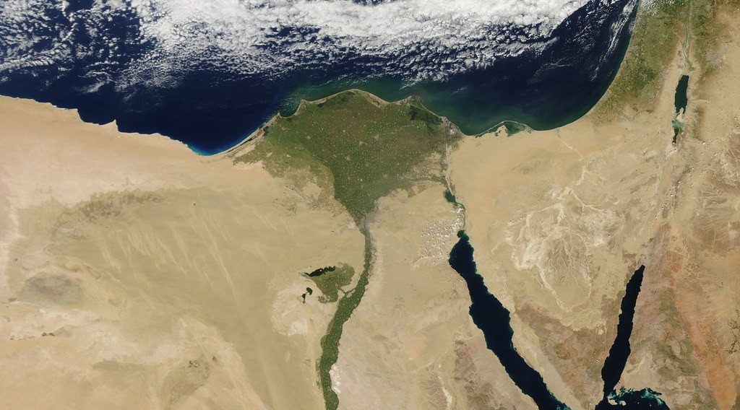
2. LANDFORMS OF THE LOWER COURSE
Activity 3
A delta seen from space.
Notes:
Activity 3. Look carefully at this picture: a delta seen from space. Observe every detail before I ask the question.

Slide 26
2. LANDFORMS OF THE LOWER COURSE
Activity 3: Question
The river drops its load where it enters the sea. What landform does it build?
Notes:
Here is the question for Activity 3: The river drops its load where it enters the sea. What landform does it build? Take one minute to think and write your answer in your rough notebook.

Slide 27
2. LANDFORMS OF THE LOWER COURSE
Activity 3: Answer
A delta.
Notes:
Let us check the answer together. A delta.

Slide 28
BOARD SUMMARY
Board Summary
Topic: Denudation Processes, Landforms and Impacts on Man
Sub-topic: The Work of Rivers on the Landscape and Impacts on Man
Lesson 21: The Lower Course of a River
Notes:
Now we are going to copy the board summary. Write the title and the headings neatly in your notebooks. I will give you enough time for each slide, so do not rush.

Slide 29
BOARD SUMMARY
DEFINITIONS
The key terms of this lesson are defined as follows:
Lower course: It is the part of a river near its mouth, where the land is almost flat.
Deposition: It is the dropping of the load when the river loses energy.
Notes:
Let us copy the definitions. The key terms of this lesson are defined as follows. On this slide we have Lower course and Deposition. Write each point on a new line, with the key term first, and explain it in your own words when we revise. When you finish, we go to the next slide.

Slide 30
BOARD SUMMARY
DEFINITIONS (continued)
Alluvium: It is the fine, fertile mud and sand deposited by a river.
Notes:
We continue with the definitions. On this slide we have Alluvium. Write each point on a new line, with the key term first, and explain it in your own words when we revise.

Slide 31
BOARD SUMMARY
1. Main Characteristics and Processes of the Lower Course
The lower course has the following characteristics and processes:
Almost flat land: The slope is very gentle, so the river flows slowly.
Wide, deep channel: The river has its greatest volume of water.
Notes:
Let us copy Main Characteristics and Processes of the Lower Course. The lower course has the following characteristics and processes. On this slide we have Almost flat land and Wide, deep channel. Write each point on a new line, with the key term first, and explain it in your own words when we revise. When you finish, we go to the next slide.

Slide 32
BOARD SUMMARY
1. Main Characteristics and Processes of the Lower Course (continued)
Fine load: The river carries mainly fine mud and sand in suspension.
Deposition: The slow river drops much of its load, especially during floods and at its mouth.
Notes:
We continue with Main Characteristics and Processes of the Lower Course. On this slide we have Fine load and Deposition. Write each point on a new line, with the key term first, and explain it in your own words when we revise.

Slide 33
BOARD SUMMARY
2. Landforms of the Lower Course
The lower course has the following landforms:
Floodplain: It is the wide, flat land beside the river, built by layers of alluvium dropped during floods.
Illustration: a floodplain
Notes:
Let us copy Landforms of the Lower Course. The lower course has the following landforms. Copy the point on Floodplain on the left, then draw the diagram on the right: a floodplain. Give it a title and label it clearly.

Slide 34
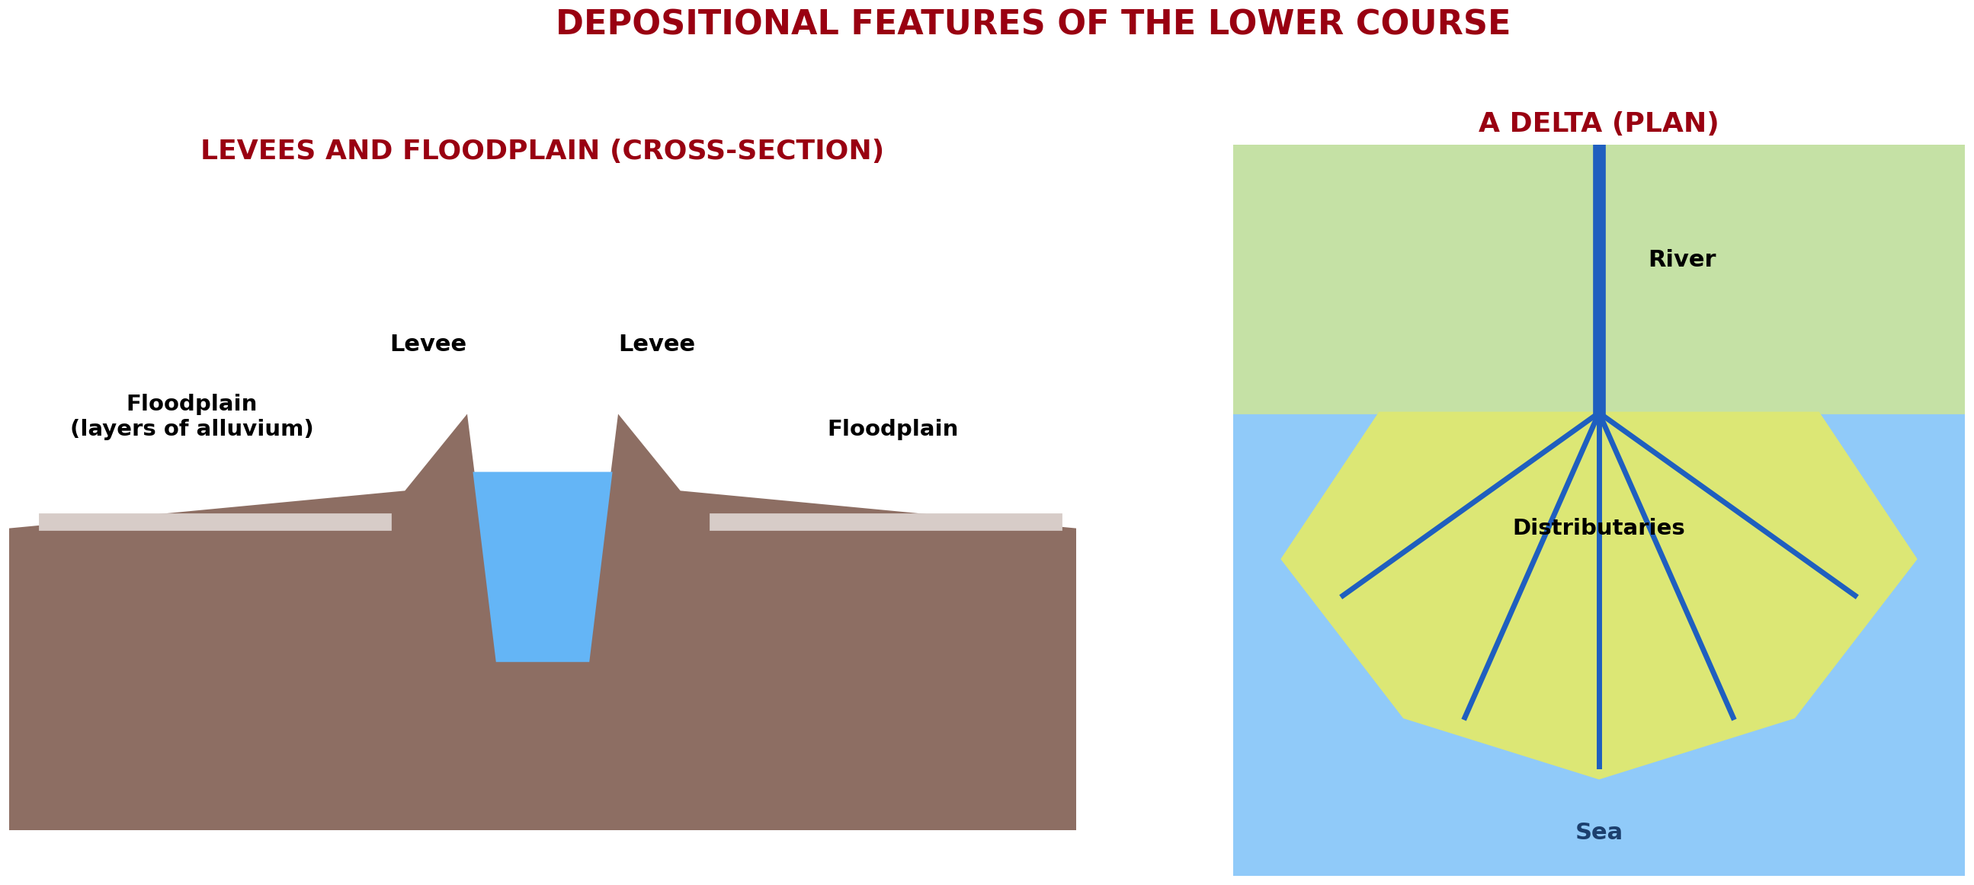
BOARD SUMMARY
2. Landforms of the Lower Course
Levees: They are raised banks built when the river drops its coarsest load next to the channel during floods.
Illustration: levees, floodplain and delta
Notes:
Copy the point on Levees on the left, then draw the diagram on the right: levees, floodplain and delta. Give it a title and label it clearly.

Slide 35
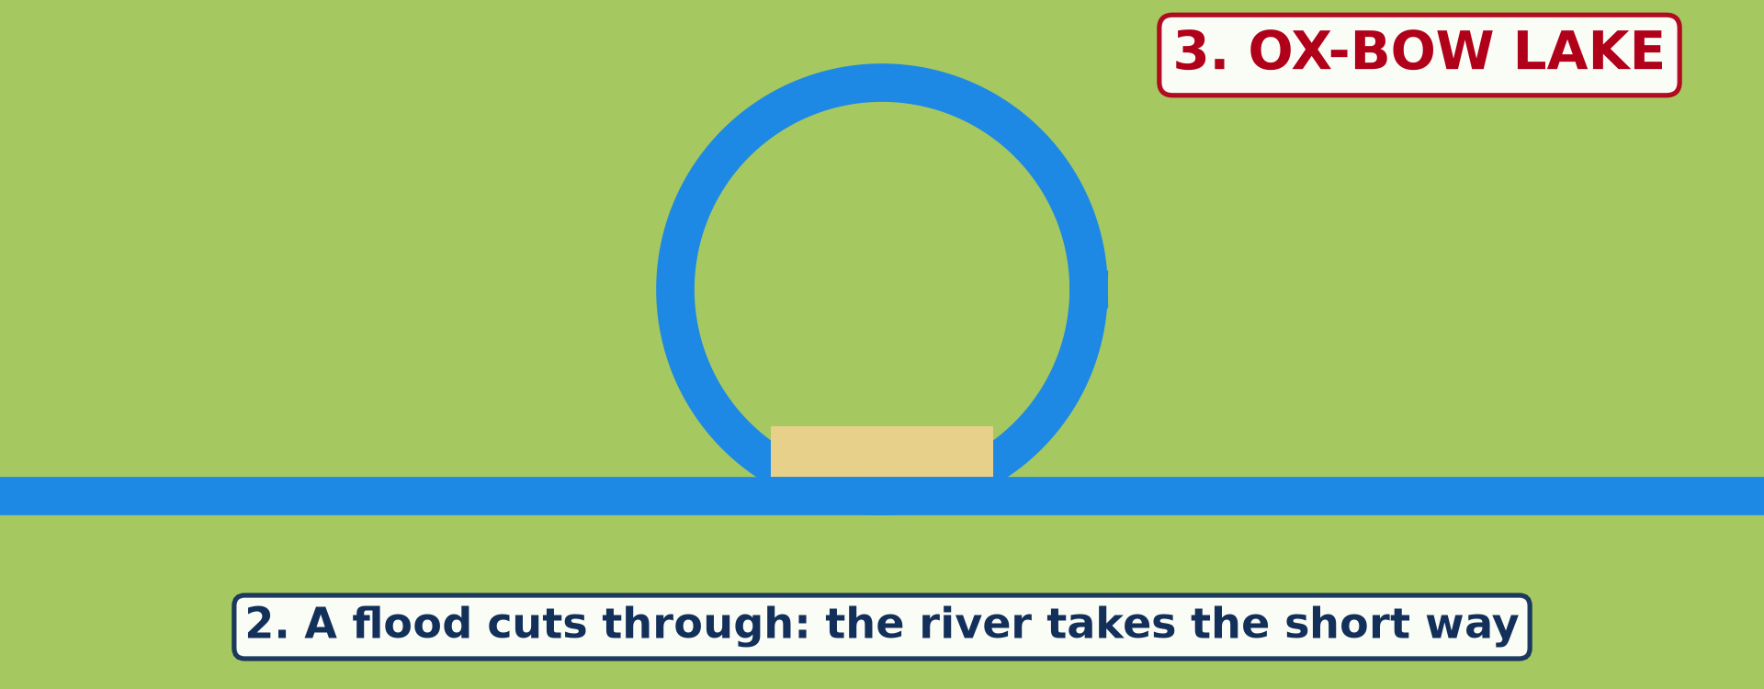
BOARD SUMMARY
2. Landforms of the Lower Course
Ox-bow lake: It is an old meander cut off from the river when a flood cuts through its neck.
Illustration: formation of an ox-bow lake
Notes:
Copy the point on Ox-bow lake on the left, then draw the diagram on the right: formation of an ox-bow lake. Give it a title and label it clearly.

Slide 36
BOARD SUMMARY
2. Landforms of the Lower Course
Delta: It is a flat, fan-shaped land built by a river at its mouth, like the deltas of the Nile and the Niger.
Illustration: a delta
Notes:
Copy the point on Delta on the left, then draw the diagram on the right: a delta. Give it a title and label it clearly.

Slide 37
BOARD SUMMARY
2. Landforms of the Lower Course
Braided channels: They form when sandbanks split the river into many small channels, as on the Benue in the dry season.
Notes:
We continue with Landforms of the Lower Course. On this slide we have Braided channels. Write each point on a new line, with the key term first, and explain it in your own words when we revise.

Slide 38
FORMATIVE EVALUATION
Evaluation 1
What is the main work of the river in its lower course?
Notes:
Now let us check what you have understood. Question 1: What is the main work of the river in its lower course? Answer in your exercise book.

Slide 39
FORMATIVE EVALUATION
Expected Answer
Deposition.
Notes:
The expected answer is: deposition. If you got it right, well done.

Slide 40
FORMATIVE EVALUATION
Evaluation 2
Give one example of a delta.
Notes:
Now let us check what you have understood. Question 2: Give one example of a delta. Answer in your exercise book.

Slide 41
FORMATIVE EVALUATION
Expected Answer
The Nile Delta (or the Niger Delta).
Notes:
The expected answer is: the Nile Delta (or the Niger Delta). If you got it right, well done.

Slide 42
REMEDIATION
Remediation
Fill in the blanks:
Flat land covered by floods is a ______.
An old meander cut off is an ______ lake.
Land made by a river at its mouth is a ______.
Notes:
For those who need more practice, fill in the blanks in your exercise book. The answers are: number 1, floodplain; number 2, ox-bow; number 3, delta.

Slide 43
HOMEWORK
Homework
Ask two people who live or farm near the Benue: what are the advantages of the river, and what problems do the floods cause? Write their answers.
Notes:
For your homework: Ask two people who live or farm near the Benue: what are the advantages of the river, and what problems do the floods cause? Write their answers. We shall correct it at the beginning of our next lesson.

Slide 44
NEXT LESSON
Next Lesson
Our next lesson will be on:
Lesson 22: Man and Floodplain Interactions
Notes:
Our next lesson will be on Lesson 22: Man and Floodplain Interactions. Thank you for your attention, and see you next time.

Slide 45
BILINGUAL GAME
Bilingual Game (Jeu Bilingue)
English | Français
Floodplain | La plaine d'inondation
Levee | La levée / le bourrelet
Ox-bow lake | Le bras mort / lac en croissant
Delta | Le delta
Distributary | Le défluent
Alluvium | L'alluvion
Braided channel | Le chenal en tresses
Flood | L'inondation / la crue
Notes:
Let us play the bilingual game. I say a word in English, and you give me the French word. Then we do the reverse.

Slide 46
LOGBOOK
Official Logbook (1/2)
Module / Topic | Denudation Processes, Landforms and Impacts on Man
Lesson Title | Lesson 21: The Lower Course of a River
Expected Learning Outcomes | Describe the main characteristics and processes of the lower course. Explain the formation of floodplains, levees, ox-bow lakes, deltas and braided channels. Give examples of these landforms.
Competence | Learners are able to recognise the landforms made by river deposition and to explain why they are good for farming but exposed to floods.
Notes:
I record this information in the official logbook of the class after the lesson.

Slide 47
LOGBOOK
Official Logbook (2/2)
Matter Taught | DEFINITIONS; Main Characteristics and Processes of the Lower Course; Landforms of the Lower Course.
Evaluation | Formative evaluation and remediation exercise.
Homework | Ask two people who live or farm near the Benue: what are the advantages of the river, and what problems do the floods cause? Write their answers.
Enrolment / Present / Absent | ____ / ____ / ____
Achievement | To be completed after the lesson.
Notes:
I complete the second page of the logbook: the matter taught, the evaluation, the homework and the attendance.

Slide 48
TEACHER'S NOTE
Teacher's Note
Timing: Homework correction, plan, objectives 4 min | Recall, situation, action 6 min | 3 activities 12 min | Board summary (copying) 15 min | Evaluation, remediation 5 min | Homework, next lesson 3 min | Logbook 5 min
Activity 2 is an animation (GIF): it plays automatically in slide-show mode.
Without the projector (Activity 1): describe the land along the Benue.
Without the projector (Activity 2): draw the three stages on the board.
Without the projector (Activity 3): show the Niger Delta in the atlas.
Notes:
This slide is for me, the teacher: it gives the timing of the lesson and what to do if the projector is not available.

Slide 49
REFERENCES
References
National Geography Syllabus (MINESEC), Form 4 — Denudation Processes, Landforms and Impacts on Man.
Teacher's lesson notes (Form 4), checked and corrected where necessary.
Photo, Activity 1: “20130501-NRCS-LSC-0605” by USDAgov, Public domain 1.0, via Flickr (https://www.flickr.com/photos/41284017@N08/8725089904)
Photo, Activity 3: “Egypt” by NASA Goddard Photo and Video, CC BY 2.0, via nasa (https://www.flickr.com/photos/24662369@N07/5635018418)
Diagrams and animations: drawn for this lesson (Geography Department).
Notes:
These are the references and picture credits used to prepare this lesson.

