Slide 1
FORM 1
GEOGRAPHY
Lesson 2
Our Planet, the Earth
Notes:
Good morning, class, and welcome to our geography lesson. I am your geography teacher, Mr Kamdem. Today we are starting Lesson 2: Our Planet, the Earth.

Slide 2
CLASS INFO
Class, Chapter and Duration
Class | Form 1
Chapter | Module 1: The Earth in the Universe
Duration | 2 periods (2 × 50 minutes)
Notes:
This lesson is for Form 1. It belongs to Module 1: The Earth in the Universe. We shall need 2 periods to cover it.

Slide 3
IDENTIFICATION
Lesson Identification
Topic | The Earth in the Universe
Sub-topic | The Earth: A Planet of the Solar System
Lesson | Lesson 2: Our Planet, the Earth
Notions / Concepts | Universe, solar system, planet, latitude, longitude, continent, ocean.
Syllabus focus | The Earth in the solar system; shape, dimensions and locational references; distribution of landmasses and water bodies.
Competence | Learners are able to situate the Earth in the solar system and describe its shape, size and main land and water areas.
Notes:
Our topic is The Earth in the Universe, and the sub-topic is The Earth: A Planet of the Solar System. The key notions we shall use today are: universe, solar system, planet, latitude, longitude, continent, ocean. At the end, you should be able to do this: learners are able to situate the Earth in the solar system and describe its shape, size and main land and water areas.

Slide 4

HOMEWORK CORRECTION
Correction of the Homework
Question (Lesson 1: Geography: Meaning, Branches, Methods and Importance):
Write three physical features and three human activities that you see on your way to school.
Notes:
Before we start the new lesson, let us correct the homework I gave you at the end of Lesson 1: Geography: Meaning, Branches, Methods and Importance. The question was: Write three physical features and three human activities that you see on your way to school. Take out your exercise books.

Slide 5
HOMEWORK CORRECTION
Correction: Possible Answer
Physical features: a hill, the River Benue, trees and grass. Human activities: trading in the market, moto-taxi transport, farming.
Notes:
Here is a good answer. Physical features: a hill, the River Benue, trees and grass. Human activities: trading in the market, moto-taxi transport, farming. Compare it with your own answer and correct your work in red.

Slide 6
LESSON PLAN
Lesson Plan
Correction of the homework
Objectives and recall
Real-life situation and action to take
Learning activities
Board summary
Evaluation, remediation and homework
Notes:
Here is the plan of our lesson today. First, we shall correct the homework. Then we shall look at the objectives and recall what you already know. After that, we shall study a situation from real life and the action to take, and do the learning activities. Finally, we shall copy the board summary, do the evaluation and the remediation, and I will give you the homework.

Slide 7
OBJECTIVES
Objectives
By the end of this lesson, you should be able to:
Situate the Earth in the solar system.
Describe the shape and the dimensions of the Earth and its locational references.
Name the continents and the oceans.
Notes:
By the end of this lesson, you should be able to do three things. Number 1: situate the Earth in the solar system. Number 2: describe the shape and the dimensions of the Earth and its locational references. Number 3: name the continents and the oceans.

Slide 8
PREVIOUS KNOWLEDGE
Previous Knowledge
Geography studies the Earth and its people.
The Sun gives us light and heat.
Maps show land and water.
Notes:
Let us first remember what you already know. Geography studies the Earth and its people. The Sun gives us light and heat. Maps show land and water. Keep this in mind, because we shall build on it today.

Slide 9
REAL-LIFE SITUATION
Situation in Real Life
During a clear night in Garoua, Aminatou sees many stars and asks her brother if the Earth is also a star. Her brother shows her a globe and says that the Earth is a planet, mostly covered by water.
Notes:
Listen carefully to this situation from real life. During a clear night in Garoua, Aminatou sees many stars and asks her brother if the Earth is also a star. Her brother shows her a globe and says that the Earth is a planet, mostly covered by water. Think about it, because I am going to ask you some questions.

Slide 10
REAL-LIFE SITUATION
Situation: Question 1
What is the problem in the situation?
Notes:
Question 1: What is the problem in the situation? Think for a moment, then raise your hand to answer.

Slide 11
REAL-LIFE SITUATION
Answer
Aminatou does not know what kind of body the Earth is.
Notes:
Good. Aminatou does not know what kind of body the Earth is.

Slide 12
REAL-LIFE SITUATION
Situation: Question 2
Is the Earth a star?
Notes:
Question 2: Is the Earth a star? Think for a moment, then raise your hand to answer.

Slide 13
REAL-LIFE SITUATION
Answer
No, it is a planet that moves around the Sun.
Notes:
Good. No, it is a planet that moves around the Sun.

Slide 14
REAL-LIFE SITUATION
Situation: Question 3
What covers most of the Earth?
Notes:
Question 3: What covers most of the Earth? Think for a moment, then raise your hand to answer.

Slide 15
REAL-LIFE SITUATION
Possible Answer
Water (oceans and seas).
Notes:
Good. Water (oceans and seas).

Slide 16
ACTION TO TAKE
Action to Take
Use a globe or a map to locate the continents and oceans of the world.
Notes:
From this situation, the action we are working towards in this lesson is the following: use a globe or a map to locate the continents and oceans of the world.

Slide 17
JUSTIFICATION
Justification of the Lesson
This lesson helps us to know the place of our planet in the universe and its main land and water areas.
Notes:
Why is this lesson important for you? This lesson helps us to know the place of our planet in the universe and its main land and water areas.

Slide 18
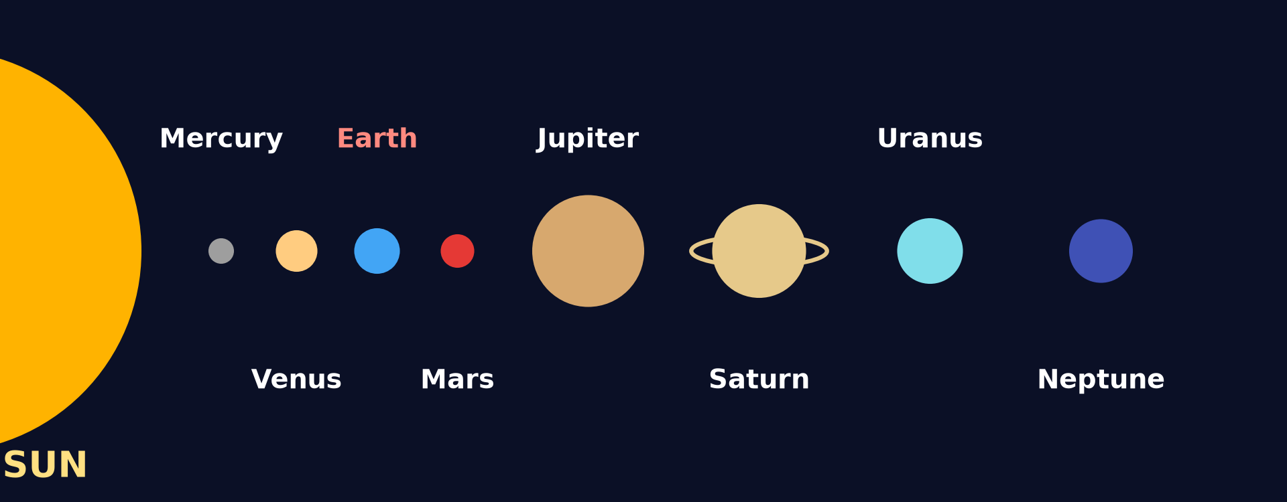
1. THE EARTH IN THE SOLAR SYSTEM
Activity 1
The Sun and the eight planets.
Notes:
Activity 1. Look carefully at this diagram: the Sun and the eight planets. Observe every detail before I ask the question.

Slide 19
1. THE EARTH IN THE SOLAR SYSTEM
Activity 1: Question
What is the position of the Earth from the Sun? How many planets are there?
Notes:
Here is the question for Activity 1: What is the position of the Earth from the Sun? How many planets are there? Take one minute to think and write your answer in your rough notebook.

Slide 20
1. THE EARTH IN THE SOLAR SYSTEM
Activity 1: Answer
The Earth is the third planet from the Sun. There are eight planets.
Notes:
Let us check the answer together. The Earth is the third planet from the Sun. There are eight planets.

Slide 21

2. SHAPE AND DIMENSIONS
Activity 2
The Earth seen from space.
Notes:
Activity 2. Look carefully at this picture: the Earth seen from space. Observe every detail before I ask the question.

Slide 22
2. SHAPE AND DIMENSIONS
Activity 2: Question
What is the shape of the Earth?
Notes:
Here is the question for Activity 2: What is the shape of the Earth? Take one minute to think and write your answer in your rough notebook.

Slide 23
2. SHAPE AND DIMENSIONS
Activity 2: Answer
It is round like a ball, slightly flat at the poles (a sphere).
Notes:
Let us check the answer together. It is round like a ball, slightly flat at the poles (a sphere).

Slide 24

2. LOCATIONAL REFERENCES
Activity 3
The main lines of latitude.
Notes:
Activity 3. Look carefully at this diagram: the main lines of latitude. Observe every detail before I ask the question.

Slide 25
2. LOCATIONAL REFERENCES
Activity 3: Question
Which imaginary line divides the Earth into a northern and a southern half?
Notes:
Here is the question for Activity 3: Which imaginary line divides the Earth into a northern and a southern half? Take one minute to think and write your answer in your rough notebook.

Slide 26
2. LOCATIONAL REFERENCES
Activity 3: Answer
The Equator (0° latitude).
Notes:
Let us check the answer together. The Equator (0° latitude).

Slide 27
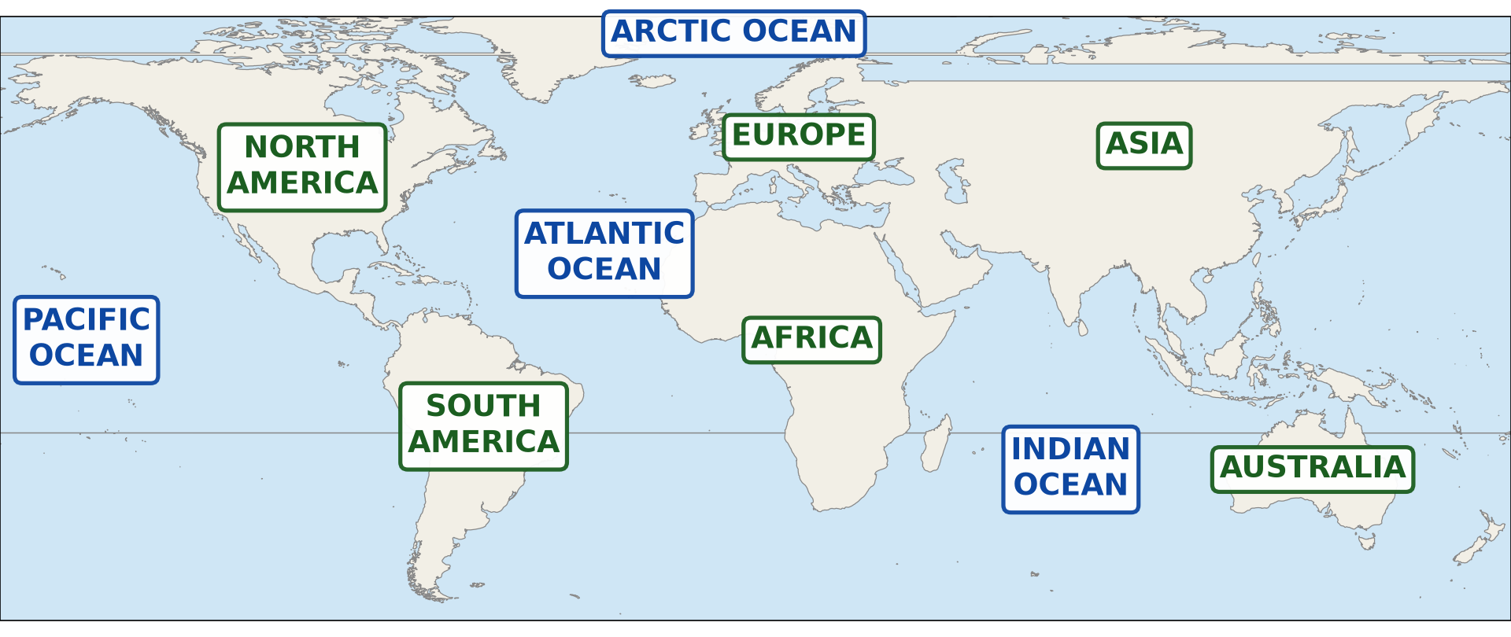
3. LANDMASSES AND WATER BODIES
Activity 4
The continents and oceans.
Notes:
Activity 4. Look carefully at this diagram: the continents and oceans. Observe every detail before I ask the question.

Slide 28
3. LANDMASSES AND WATER BODIES
Activity 4: Question
Name four continents and three oceans.
Notes:
Here is the question for Activity 4: Name four continents and three oceans. Take one minute to think and write your answer in your rough notebook.

Slide 29
3. LANDMASSES AND WATER BODIES
Activity 4: Answer
Africa, Asia, Europe, America (also Australia, Antarctica); the Pacific, the Atlantic and the Indian Ocean.
Notes:
Let us check the answer together. Africa, Asia, Europe, America (also Australia, Antarctica); the Pacific, the Atlantic and the Indian Ocean.

Slide 30
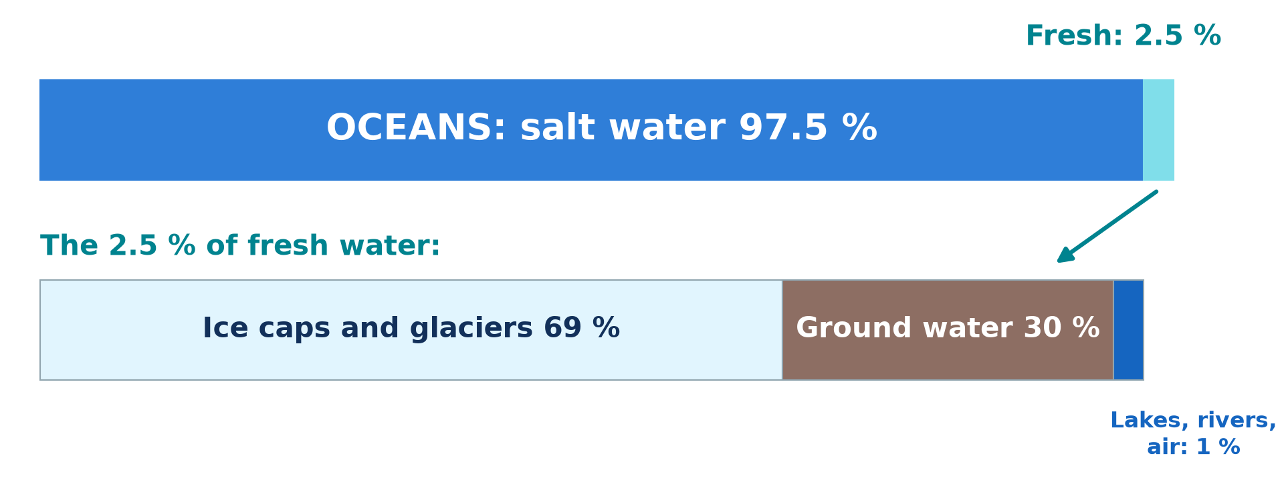
3. LANDMASSES AND WATER BODIES
Activity 5
Water on the Earth.
Notes:
Activity 5. Look carefully at this diagram: water on the Earth. Observe every detail before I ask the question.

Slide 31
3. LANDMASSES AND WATER BODIES
Activity 5: Question
Which covers more of the Earth: land or water?
Notes:
Here is the question for Activity 5: Which covers more of the Earth: land or water? Take one minute to think and write your answer in your rough notebook.

Slide 32
3. LANDMASSES AND WATER BODIES
Activity 5: Answer
Water covers about 71 % of the Earth; land covers only about 29 %.
Notes:
Let us check the answer together. Water covers about 71 % of the Earth; land covers only about 29 %.

Slide 33
BOARD SUMMARY
Board Summary
Topic: The Earth in the Universe
Sub-topic: The Earth: A Planet of the Solar System
Lesson 2: Our Planet, the Earth
Notes:
Now we are going to copy the board summary. Write the title and the headings neatly in your notebooks. I will give you enough time for each slide, so do not rush.

Slide 34
BOARD SUMMARY
DEFINITIONS
The key terms of this lesson are defined as follows:
Universe: It is all of space and everything in it: stars, planets and galaxies.
Solar system: It is the Sun and the eight planets that move around it.
Notes:
Let us copy the definitions. The key terms of this lesson are defined as follows. On this slide we have Universe and Solar system. Write each point on a new line, with the key term first, and explain it in your own words when we revise.

Slide 35
BOARD SUMMARY
1. The Earth in the Solar System
The Earth is situated as follows:
A planet: The Earth is the third of eight planets that move around the Sun.
Life: The Earth is the only planet known to have life, water and air to breathe.
Notes:
Let us copy The Earth in the Solar System. The Earth is situated as follows. On this slide we have A planet and Life. Write each point on a new line, with the key term first, and explain it in your own words when we revise.

Slide 36
BOARD SUMMARY
1. The Earth in the Solar System
Illustration: the solar system
Notes:
Now draw this illustration in your notebook: the solar system. Give it a title and label it clearly.

Slide 37
BOARD SUMMARY
2. Shape, Dimensions and Locational References
The Earth has the following characteristics:
Shape: The Earth is a sphere slightly flattened at the poles.
Dimensions: The distance around the Equator is about 40,000 km and the diameter is about 12,700 km.
Notes:
Let us copy Shape, Dimensions and Locational References. The Earth has the following characteristics. On this slide we have Shape and Dimensions. Write each point on a new line, with the key term first, and explain it in your own words when we revise. When you finish, we go to the next slide.

Slide 38
BOARD SUMMARY
2. Shape, Dimensions and Locational References (continued)
Locational references: Lines of latitude and longitude help us to locate any place on the Earth.
Notes:
We continue with Shape, Dimensions and Locational References. On this slide we have Locational references. Write each point on a new line, with the key term first, and explain it in your own words when we revise.

Slide 39
BOARD SUMMARY
3. Landmasses and Water Bodies
The surface of the Earth is shared as follows:
Continents: The seven continents are Africa, Asia, Europe, North America, South America, Australia and Antarctica.
Oceans: The main oceans are the Pacific, the Atlantic, the Indian and the Arctic Oceans.
Notes:
Let us copy Landmasses and Water Bodies. The surface of the Earth is shared as follows. On this slide we have Continents and Oceans. Write each point on a new line, with the key term first, and explain it in your own words when we revise. When you finish, we go to the next slide.

Slide 40
BOARD SUMMARY
3. Landmasses and Water Bodies (continued)
Distribution: Water covers about 71 % of the Earth and land covers about 29 %.
Notes:
We continue with Landmasses and Water Bodies. On this slide we have Distribution. Write each point on a new line, with the key term first, and explain it in your own words when we revise.

Slide 41
BOARD SUMMARY
3. Landmasses and Water Bodies
Illustration: the continents and oceans
Notes:
Now draw this illustration in your notebook: the continents and oceans. Give it a title and label it clearly.

Slide 42
FORMATIVE EVALUATION
Evaluation 1
What is the position of the Earth in the solar system?
Notes:
Now let us check what you have understood. Question 1: What is the position of the Earth in the solar system? Answer in your exercise book.

Slide 43
FORMATIVE EVALUATION
Expected Answer
It is the third planet from the Sun.
Notes:
The expected answer is: it is the third planet from the Sun. If you got it right, well done.

Slide 44
FORMATIVE EVALUATION
Evaluation 2
Name three continents and two oceans.
Notes:
Now let us check what you have understood. Question 2: Name three continents and two oceans. Answer in your exercise book.

Slide 45
FORMATIVE EVALUATION
Expected Answer
Africa, Asia, Europe; the Atlantic and the Pacific Oceans.
Notes:
The expected answer is: africa, Asia, Europe; the Atlantic and the Pacific Oceans. If you got it right, well done.

Slide 46
REMEDIATION
Remediation
Fill in the blanks:
The Earth is the ______ planet from the Sun.
The largest ocean is the ______ Ocean.
Cameroon is on the continent of ______.
Notes:
For those who need more practice, fill in the blanks in your exercise book. The answers are: number 1, third; number 2, Pacific; number 3, Africa.

Slide 47
HOMEWORK
Homework
On a map of the world in your atlas, find Cameroon, the Equator and the Greenwich Meridian.
Notes:
For your homework: On a map of the world in your atlas, find Cameroon, the Equator and the Greenwich Meridian. We shall correct it at the beginning of our next lesson.

Slide 48
NEXT LESSON
Next Lesson
Our next lesson will be on:
Practical Work 1: Representation of the Earth's Shape and Size
Notes:
Our next lesson will be on Practical Work 1: Representation of the Earth's Shape and Size. Thank you for your attention, and see you next time.

Slide 49
BILINGUAL GAME
Bilingual Game (Jeu Bilingue)
English | Français
Planet | La planète
Solar system | Le système solaire
Continent | Le continent
Ocean | L'océan
Equator | L'équateur
Globe | Le globe
Notes:
Let us play the bilingual game. I say a word in English, and you give me the French word. Then we do the reverse.

Slide 50
LOGBOOK
Official Logbook (1/2)
Module / Topic | The Earth in the Universe
Lesson Title | Lesson 2: Our Planet, the Earth
Expected Learning Outcomes | Situate the Earth in the solar system. Describe the shape and the dimensions of the Earth and its locational references. Name the continents and the oceans.
Competence | Learners are able to situate the Earth in the solar system and describe its shape, size and main land and water areas.
Notes:
I record this information in the official logbook of the class after the lesson.

Slide 51
LOGBOOK
Official Logbook (2/2)
Matter Taught | DEFINITIONS; The Earth in the Solar System; Shape, Dimensions and Locational References; Landmasses and Water Bodies.
Evaluation | Formative evaluation and remediation exercise.
Homework | On a map of the world in your atlas, find Cameroon, the Equator and the Greenwich Meridian.
Enrolment / Present / Absent | ____ / ____ / ____
Achievement | To be completed after the lesson.
Notes:
I complete the second page of the logbook: the matter taught, the evaluation, the homework and the attendance.

Slide 52
TEACHER'S NOTE
Teacher's Note
Timing: Homework correction, plan, objectives 8 min | Recall, situation, action 10 min | 5 activities 30 min | Board summary (copying) 30 min | Evaluation, remediation 10 min | Homework, next lesson 5 min | Logbook 7 min
Without the projector (Activity 1): draw the Sun and eight circles on the board.
Without the projector (Activity 2): show a ball or an orange.
Without the projector (Activity 3): draw a circle with the Equator.
Without the projector (Activity 4): show a world map.
Without the projector (Activity 5): shade a circle: 7 parts water, 3 parts land.
Notes:
This slide is for me, the teacher: it gives the timing of the lesson and what to do if the projector is not available.

Slide 53
REFERENCES
References
Geography Syllabus, Forms I–V, MINESEC (2023) — Form 1, Module 1: The Earth in the Universe.
Photo, Activity 2: “Blue Marble, Eastern Hemisphere March 2014” by NASA Goddard Photo and Video, CC BY 2.0, via nasa (https://www.flickr.com/photos/24662369@N07/14990033062)
Diagrams and animations: drawn for this lesson (Geography Department).
Notes:
These are the references and picture credits used to prepare this lesson.

