Slide 1
FORM 4
GEOGRAPHY
Lesson 28
Depositional Features of Wind Action
Notes:
Good morning, class, and welcome to our geography lesson. I am your geography teacher, Mr Kamdem. Today we are starting Lesson 28: Depositional Features of Wind Action.

Slide 2
CLASS INFO
Class, Chapter and Duration
Class | Form 4
Chapter | Denudation Processes, Landforms and Impacts on Man — Hot Desert Landscapes: Wind Action and Human Adaptation
Duration | 50 minutes
Notes:
This lesson is for Form 4. It belongs to Denudation Processes, Landforms and Impacts on Man — Hot Desert Landscapes: Wind Action and Human Adaptation. We shall need 50 minutes to cover it.

Slide 3
IDENTIFICATION
Lesson Identification
Topic | Denudation Processes, Landforms and Impacts on Man
Sub-topic | Hot Desert Landscapes: Wind Action and Human Adaptation
Lesson | Lesson 28: Depositional Features of Wind Action
Notions / Concepts | Barchans and seif dunes.
Syllabus focus | Depositional features of wind action; sand dunes (barchans and seif dunes).
Competence | Learners are able to explain why sand and dust pile up behind walls, stones and bushes, and to recognise barchan and seif dunes.
Notes:
Our topic is Denudation Processes, Landforms and Impacts on Man, and the sub-topic is Hot Desert Landscapes: Wind Action and Human Adaptation. The key notions we shall use today are: barchans and seif dunes. At the end, you should be able to do this: learners are able to explain why sand and dust pile up behind walls, stones and bushes, and to recognise barchan and seif dunes.

Slide 4

HOMEWORK CORRECTION
Correction of the Homework
Question (Lesson 27: Semi-Arid and Desert Landscapes):
After the next windy day, look around your compound. Find a place where sand or dust has piled up, for example behind a wall, a stone or a bush, and write down why you think it collected there.
Notes:
Before we start the new lesson, let us correct the homework I gave you at the end of Lesson 27: Semi-Arid and Desert Landscapes. The question was: After the next windy day, look around your compound. Find a place where sand or dust has piled up, for example behind a wall, a stone or a bush, and write down why you think it collected there. Take out your exercise books.

Slide 5
HOMEWORK CORRECTION
Correction: Possible Answer
Sand piles up behind a wall, a stone or a bush because the obstacle slows down the wind, so the wind drops the sand it was carrying.
Notes:
Here is a good answer. Sand piles up behind a wall, a stone or a bush because the obstacle slows down the wind, so the wind drops the sand it was carrying. Compare it with your own answer and correct your work in red.

Slide 6
LESSON PLAN
Lesson Plan
Correction of the homework
Objectives and recall
Real-life situation and action to take
Learning activities
Board summary
Evaluation, remediation and homework
Notes:
Here is the plan of our lesson today. First, we shall correct the homework. Then we shall look at the objectives and recall what you already know. After that, we shall study a situation from real life and the action to take, and do the learning activities. Finally, we shall copy the board summary, do the evaluation and the remediation, and I will give you the homework.

Slide 7
OBJECTIVES
Objectives
By the end of this lesson, you should be able to:
Explain why the wind deposits the sand and dust it carries.
Describe the structure and movement of a sand dune.
Notes:
Take your time to copy this part; we will continue together.

Slide 8
OBJECTIVES
Objectives (continued)
Distinguish between barchan and seif dunes, and define loess.
Notes:
By the end of this lesson, you should be able to do three things. Number 1: explain why the wind deposits the sand and dust it carries. Number 2: describe the structure and movement of a sand dune. Number 3: distinguish between barchan and seif dunes, and define loess.

Slide 9
PREVIOUS KNOWLEDGE
Previous Knowledge
Wind erodes the land by deflation, abrasion and attrition.
Wind erosion forms rock pedestals, zeugen, yardangs and inselbergs.
The sand and dust removed by the wind must be dropped somewhere.
Notes:
Let us first remember what you already know. Wind erodes the land by deflation, abrasion and attrition. Wind erosion forms rock pedestals, zeugen, yardangs and inselbergs. The sand and dust removed by the wind must be dropped somewhere. Keep this in mind, because we shall build on it today.

Slide 10
REAL-LIFE SITUATION
Situation in Real Life
After a windy Harmattan day, Aminatou sweeps her compound. The sand has piled up only in some places: at the foot of a wall, behind a stone and around a bush.
Notes:
Listen carefully to this situation from real life. After a windy Harmattan day, Aminatou sweeps her compound. The sand has piled up only in some places: at the foot of a wall, behind a stone and around a bush. Think about it, because I am going to ask you some questions.

Slide 11
REAL-LIFE SITUATION
Situation: Question 1
What is the problem in the situation?
Notes:
Question 1: What is the problem in the situation? Think for a moment, then raise your hand to answer.

Slide 12
REAL-LIFE SITUATION
Answer
Aminatou does not know why the sand piled up in some places.
Notes:
Good. Aminatou does not know why the sand piled up in some places.

Slide 13
REAL-LIFE SITUATION
Situation: Question 2
Where did the sand pile up?
Notes:
Question 2: Where did the sand pile up? Think for a moment, then raise your hand to answer.

Slide 14
REAL-LIFE SITUATION
Answer
Near the wall, the stone and the bush.
Notes:
Good. Near the wall, the stone and the bush.

Slide 15
REAL-LIFE SITUATION
Situation: Question 3
Why there?
Notes:
Question 3: Why there? Think for a moment, then raise your hand to answer.

Slide 16
REAL-LIFE SITUATION
Possible Answer
These obstacles slow the wind, so it drops the sand.
Notes:
Good. These obstacles slow the wind, so it drops the sand.

Slide 17
ACTION TO TAKE
Action to Take
Plant trees and hedges to stop moving sand.
Notes:
From this situation, the action we are working towards in this lesson is the following: plant trees and hedges to stop moving sand.

Slide 18
JUSTIFICATION
Justification of the Lesson
This lesson helps us to know the landforms made when the wind drops sand.
Notes:
Why is this lesson important for you? This lesson helps us to know the landforms made when the wind drops sand.

Slide 19
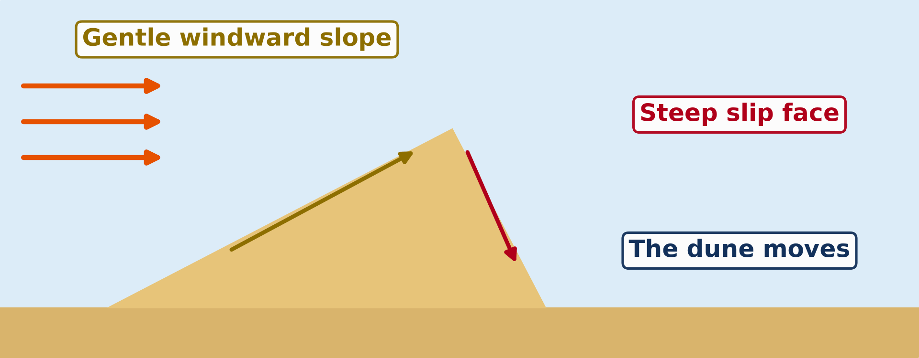
2. SAND DUNES
Activity 1
Animation: a sand dune moves.
Notes:
Activity 1. Look carefully at this animation: animation: a sand dune moves. Watch the animation to the end; it will play again.

Slide 20
2. SAND DUNES
Activity 1: Question
Which slope faces the wind? Is it gentle or steep?
Notes:
Here is the question for Activity 1: Which slope faces the wind? Is it gentle or steep? Take one minute to think and write your answer in your rough notebook.

Slide 21
2. SAND DUNES
Activity 1: Answer
The windward slope. It is gentle.
Notes:
Let us check the answer together. The windward slope. It is gentle.

Slide 22
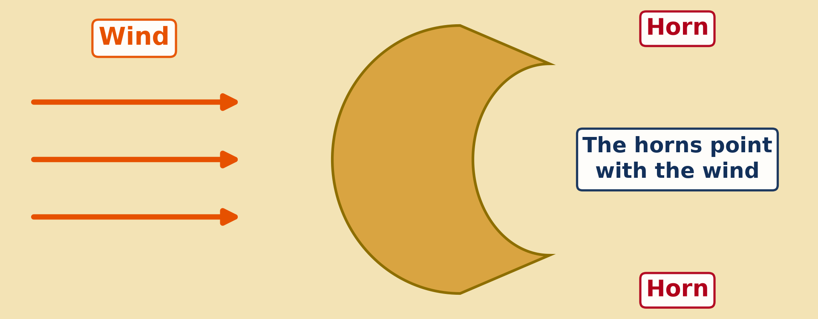
2. BARCHANS
Activity 2
A dune seen from above, shaped like a crescent (a new moon).
Notes:
Activity 2. Look carefully at this diagram: a dune seen from above, shaped like a crescent (a new moon). Observe every detail before I ask the question.

Slide 23
2. BARCHANS
Activity 2: Question
What is this dune called?
Notes:
Here is the question for Activity 2: What is this dune called? Take one minute to think and write your answer in your rough notebook.

Slide 24
2. BARCHANS
Activity 2: Answer
A barchan.
Notes:
Let us check the answer together. A barchan.

Slide 25
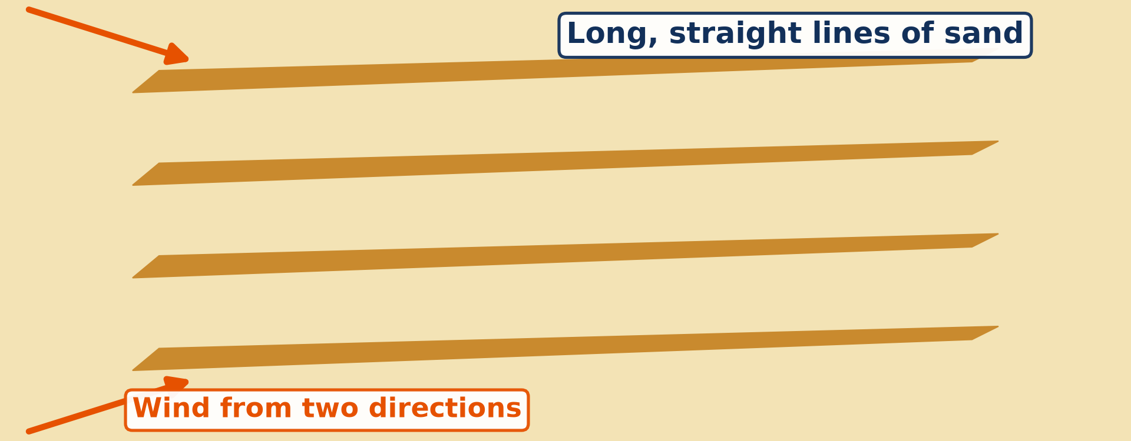
2. SEIF DUNES
Activity 3
Long, straight lines of dunes seen from above.
Notes:
Activity 3. Look carefully at this diagram: long, straight lines of dunes seen from above. Observe every detail before I ask the question.

Slide 26
2. SEIF DUNES
Activity 3: Question
What do we call these long, narrow dunes?
Notes:
Here is the question for Activity 3: What do we call these long, narrow dunes? Take one minute to think and write your answer in your rough notebook.

Slide 27
2. SEIF DUNES
Activity 3: Answer
Seif dunes.
Notes:
Let us check the answer together. Seif dunes.

Slide 28
BOARD SUMMARY
Board Summary
Topic: Denudation Processes, Landforms and Impacts on Man
Sub-topic: Hot Desert Landscapes: Wind Action and Human Adaptation
Lesson 28: Depositional Features of Wind Action
Notes:
Now we are going to copy the board summary. Write the title and the headings neatly in your notebooks. I will give you enough time for each slide, so do not rush.

Slide 29
BOARD SUMMARY
1. Wind Deposition
The wind drops sand for the following reasons:
Meaning: Wind deposition is the dropping of sand and dust carried by the wind.
Slower wind: The wind drops sand when it loses its force.
Notes:
Let us copy Wind Deposition. The wind drops sand for the following reasons. On this slide we have Meaning and Slower wind. Write each point on a new line, with the key term first, and explain it in your own words when we revise. When you finish, we go to the next slide.

Slide 30
BOARD SUMMARY
1. Wind Deposition (continued)
Obstacles: Walls, stones and bushes slow the wind and make it drop sand.
Rain: Wet sand becomes heavy and stops moving.
Notes:
We continue with Wind Deposition. On this slide we have Obstacles and Rain. Write each point on a new line, with the key term first, and explain it in your own words when we revise.

Slide 31
BOARD SUMMARY
2. Depositional Features
Wind deposition forms the following features:
Sand dune: It is a hill of sand with a gentle windward slope and a steep slip face.
Barchan: It is a crescent-shaped dune whose horns point in the direction of the wind.
Notes:
Let us copy Depositional Features. Wind deposition forms the following features. On this slide we have Sand dune and Barchan. Write each point on a new line, with the key term first, and explain it in your own words when we revise. When you finish, we go to the next slide.

Slide 32
BOARD SUMMARY
2. Depositional Features (continued)
Seif dune: It is a long, straight ridge of sand lying parallel to the wind.
Loess: It is a thick layer of fine dust deposited far from the desert.
Notes:
We continue with Depositional Features. On this slide we have Seif dune and Loess. Write each point on a new line, with the key term first, and explain it in your own words when we revise.

Slide 33
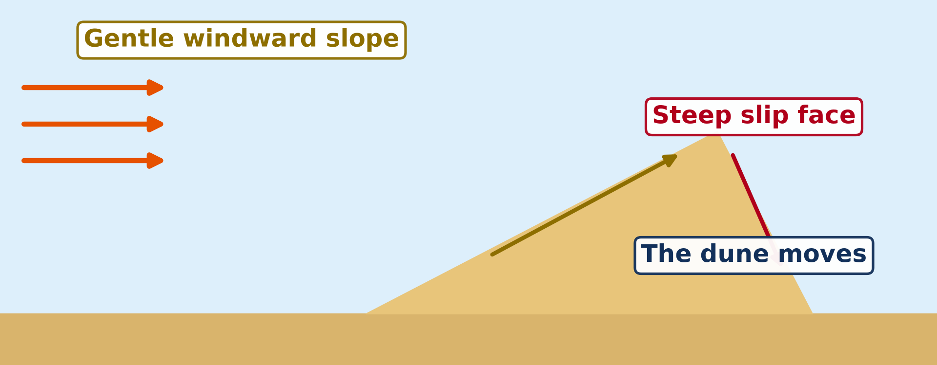
BOARD SUMMARY
2. Depositional Features
Illustration: how a dune moves
Notes:
Now draw this illustration in your notebook: how a dune moves. Give it a title and label it clearly.

Slide 34
FORMATIVE EVALUATION
Evaluation 1
Why does the wind drop its sand behind a wall?
Notes:
Now let us check what you have understood. Question 1: Why does the wind drop its sand behind a wall? Answer in your exercise book.

Slide 35
FORMATIVE EVALUATION
Expected Answer
The wall slows the wind.
Notes:
The expected answer is: the wall slows the wind. If you got it right, well done.

Slide 36
FORMATIVE EVALUATION
Evaluation 2
What is a barchan?
Notes:
Now let us check what you have understood. Question 2: What is a barchan? Answer in your exercise book.

Slide 37
FORMATIVE EVALUATION
Expected Answer
A dune shaped like a crescent.
Notes:
The expected answer is: a dune shaped like a crescent. If you got it right, well done.

Slide 38
REMEDIATION
Remediation
Fill in the blanks:
A hill of sand made by the wind is a sand ______.
A crescent-shaped dune is a ______.
Long, straight dunes are ______ dunes.
Notes:
For those who need more practice, fill in the blanks in your exercise book. The answers are: number 1, dune; number 2, barchan; number 3, seif.

Slide 39
HOMEWORK
Homework
Ask an elder in your family how people in your area cope with the heat, the dust and the shortage of water during the dry season. Write down two ways.
Notes:
For your homework: Ask an elder in your family how people in your area cope with the heat, the dust and the shortage of water during the dry season. Write down two ways. We shall correct it at the beginning of our next lesson.

Slide 40
NEXT LESSON
Next Lesson
Our next lesson will be on:
Lesson 29: Man in the Hot Desert Environments
Notes:
Our next lesson will be on Lesson 29: Man in the Hot Desert Environments. Thank you for your attention, and see you next time.

Slide 41
BILINGUAL GAME
Bilingual Game (Jeu Bilingue)
English | Français
Deposition | Le dépôt (l'accumulation)
Sand dune | La dune de sable
Barchan | La barkhane
Seif dune | Le sif (dune longitudinale)
Windward | Au vent
Leeward | Sous le vent
Slip face | La face d'avalanche
Loess | Le lœss
Notes:
Let us play the bilingual game. I say a word in English, and you give me the French word. Then we do the reverse.

Slide 42
LOGBOOK
Official Logbook (1/2)
Module / Topic | Denudation Processes, Landforms and Impacts on Man
Lesson Title | Lesson 28: Depositional Features of Wind Action
Expected Learning Outcomes | Explain why the wind deposits the sand and dust it carries. Describe the structure and movement of a sand dune. Distinguish between barchan and seif dunes, and define loess.
Competence | Learners are able to explain why sand and dust pile up behind walls, stones and bushes, and to recognise barchan and seif dunes.
Notes:
I record this information in the official logbook of the class after the lesson.

Slide 43
LOGBOOK
Official Logbook (2/2)
Matter Taught | Wind Deposition; Depositional Features.
Evaluation | Formative evaluation and remediation exercise.
Homework | Ask an elder in your family how people in your area cope with the heat, the dust and the shortage of water during the dry season. Write down two ways.
Enrolment / Present / Absent | ____ / ____ / ____
Achievement | To be completed after the lesson.
Notes:
I complete the second page of the logbook: the matter taught, the evaluation, the homework and the attendance.

Slide 44
TEACHER'S NOTE
Teacher's Note
Timing: Homework correction, plan, objectives 4 min | Recall, situation, action 6 min | 3 activities 12 min | Board summary (copying) 15 min | Evaluation, remediation 5 min | Homework, next lesson 3 min | Logbook 5 min
Activity 1 is an animation (GIF): it plays automatically in slide-show mode.
Without the projector (Activity 1): draw a dune: a gentle slope and a steep slope.
Without the projector (Activity 2): draw a crescent with two horns.
Without the projector (Activity 3): draw long parallel lines of sand.
Notes:
This slide is for me, the teacher: it gives the timing of the lesson and what to do if the projector is not available.

Slide 45
REFERENCES
References
National Geography Syllabus (MINESEC), Form 4 — Denudation processes, landforms and impacts on man — Lesson 28.
Teacher's lesson notes, Lesson 28 (f4.docx).
Dune diagrams: teacher's images (dune profile, seif) and a barchan diagram redrawn with the horns pointing downwind.
Diagrams and animations: drawn for this lesson (Geography Department).
Notes:
These are the references and picture credits used to prepare this lesson.

